Slide 1


Citizen Science in the U.S.
With a focus on Crowdsourcing Smartphone Pressures.
Conor McNicholas
University of Washington

Slide 2
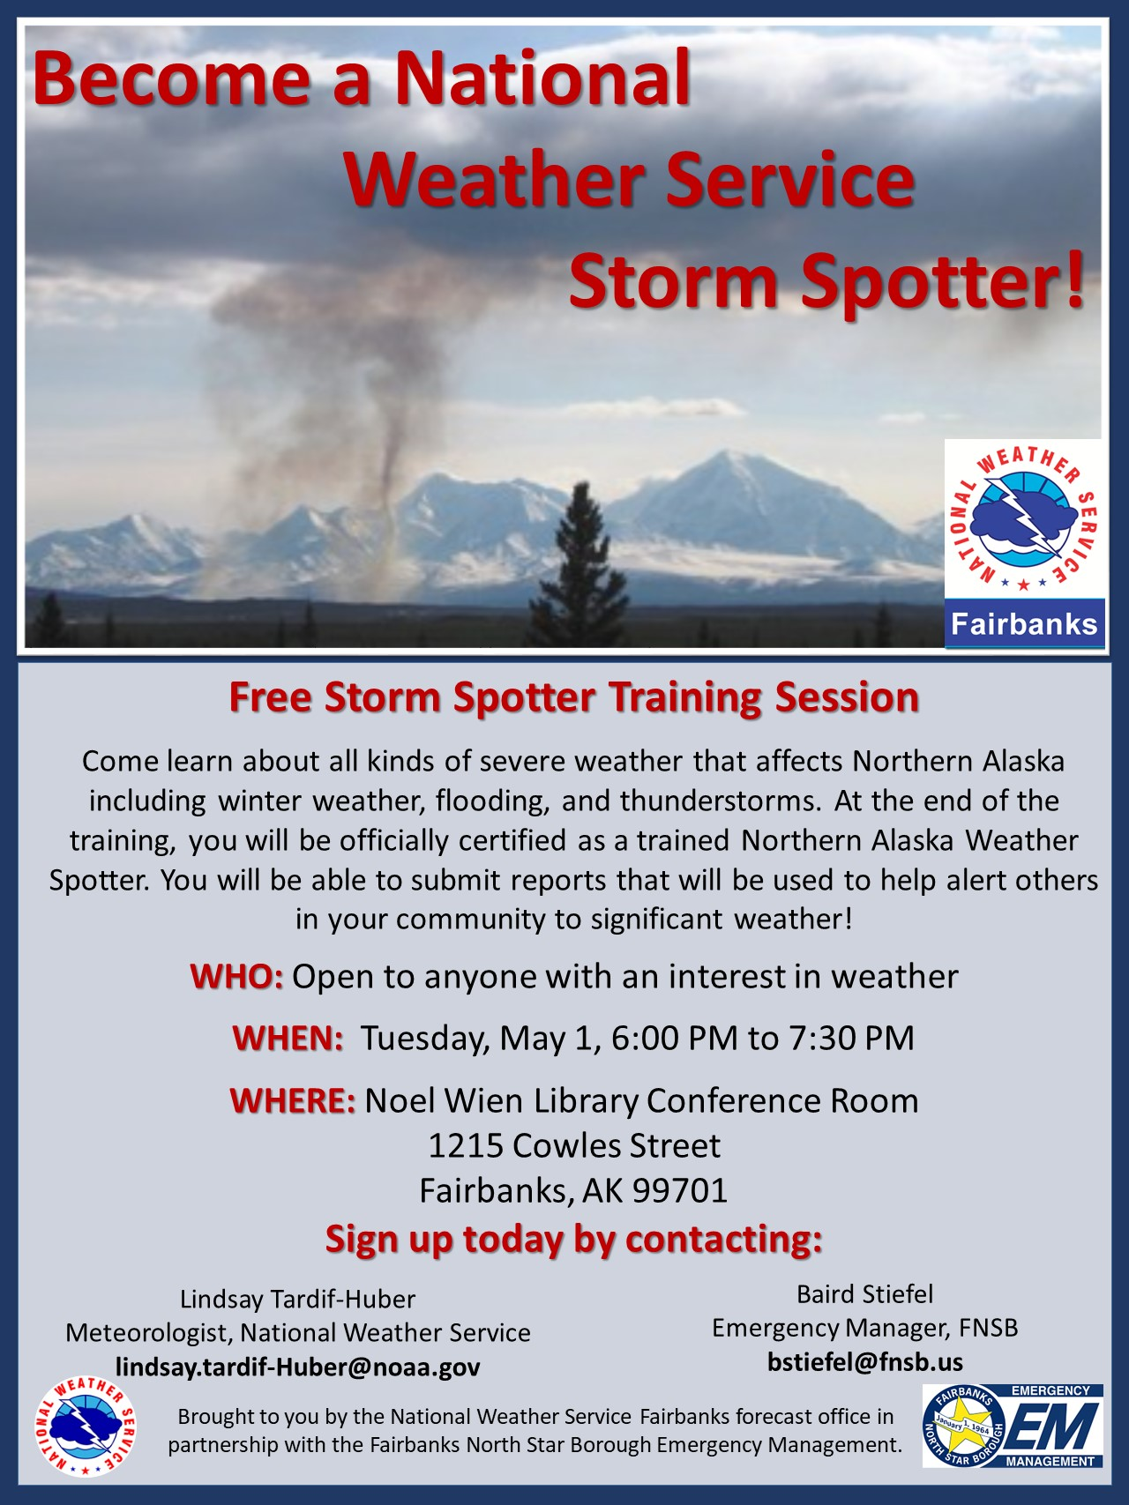
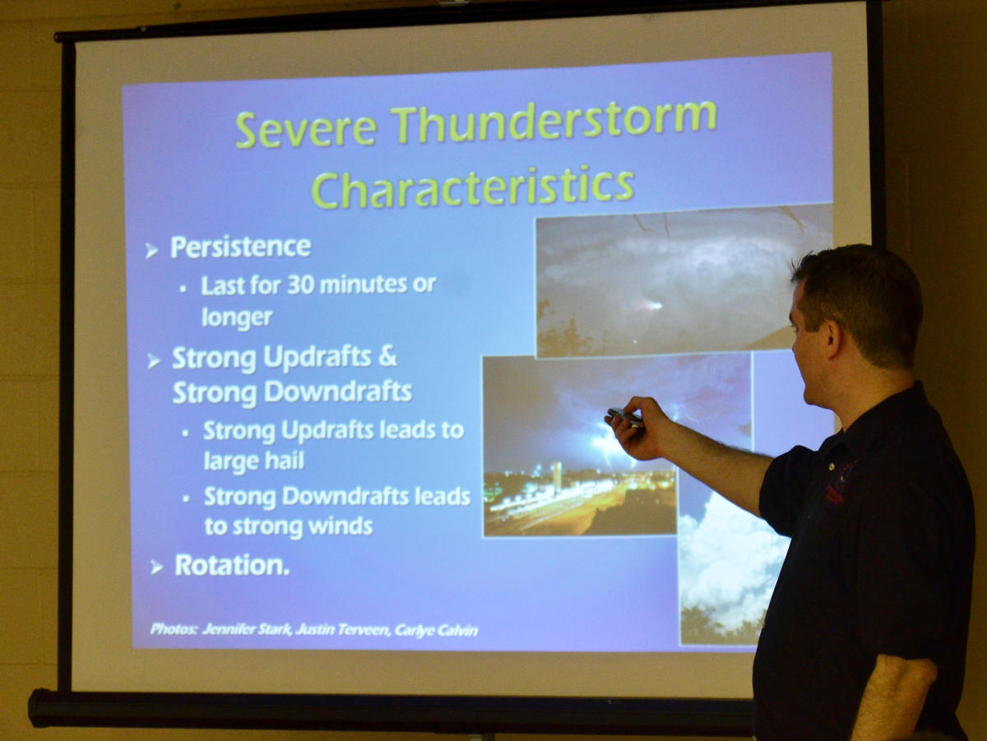
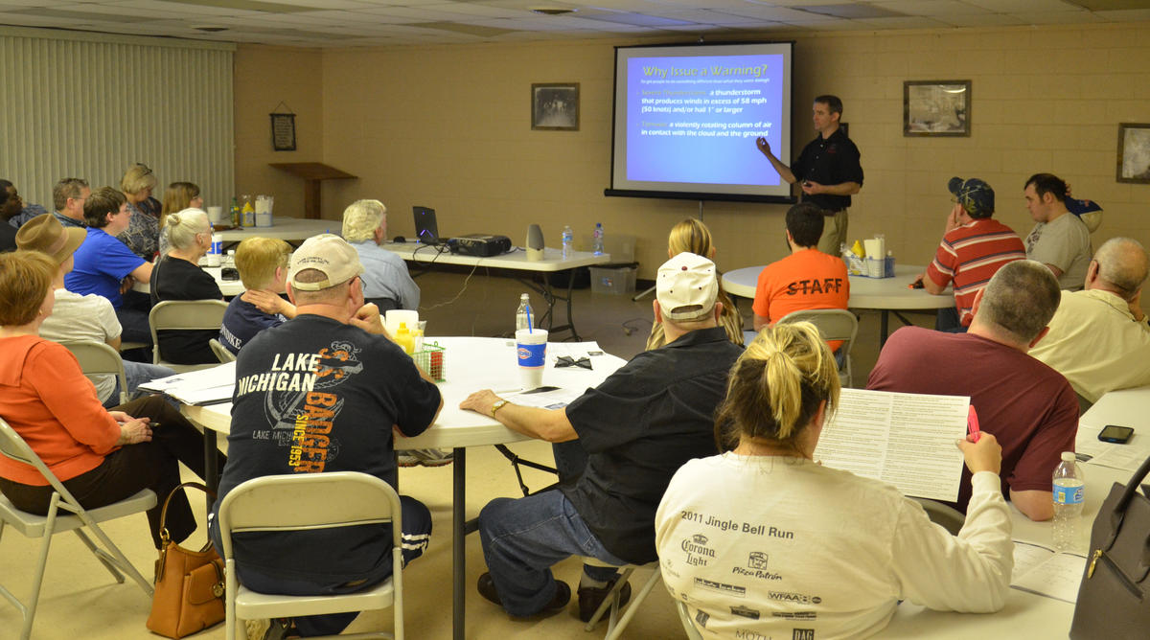
Notes:
SKYWARN is a volunteer program with between 350,000 and 400,000 trained severe weather spotters. Reports are submitted to NWS via social media, phone, email, or the spotter network (online community).
These volunteers help keep their local communities safe by providing timely and accurate reports of severe weather to the National Weather Service.
Spotters are concerned citizens, amateur radio operators, truck drivers, mariners, airplane pilots, emergency management personnel, and public safety officials who volunteer their time and energy to report on hazardous weather impacting their community
The program started in the 1970s. The information provided by SKYWARN spotters has helped the NWS issue more timely and accurate warnings for tornadoes, severe thunderstorms and flash floods.
SKYWARN storm spotters are citizens who form the nation's first line of defense against severe weather.

Slide 3
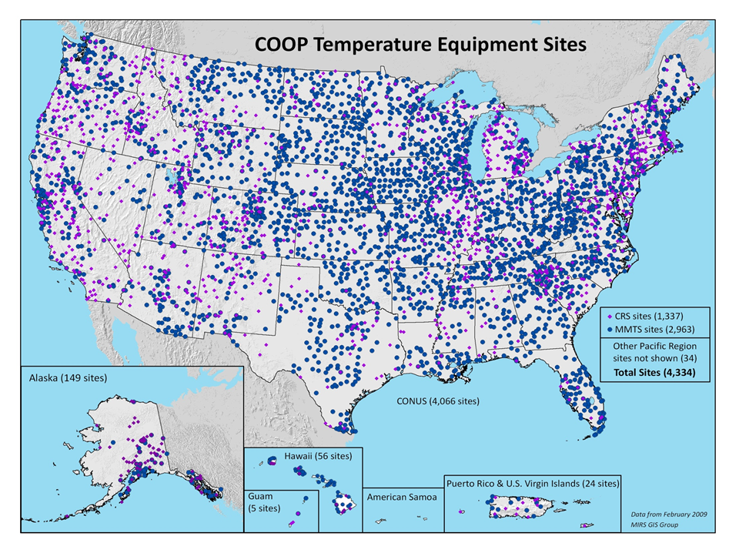

Notes:
The Cooperative Observer Program (Coop) was initiated by an act of Congress in 1890.
It provides daily meteorological observations of min/max precipitation, snowfall and temperature to support weather forecasting, warning and public service purposes.
The program has nearly 10,000 volunteers that contribute to daily measurements in a variety of locales.
The NWS supports Coop through the selection of observation locations, the recruitment and training of observers, the installation of equipment, as well as maintenance, collection and disbursement of data with the help of NCDC.

Slide 4

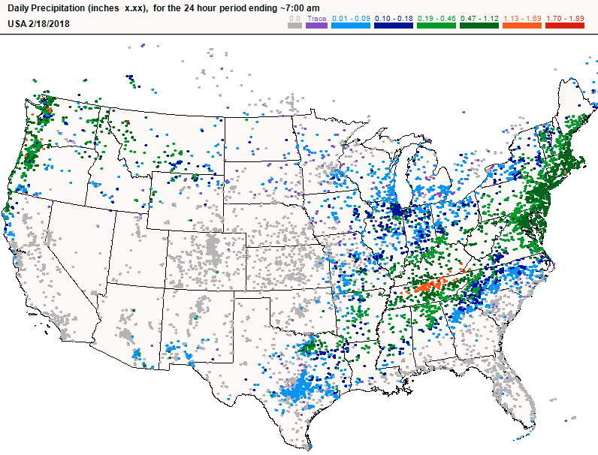
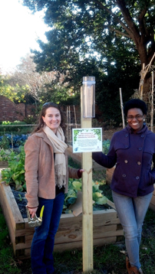
￼
Reges et al. (2016)
Notes:
CoCoRaHS is a grassroots volunteer network of backyard weather observers of all ages and backgrounds working together to measure and map precipitation (rain, hail and snow) in their local communities.
Active in all 50 states CoCoRaHS includes over 20,000 volunteers whose measurements contribute to daily precipitation maps published by the national weather service.

Slide 5

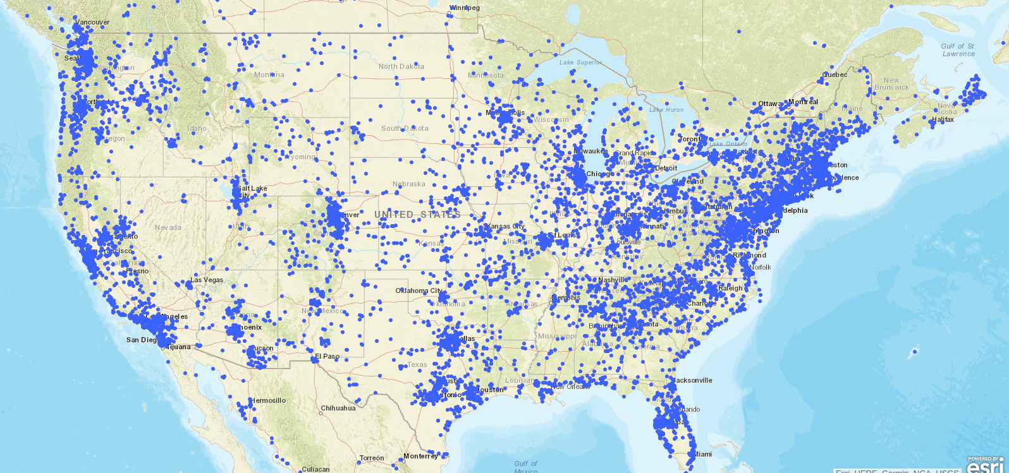
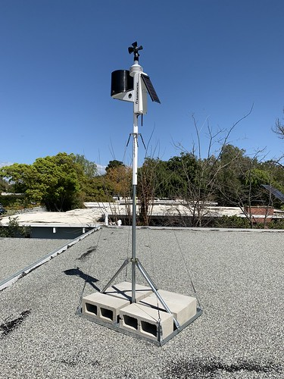
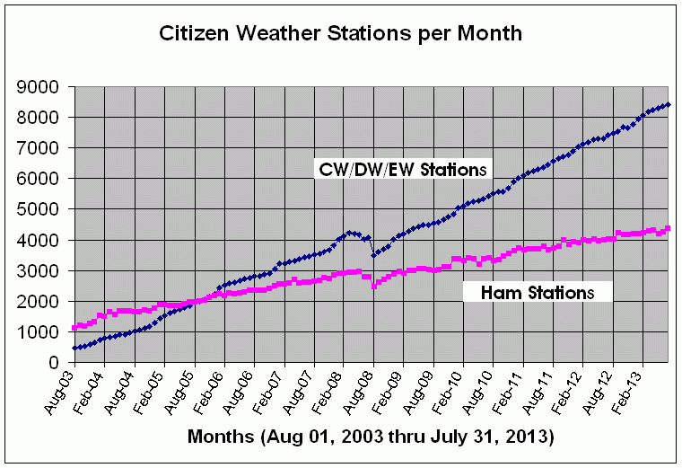
Notes:
Citizen Weather Observer Program (CWOP) is a network of privately owned electronic weather stations concentrated in the United States but also located in over 150 countries.
Network participation allows volunteers with computerized weather stations to send automated surface weather observations to the National Weather Service (NWS) by way of the Meteorological Assimilation Data Ingest System (MADIS).

Slide 6
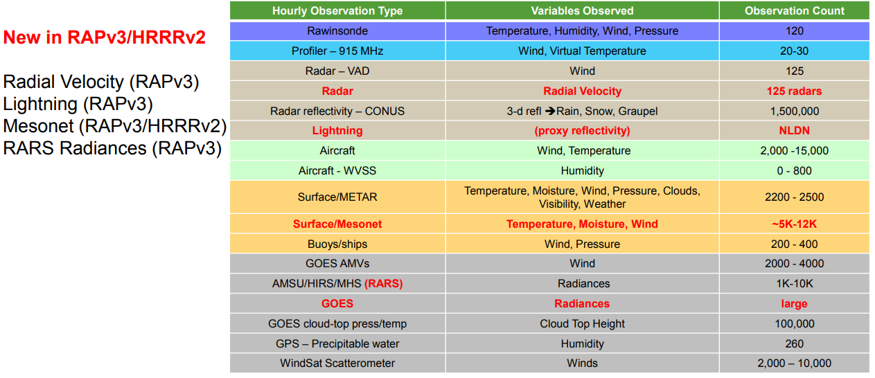

Notes:
CWOP observations are actively assimilated by the High Resolution Rapid Refresh model (HRRR) - (WRF ARW Core), a real-time 3-km resolution, hourly updated, cloud-resolving, convection-allowing atmospheric model.

Slide 7
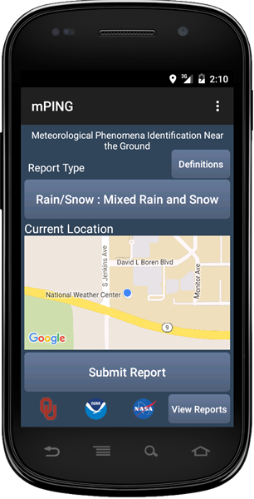
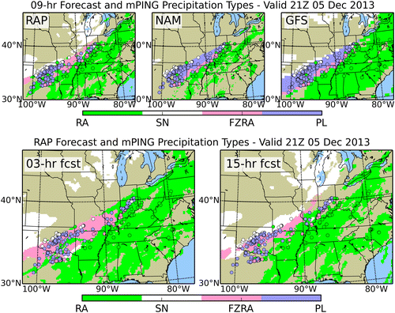
mPing: Meteorological Phenomena Identification Near the Ground
Elmore et al. (2014; 2015)
Notes:
Using the free mPING app, anyone can submit a weather observation anonymously. mPING data is used to verify precipitation forecasts, predict ground icing for road maintenance and aviation operations, and predict the potential for in-flight icing. NWS forecast offices display the data and have used the reports to fine-tune their forecasts.

Slide 8
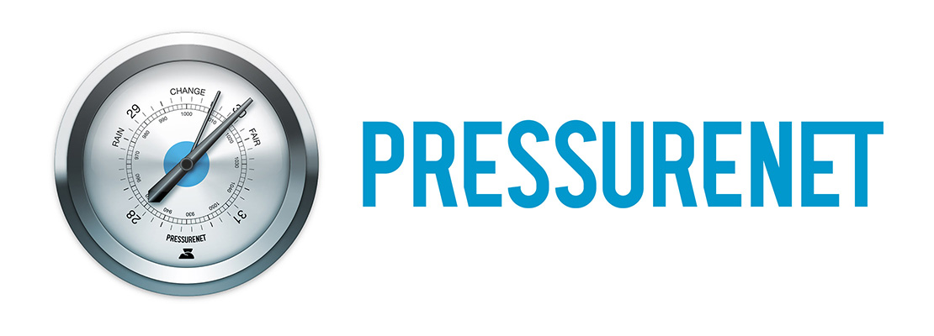
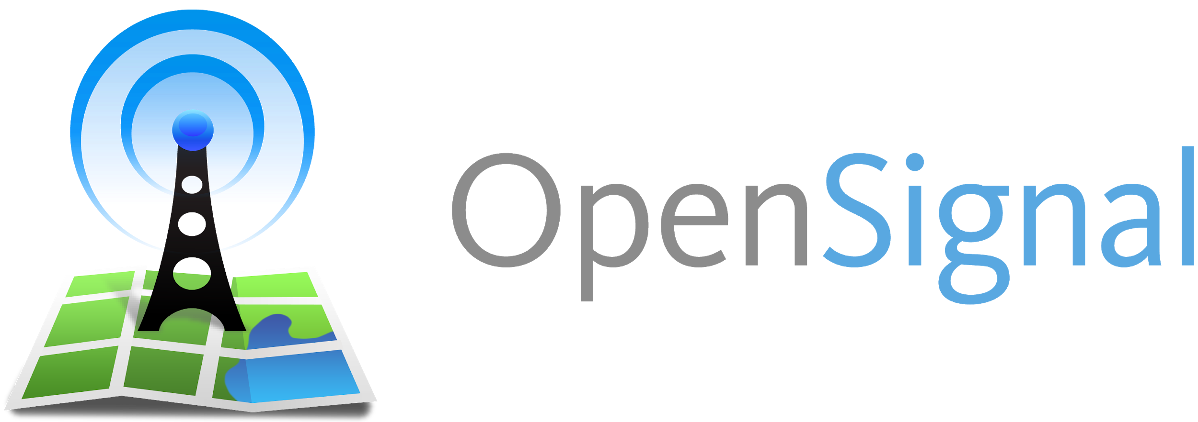
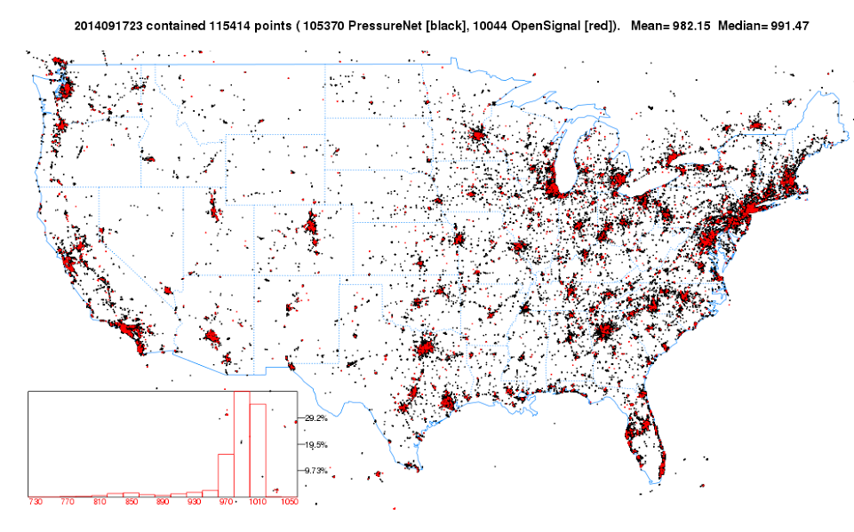
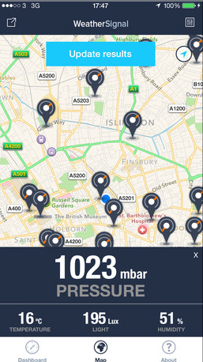
Mass and Madaus (2014)
Notes:
Beginning in 2012, pressure sensors were introduced to smartphones. Soon after several private companies began to collect and share these observations with the University of Washington amongst others.
The potential utility of crowdsourced smartphone pressure observations from networks such as PressureNet and Opensignal were outlined in a BAMS article by Mass and Madaus (2014). They performed some limited experiments, including smartphone pressures into the realtime EnKF system at UW finding improvements in 3-h QPF forecasts during a single convective case in Washington State.

Slide 9

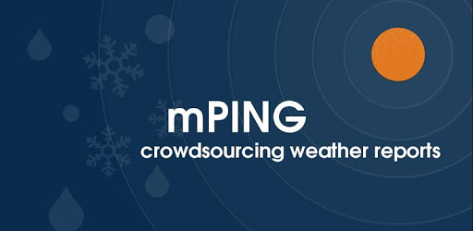
Reviewing Citizen Science in the U.S.
Level 3
Citizens are considered as participators for problem definition and data collection
3
Data Quantity
Level 2
Distributed Intelligence: Citizens are considered as interpreters.
2
Data Quality
Level 1
Citizens contribute to sensing
1
(adapted from Haklay, 2013 and Zheng et al. 2018)
Notes:
This pyramid represents a hierarchy of citizen science. The foundation of the pyramid (Level1 ) is the most basic form of citizen science (crowdsourcing) whereby citizens contribute to sensing typically via the internet/passively. Smartphone pressure observations fall under this category.
Higher up the chain we have Level 2. At this level of engagement citizens contribute and interpret data (for example think of the mPing app - where citizens classify and submit precipitation type and intensity).
Lastly, at the top of the pyramid we have Level 3. This level requires the most engagement of citizens who, at the stage, are active participants in data collection and even problem definition. An example of citizen science at this level is the SKYWARN program… in which citizens require training to identify and report developing severe weather phenomena.

Slide 10
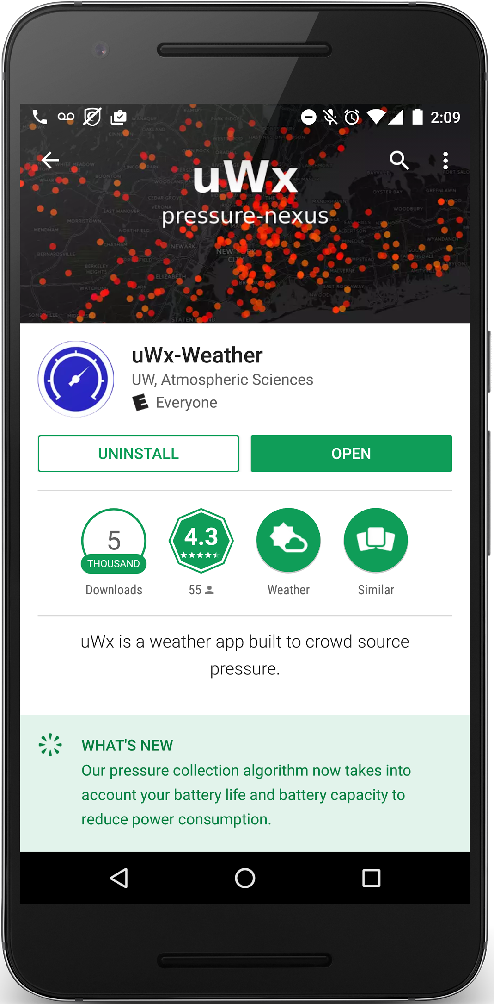
The Solution: Develop an app
uWx:
Free app available for android.
Averaged 2,000 active users submitting pressures.
Retrieval rate: 80 obs/min
  3500/hour, 1 million/week
Battery usage: <1-4%
Server costs: $84 USD/month
  (2.4￠/ 1000 obs).
McNicholas and Mass (2018a)
Notes:
Thus far, uWx has been downloaded over 5K times.
There are currently 3800 active users, ~1900 of whom actively submit pressures.
Few battery life complaints overall. Substantial effort was placed on optimizing power consumption without sacrificing accuracy and frequency of observations.
I lease 2 dedicated racks for 84$/month in total. All in all it costs me about 2.4 cents for every 1000 observation I collect.

Slide 11
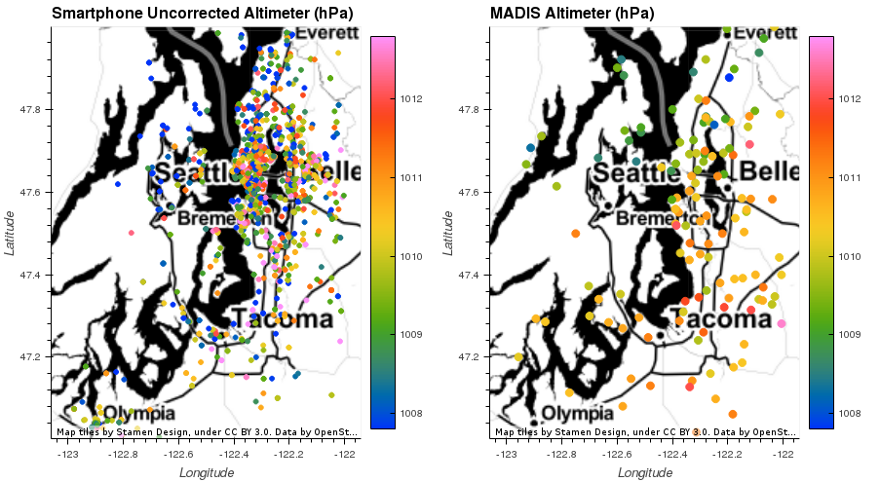
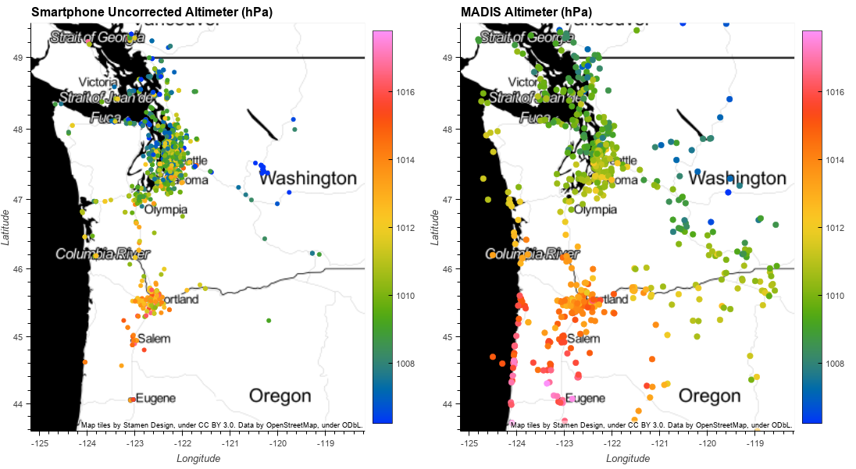
Altimeter Data Quality
Valid: 2016-11-16 00:00:00 UTC
Notes:
Big issue remains: smartphone users are often above/below ground level or moving in a vehicle (e.g. car, train, bike, plane).
GPS provides accurate horizontal location and poor vertical location.
Rely on ground elevation from DEM as first guess for altimeter setting estimate.
No practical way to estimate elevation AGL/BGL in-app.

Slide 12
Bias Correction
uWx collects a plethora of sensor data.
Patterns in this data are connected to user behavior.
Can we use this data to predict smartphone pressure errors (bias)?
Motion Sensor
Light Sensor
Pressure Sensor
Machine Learning
Location Data
GPS Stats
Pressure Error
Notes:
We know pressure error is related to user behavior and we collect a wealth of data from the app.
Can we leverage correlations between these ancillary features/variables and smartphone pressure errors to effectively predict smartphone pressure errors in advance.
How do we do this? We use an ensemble decision tree algorithm trained on smartphone sensor data to predict the difference between the smartphone pressure and the best estimate of the true pressure at the smartphone location (which is derived through OI of conventional surface data). This is done independently for each smartphone.
The training occurs over the course of a few months and predictions are made for the month after training is complete.

Slide 13
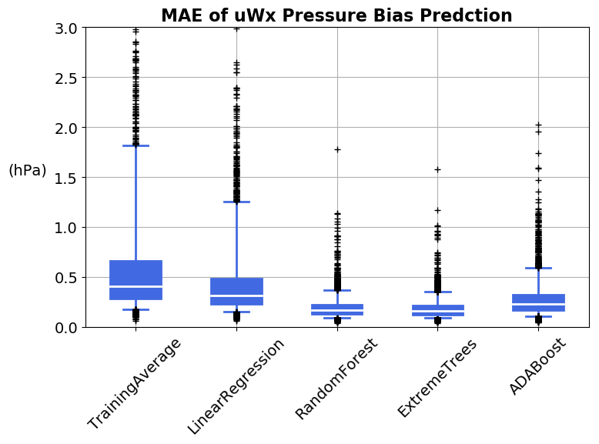
MAE of Pressure Bias Predictions for all uWx smartphones.
Decision Tree algorithms
Algorithm Complexity
Notes:
For each smartphone, we predict the smartphone pressure error for the month after training is complete.
These predictions are made by:
Computing the average error during training
Performing a multivariate linear regression
Using decision tree algorithms
Decision tree algorithms perform well and are robust to outliers (random forests are less complex and so we used the random forest algorithm to predict smartphone pressure errors).

Slide 14
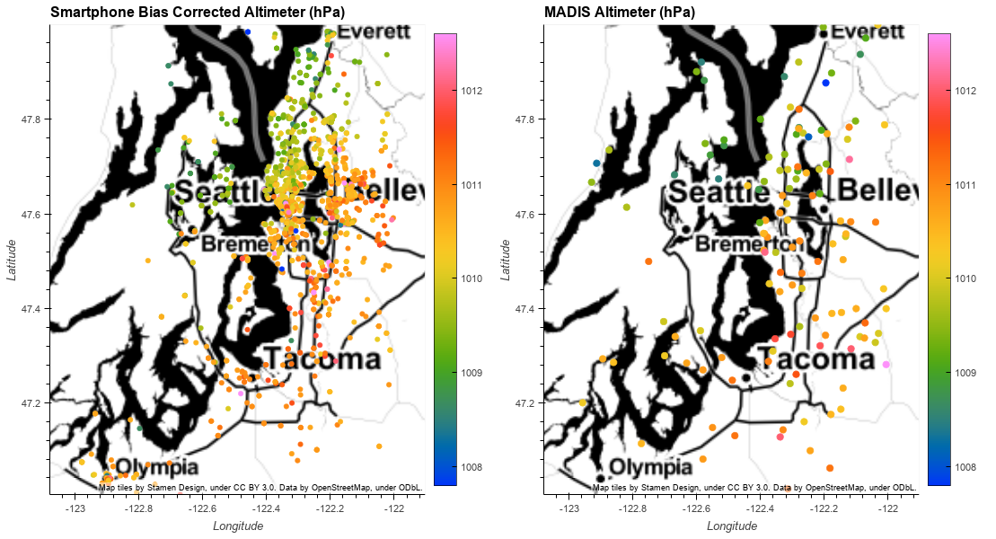
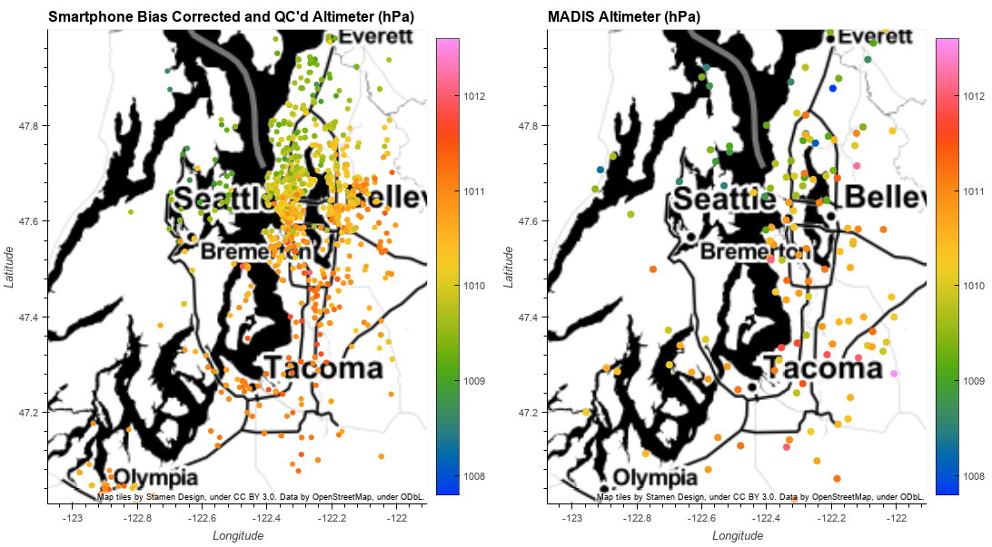
Bias Correction Performance
Valid: 2016-11-16 00:00:00 UTC
Notes:
Bias correction substantially reduces smartphone pressure error but not always. A small fraction of the time bias predictions actually increase smartphone pressure errors. Thus, some QC (spatial consistency check is required).

Slide 15
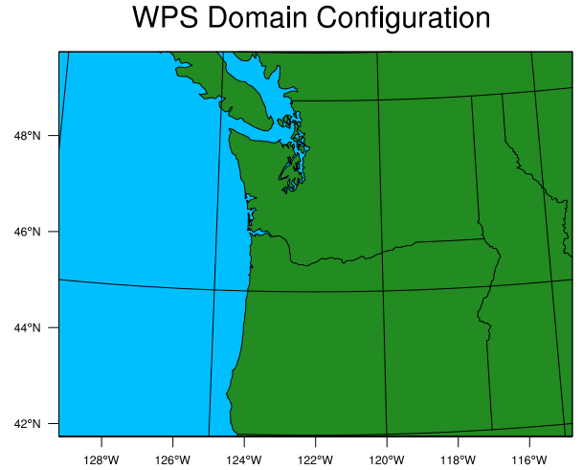
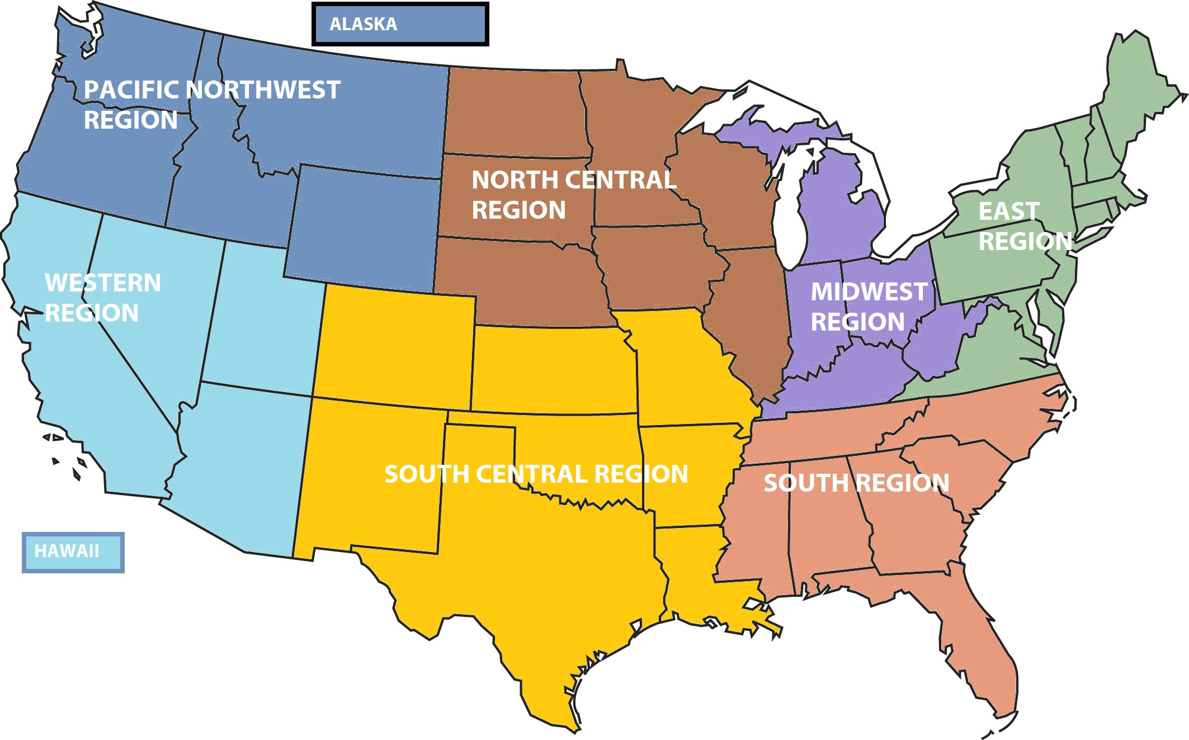
Smartphone Pressure EnKF Case Study
Familiar scenario for operational forecasts in the U.S. Pacific Northwest, surface low and cold frontal passage.
Period of Study: 12 UTC 14 November - 00 UTC 17 November, 2016
Model: 48-ensemble member, 4-km WRF run (domain: lower left) with hourly boundary conditions from the Rapid Refresh model (RAP).
Notes:
Case study: Familiar scenario for operational forecasts in the U.S. Pacific Northwest. The domain was centered on Washington and Oregan State in the Pacific Northwest region of the U.S.
A 48 ensemble 4-km WRF simulation was initialized with analysis from the Rapid Refresh model and updated with boundary conditions from 1-hr Rapid Refresh model (RAP) forecasts emulating a real-time NWP system.

Slide 16
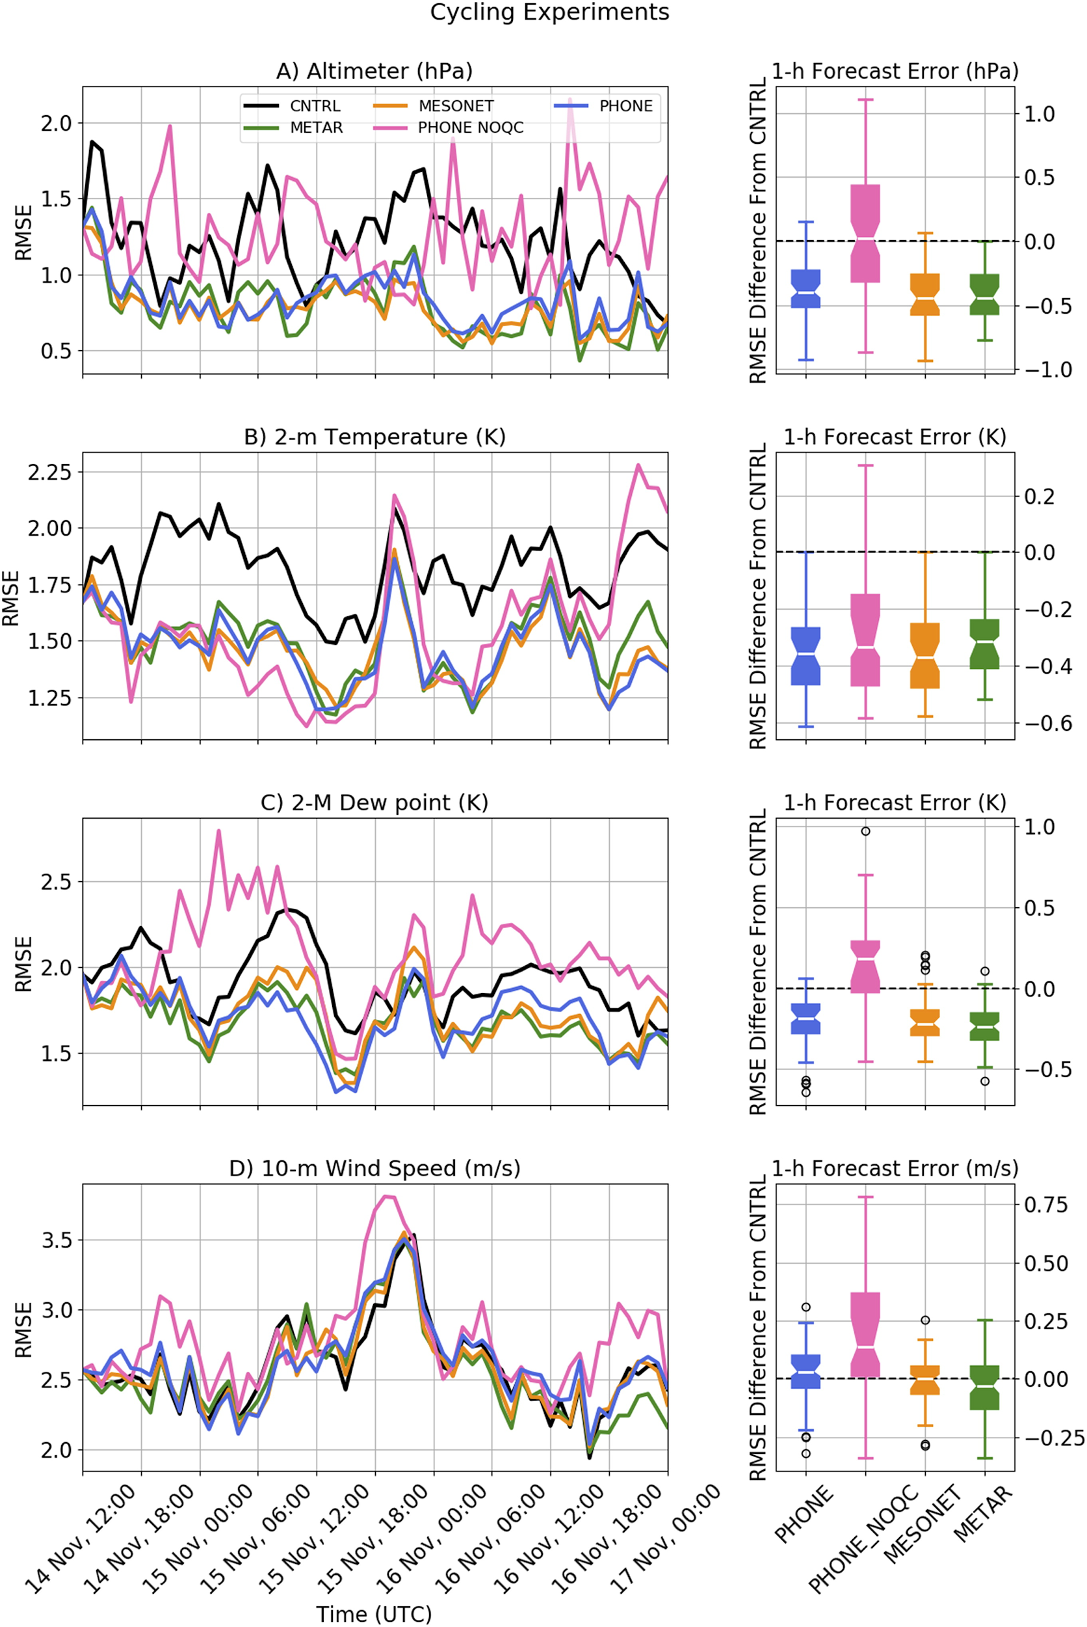
EnkF Case Study: Cycled Data Assimilation
RMSE of select surface variables during 60-hr Case Study
PHONE - QC’d and bias corrected smartphones assimilated
PHONE_NOQC - uncorrected smartphones assimilated
MESO - mesonet data assimilated
METAR - airport (ASOS) data assimilated (used for Verification)
McNicholas and Mass (2018b)
Notes:
Time-series of RMSE for altimeter, 2-m temperature, and 2-m dewpoint for the 60-hr case study (left). Distribution of RMSE error difference from the CNTRL (no assimilation) is displayed on the right.
Assimilating corrected and QC’d smartphone pressures consistently improved 1-hr cycled forecasts of altimeter setting, 2-m temperature, and 2-m dewpoint.
Uncorrected smartphone pressures degrade 1-hr cycled forecast of 2-m dewpoint and provide no improvement to 1-hr forecasts of altimeter. Uncorrected smartphone pressure assimilation did improve 1-hr forecasts of 2-m temperatures; however, this result was a consequence of compensating biases. Uncorrected smartphone pressure assimilation induced anomalous pressure increments and commensurate temperature increments that happened to offset biases in the modelled 2-m temperature field.
The assimilation of mesonets (citizen weather obs, state/local government mesonets) consistently improved 1-hr forecasts of altimeter, 2-m temperature, and 2-m dewpoint to the same degree as smartphone pressure assimilation (corrected).
Verification was performed with METAR (airport observations). The assimilation of METAR observations was thus not independent of the verification and is shown only to demonstrate the EnkF is working as expected (if you assimilate obs and then verify using the same set of obs you assimilated you should expect the analysis/forecast to be better… which is what we see) This is sanity check of sorts.

Slide 17
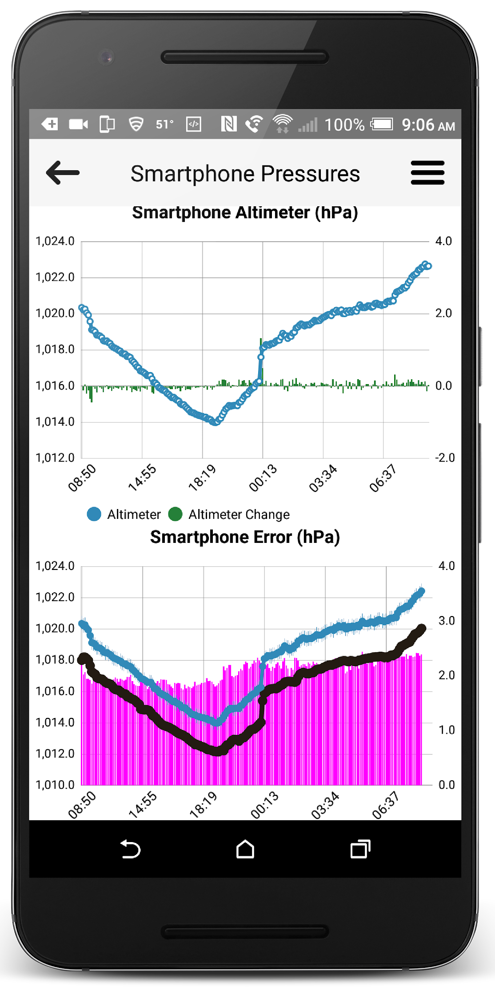
uWx Summary
Smartphone pressure errors can be predicted from phone sensor data alone using machine learning.
Bias corrected and QC’d smartphone pressures have the potential to improve model analyses and short-term forecasts.
Key Issues:
Only used a few thousand phones over a very small geographic area.
Does this bias-correction approach scale?
McNicholas and Mass (2018a,2018b) – JTECH,WAF
Notes:
Summary of lessons learned from uWx app
Smartphone pressure errors can be predicted using solely sensor data from each smartphone, which means that smartphone pressures can be corrected in real-time independently (without having to rely on data from conventional in-situ networks or model analyses).
One case study presented here demonstrated the potential of smartphone pressures to improve short-term forecasts
Two big caveats:
Only looked at a few case-studies in McNicholas and Mass (2018b). Not clear whether these results are applicable in other parts of the U.S. or globe. Furthermore, only a few thousand smartphones were used.
Would the bias-correction and QC methodology scale to work for millions of smartphones?
To view additional (non-public / unpublished) slides discussing the application of bias-correction and QC techniques to a much larger smartphone pressure dataset, please contact the presenter at: cmcnich@uw.edu.

Slide 18
Thank You
Email: cmcnich@uw.edu
Website: https://www.cmetwx.com
Additional slides, presented at the EWGLAM meeting, discussed the application of bias-correction and QC techniques to millions of smartphone pressures. Since this work is ongoing and unpublished it has not been included here. If you would like to view these non-public slides, please contact the presenter at the email address listed above.

