Slide 1

Further developments in the Discontinuous Galerkin based dynamical core for ICON –
The BRIDGE project
46th EWGLAM / 31st SRNWP meeting, Prague
30 Sept. – 03 Oct. 2024
Michael Baldauf (DWD)
M. Baldauf (DWD)
1

Slide 2
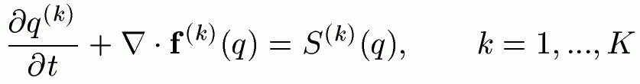
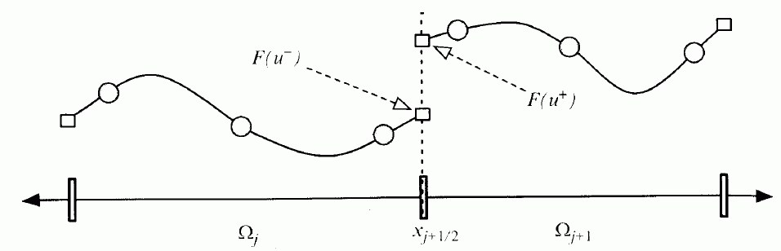

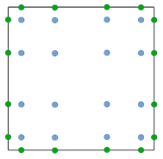
Discontinuous Galerkin (DG) methods in a nutshell
e.g. Cockburn, Shu (1989) Math. Comput.
Cockburn et al. (1989) JCP
Hesthaven, Warburton (2008)
1.) Finite-element representation
2.) Galerkin approach → weak formulation
From Nair et al. (2011) in ‚Numerical
techniques for global atm. models'
3.) Finite-volume ingredient: numerical flux
4.) Gaussian quadrature for the volume and surface integrals
→ ODE-system for q^{(k)}_{jl}(t)
5.) Use a time-integration scheme (Runge-Kutta, IMEX-RK, …)
M. Baldauf (DWD)
2

Slide 3
Discontinuous Galerkin (DG) methods in a nutshell
e.g. Cockburn, Shu (1989) Math. Comput.
Cockburn et al. (1989) JCP
Hesthaven, Warburton (2008)
1.) Finite-element representation
higher order discretization ✓
2.) Galerkin approach → weak formulation
From Nair et al. (2011) in ‚Numerical
techniques for global atm. models'
works on unstructured grids ✓
Local conservation ✓
3.) Finite-volume ingredient: numerical flux
allows explicit time integration ✓
4.) Gaussian quadrature for the volume and surface integrals
→ ODE-system for q^{(k)}_{jl}(t)
allows massive parallelisation ✓
5.) Use a time-integration scheme (Runge-Kutta, IMEX-RK, …)
high computational intensity ✓
M. Baldauf (DWD)
3

Slide 4
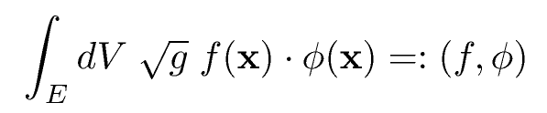
Exponential filter with (local) conservation
The low dissipation of higher order methods sometimes leads to stability problems.
→ Filtering: transform amplitudes to an orthogonal function base and damp these ampl. Q_{j} according to the polynomial degree. This is done after every (IMEX-)Runge-Kutta step by a filter matrix F = V F V⁻¹
First base function φ₁=const.; don‘t modify Q₁ → local conservation!
Orthogonality related to the scalar product
← done by Gram-Schmidt-orthogonalization during init. Phase for each cell.
Note: for our terrain-foll. coordinate system the Jacobian J = √g separates into f(x¹, x²) g(x³)
→ tensor product representation of the filter matrix F is possible
Practically used filter coeff.s for the Held, Suarez (1994) test: F ⁼ diag( 1.0, 0.999985…, 0.9961…, 0.9047… )
M. Baldauf (DWD)

Slide 5
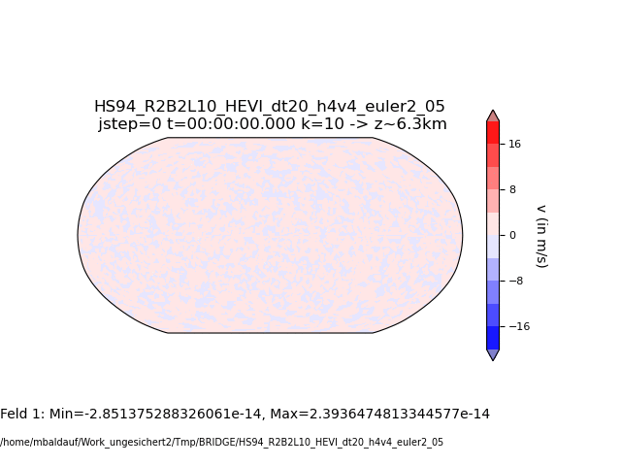
Held, Suarez (1994) test = ‚poor mans climate run‘
Only solve the pure Euler equations (no diffusion, no microphysics, …),
but add height and latitude dependent relaxation terms on the rhs of the momentum and energy equations.
Stabilization by exponential filtering
Necessary!
M. Baldauf (DWD)
5

Slide 6
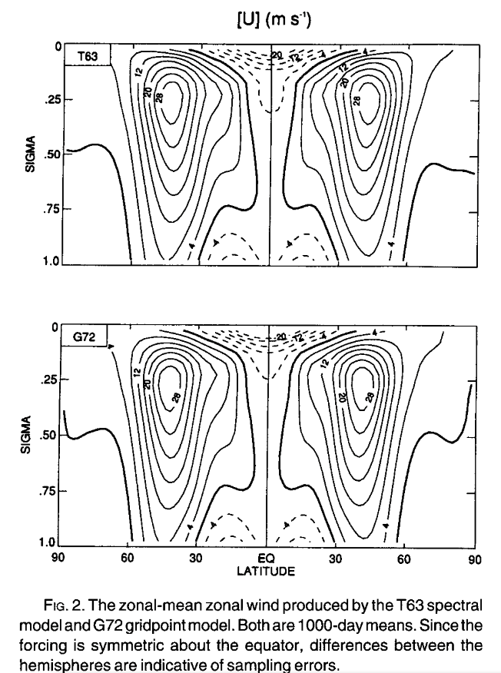
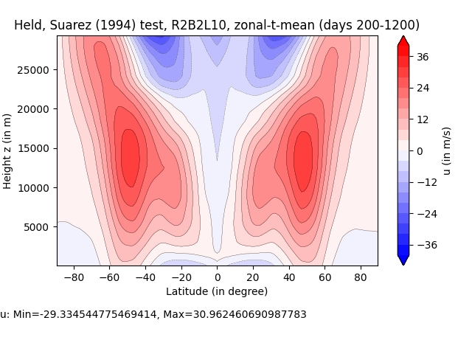

Held, Suarez (1994) test = ‚poor mans climate run‘
Initialization: analogous to Jablonowski, Will. (2006)
Initialization: v=0, T=250K
From Held, Suarez (1994)
M. Baldauf (DWD)
6
BRIDGE

Slide 7
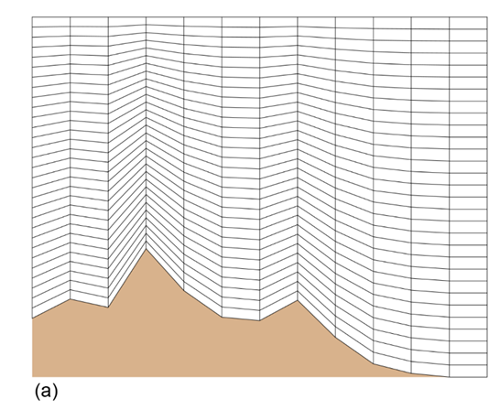
Using real orography data
Orography is treated by the usual terrain-following coordinate:
Our DG scheme needs in every (horizontal) quadrature point (i.e. in the cells and on hfaces):
Orography h_{oro}
First horizontal derivatives of h_{oro} for transformation matrices and the metric tensor g_{ij}
Second horizontal derivatives of h_{oro} for Christoffel symbols Γ ^{i}_{jk} (mainly needed in the diffusion operator)
Until now, we have used only analytically given orography and their derivatives and just calculated it in every point we needed.
Dealing with real orography data requires a more general approach …
M. Baldauf (DWD)
7

Slide 8

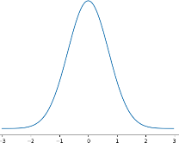
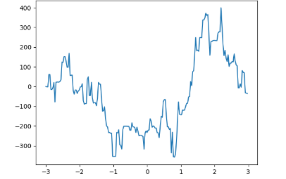
How to treat orography?
Numerically via terrain-following coordinates (ICON, COSMO-model, …)
New: preprocessor for orography (pre_pr_oro.py): goal: generate filtered orogr. + 1st + 2nd derivatives (consistently!)
scipy: kd-tree, 2D-interpolation unstruct. -> regular, integrations (on tangential planes)
pre_pr_oro.py is ‚embarassingy‘ parallelized
EXTPAR delivers the ultra-highly resolved orography data (runs into memory problems ☹)
Maybe also of interest for current ICON?
(Baldauf, 2021, JCP)
x²
x¹
h(ξ) =
maybe fractal orography
M. Baldauf (DWD)
8

Slide 9
Limited area modelling (LAM-mode)
1.) Treat lateral boundaries
Enhance the grid data structures (mo_model_domain: extensions in t_triangulation, ..): identify and enumerate boundary edges and nudging zone cells (in an MPI parallelized environment, possibly with local refinement) ✓
Implement lateral boundary conditions (weak DG approach): Dirichlet conditions with prescribed boundary values ✓
Apply nudging zone: additional, explicitly treated, relaxation source terms ✓
Environment: torus grid generator torus_gridgen.py now can generate rectangly shaped triangle LAM grids, too. ✓
2.) Interpolate boundary values from a coarser model run this step is postponed to the ICON implementation of BRIDGE
1
1
1
1
2
2
2
3
3
3
M. Baldauf (DWD)
9

Slide 10
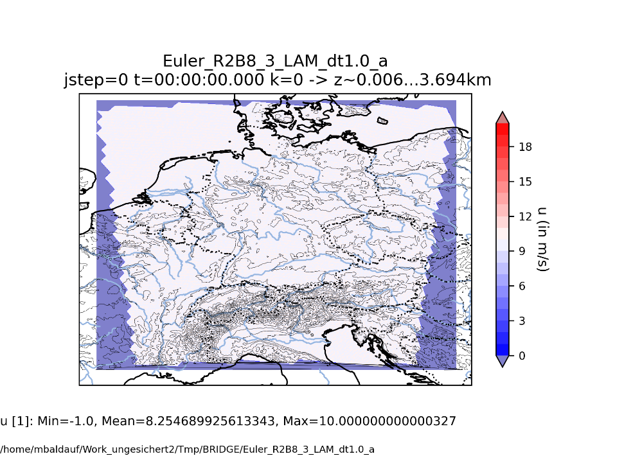

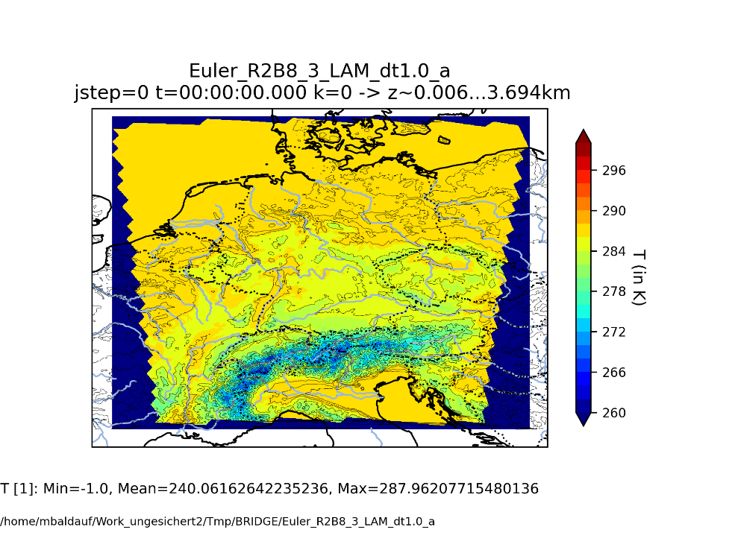
Example of a LAM run: central Europe, R2B8 (~10km)-LAM grid
u
v
T
Constant inflow (u,v)=(10,10) m/s, N=0.01 1/s, note: no geostrophic balance by the pressure field
pre_pr_oro.py: orography on R2B10, (~2.5km) generated from R2B13 (~300m) ASTER data
M. Baldauf (DWD)

Slide 11
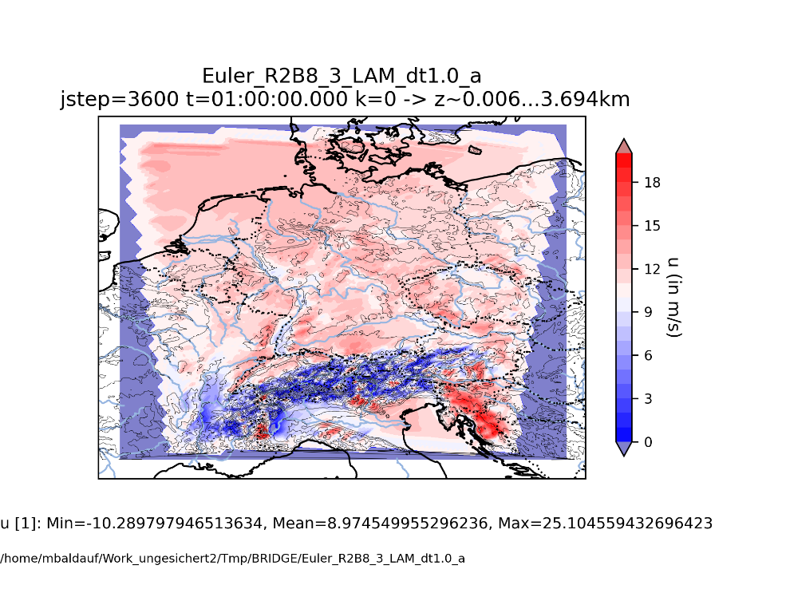
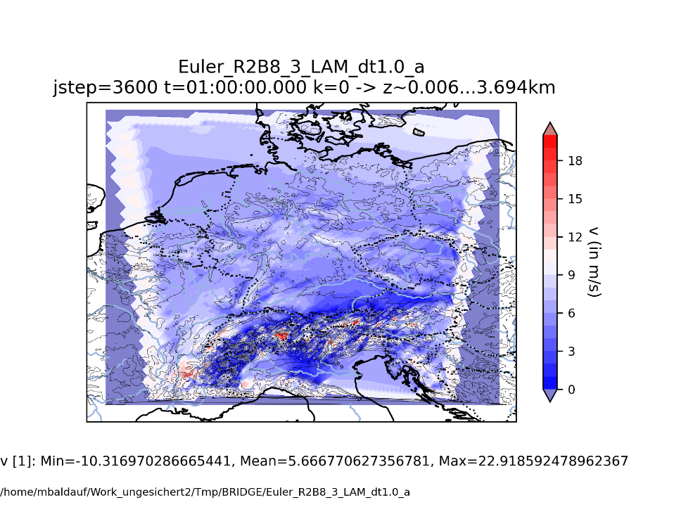
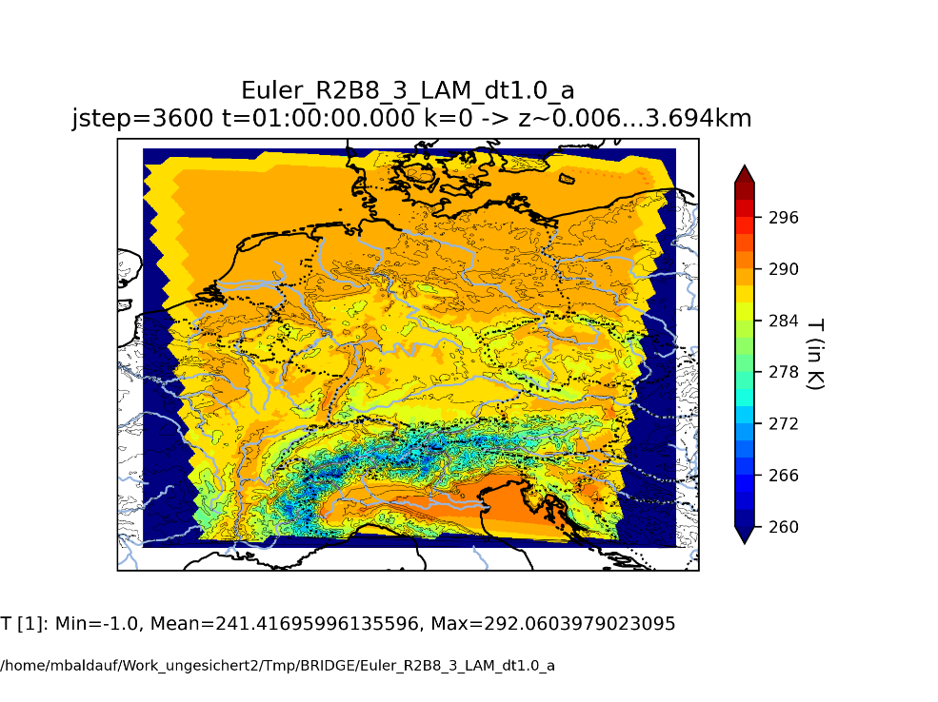
Example of a LAM run: central Europe, R2B8 (~10km)-LAM grid
u
v
T
Constant inflow (u,v)=(10,10) m/s, N=0.01 1/s, note: no geostrophic balance by the pressure field
pre_pr_oro.py: orography on R2B10, (~2.5km) generated from R2B13 (~300m) ASTER data
M. Baldauf (DWD)

Slide 12
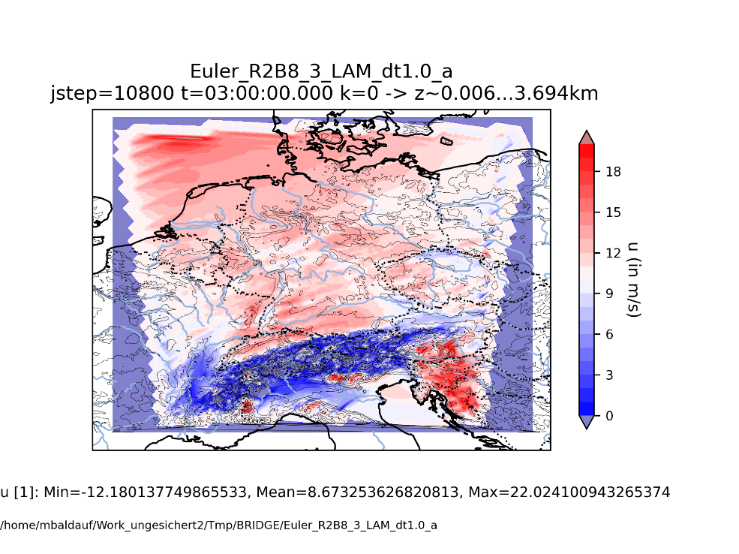
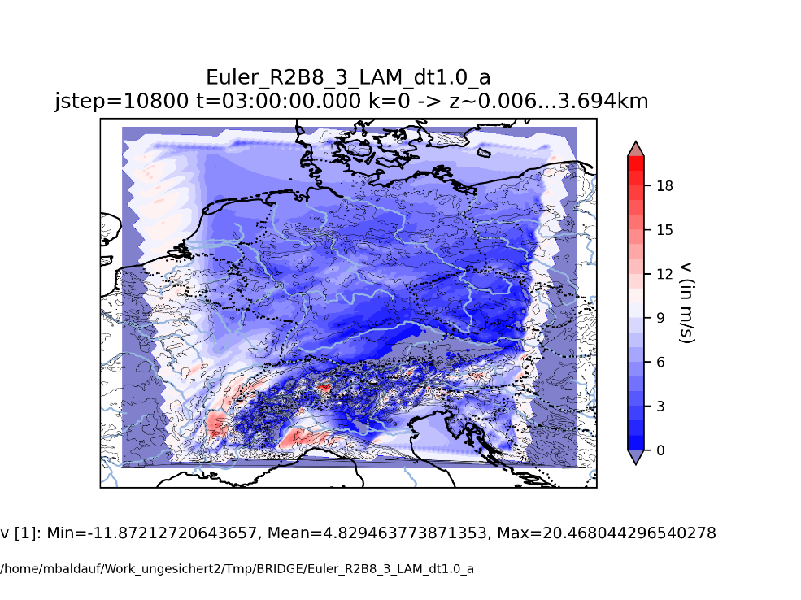
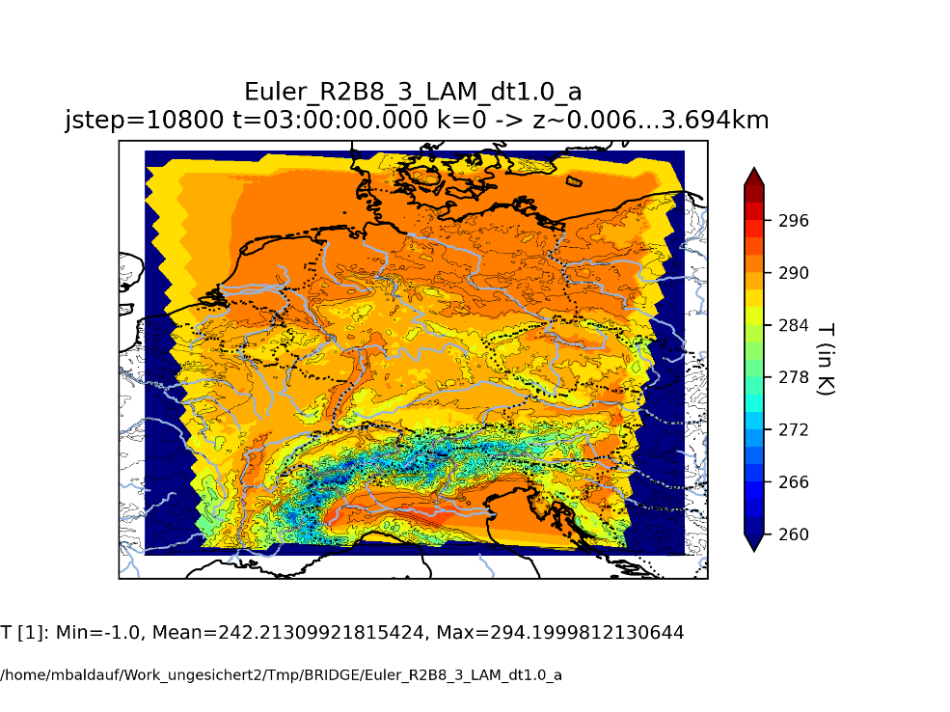
Example of a LAM run: central Europe, R2B8 (~10km)-LAM grid
u
v
T
Constant inflow (u,v)=(10,10) m/s, N=0.01 1/s, note: no geostrophic balance by the pressure field
pre_pr_oro.py: orography on R2B10, (~2.5km) generated from R2B13 (~300m) ASTER data

Slide 13
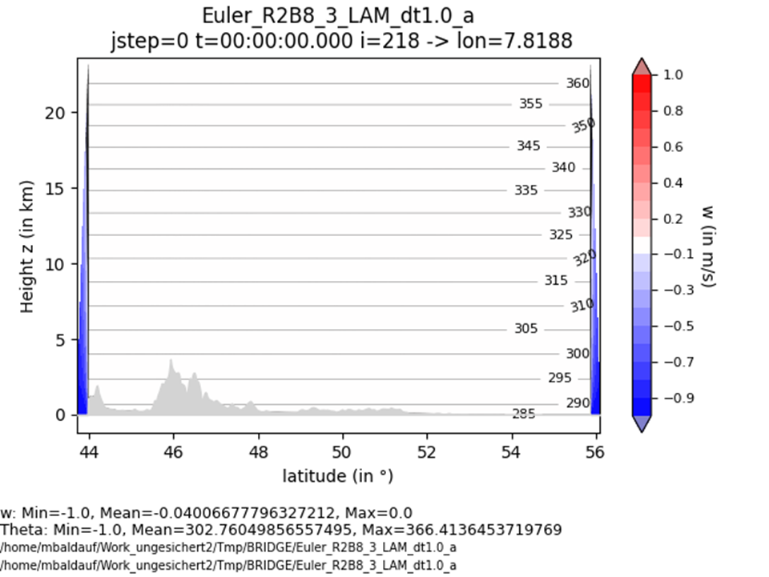
Example of a LAM run: central Europe
North-south cross section through the Monte Rosa region.
Constant inflow (u,v)=(10,10) m/s, N=0.01 1/s, note: no geostrophic balance by the pressure field
pre_pr_oro.py: orography on R2B10, (~2.5km) generated from R2B13 (~300m) ASTER data
M. Baldauf (DWD)

Slide 14

Example of a LAM run: central Europe
North-south cross section through the Monte Rosa region.
The 4th order DG scheme proves to be quite stable over steep terrain (Baldauf (2021) JCP)
Constant inflow (u,v)=(10,10) m/s, N=0.01 1/s, note: no geostrophic balance by the pressure field
pre_pr_oro.py: orography on R2B10, (~2.5km) generated from R2B13 (~300m) ASTER data
M. Baldauf (DWD)

Slide 15
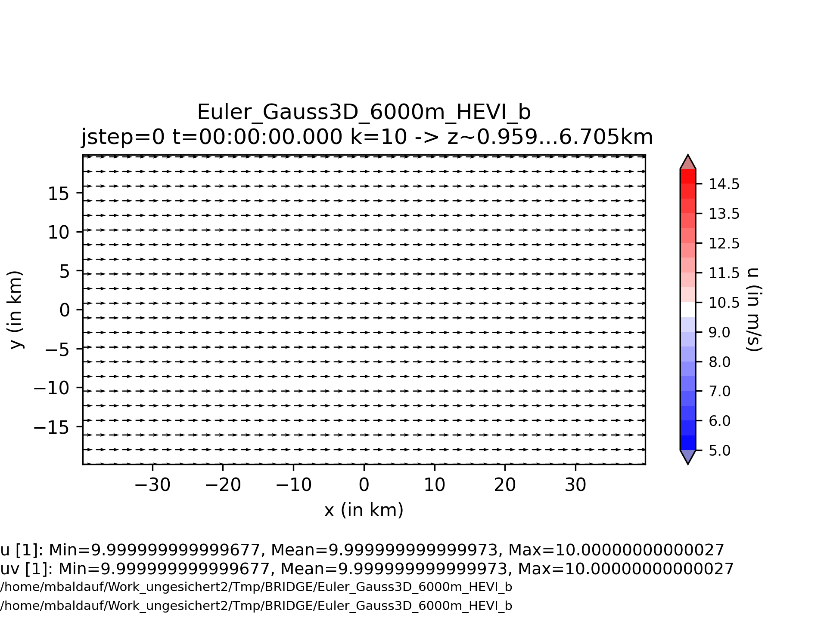
Flow over a mountain with fixed inflow conditions
Generation of a Karman vortex street
U=10 m/s
N=0.01 1/s
max h_{oro} = 6000m
Δx=Δy=2 km
M. Baldauf (DWD)
15

Slide 16
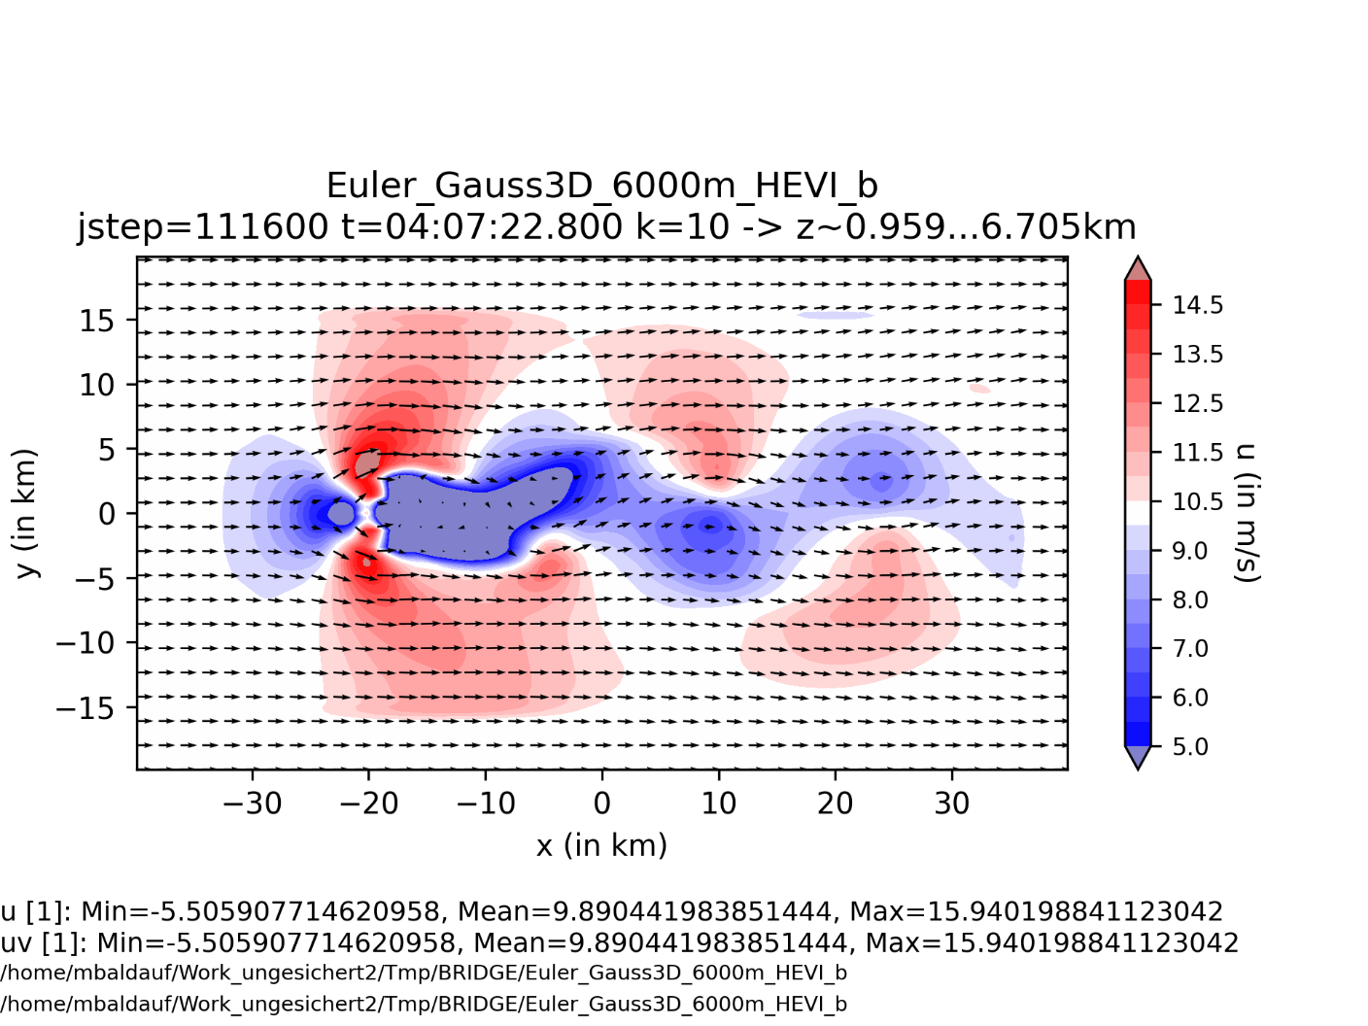
Flow over a mountain with fixed inflow conditions
Generation of a Karman vortex street
U=10 m/s
N=0.01 1/s
max h_{oro} = 6000m
Δx=Δy=2 km
M. Baldauf (DWD)
16

Slide 17

Project: ICON-DG: Gearing up the ICON Model with Smarter Discretizations
in the call ‚WarmWorld Module 4 Smarter‘ by German Ministry of Research and Educ. (BMBF)
has been accepted.
Duration: 01.07.2024 - 30.06.2027
Project partners:
DLR Köln, Inst. for software technology, project leader: Johannes Markert
Univ. Köln, Division of Mathematics, group Prof. Gregor Gassner postdoc: Tristan Montoya
DWD, M. Baldauf, BRIDGE group
Goal: develop further stabilization of DG schemes by designing entropy stable / entropy conserving schemes (=obeying 2nd law of thermodynamics) especially for the prismatic grid cells used in ICON / BRIDGE with HEVI and horiz. flux transformations. → ‚Next Generation DG methods‘
e.g. Gassner, Winters (2021) Front. Phys.
M. Baldauf (DWD)
17

Slide 18
Milestones of the BRIDGE-project (status Sept. 2023)
0. first version of a FE/DG framework available, MPI parallelized Q2/2021 ✓
1. shallow water equations on the sphere, explicit time integration (RK) Q3/2021 ✓
2. 3D Euler equations on the sphere, explicit time integration (RK) Q1/2022 ✓
2.b with 3D diffusion (+ a simple turbulence scheme) BR1/BR2 Q2/2022 ✓/
2.c grid refinement works Q2/2022 ✓
3. Euler equations, HEVI time integration (IMEX-RK) Q3/2022 ✓
3.b optimization of the vertically implicit solver (Schur compl.,...) Q4/2022 ✓/... 3.c with 3D diffusion (+ a simple turbulence scheme), HEVI Q1/2023 ✓
4. cloud microphysics (Kessler) + tracer advection (positive definit)
+ explicit sedimentation scheme Q4/2022  !
4.b cloud microphysics (cloud ice, Graupel) + vertically implicit sedimentation scheme Q1/2023 4.c HEVI diffusion on physics time step; overall time integration Q4/2023
5. limited area version available Q1/2023
5.b vectorized version available Q2/2023
5.c GPU version Q1/2024
6. coupling of a full fledged turbulence + BL scheme Q2/2023 
M. Baldauf (DWD)
18

Slide 19
Milestones of the BRIDGE-project (status Sept. 2024)
0. first version of a FE/DG framework available, MPI parallelized Q2/2021 ✓
1. shallow water equations on the sphere, explicit time integration (RK) Q3/2021 ✓
2. 3D Euler equations on the sphere, explicit time integration (RK) Q1/2022 ✓
2.b with 3D diffusion (+ a simple turbulence scheme) BR1/BR2 Q2/2022 ✓/
2.c grid refinement works Q2/2022 ✓
3. Euler equations, HEVI time integration (IMEX-RK) Q3/2022 ✓
3.b optimization of the vertically implicit solver (Schur compl.,...) Q4/2022 ✓
3.c with 3D diffusion (+ a simple turbulence scheme), HEVI Q1/2023 ✓
4. cloud microphysics (Kessler) + tracer advection (positive definit)
+ explicit sedimentation scheme Q4/2022  !
4.b cloud microphysics (cloud ice, Graupel) + vertically implicit sedimentation scheme Q1/2023 ! 5. HEVI diffusion on dt(fast phys.); physics-dynamics coupl./time integr. Q4/2023 ✓/
6. limited area (=use lateral BCs) version available Q1/2023 ✓/…
7.a vectorized version available Q2/2023
7.b GPU version Q1/2024
7.c general code optimization Q4/2024 !
8. coupling of a one-equation turbulence + BL scheme Q2/2023 ✓
At the moment a dramatic paradigm change takes place:
AI/ML development sucks off people since ~end of last year.
M. Baldauf (DWD)
19

Slide 21
The BRIDGE project (Basic Research for ICON with DG Extension)
BRIDGE is an informal project at DWD, started ~ mid 2020
Staff: M. Baldauf, F. Prill, D. Reinert
Goals:
develop a prototype for a Discontinuous Galerkin (DG) discretization of the 3D Euler equations (‚DG-HEVI on the sphere‘)
together with a minimal set of physical parameterizations
using ICON infrastructure (parallelisation via YAXT, I/O, ...)
more object-orientation and use of standard software (e.g. YAC coupler, ...)
→ BRIDGE is an intermediate step to a full–fledged ICON implementation.
Later on (starting ~2025 ?), the BRIDGE code will serve as a code base for the final ICON-DG model.
M. Baldauf (DWD)
21
21

Slide 22
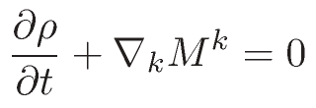

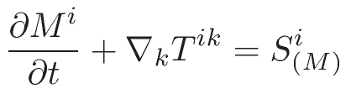
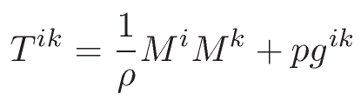


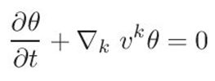

Euler equations (in covariant form)
Continuity eq.:
Momentum eq.:
Energy budget eq.:
Variant 1: use density weighted potential temperature
Variant 2: use total energy density
p=p(θ)
E = E_{kin} + E_{pot} + E_{int}
p=p(E_{int})
In case of diffusion: T^{ik} → T^{ik} + T^{ik}_{diffus} , …
M. Baldauf (DWD)
22
M. Baldauf (DWD)

Slide 23
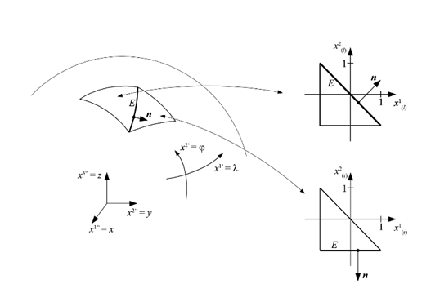
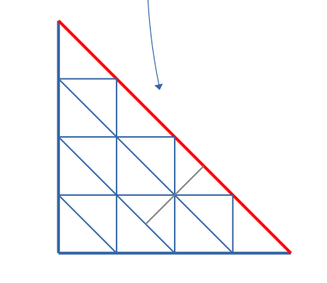
Sequence of coordinates and their transformations in BRIDGE
1. Geographical coordinate
for external data and general I/O purposes
2. Local (gnomonial) coordinate
maps a spherical or ellipsoidal (or just flat) triangle to a unit triangle.
Use covariant form of eqns. (Ricci tensor calculus)
avoids any singularity both in coordinates and in base vectors!
~ concept of a differentiable manifold (Baldauf (2020) JCP)
3. Unit coordinate
affine trafo., compatible to standard FE codes
4. Terrain-following coordinate
treat orography, use strong conservation form (Baldauf (2021) JCP)
5. Submapping coordinate
affine trafo., reduce number of flux transf. at edges
affine
trafo.
Remark: J = √g separates into f(x¹, x²) g(x³)
M. Baldauf (DWD)
23

Slide 24
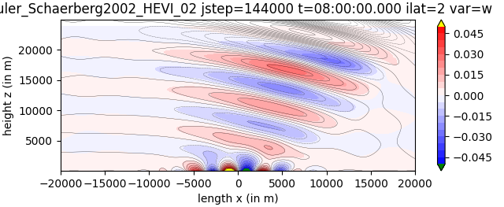
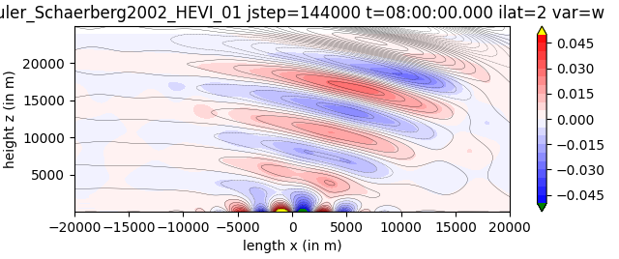
Linear flow over mountains
Schaer et al. (2002) MWR, test case 5b: U₀=10m/s, N=0.01 1/s, a=5 km
Inflow conditions
U=10m/s
→ Slightly improve similarity with the analytic solution (black lines)
Periodic BCs
M. Baldauf (DWD)
24

Slide 25
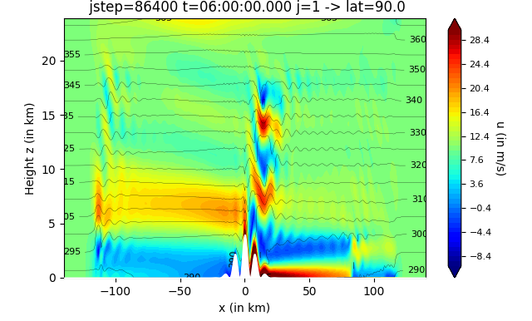
Flow over mountains with steep slopes and vertical grid stretching
Schaer et al. (2002) MWR, test case 5b: U₀=10m/s, N=0.01 1/s, but a=10km
H_{oro}= 4000m,
α_{max} = 58°
Δx=4 km; vertical grid stretching: Δz_{min}~46m, Δz_{max}~736m, z_{lowest QP}~10.3m
HEVI-DG simulation (4th order) remains stable even for steeper slopes! (Baldauf, 2021)
to avoid instability by strong gravity wave breaking, vertically implicit diffusion with K=100 m²/s was used
M. Baldauf (DWD)
25

Slide 26
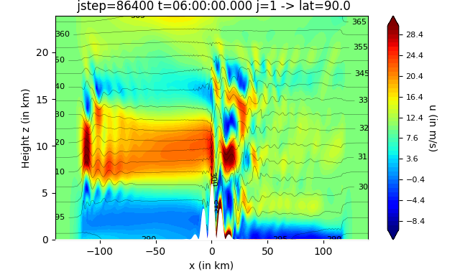
Flow over mountains with steep slopes and vertical grid stretching
Schaer et al. (2002) MWR, test case 5b: U₀=10m/s, N=0.01 1/s, but a=10km
H_{oro}= 6000m,
α_{max} = 67°
Δx=4 km; vertical grid stretching: Δz_{min}~46m, Δz_{max}~736m, z_{lowest QP}~10.3m
HEVI-DG simulation (4th order) remains stable even for steeper slopes! (Baldauf, 2021)
to avoid instability by strong gravity wave breaking, vertically implicit diffusion with K=100 m²/s was used
M. Baldauf (DWD)
26

Slide 27
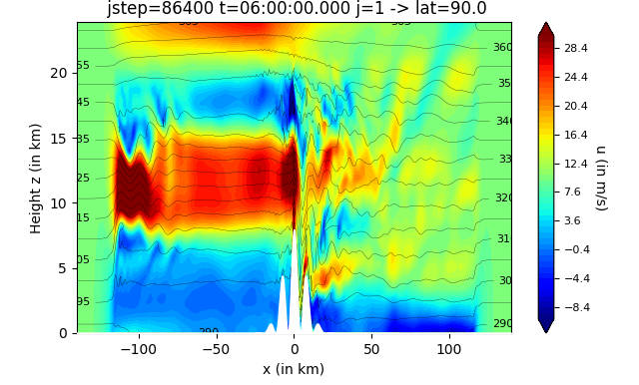
Flow over mountains with steep slopes and vertical grid stretching
Schaer et al. (2002) MWR, test case 5b: U₀=10m/s, N=0.01 1/s, but a=10km
H_{oro}= 8000m,
α_{max} = 72°
Δx=4 km; vertical grid stretching: Δz_{min}~46m, Δz_{max}~736m, z_{lowest QP}~10.3m
HEVI-DG simulation (4th order) remains stable even for steeper slopes! (Baldauf, 2021)
to avoid instability by strong gravity wave breaking, vertically implicit diffusion with K=100 m²/s was used
M. Baldauf (DWD)
27

