Slide 1
News about C-SRNWP 30th September 2024
Chiara Marsigli (DWD, Germany)

Slide 2
Organisation
EUMETNET – WEATHER FORECASTING COOPERATION (E-WFC)
Legend:
Manager
Scientist
SRNWP-EPS module
C-SRNWP module
software scientist
DWD- Coordinating Member
Vacant
E-NWC module
Chiara Marsigli
GeoSphere Austria
Coordinating Member
AEMET – co-coordinator
PP module
Franziska Schmid
Alfons Callado Pallares
vacant
RMIB
Coordinating Member
Aitor Atencia
Itaf-Met – co-coordinator
Stephane Vannitsem
Francesca Marcucci
Jonathan Demaeyer
vacant

Slide 3
New phase 2024-2028 – C-SRNWP
AIM
exchanges and cooperation between limited area modeling consortia in Europe
THROUGH
efficient exchange of information on scientific, technical and operational aspects of NWP
FOCUS ON THE NEW CHALLENGES
for the development of next generation forecasting systems
high resolution and Digital Twins -> applications and the end-users
AI/ML based method -> interaction with the traditional NWP approaches
representation of uncertainties -> with SRNWP-EPS
Cooperative effort and synergies with the other Modules

Slide 4
C-SRNWP 2024 – 2028 - requirements
EWGLAM/SRNWP annual workshop
Expert Teams of selected topics
SRNWP website
Contact with the OBS programmes -> A. Cress, DWD
Short Term Scientific Missions -> E-WFC
Inform about other conferences/projects
Follow the DestinE project
Organise thematic workshops
Req no. | Requirement description | Priority
C-SRNWP_1 | Ensure efficient exchange of information between Participating Members and European LAM consortia in relation to scientific, technical and operational aspects of NWP. | M
 |  | RU
C-SRNWP_2 | Ensure the maintenance of resources (e.g. existing software) and development of new resources under the EUMETNET 'umbrella' to support the NWP community, e.g. in data assimilation (DA) and parametrization. | M
 |  | RU
Catalogue of resources
Maintain and develop existing resources (Global Lake Database, SRNWP Surface Data Pool) -> new proposal from ET SURF?

Slide 5
C-SRNWP Expert Teams
Advisory Expert Team:
Consortia Leaders and thematic Expert Teams chairpersons
Thematic Expert Teams:
Data assimilation and use of observations
Diagnostics, validation and verification
Dynamics and lateral boundary coupling
Link with applications
Physical parameterisation (upper air)
Predictability and EPS
Surface and soil processes (model and data assimilation)
System aspects
Tomorrow (15:20 – 16:00): discussion on reviewing the role of the Expert Teams

Slide 6

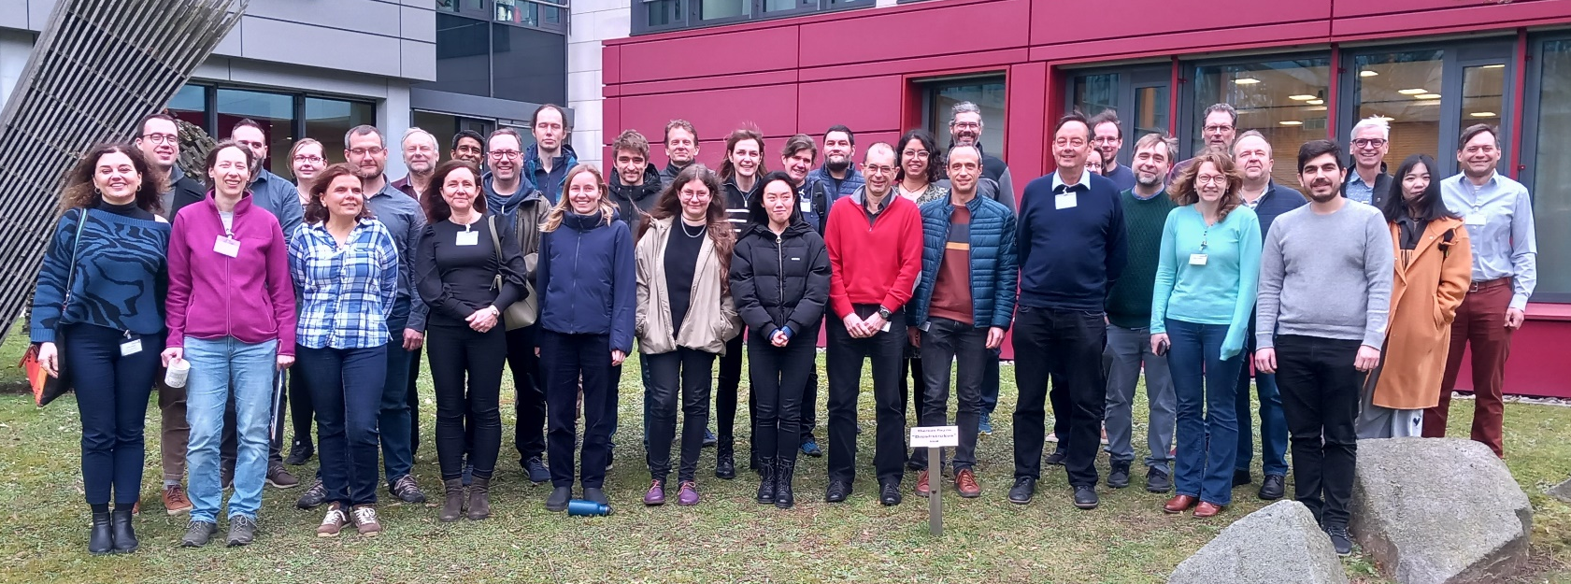
PHY-EPS hectometric workshop 5-7 February 2024, DWD
Topics:
observations
campaigns: FESSTVaL, urbisphere, WesCon, …
ensemble
turbulence
surface
convection
Participants:
76 (46 in person)
Met Services, Universities, Research Centres
mainly Europe but also from outside Europe

Slide 7
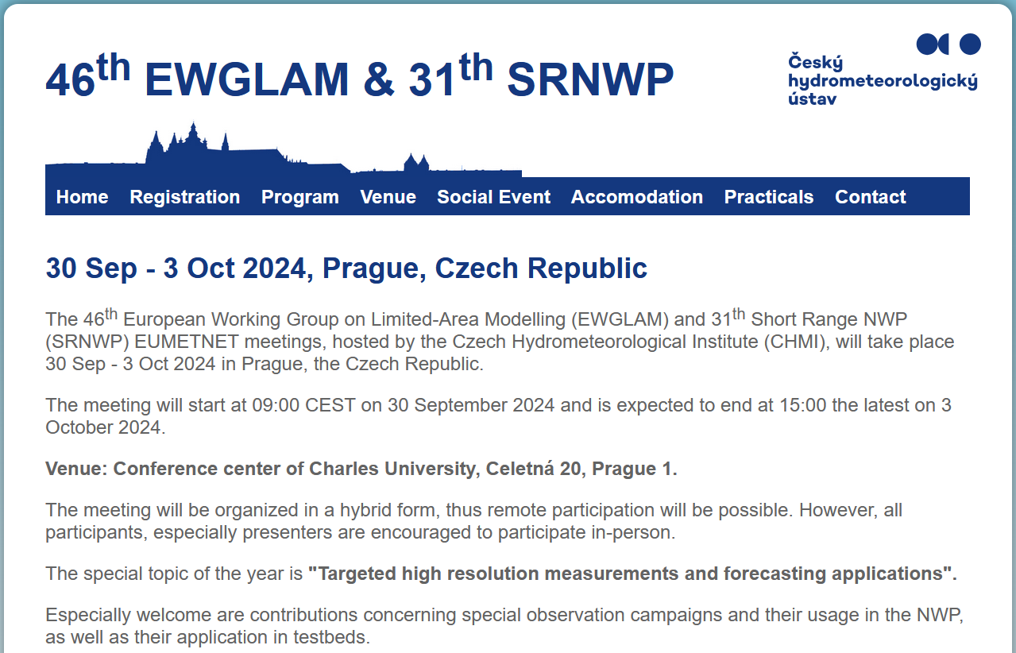
C-SRNWP annual meeting – EWGLAM/SRNWP
137 participants
87 in person
29 countries
mostly European and Consortia
also one representative from Japan and one invited from US

Slide 8
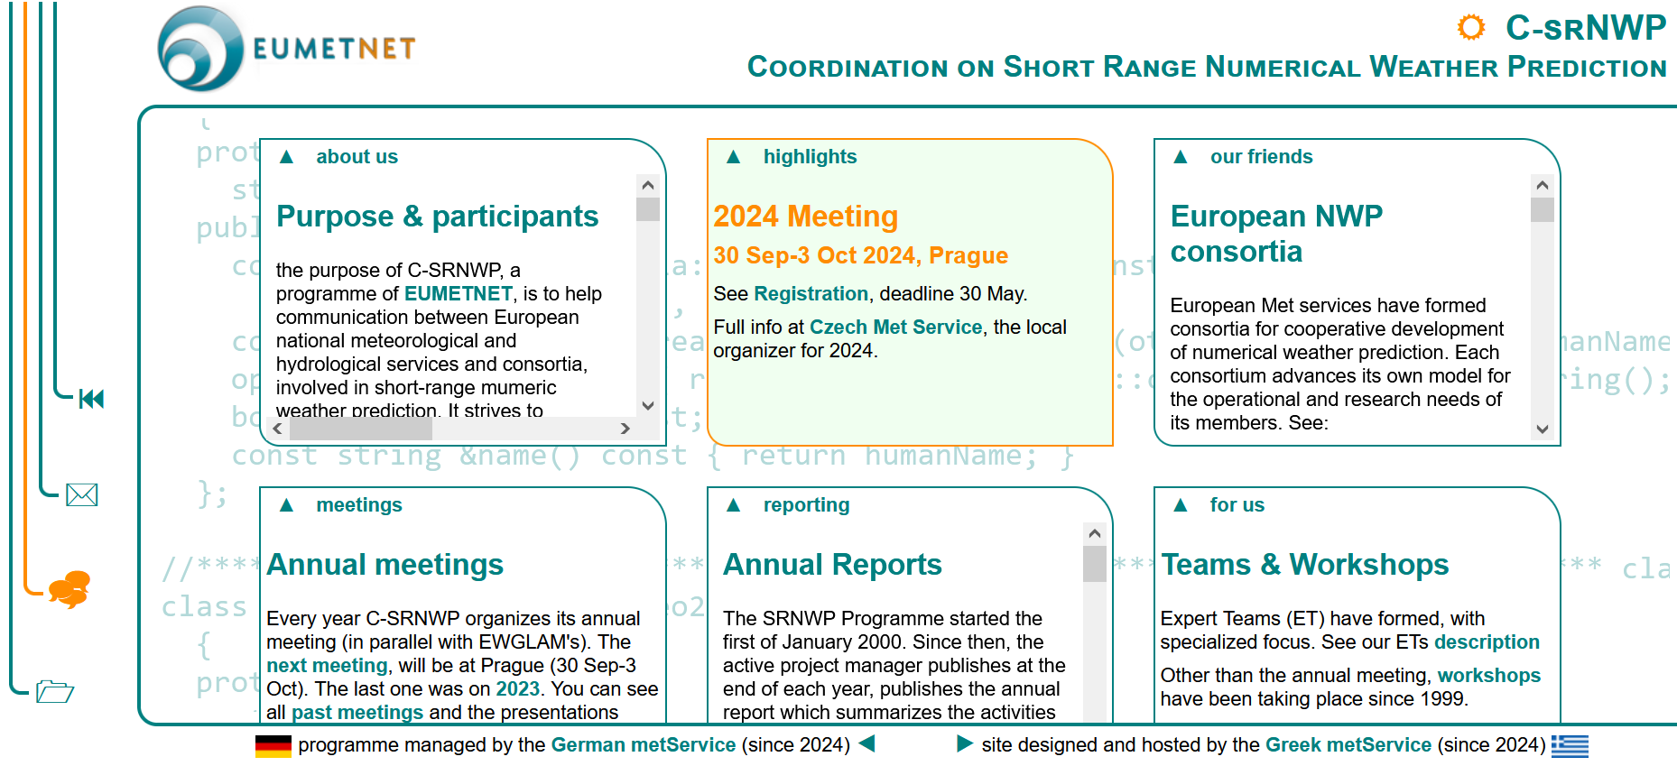
New website: srnwp.eu
Many thanks to Theodore Andreadis (HNMS)!!!

Slide 9
Thank you!

