Slide 1

Some recent physics developments in COSMO for the ICON model
Ice optical properties of large hydrometeors for ecRAD in ICON
COSMO-PP CAIIR
ART-component of ICON
DWD action
Actions around Aerosols and Reactive Trace gases
Dusty Cirrus Parameterization
Recent extensions of adaptive parameter tuning
DWD action
ICON D05; GLORI
Problems at high horizontal resolution in the stable BL above complex terrain
Current, empirically based countermeasures
DWD action
Related methodological development:
Integrating Lower Limits of Diff.-Coeffs. and surface-layer turbulence into the STIC concept
ConSAT – Atm.
More advanced treatment of topographic effects
ConSAT – Atm. and Action at Meteo Swiss
Matthias Raschendorfer
EWGLAM/SRNPW, Prague-Hybrid 2024

Slide 2



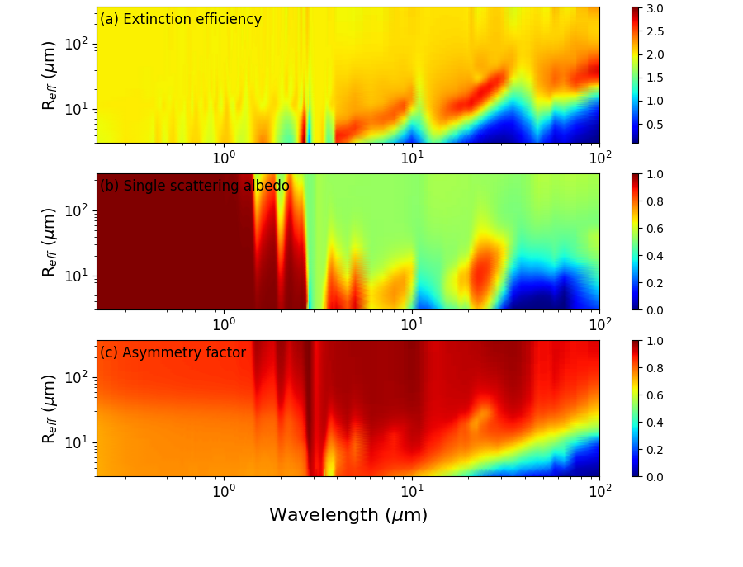

New ice optical properties for ecRAD:
Clouds and Aerosols Improvements in ICON Radiation scheme – COSMO PP CAIIR
Muskatel, Blahak, Khain, Levi & Fu; Atmosphere 2021, 12, 89.
Extinction efficiency
Extended size and shape:
60 µm → 300 µm
Ice particles surfaces:
Rough/Smooth
Single scattering albedo
High resolution:
Reff / Wavelength
Asymmetry factor
provided by Harel Mulkatel (IMS)
Matthias Raschendorfer
EWGLAM/SRNPW, Prague-Hybrid 2024
Notes:
One major activity of our COSMO PP CAIIR about „Clouds and Aerosols Improvements in the ICON Radiation scheme“ is the improved parameterization of optical properties, that is, above all, the inclusion of larger and multi-shape ice particles …

Slide 3
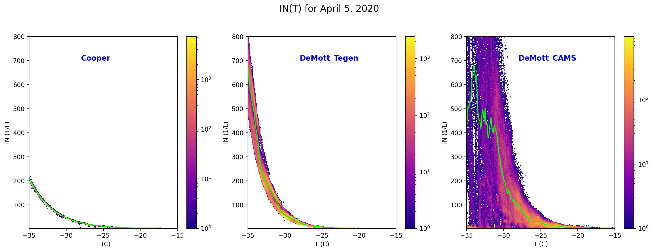
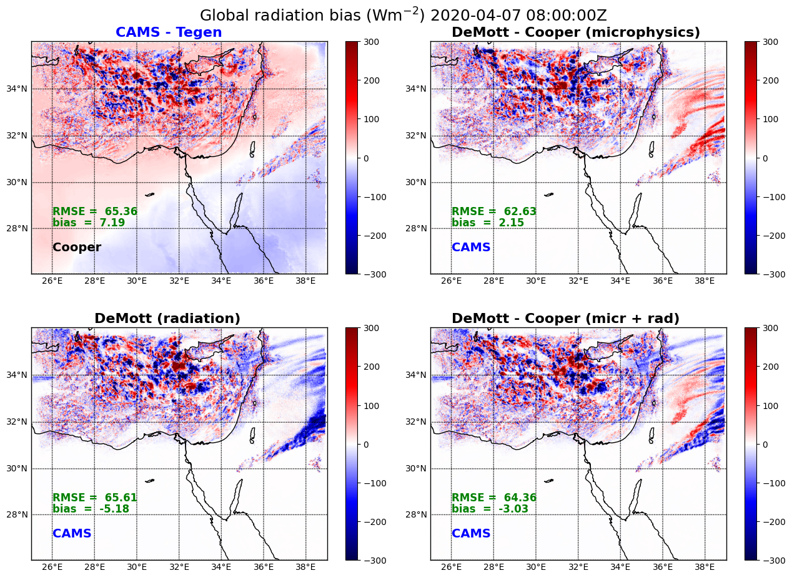


PP CAIIR: New ice nucleation with DeMott (2015) scheme:
$IN(T,ndust)=1000∙{n_{dust}}^{1.25}\exp^{0.46\left(T_{0}−T\right)−11.6}$
$$IN(T)=5∙\exp^{0.304(T_{0}−T)}$$
Impact on global radiation (Wm⁻²) 2020-04-07 08:00:00 Z
direct aerosol effect
indirect aerosol effect due to impact on cloud processes
provided by Harel Mulkatel (IMS)
Matthias Raschendorfer
EWGLAM/SRNPW, Prague-Hybrid 2024
Notes:
In contrast to the previous ice-nucleation scheme by Cooper, which describes the ice-nucleation number concentration as a pure function of temperature, the new one by DeMott includes a dependency on the dust concentration.
This impacts, of course, the temperature distribution of ice nucleation dependent on the used aerosol data, where this distribution is drastically broadened with the CAMS data (as shown in the upper panels).
The Impact on global radiation by the direct aerosol effect is demonstrated in the lower left panel through the difference plot CAMS-Tegen, both running with the same Cooper nucleation scheme. Quite striking is the removal of an overall too large opacity with Tegen.
The indirect aerosol effect due to the impact of cloud processes is striking as well, as you can see in the lower right chart.

Slide 4
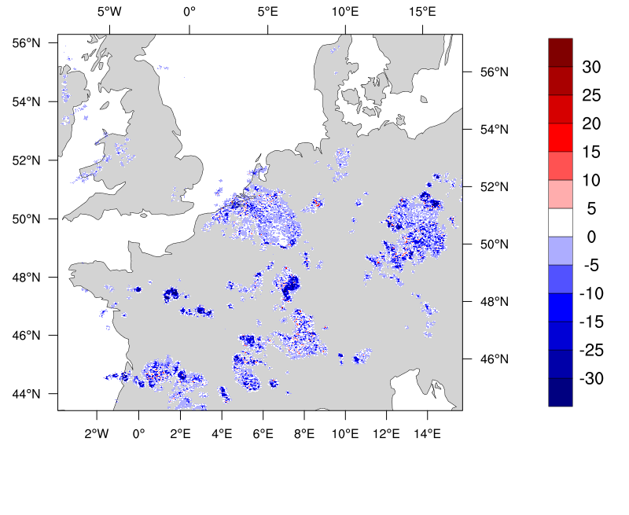

Net direct radiation effect of large particles:
Upwelling LW TOA (q_{c}q_{i}q_{s}q_{g}q_{r} – q_{c}q_{i}) (W/m²)
All (-0.31 W/m²)
Snow (-0.05 W/m²)
Difference from reference (W/m²)
Graupel and snow in high clouds block long-wave radiation from the surface resulting in less upwelling radiation at the top of the atmosphere.
In the above example, the atmosphere warms by 0.31 W/m² (in average domain) due to the additional consideration of all lager particles
0.05 snow only
provided by Alberto De Lozar (DWD)
Matthias Raschendorfer
EWGLAM/SRNPW, Prague-Hybrid 2024

Slide 5
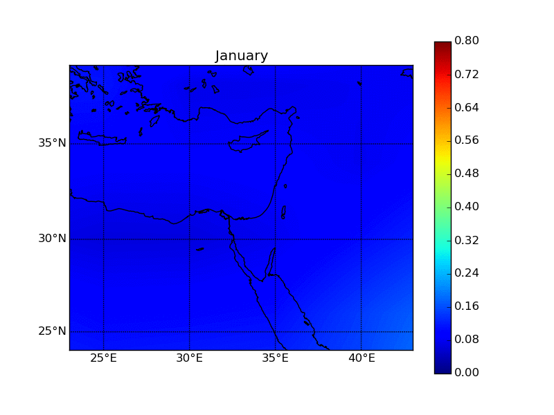
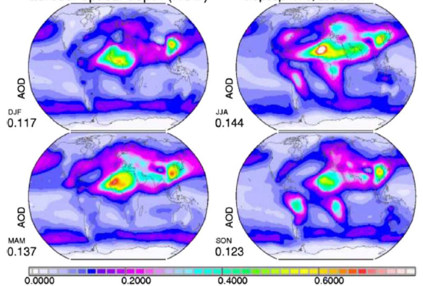
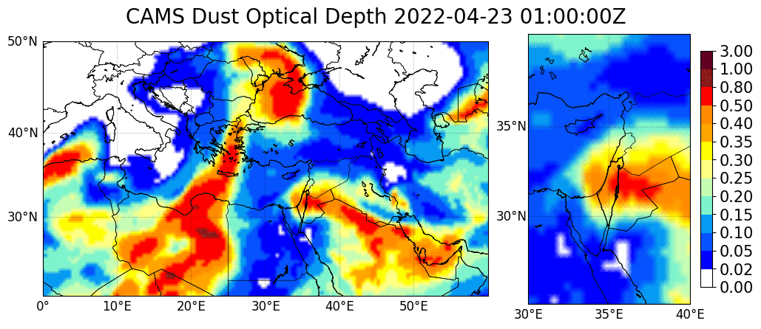
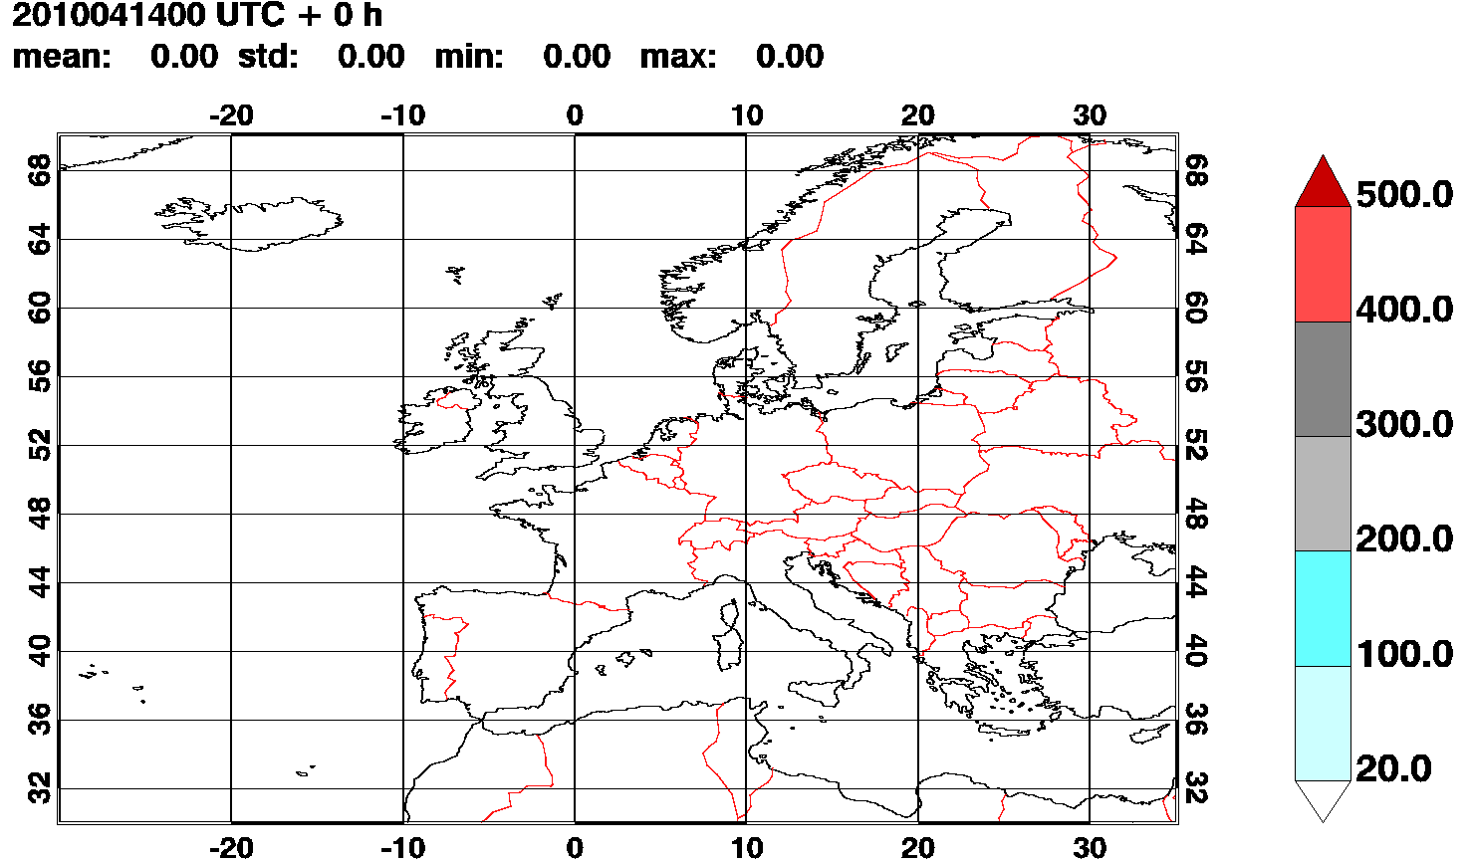
Aerosols Inputs in ICON Radiation scheme:
Tegen (1997)
Kinne (2013)
CAMS climtology
irad_aero = 6
irad_aero = 13
irad_aero = 7
CAMS forecast
Prognostic 2D AOD
ICON-ART
irad_aero = 8
irad_aero=6 & iprog_aero=1
irad_aero = 9
Now including so far missing sources of: sea-salt,
black/organic carbon and sulfate
(anthropogenic and by wild-fires)
Verification against AERONET:
Always better than Tegen-clim.
5 days forecast
provided by Harel Mulkatel (IMS)
Matthias Raschendorfer
EWGLAM/SRNPW, Prague-Hybrid 2024
Notes:
An important part of the PP is the provision and incorporation of more realistic aerosol information, which includes CAMS climatological and offline-forecasted data as well as a prognostic or semi-prognostic online treatment by ICON itself …
Eja-svatja-jökudl

Slide 6

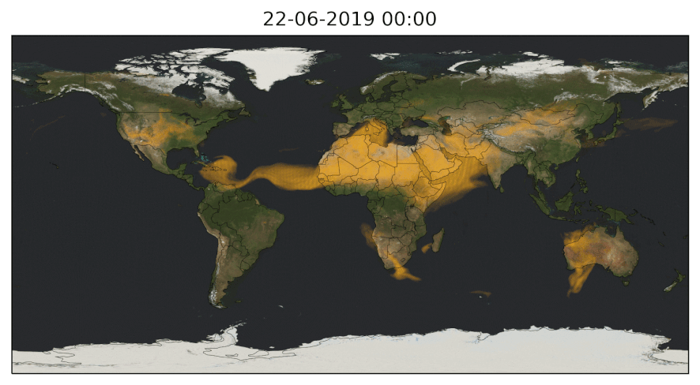
Expanding ICON-ART to multi-aerosol global simulations:
Dust was investigated in PerduS; in PermaStrom expansion to wildfire and sea salt aerosols
Sea Salt Emission Parameterizations
Sea Salt Aerosol Modes
Effects of Aerosol Dynamical Processes on Atmospheric Burden
Biomass Burning Aerosols - Combined Global Simulation
Daily forecast using ICON-ART:
R2B06
latest release 2024.07
Mineral Dust
Sea Salt
Biomass Burning Aerosols
as to estimate reduction of photovoltaic power supply
provided by Anika Rohde (KIT)
Matthias Raschendorfer
EWGLAM/SRNPW, Prague-Hybrid 2024

Slide 7
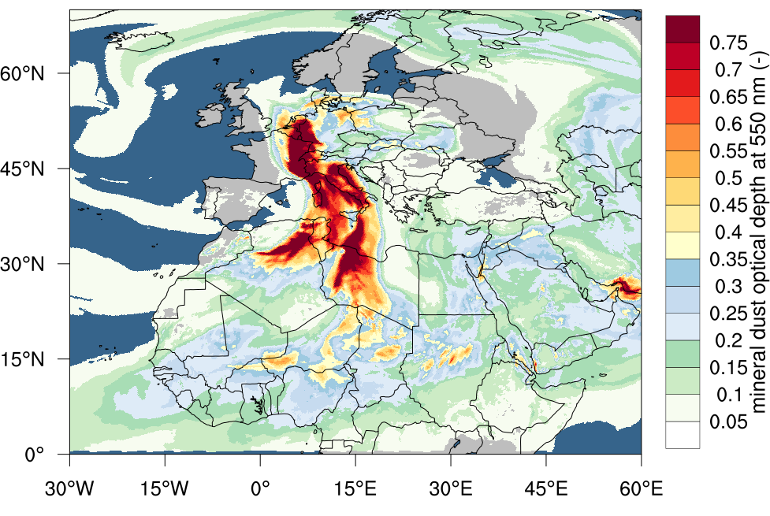
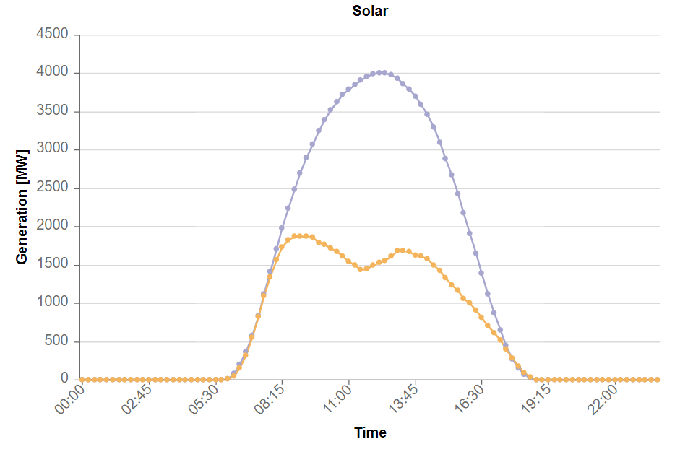
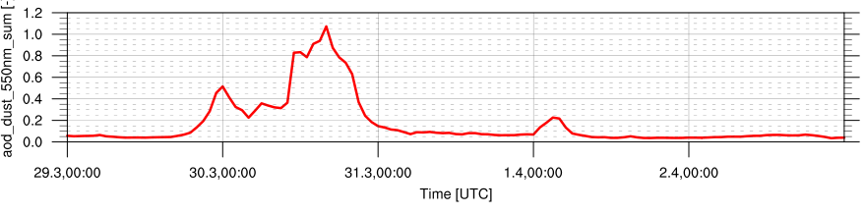
Easter weekend 30.03.2024 in SW Germany:
The error in PV forecast is ca 2.5 Mi EUR
-- forecast
-- actual
Karlsruhe
provided Ali Hoshyaripour (KIT)
Matthias Raschendorfer
EWGLAM/SRNPW, Prague-Hybrid 2024

Slide 8
Dusty Cirrus parameterization:
moist clean air
LW cooling
Seifert et al., 2022:
Seifert, A., Bachmann, V., Filipitsch, F., Förstner, J., Grams, C., Hoshyaripour, G. A., Quinting, J., Rohde, A., Vogel, H., Wagner, A., and Vogel, B.: Aerosol-cloud-radiation interaction during Saharan dust episodes: The dusty cirrus puzzle, Atmos. Chem. Phys., 23, 6409–6430, 2023, https://doi.org/10.5194/acp-23-6409-2023.
RH >100%
LW cooling
heterogeneous ice nucleation
initial cirrus at interface
dusty cirrus
dusty dry air
RH < 100%
ice sedimentation
Matthias Raschendorfer
EWGLAM/SRNPW, Prague-Hybrid 2024
Notes:
This has been achieved by a consideration of heterogeneous ice nucleation, so that in case of moist, clean and supersaturated air above dry and dusty air, initial cirrus clouds can evolve due to turbulent mixing of both phases. Through the enhancement of this mixing-process by LW cooling at the cloud top, more and more cirrus clouds can be generated, which reduces to a large extent our persistent problem with much to few cirrus clouds when using prognostic ICON-ART dust.

Slide 9
Not only PV but also temperature forecast goes wrong:
Even dusty-cirrus is not enough to fill this gap. What about aging and CCN-activation?
provided by Heike Vogel (KIT)
Matthias Raschendorfer
EWGLAM/SRNPW, Prague-Hybrid 2024

Slide 10
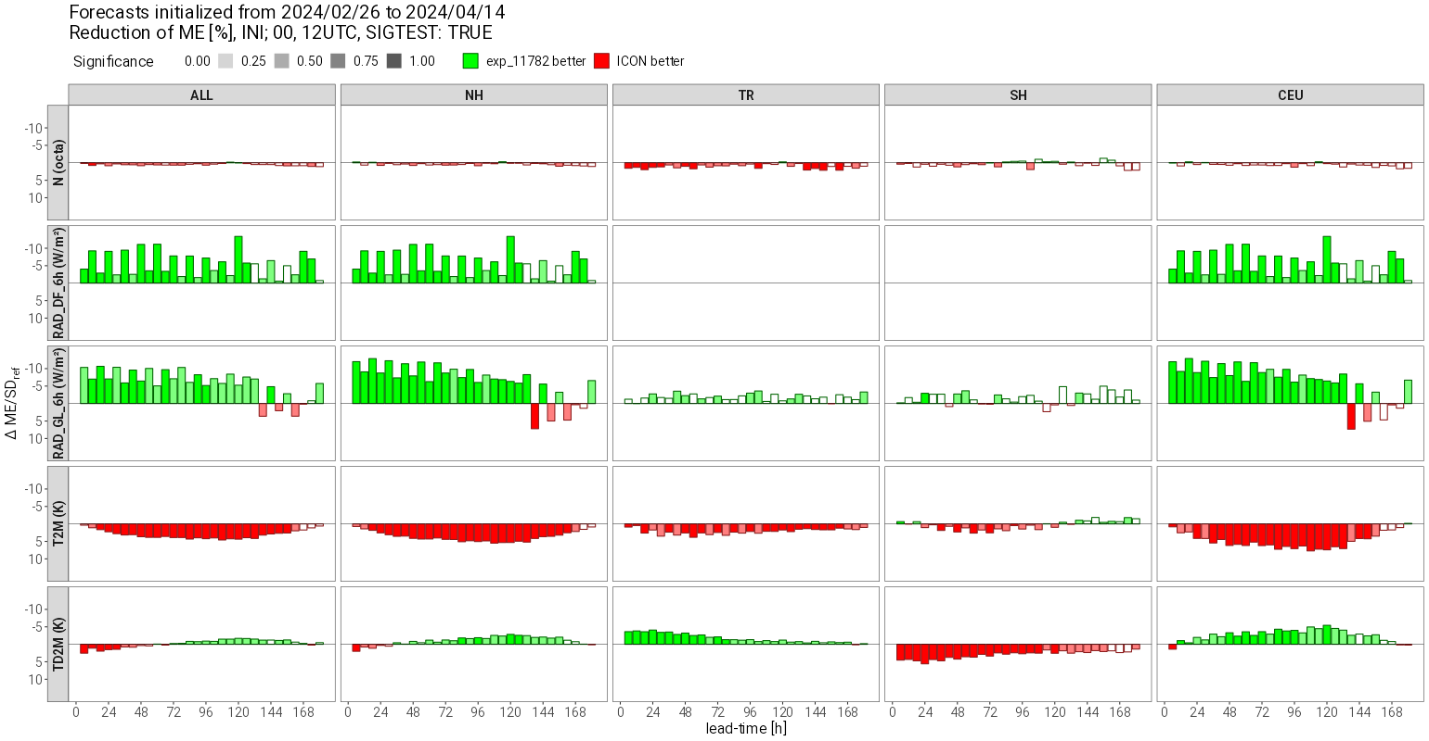
Verification with glabal ICON (13 km)
At dust events:
Improved global radiation
Declined T2m
Over-tuning of the model:
adapting to current opacity-bias with Tegen-climatology
provided Jochen Förstner (DWD)
Matthias Raschendorfer
EWGLAM/SRNPW, Prague-Hybrid 2024

Slide 11
Empirical Extensions of Physical Parameterizations:
non-confident model parameters:
treated as a constants
turn out to be functions of the
model state (including gradients)
DA-increments as an estimate of model errors
any derived variable of a specific SGS process
new parameters of a
statistical hyper-parameterization
new parameters of an
Adaptive Parameter Tuning
Current incomplete parameterization function
Desired complete parameterization function
Expectations related to :
Reduces systematic model error by some automatic procedure
It is dependent only on a few sensitive components of full !
It is easier to find than !
Should be AI-aided in future !
Matthias Raschendorfer
EWGLAM/SRNPW, Prague-Hybrid 2024

Slide 12
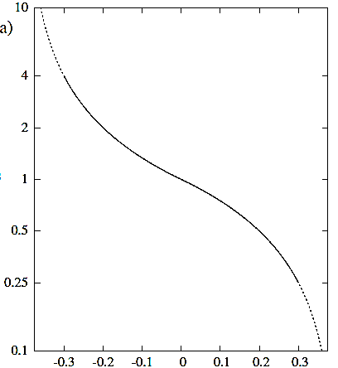
Adaptive Parameter Tuning (ADP) by Günther Zängl:
i = 1 2 3 4
Time-filtered DA-increments of and at the lowermost model level
Dominated by measurements of
Proxies for local systematic error of and -amplitude
adapting to weather condition
Used as predictors for multiplicative empirical correction-factors for non-confident parameters :
Land-use roughness and SSO blocking tendency
Minimal evaporation resistances of bare soil and plant stomata
Heat-conductivity and -capacity
Snow-albedo
Minimal diffusion coefficient
Hydraulic diffusivity of uppermost soil layer
Albedo of snow-free land-fraction
recently included
Scaling factor in snow-fraction diagnostics
https://rmets.onlinelibrary.wiley.com/doi/10.1002/qj.4535
default value of (internal global or external local) parameter
Matthias Raschendorfer
EWGLAM/SRNPW, Prague-Hybrid 2024

Slide 13
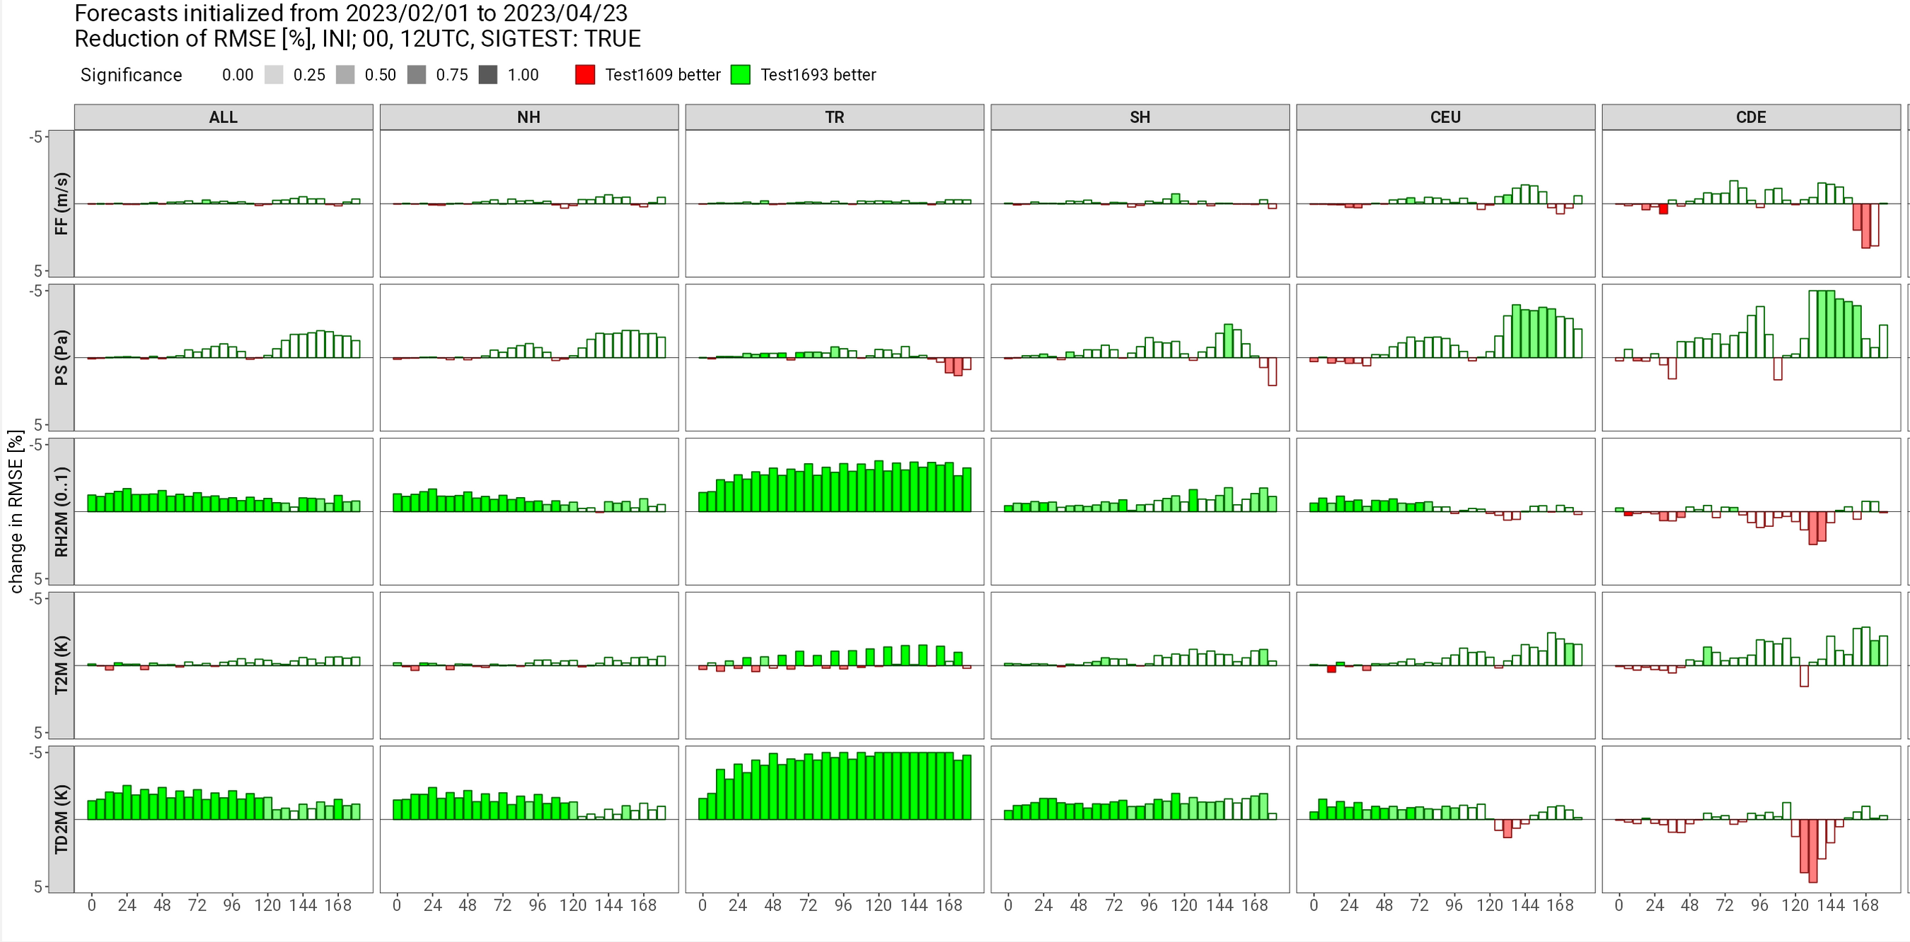
Scorecard SYNOP DET; Feb-Apr 2023
APT of hydraulic conductivity:
Better TD2m in (sub-)topics
APT of snow-free albedo:
Reduction of warm-bias in north-american summer
APT related to snow-fraction:
Positive impact in regions with partial snow
Revised surface smoothing by snow (including surface-reduction)
Reduced moist bias in Sibiria
provided by G. Zängl (DWD)
Matthias Raschendorfer, (DWD)
Matthias Raschendorfer
EWGLAM/SRNPW, Prague-Hybrid 2024

Slide 14
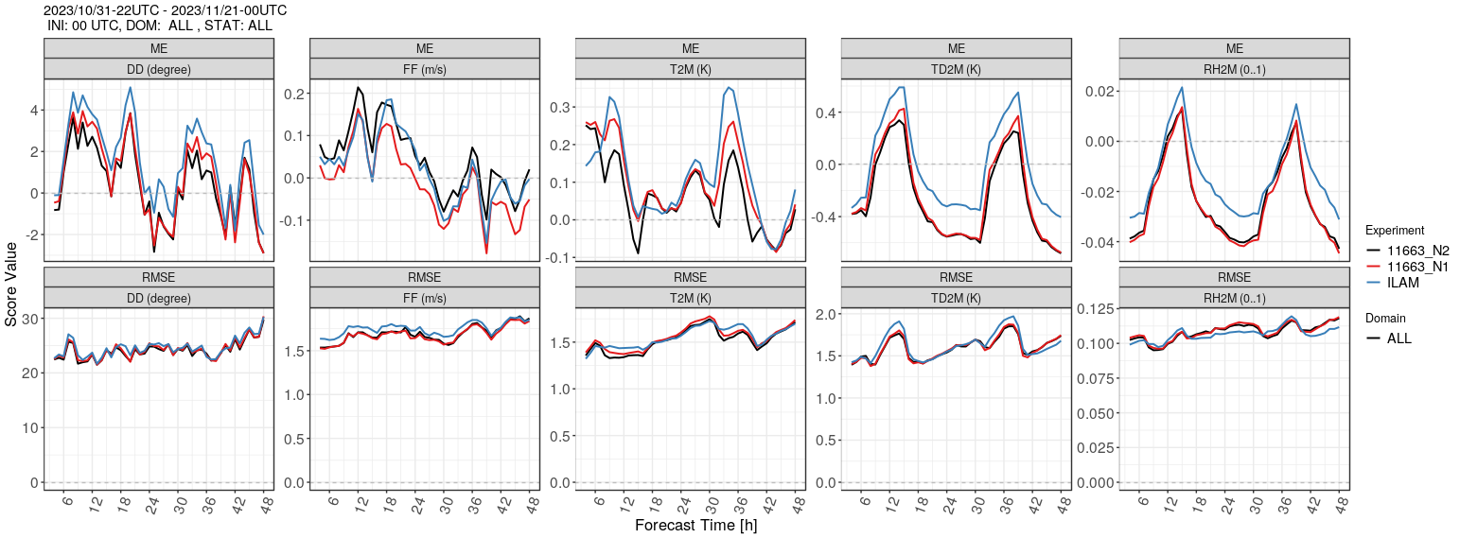
-LAM:
General result at 500 m horizontal resolution:
Mesh-size refinement 2 km -> 500 m tends to improve the model skill in various aspects
Improved 10-m winds in mountainous regions under stable conditions,
for T2M this depends on the time period
Nov 2023, Alpine domain
500 m
1 km
2 km
provided by G. Zängl (DWD)
Matthias Raschendorfer
EWGLAM/SRNPW, Prague-Hybrid 2024
Notes:
14

Slide 15
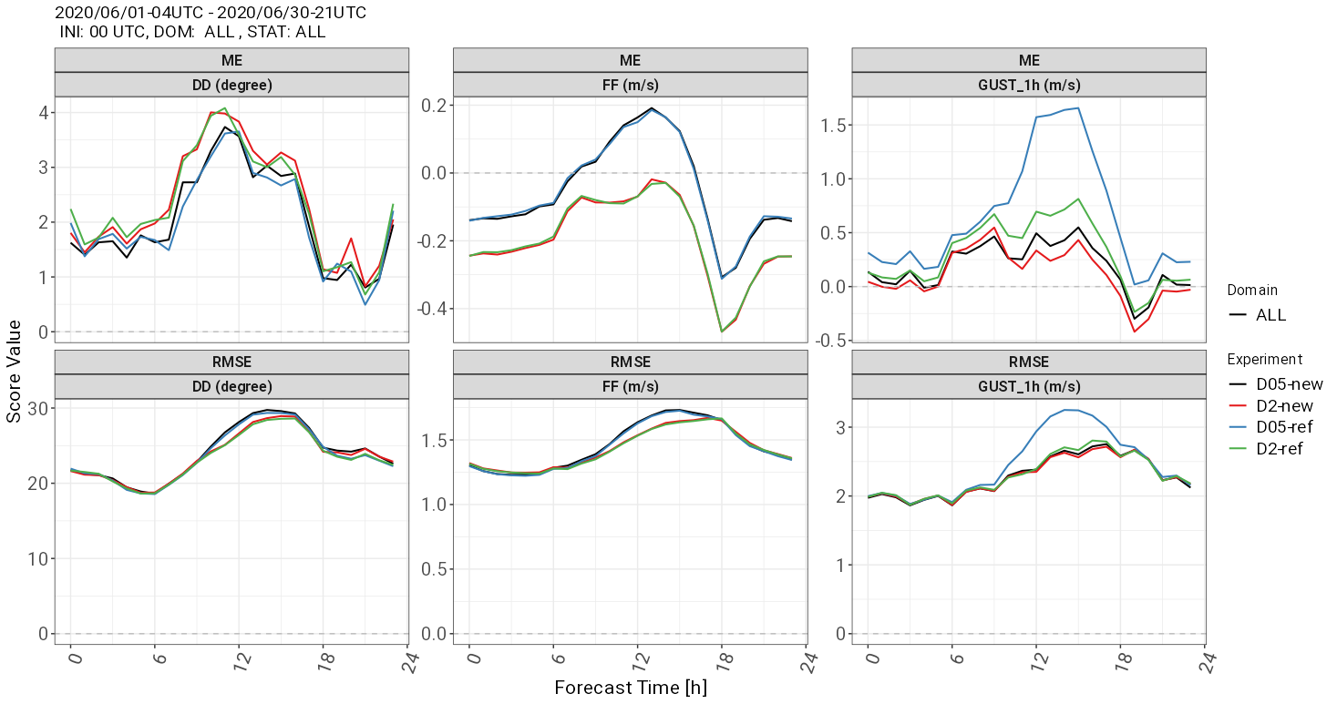
-LAM:
Impact of and countermeasures against the daytime wind-gust problem:
Large overestimation of diagnosed wind gusts in summertime conditions with a deep daytime PBL due to double-counting issues with ‘permitted large eddies’
Adapted gust parameterization
Based on 10-min averaged low-level wind (smoothing out already resolved gusts).
Limitation of gust excess speed to a fraction of resolved wind maximum within the PBL
500m
2 Km
Hindcast for June 2020
10-m winds used for verification are still instantaneous values
provided by G. Zängl (DWD)
Matthias Raschendorfer
EWGLAM/SRNPW, Prague-Hybrid 2024

Slide 16
-LAM:
The nocturnal T2m problem at high resolution above complex terrain:
Quite strong positive nocturnal T2m-bias close to the floor of resolved narrow valleys
Problem disappears at using a filtered (coarser) topography
So far hypothesized reason:
Grid-scale kathabatic outflow of near-surface cold air along now resolved valleys
Too excessive near surface turbulent mixing through additional shear by
Resolved katabatic winds
STIC-terms: SSO wakes and current “sub-grid thermal circulation term”: possible due to not sufficiently reduced SSO parameters
Cold pools associated with resolved katabatic winds are vertically mixed out by too strong turbulence
Countermeasures:
warm
Damping down BL turbulence
Reduced ‘scaling factors’ for STIC-forcing by SSO-wakes
Reduced laminar resistance for scalar transfer
at steep slopes (by means of ‘rlam_heat’).
turb. mixing
cold
cold air outflow
Matthias Raschendorfer
EWGLAM/SRNPW, Prague-Hybrid 2024

Slide 17
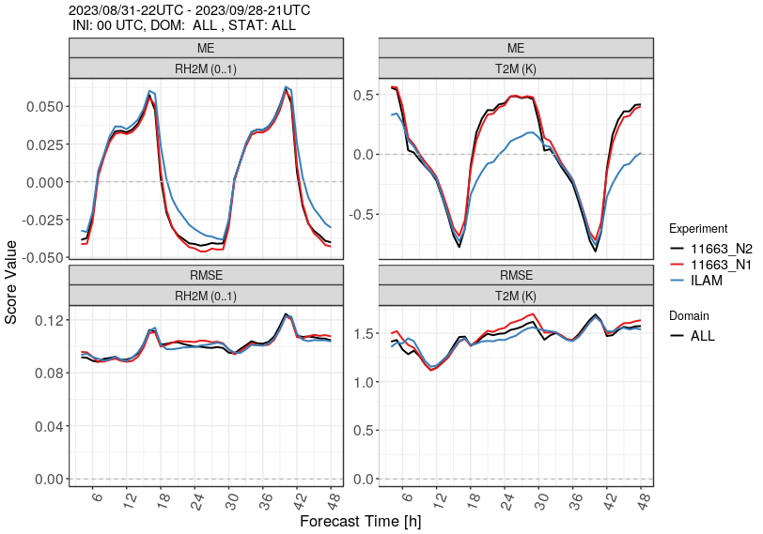
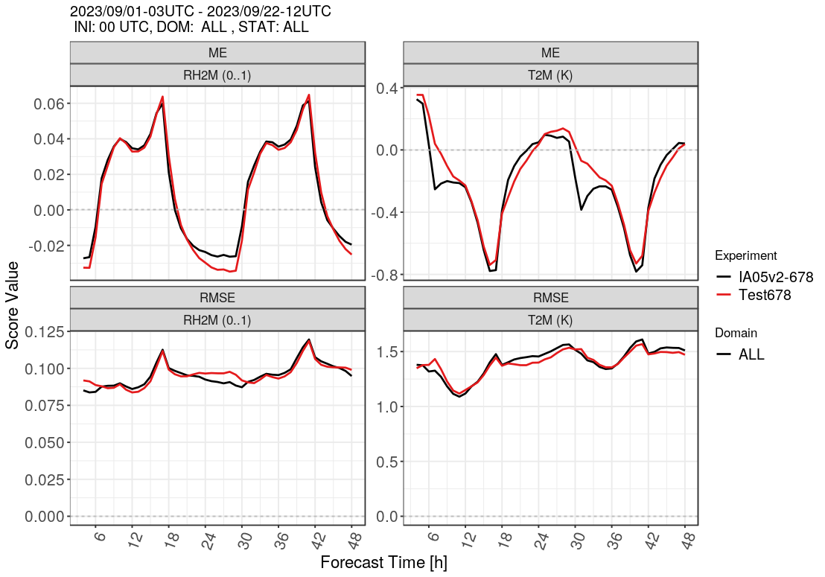
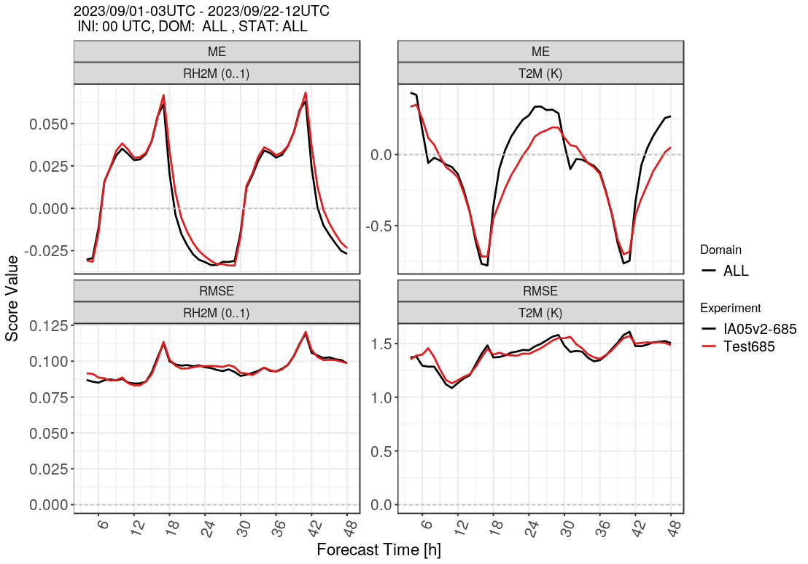
-LAM:
Impact of and countermeasures against the nocturnal T2m problem:
Increased nocturnal warm bias in valleys during the summer months for higher horizontal resolution
Interpolating the model orography from 2 km to 500 m
Conditional reduction of turbulent mixing and increasing surface transfer
at sloping terrain
almost removes the bias difference
Red. turbulent length-scale
Red. SSO-source for TKE
Red. laminar transfer-resistance for scalars
500 m
1 km
2 km
500 m
2 km
Sep 2023, Alpine domain, reeference
Sep 2023, Alpine domain, interpolated orography
Sep 2023, Alpine domain, turbulence tuning
provided by G. Zängl (DWD)
Matthias Raschendorfer
EWGLAM/SRNPW, Prague-Hybrid 2024

Slide 18
-LAM:
STIC and the crucial impact of
Lower Limits of turb. Diff.-Coeff. (LLDC):
STIC: Separated Turbulence Interacting with NTCs
NTC: Non-Turbulent SGS Circulation
production terms dependent on:
specific length scales
and a specific velocity
scale ( )
production terms depend on:
turbulent length scale and the turbulent velocity scale ( )
CKE
TKE
The scale interaction term shifts Sugbgrid KE from the NTC part of the spectrum (Circulation KE)
towards the turbulent part (TKE) by virtue of shear
generated by the sub-grid circulation flow patterns.
TKE needs to be adapted to !
Excess of over is due to missing shear by NTCs
with some empirical conditional scaling
turbulent master length scale
Excess of over is due to missing SGS pressure-
forces in momentum budget !!
artificially limited by a LLDC
turbulent diffusion coefficient
substituting not yet properly represented STIC-terms!
Some so far missing NTC-shear due to not properly considered
SSO-effects: is obsolete at higher horizontal resolution:
katabatic circulation (Therm.-SSO) or 3D effects (both sub-grid) :
turbulent velocity scale
stability function
scalars like Heat
needs to be reduced at higher horizontal resolution!
Momentum
Should partly substitute artificial reduction of the remaining STIC-forcing by SSO-wakes
Matthias Raschendorfer
EWGLAM/SRNPW, Prague-Hybrid 2024

Slide 19
-LAM:
New Surace-Layer Shear-Amplification could be a missing effect:
Additional shear from SSO-wakes or sub-grid thermal circulation is also connected with NTC wind
Magnitude of this NTC wind may be >> magnitude of mean horizontal wind-vector
warm
This additional NTC wind induces additional surface shear
P-level TKE-equation
Increased turbulent transfer leads to more near surface cooling at night
lowermost model layer
Significant impact to 10m wind-speed diagnostics (wind-gusts)
increased surface shear
for
-surface of lowest model main-level
constant flux
transfer-layer
turbulent transfer with
0-level TKE-equation
0
cold
soil
Should substitute artificial reduction of laminar transfer-resistance at steep surface slopes!
Matthias Raschendorfer
EWGLAM/SRNPW, Prague-Hybrid 2024

Slide 20
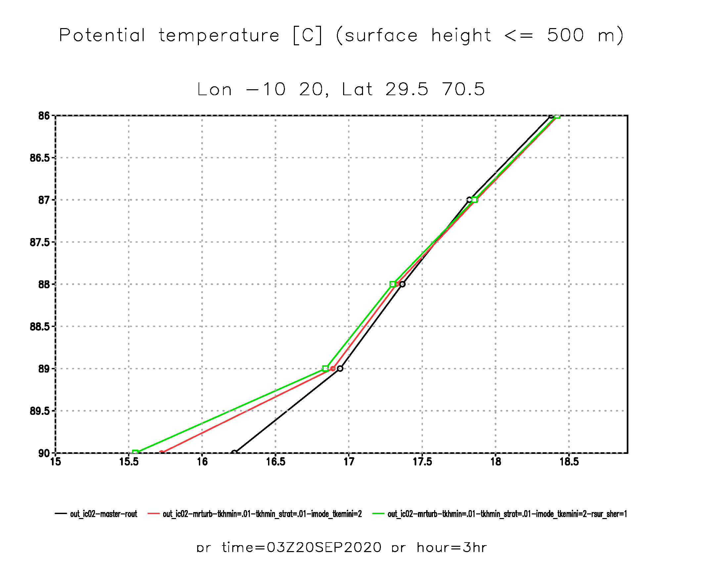
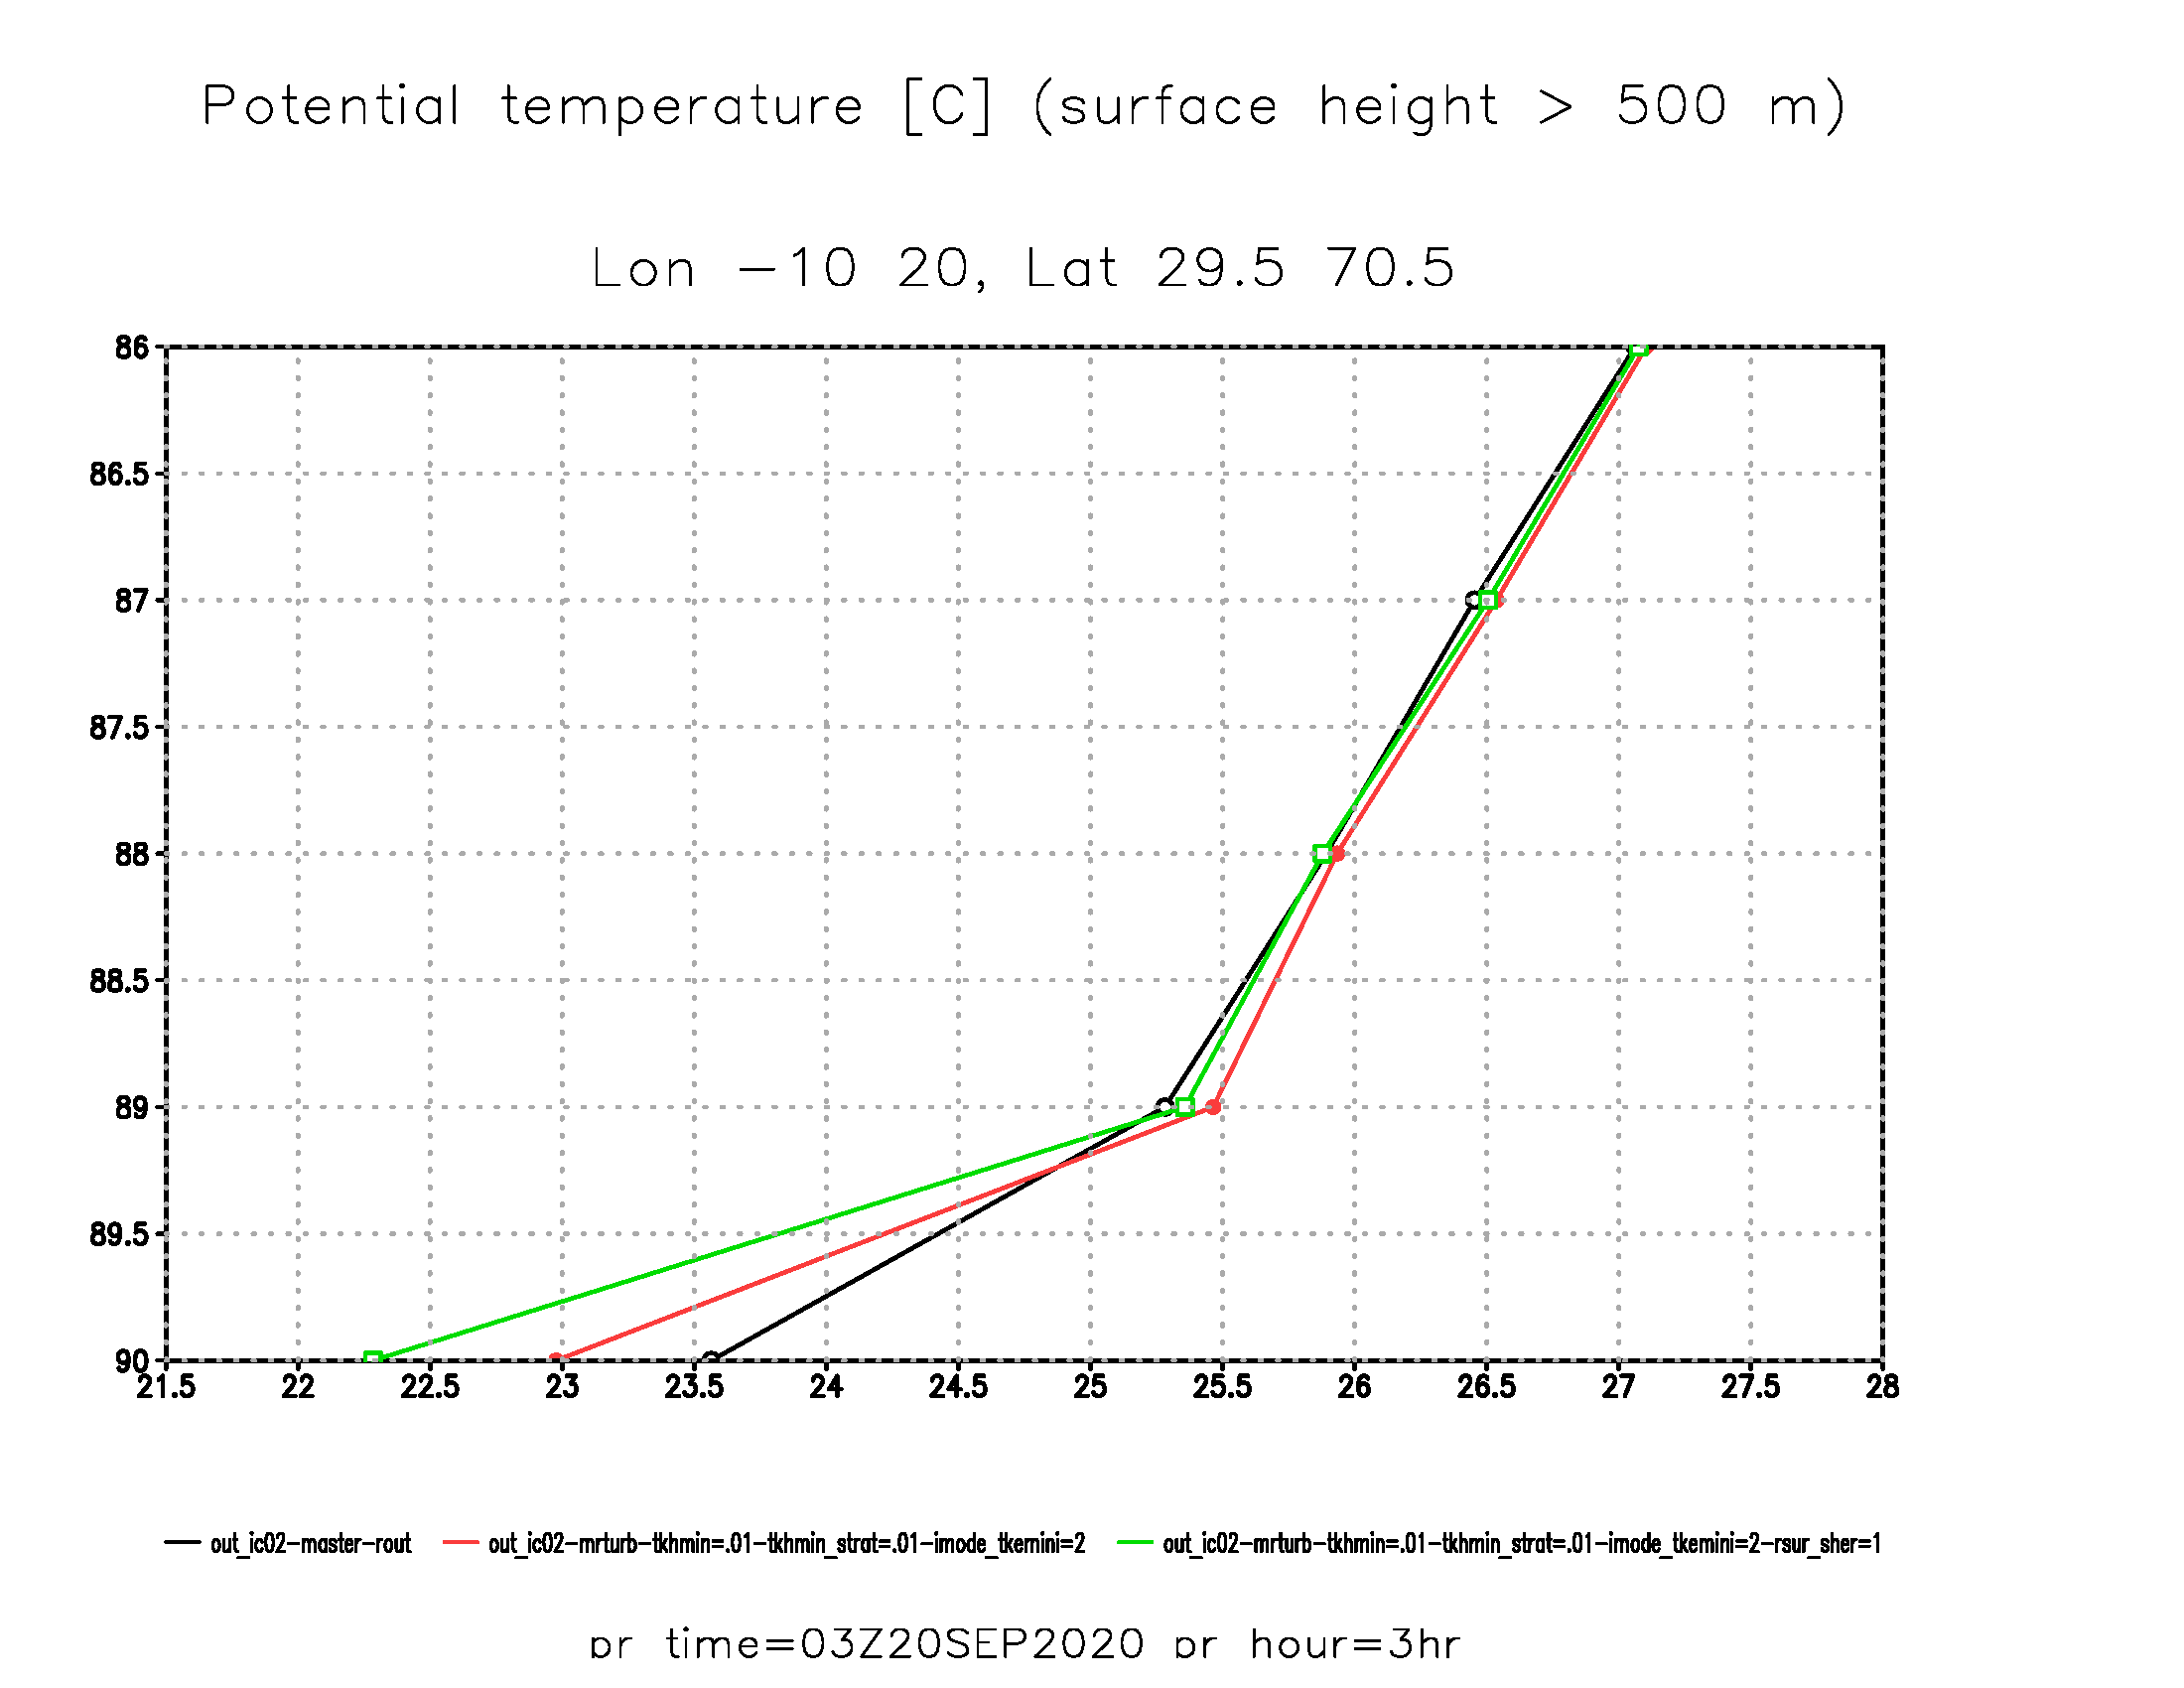
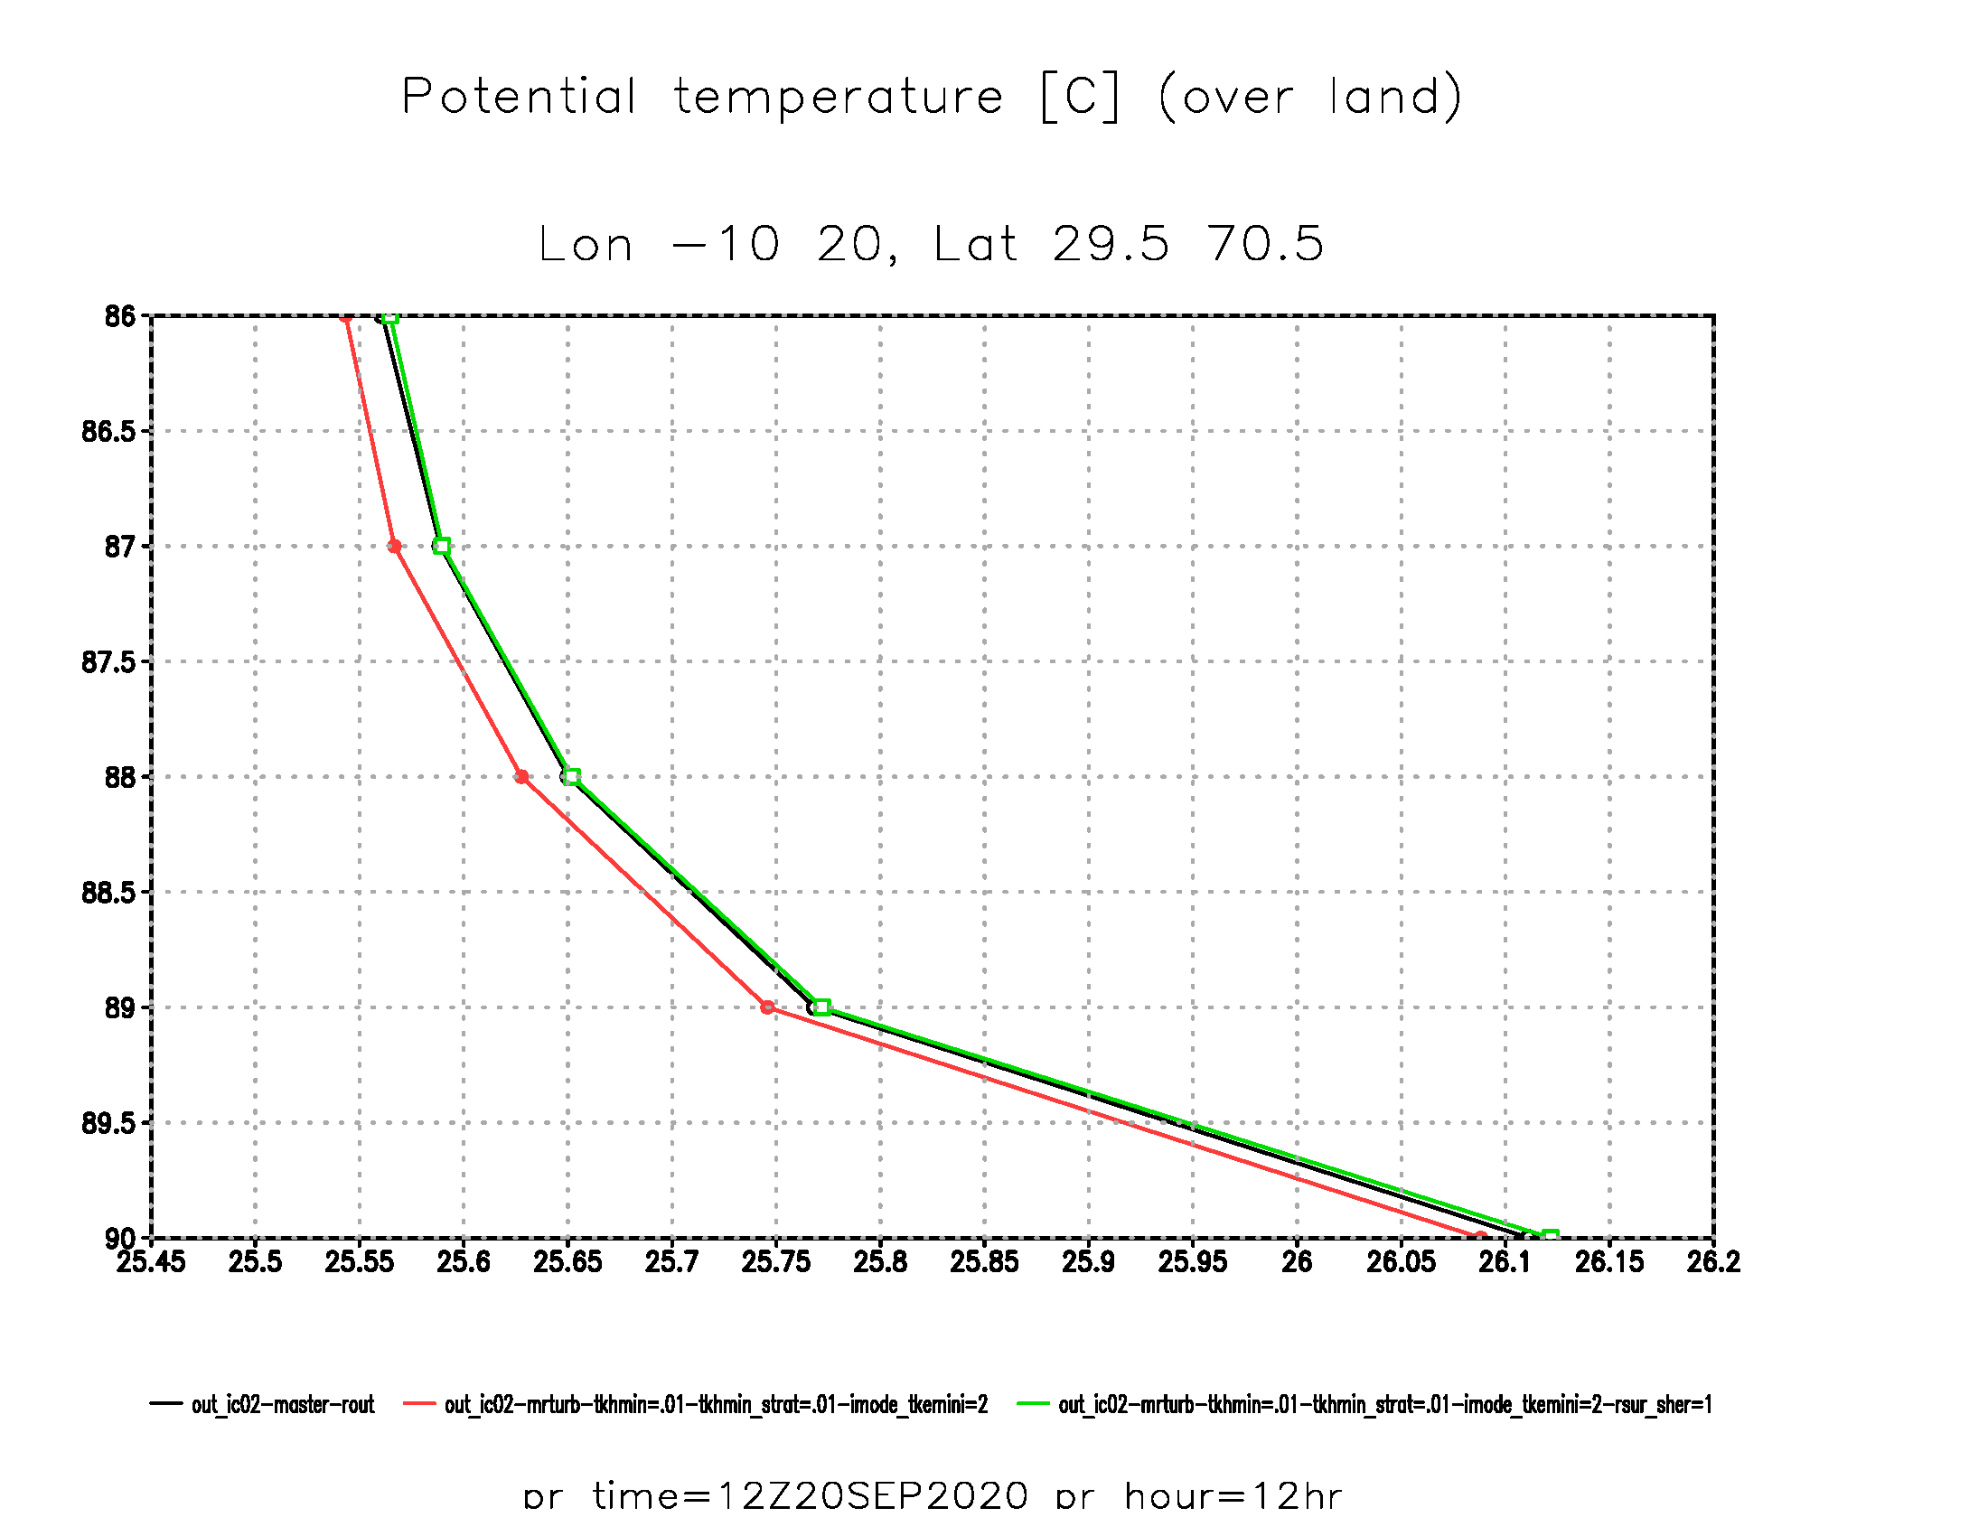
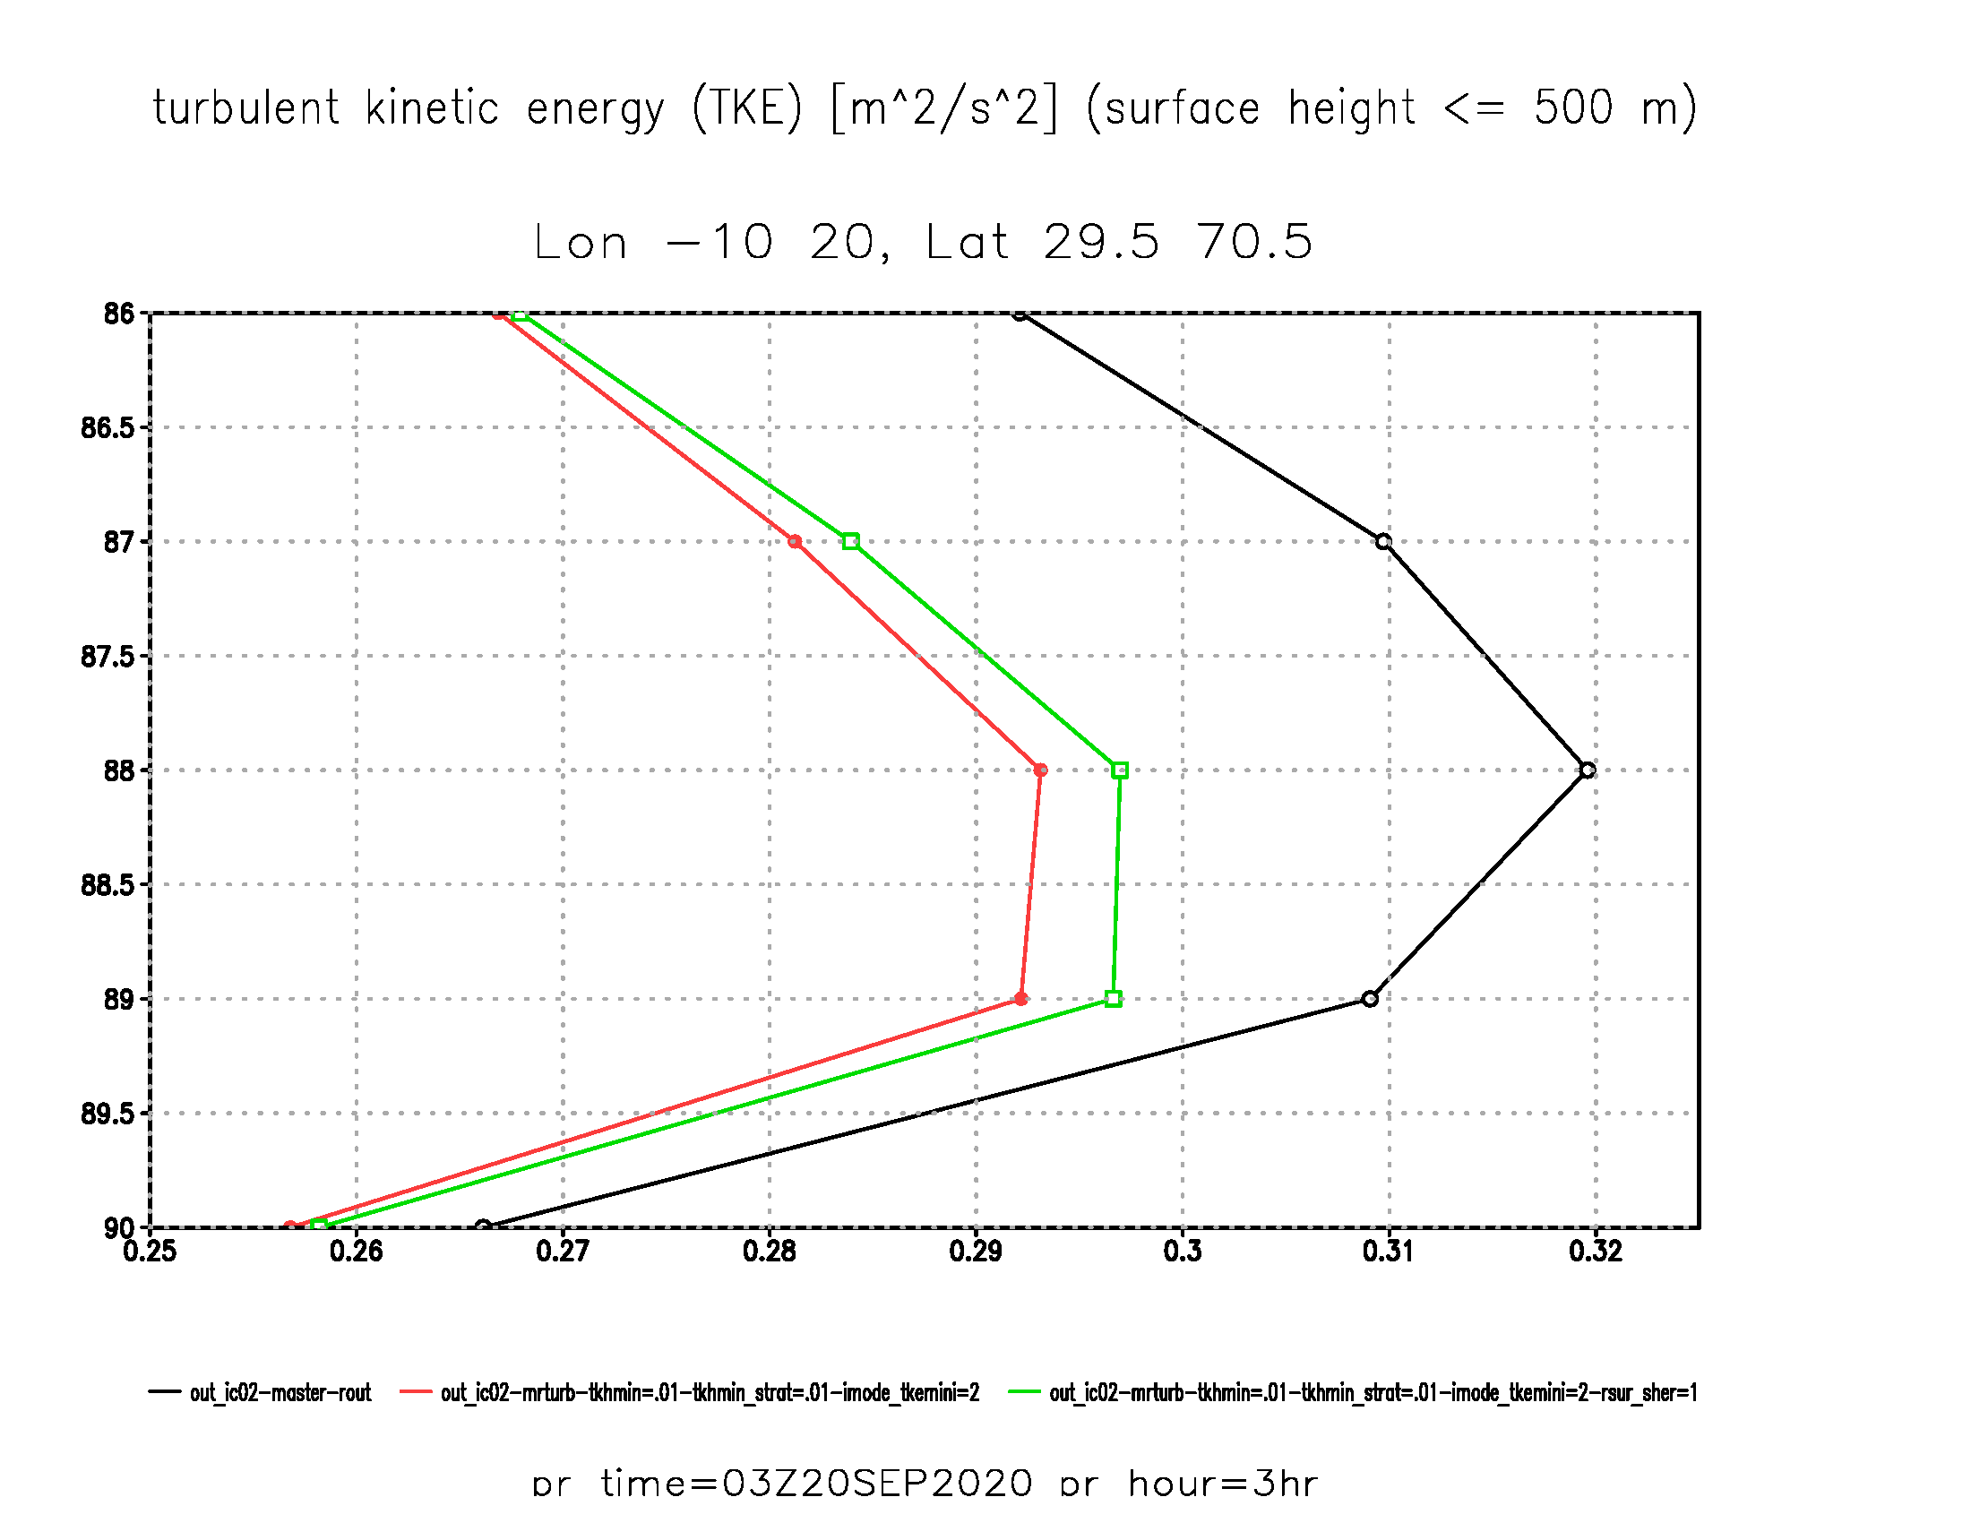
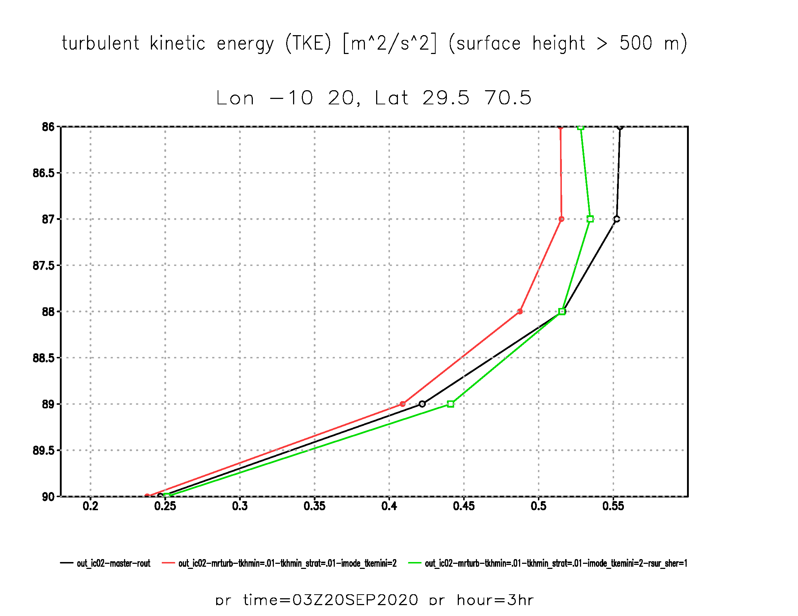
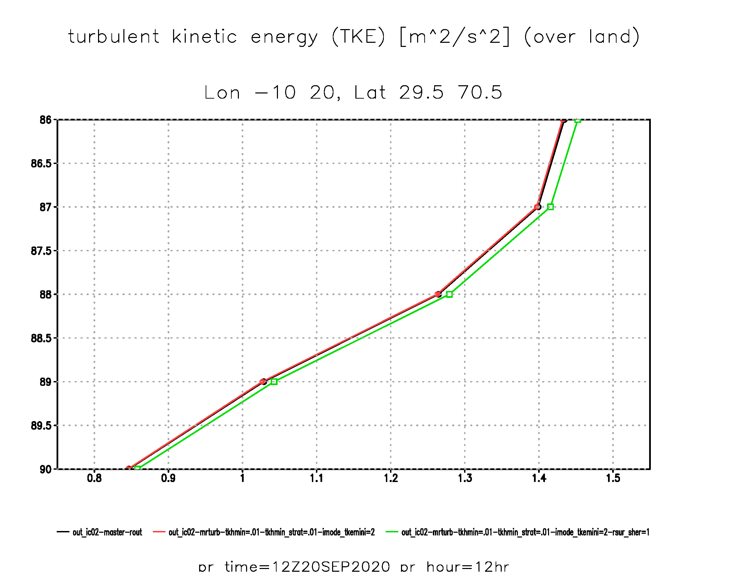
-LAM:
Vert. profiles: Testcase 00Z 20 Sep 2020
averaged Lon: -10 – 20; Lat: 29,5 – 70,5:
330 m
at night: lead-time = 03hr
at noon: lead-time = 12hr
330 m
Potential temperature [°C]
Potential temperature [°C]
Potential temperature [°C]
(surface height <= 500 m)
(surface height > 500 m)
(all land points)
160 m
small additional cooling by adapted TKE
small additional cooling by adapted TKE
160 m
no impact by adapted TKE
90 m
90 m
almost
no impact
40 m
small cooling of lowest layer
by SLSA
40 m
moderate
cooling of
lowest layer
significant cooling of lowest layer by SLSA
moderate
cooling of
lowest layer
no combined impact
10 m
10 m
330 m
330 m
TKE [m²/s²]
TKE [m²/s²]
TKE [m²/s²]
(surface height <= 500 m)
(surface height > 500 m)
(all land points)
160 m
sign. reduction
by TKE-adapt. of:
160 m
TKE not reduced accordingly
small reduction of:
no impact
small TKE level without NTC-shear
moderate TKE level due to SSO-shear
90 m
no impact
some small feedback with increased TKE
of surface layer
by SLSA
some small feedback with increased TKE
of surface layer
by SLSA
90 m
some small feedback with increased TKE of surface layer by SLSA
almost
no impact
40 m
40 m
10 m
10 m
Reference: LLDC for heat = 0.75 m²/s
LLDC for heat = 0.01 m²/s
LLDC for heat = 0.01 m²/s + adapted TKE
LLDC for heat = 0.01 m²/s + adapted TKE + SLSA active
Matthias Raschendorfer
EWGLAM/SRNPW, Prague-Hybrid 2024

Slide 21
-LAM:
GBLA and so far missing 3D-effects of the
Vertically Resolved Roughness Layer
(VRRL by “envelope”-approach):
SAI: Surface Area Index
GBLA: Generalized (tilted) Boundary-Layer Approximation
turbulent distance δ
Internal BL
IBL
SAI of gird-scale slope within Horizontally RRL
SAI of - surfaces is decreasing with height
Transition Layer
Strong reduction of positive Ri-number
close to the surface is decreasing with height
gradient-fluxes
TL
Additional divergence of downward turbulent heat flux (<=> nocturnal cooling) in the lower BL
- surface
Facilitating 3D-diffusion for Diff.-Coeffs. from Turbdiff within the HRRL (3D shear is already present) or
IBL
TL
R-elements from LU
Metric corrections (from SSO-parameters and grid-scale slopes) by means of GBLA (beeing implemented together with a T-SSO scheme)
dense soil
horizontal grid-scale
Should partly substitute artificial reduction of R-Layer turbulence and transfer-layer resistance
Matthias Raschendorfer
EWGLAM/SRNPW, Prague-Hybrid 2024
Notes:
3D shear

Slide 22
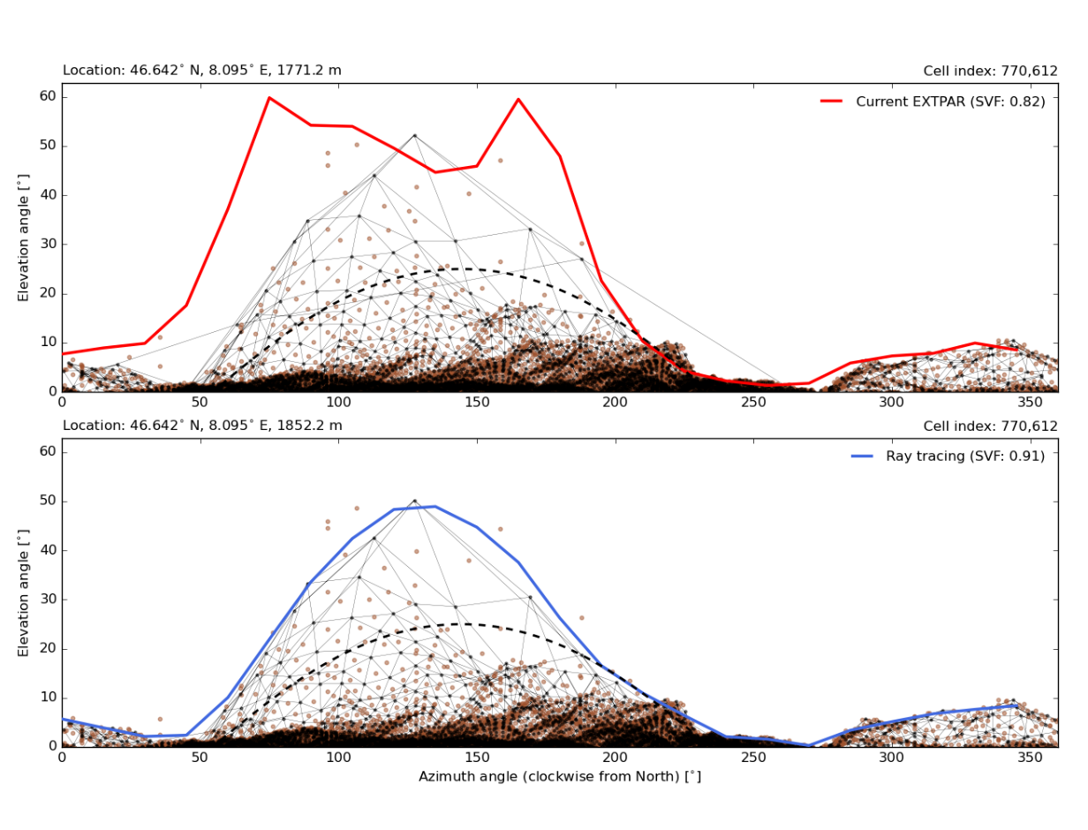
-LAM:
Topographic effects for radiation fluxes:
Ray-tracing based terrain horizon algorithms
being implemented into EXTPAR
Atmospheric
model
Impacts resolved ana- and katabatic flows:
More cooling at night due to SAI-effect for LWR
Creates not yet considered sub-grid Ts-patterns
Needs to be integrated into SAI-treatment of material heat fluxes
<-> T-SSO scheme (ICON dev. branch)
Effects of sub-grid topography not yet considered
Should partly substitute artificial reduction of R-Layer turbulence and transfer-layer resistance
<-> semi-transparent canopy layer (TERRA dev-version)
provided by Chirstian Steger (Meteo Swiss)
Matthias Raschendorfer
EWGLAM/SRNPW, Prague-Hybrid 2024

Slide 23
Conclusion:
Promising progress;
ART-development continues;
follow-up COSMO-PP ACLIIM about aerosol-cloud interaction
Ice optical properties of large hydrometeors for ecRAD in ICON
Actions around Aerosols and Reactive Trace gases
Dusty Cirrus Parameterization
Very important at dust periods but not all problems solved
Recent extensions of adaptive parameter tuning
Again convincing results
Problems at high horizontal resolution in the stable BL above complex terrain
Current, empirically based countermeasures
Already quite effective
Related methodological development:
Promises to substitute empirical countermeasures and to further improve the model
Integrating Lower Limits of Diff.-Coeffs. and surface-layer turbulence into the STIC concept
More advanced treatment of topographic effects
Matthias Raschendorfer
EWGLAM/SRNPW, Prague-Hybrid 2024

