Slide 1
Ensemble activities in COSMO
Chiara Marsigli
Deutscher Wetterdienst

Slide 2
Outline
The COSMO (Consortium) ensembles in transition to the ICON model
  almost completed
The PROPHECY Priority Project: achievements of the last 4 years
Next ensemble developments: plans for a new PP
  continue with model uncertainties
  going higher resolution

Slide 3

The ensembles in transition to ICON
“C2I-ensembles”:
  DWD: ICON-D2-EPS, operational
  MCH: ICON-CH1-EPS and ICON-CH2-EPS, operational
  Arpae: ICON-2I-EPS, operational
  IMS: ICON-IL-EPS, operational
  CNMCA: transition for KENDA (DA) ensemble made, forecast ensemble coming soon
  IMGW: not planned yet, first move to the new machine
COSMO-LEPS: transition to ICON on-going, intermediate step (current resolution) available in Autumn, 2.5 km resolution available in 2025 (delayed), configuration to be decided

Slide 4
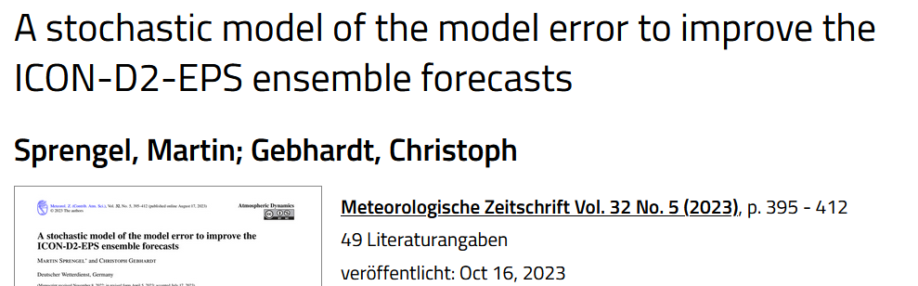
PROPHECY Priority Project
Model perturbations
  SPPT, Stochastically Perturbed Parametrization Tendency
  SEM, a stochastic model of the model error (M. Sprengel)
  Stochastic Shallow Convection scheme (M. Ahlgrimm)
  Parameter sensitivity and perturbation
  PSP, Physically Based Stochastic Perturbations
  SPP, Stochastically Perturbed Parametrisations
Boundary conditions
  Selection
  Weighting

Slide 5
SPPT in ICON at MeteoSwiss
André Walser, Sascha Bellaire, Matthias Röthlin
Acknowledgement: Daniel Reinert, Axel Seifert, Carlos Osuna
COSMO GM 2022, Athen, WG7

Slide 6
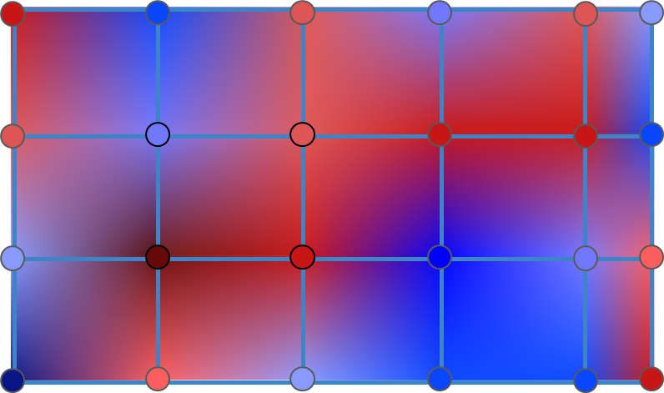
Stochastically Perturbed Parametrization Tendency
sppt_nml
Implementation in ICON of a random pattern field with horizontal correlation
switch | default | ICON-CHx-EPS exp. | description
lsppt | .false. | .true.
hinc_rn | 21600 | 21600 | time increment (s) for drawing a new field of random numbers
dlat_rn | 0.1 | 5.0 | random number coarse grid point distance in meridional direction (deg)
dlon_rn | 0.1 | 5.0 | random number coarse grid point distance in zonal direction (deg)
range_rn | 0.8 | 0.6 / 0.8 | max magnitude of random numbers
stdv_rn | 1 | 1 | standard deviation of the gaussian distribution of random numbers

Slide 7
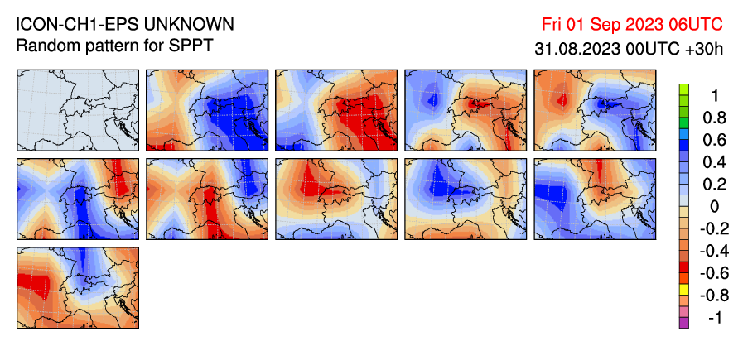
Opposed random patterns
new approach uses for every second member the opposed pattern from the previous one
to better sample the PDF with small ensembles
(idea and implementation by Daniel Hupp)

Slide 8
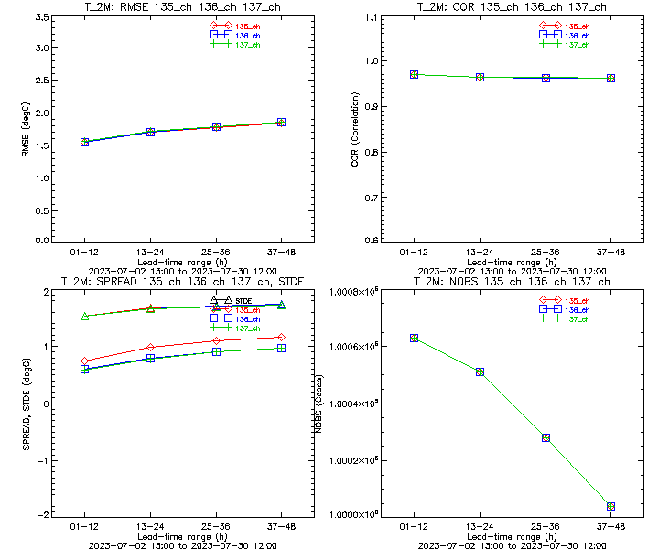
Spread and RMSE for t2m
SPPT
Parameter Perturbations
no model perturbations
Spread increased with SPPT,
but hardly with PP:
RMSE for ensemble mean ~identical:

Slide 9
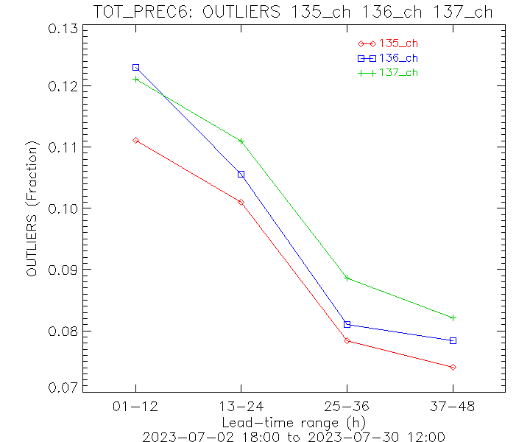
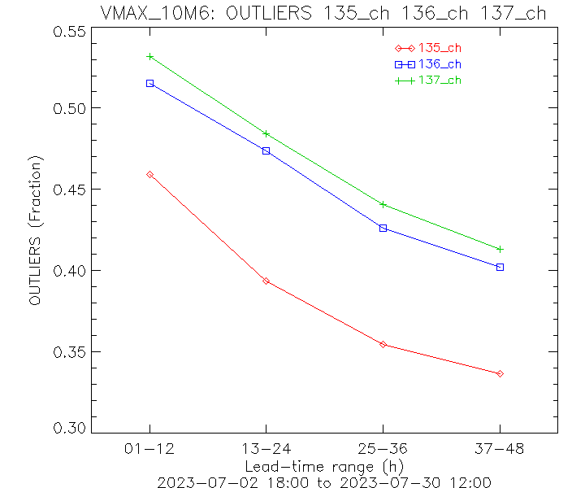
Outliers 6h precip & gusts
SPPT
Parameter Perturbations
no model perturbations
Reduction of outliers with model pert., particularly with SPPT for gusts:
~20%
6h precip
6h vmax@10m

Slide 10
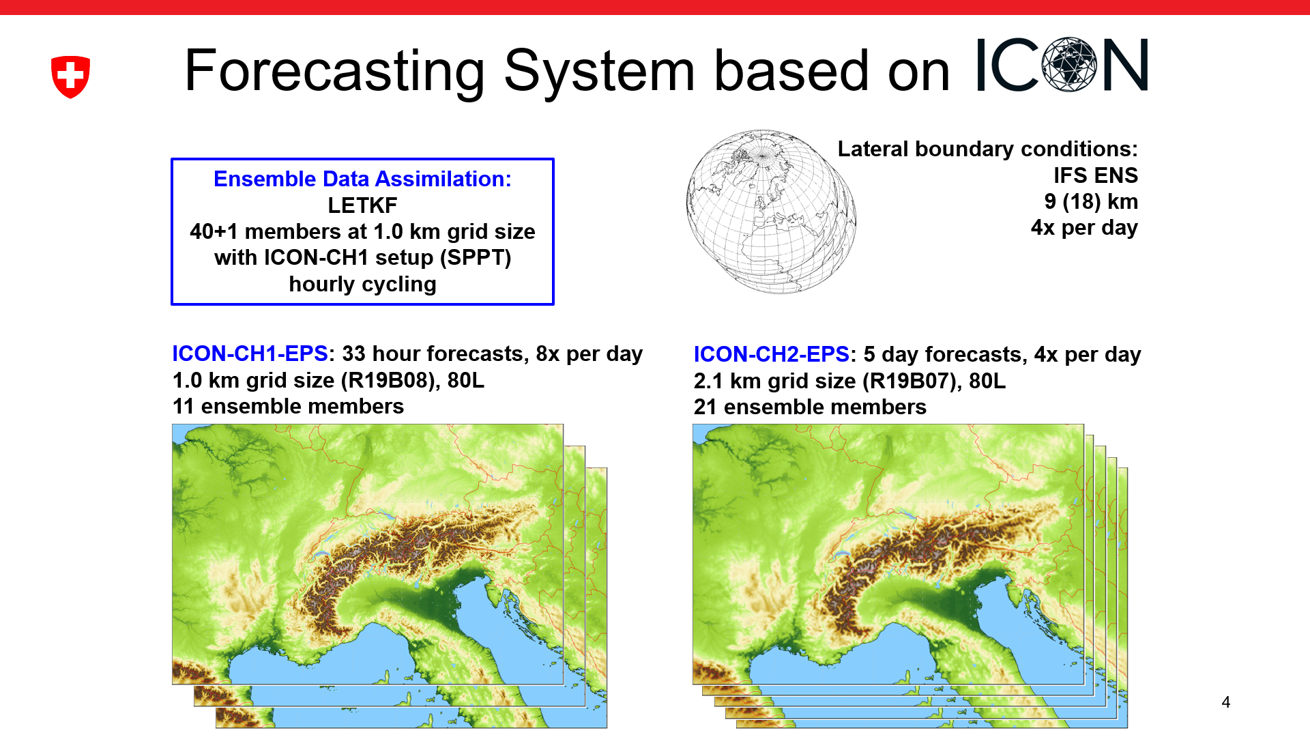
Operational system, GM2024
M. Arpagaus and the MCH team

Slide 11
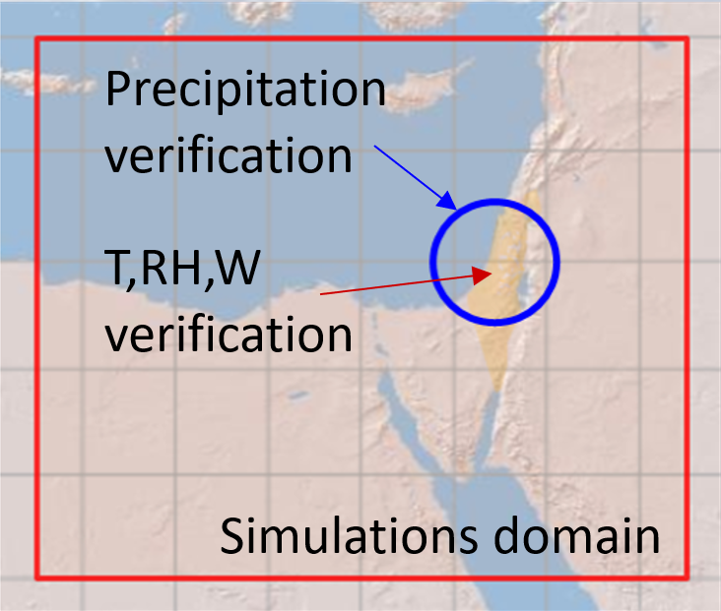
ICON ensemble (with SPPT) at IMS
ICON 20-members (2.5km resolution) driven by randomly selected ECMWF ensemble (EC-ENS) members over the Eastern Mediterranean using different perturbation methods.
EC_ENS_51 - full ECMWF ensemble (EC-ENS)
COSMO_SPPT_20 - Stochastic Perturbation
of Physics Tendencies (SPPT)
ICON_20 - unperturbed
ICON_PP_20 - Parameter Perturbation (PP)
ICON_SPPT_20 - Stochastic Perturbation
of Physics Tendencies (SPPT)
2022, 2023
P. Khain, S. Bellaire, A. Shtivelman

Slide 12
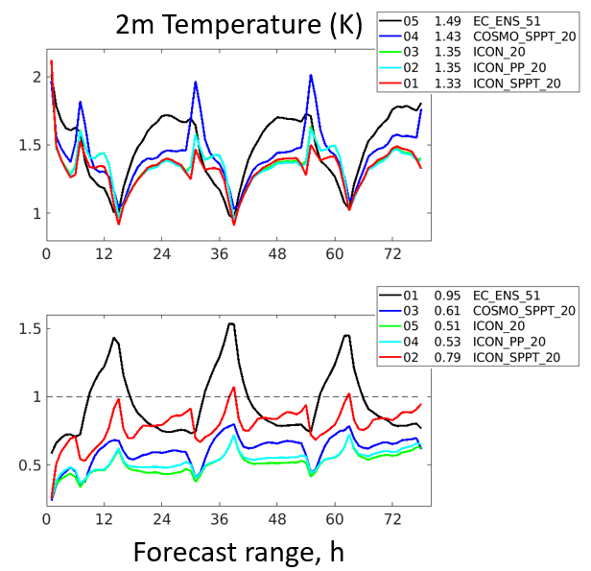
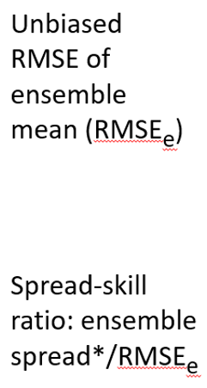
Spread Skill verification

Slide 13
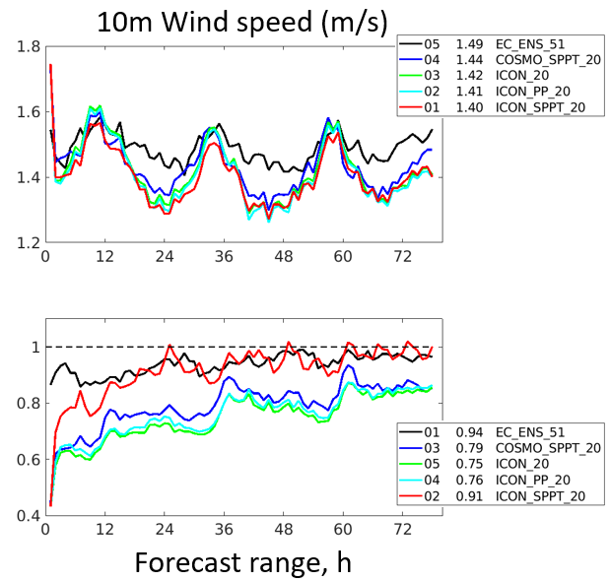
Spread Skill verification

Slide 14
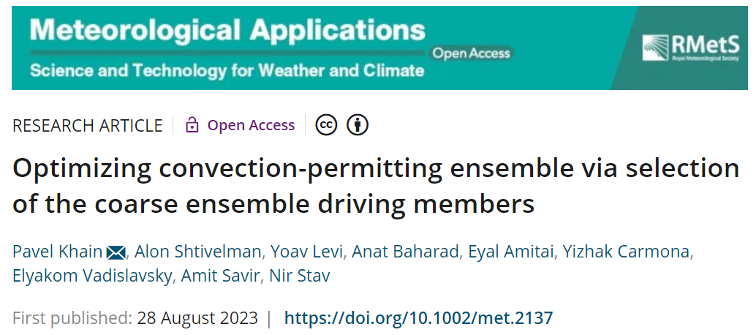
Boundary Conditions: selection

Slide 16
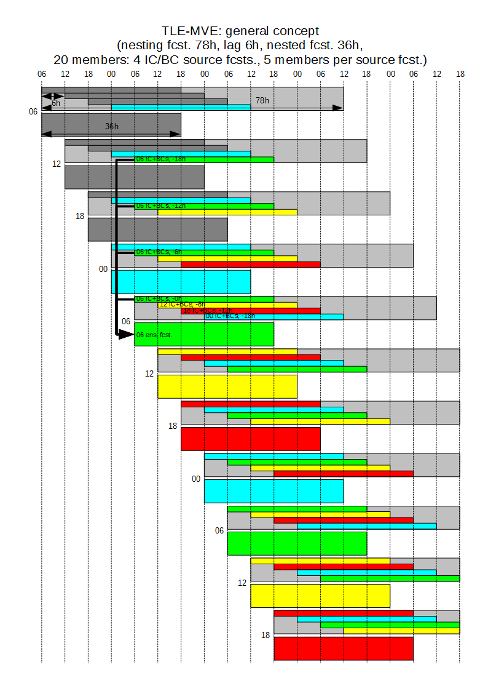
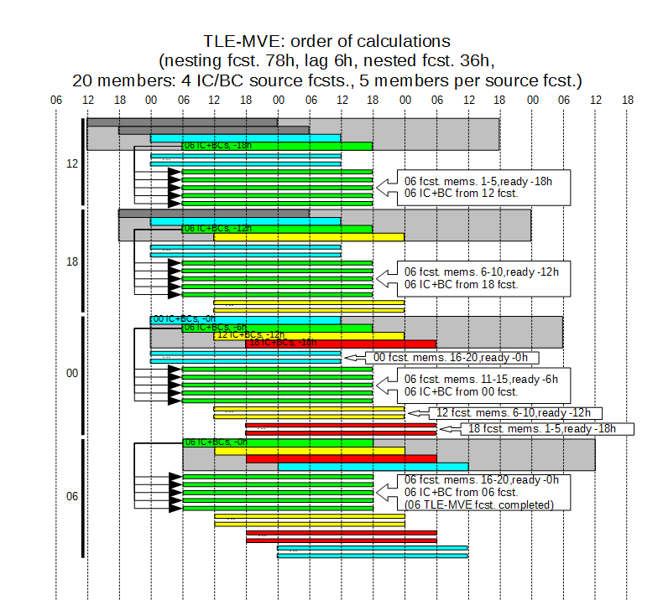
Introduction
Details of the deterministic models configuration.
Model Res. Grid size XxYxH Forecast length
ICON 13 2949120 triangles 120
COSMO 7 415x460x40 84
COSMO 2.8 380x405x50 36 (det. 48)
TLE – Time-Lagged Ensemble; MVE – Model-Varied Ensemble

Slide 17
Subtask 2.2
Influence of various methods of perturbation of soil temperature’s initial field.
Spotlight on how deep into the ground the temperature perturbation should be introduced for significant/positive impact.
Dataset used for verification – ERA-5 reanalysis fields for 2011-2020 (https://cds.climate.copernicus.eu), 0.25x0.25 degree, hourly data.

Slide 18
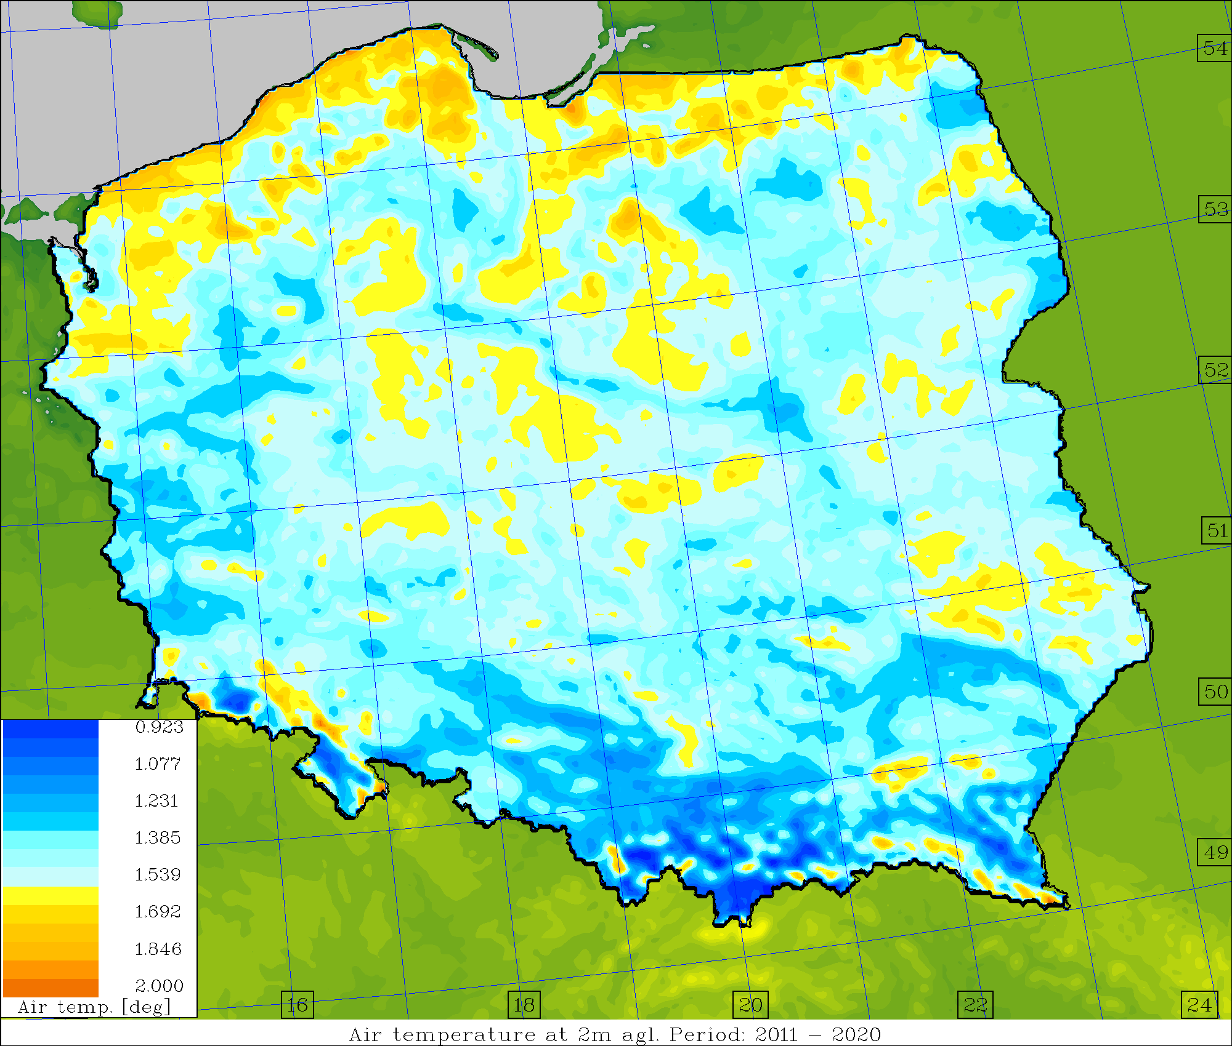
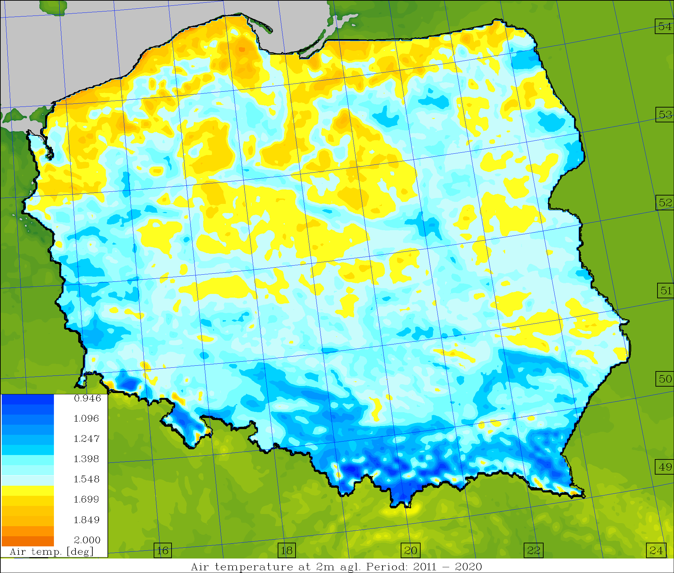
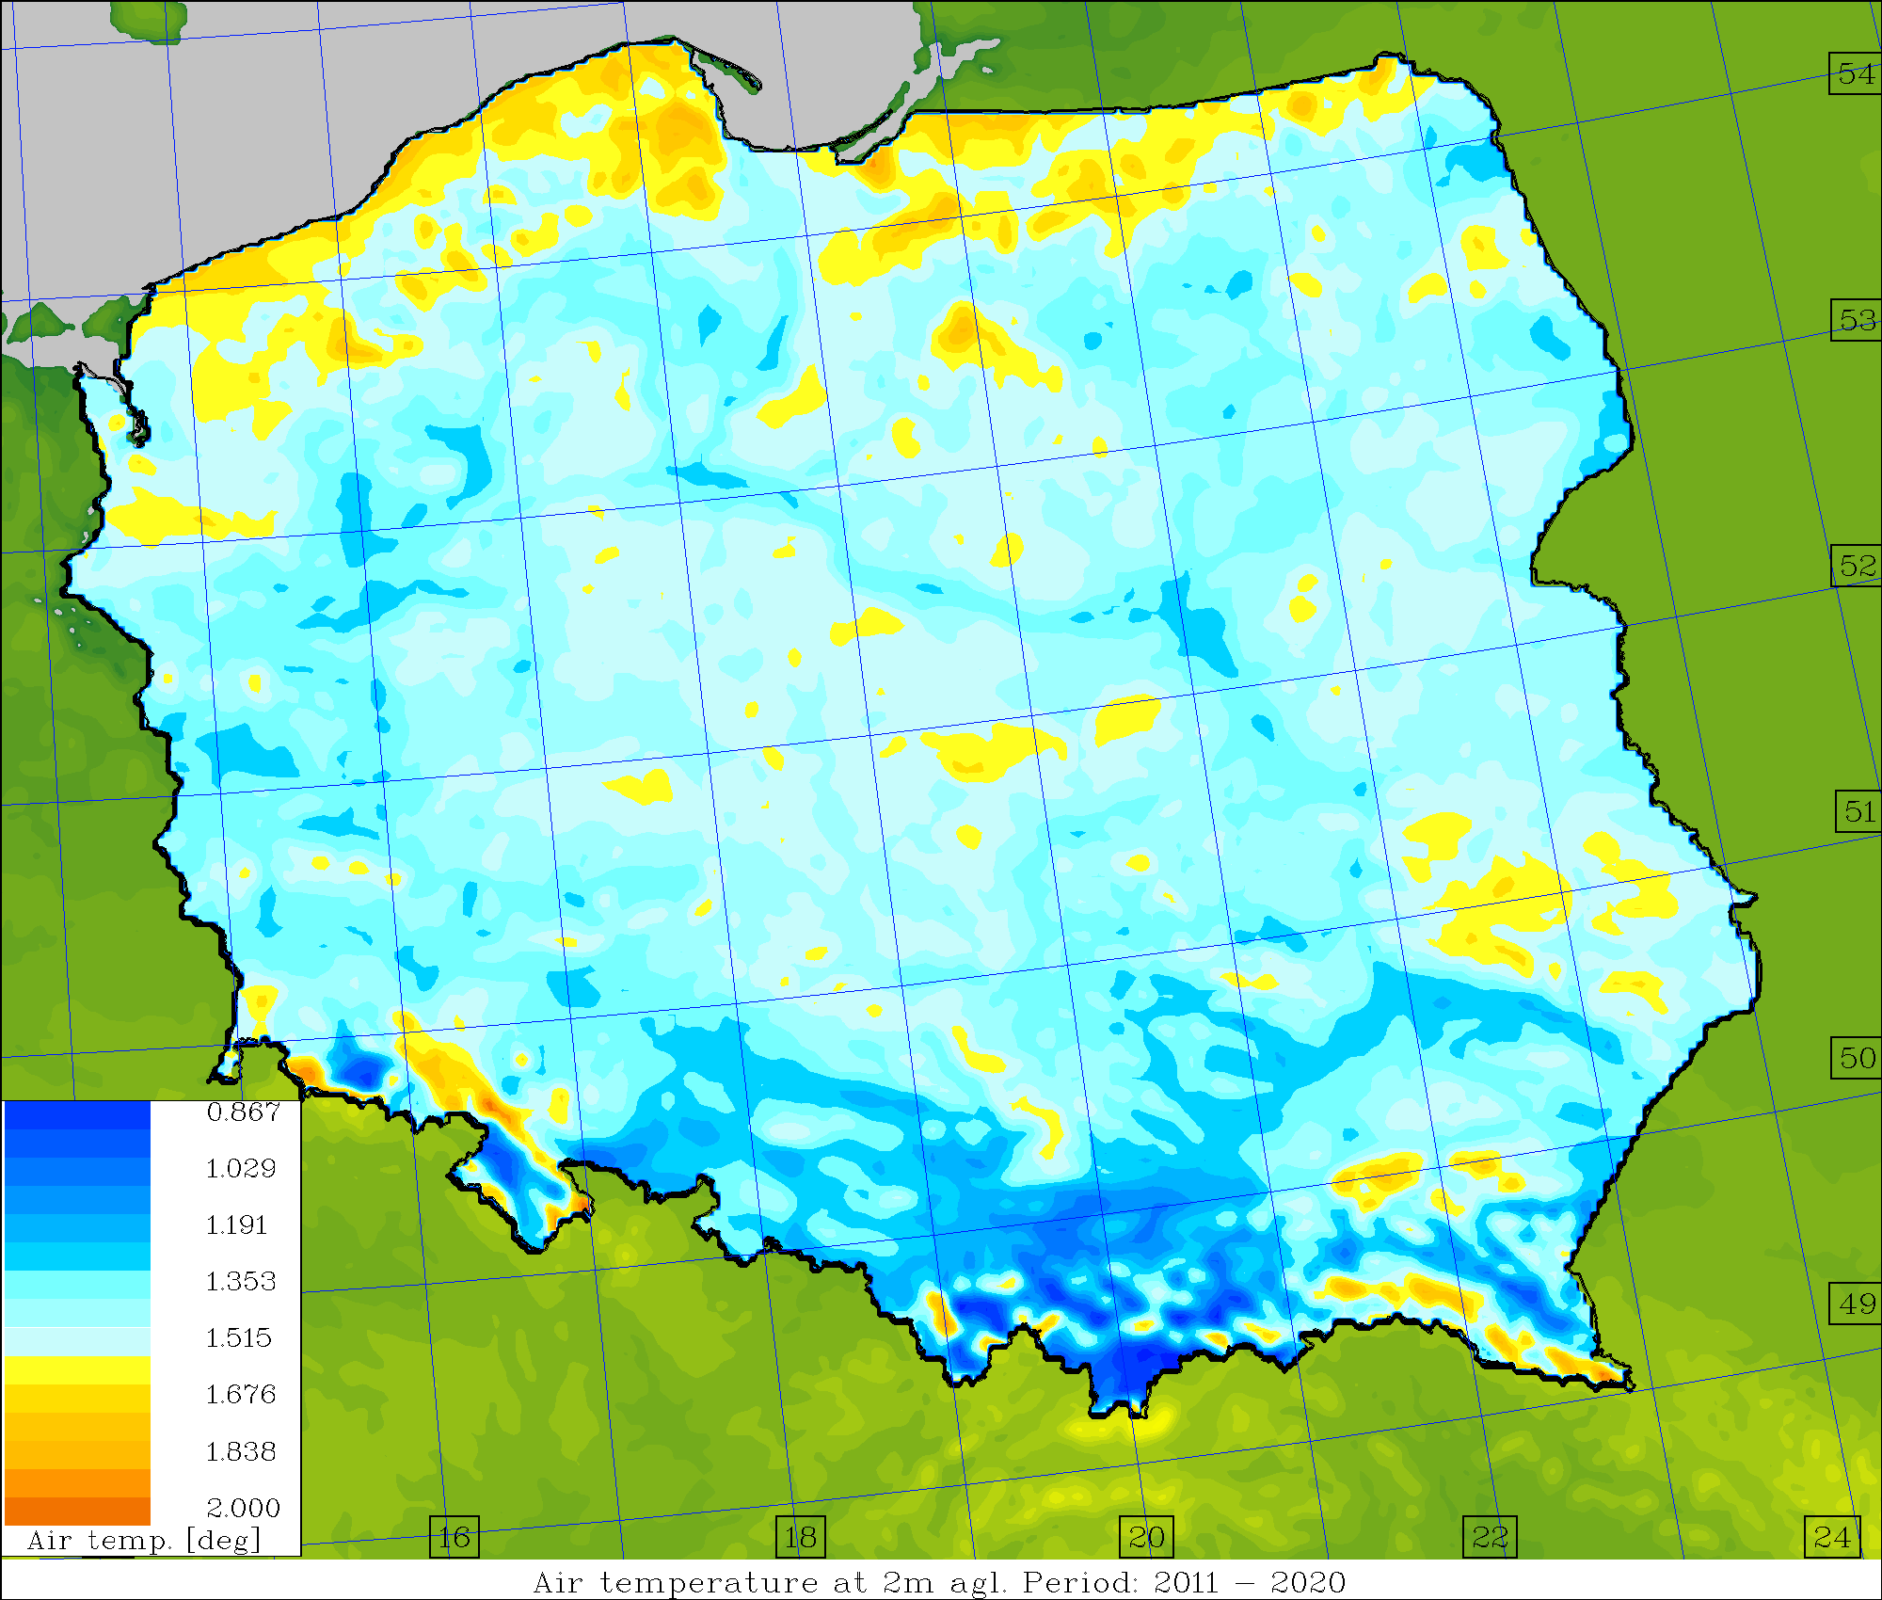
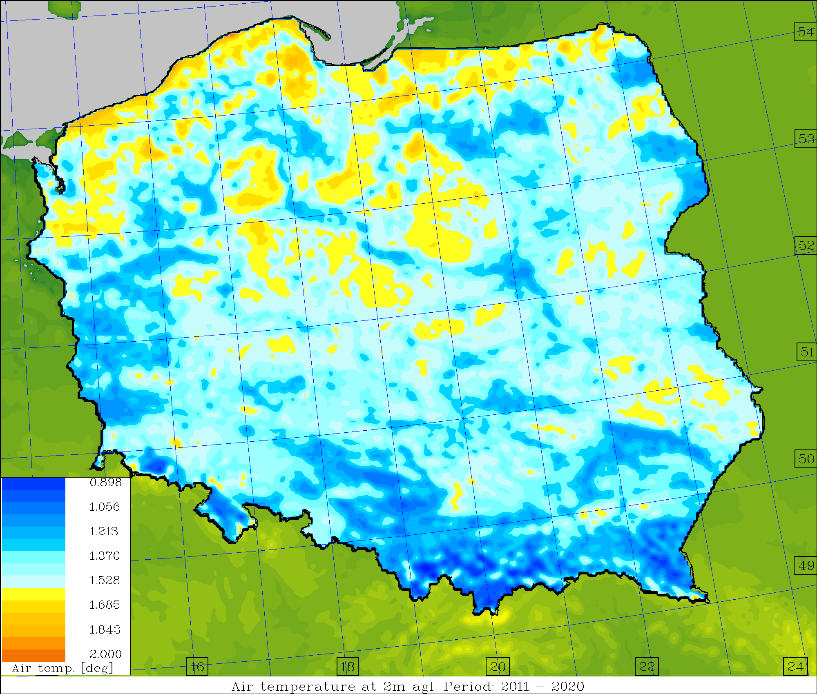
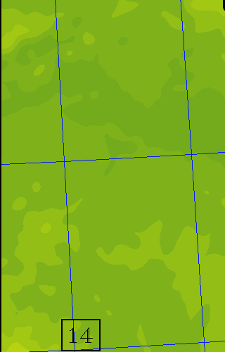
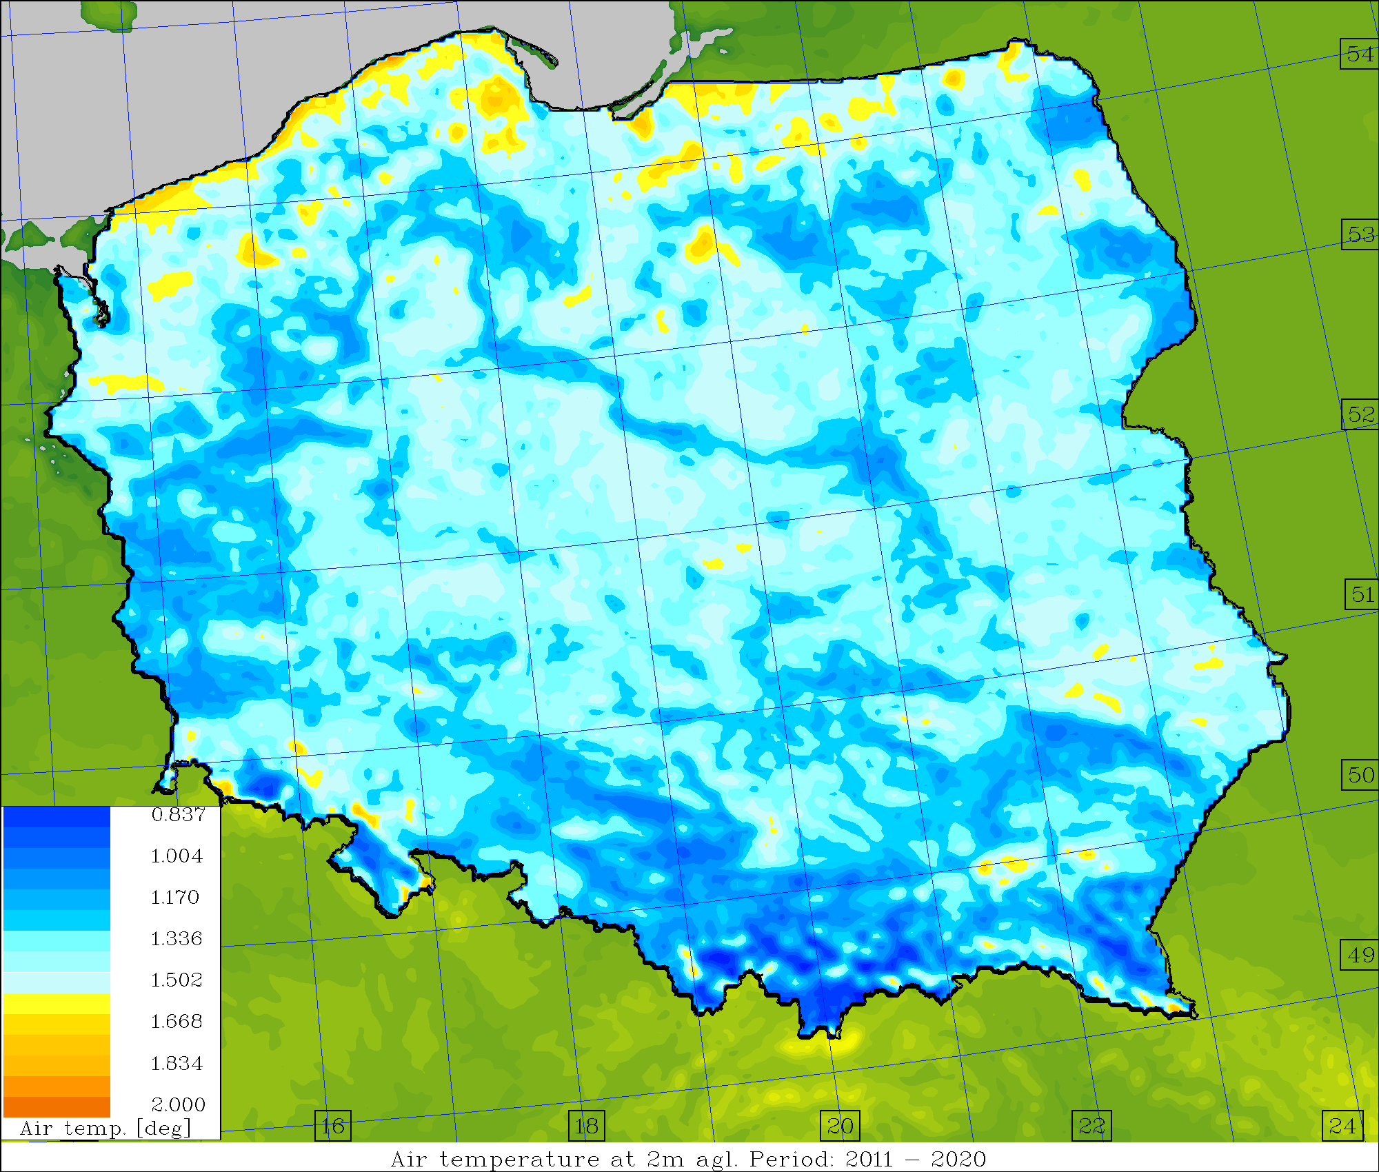
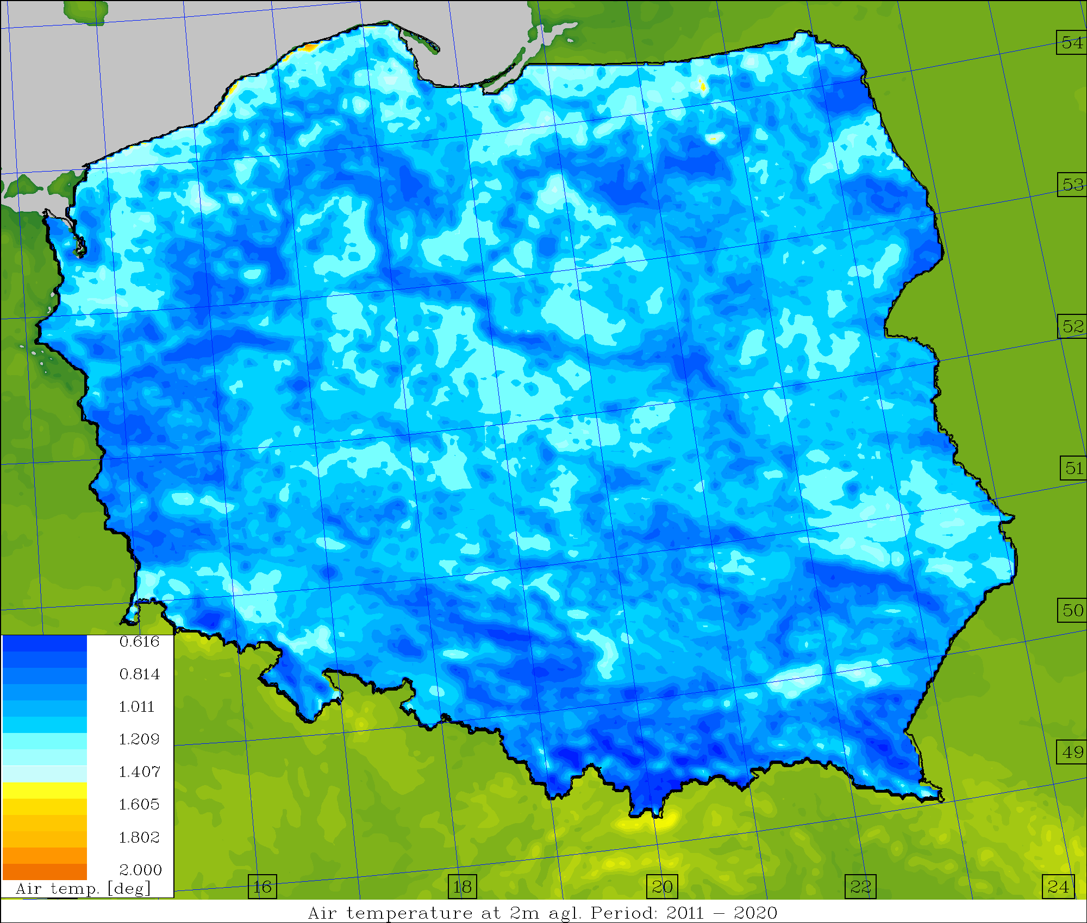
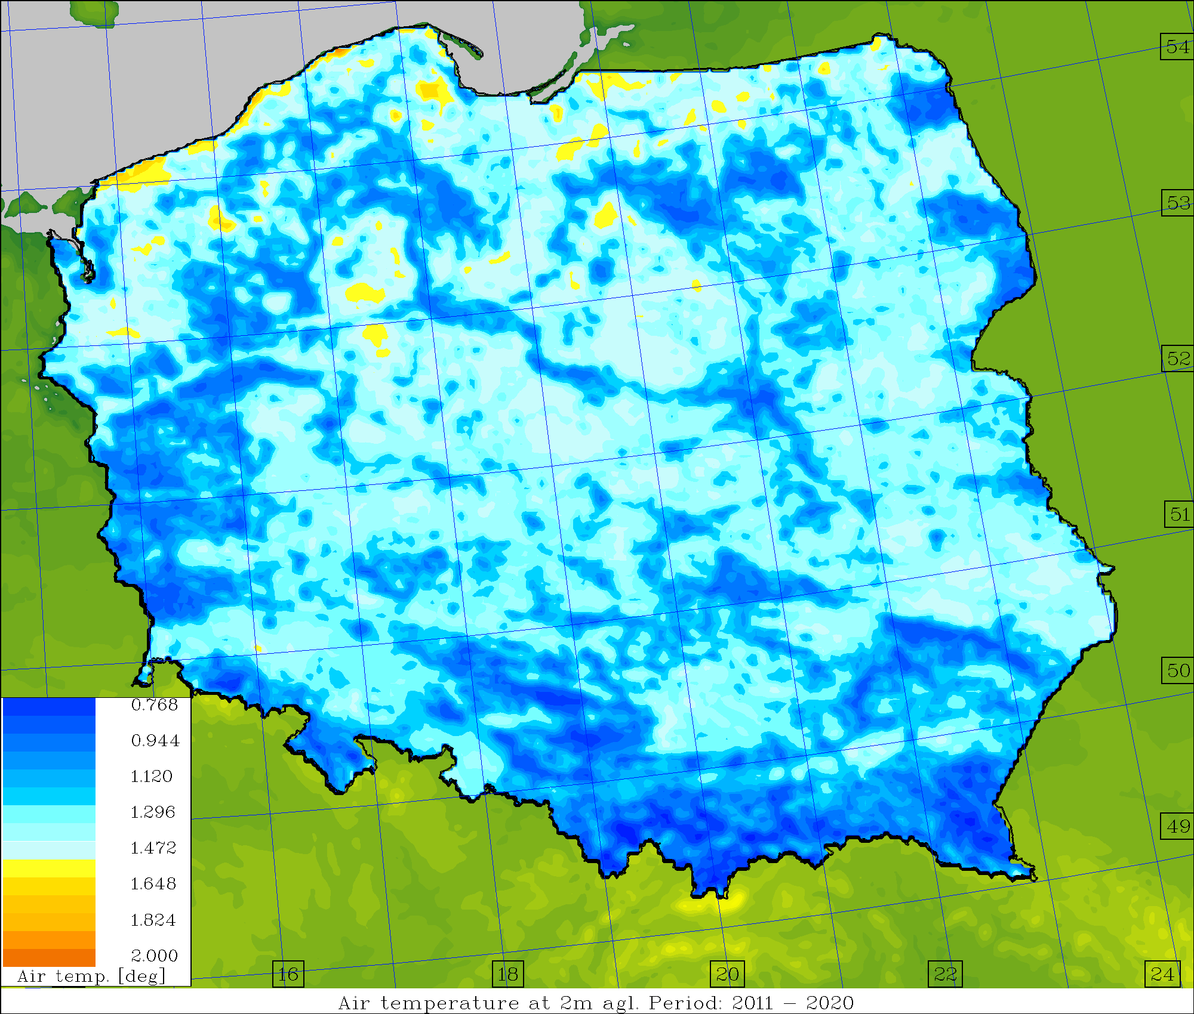
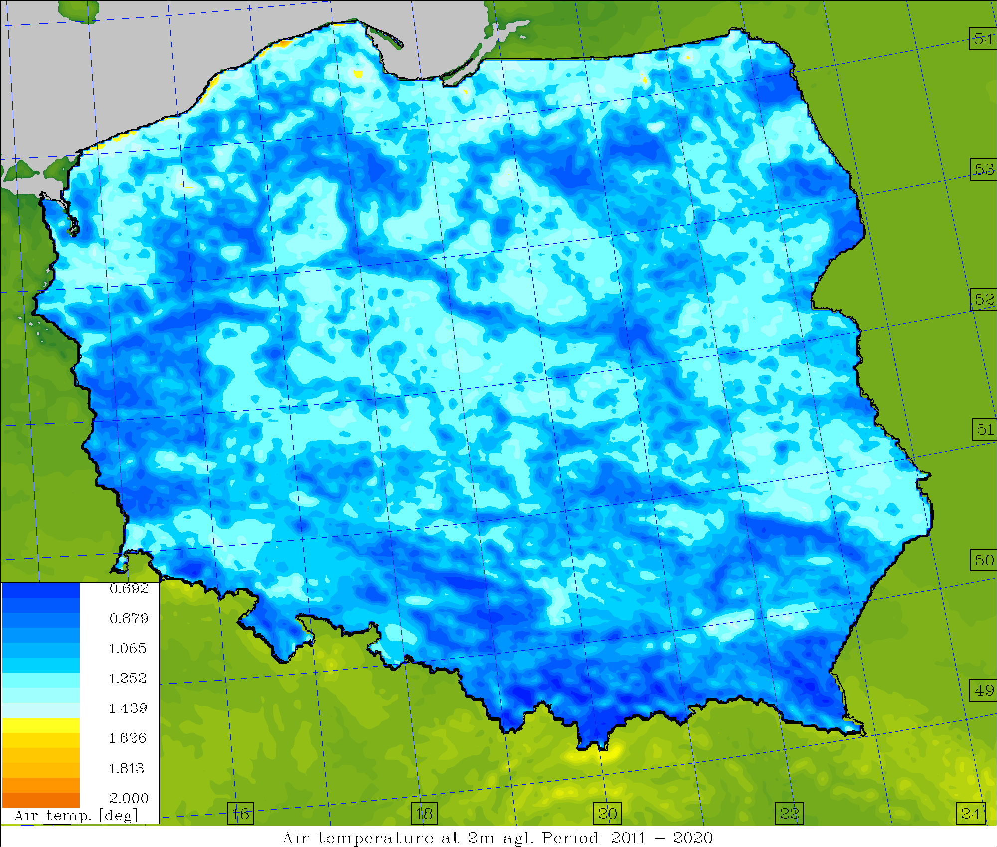
Average skill/spread values, T2M [deg.] (2011-2020)
Increase in depth to 2-2.5 meters resulted in various improvement in skill very significant in cold period(s) – DJF, SON
not that significant at all – during warm periods (MAM, JJA)
Operational Surface pert. Down to ~1.0m Down to ~2.5m

Slide 19
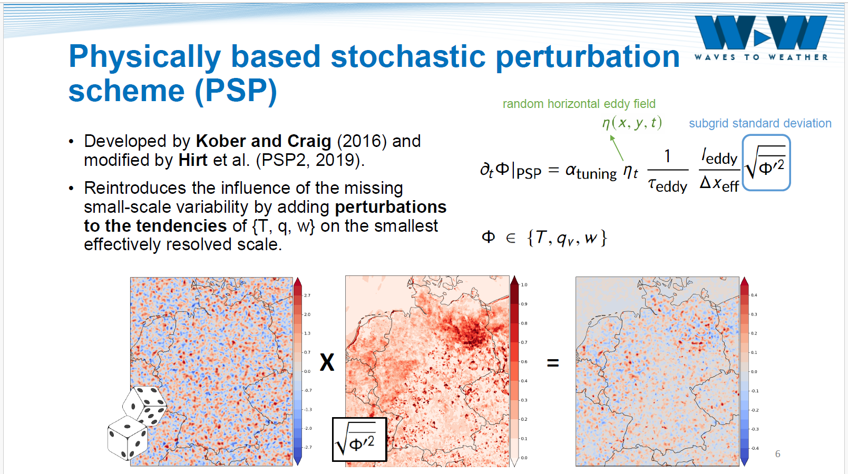
Physically based model perturbation: PSP
M. Puh, LMU

Slide 20
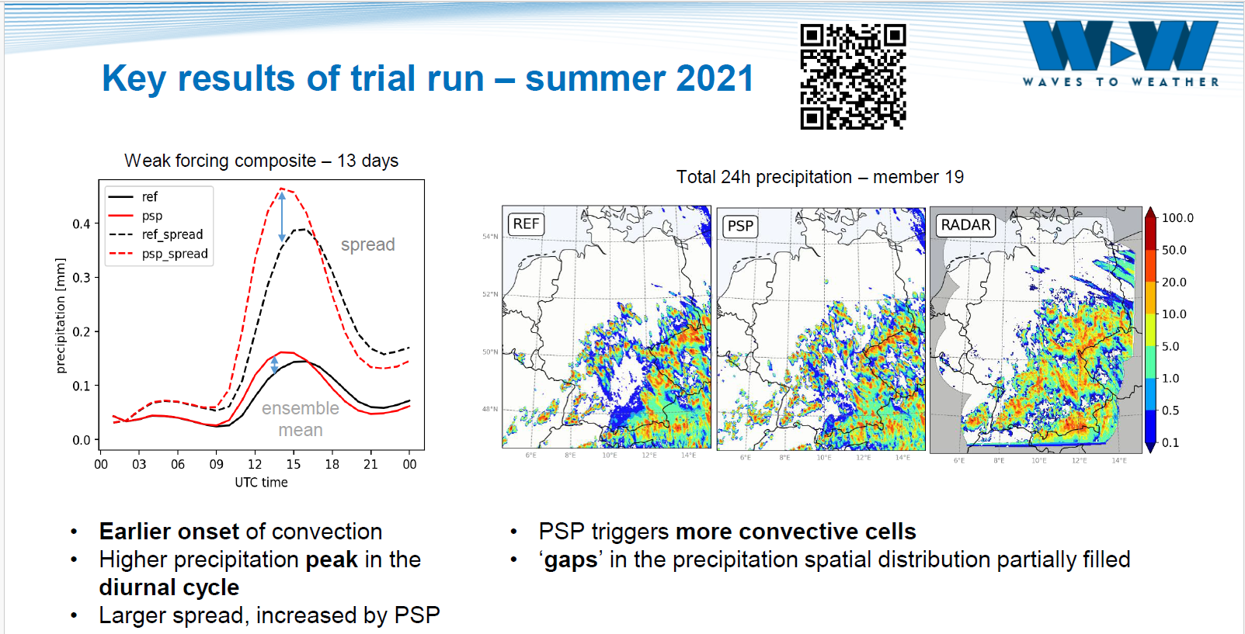
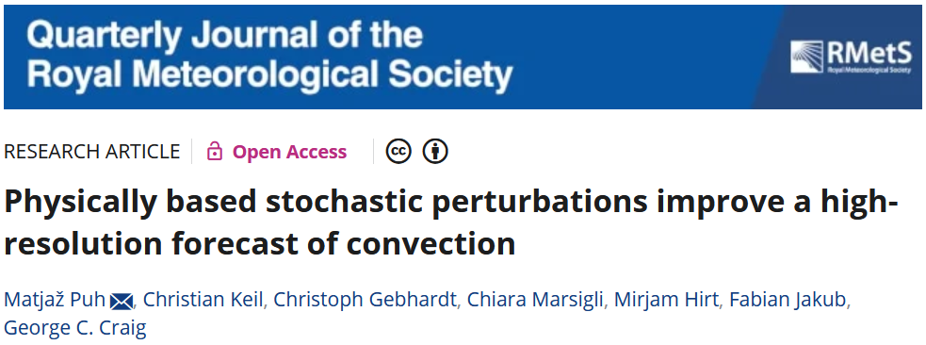
PSP: impact on convection initiation
M. Puh, LMU

Slide 21
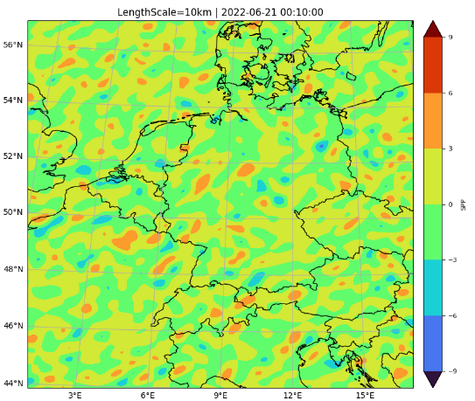
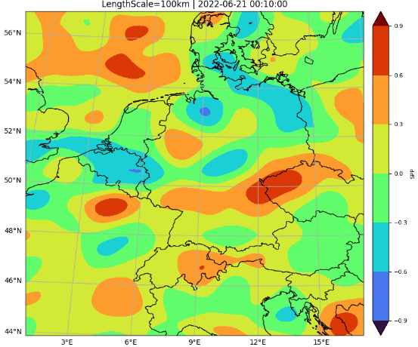

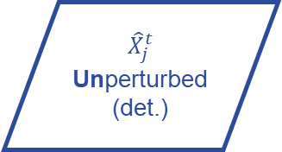
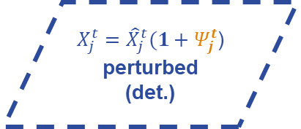

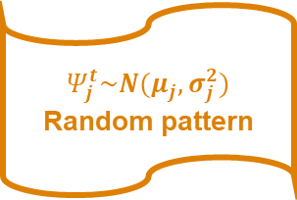
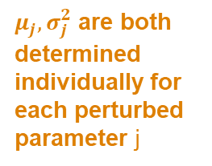
SPP (Stochastically Perturbed Parametrisations) in ICON
Implemented by A. Seifert
$${\hat{X}}_{j}^{t}$$
Unperturbed
(det.)
$$Ψ_{j}^{t}\sim N(μ_{j},σ_{j}^{2})$$
Random pattern
$X_{j}^{t}={\hat{X}}_{j}^{t}(1+Ψ_{j}^{t}$)
perturbed
(det.)
$$t:$$
additive
$μ_{j},σ_{j}^{2}$ are both determined individually for each perturbed parameter j
Pattern properties:
Length scale
Time scale
Modes
Variance
Z. Parsakhoo, DWD
Ref: Ollinaho et. al. 2016, and Frogner et al. 2021
Notes:
Option a implies that the mean of the distribution of the perturbed parameter is equal to the unperturbed value while option b implies that the median of the distribution is equal to unperturbed value

Slide 22
Next developments
SPPT operational in two COSMO ensembles, but no further development foreseen
Focus on SPP (Stochastically Perturbed Parametrisations)
  test in different countries
  test (and implementation) for different parameters
  resources in GLORI
Research on process-based perturbations
  From works in LMU, IMGW
  Combination with other methods
Ensemble for nowcasting, very short range, higher resolution, best member selection
  Parameters relevant for high-resolution
Benefit from CARMENs: common verification method, scores, plots

Slide 23
Thank you for your attention!

