Slide 1
WG ENS activities and PROPHECY PP
Chiara Marsigli
Deutscher Wetterdienst

Slide 2
Outline
The COSMO (Consortium) ensembles in transition to the ICON model
The PROPHECY Priority Project: achievements of the last 4 years
Next ensemble developments: plans for a new PP

Slide 3

The ensembles in transition to ICON
“C2I-ensembles”:
DWD: ICON-D2-EPS, operational
MCH: ICON-CH1-EPS and ICON-CH2-EPS, operational
Arpae: ICON-2I-EPS, operational
IMS: ICON-IL-EPS, operational
CNMCA: transition for KENDA (DA) ensemble made, forecast ensemble coming soon
IMGW: not planned yet, first move to the new machine
COSMO-LEPS: transition to ICON on-going, intermediate step (current resolution) available in Autumn, 2.5 km resolution available in 2025 (delayed), configuration to be decided

Slide 4
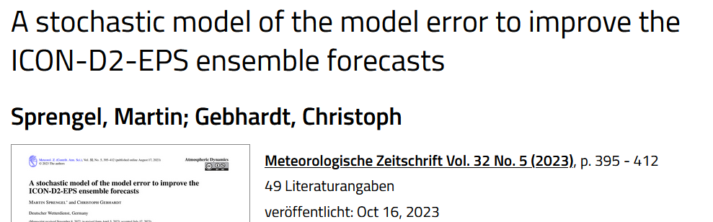
PROPHECY Priority Project
Model perturbations
SPPT, Stochastically Perturbed Parametrization Tendency
SEM, a stochastic model of the model error (M. Sprengel)
Stochastic Shallow Convection scheme (M. Ahlgrimm)
Parameter sensitivity and perturbation
PSP, Physically Based Stochastic Perturbations
SPP, Stochastically Perturbed Parametrisations
Boundary conditions
Selection
Weighting

Slide 5
SPPT in ICON at MeteoSwiss
André Walser, Sascha Bellaire, Matthias Röthlin
Acknowledgement: Daniel Reinert, Axel Seifert, Carlos Osuna
COSMO GM 2022, Athen, WG7

Slide 6
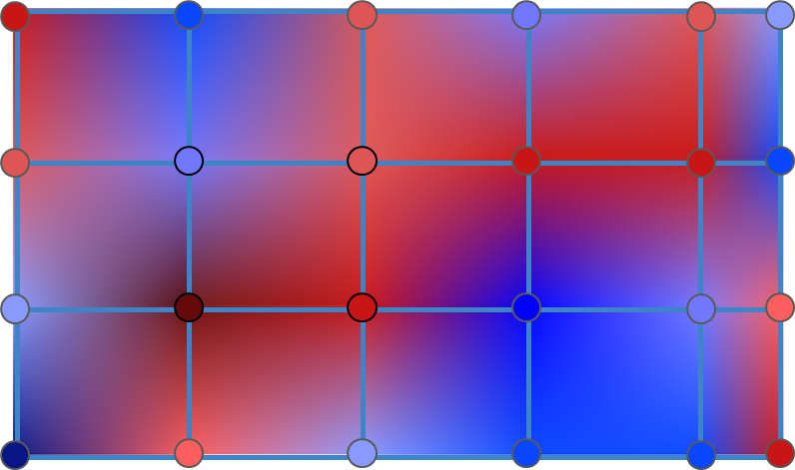
Stochastically Perturbed Parametrization Tendency
sppt_nml
Implementation in ICON of a random pattern field with horizontal correlation
switch | default | ICON-CHx-EPS exp. | description
lsppt | .false. | .true.
hinc_rn | 21600 | 21600 | time increment (s) for drawing a new field of random numbers
dlat_rn | 0.1 | 5.0 | random number coarse grid point distance in meridional direction (deg)
dlon_rn | 0.1 | 5.0 | random number coarse grid point distance in zonal direction (deg)
range_rn | 0.8 | 0.6 / 0.8 | max magnitude of random numbers
stdv_rn | 1 | 1 | standard deviation of the gaussian distribution of random numbers

Slide 7
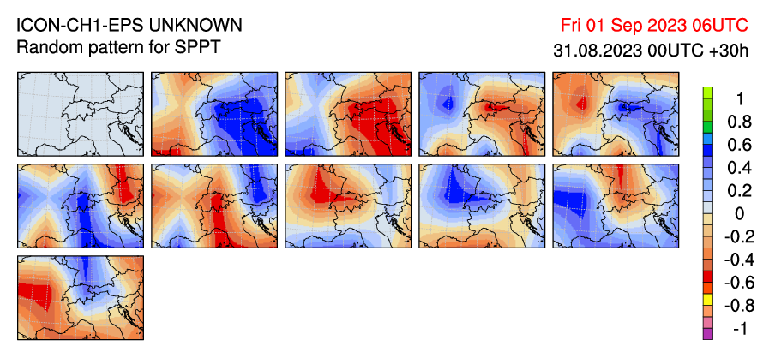
Opposed random patterns
new approach uses for every second member the opposed pattern from the previous one
to better sample the PDF with small ensembles (idea and implementation by Daniel Hupp)

Slide 8
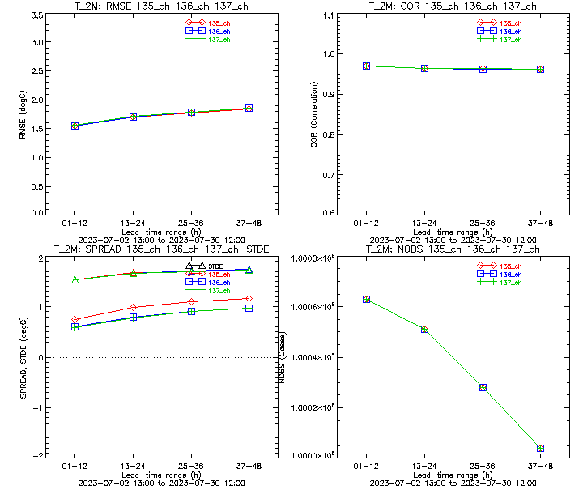
Spread and RMSE for t2m
SPPT
Parameter Perturbations no model perturbations
Spread increased with SPPT, but hardly with PP:
RMSE for ensemble mean ~identical:

Slide 9
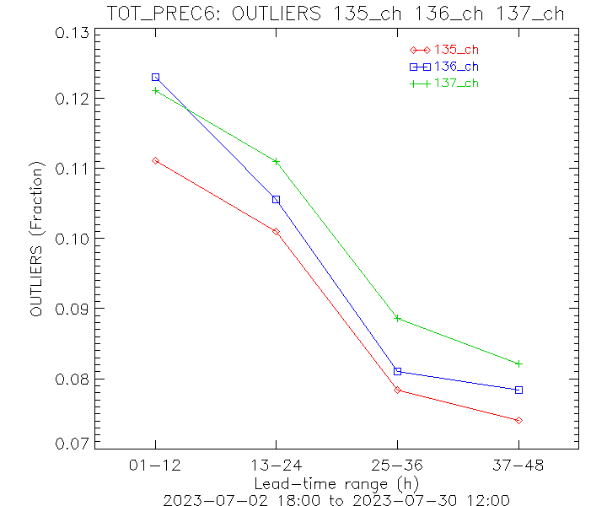
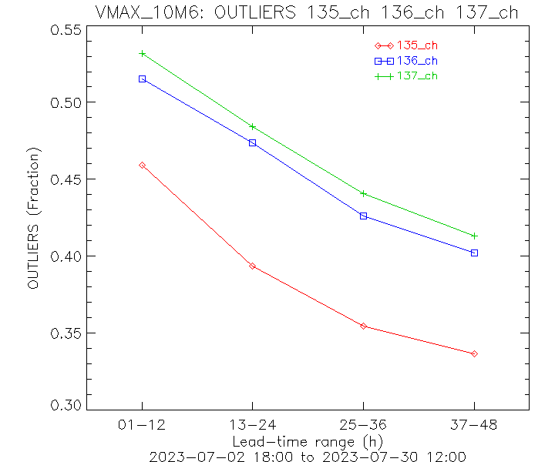
Outliers 6h precip & gusts
SPPT
Parameter Perturbations no model perturbations
Reduction of outliers with model pert., particularly with SPPT for gusts:
~20%
6h precip
6h vmax@10m

Slide 10
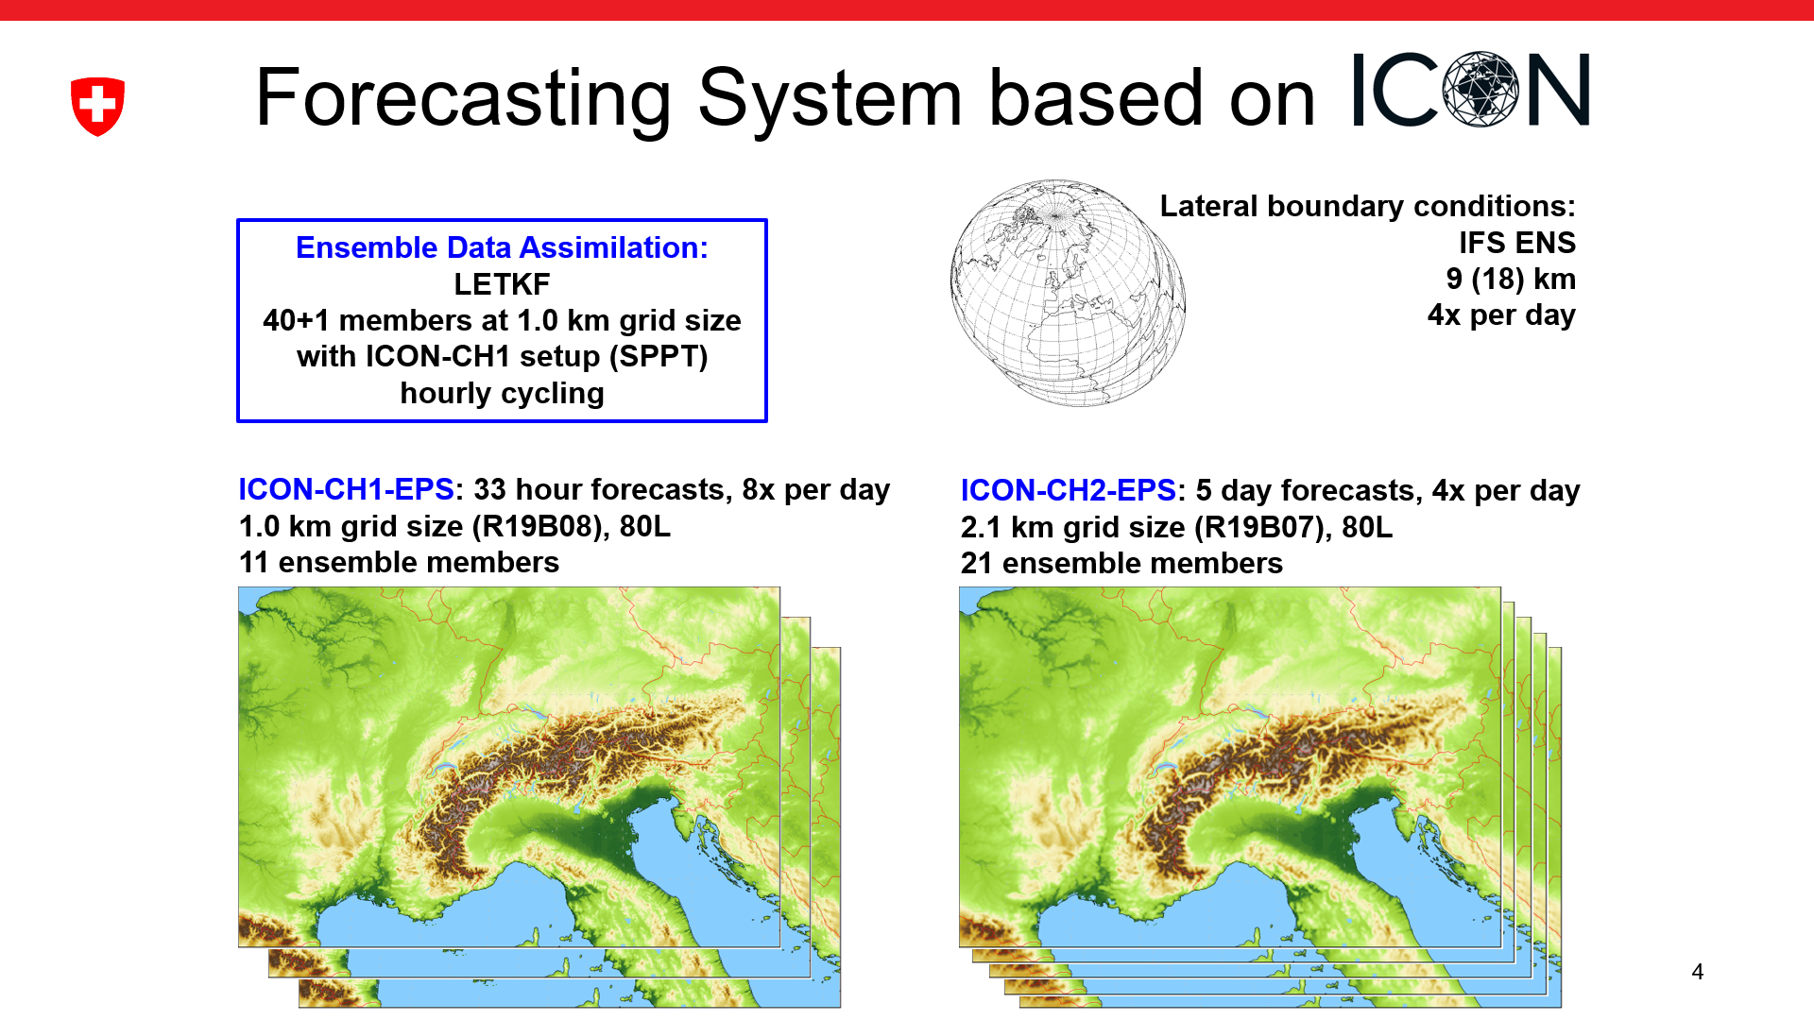
Operational system, GM2024
M. Arpagaus and the MCH team

Slide 11
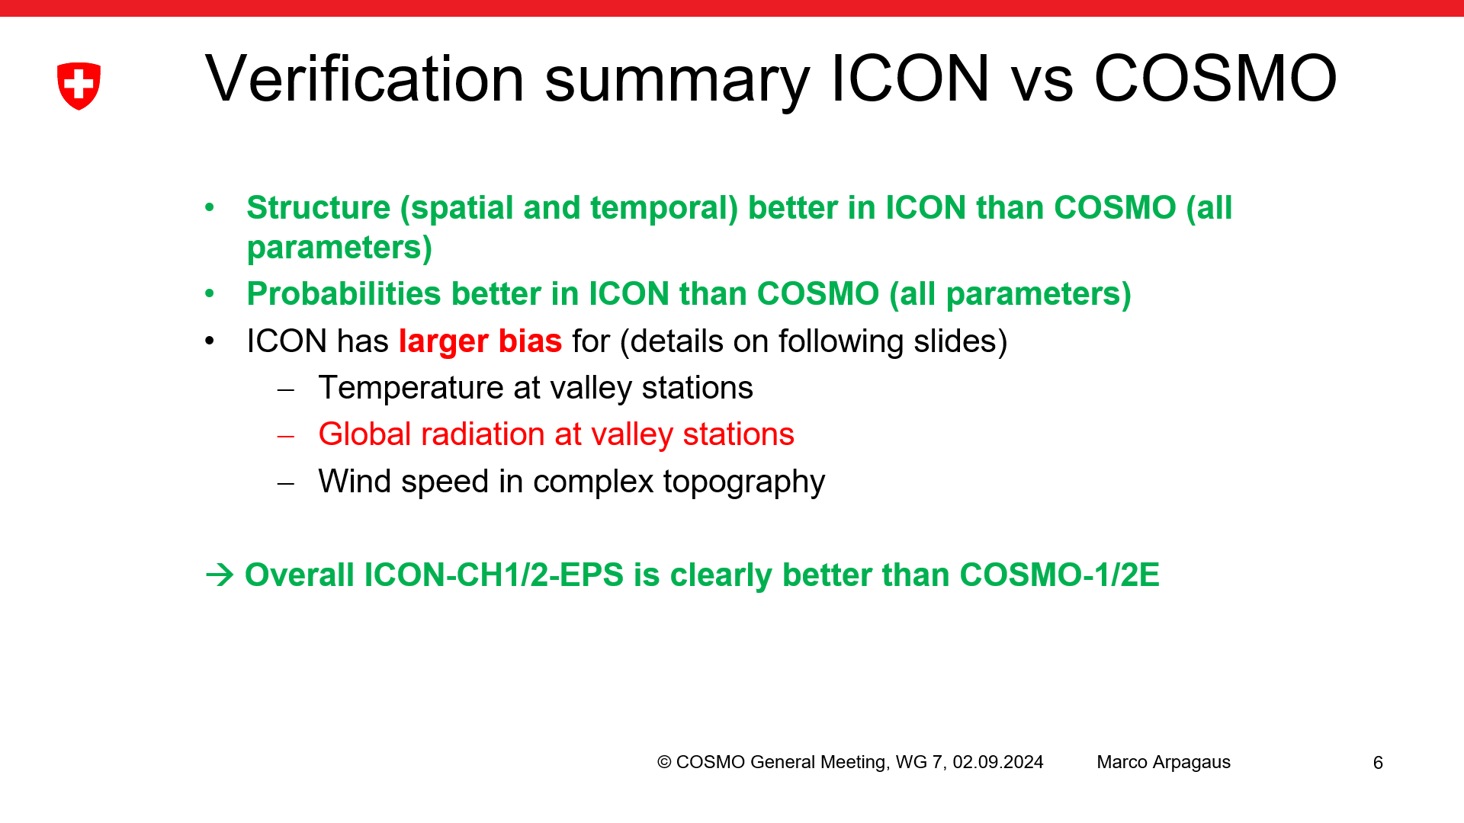

Slide 12
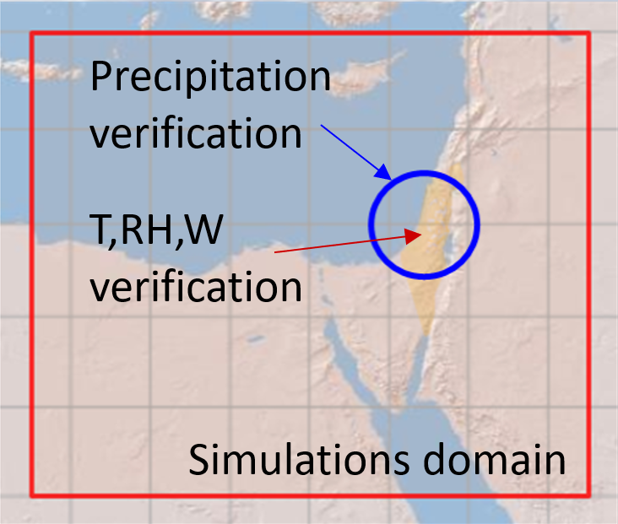
ICON ensemble (including SPPT) at IMS
ICON 20-members (2.5km resolution) driven by randomly selected ECMWF ensemble (EC-ENS) members over the Eastern Mediterranean using different perturbation methods.
EC_ENS_51 - full ECMWF ensemble (EC-ENS)
COSMO_SPPT_20 - Stochastic Perturbation of Physics Tendencies (SPPT)
New:
ICON_20 - unperturbed
ICON_PP_20 - Parameter Perturbation (PP)
ICON_SPPT_20 - Stochastic Perturbation of Physics Tendencies (SPPT)
ICON_SPPT4_20 – as previous but after precipitation calibration
2022, 2023
P. Khain, S. Bellaire, A. Shtivelman

Slide 13
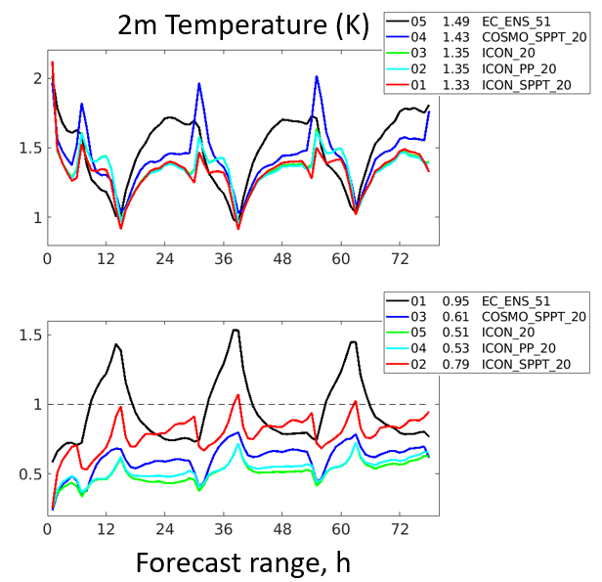
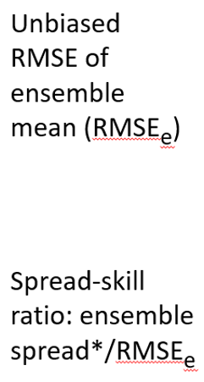
Spread Skill verification

Slide 14
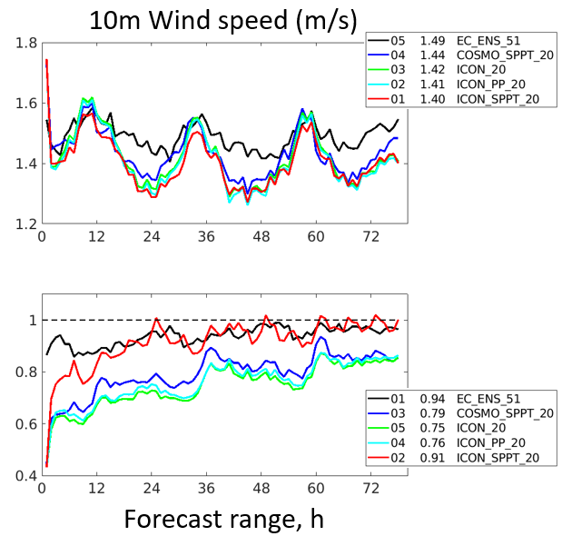
Spread Skill verification

Slide 15
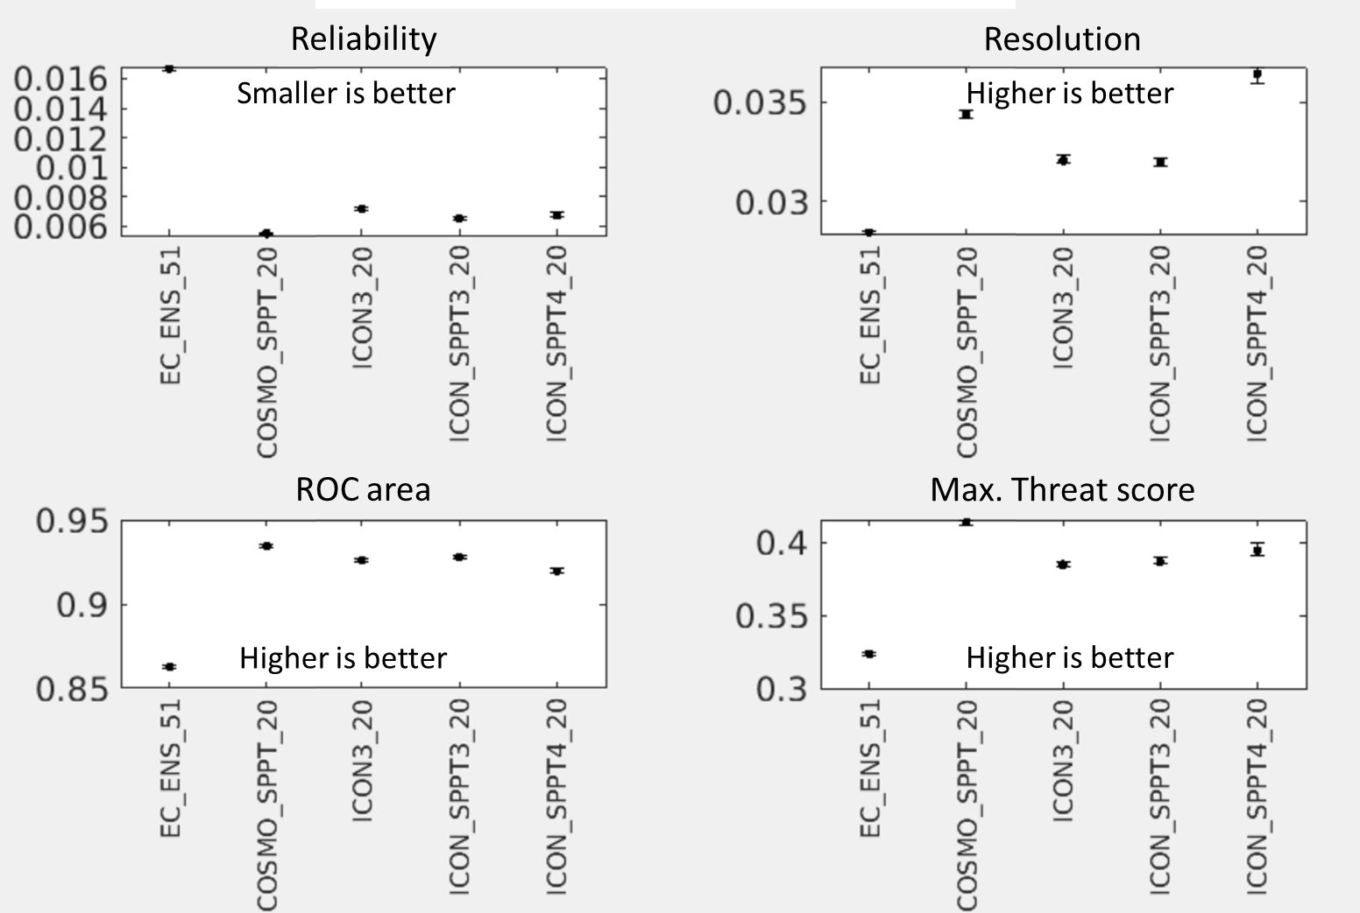
Precipitation verification

Slide 17
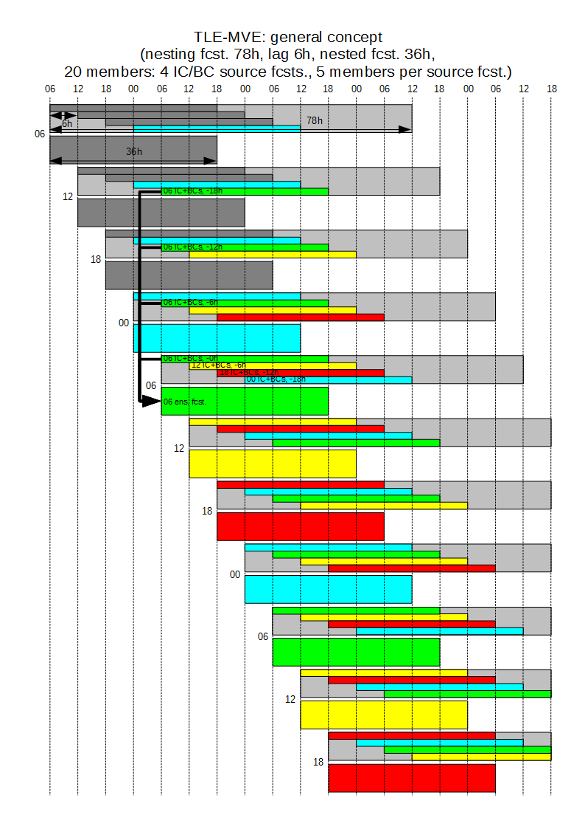
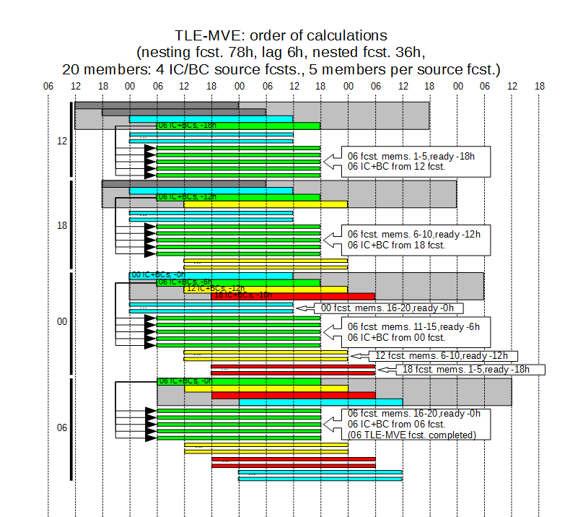
Introduction
Details of the deterministic models configuration.
Model Res. Grid size XxYxH Forecast length
ICON 13 2949120 triangles 120
COSMO 7 415x460x40 84
COSMO 2.8 380x405x50 36 (det. 48)
TLE – Time-Lagged Ensemble; MVE – Model-Varied Ensemble

Slide 18
Subtask 2.2
Influence of various methods of perturbation of soil temperature’s initial field.
Spotlight on how deep into the ground the temperature perturbation should be introduced for significant/positive impact.
Dataset used for verification – ERA-5 reanalysis fields for 2011-2020 (https://cds.climate.copernicus.eu), 0.25x0.25 degree, hourly data.

Slide 19
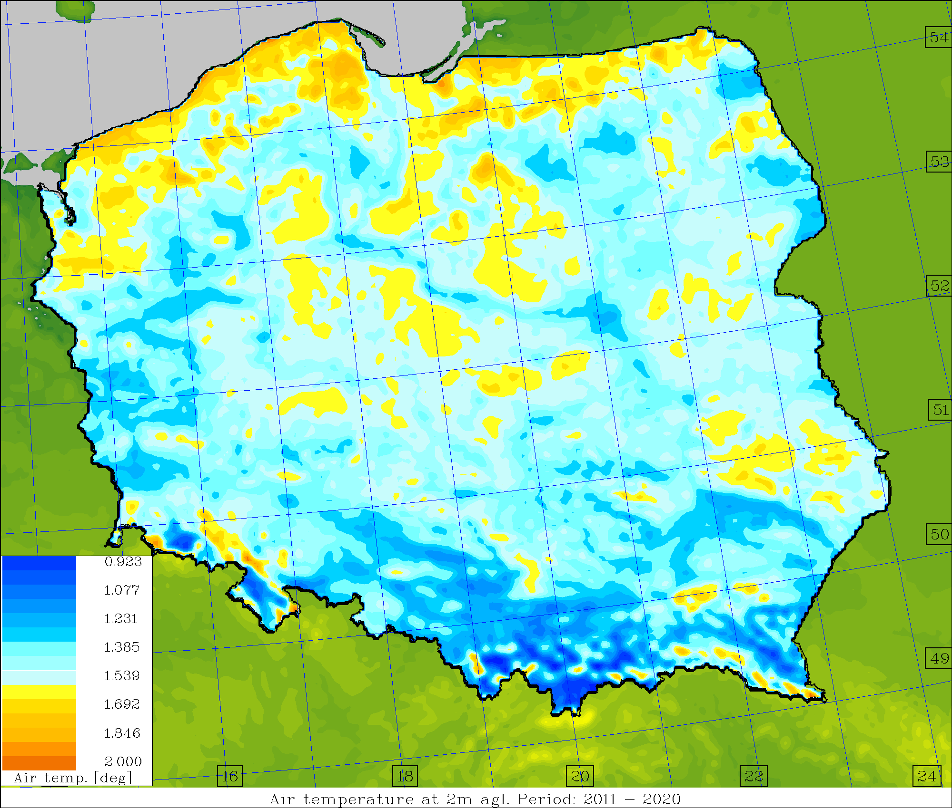
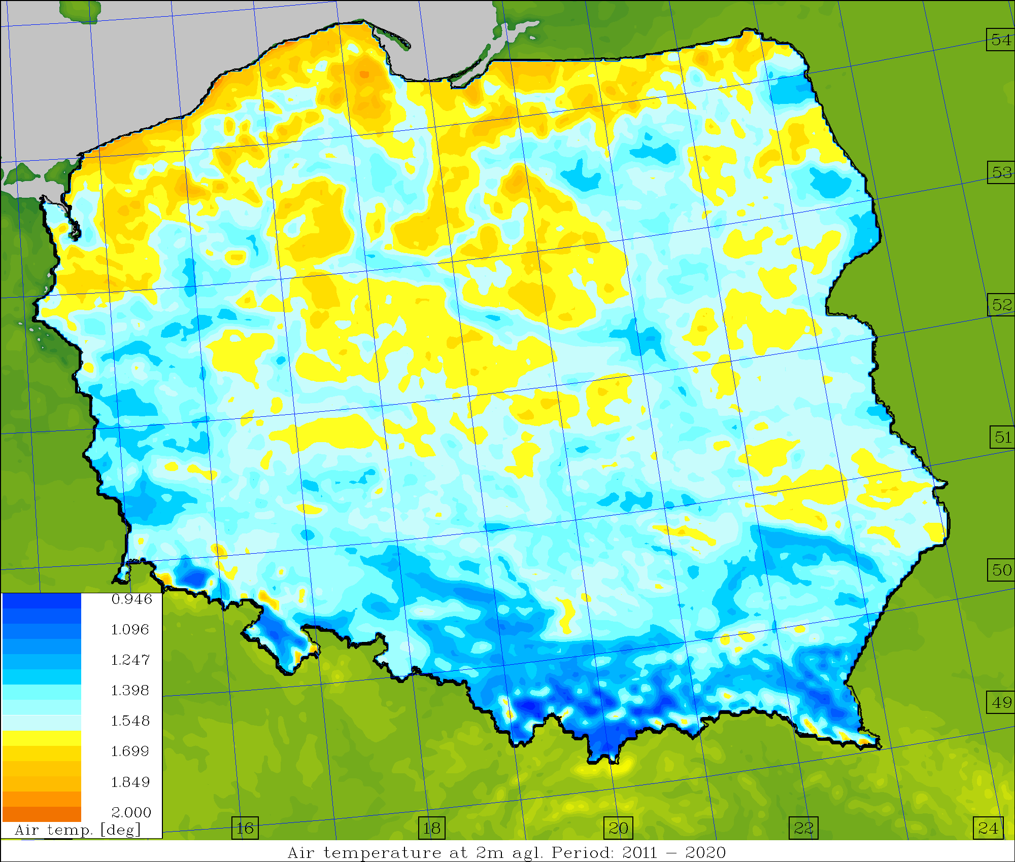
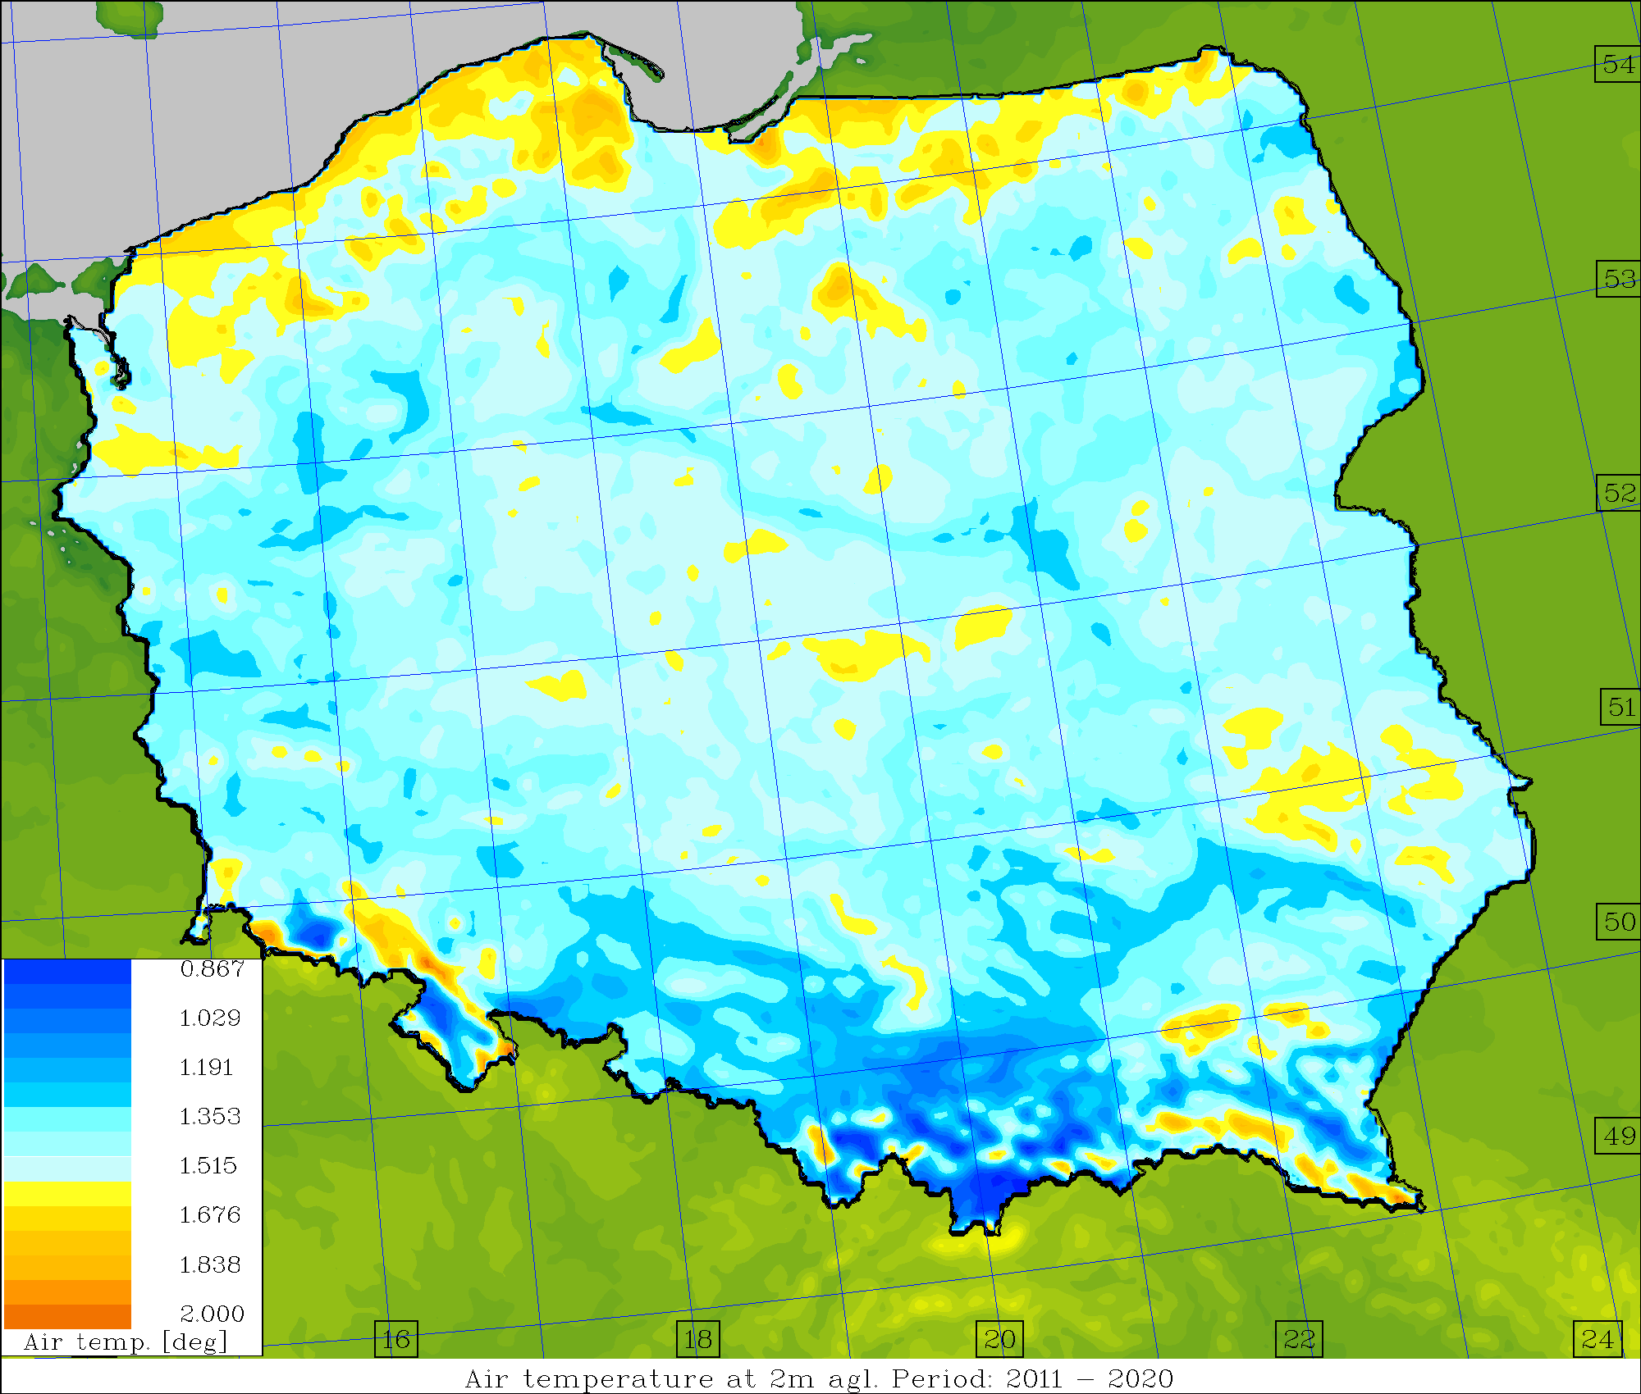
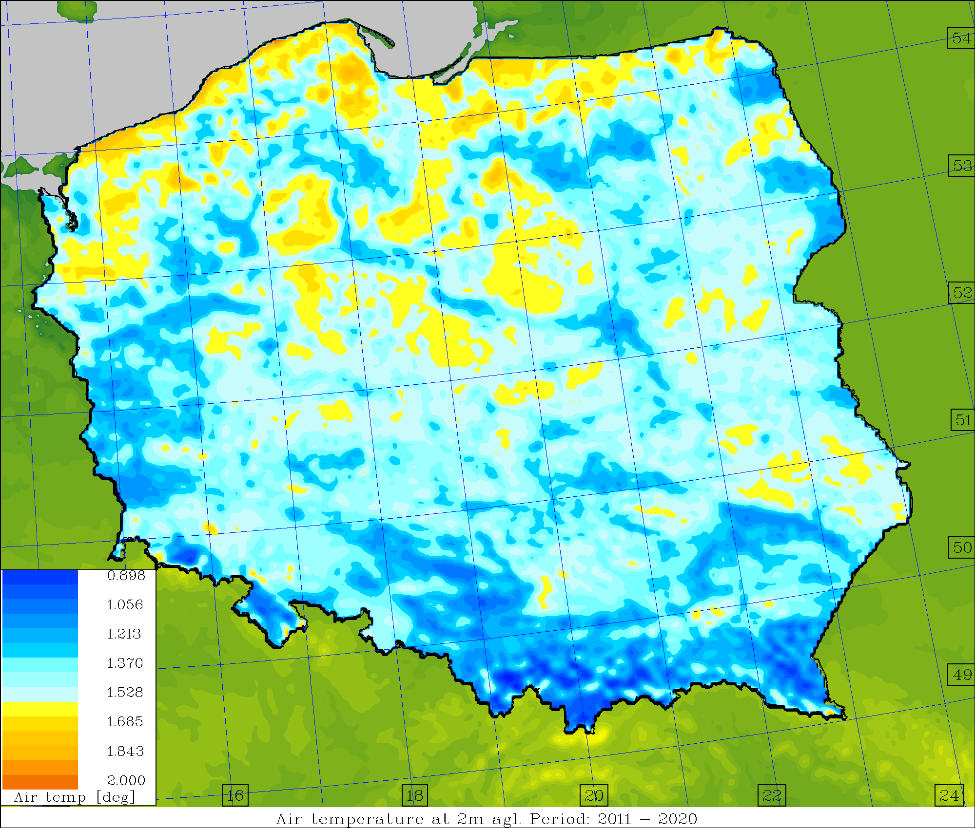
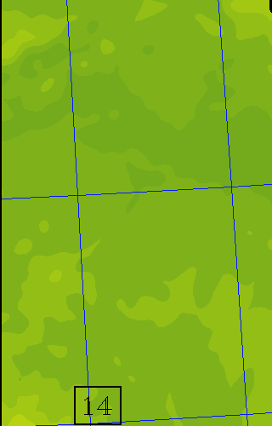
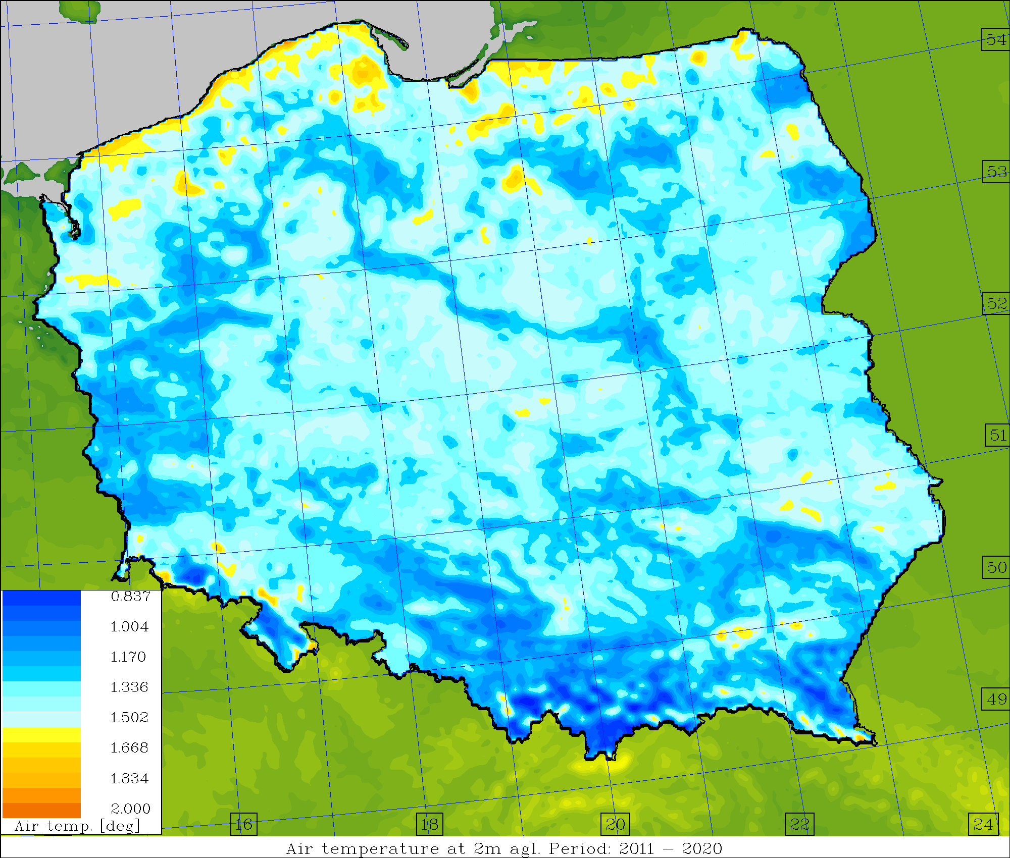
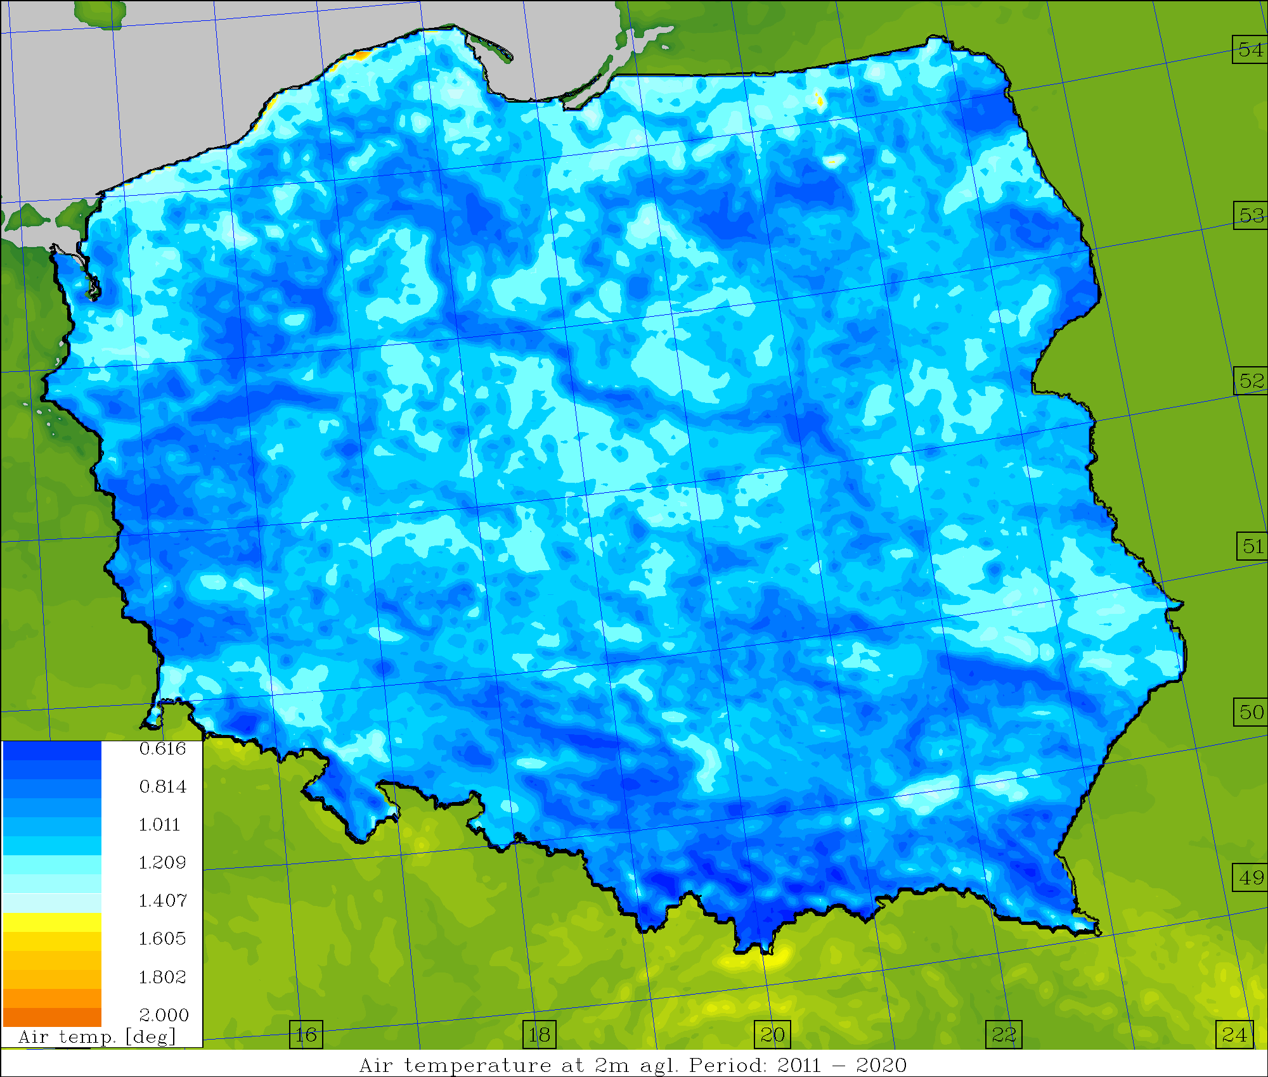
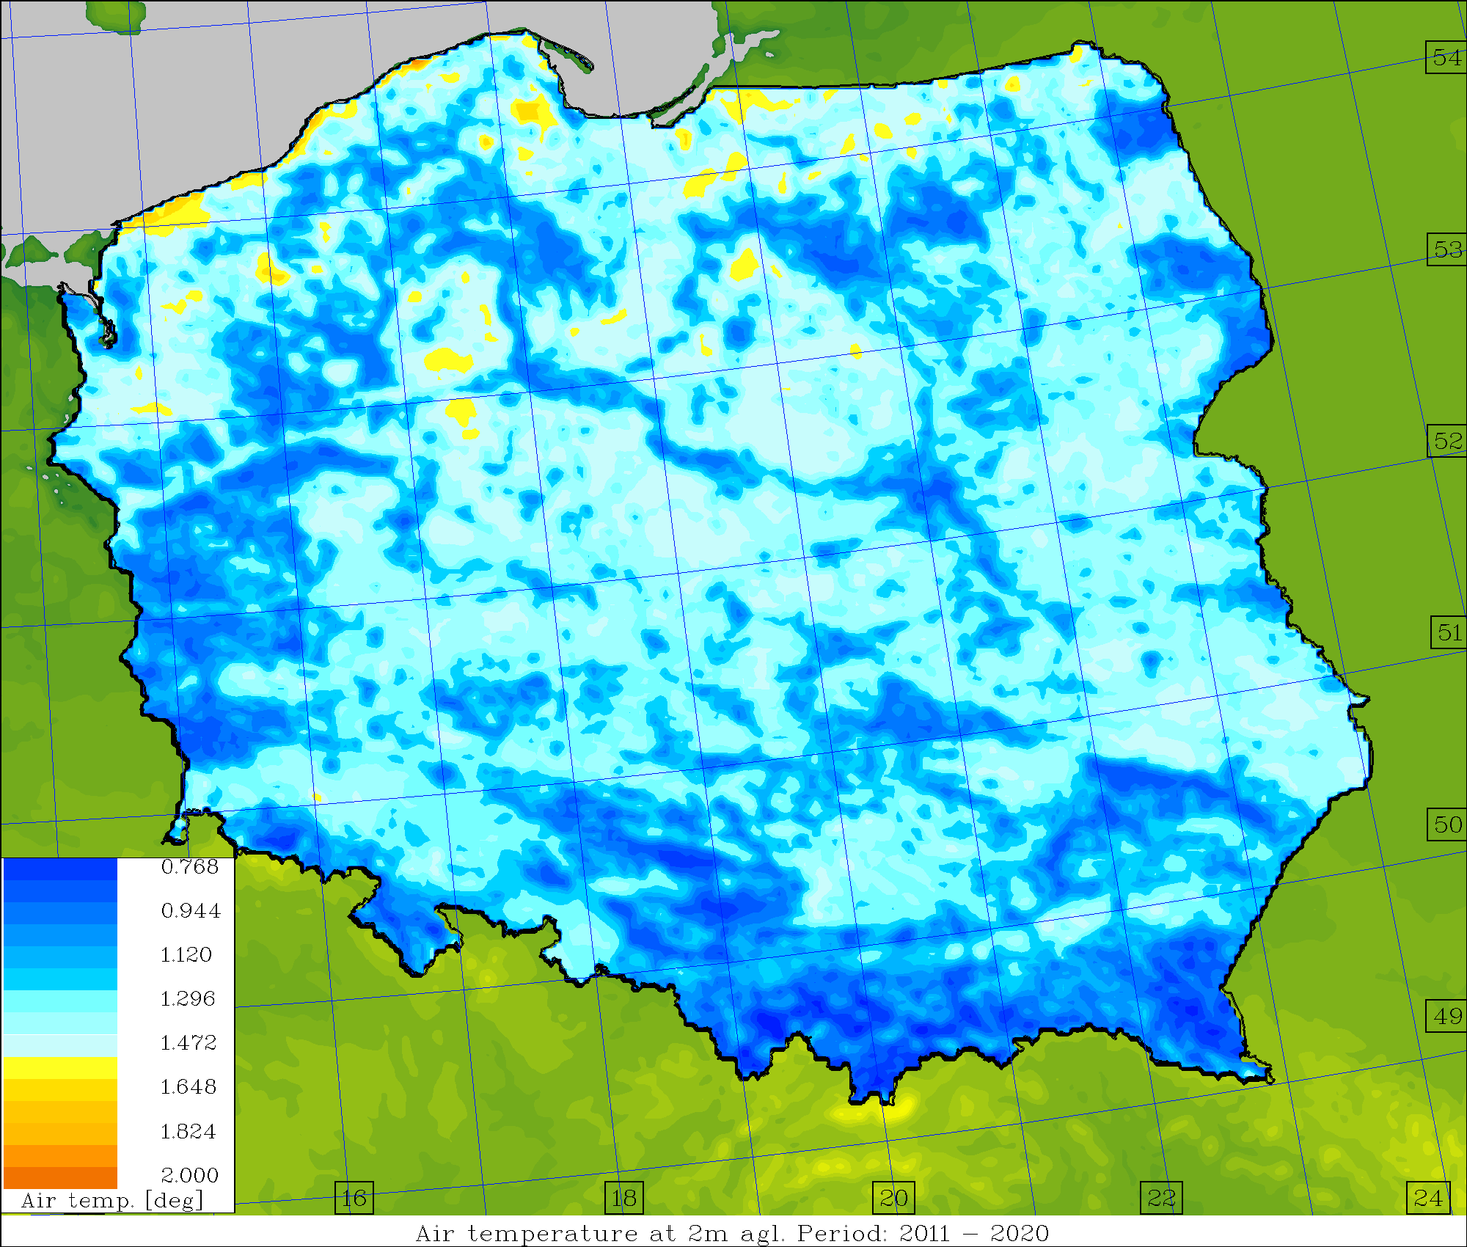
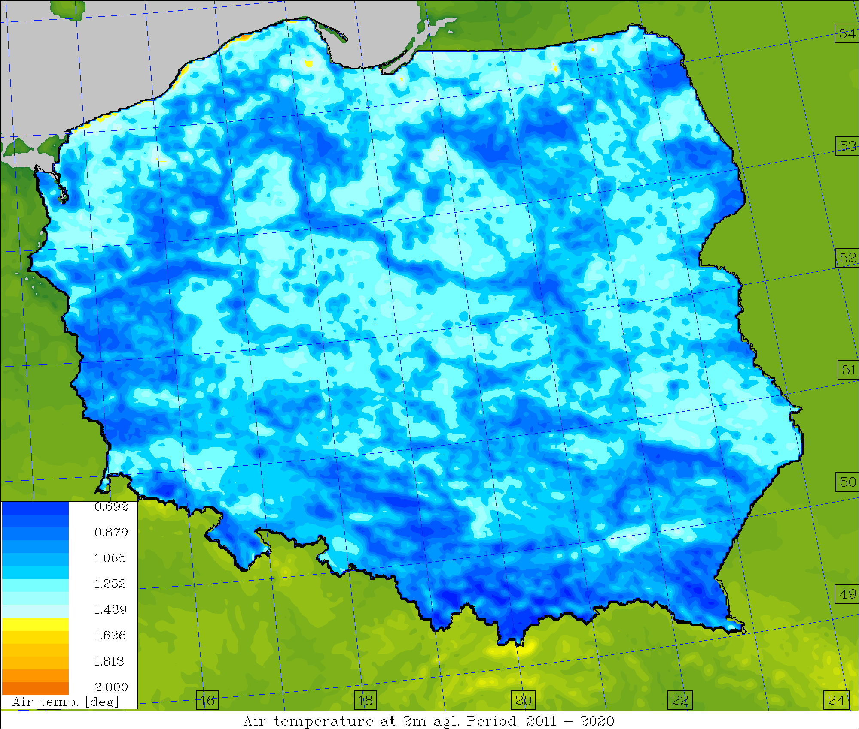
Average skill/spread values, T2M [deg.] (2011-2020)
Operational Surface pert. Down to ~1.0m Down to ~2.5m

Slide 20
Subtasks
Subtask 2.2
Question: How deep into the ground the temperature perturbation should be introduced for significant/positive impact.
Answers…
CGM2023: ”Similarly, increasing the depth to 2.5 meters did not introduce a significant improvement (compared to the previous assumptions – 1m down), only a slight improvement in skill (on average, about 1-2%) for MAM 2021 – SON 2023”.
ICCARUS 2024: ”Increase in depth to 2-2.5 meters resulted in significant improvement in skill – over the last three months (DJF 2023/2024), about 10-15%”.
Now: ”Increase in depth to 2-2.5 meters resulted in various improvement in skill – very significant in cold period(s) – DJF, SON, not that significant at all – during warm periods (MAM, JJA)”

Slide 21



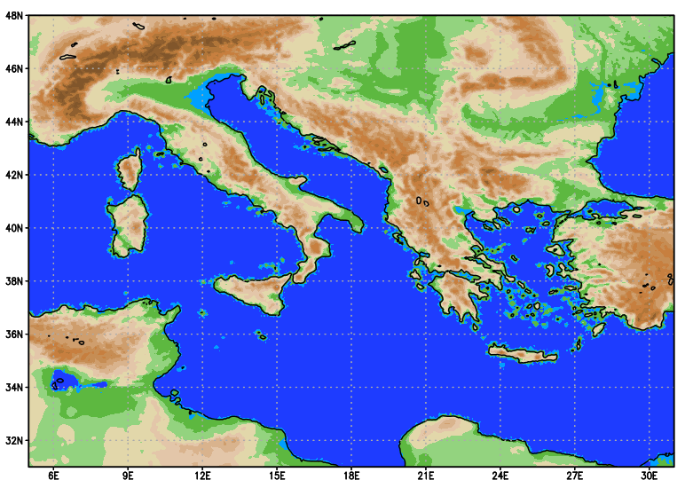
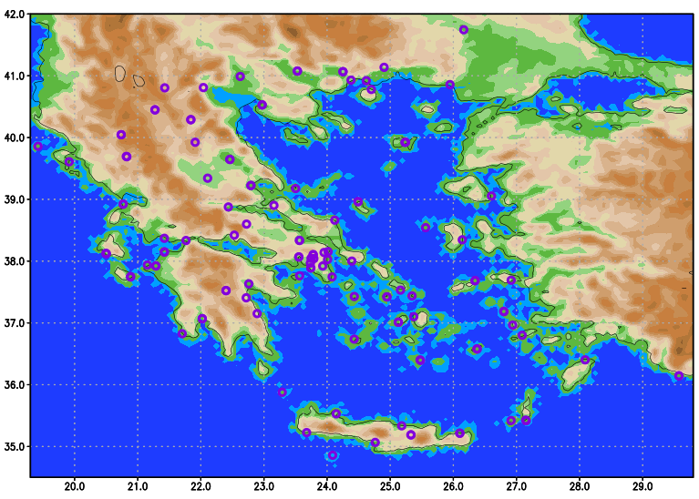
SENSITIVITY TESTS BLUEPRINT
24 parameters are considerd.
3 values/parameter including default.
The evaluation period consisted of the year 2020 (366 days).
≈
~26500 runs based on ICON-IMS:
Horizontal grid size: R3B08 (~6.5km).
417x273 grid points (wider area of Greece and Italy), 65 levels.
Integration time-step: 60 secs.
Integration period: 132 hs. ( An equivalent period of two centuries of model runs)
Boundary conditions : 3hr IFS Forecast.
Computational Cost ~ 10⁷-10⁸ b.u. on Cray X C40 of ECMWF (Gratis HNMS).
Euripides Avgoustoglou, Hellenic National Meteotological Service, 24th COSMO GM , Athens, September 12, 2022
03

Slide 22
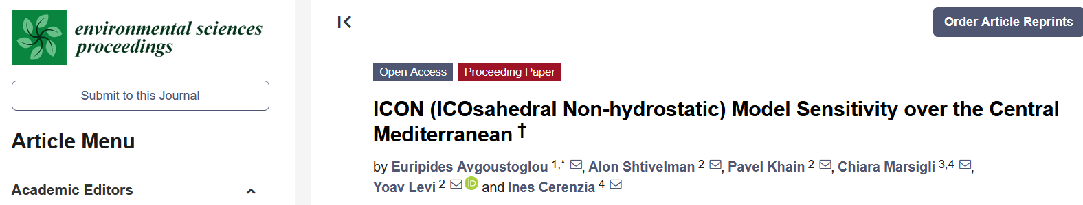
Conclusions and prospects:
The impact for the minimum and maximum values for most of the parameters turned out to be important for the considered meteorological fields, in reference to their default values regarding SYNOP observations over Greece.
The sensitivity was quite versatile justifying the choice to examine directly a very large number of parameters, probably one of the largest ever in a NWP model. However a set 7-9 parameters looks like displaying distinguished sensitivity regarding standard meteorological fields i.e. T, TD, PRECI, PMSL and U10M.
These sensitivities look practically independent of the lead time.
The advancement towards ICON-LEPS is a formidable operational but also research challenge for the years to come and is expected to have some impact model to ICON model overall.
Due to the inclusion of a large and complicated marine area in the desired integration domain (i.e. the whole Mediterranean) for the proposed ICON-LEPS, the project is expected to provide significant and lasting advancements in the area of marine meteorology along with additional challenges in NWP in general.
Euripides Avgoustoglou, Hellenic National Meteotological Service, 25^{5h} COSMO GM , Gdańsk, Poland, September 11-15, 2023
17

Slide 23
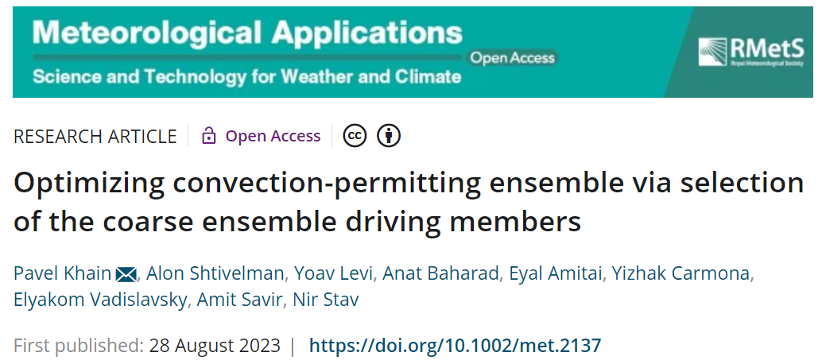
Boundary Conditions: selection

Slide 24
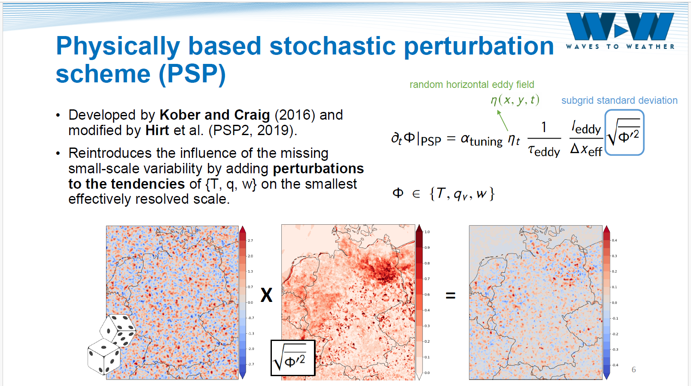
Physically based model perturbation: PSP
M. Puh, LMU

Slide 25
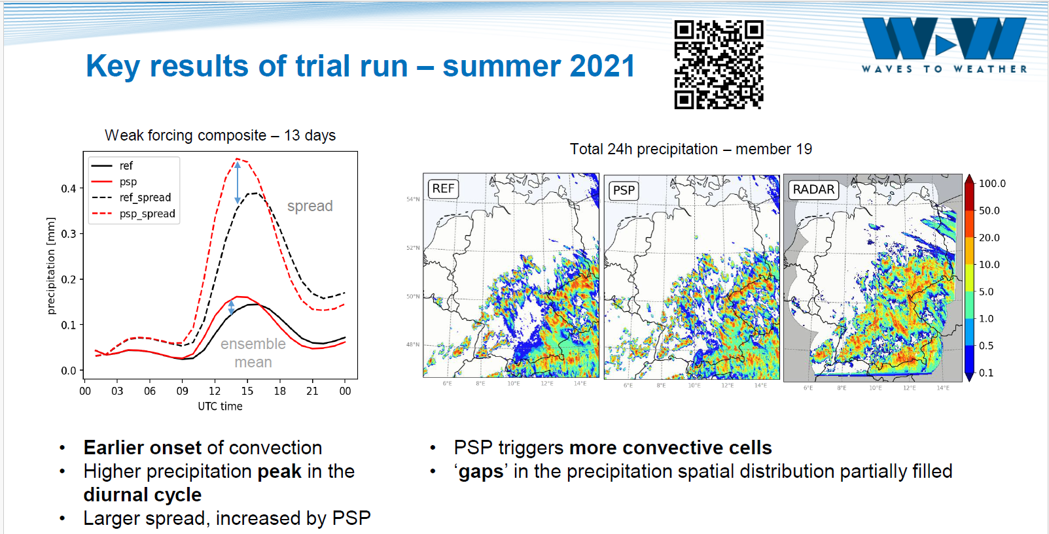
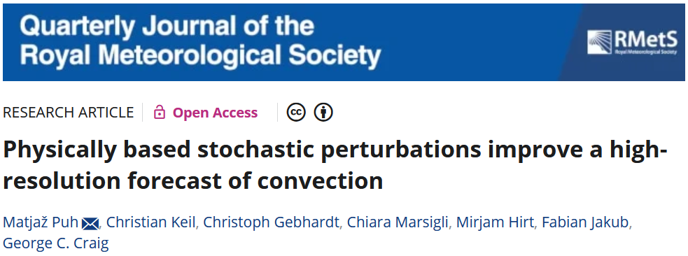
PSP: impact on convection initiation
M. Puh, LMU

Slide 26
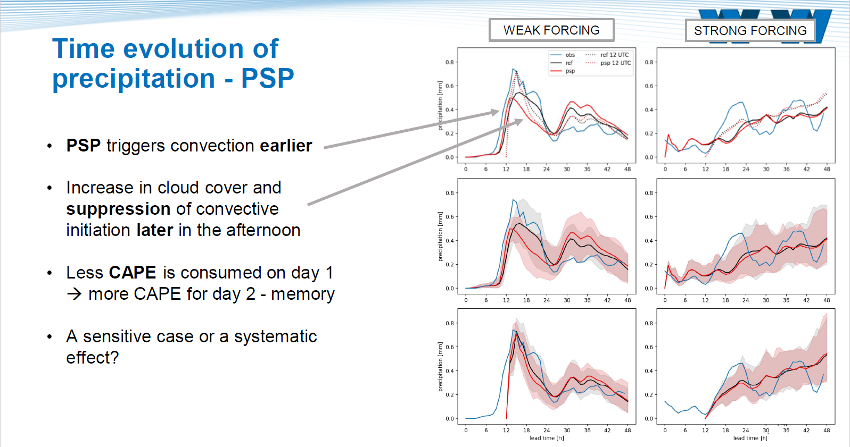
Physically based model perturbation: PSP
M. Puh, LMU

Slide 27
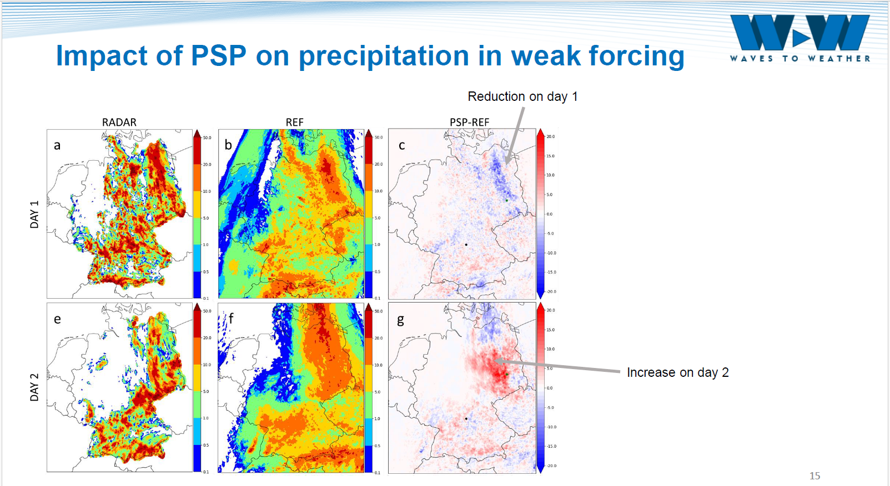
Physically based model perturbation: PSP
M. Puh, LMU

Slide 28
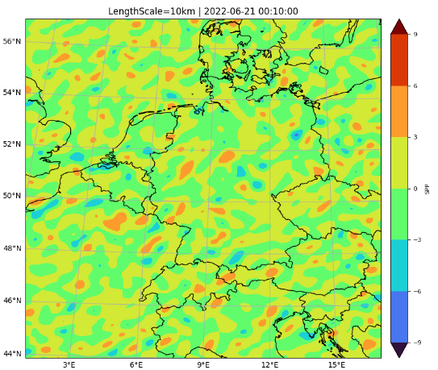
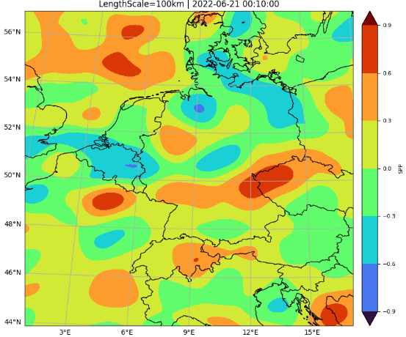

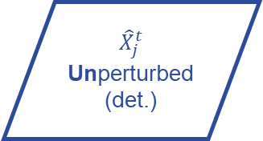
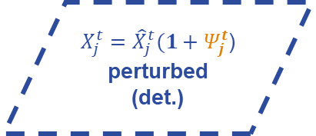

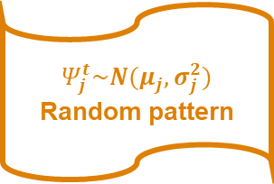
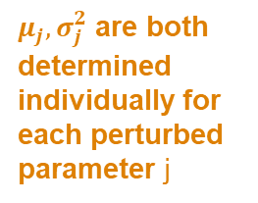
SPP (Stochastically Perturbed Parametrisations) in ICON
Implemented by A. Seifert
$${\hat{X}}_{j}^{t}$$
Unperturbed
(det.)
$$Ψ_{j}^{t}\sim N(μ_{j},σ_{j}^{2})$$
Random pattern
$X_{j}^{t}={\hat{X}}_{j}^{t}(1+Ψ_{j}^{t}$)
perturbed
(det.)
$$t:$$
additive
$μ_{j},σ_{j}^{2}$ are both determined individually for each perturbed parameter j
Pattern properties:
Length scale
Time scale
Modes
Variance
Z. Parsakhoo, DWD
Ref: Ollinaho et. al. 2016, and Frogner et al. 2021
Notes:
Option a implies that the mean of the distribution of the perturbed parameter is equal to the unperturbed value while option b implies that the median of the distribution is equal to unperturbed value

Slide 29
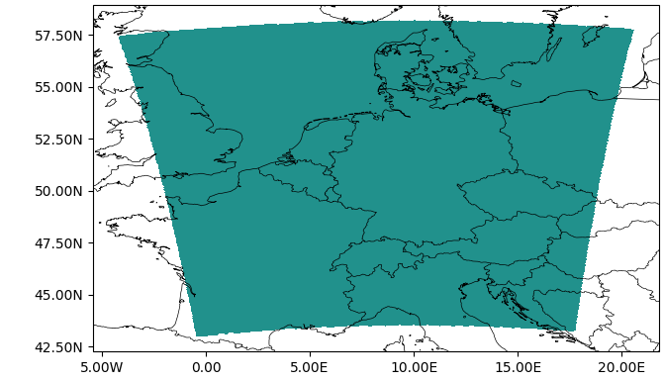
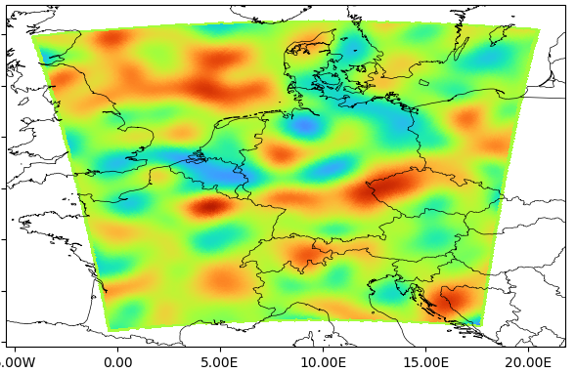
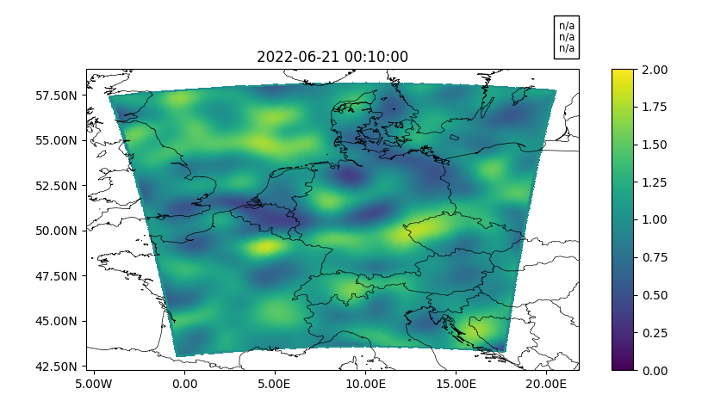
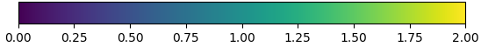
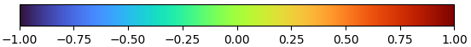
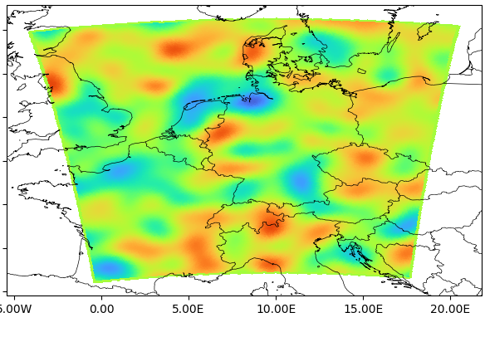
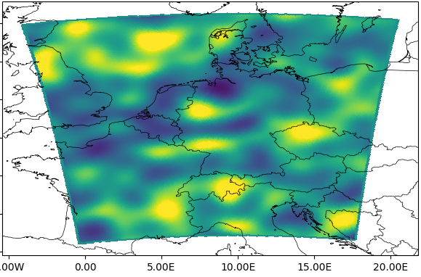






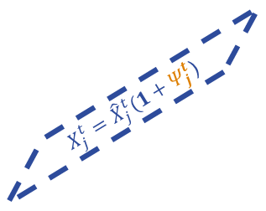











Unperturbed parameter: ${\hat{X}}_{j}^{t}$
Stochastic pattern: $Ψ_{j}^{t}$
Perturbed parameter at t: $X_{j}^{t}$
$${\hat{X}}_{j}^{t}$$
Unperturbed
(det.)
$$Ψ_{j}^{t}$$
Random pattern
$X_{j}^{t}$by $Ψ_{j}^{t}$
perturbed
(det.)
$$t:$$
$X_{j}^{t}={\hat{X}}_{j}^{t}(1+Ψ_{j}^{t}$)
via spectral space
at $t+∆t$
via spectral space
at $t+∆t$
Perturbed parameter at t: $X_{j}^{t}$
$$Ψ_{j}^{t+∆t}$$
Perturbed parameter at t+∆t: $X_{j}^{t+∆t}$
$$t+∆t :$$
$$Ψ_{j}^{t+∆t}$$
Random pattern
$X_{j}^{t+∆t}$by $Ψ_{j}^{t+∆t}$
perturbed
(det.)
$X_{j}^{t}$by $Ψ_{j}^{t}$
perturbed
(det.)
$X_{j}^{t+∆t}=X_{j}^{t}(1+Ψ_{j}^{t+∆t}$)
Z. Parsakhoo, DWD

Slide 30


Test on a real case
Test: Coupled SPP with 2mom microphysics scheme
For perturbing the sedimentation velocity of graupel
24h run
ICON-LAM: D2 domain
21st of June 2022
Z. Parsakhoo, DWD

Slide 31
The PROPHECY PP: summary
SPPT implemented in ICON by MCH, with a Stochastic Pattern Generator. SPPT is in the ICON master, independent on owned software (usable with the open license). Ported on GPU.
SPPT in ICON currently operational at MCH and IMS
Other model perturbation methods tested at DWD:
Stochastic Shallow Convection: more work needed
Physically Based Stochastic Perturbations (PSP): collaboration with LMU, more work needed
Stochastically Perturbed Parametrisations (SPP): implementation and testing in ICON ongoing, work in GLORI
Development of ensemble at IMGW
Sensitivity of ICON to selected parameters tested on the Mediterranean at HNMS, for ICON-LEPS
Work on selection of BC and model perturbation by IMS, paper published

Slide 32
Next developments: plans for new PP
SPPT operational in two COSMO ensembles, but no further development foreseen
Focus on SPP (Stochastically Perturbed Parametrisations)
test in different countries
test (and implementation) for different parameters
resources in GLORI
Research on process-based perturbations
From works in LMU, IMGW
Combination with other methods
Ensemble for nowcasting, very short range, higher resolution, best member selection
Parameters relevant for high-resolution
Benefit from CARMENs: common verification method, scores, plots

Slide 33

Study the ensemble behaviour

Slide 34

Study the ensemble behaviour

Slide 35

ICON experiments
Grayzone tuning
SPPT

Slide 36
Process-based perturbations

Slide 37



Increase model resolution
the model will resolve explicitly some processes and their parametrisation will not be needed anymore
less parameters, less ad-hoc
but, we will introduce in the models more processes which will require new parametrisations
new unknowns, new perturbations
37

Slide 38
Thank you for your attention!

Slide 39

Outline

