Slide 1

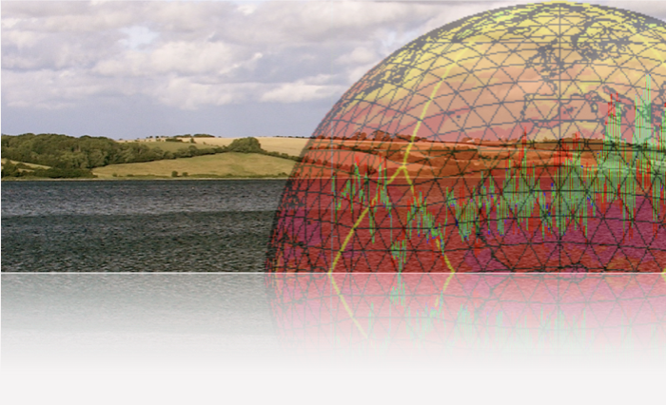
Towards implementation of HiHydroSoil v2.0 in the ICON-(ART) system at DWD: Global Maps of Soil Hydraulic Properties at 250m Resolution
J. Helmert, L. Schlemmer, J. Förstner

Slide 2
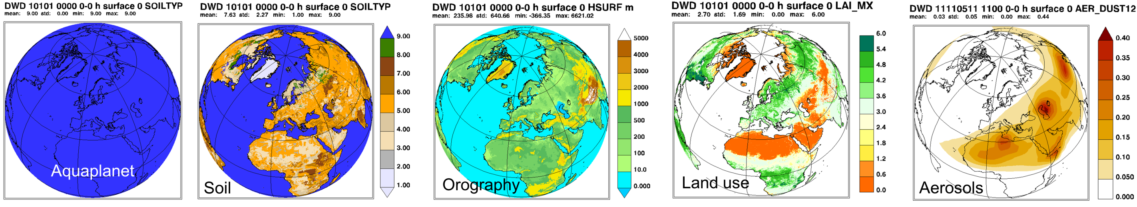
Physiographic Parameter - Background
Physiographic data are retrieved from high-resolution satellite information or land registers and are aggregated to the model’s global or limited-area grid.
In a final processing step all available data are cross-checked for consistency (e.g., to exclude vegetation on glaciers).
The required model parameters are very similar for NWP models, but the used data sources and the applied tools vary between different models – i.e. different mapping of geospatial information (Onvlee et al, 2014).
Bog - St-Daniel sector - Frontenac National Park (Québec, Canada) -Wikipedia

Slide 3
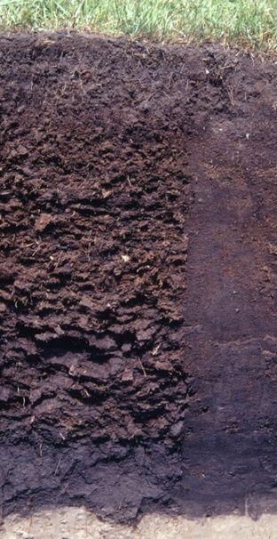
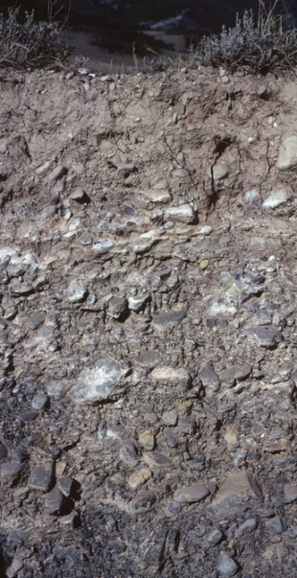
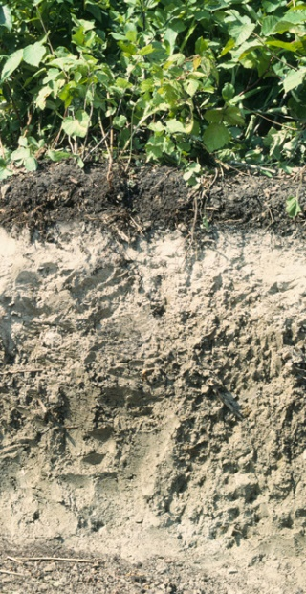
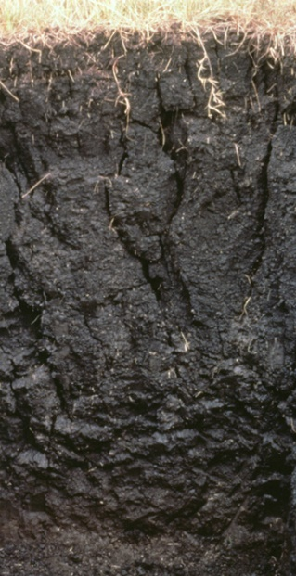
Physiographic Parameter – Resolution gap
Global soil properties
large variability in space !!!
small temporal variability
very different physical and
chemical properties !!!
Challenge for soil models to capture the main features of the soil at every gridpoint

Slide 4
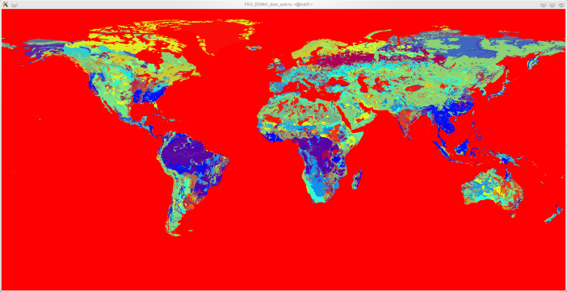
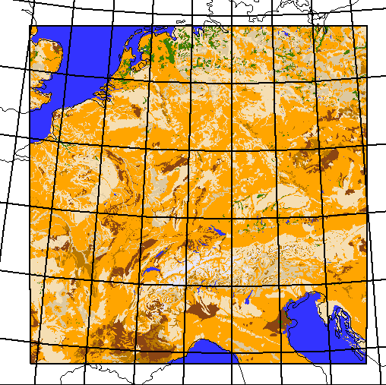
Retrieval of model soil properties for ICON
EXTPAR
Soil data set
ICON
TERRA look-up table physical properties
Soil textures
f_snow
1 - f_snow
TERRA soil types
TERRA SVAT model
TERRA soil types

Slide 5
Soil data sets for ICON
FAO Digital Soil Map of the World (DSMW): Resolution 0.083°
Textures, e.g. coarse, medium, fine – 9 TERRA soiltypes
Harmonized World Soil Database (HWSD): Resolution 0.0083°
https://iiasa.ac.at/models-tools-data/hwsd
Textures, e.g. coarse, medium, fine – 9 TERRA soiltypes
Problem: data artefacts

Slide 6
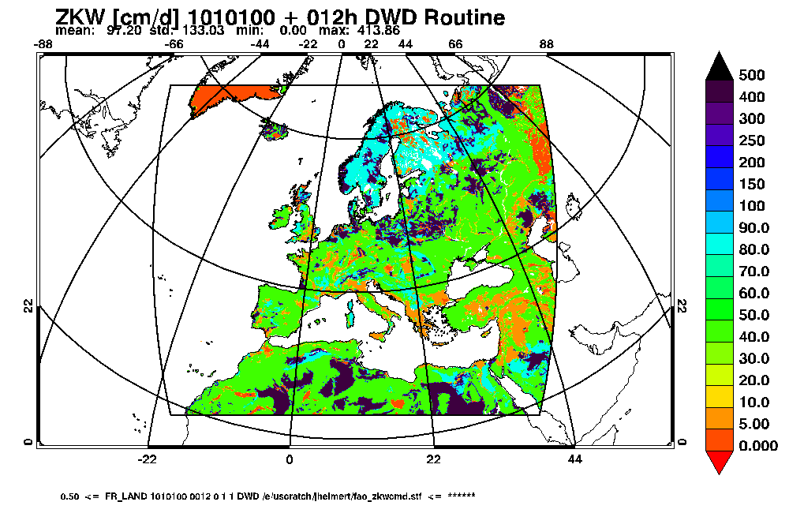
FAO – hydraul. conductivity

Slide 7
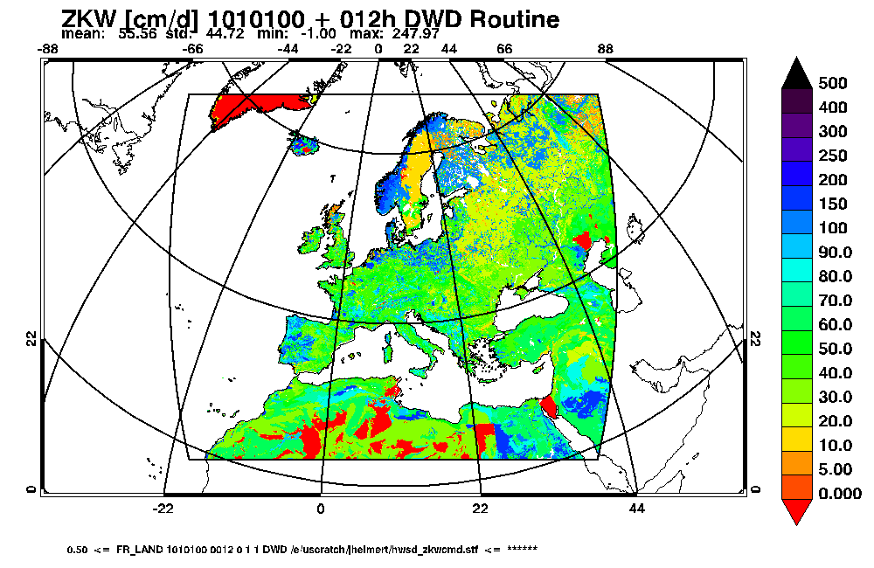
HWSD – hydraul. conductivity

Slide 8
Soil data sets for ICON
FAO Digital Soil Map of the World (DSMW): Resolution 0.083°
Textures, e.g. coarse, medium, fine – 9 TERRA soiltypes
Harmonized World Soil Database (HWSD): Resolution 0.0083°
https://iiasa.ac.at/models-tools-data/hwsd
Textures, e.g. coarse, medium, fine – 9 TERRA soiltypes
Problem: data artefacts
HiHydroSoil v2.0: Resolution 0.003°
https://www.futurewater.eu/projects/hihydrosoil/
Preprocessed fields of soil properties in 6 depths - huge amount of data for global model grids (~3GB/parameter in GeoTIFF, ~50GB/parameter NetCDF)
First implementation uses gdal averaged data at 1km resolution (~3GB/parameter NetCDF)
Preprocessed data transfered and stored in GIT-LFS-system

Slide 9
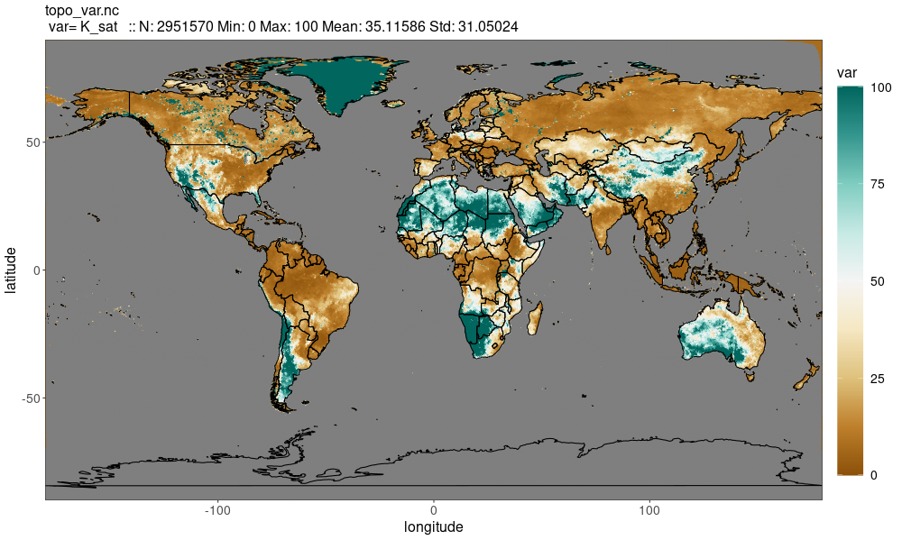
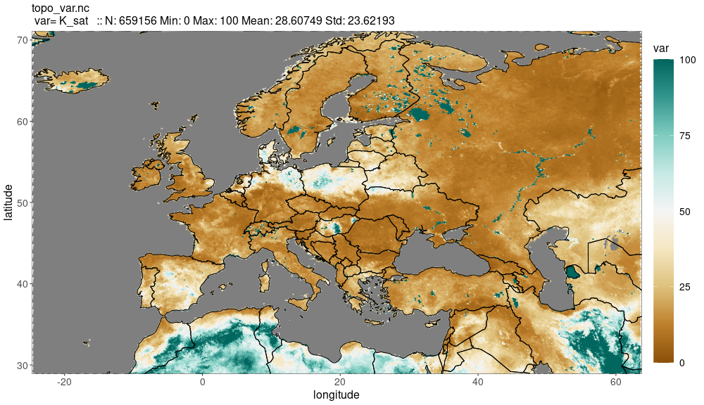
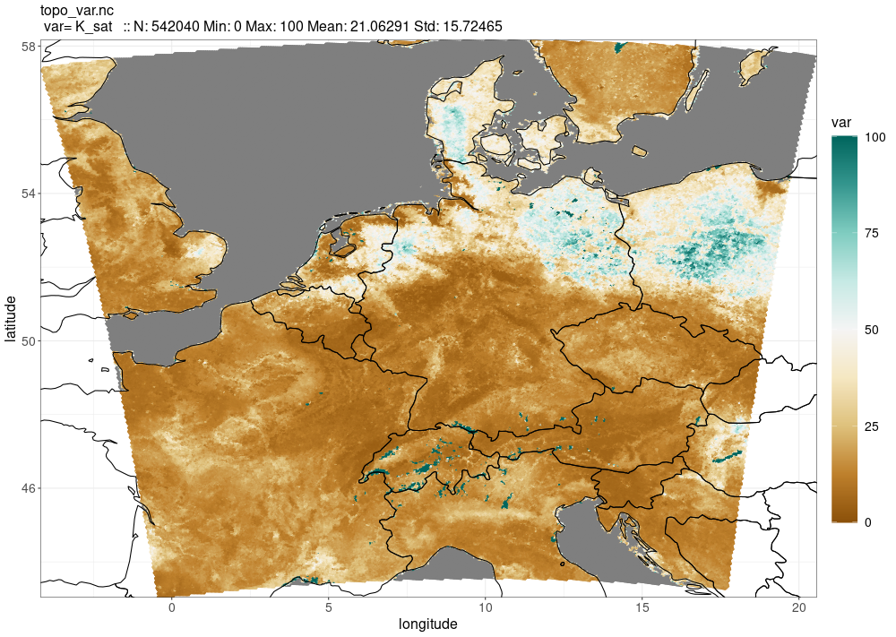
HiHydroSoil v2.0 – hydraul. conductivity
ICON-EU 6.5km
ICON-D2 2.2km
ZKW [cm/d]
ICON-GLOBAL 13km

Slide 10
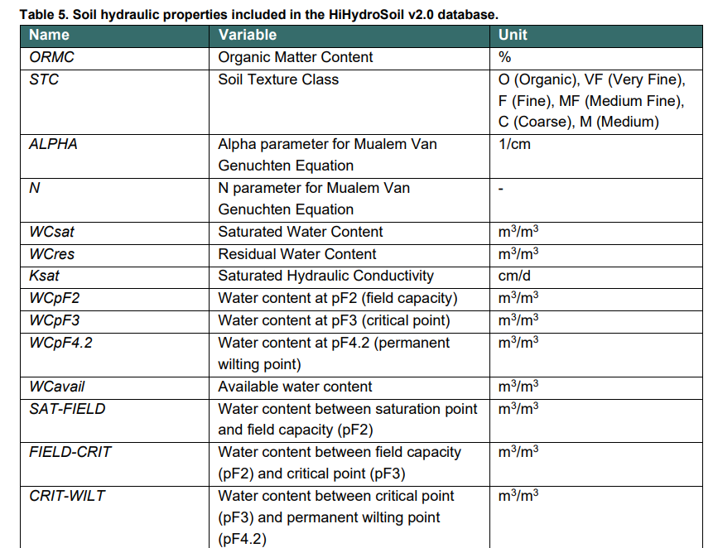
HiHydroSoil v2.0 – global physical parameters
HiHydroSoil v2.0: Enhancing Global Soil Data
Important input: ISRICS’ SoilGrids database
Basis for environmental studies
Addresses the limitations of global soil maps
Data provided by HiHydroSoil v2.0:
Organic Matter Content
Soil Texture Class
Saturated Hydraulic Conductivity
Mualem van Genuchten parameters (Alfa and N)
Saturated Water Content
Residual Water Content
Water content at pF2, pF3, and pF4.2
Hydrologic Soil Group (USDA)
https://www.futurewater.eu/projects/hihydrosoil/

Slide 11
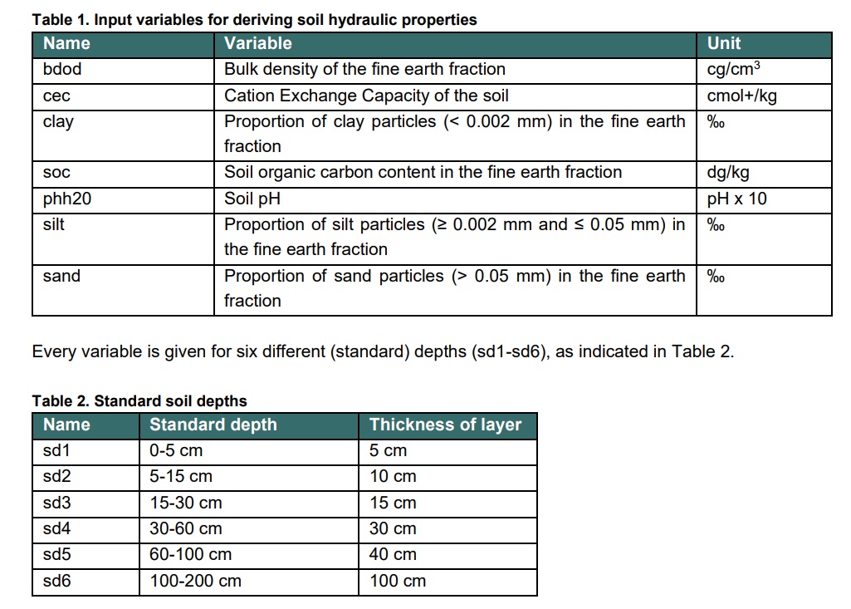

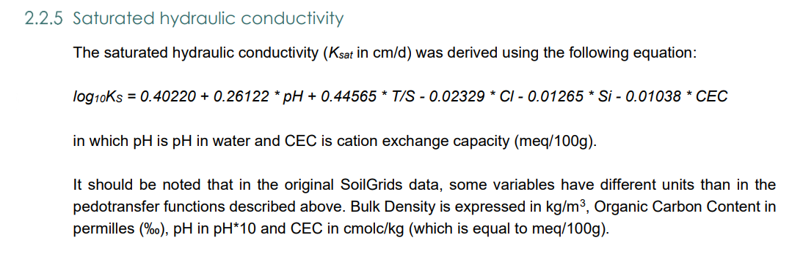
HiHydroSoil v2.0 – How it works
SOILGRIDS based input
Pedotransfer functions
https://www.futurewater.eu/projects/hihydrosoil/

Slide 12
Retrieval of TERRA soil properties HiHydroSoil v2.0
EXTPAR
HiHydroSoil physical parameters
ICON
Direct usage of fields of physical parameters without look-up table
Mapping to ICON grid
f_snow
1 - f_snow
TERRA SVAT model

Slide 13
Summary - 1
Soil information plays a pivotal role in various aspects of atmospheric modeling, including numerical weather prediction (NWP), mineral dust dispersion forecasts, and climate studies.
However, the reliability and accessibility of global soil data have been limited, leading models to rely on outdated and lower-resolution soil maps.
Recent advancements have paved the way for the development of high-resolution global soil datasets, such as SoilGrids, supplemented by HiHydroSoil v2.0, which provides crucial soil hydraulic properties in ready to use physical parameter fields.
At DWD the integration of HiHydroSoil v2.0 is prepared, seamlessly incorporating it into the modular land-surface component of the ICON model and its ART extension.

Slide 14
Summary - 2
The high-resolution soil information in ICON is expected to enhance the accuracy and applicability of NWP models, providing a more precise and detailed representation of land-surface processes.
The chosen approach at resolution of 1km allows further increase in resolution with available storage space and computational resources as well as advanced interpolation techniques (e.g. Montzka et al., 2017)
Additionally, when applied in coupled dispersion forecasts for mineral dust, with feedback on atmospheric processes, it is anticipated to significantly improve the precision and resolution of mineral dust forecasts within the ICON-ART system.

Slide 15
Thank you

Slide 16
Supplementary material

Slide 17
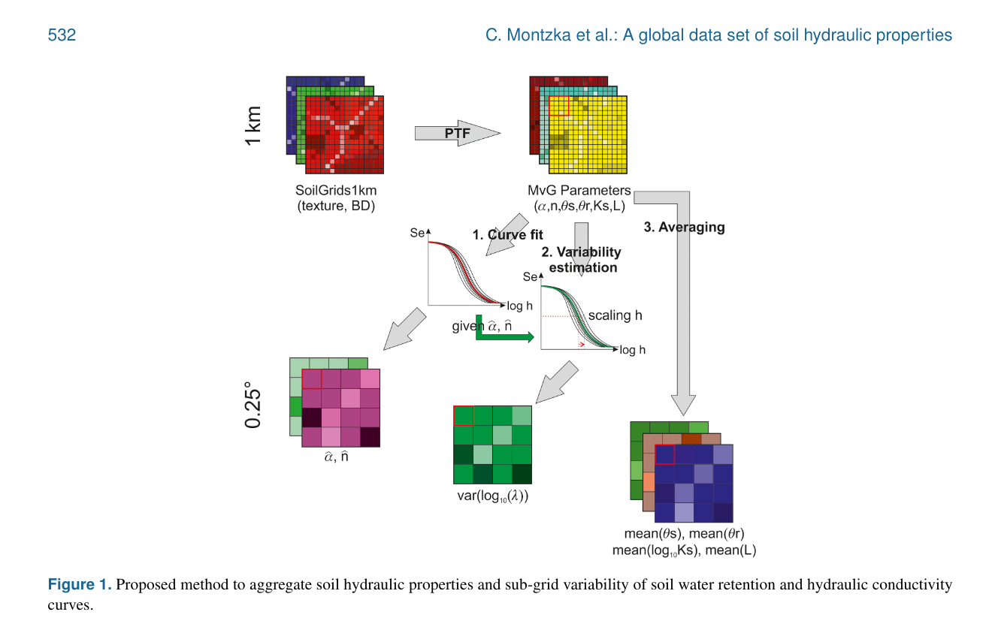
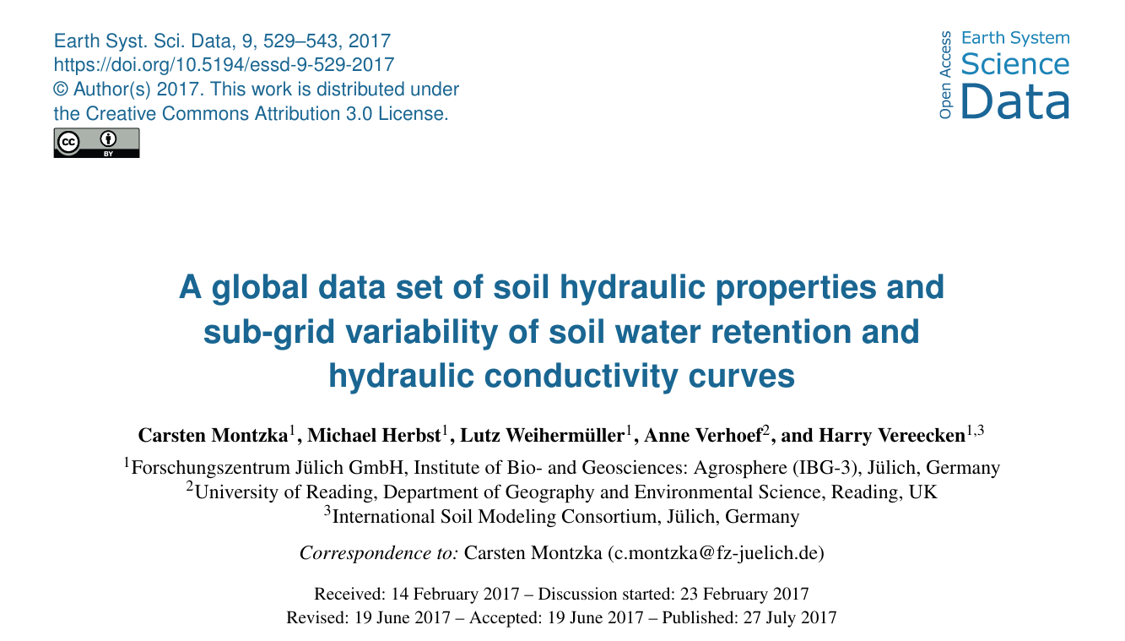
Advanced interpolation

Slide 18
TERRA Tiles
H₁
L_{v}E₁
H₂
L_{v}E₂
H₃
L_{v}E₃
H₄
L_{v}E₄
H₅
L_{v}E₅
H₆
L_{v}E₆
0.00-0.01
0.01-0.03
0.03-0.09
0.09-0.27
0.27-0.81
0.81-2.43
2.43-7.29
7.29-21.87

Slide 19
TERRA soil properties

Slide 20
Soil water transport
Rijtema model in TERRA
soil water change
soil water flux, Richards equation
soil water diffusivity, Rijtema (1969)
soil water conductivity, Rijtema (1969)

Slide 21
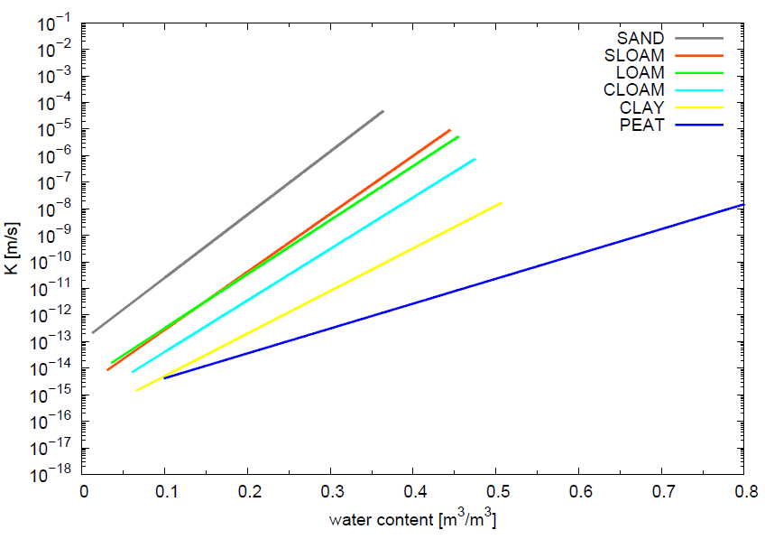
Hydraulic properties- TERRA
Diffusivity m²/s
Conductivity m/s

Slide 22
Hydraulic properties- IFS
Diffusivity m²/s
Conductivity m/s
IFS documentation

Slide 23
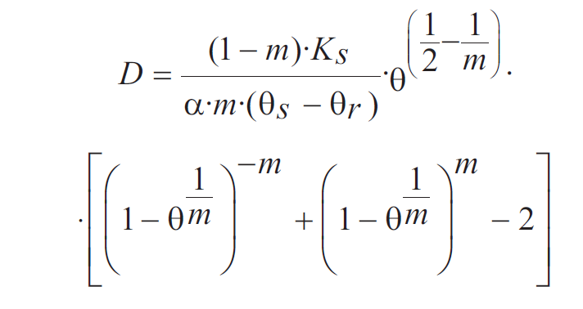
Soil water transport
van Genuchten model
soil water change
soil water flux, Richards equation

Slide 24



Soil water transport
van Genuchten model
soil water change
soil water flux, Richards equation
Determination of required soil parameters

Slide 25
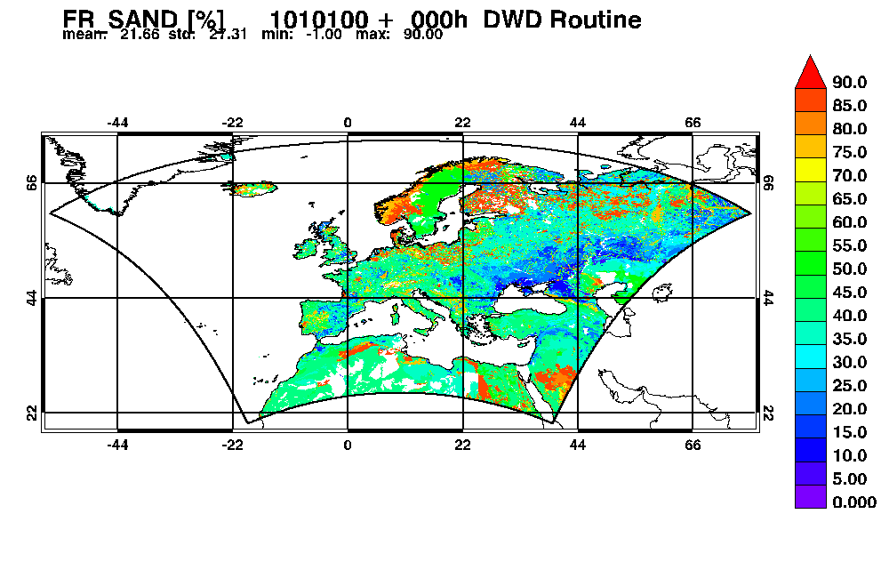
HWSD: COSMO-EU

Slide 26
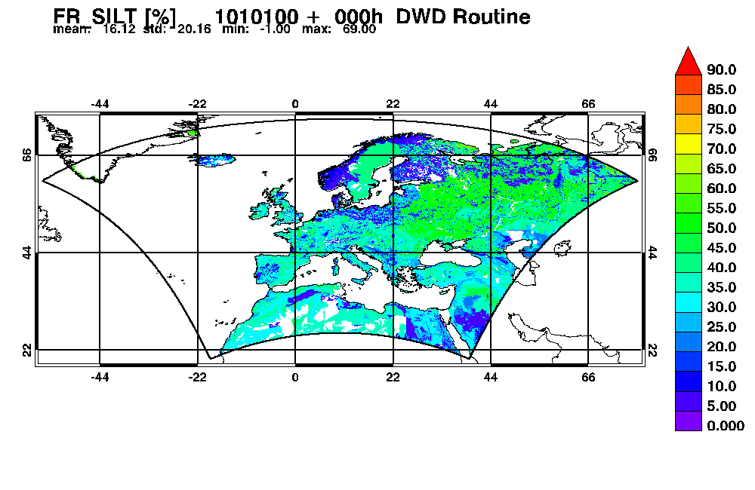
HWSD: COSMO-EU

Slide 27
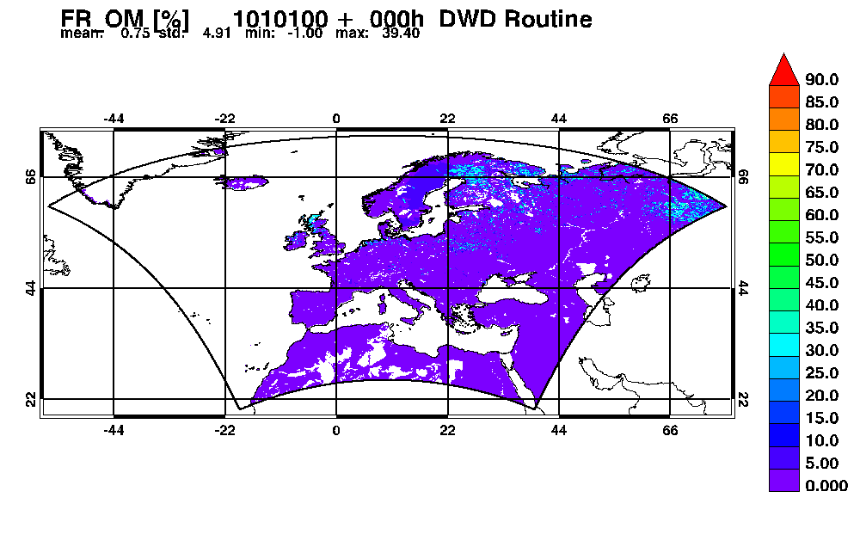
HWSD: COSMO-EU

Slide 28
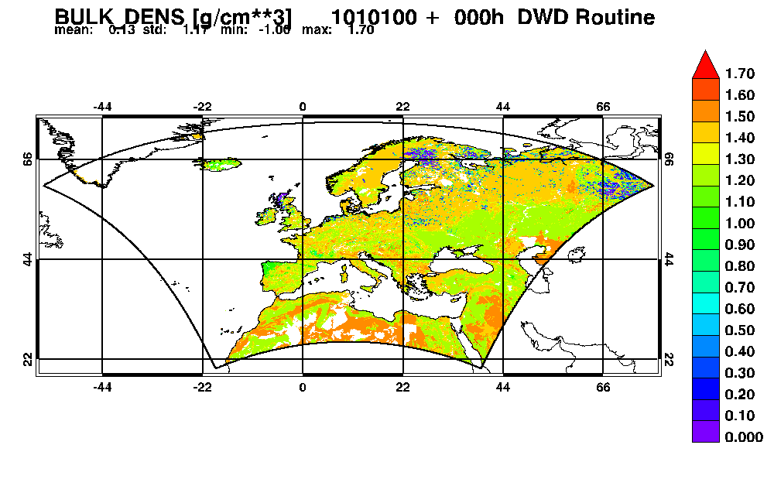
HWSD: COSMO-EU

Slide 29
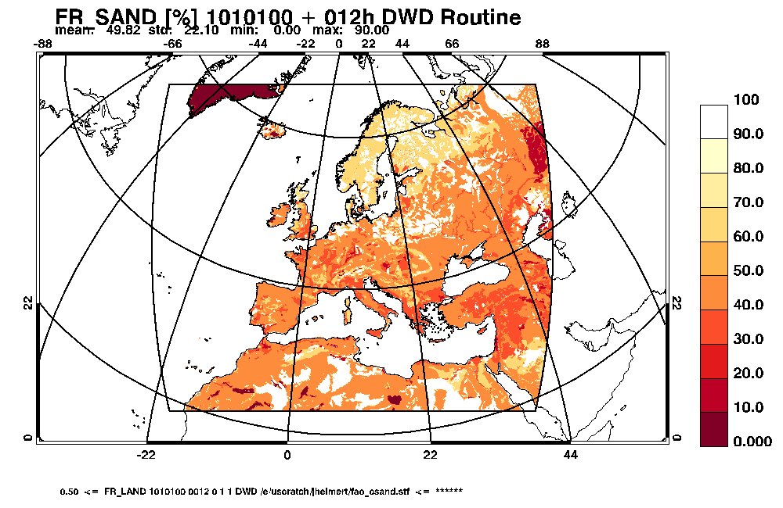
FAO – sand fraction

Slide 30
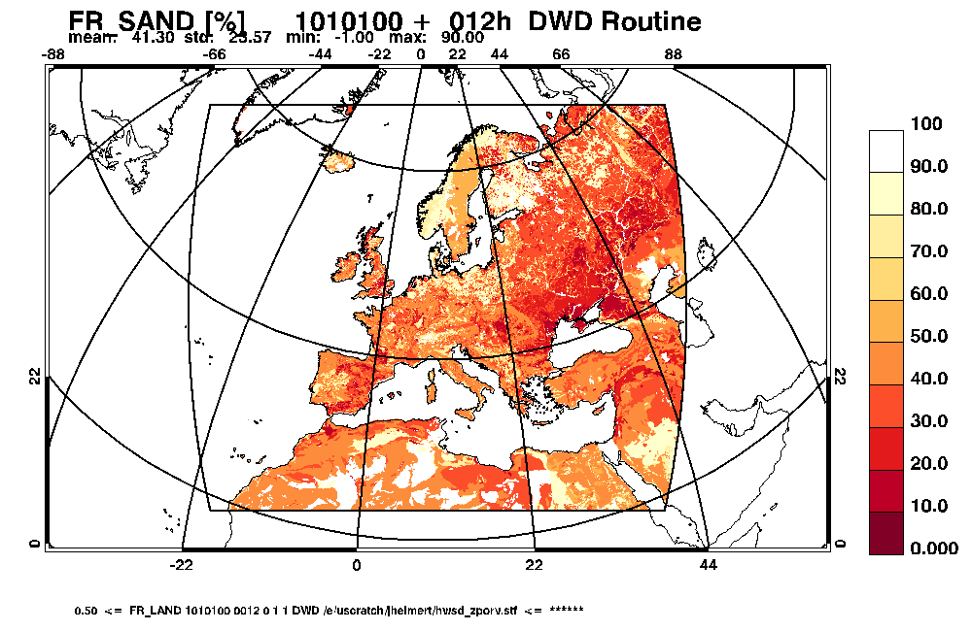
HWSD – sand fraction

Slide 31
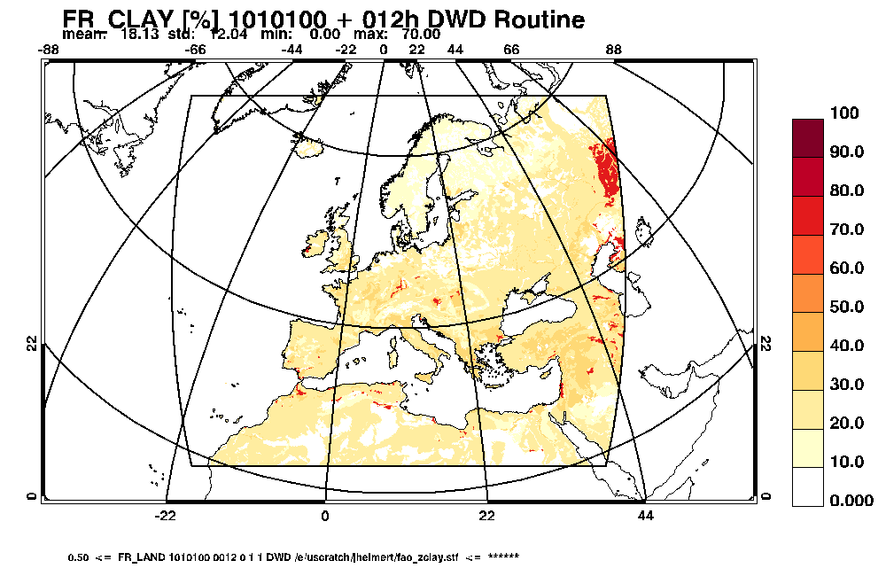
FAO – clay fraction

Slide 32
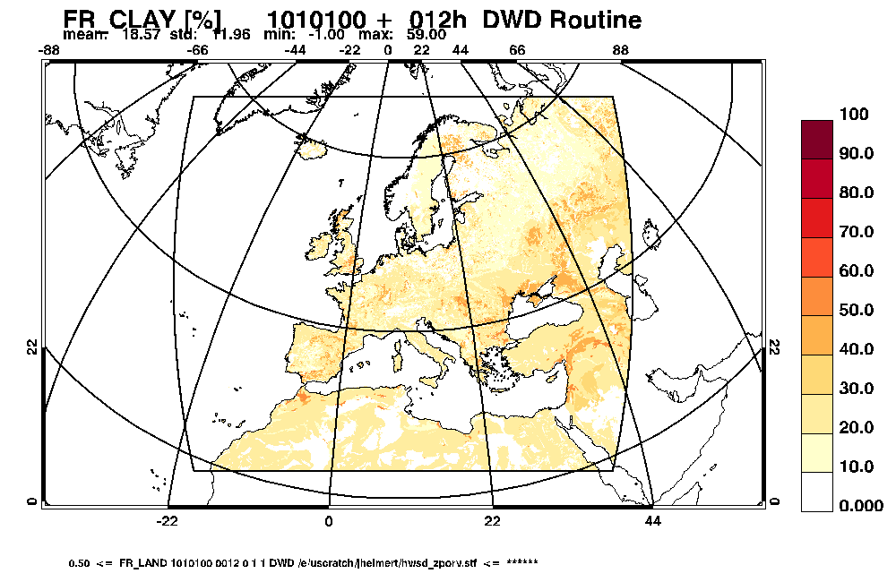
HWSD – clay fraction

Slide 33
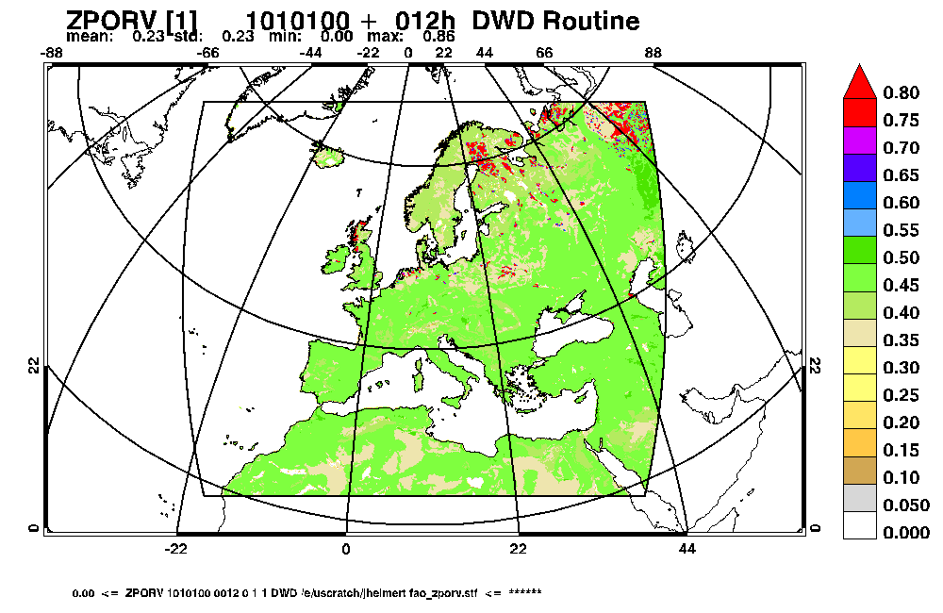
FAO – pore volume

Slide 34
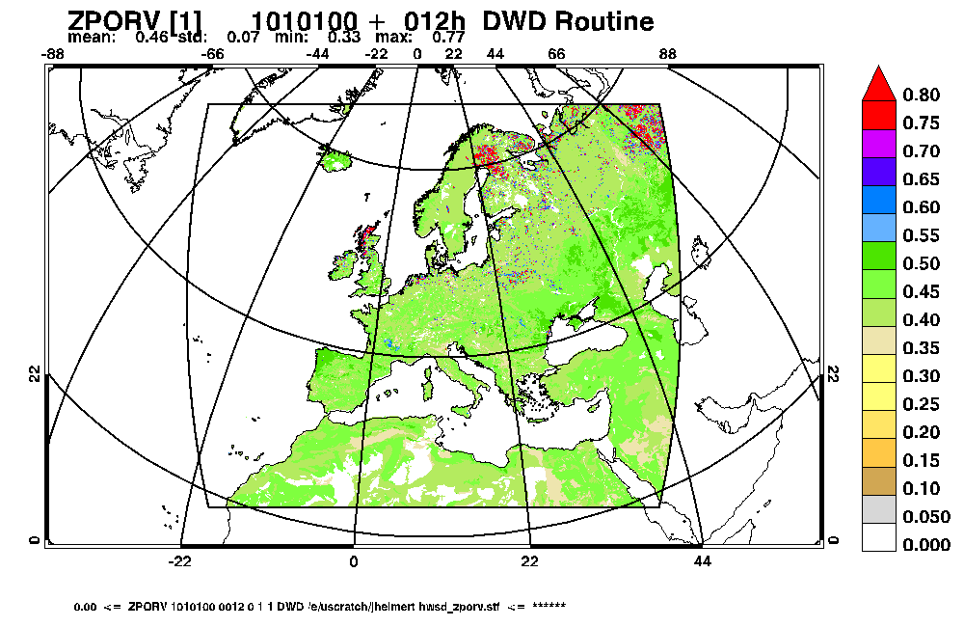
HWSD – pore volume

Slide 35
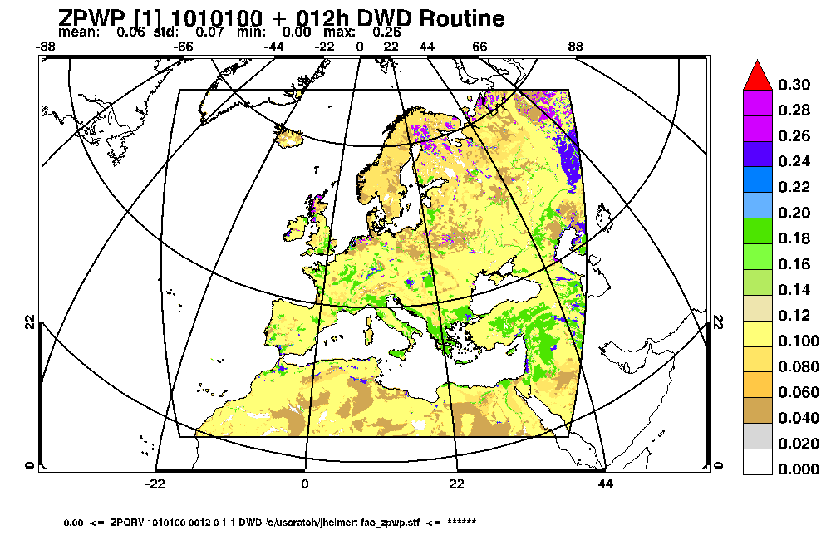
FAO – plant wilting point

Slide 36
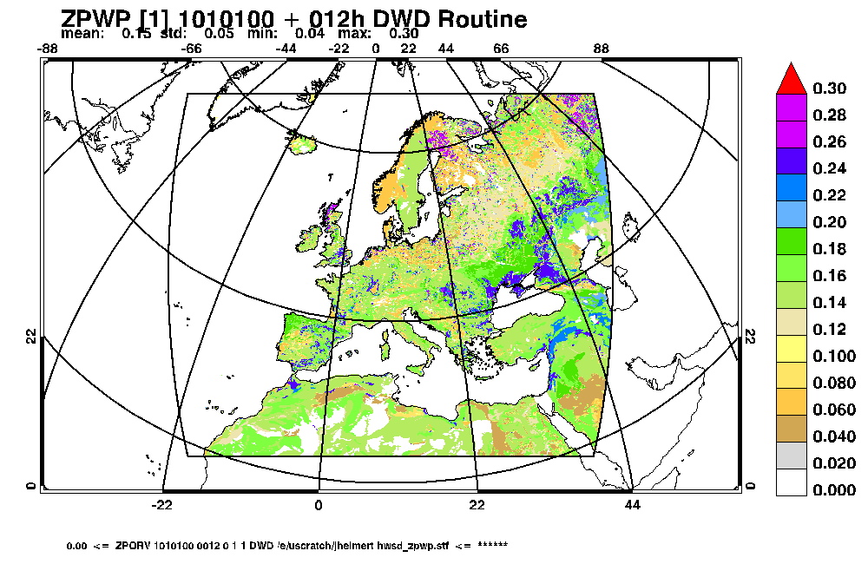
HWSD – plant wilting point

Slide 37
FAO – hydraul. conductivity

Slide 38
HWSD – hydraul. conductivity

Slide 39
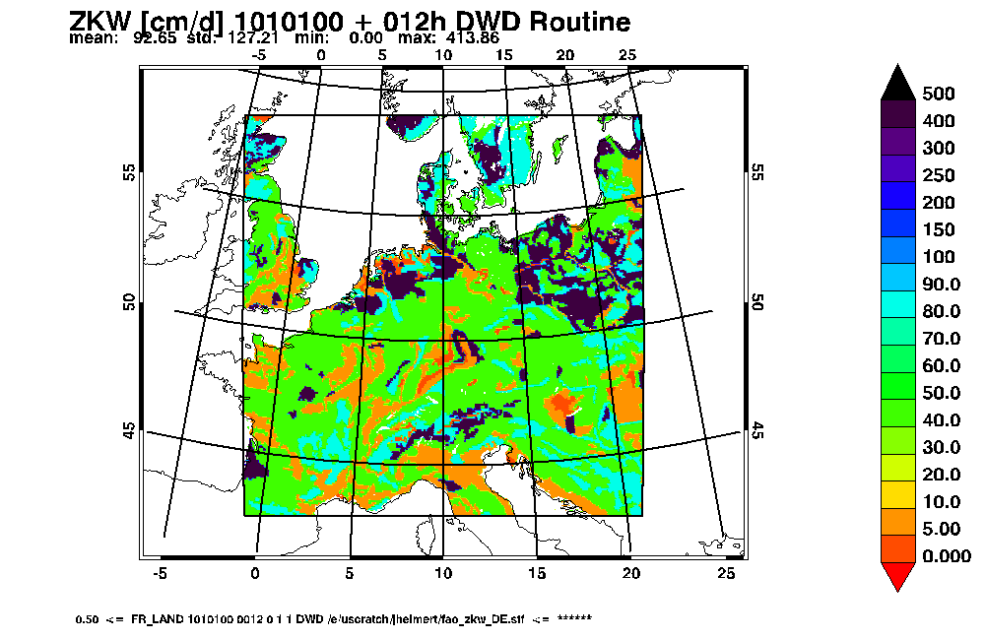
FAO – hydraul. conductivity
model resolution: 2.8 km

Slide 40
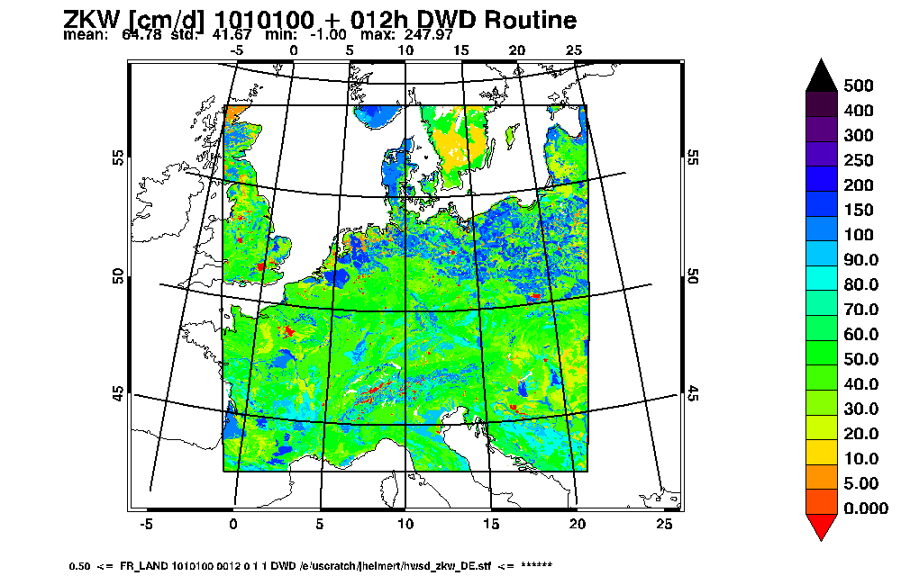
HWSD – hydraul. conductivity
model resolution: 2.8 km

