Slide 1
Verification summary

Slide 2
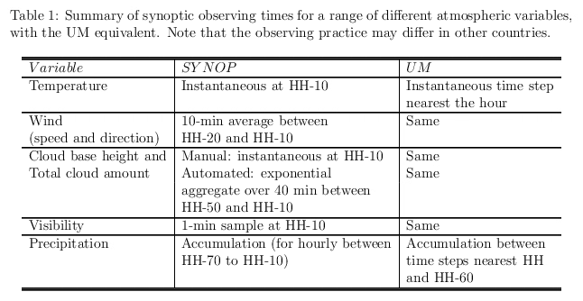
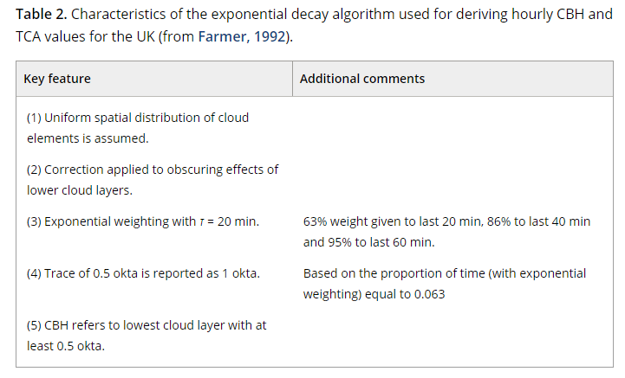
Observations
Exchanging how observations are made and prepared for exchange via GTS → could we document what we all do?
Common (homogeneous) datasets (e.g. remote/satellite-based) which facilitate intercomparison
Super-site observations for process-based understanding and intercomparison?
Observations QC including crowd-sourced obs. Role of DA in this.
From Mittermaier (2012, QJ)
Notes:
The tables on the right are taken taken from an internal document of mine and my QJ paper to indicate what is done to derive cloud obs from the ceilometers (Table 2) and how/what is exchanged via the GTS and what the model actually does, showing there is a time offset. This table did not make it into the paper I published with David Stephenson in 2015.
A critical assessment of surface cloud observations and their use for verifying cloud forecasts - Mittermaier - 2012 - Quarterly Journal of the Royal Meteorological Society - Wiley Online Library
Inherent Bounds on Forecast Accuracy due to Observation Uncertainty Caused by Temporal Sampling in: Monthly Weather Review Volume 143 Issue 10 (2015) (ametsoc.org)

Slide 3
Tools
So many interesting tools with many common features but also unique functionality.
There is no such thing as a single all-singing-all-dancing tool. One tool cannot do it all.
Could we agree to run/adopt each other’s tools or a subset? Is that even possible? Is this desirable?
How can we support model development in an optimal way?

