Slide 1

46th EWGLAM and 31th SRNWP Meeting
1 October 2024
ECMWF coupled land-atmosphere data assimilation
Patricia de Rosnay, David Fairbairn, Sébastien Garrigues, Christoph Herbert, Ewan Pinnington, Kirsti Salonen, Dinand Schepers, Pete Weston,
and many others

Slide 2
Coupled data assimilation: Why?
ECMWF Earth system approach --> Earth system data assimilation
Provide balanced initial conditions across the coupled forecast model components
Enhance consistency of assimilation approaches and find optimal level of coupling between the various components of the Earth system
Improve exploitation of satellite data sensitive to several Earth system components (interface observations) towards an “all surface” approach
2

Slide 3
Coupled DA developments at ECMWF: How?
Coupled trajectory
4D-Var
Atmosphere
NEMOVAR
Ocean/sea-ice
SEKF
Land
outer-loop cycling
Coupled trajectory
Laloyaux P. et al QJRMS 2016 → Proof of concept demonstration
Hersbach H. et al 2018 → SAC paper on future reanalysis
de Rosnay P. et al 2021 → SAC paper 2021 on coupled DA strategy
Browne P. et al 2024 → Eight years of development towards operational, input from IFS 45r1 to 50r1
More in de Rosnay, et al. 2022 Coupled data assimilation at ECMWF: current status, challenges and future developments. QJRMS, https://doi.org/10.1002/qj.4330
3

Slide 4
ECMWF Land Data Assimilation System (LDAS) – current status
satellite ASCAT SSM
satellite
SMOS SSM NN
in-situ T2m + RH2m
in-situ Snow Depth
satellite IMS Snow Cover
Observations
2D Optimal Interpolation T2m, RH2m
2D Optimal Interpolation Snow Depth
Assimilation
SEKF Jacobians based on the Ensemble Data Assimilation (EDA) spread
Simplified Extended KF SM1, SM2, SM3
1D Optimal Interpolation
Tsoil, Tsnow
Output
Analysed control vector:
(SM, ST, SnowD, Tsoil, Tsnow)

Slide 5
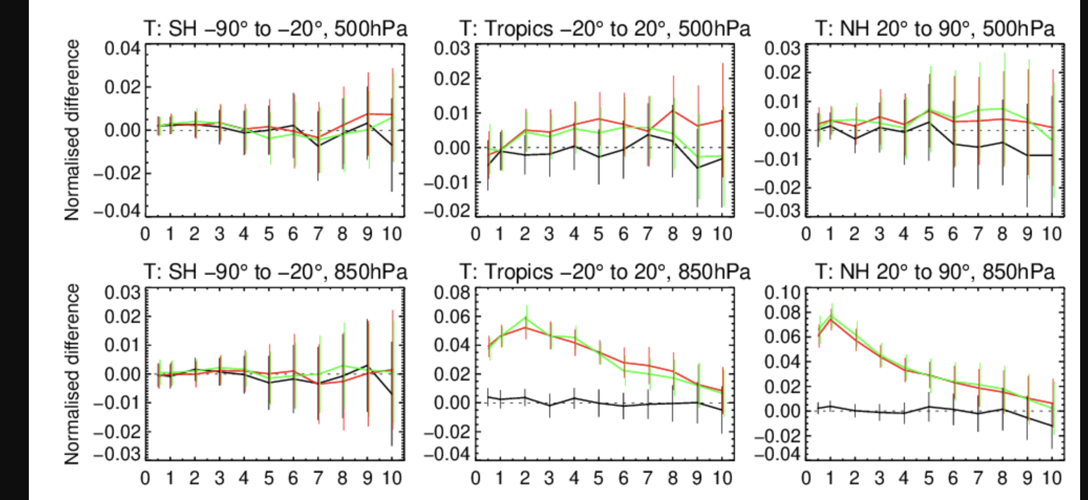
Soil analysis: impact on the atmospheric forecast
Temperature RMSE
JJA 2020
IFS cycle 48r1
☺
☹
☺
☹
Without soil moisture DA
Without soil moisture DA
With soil moisture DA
FC lead time
FC lead time
FC lead time
Significant positive impact of land DA on low level atmospheric temperature forecasts
5

Slide 6


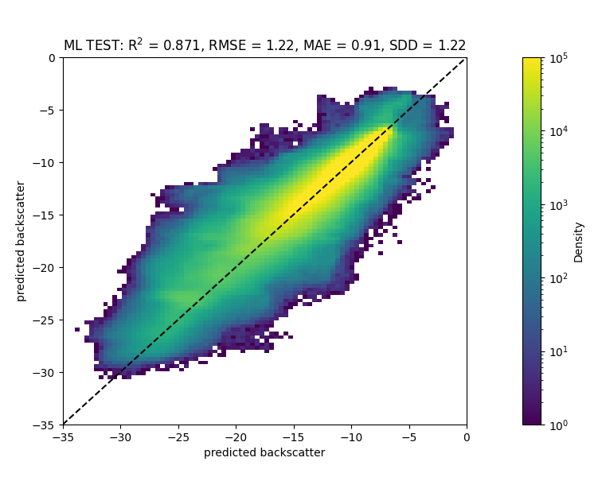
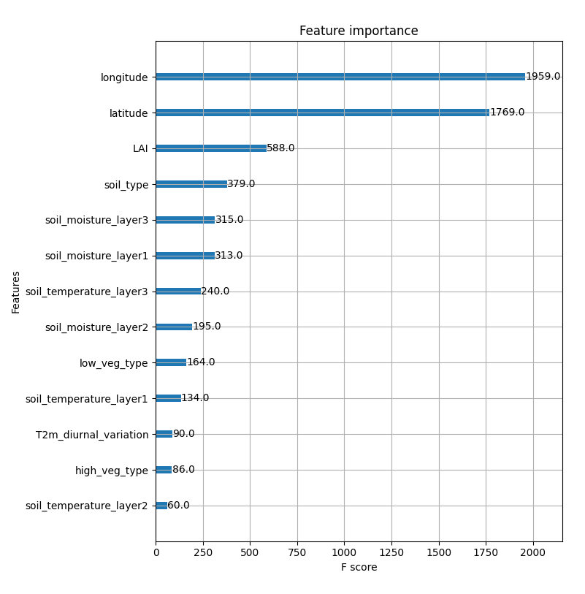
Passive and active MW observation operators
Enhance the exploitation of satellite observations in coupled land-atmosphere
assimilation to constrain vegetation water and carbon cycle variables.
Development of ML-based observation operators for MW and SIF observations
Information content analysis
ASCAT Observations
Sébastien Garrigues et al.
→ Prepares for future observations assimilation such as Metop-SG/SCA, Copernicus Expansion CO2 and CIMR missions, which are all relevant to consistently constrain vegetation and carbon fluxes in CO2MVS
NN model
→ Ongoing implementation in the IFS
The CORSO project (grant agreement No101082194) is funded by the European Union. Views and opinions expressed are however those of the author(s) only and do not necessarily reflect those of the European Union or the Commission. Neither the European Union nor the granting authority can be held responsible for them.

Slide 7

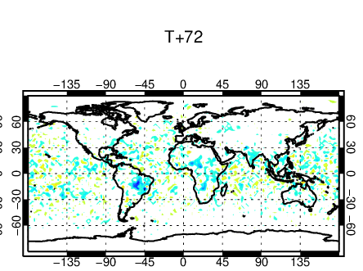

VOD assimilation→CoCO2 project
Assimilation of Vegetation Optical Depth (VOD) from passive microwave sensors to constrain vegetation water and carbon cycle variables.
- L-band VOD (1.41GHz) from SMOS
- C-band VOD (6.9GHz) and X-band VOD (10.65GHz) from AMSR2
T2m RMSE reduction (blue) 2018-2021
Positive impact of VOD assimilation on NWP
Challenges in terms of GPP impact
Pete Weston et al

Slide 8
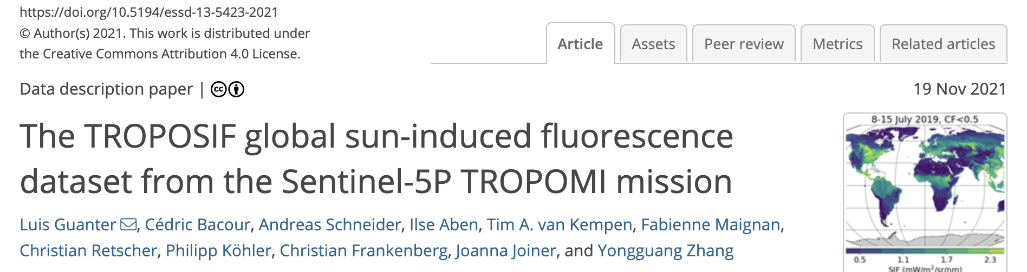

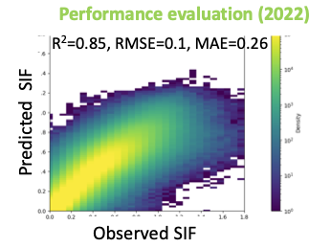
LAI analysis using Solar Induced Fluorescence (SIF)
Exploratory work to use SIF at ECMWF. Observation operator development
SIF: electromagnetic signal emitted by the chlorophyll of assimilating plants
part of the energy absorbed by chlorophyll a is not used for photosynthesis but emitted at longer wavelengths as a two-peak spectrum roughly covering the 650–850 nm spectral range.
Relevant to analyse vegetation LAI and Gross Primary Production
Sébastien Garrigues et al.

Slide 9
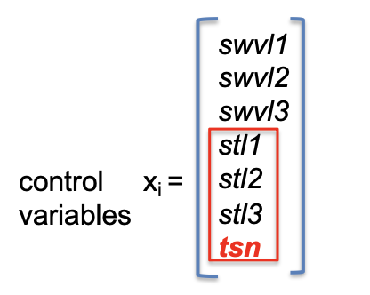

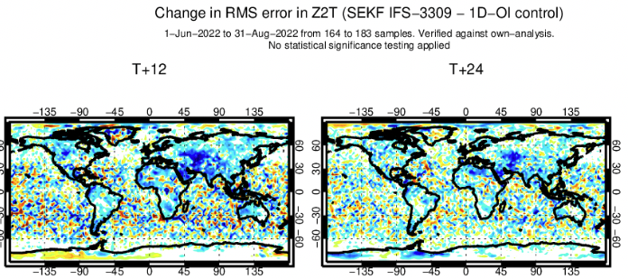

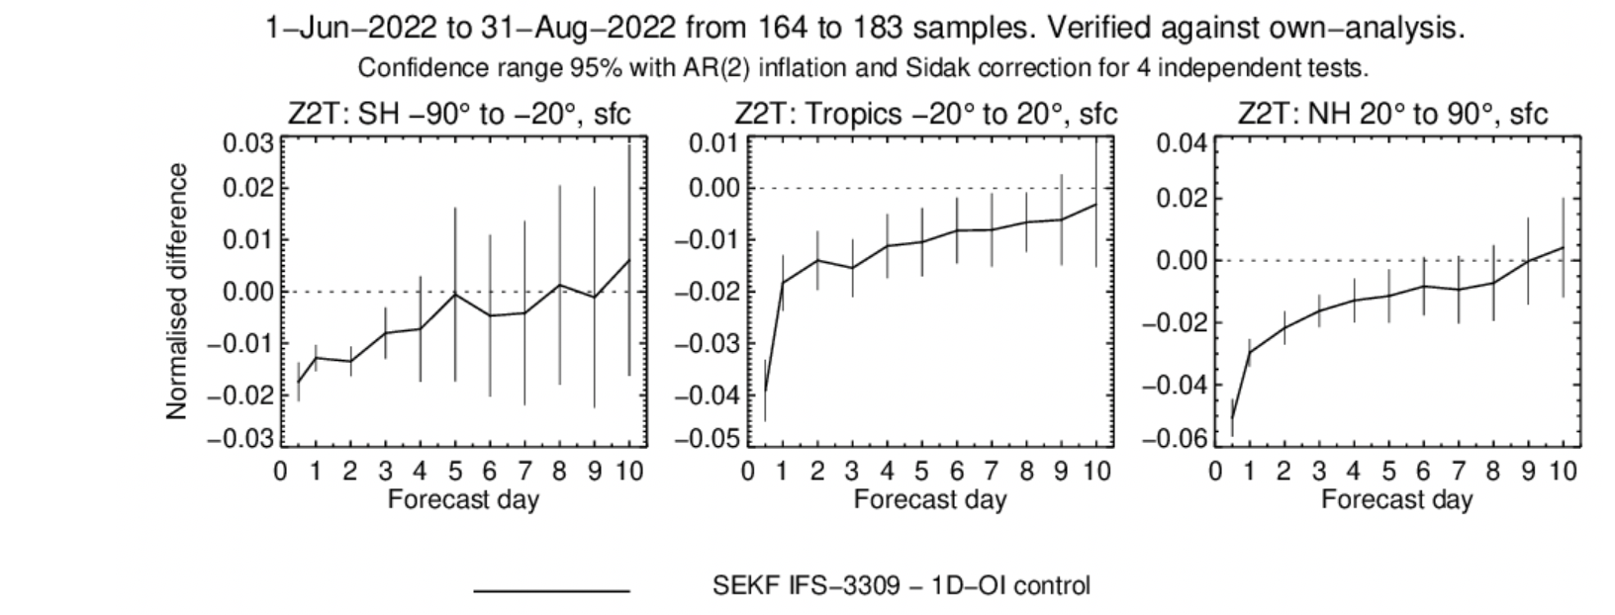
Soil and snow temperature analysis
Integration of the soil and snow temperature analysis in the SEKF, instead of using a 1D-OI approach
☹
☺
- Significant improvement in T2m analysis and forecasts
Steps towards unified LDAS
Will be used in ERA6 (IFS 49r2)
☹
☺
Christoph Herbert et al. QJRMS 2024
The CERISE project (grant agreement No101082139) is funded by the European Union. Views and opinions expressed are however those of the author(s) only and do not necessarily reflect those of the European Union or the Commission. Neither the European Union nor the granting authority can be held responsible for them.

Slide 10



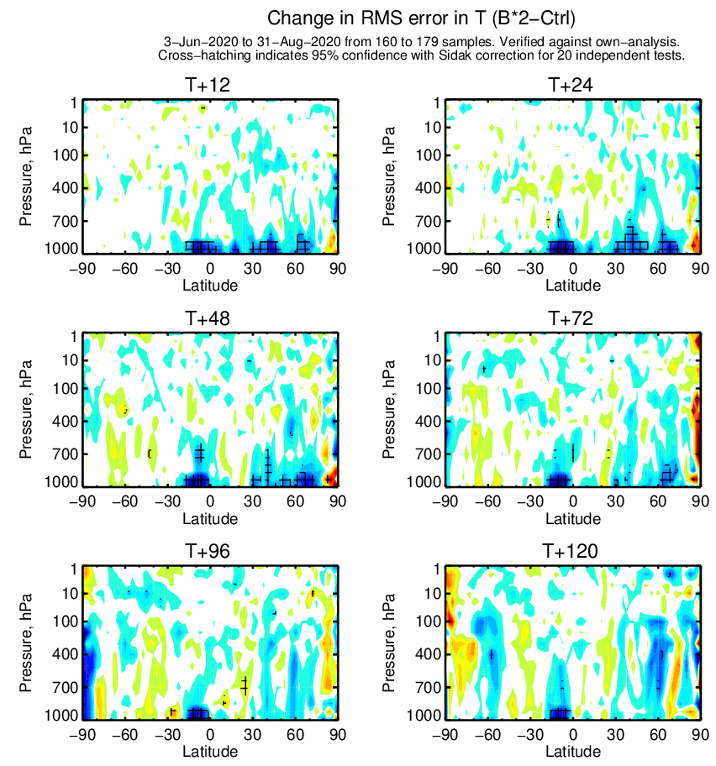
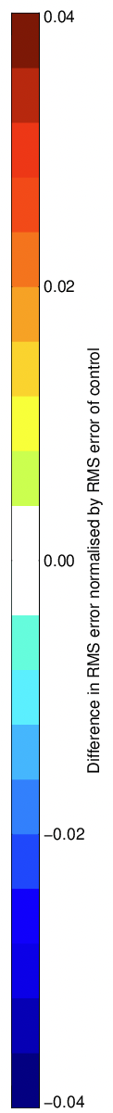
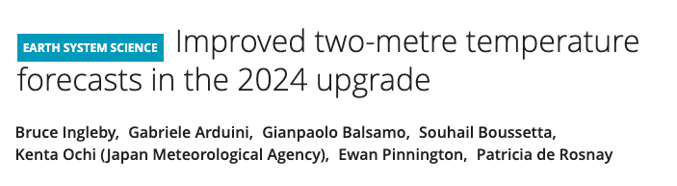
Ensembles for the Land Surface
Change in RMSE for Temperature (inflated B – CTRL)
Change in RMSE for Temperature (inflated B – CTRL)
Increasing the use of ensemble information in the Land Data Assimilation System (LDAS) on the CERISE project
In IFS CY49R1 update the specification of background errors in the LDAS to improve T2m scores
Newsletter article outlining changes: bit.ly/3zojysx
Potential to use more information on land variable spread in ECMWF’s LDAS…
Ewan Pinnington et al.

Slide 11
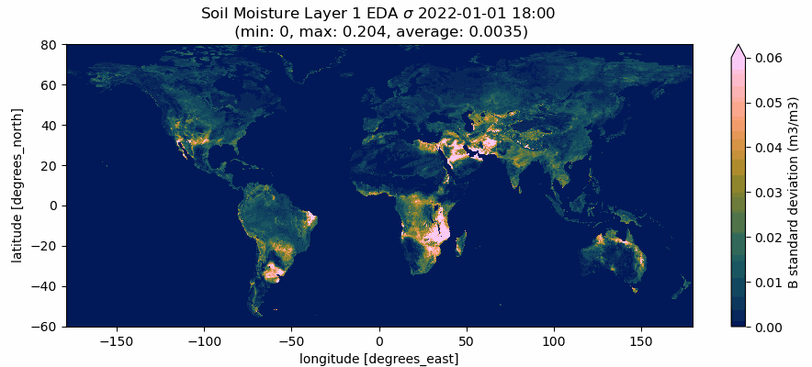
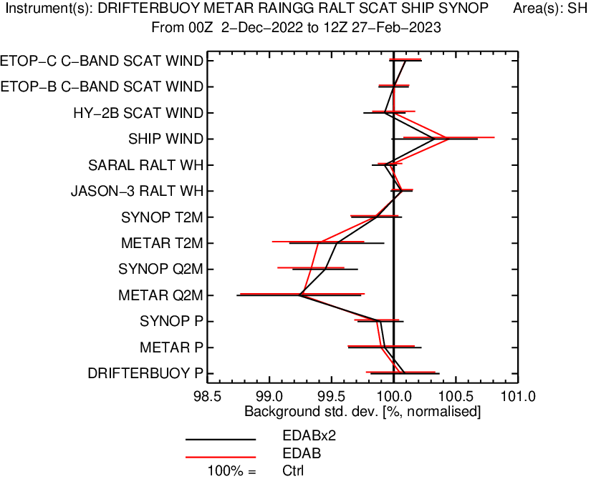
Ensembles for the Land Surface
Background errors remain static in LDAS, targeting the inclusion of flow-dependent B matrix in CY50R1(implementation 2025)
Spread in Ensemble of Data Assimilations (EDA) soil moisture up to 10x larger than current specified static Background error (0.02 m³ m⁻³)
Find improvement in surface temperature and humidity scores against observations when using flow-dependent B
Looking at ways to increase land surface variable spread in the EDA
😀
😩

Slide 12
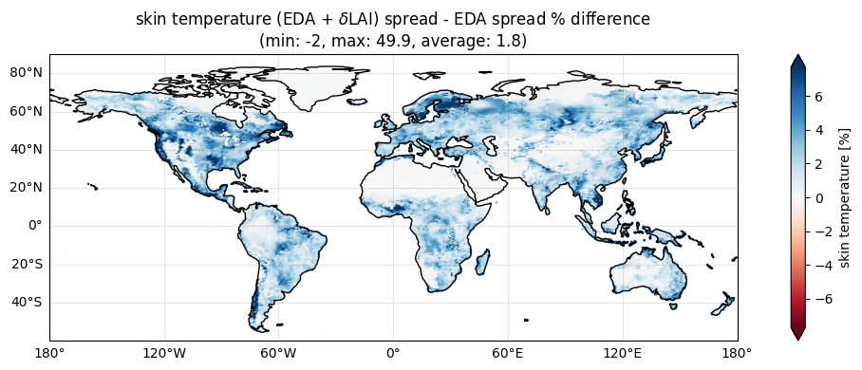
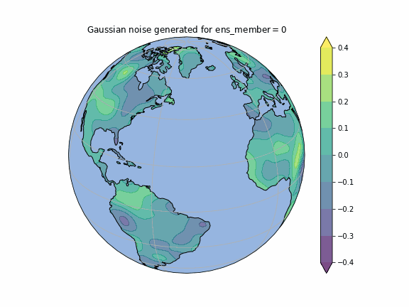
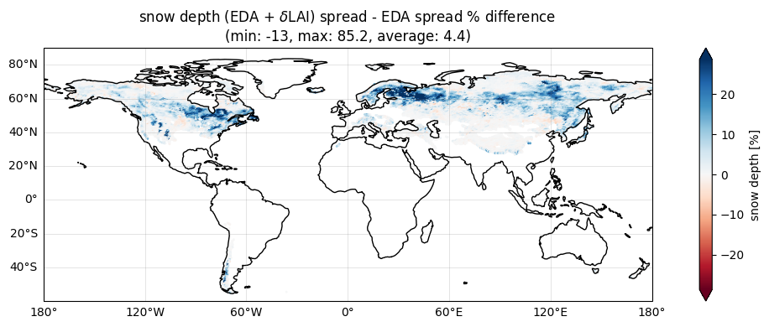
Land surface parameter perturbations
Stochastic Parameter Perturbation approach for Leaf Area Index (LAI) and vegetation fraction in the offline land DA system (following Draper et al., JHM 2021 https://doi.org/10.1175/JHM-D-21-0016.1)
Skin temperature
Snow depth
Perturbations generated with spatial
and temporal correlation length scale
Differences in spread between the EDA offline surface ensemble with and without perturbations.
Ewan Pinnington et al.

Slide 13
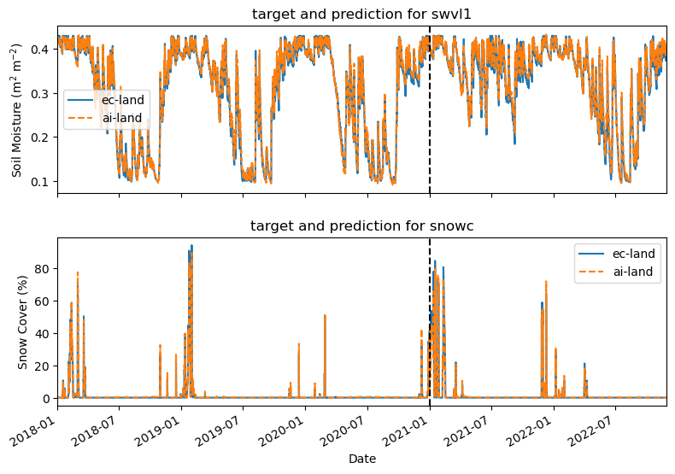
Emulating the land surface for Data Assimilation
Developing ML emulator of land surface model (ECLand), providing Jacobian and ensemble information at much reduced cost
500 milliseconds vs 20 mins for 1-month Global run 🚀
Next steps to test this in “offline” LDAS system for generation of Jacobians
Emulator more stable than expected, no sign of divergence even after multiple years
Ewan Pinnington et al.

Slide 14
Summary
Progressive implementation of coupled data assimilation across ECMWF systems for NWP, reanalyses, CAMS)
Modular coupled and uncoupled DA system → flexibility in coupling configuration
Towards a unified consistent ensemble-based land data assimilation in coupled IFS & offline ECLand
Flow dependant background errors
SPP key to represent near surface spread in coupled Ensemble DA
Integration of machine learning (observation operators and model emulator)
Importance of localisation in machine learning forward models
Potential to compute Jacobians
14

