Slide 1



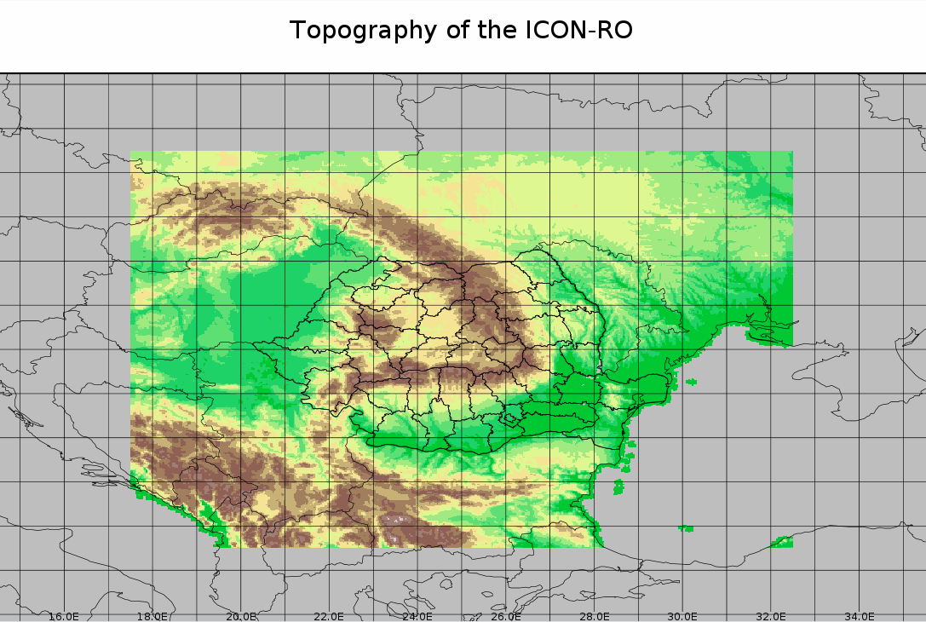
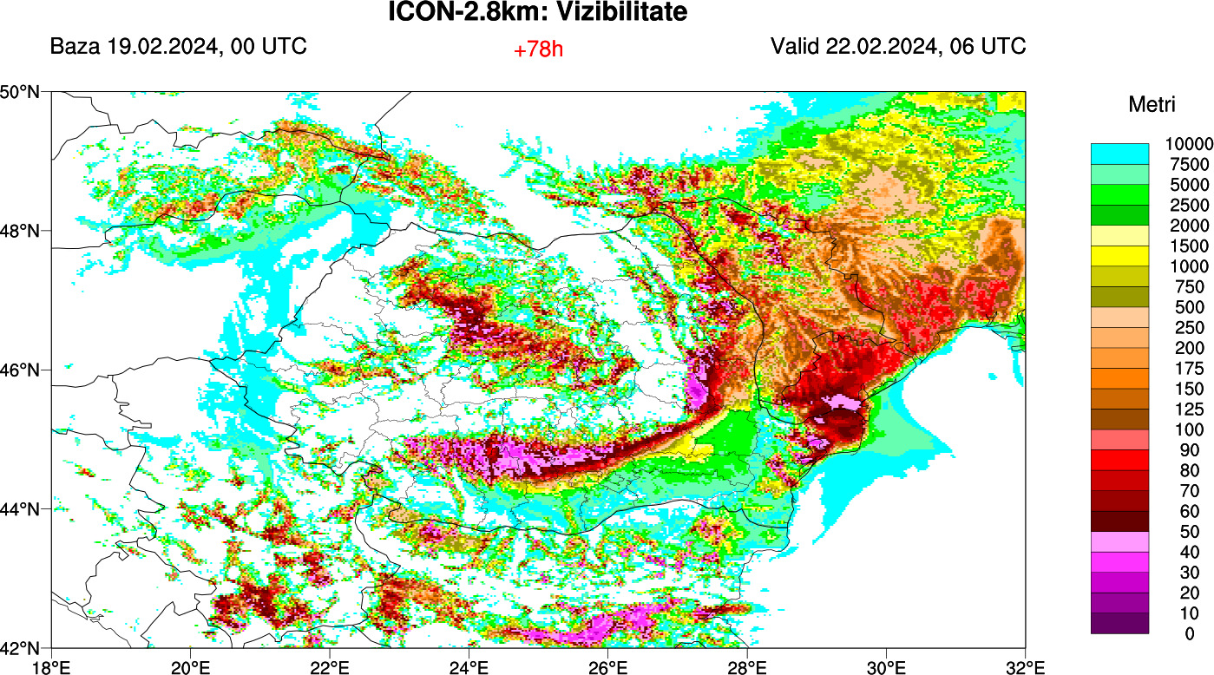
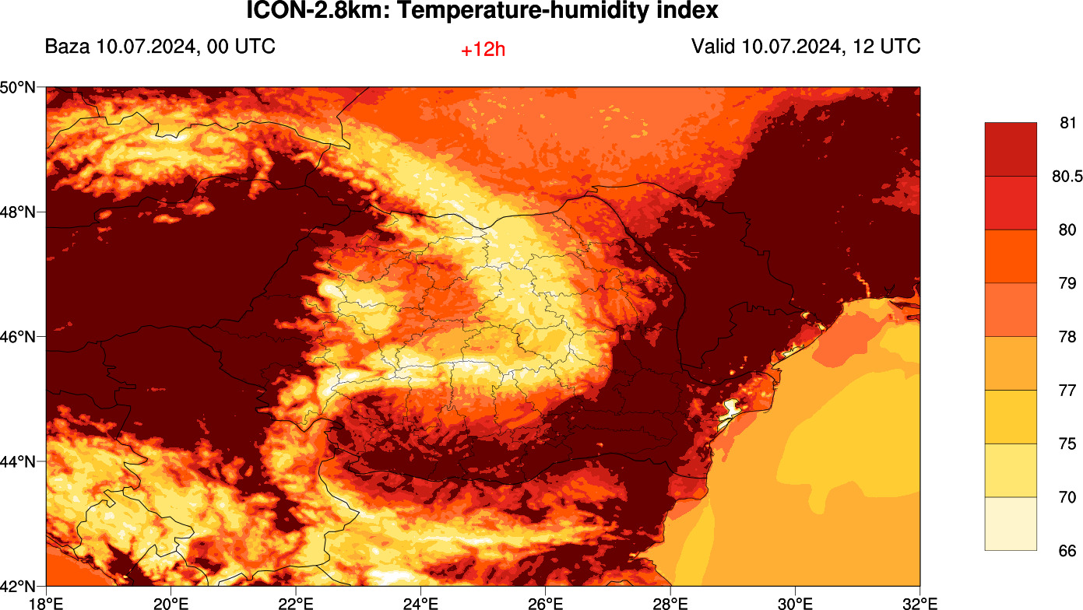
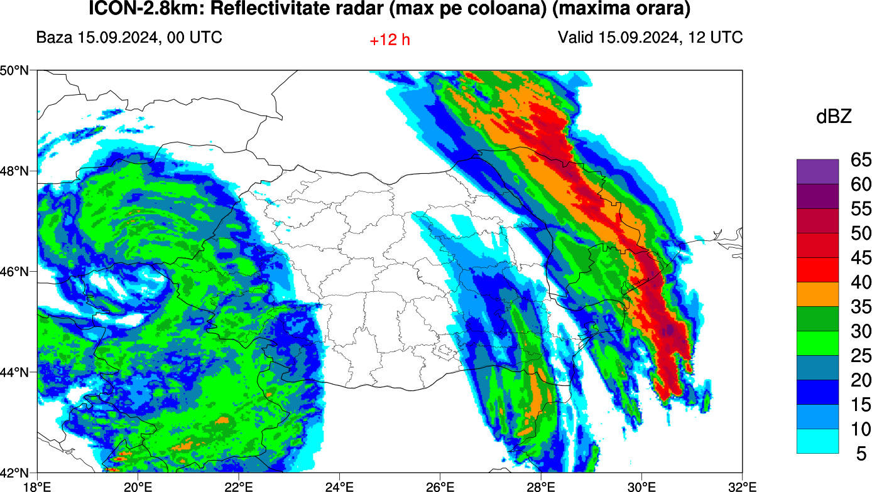
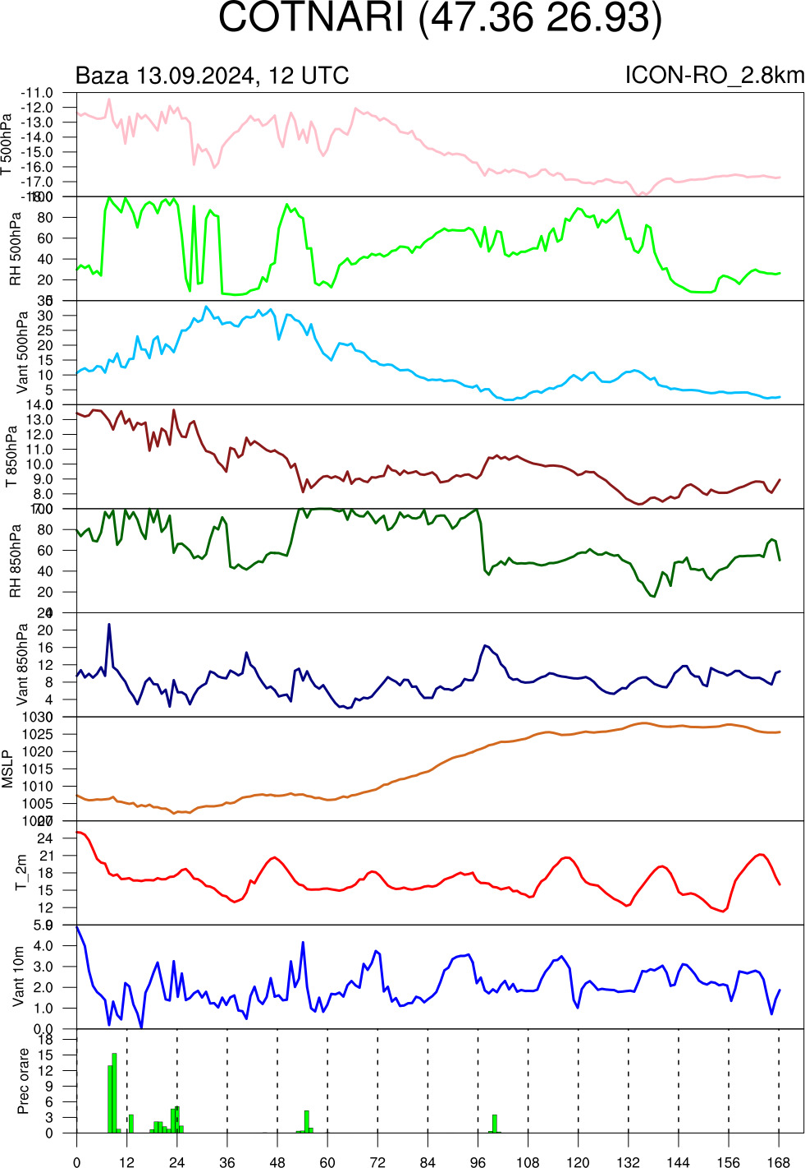
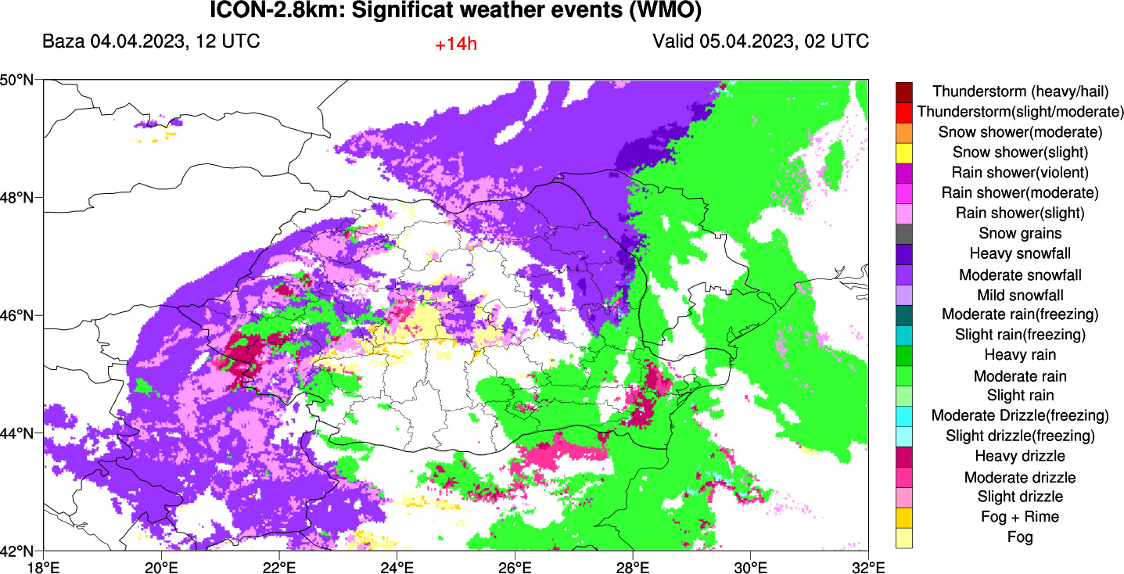
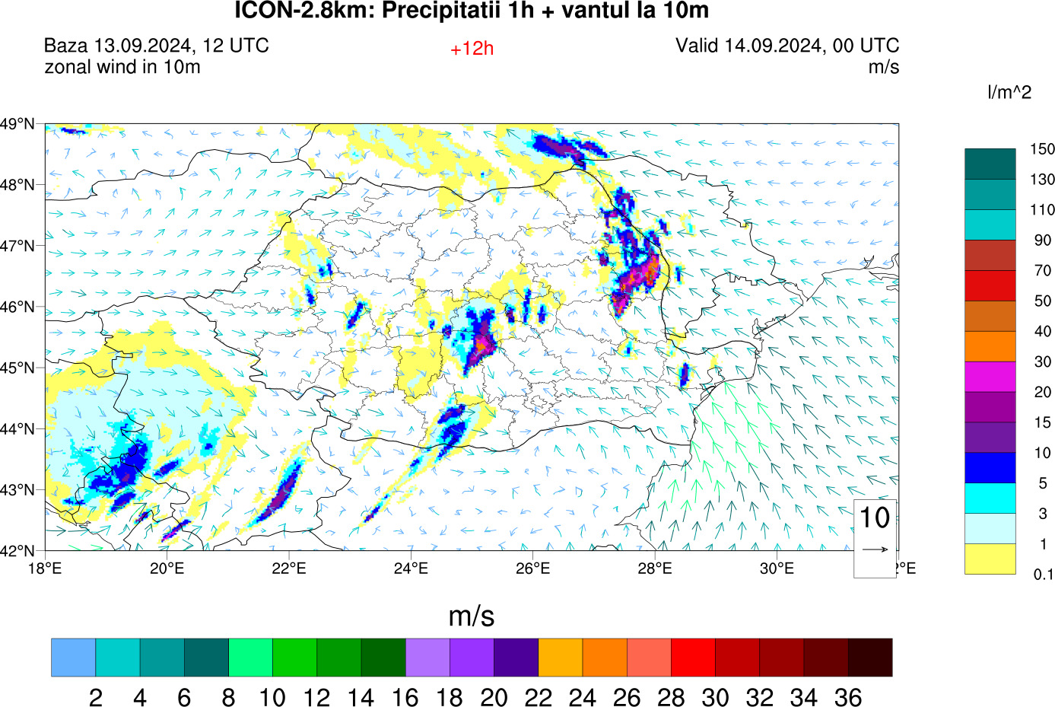
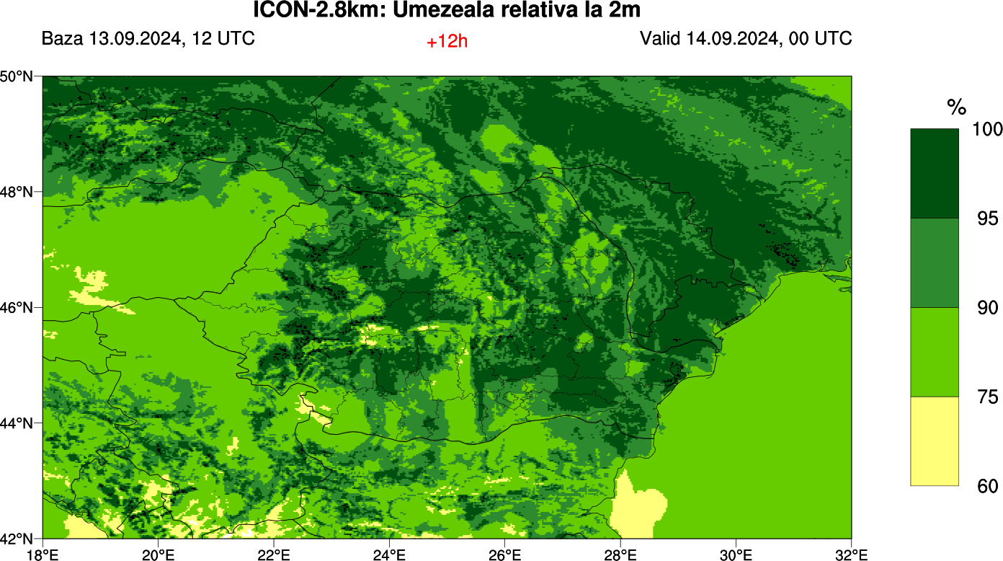
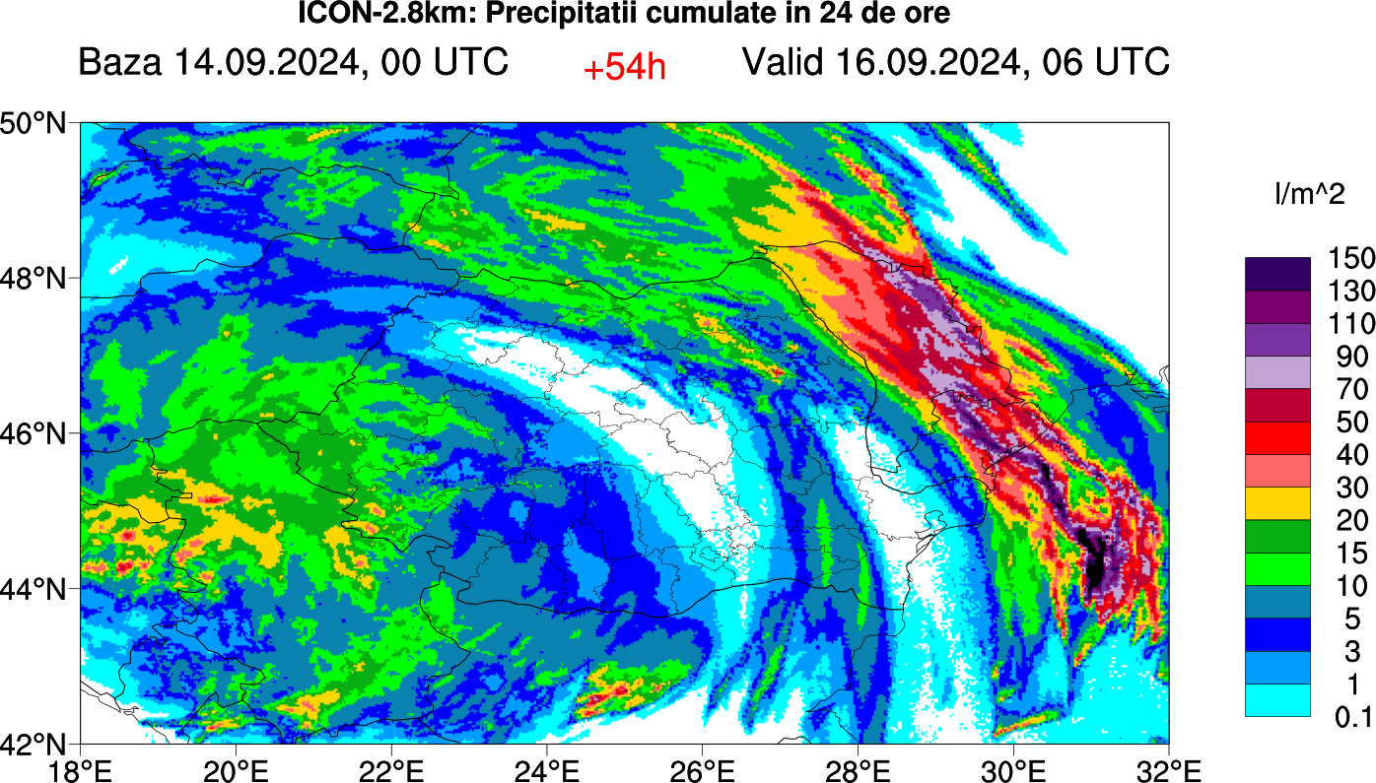
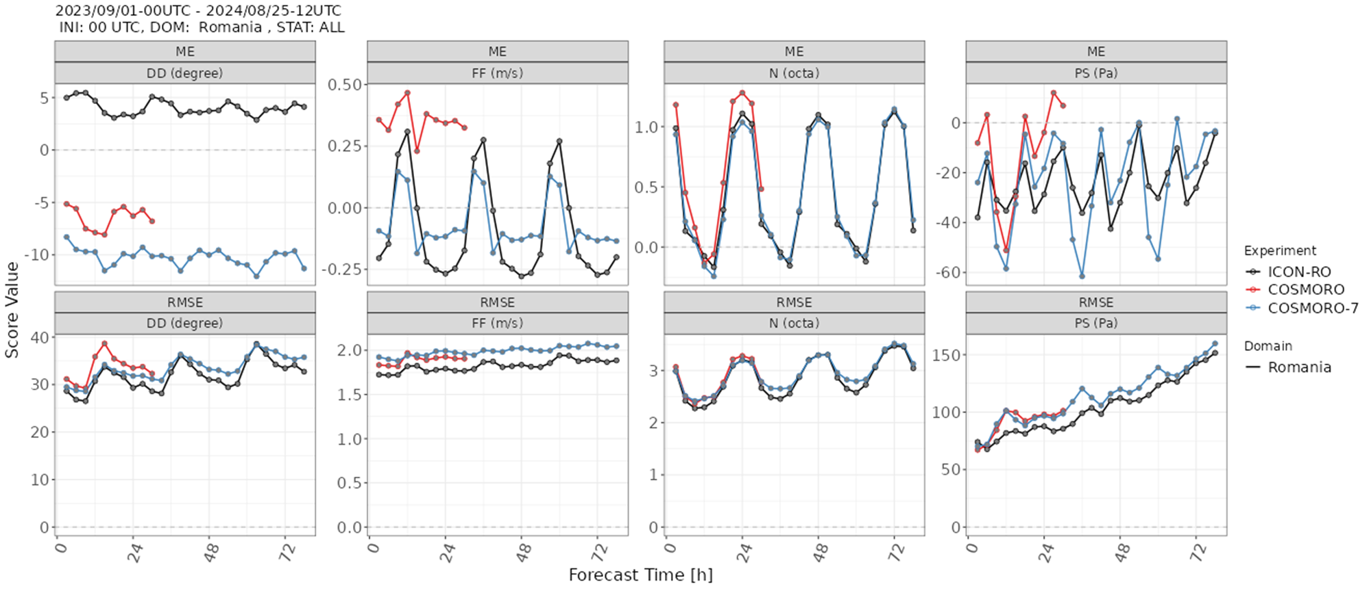
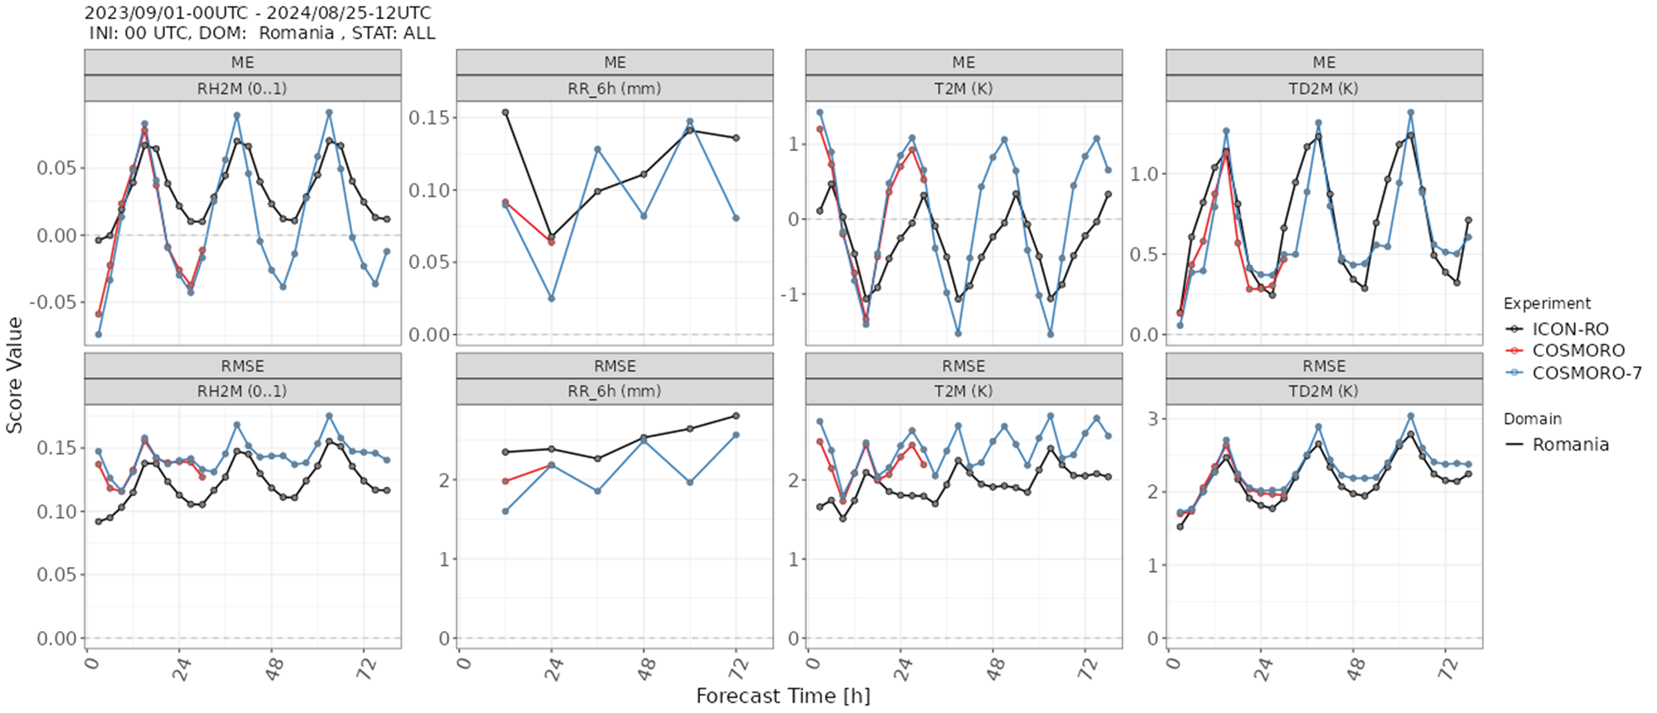
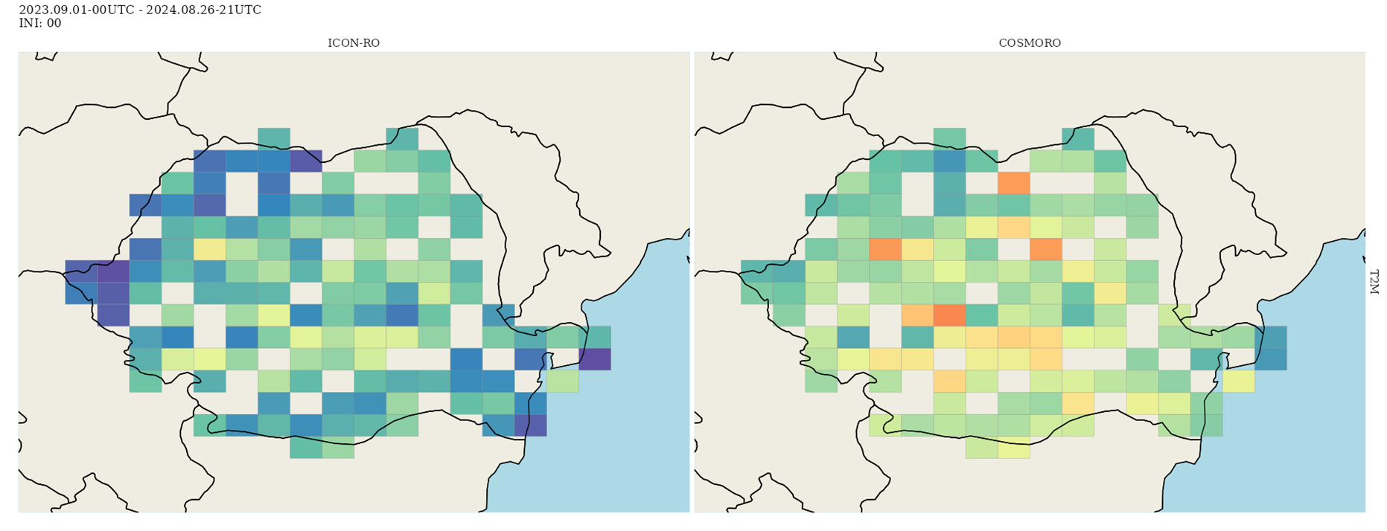
46th EWGLAM & 31th SRNWP 30 Sep - 3 Oct 2024, Prague, Czech Republic
Meteo Romania
Numerical Weather Prediction using ICON-LAM-2.8km for Romanian territory
Stefan Dinicilă, Mihaela Bogdan, Ioan-Stefan Gabrian
stefan.dinicila@meteoromania.ro
ICON-LAM-2.8km Operational Suite
-ICON RO -2.8km operational suits -Verification results -Testing dedicated products for forecaster
Operational characteristics
Microphysics – COSMO 1 moment scheme
convection scheme: Shallow Convection (tuned for the Romanian territory);
radiation scheme – ecRad solved on a reduced grid
turbulence parameterization which calculates the transport coefficients for momentum and heat in the atmosphere and the transfer coefficients at the ground;
multi-layer soil model TERRA ML;
Two-time-level predictor-corrector time stepping scheme
Testing dedicated products for forecaster
Operational domains
ICON-LAM-2.8km
Operational version 2.6.6
x= 2.8km ; 147260 grid points, 65 levels, t=24s
IC & LBC: ICON (grib2), every 3h
No data assimilations
Forecast range: 00 UTC 174h and 12 UTC 78h)
Operational suite for 2 runs/day
Output: Netcdf, Grib2/regular grid
ICON-LAM-2.8km - Visibity
Temperature and humidity
ICON-LAM-2.8km - Radar Reflectivity
Significant weather events (WMO)
Meteograms
Operational products
Temperature 2m,
Total, convective, grid scale precipitation
Radar reflectivity,
2m Relative Humidity, 10m wind speed
Significant weather events
Meteograms
Hourly Precipitation and wind speed 10 m
2 m relative humidity
Precipitation – 24h
VERIFICATION RESULTS
Continuous parameters annual verification by station
Continuous parameter annual verification
The verification was performed using the verification suite MEC/FFV2
NMA database of synoptic observations, including all 168 stations
Feedback Files are produced automatically from both MARS and NMA observations
Notes:
1
1

