Slide 1

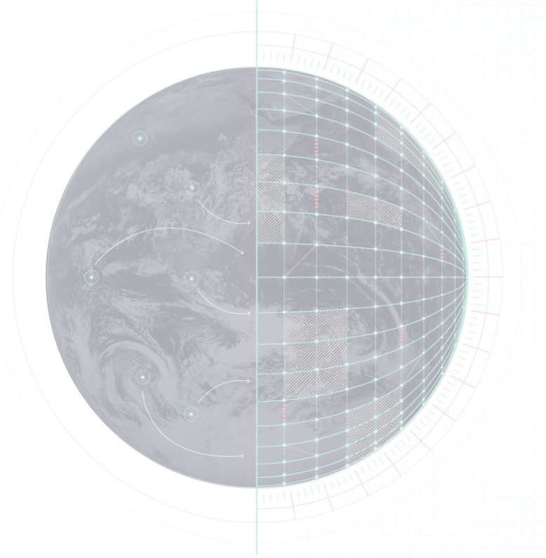
On-Demand Extremes Digital Twin
Roger Randriamampianina
on behalf of the Extremes DT Teams at ECMWF and in DE330

Slide 2

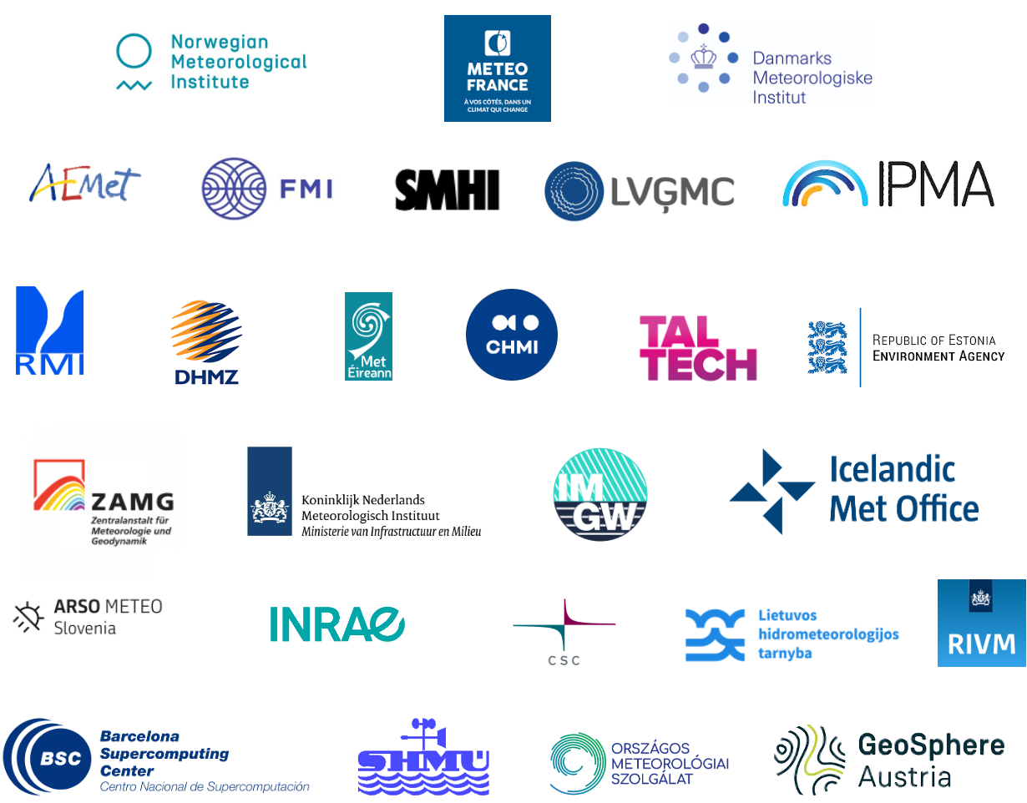

GOALS
Build a configurable capability to model past, present, and future extreme events with unprecedented detail and explore What-If scenarios
Leverage EuroHPC supercomputing
Two components
  🌐 Global → High-resolution simulations at km-scale
  🇪🇺 Regional / On-demand → Regional focus over Europe at sub-km scale
Provide actionable insights to national authorities for better preparedness, complementing the existing tools and services

Slide 3
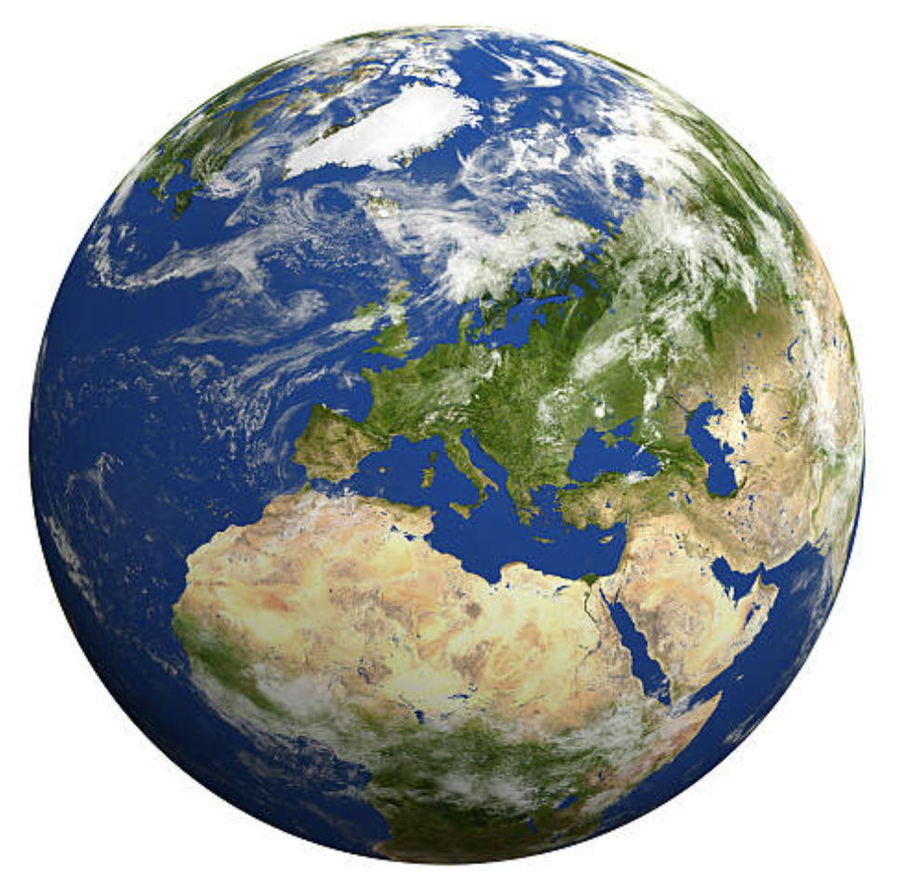
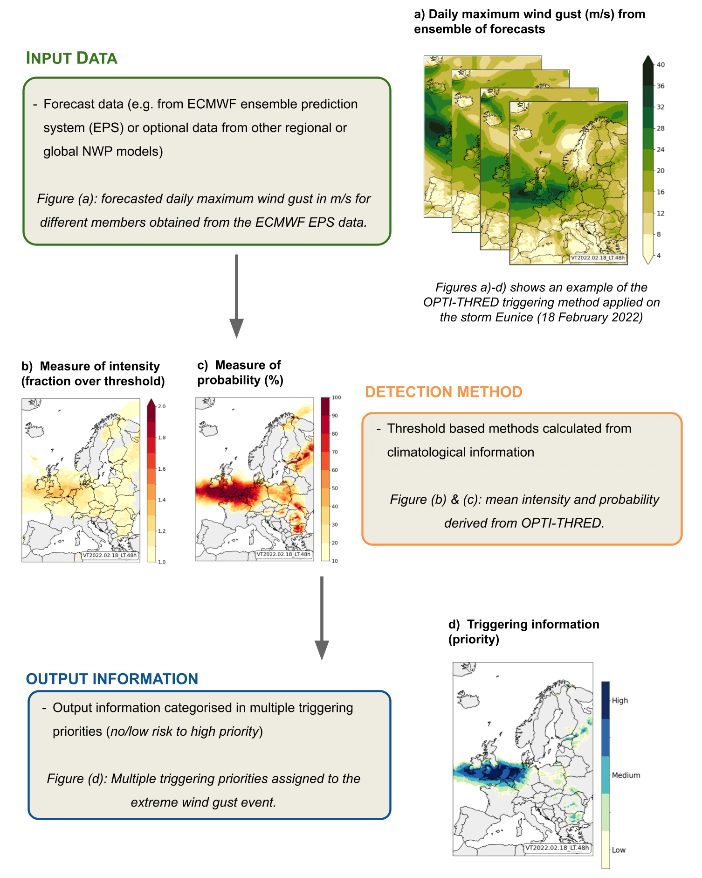
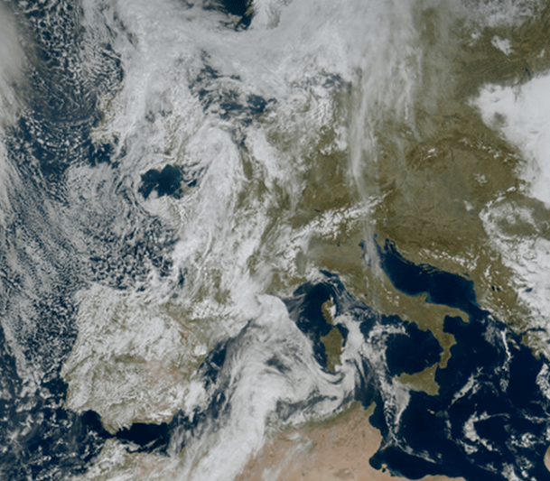
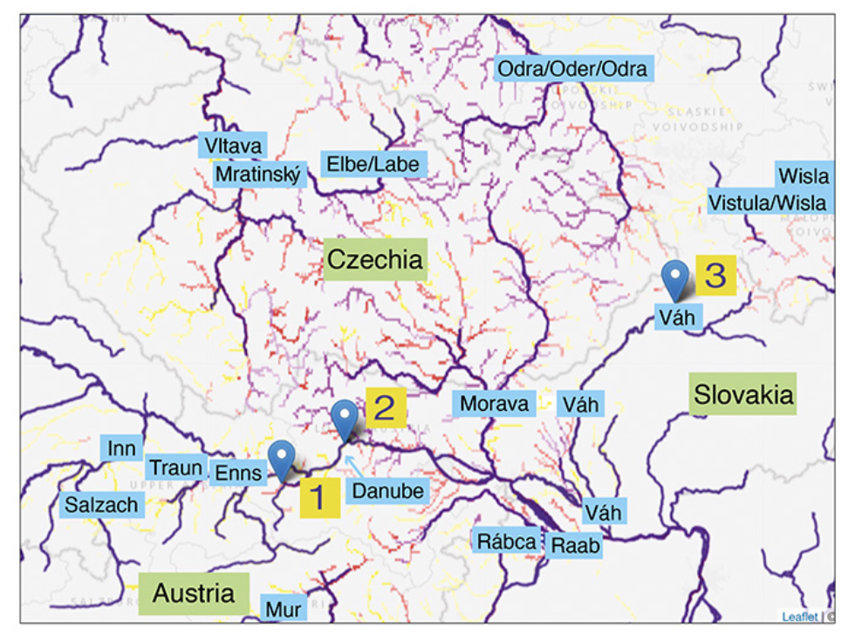

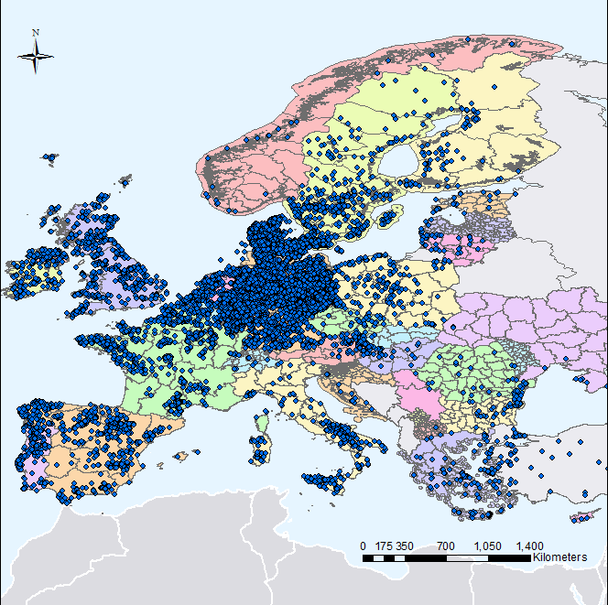

EXTREMES DT : A MAGNIFYING GLASS ON EXTREME WEATHER EVENTS
4
1
2
3
4
Global simulations
IFS-NEMO
Initialized daily
4 days ahead
Resolution: 4.4 km
Detection/Configuration
IFS ensemble (9km)
Detection of extreme weather (intensity and likelihood)
Wind, precipitation, CAPE, surge…
Regional simulations
ALARO, AROME, HARMONIE-AROME
On-demand
Flexible domain
2 days ahead
Resolution: 750-500m
Impact sector models
Floods, renewable energy, air quality, storm surge, thermal comfort, fires
User-relevant information
Arome
Harmonie-Arome
Alaro
Arome
Harmonie-Arome
Alaro
Detection / Triggering
Detection / Triggering

Slide 4
HIGHLIGHTS

Slide 5
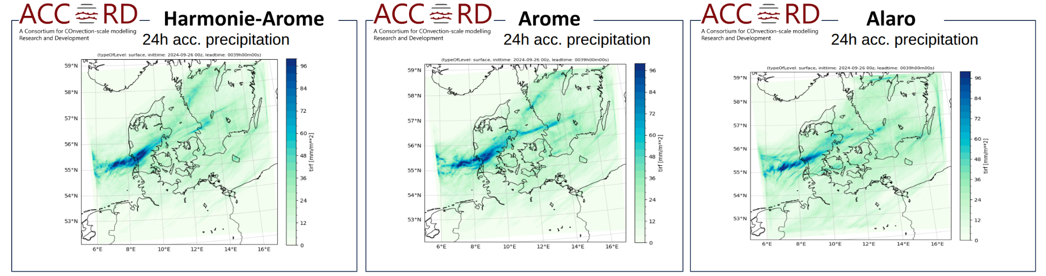
REGIONAL DT : ACCORD MODELS UPGRADE
Model upgrade through three cycles — CY46, CY48, CY49.
  CY49 allows all ACCORD models running with single executable and SURFEX surface model.
  HARMONIE-AROME and AROME run with single precision.
GPU adaptation ALARO model run fully (no diagnostics) under GPUs
High-resolution physiography : implementation of both land-cover fractions and urban parameters.
Esbjerg/Vejle flooding 27 Sept. 2024

Slide 6
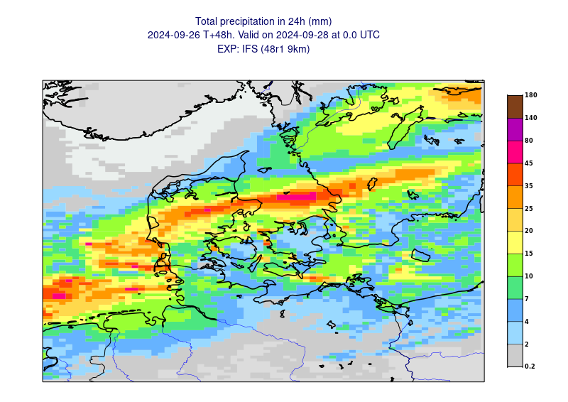
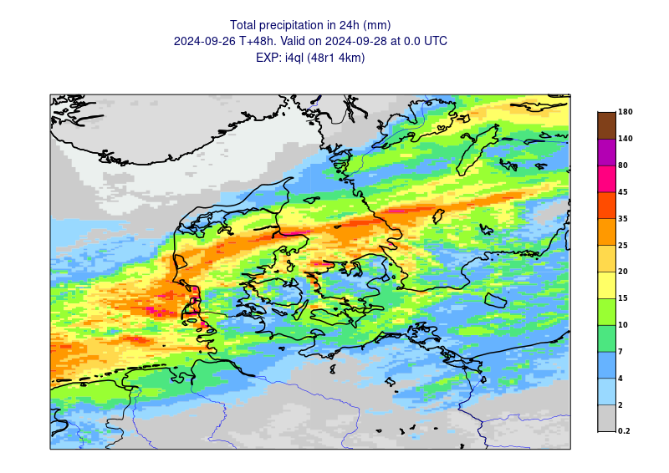
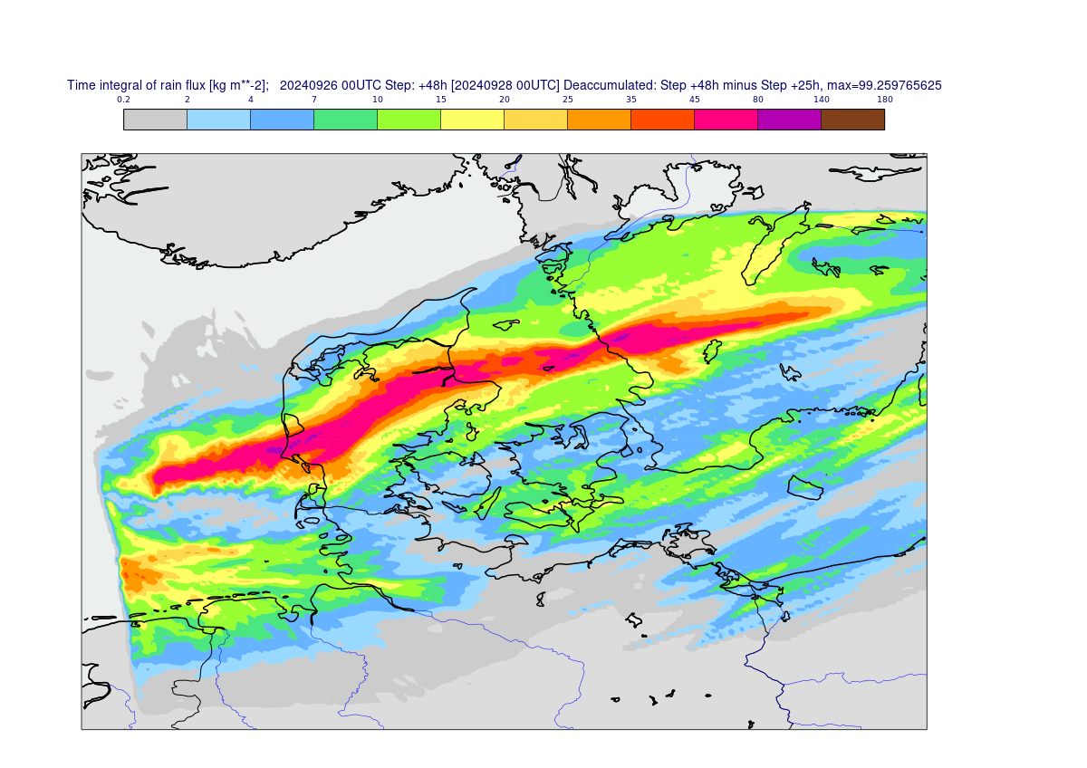
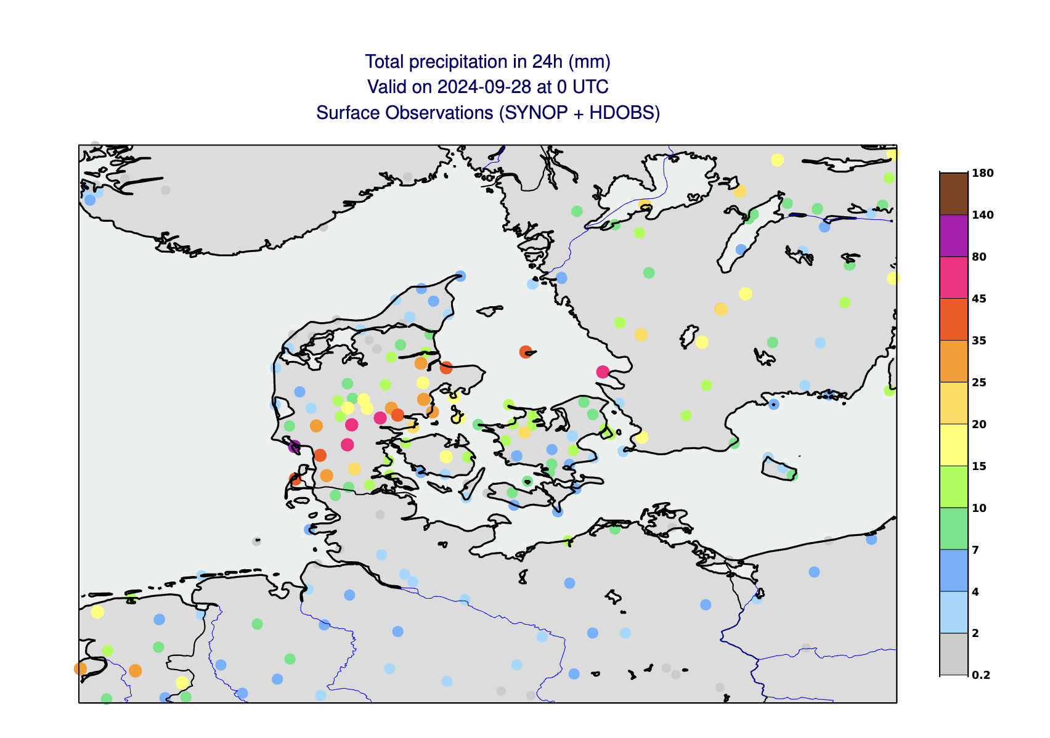
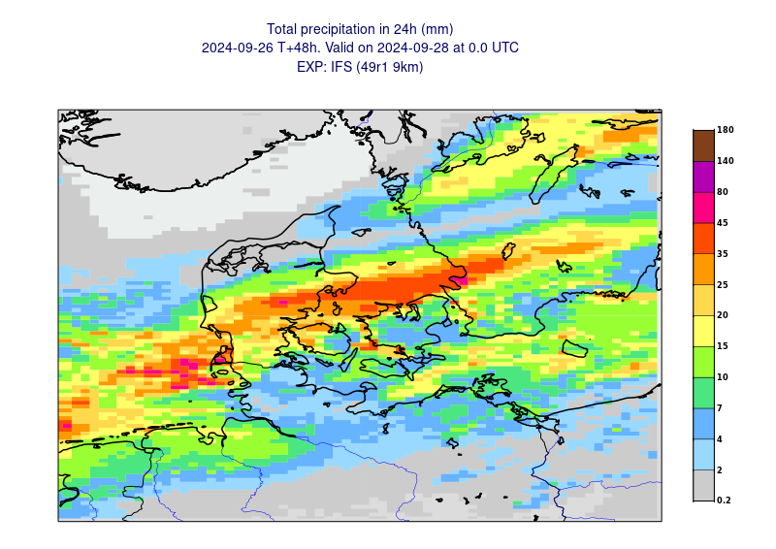
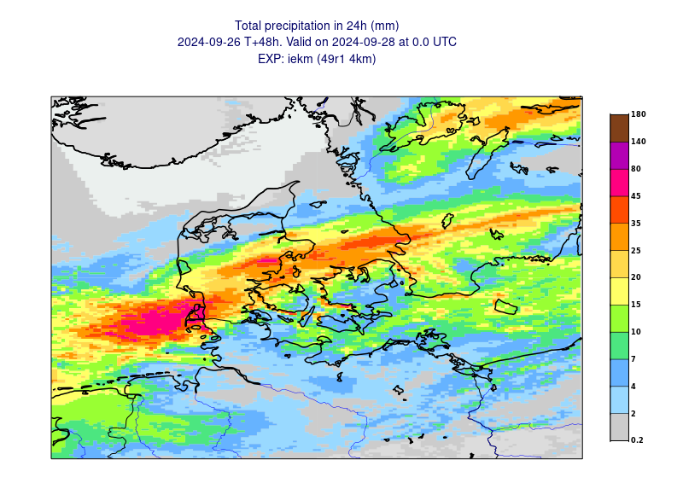
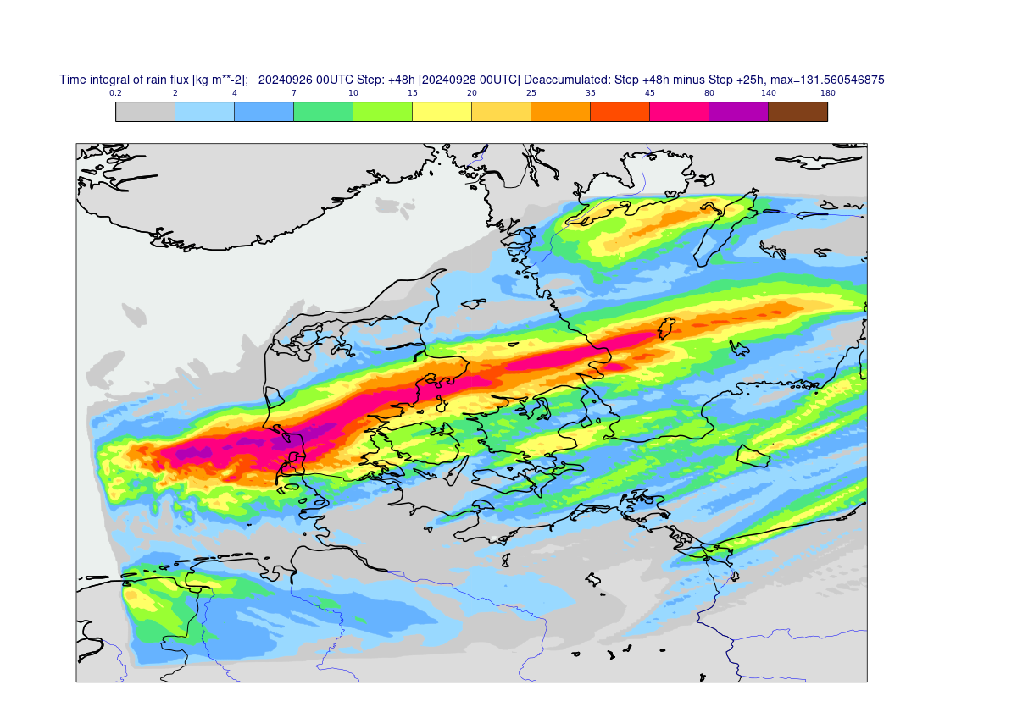
GLOBAL & HECTOMETRIC SCALE MODELS
IFS 9km
Global DT
DEODE 500m
OBS
48r1
49r1
Sept 27 2024

Slide 7
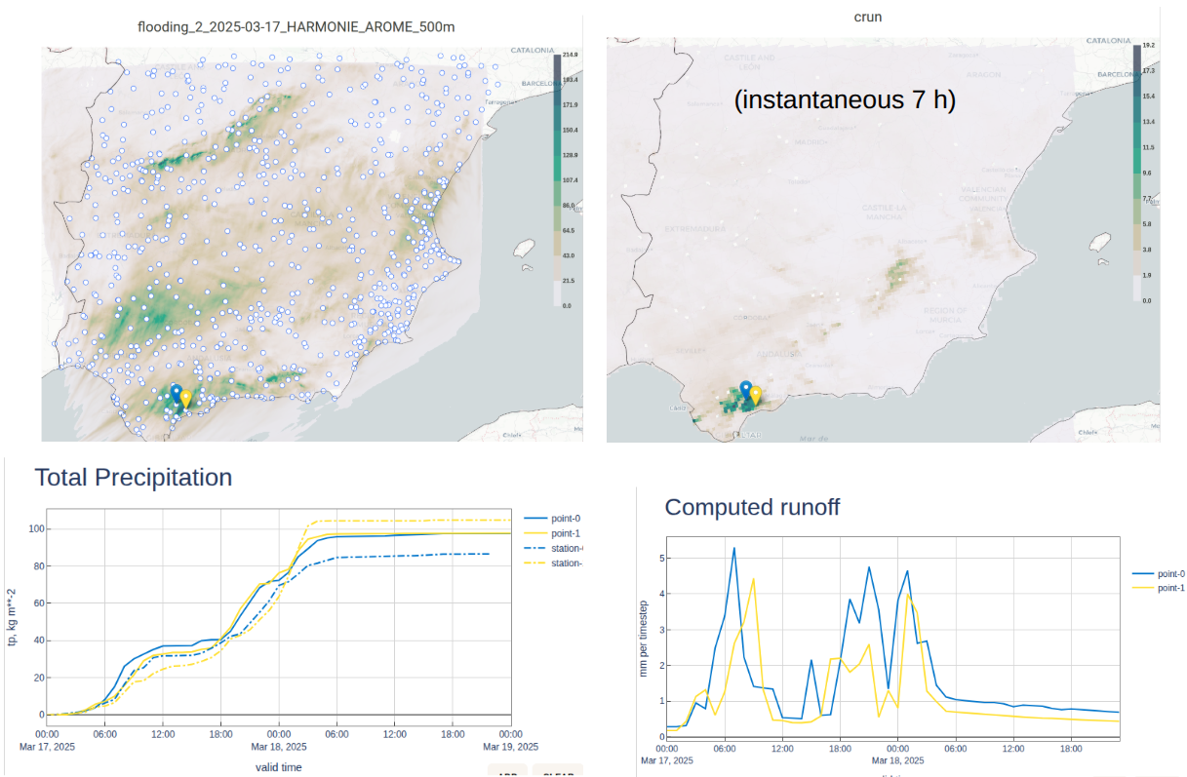
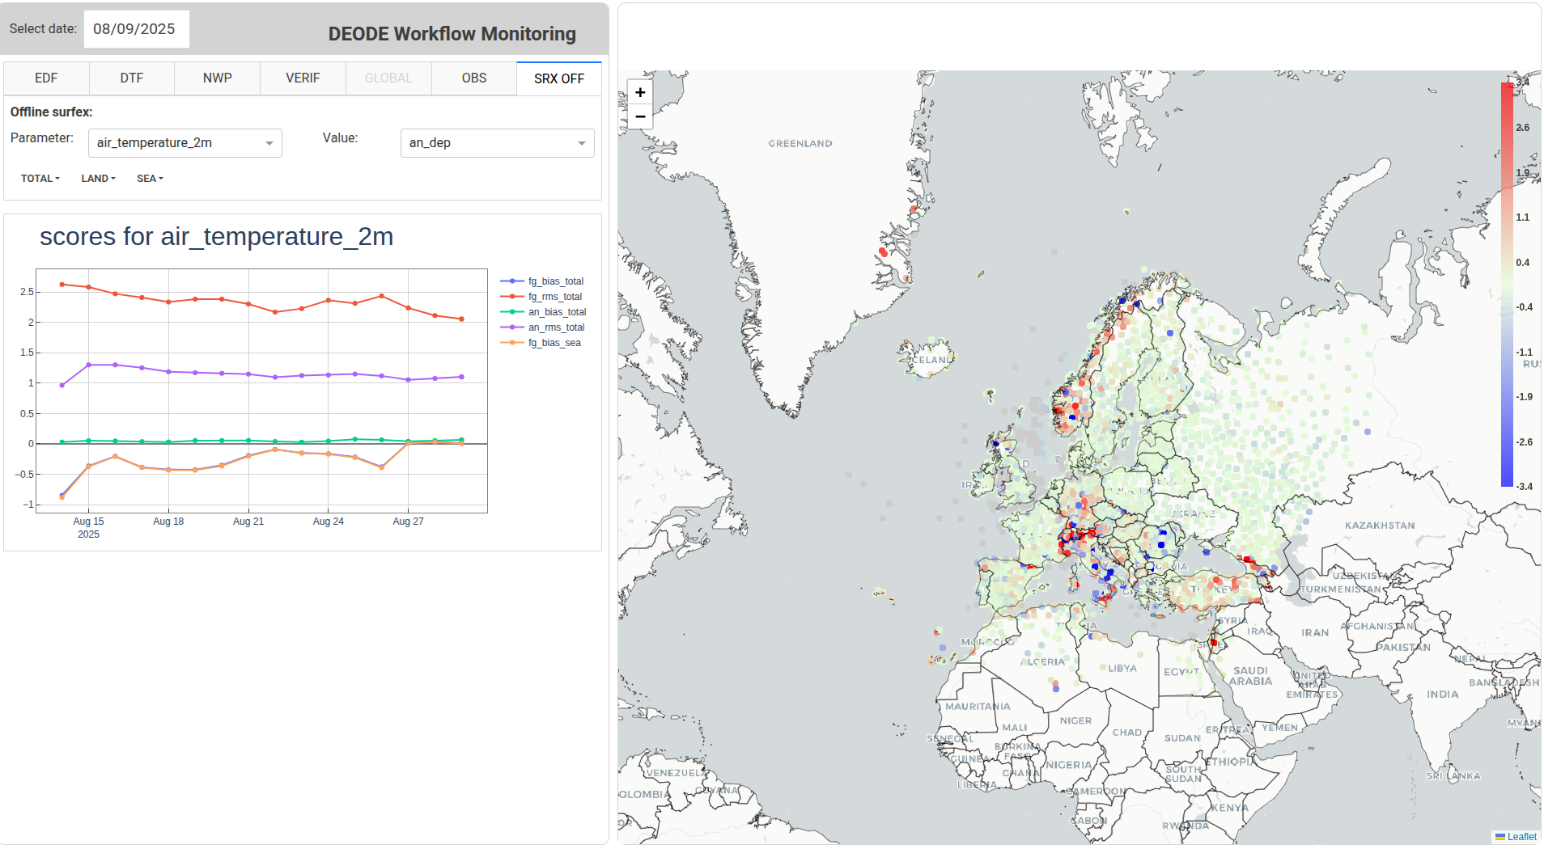
REGIONAL DT WORKFLOW ON ATOS
Automated Extreme Event Detection / Triggering → for meteorological extremes (OPTI-THRED), storm surges
(HIDRA2) running daily
Flood Modelling → Pan-European E-HYPE hydrological model activated for all high precipitation events
Enhanced Surface Predictions → Off-line SURFEX implementation to improve near-surface environmental fields
Operationalization → workflow runs daily on ECMWF ATOS, tested on EuroHPC LUMI, with first test datasets
available via Polytope on the Data Bridge
Data quality evaluation → Using high-resolution observations
Off-line SURFEX: First-guess and analyses departures stats for T2m
E-HYPE: 17 March, 2025, a flood case over Spain

Slide 8
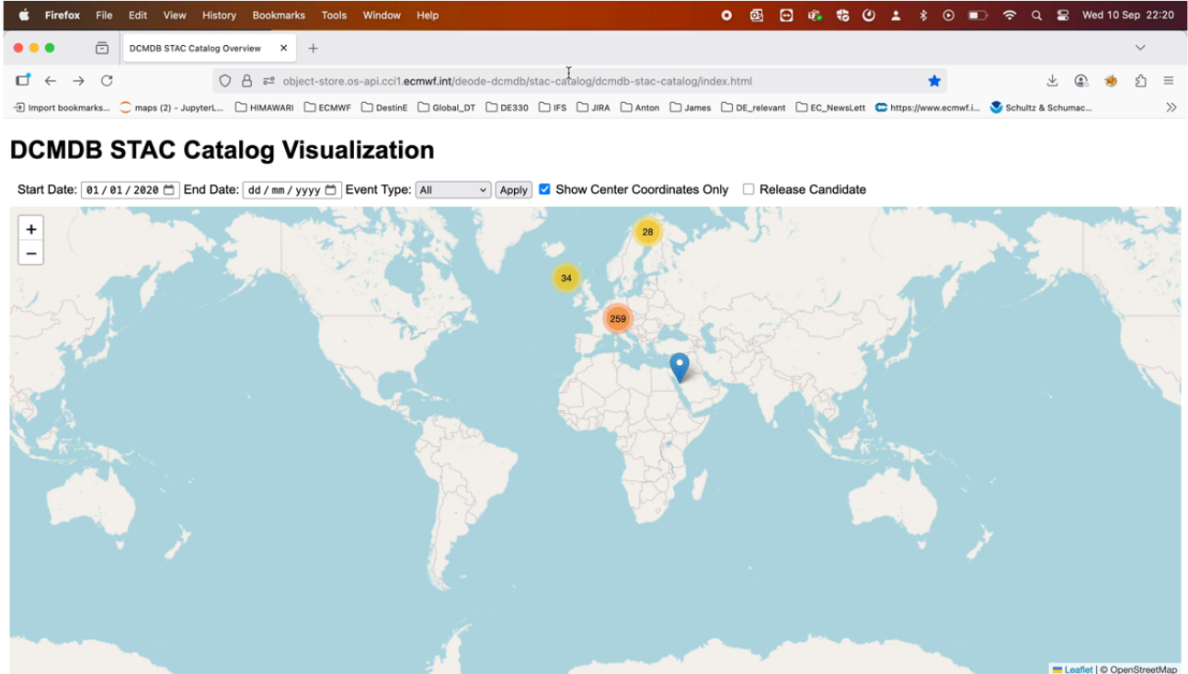
STAC CATALOG VISUALIZATION
Operationalization : more than 600 events in the archive and 480 in the catalog!
Support decision-making : event organization (Ski World Championship 2025), agriculture (frost for apricots)

Slide 9
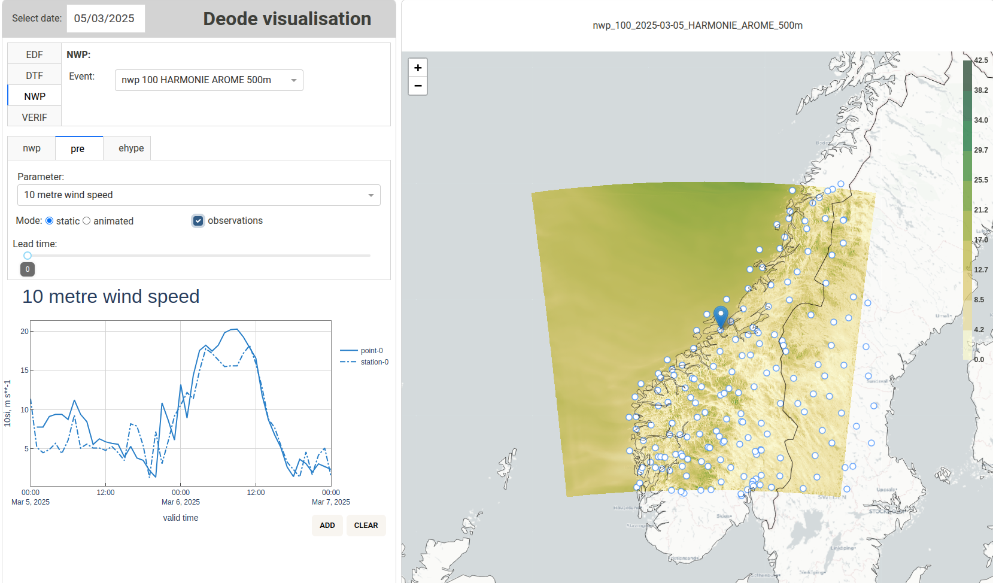
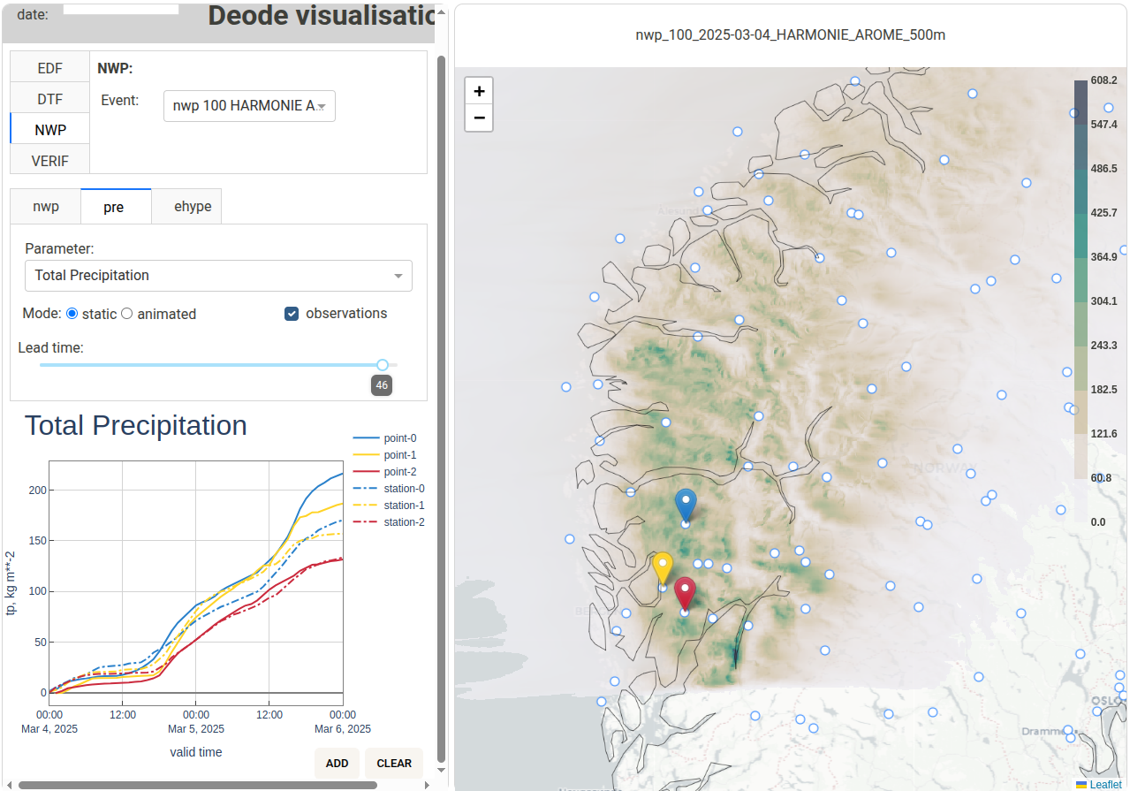
ADDITIONAL INFORMATION TO NATIONAL SERVICES/AUTHORITIES
Supporting FIS Nordic World Ski Championships
26 / 02 to 09 / 03 / 2025
Right wind speed 24h ahead
Extreme precipitation
05 / 03 /2025
Notes:
Points to make :
- point wise verification
-

Slide 10
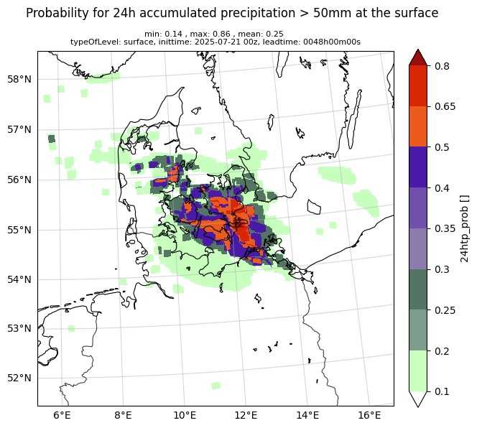
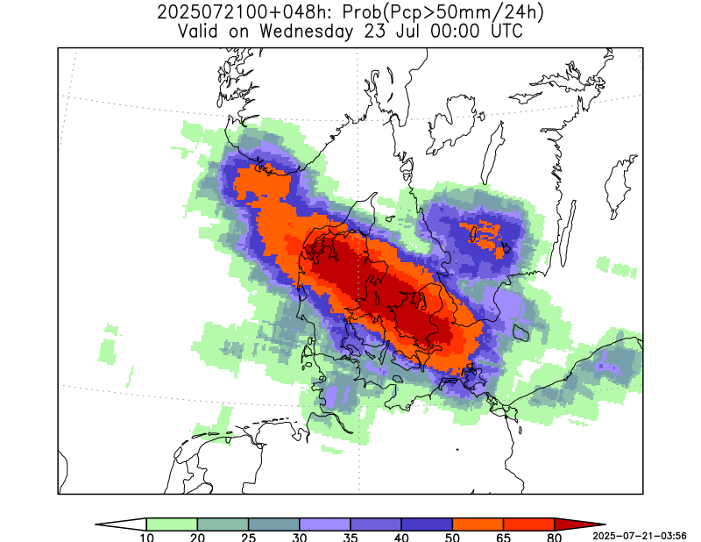
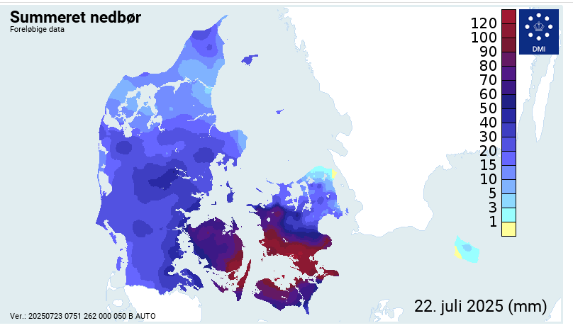
REGIONAL DT : UNCERTAINTY QUANTIFICATION
Physics-based EPS at 750 m resolution (optional part of the DEODE workflow since June)
Post-processing with Bernstein Quantile Networks (precipitation) and Tree-Based methods (wind gusts)
ECMWF Anemoi framework adapted for training a model efficiently on multiple domains.
  deterministic model successfully trained on the MEPS, ARA, AROME-Arctic and UWC-West datasets
  but ensemble model has reduced accuracy compared to MEPS model
Harmonie-Arome 2 km
Harmonie-Arome 750 m
Observations
Physics-based EPS
Probability of exceedance of
50 mm/day over 24h in the ensemble forecast

Slide 11
SECTORAL APPLICATION MODELS INTEGRATION TO THE WORKFLOW
✅ Application integrated into the DEODE Workflow:
Air quality: 6/7 models now can be triggered for the Benelux and Central Europe
Renewable energy: on-demand detection, wind power ramping events, theoretical solar
potential ramping, satellite nowcasting
Storm surge: on-demand configuration capability in the Baltic and Adriatic Seas
Floods: tested on historical events, planned pilot use cases on near real-time events
🔄 On-going integration into the DEODE Workflow:
Fire risk and thermal comfort: demonstration of added value, user needs
Frost

Slide 12
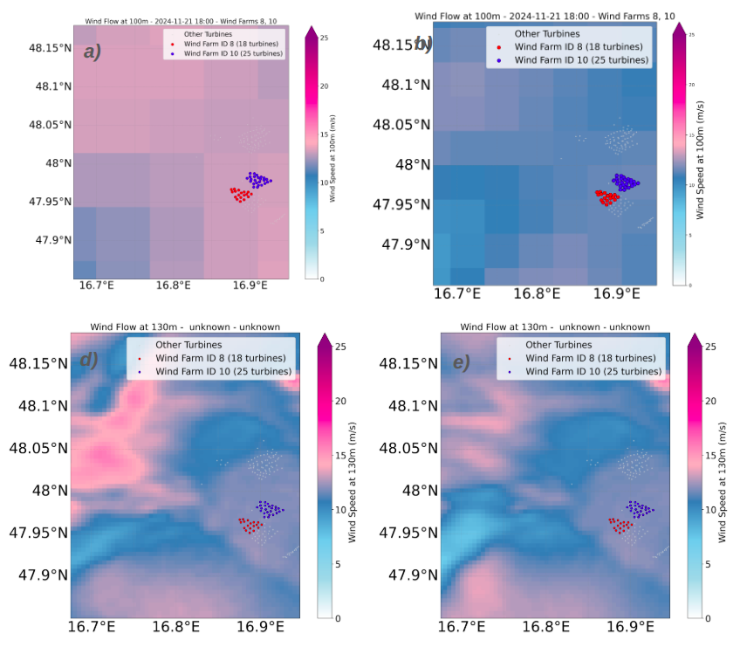
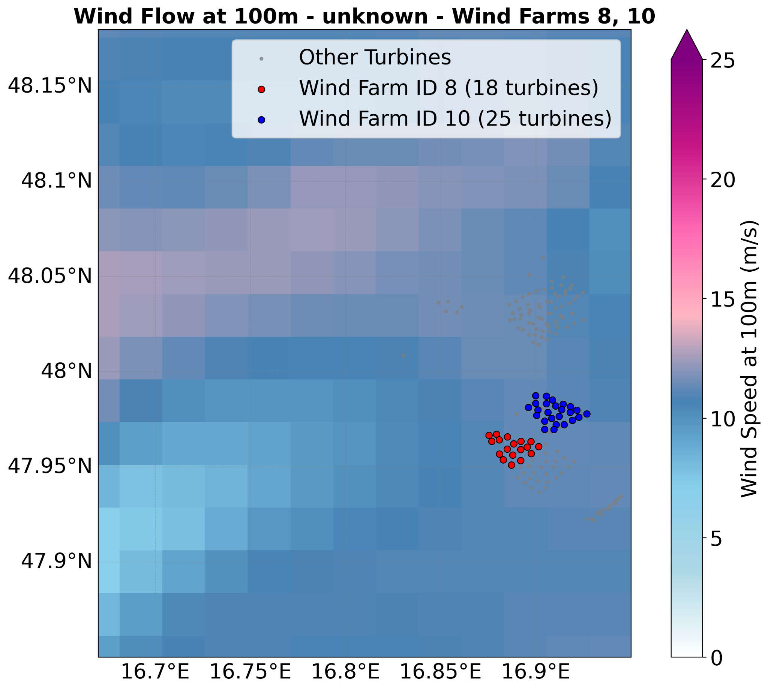
CO-DESIGNED (HIGH RESOLUTION) IMPACT SECTOR INFORMATION
IFS 9 km, 100m wind
DT 4.4 km, 100m wind
Wind farms
Operational AROME 2.5 km, 100m wind
AROME 500 m, 130m wind
HARMONIE-AROME 500 m, 130m wind

Slide 13
EVALUATION

Slide 14
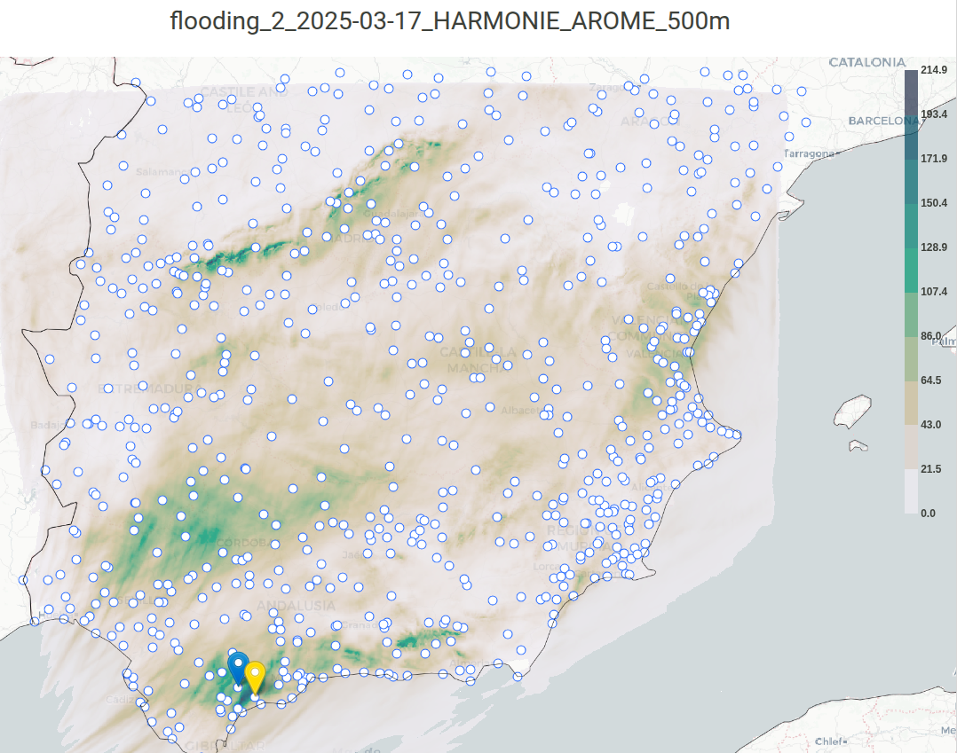
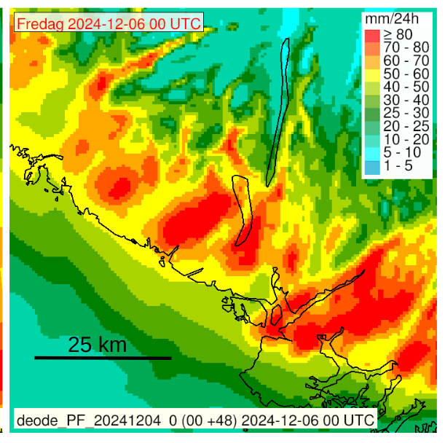
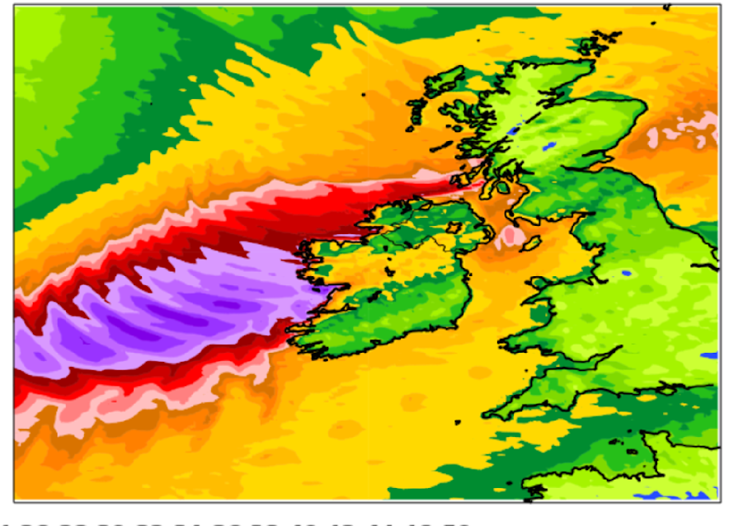
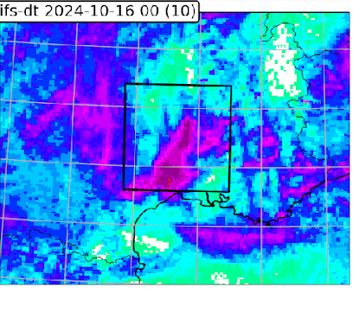
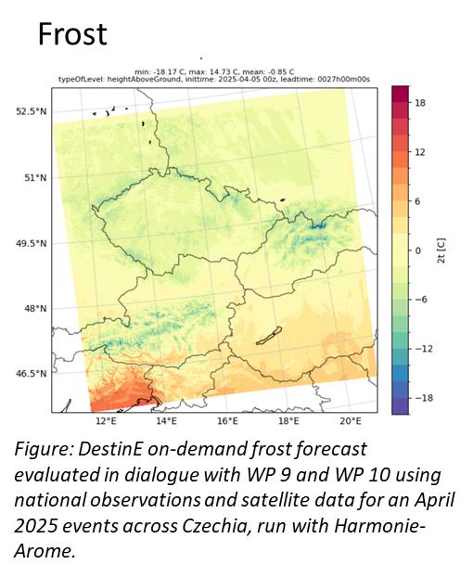
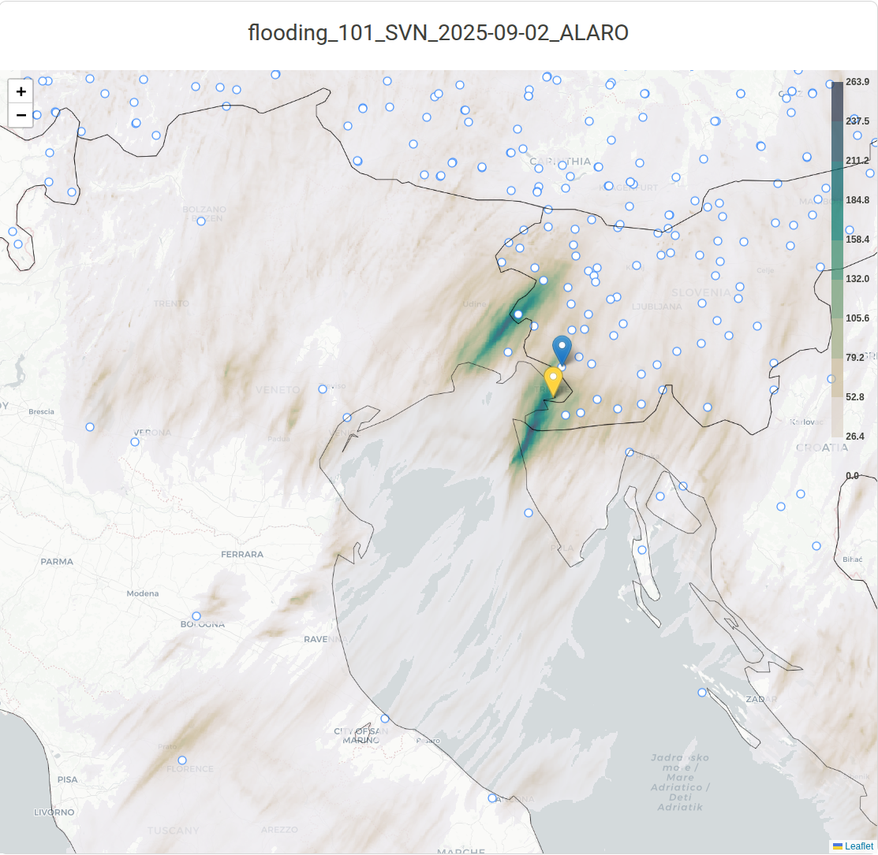
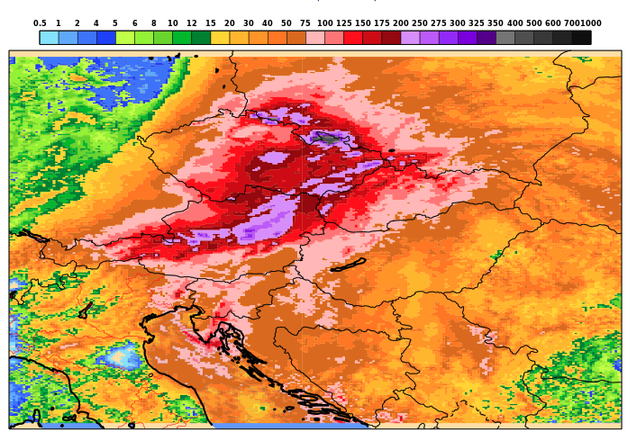
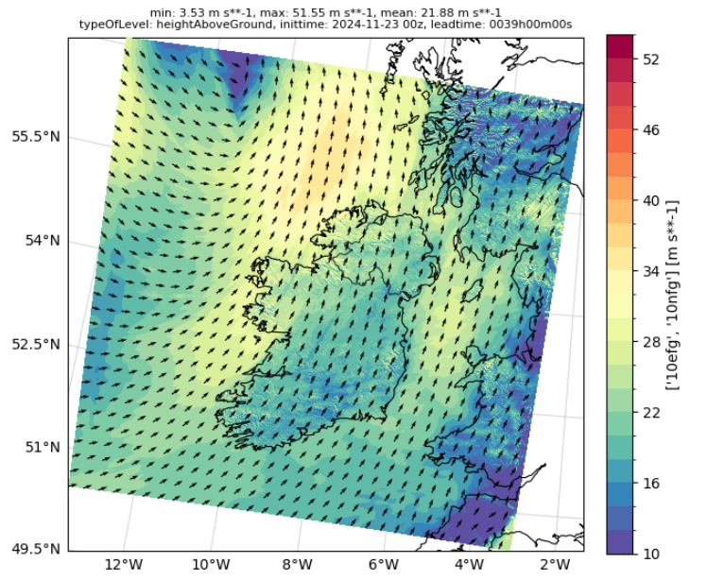
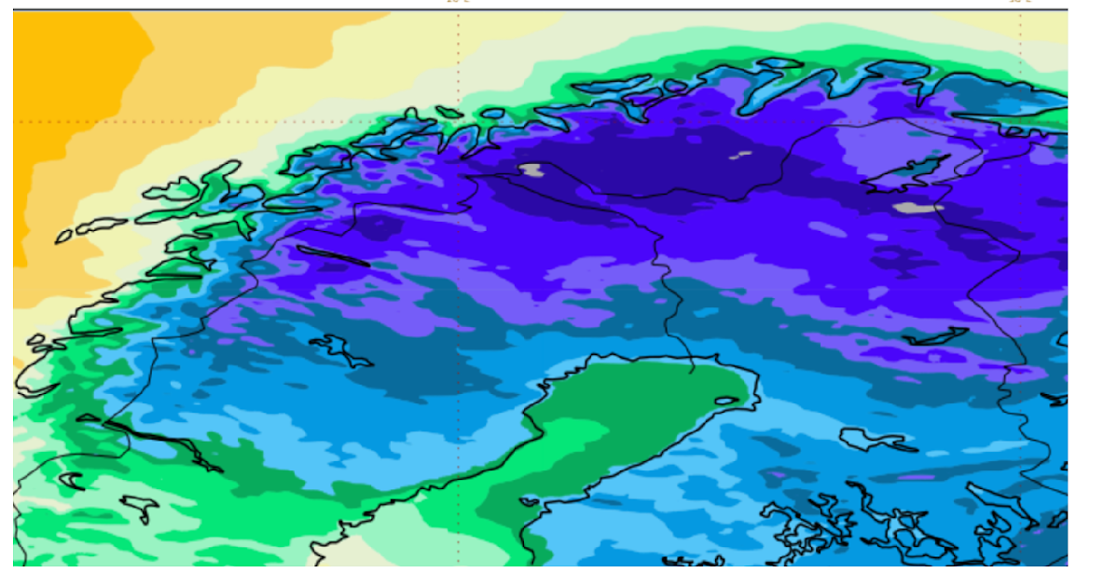
EXTREME EVENTS EVALUATED IN THE EXTREMES SINCE LAST YEAR
Mediterranean event
(17/10) France
Windstorm Éowyn
(24/01) Ireland
Extreme precipitation
(17/03) Spain
Extreme precipitation
(22/06) Denmark
Extreme precipitation
(06/12) Norway
Sep
Oct
Nov
Dec
Jan
Feb
Mar
Apr
May
June
July
Aug
Sep
2025
Storm Boris
(26/06-06/07)
Austria, Czech Republic
Storm Bert
(22-23/11)
Ireland
Cold spell
(04/02)
Finland
Frost
(05/04) Czech Republic
Flood Trieste
(02/09)
Italy
Ski World Championship
Norway
Evaluated in both in Global DT and On-Demand DT

Slide 15
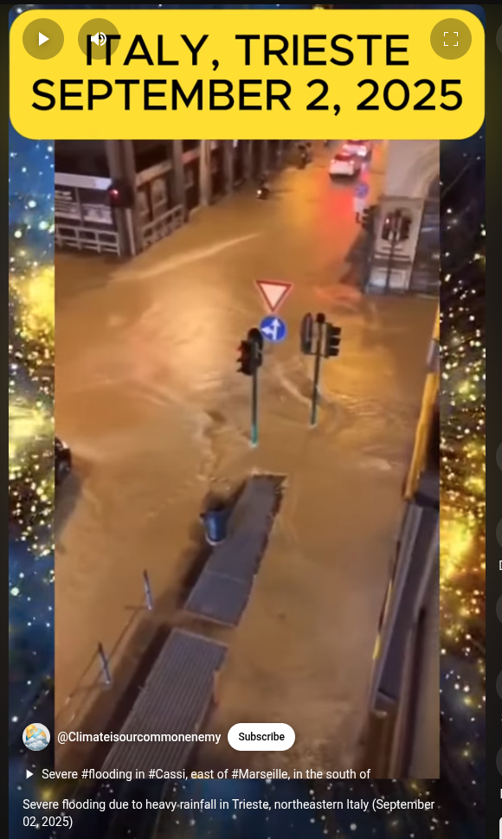
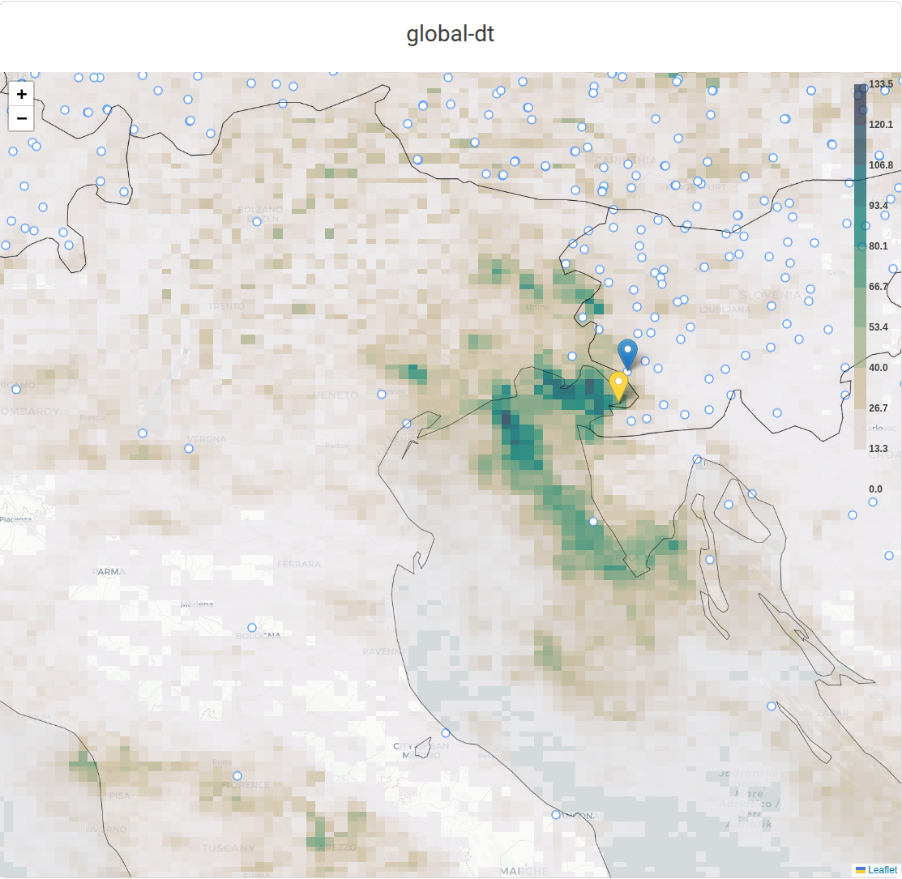
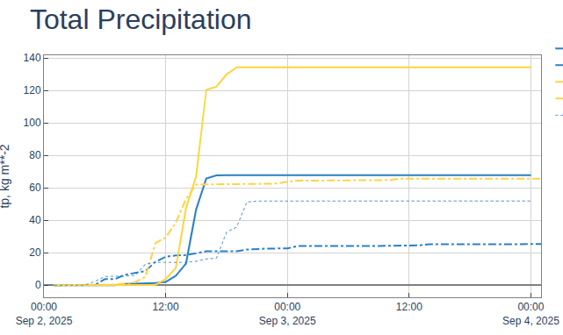
STORM ULRICH: 100 MM IN ONE HOUR, TRIESTE, ITALY
A violent and sudden storm swept across northeastern Italy
Trieste and Muggia flooded
Residents barely had time to react before torrential rain poured down like waterfalls, reaching 100 mm in one hour
Around 11 PM more than 150 emergency calls have been recorded
Source: YouTube
Regional DT
Regional DT
Global DT
Obs
Global DT at 4.4 km,
48 h acc. precip.
Alaro at 500 m,
48 h acc. precip.
Global DT

Slide 16
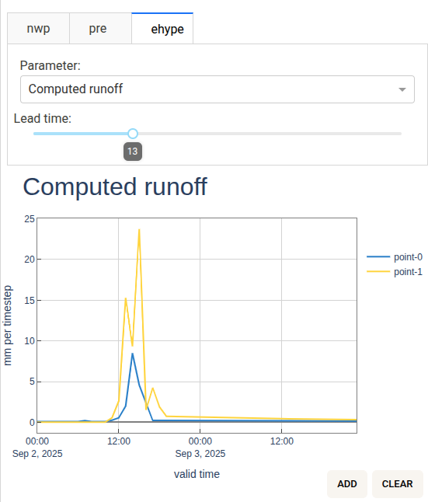
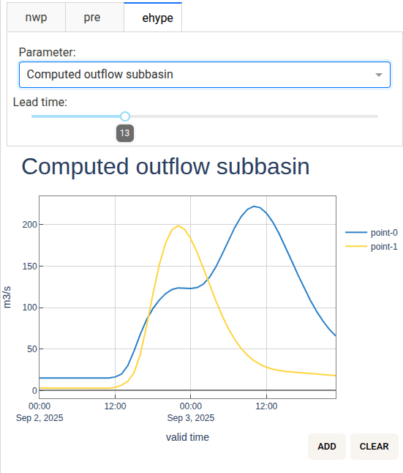
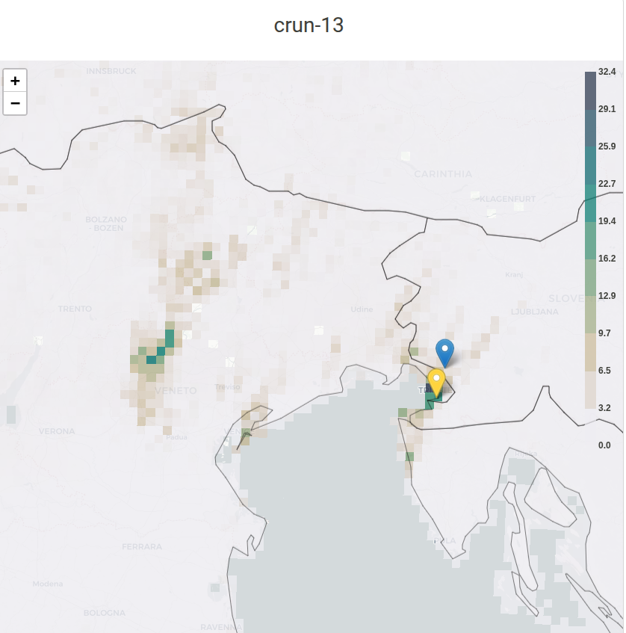
STORM ULRICH: 100 MM IN ONE HOUR, TRIESTE, ITALY
A violent and sudden storm swept across northeastern Italy
Trieste and Muggia flooded
Residents barely had time to react before torrential rain poured down like waterfalls, reaching 100 mm in one hour
Around 11 PM more than 150 emergency calls have been recorded
Alaro at 500 m,
48 h acc. precip.
E-HYPE
Run-off

Slide 17






SUMMARY : ADDED VALUE EXTREMES DT COMPONENT
 | DT Global (4.4 km) added value vs OPER (9 km) |  | Regional (On-Demand) added value vs DT Global
 | Flat areas | Mountains | Flat areas | Mountains
Extreme precipitation (convective and large-scale) | ↓/→ | ↑ | ↑ | ↑
Extreme wind/wind gusts | ↑ | ↑ | ↑ | ↑
Extreme low temperatures | → | ↑ | →/↑ | →/↑
Extreme warm temperatures | → | ↑ | →/↑ | →/↑
Medicanes/ rapid development cyclones | ↑ | ↑ | ?/↑ | ?/↑
Squall lines | ↑ | ↑ | ? | ?
↑
Improvement
→
Similar Performance
↓
Degradation

Slide 18
WHAT NEXT?

Slide 19
REPLAYING THE STORY:
What if Belgian offshore wind farms were refactored with modern turbine technology during Storm Eunice?
Scenario Overview
  Event: Storm Eunice (February 17-18, 2022) - Major European windstorm
  Location: Belgian offshore wind zone (8 wind farms, 2251 MW total capacity)
  Analysis: DestinE hectometric resolution (250-750m) weather forecasting
  Target Farms: Belwind (3MW turbines) and C-Power (6MW turbines) for modernization
Infrastructure Transformation
Aspect | Current Layout | Refactored Layout | Impact
Total Turbines | 398 turbines | 321 turbines | -19% fewer turbines
Total Capacity | 2,251 MW | 2,241 MW | Same capacity
Belwind Farm | 55 × 3MW | 11 × 15MW | -80% turbines, same power
C-Power Farm | 54 × 6MW | 21 × 15MW | -61% turbines, same power
(Irene Schicke, Geosphere Austria)

Slide 20
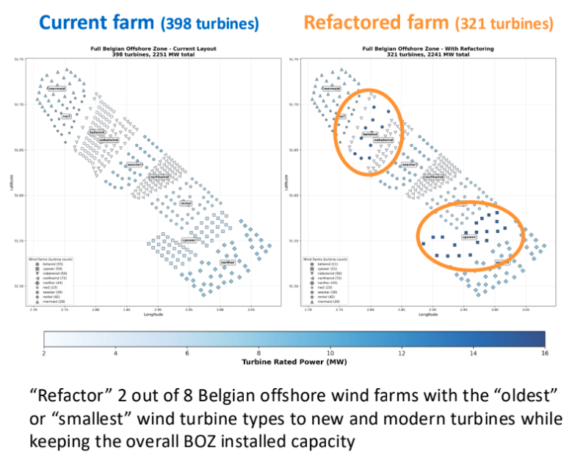
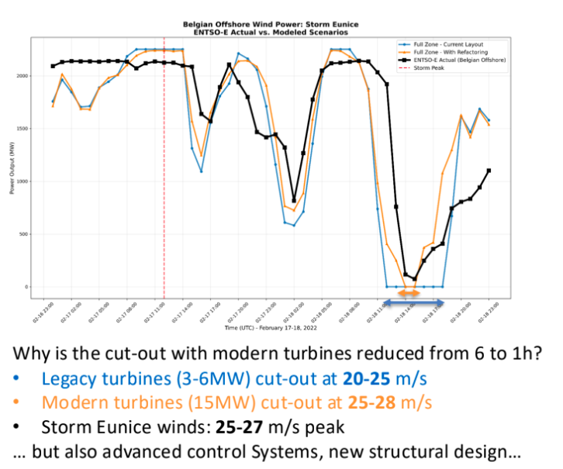
What if Belgian offshore wind farms were refactored with modern turbine technology during Storm Eunice?
(Irene Schicke, Geosphere Austria)

Slide 21
WHAT NEXT?
Phase 2
  Continue regular production
  Expand the support to decision-making of National Authorities
  Continue collaboration between Global and Regional DTs to validate, demonstrate added value compared to existing operational systems
  Enhance uncertainty quantification
  Work with the DestinE Pilot Services (e.g. hackathon)
  Upgrade the configurations
  Collaborate with the Anemoi community to exploit km and sub-km scale data for AI training
Activities to start in phase 3 and beyond
  Produce What-If scenarios
  Produce storylines of plausible future events by coupling the Regional DT with Climate DT
  Demonstrate the value of application sectors and strengthen user engagement
Notes:
We are entering the season of mediterranean events.
We will continue this common verification that is working really well between ECMWF and the Regional components. I feel we have never worked so closely before. Closer than ever in the veritifcation effort
In the phase III we will simulate what-if scenario.
Plroduce plausible storylines.
Enhance uncertainty quantification.

Slide 22
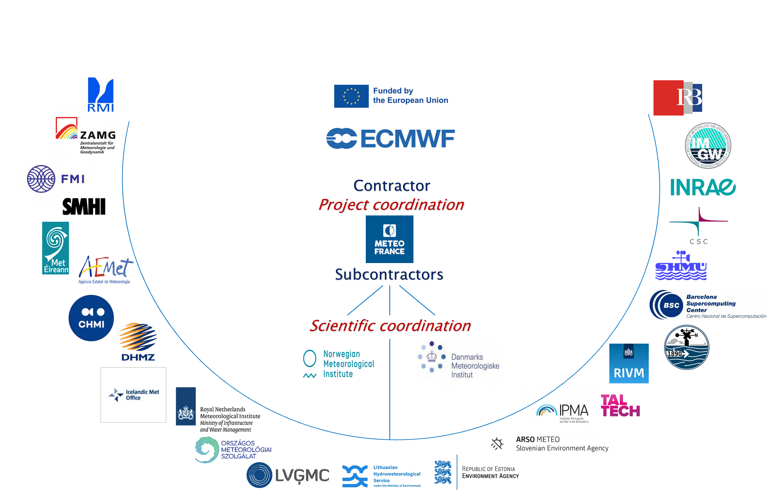
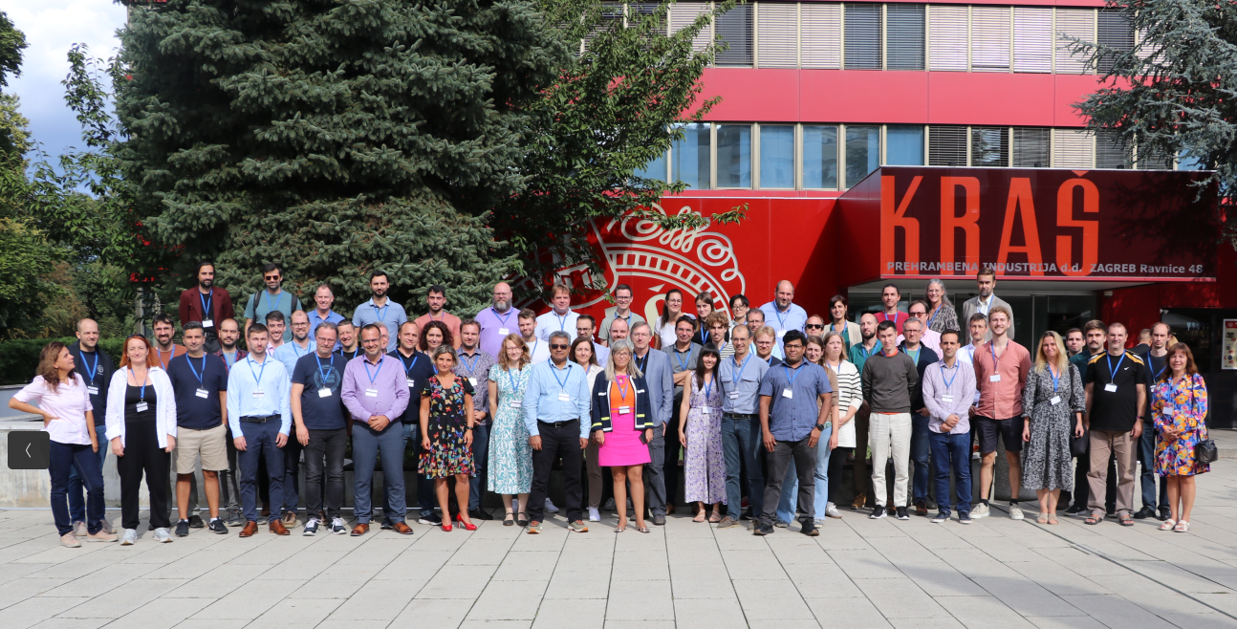
Thanks you for your attention

