Slide 1

An organisation aware convection scheme for the grey zone
Wim de Rooy, Natalie Theeuwes, Pier Siebesma, Alessandro Savazzi, Louise Nuijens, Charlotte Raven, Emily Gleeson, et al.
An updated Harmonie-Arome convection scheme to improve forecasts of organised convection and the associated rain and cloud fields

Slide 2
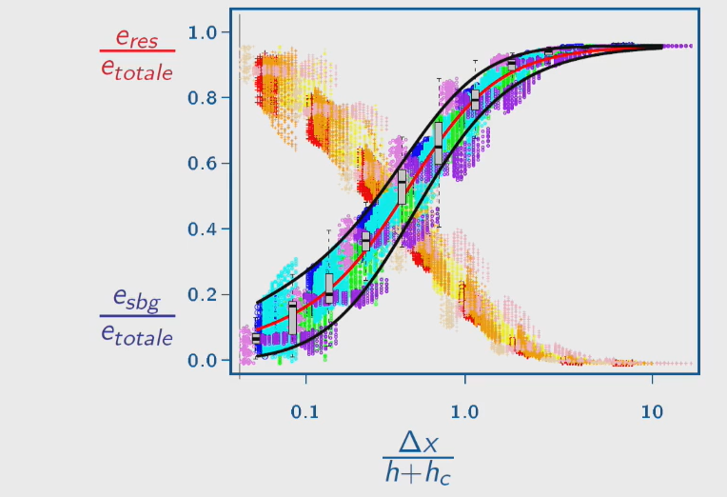
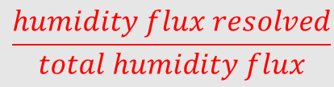
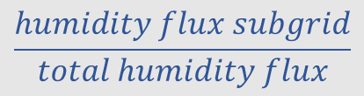
Fundamental question: What part of the convection should be done by the
convection scheme and what should be resolved?
This partitioning can be studied by coarse graining LES (Honnert, 2011)
$$\frac{humidity flux resolved}{total humidity flux}$$
parameterised
Rachel Honnert plot
(e.g. Honnert 2011, JAS)
We want similar
behavior in NWP
(referred to as
scale-aware)
LES based
(coarse graining)
$$\frac{humidity flux subgrid}{total humidity flux}$$
resolved
h+h_{c} is an estimate of the relevant (dominant) scales

Slide 3
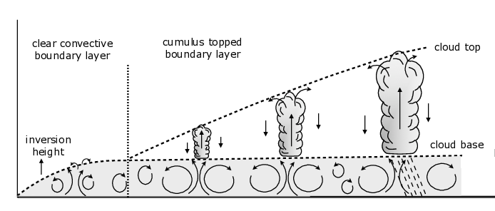
Implementation of switch scale-aware in Harmonie-Arome
Boundary layer height h or h+h_{c} as an estimate of the scales
h
h
h+h_{c}
Harmonie-Arome: h or h+h_{c}
Very simple: Termination height
moist and/or dry updraft.
Decrease Mass flux with
for dry: f(∆x/h)
and moist: f(∆x/(h+h_{c}))
Notes:
To answer this question, we need to take a look at the relationship betweeen the ratio of resolved/unresolved energy and the grid size.
For this, we need to normalize the lenght scale with the height of the boundary layer.
For example, assuming this is the growth of the boundary layer over time. In the beginning of the day, we see a low inversion height, with small turbulent eddies. Taking a grid size of 500 m, all of the turbulence is probably smaller than that size, and needs to be parametrized. But looking futher in the day, the boundary layer and thus the turbulent motions have grown, and with the same grid size, now more of the turbulence can be solved by the model
Now, the relationship of what can be resolved/unresolved with this normalized grid size is investigated by Rachel Honnert. Starting with an LES simulation where all the turbulence is resolved by the model, she increased the gridsize gradually till the point where nothing was resolved anymore. By constantly considering the ratio of resolved and unresolved energy, she found the following figure; this shows for example, that when the grid box is way larger than the turbulent motions, all of the energy needs to parametrized. This relationship can be used to develop a scale adaptive convection scheme.

Slide 4
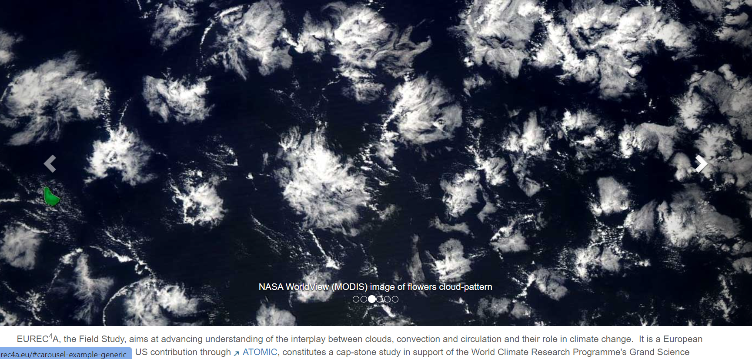
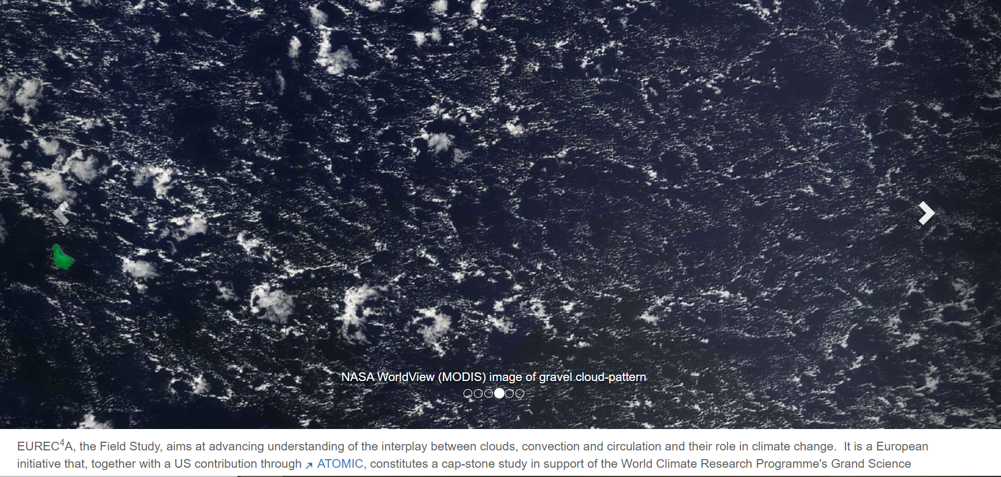

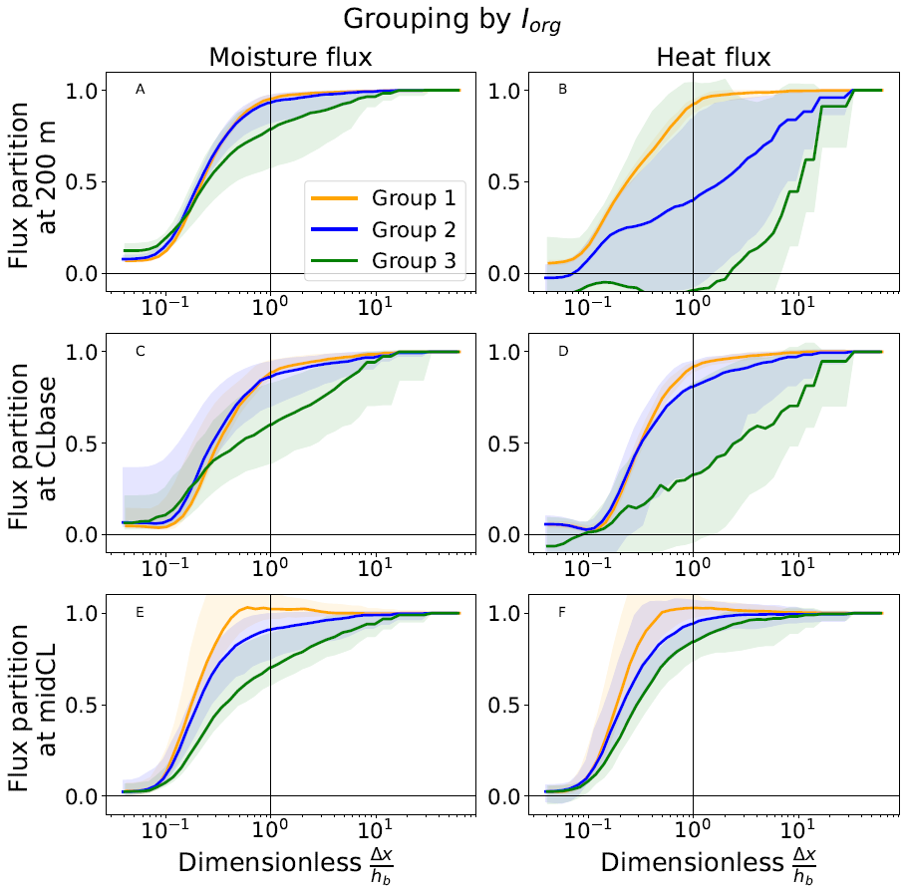
Investigate partitioning for several conditions: EUREC4A field campaign (cloud organisation)
What should be done
by the convection scheme
grouping by Iorg
unresolved moisture flux middle cloud layer
group 1 unorganized
group 2 in-between
group 3 (very) organized
PBL height not always a good indicator for scale size!
Apart from switch scale-aware we need organisation
awareness.
Alessandro Savazzi et al., 2024 JAS

Slide 5
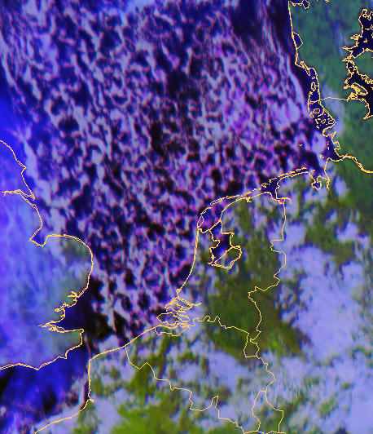
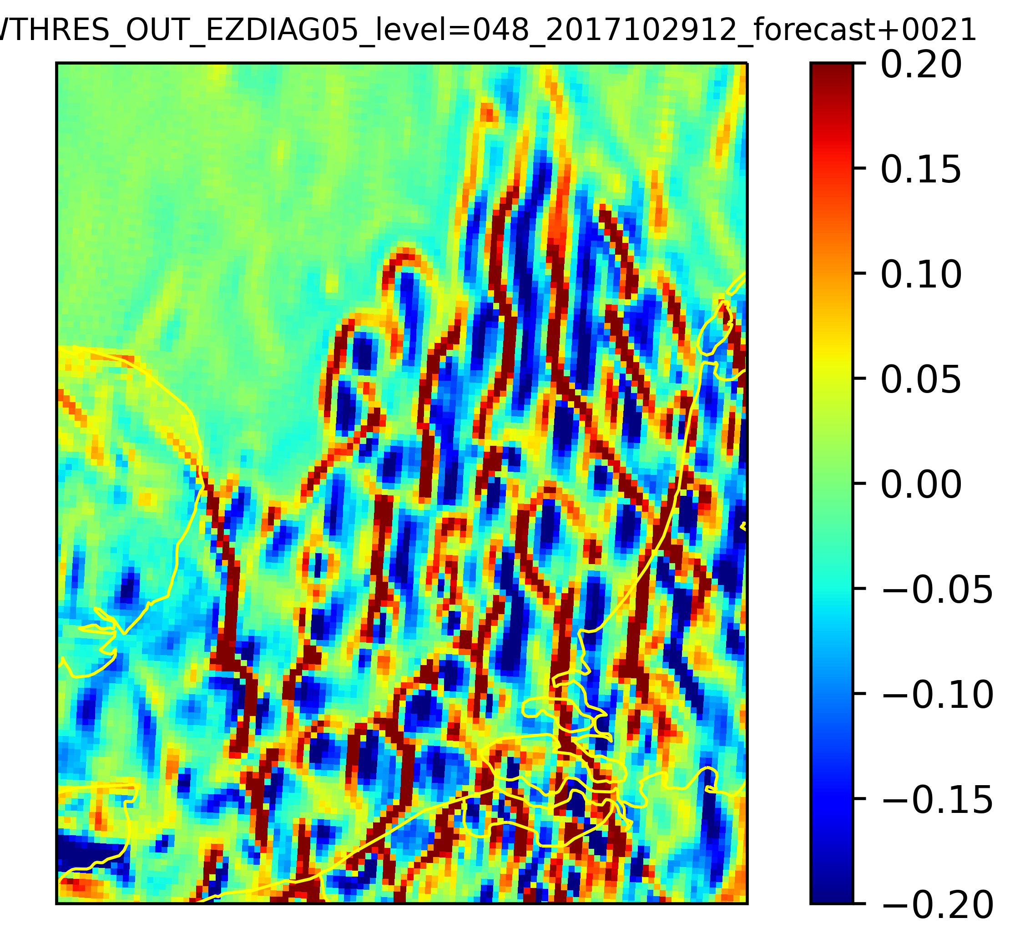
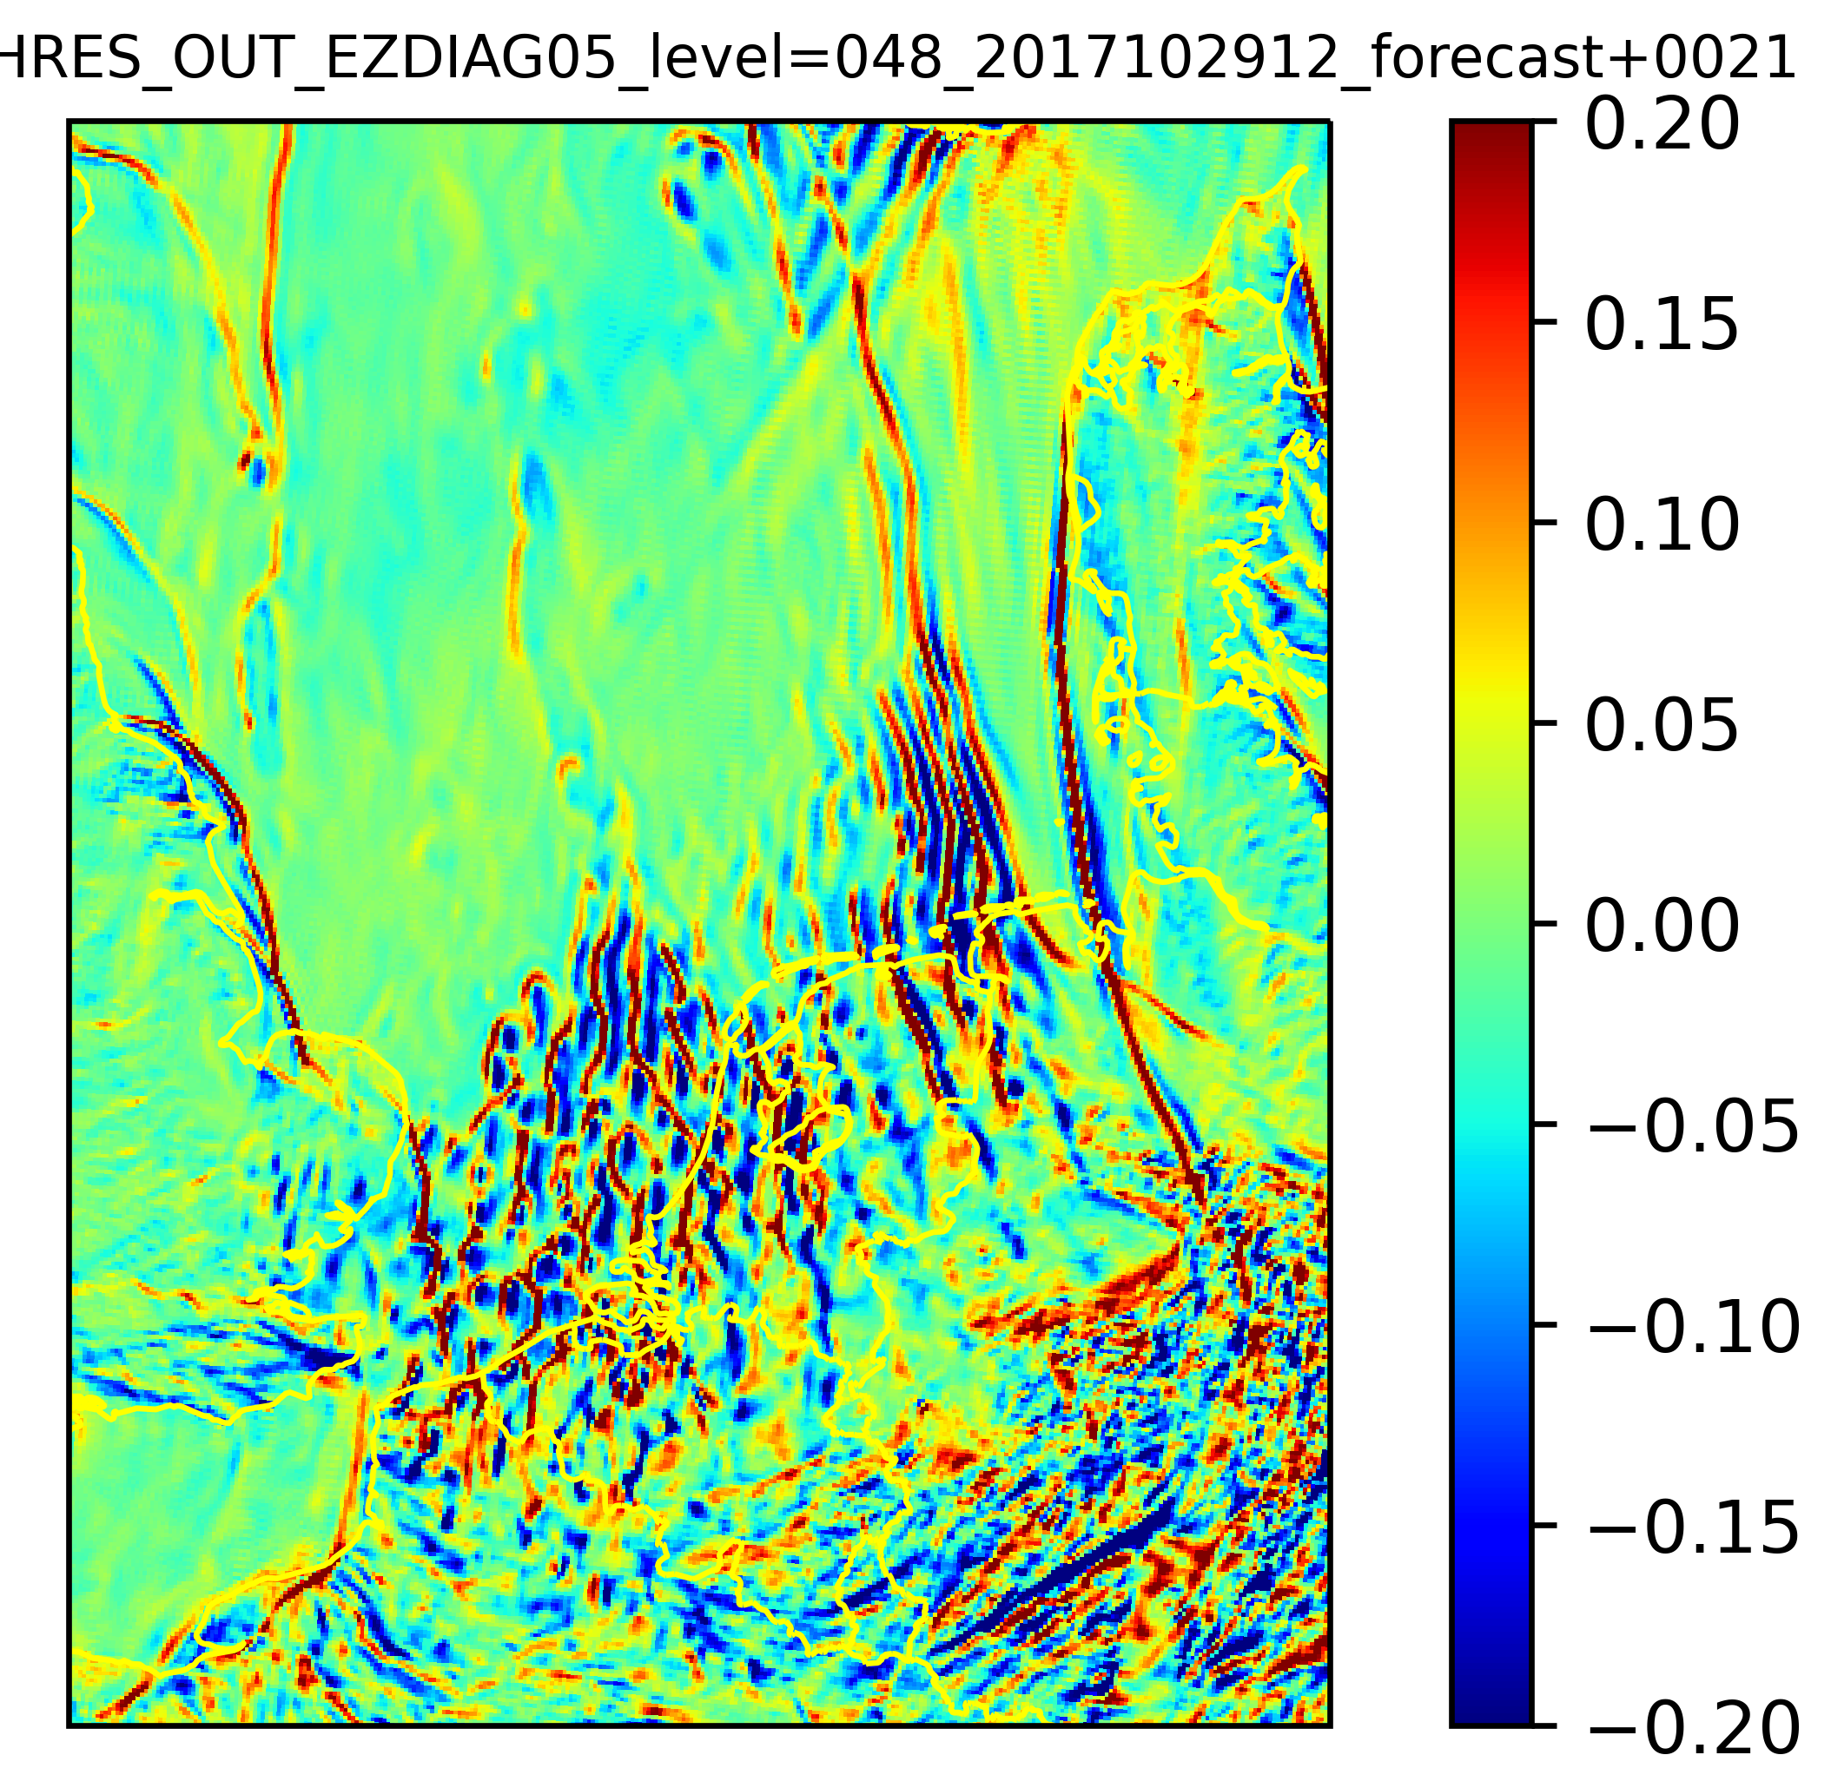
Satellite
Another illustration boundary layer height h is not always suitable:
Harmonie-Arome at 2.5km resolution: open cell convection case.
BL height is small compared to ∆x but clear signs resolved convection!
Vertical (resolved) velocity at 750m height
Vertical (resolved) velocity at 750m height

Slide 6
Key question: How to make a distinction between organized ↔ unorganized?
If the model starts to resolve convection, like in the previous slide, it should!
Khain et al., AR 2021 introduced: shut down convection parameterization if w>w_threshold:
Implementation in Harmonie-Arome: In every grid point shut down convection where |w|>w_threshold
Some issues:
  What about the w threshold value? (Kain took optimal value based on precipitation)
  If threshold is met, shut down moist updraft, but what about the dry updraft? (representing smaller thermals)

Slide 7
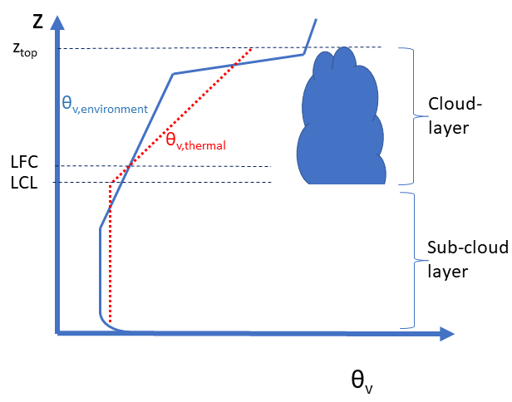
If |w_resolved|> wthreshold moist updraft is shut down. What to do with dry updraft?
Option 1: Also shut down dry convection (LWTHRES). Long term verification reveals lack of non-local mixing
near the surface. Moreover, LES coarse-graining indicates the need for parameterized dry convection (shown later).
Option 2: Keep dry convection as it is (LWTHRESMOIST)
Impact keeping dry convection if moist convection is shut down:
  stronger inversion (CIN)
  building up moisture near inversion (more stratus)
Option 3: reduced dry convection if moist is shut down (verification and LES)
How to evaluate?
Subjective by investigating for example cloud cover, precipitation
More quantitative: Compare resolved/unresolved partitioning of fluxes in the NWP model with coarse-grained
LES partitioning at the same resolution.

Slide 8
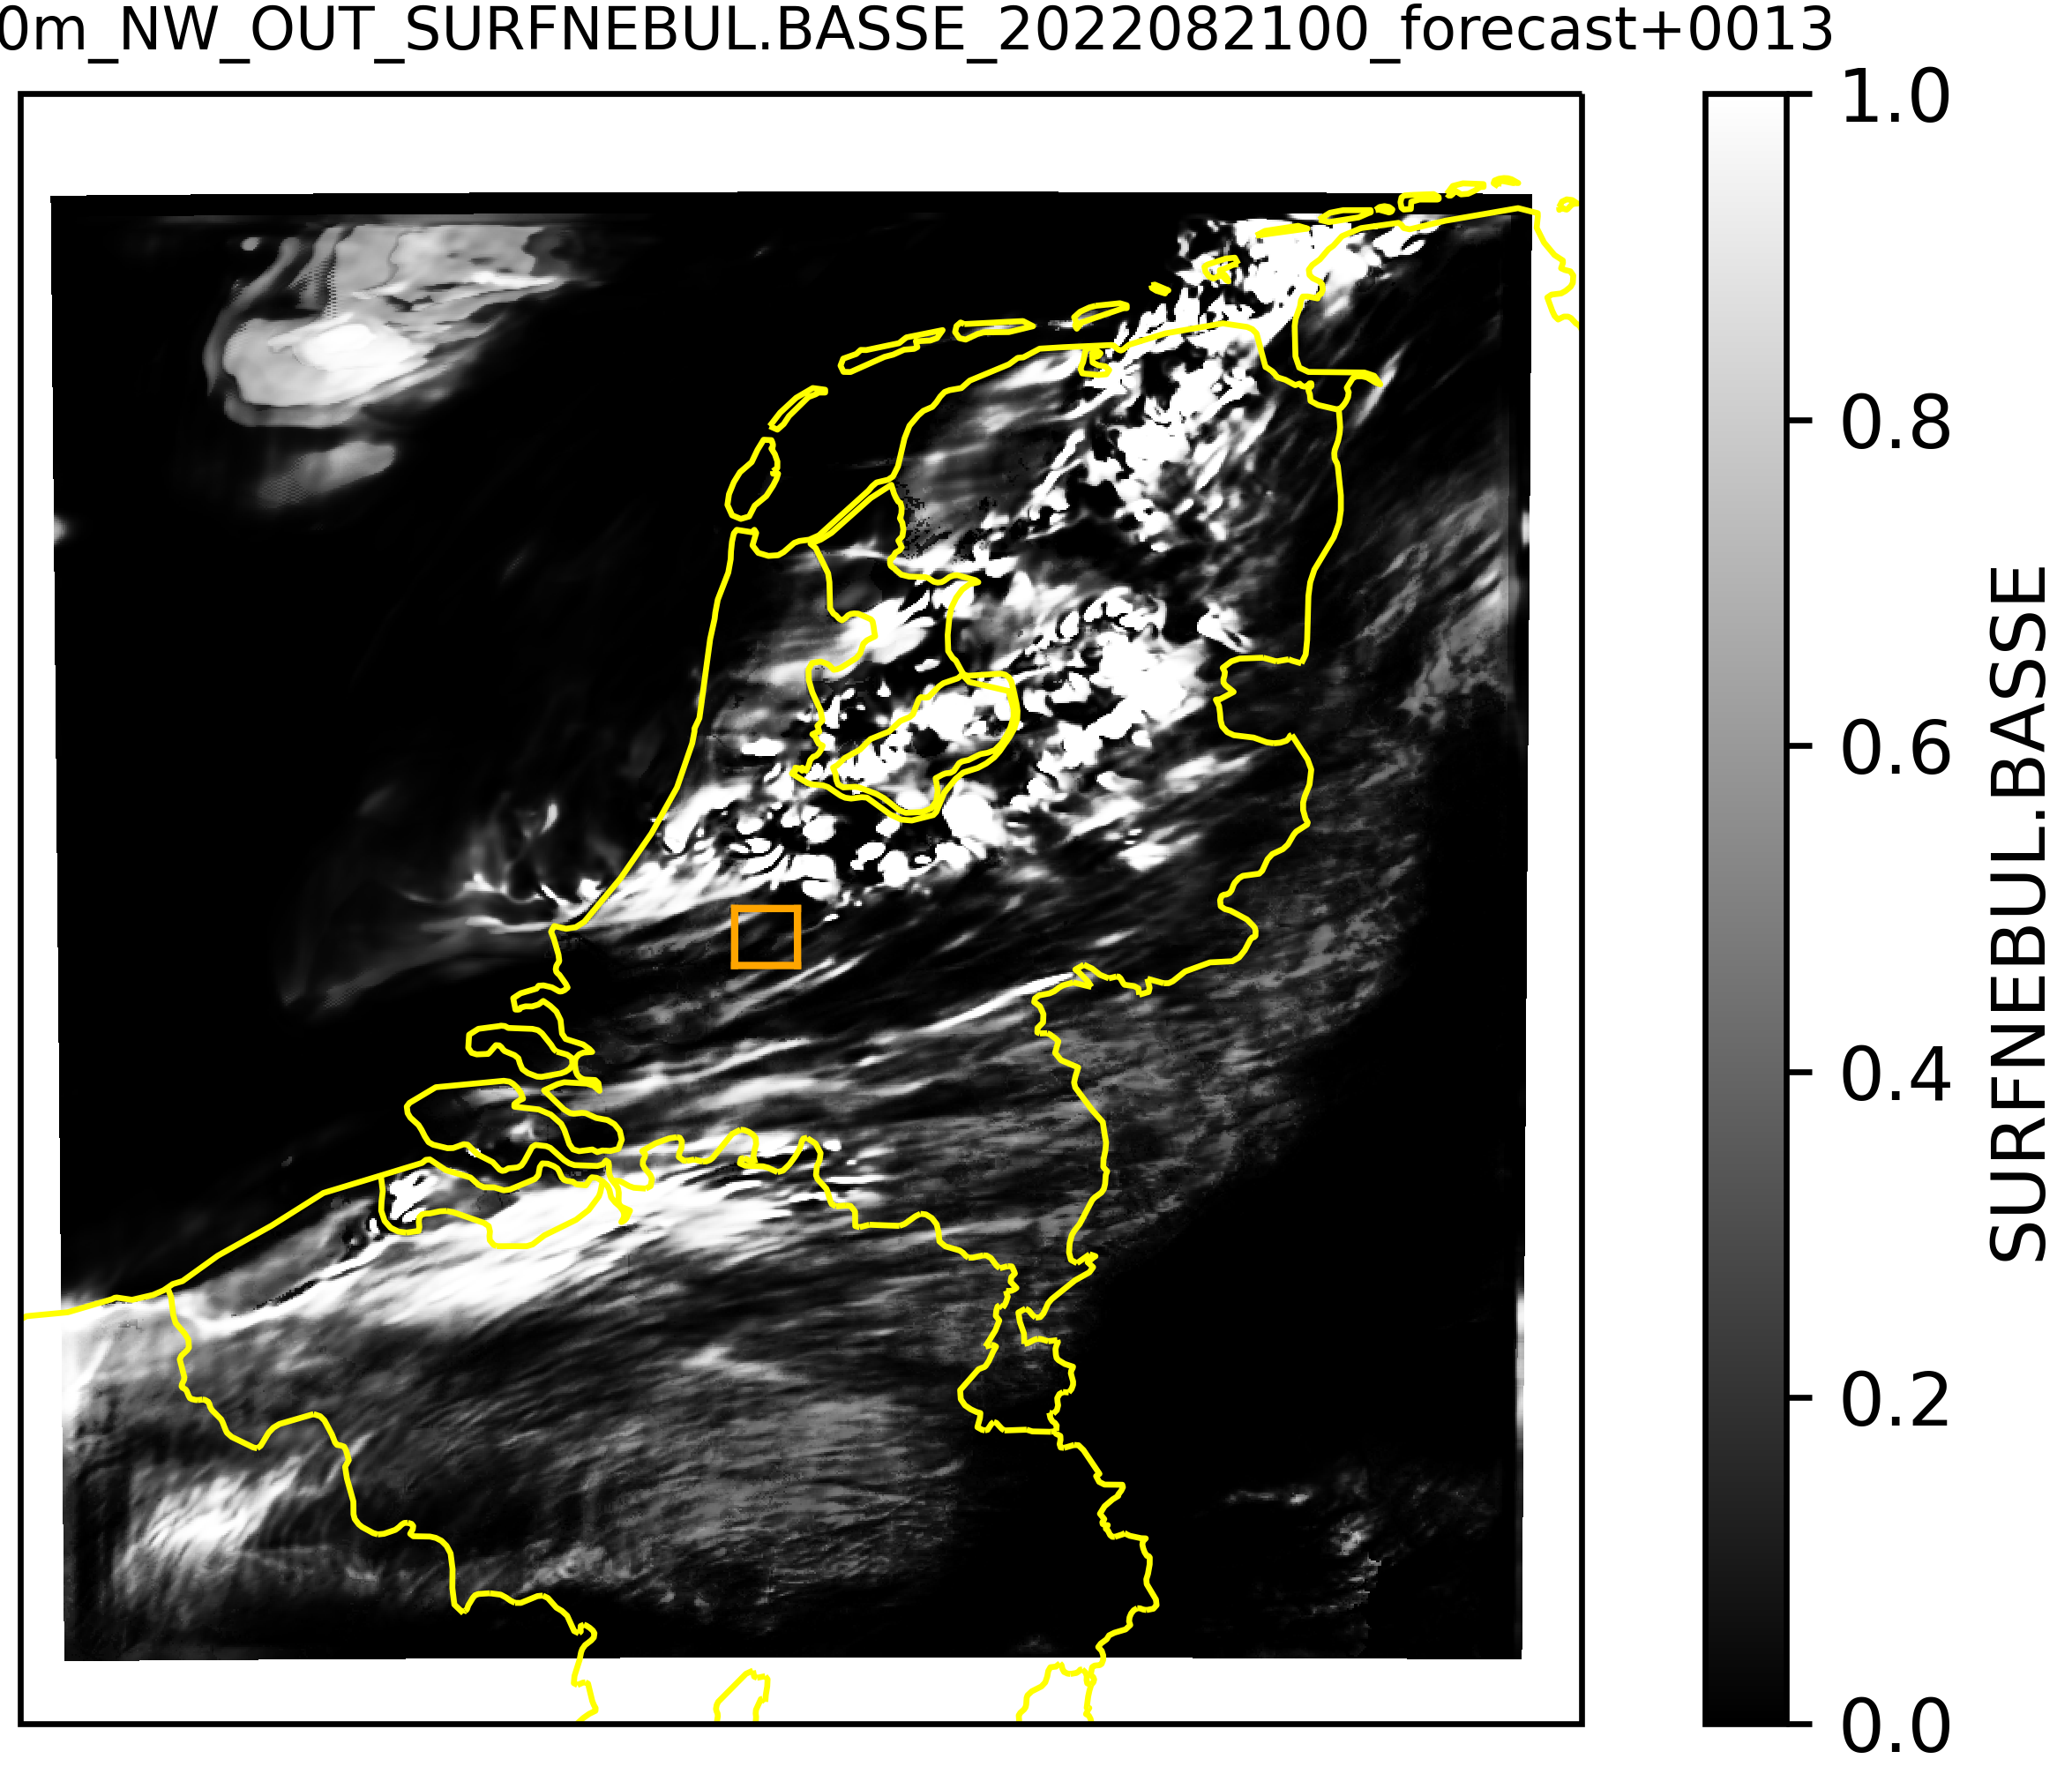
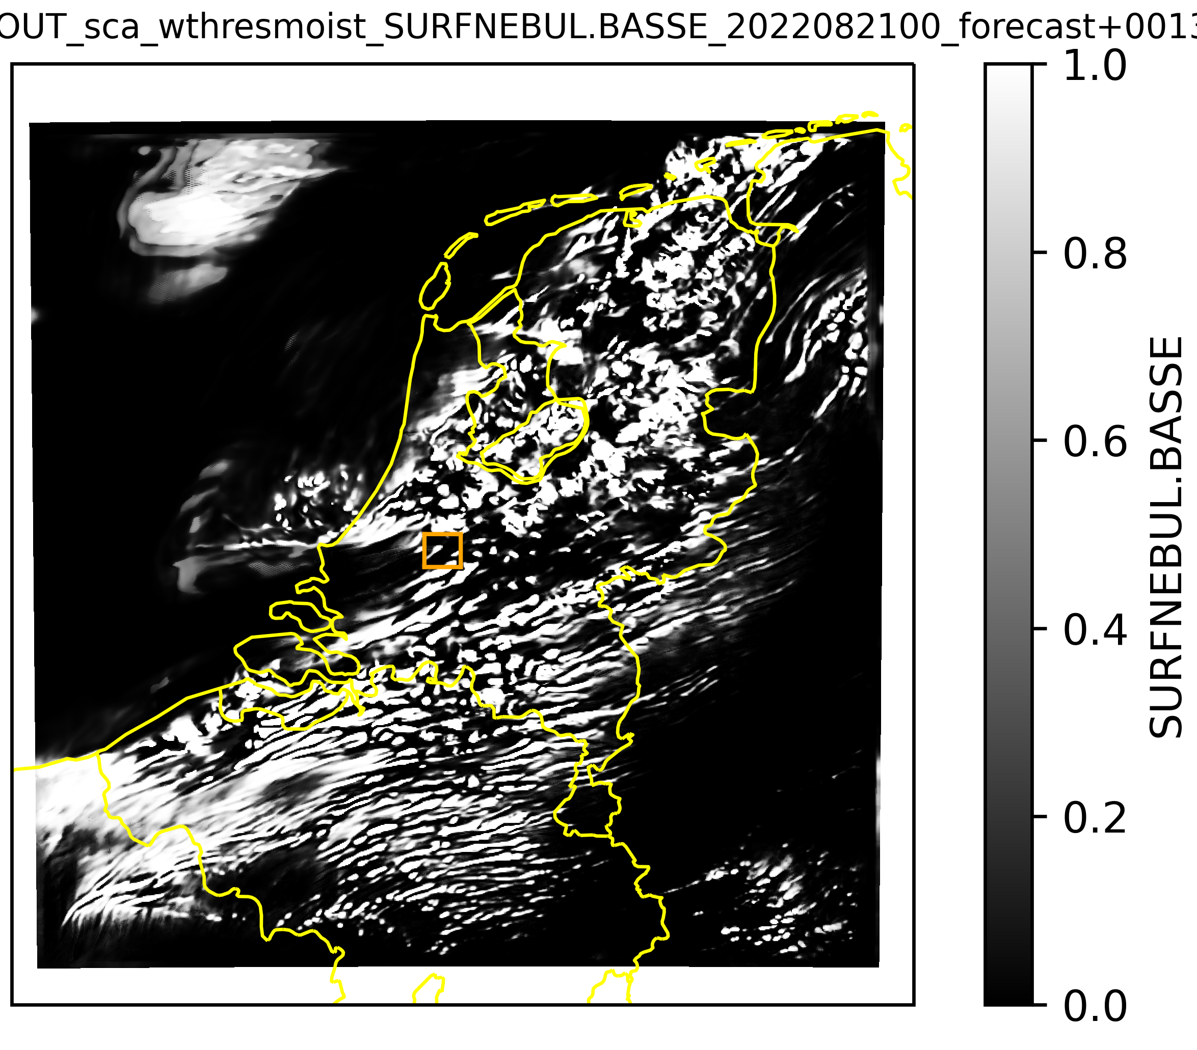
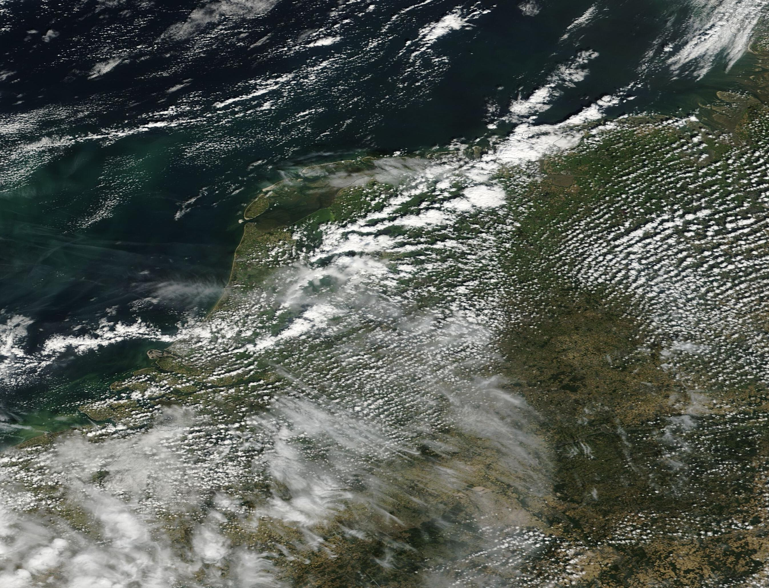
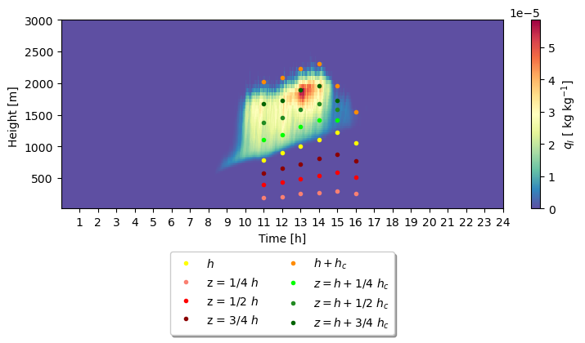
Quantitative comparison: Resolved/unresolved partitioning LES coarse-grained ↔ Harmonie-Arome 500m
2022 21th August approx. 12:30 UTC
Reference 500m
Scale-aware+Wthresmoist 500m
LES domain
LES liquid water
Compare LES coarse-grained partitioning resolved/unresolved
with Harmonie-Arome at e.g. halfway cloud-layer and
halfway dry sub-cloud layer.
Many aspects

Slide 9
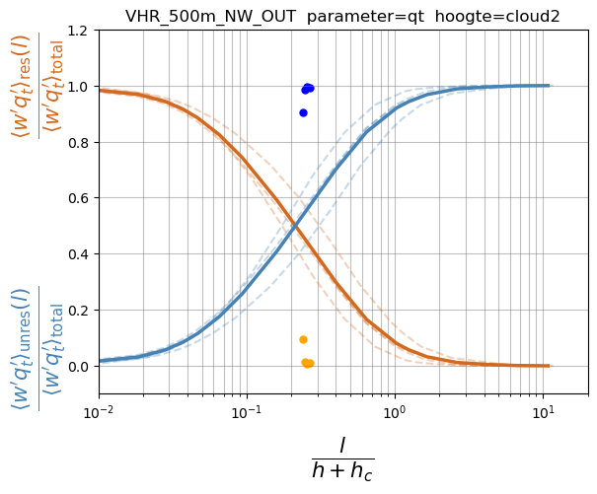

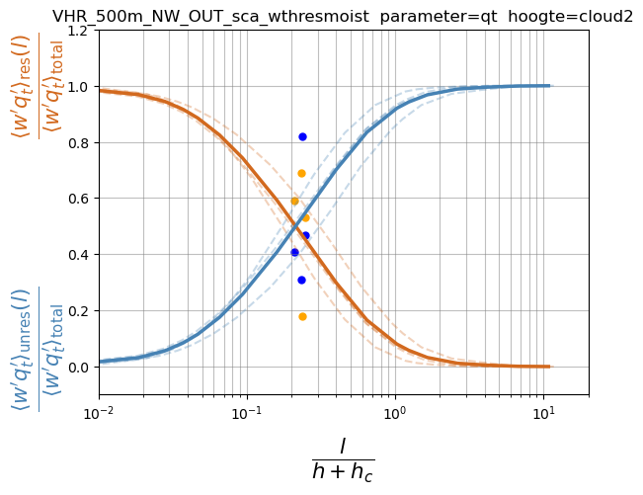
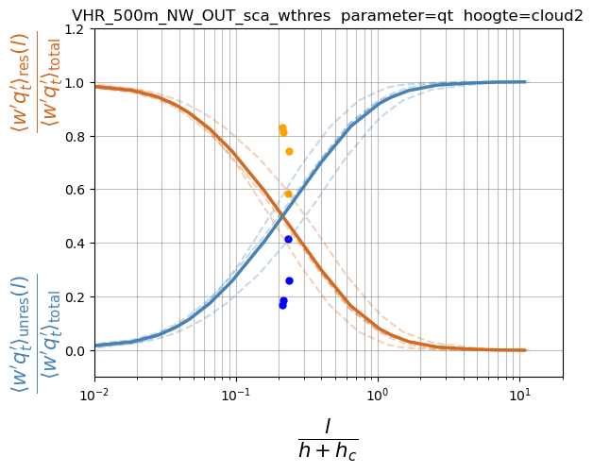
Quantitative analysis: Compare the partitioning of total turbulent moisture transport in LES (coarse-grained) and
Harmonie-Arome (dots) in Honnert plot. Here for the middle of the cloud layer
REF
with convection off
orange points = blue
and vice versa->
Scale aware + wthresmoist (only shut down moist)
Scale aware + wthres (shut down moist and dry)
Too much resolved?
Right ballpark?

Slide 10
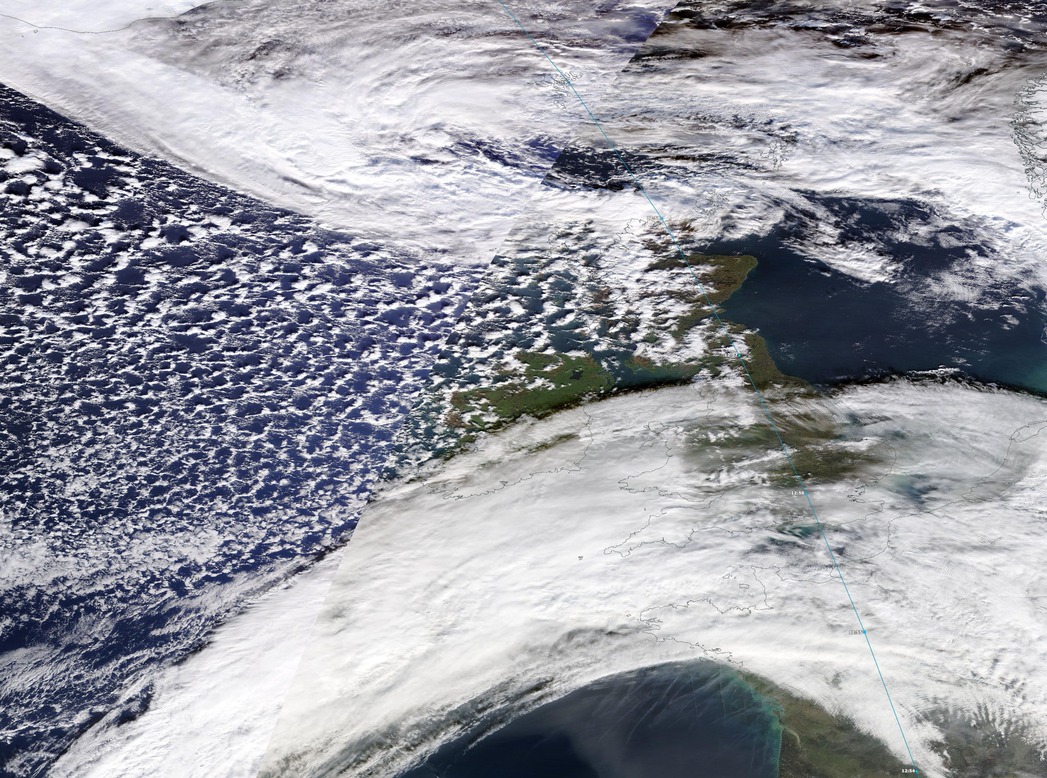
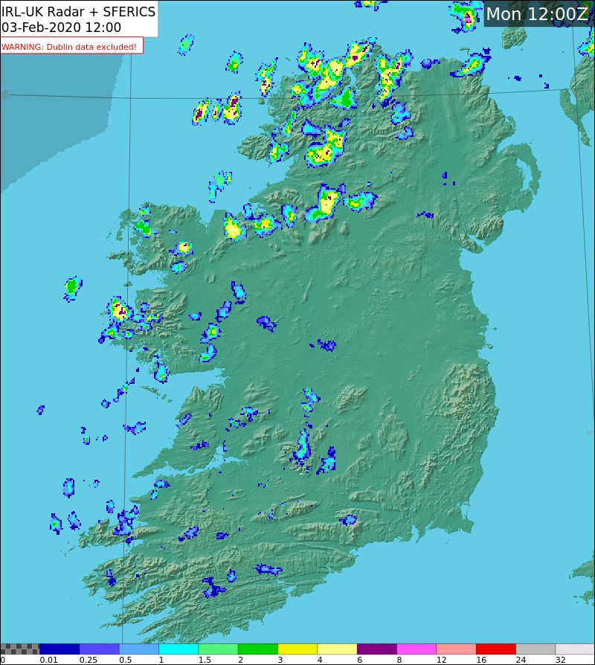
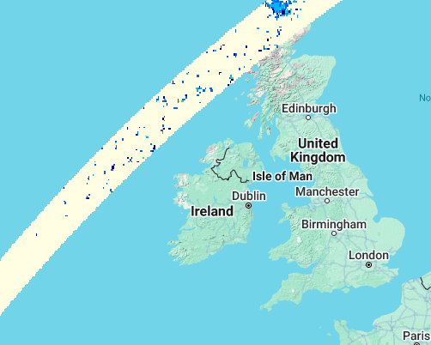
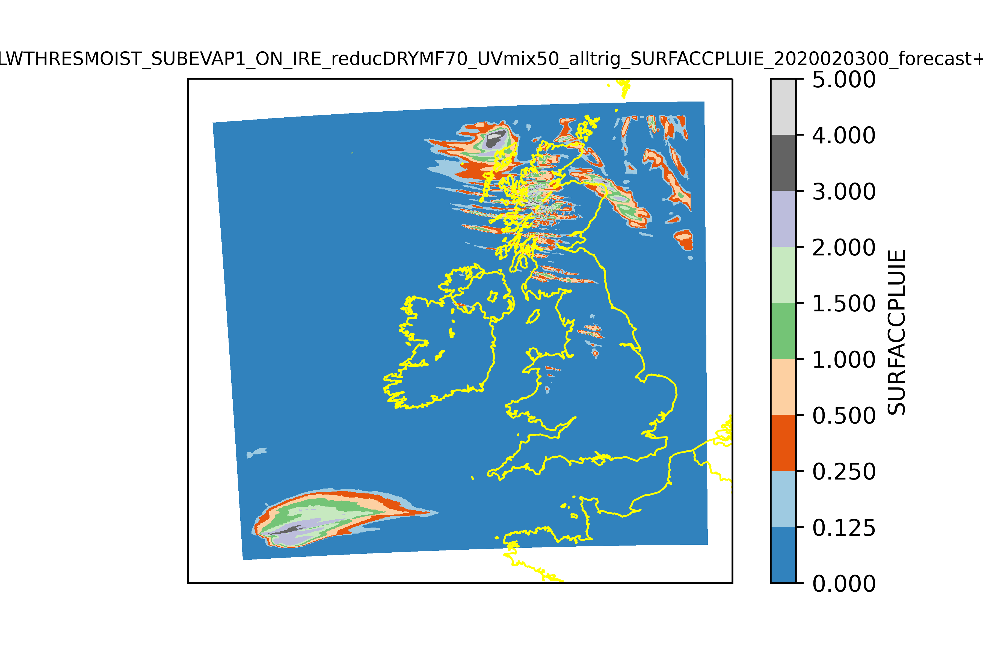
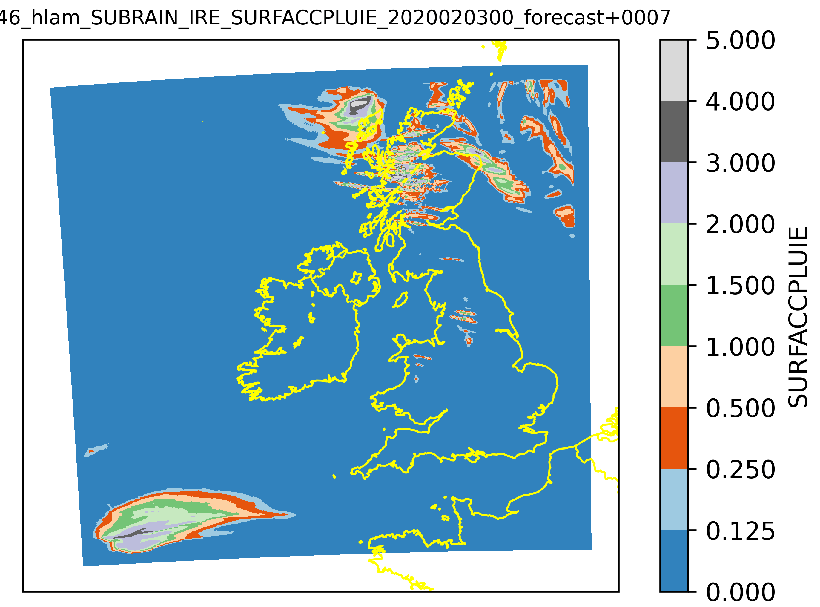
Example: Impact changes convection scheme at 2.5km resolution
Open cell convection precipitation.
New convection scheme:
  scale aware (less relevant at km scale)
  LWTHRESMOIST trigger
  if triggered 70% dry mass flux
  sub-grid evaporation/melting trigger
Reference
New convection

Slide 11
        Discussion, conclusions
LES are an important tool to study the grey zone
Shutting down shallow convection for resolutions ≥ 500m is bad idea.
Boundary layer height not always suitable as measure of scales.
Use resolved w to indicate organisation. If the model starts resolved convection,
it should!
All convection options in cy46 and 49. UWCW option is to use LWTHRESMOIST and reduce (grid-size dependent) dry convection.
Adding sub-grid evaporation/melting trigger is at least useful for 2km.
The new convection options solve the long-lasting problem of missing rain associated with organised convection and substantially improves cloud fields.

Slide 12

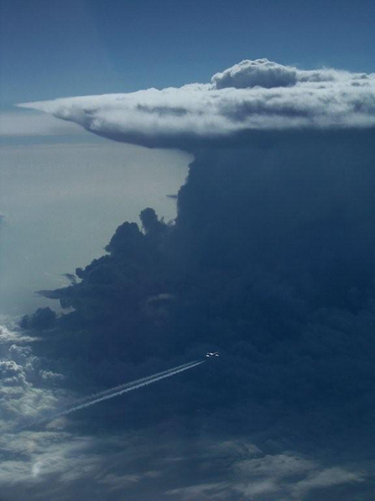
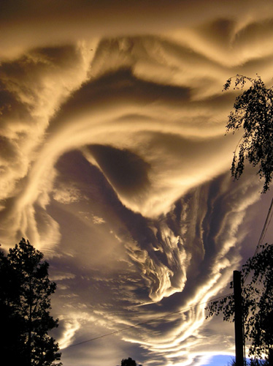
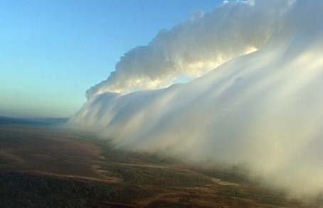

Thanks, questions?
www.cloudappreciationsociety.org

Slide 13
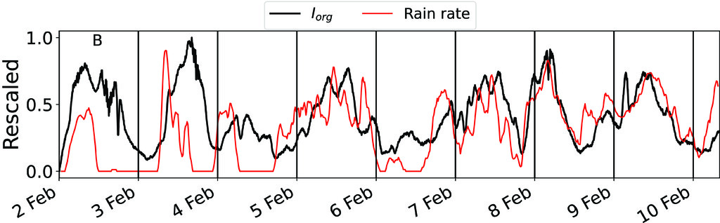
Options with a resolved w threshold often improves the representation of clouds and rain
related to organised convection, but not allways.
We know that often rain is associated with (and sometimes precedes) convective organization.
An extra trigger is added: Threshold on sub-grid evaporation and melting in the convection scheme.
Alessandro Savazzi et al., 2024 JAS

Slide 14
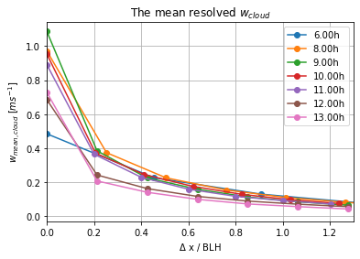
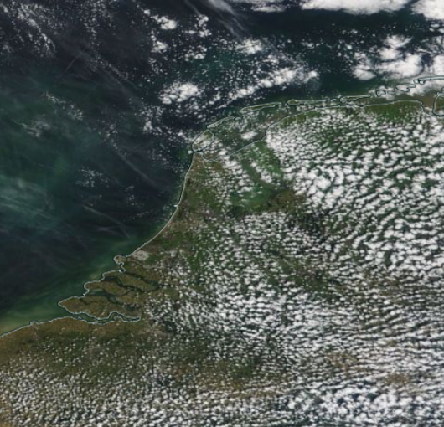
Suitable value for w_threshold?
Should depend on grid size
Guideline by LES? (many cases)
Conditional sampling in LES: Mean convective w
Charlotte Raven

