Slide 1

Some recent physics developments in COSMO for the ICON model
Parameterization of micro-physical source terms (mainly excluding sub-grid heterogeneity):
COSMO-PP CAIIR
ART-component of ICON
Updated droplet activation in connection with new aerosol input
Implementation of Spectral Bin Microphysics (SBM) as a reference
Actions around Aerosols and Reactive Trace gases (ART)
Parameterization of macroscopic sub-grid heterogeneity:
COSMO-action ConSAT
Particular DWD initiative
Consideration of dissipation heating
TKE-feedback on Lower Limits of Diffusion Coefficients (LLDC)
Towards Empirical Hyper-Parameterization by Conditional Adaptive Parameter Tuning (APT)
Matthias Raschendorfer
EWGLAM/SRNPW, Norrköping-Hybrid 2025

Slide 2


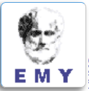



COSMO-Priority-Project
Aerosol-CLoud Interactions in ICON Model (ACLIIM):
September 2024 - August 2027
Total planed FTEs : 6.1
Participants:
Harel Muskatel (IMS)
Pavel Khain (IMS)
Euripides Avgoustoglou (HNMS)
Daniel Rieger (DWD)
Alberto de Lozar (DWD)
Piero Serafini (CETEMPS)
  PL
Matthias Raschendorfer
EWGLAM/SRNPW, Norrköping-Hybrid 2025

Slide 3


Aerosol-CLoud Interactions in ICON Model (ACLIIM) in connection with ICON-ART:
  optical properties (as input for radiation): ext. coeff. (β_{ext}), single scat. alb. (ω), asymm. fact. (g), delta-transm. fact. (f_{d})
  Hu et Stamnes, 1993
  (RG-COSMO, RRTM-ICON)
indirect aerosol effect introduced into ecRAD
  Mi-AI: AI-based ONline
  Mi-scattering
  as part of ICON-ART
  Ray-tracing for randomly distributed hexagonal or ellipsoidal particles (visible bands, Fu, 2007)
  direct aerosol effect
  Hogan et Bozzo, 2018
  (ecRAD-ICON:
  SOCRATES-package)
extended particle-size range (even snow-flakes, hail-stones included)
  Mie-scattering (IR bands, Fu, 1998)
and
sub-grid
effects
  effective radius (R_{eff}) of liquid clouds
  effective radius (R_{eff}) and aspect ratio of particles
  SGS variability
  & cloud water content
  & particle-size distribution
  & mass-size relation
  being further harmonized with
  1- and 2- moment microphysics
  number concentration of activated cloud droplets (CDNC)
  number concentration of activated ice particles
  & hygroscopicity: ‘pyrcl’:
  Rothenberg/Wang, 2016
  & effective updraft wind-speed:
  SGS variability
  Segal/Khain, 2006: 4D Look-Up-Table
  & temperature:
  DeMott, 2015 cloud-ice activation
  local aerosol/dust number concentration (N_{CN} in m⁻³), particle size distribution (mean and standard-deviation)
  mean particle-radius and -density
  interpolation in space and time
  assumed (exponent.) vertical decay
  grid-column integrated mass per m²
  OFFline prognostic or climatologic 4D CAMS aerosols:
  Sulphate, Mineral Dust and Sea-Salt (3 size-bins each), Black Carbon, Organic Matter (hydro-phil. and -phob.)
  ONline prognostic 4D ICON-ART:
  dust, sea-salt and
  Biomass-Burning-aerosols
  assumed extinction coefficient
  2D AOD-550nm climatology (Tanre, Tegen, MACv2 (Kinne), CAMS)
  online prognostic correction
Matthias Raschendorfer
EWGLAM/SRNPW, Norrköping-Hybrid 2025

Slide 4
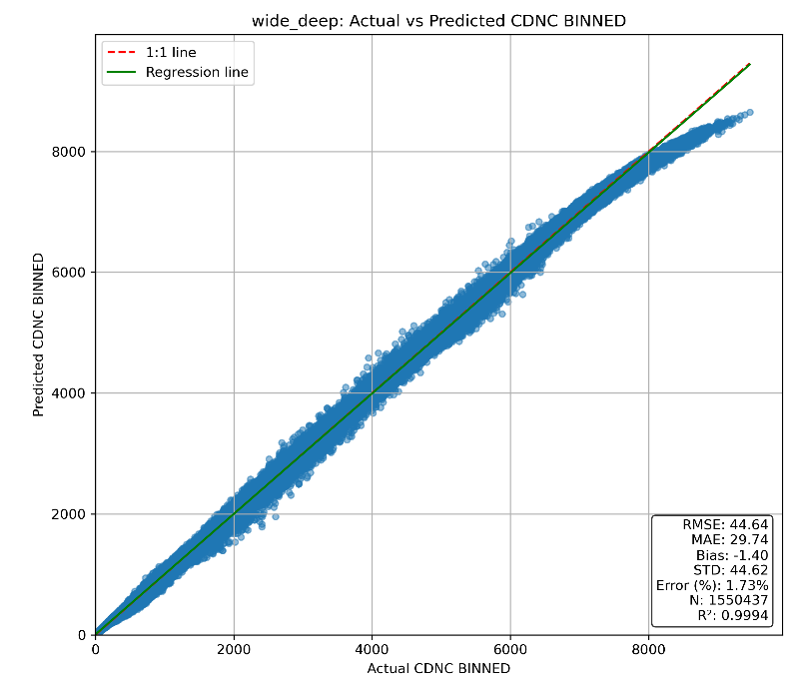
ACLIIM: Optional Droplet Activation by ‘pyrcl’
  CDNC
  + effective updraft wind-speed
  Segal/Khain, 2006: 4D Look-Up-Table
Wide and Deep ML architecture results:
  + initial state:
  updraft speed
  pressure
  temperature
  super-saturation
  ‘pyrcel’: adiabatic cloud-parcel model,
  Rothenberg/Wang, 2016:
  numerical solution of 5 ordinary differential-equs.
  ML-emulation:
  Wide & Deep Model
  CDNC & max. super-saturation
provided by Harel Muskatel (IMS)
4
Matthias Raschendorfer
EWGLAM/SRNPW, Norrköping-Hybrid 2025

Slide 5
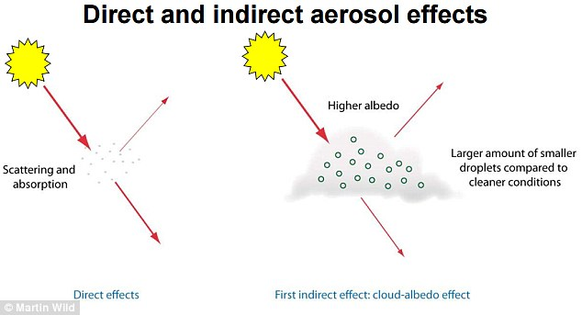
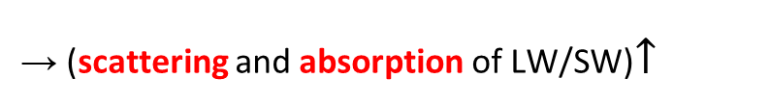
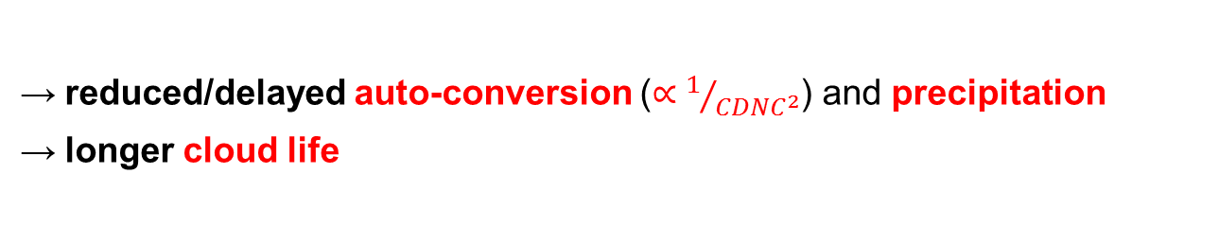
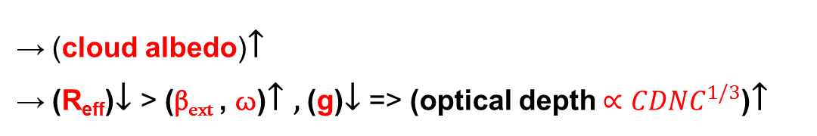
ACLIIM: General Aerosol-Effect:
  direct radiation effect:
  indirect radiation effect:
  more aerosols
  (scattering and absorption of LW/SW)$↑$
  (cloud albedo)$↑$
  (R_{eff})$↓$> (β_{ext} , ω)$↑ ,$ (g)$↓$ => (optical depth$∝{CDNC}^{1/3}$)$↑$
  microphysical effect:
  reduced/delayed auto-conversion ($∝1/{{CDNC}^{2}}$) and precipitation
  longer cloud life
according to ACLIIM-Plan
5
Matthias Raschendorfer
EWGLAM/SRNPW, Norrköping-Hybrid 2025

Slide 6
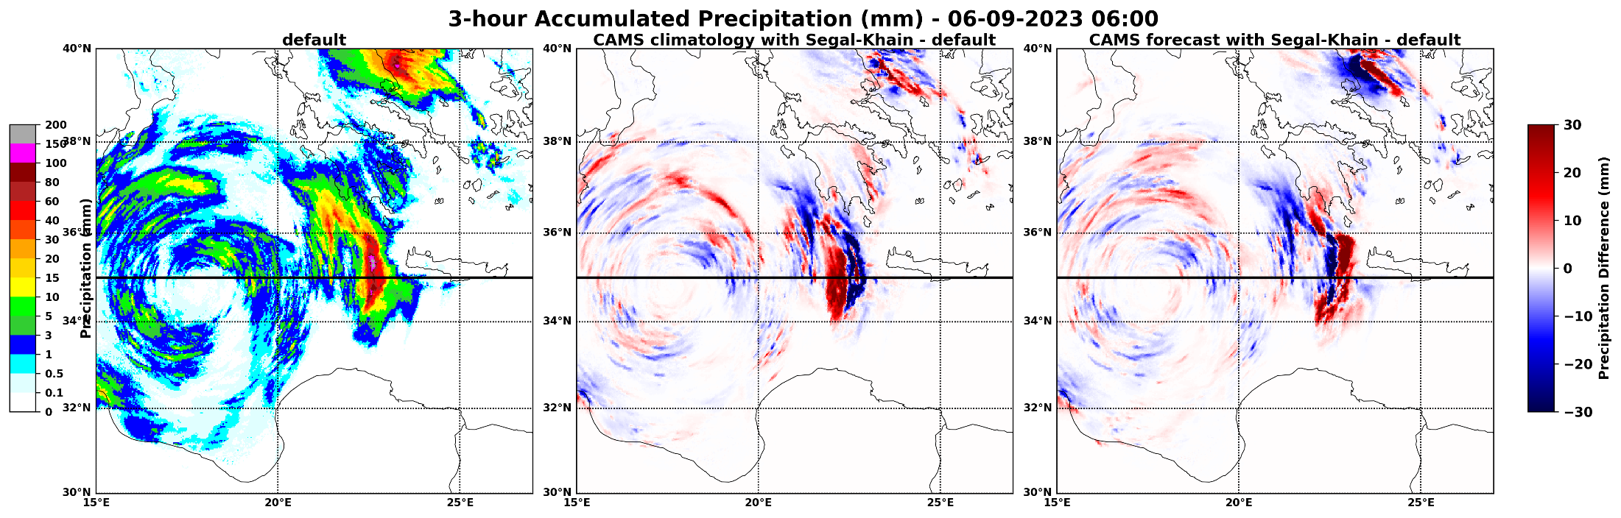
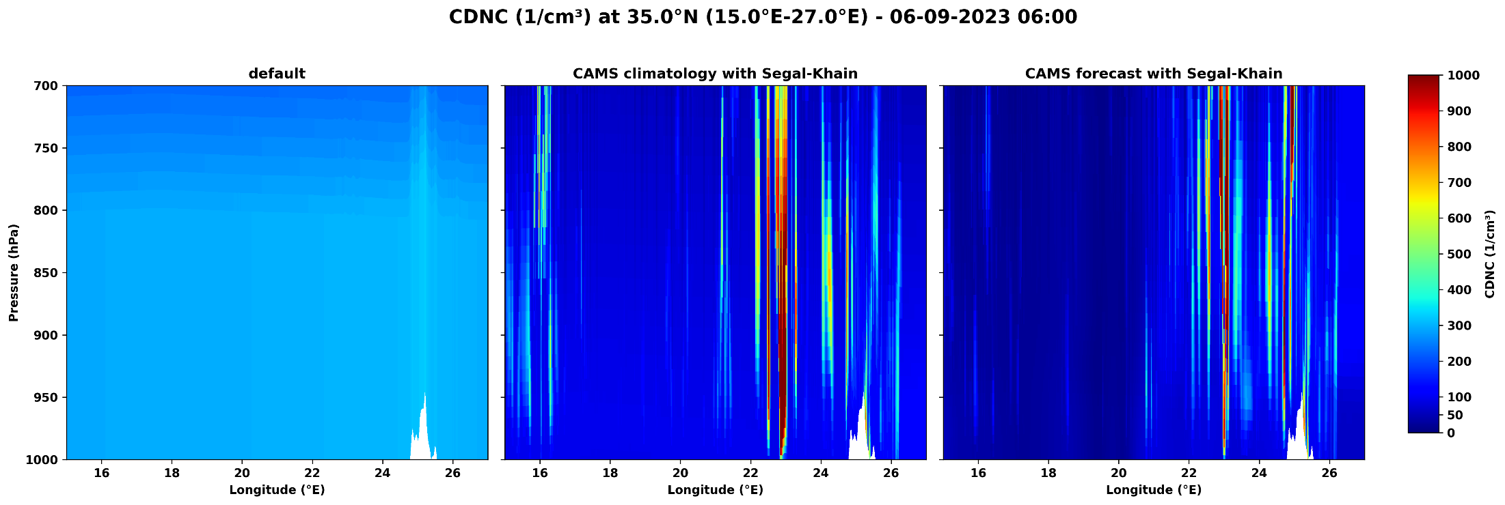
ACLIIM: Precipitation and CNCD
Precipitation (mm)
  CDNC (cm⁻³) at 35.0°N (15.0 – 26.0)°E – 06.09.2023 06:00
2D AOD-550nm climatology (with prognostic correction and constant R_{eff})
provided by Harel Muskatel (IMS)
6
Matthias Raschendorfer
EWGLAM/SRNPW, Norrköping-Hybrid 2025

Slide 7
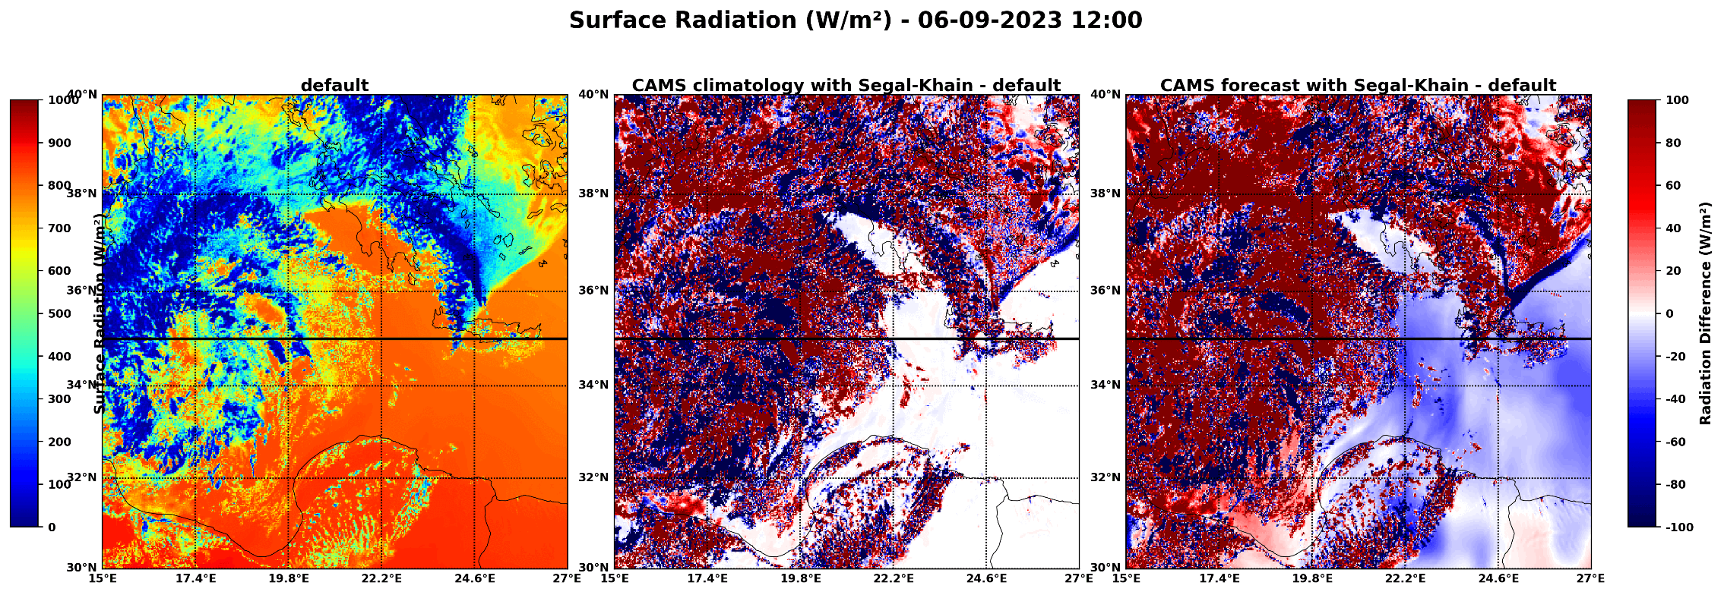
ACLIIM: Surface-Radiation
Aerosols-Radiation:
2D AOD-550nm climatology
(with prognostic correction and constant R_{eff})
Aerosols-Radiation:
CASM climatology
Aerosols-Radiation:
CASM forecast
Surface Radiation (W/m²)
provided by Harel Muskatel (IMS)
7
Matthias Raschendorfer
EWGLAM/SRNPW, Norrköping-Hybrid 2025

Slide 8

ACLIIM: Spectral Bin Microphysics in ICON
16
Mixed-Phase Spectral-Bin Microphysics (SBM)
  as a sophisticated reference
  66 bins: droplets + CCN tracers
  runs about 7-times slower than 1-mom scheme
Comparison of SBM against 2-mom scheme:
SBM shows reasonable behavior
strong sensitivity to CCN
Example:
  Cumulonimbus development (Weisman-Klemp 1982)
12
QC+QR (g/kg)
8
4
0
50km
Khain, P., J. Shpund, Y. Levi and A.P. Khain, 2022. Atmos. Res., 279, 106388.
provided by Pavel Khain (IMS)
8
Matthias Raschendorfer
EWGLAM/SRNPW, Norrköping-Hybrid 2025

Slide 9

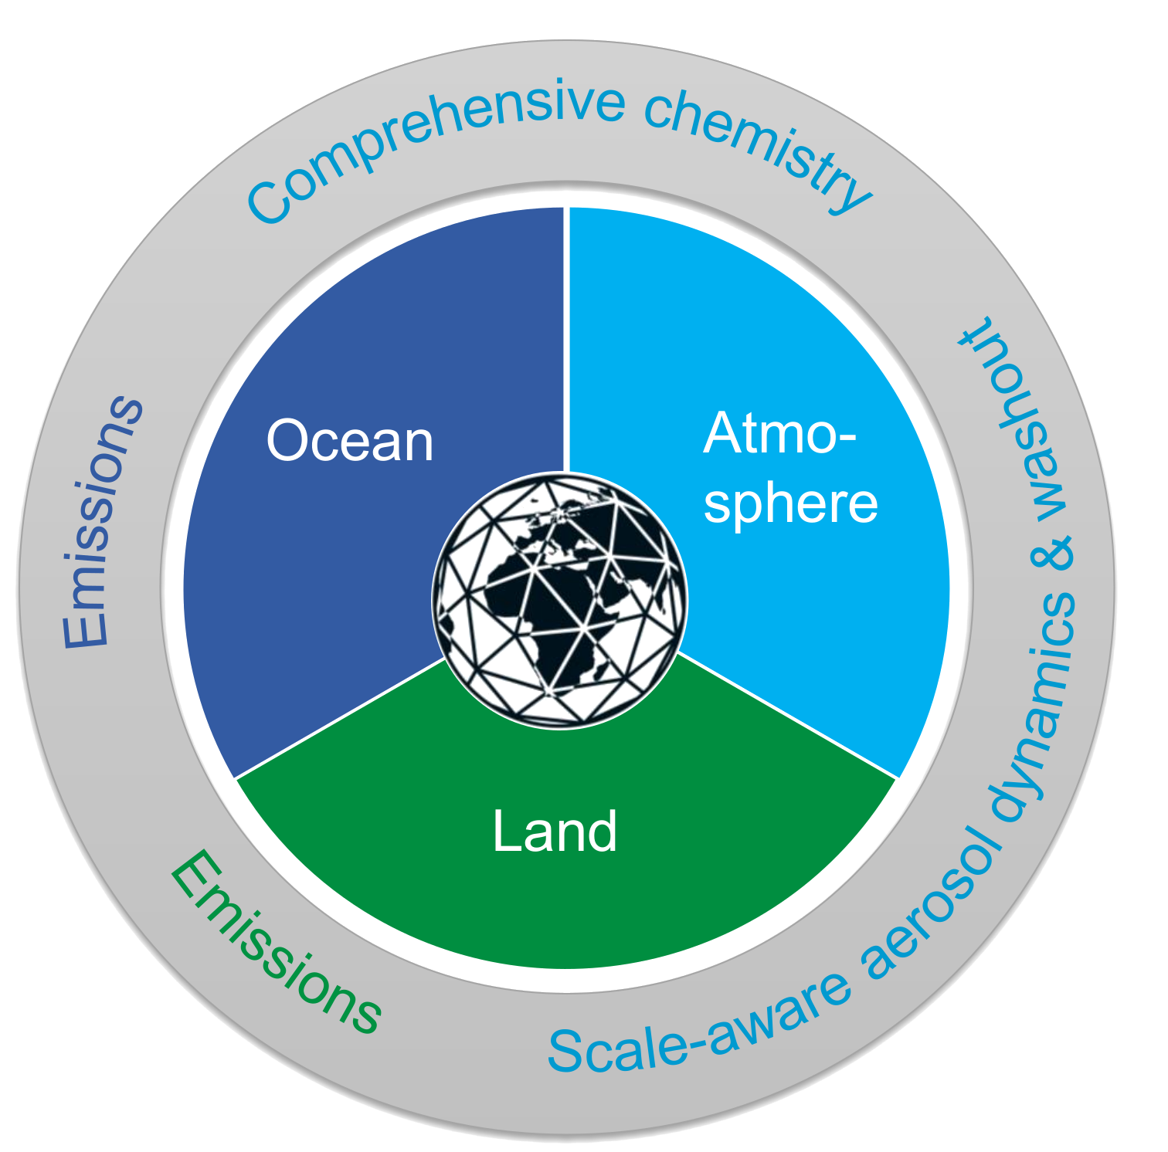

HErZ project (2023-2027)
Preparing ICON-ART for seasonal to decadal climate predictions in seamless regional to global model configurations
→ ICON-Seamless + ART = ICON-SmART
Emissions of natural aerosols and trace gases from fully coupled and interactive ocean and land modules
Comprehensive atmospheric chemistry (troposphere and stratosphere) → optimization and acceleration
ML-based and scale-aware aerosol dynamics and washout
Multi-year simulation with full chemistry- and aerosol-treatment
provided by Ali Hoshyaripour (KIT)
9
Matthias Raschendorfer
EWGLAM/SRNPW, Norrköping-Hybrid 2025

Slide 10
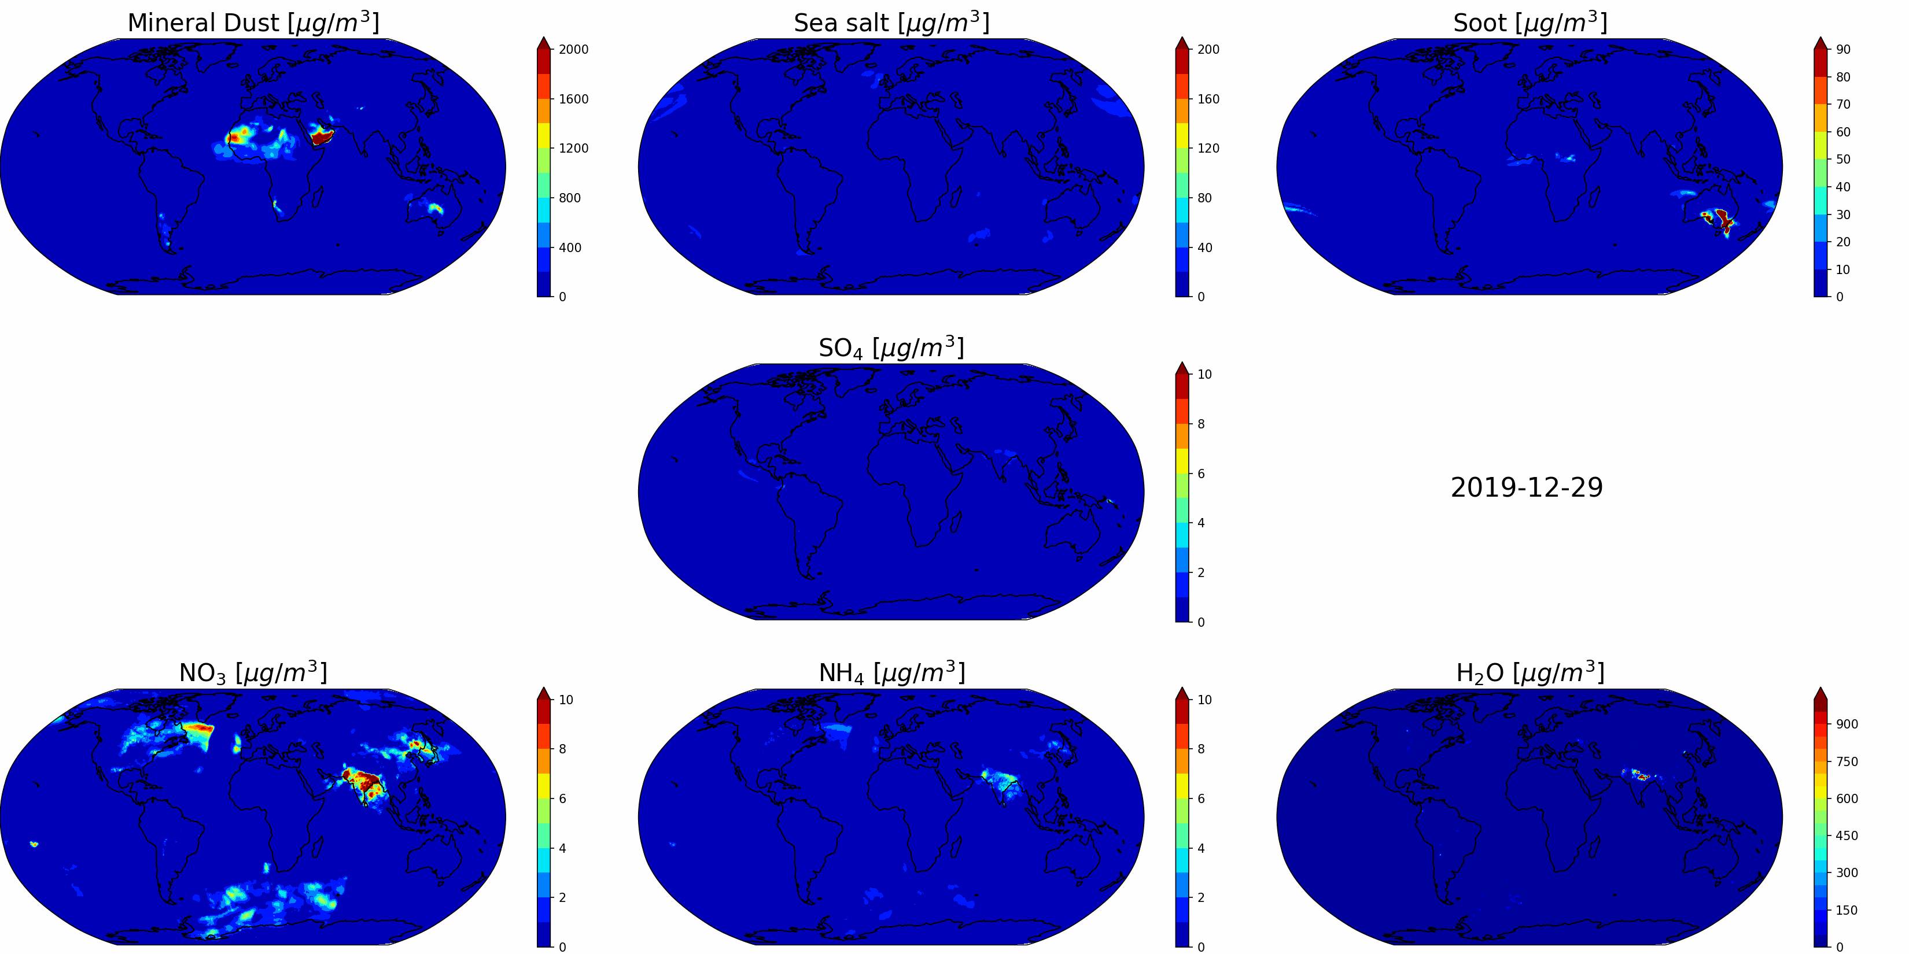
Preliminary results: aerosols
Evaluation and acceleration in progress!
provided by Sanhita Ghosh and Pankaj Kumar (KIT)
10
Matthias Raschendorfer
EWGLAM/SRNPW, Norrköping-Hybrid 2025

Slide 11
Consolidation of Surface-to-Atmosphere Transfer (ConSAT)
Thermodynamic coupling of Sub-grid Kinetic Energy (SKE) according to STIC :
STIC: Separated Turbulence Interacting with NTCs
  Circulation Kinetic Energy
  Turbulent Kinetic Energy
  MKE
  Mean Kinetic Energy
  D-SSO: Dynamic SSO-scheme: induced sub-grid wakes and gravity waves
  SHS: Separated Horizontal Shear Eddies
  (part of TURBDIFF-code)
  D-SSO, SHS
  Shear/Form-Drag
  CKE
  TKE
  Buoyancy
  T-SSO: Thermal SSO-scheme: sub-grid ana- and katabatic circulations (part of TURBDIFF-code, totally revised version in ICON-branch ‘mrturb’)
  CON: Convection scheme: buoyancy driven plumes
  Dissipation
  T-SSO, CON
  Potential Thermal Enthalpy
  PTE
  Radiation
Heating by dissipation of TKE has been neglected so far due to numerical problems
  SRE
  Spatial/Solar Radiation Energy
A stable approximation of dissipative heating (through neglecting the buoyancy impact) shows a significant impact!
Matthias Raschendorfer, Günther Zängl (DWD)
11
Matthias Raschendorfer
EWGLAM/SRNPW, Norrköping-Hybrid 2025

Slide 12
Consolidation of Surface-to-Atmosphere Transfer (ConSAT)
STIC and the crucial impact of Lower Limits of turb. Diff.-Coeff. (LLDC):
STIC: Separated Turbulence Interacting with NTCs
production terms dependent on:
specific length scales
and a specific velocity
scale ( )
related to NTCs, such as:
SSO-generated wakes and thermals,
separated horizontal shear-eddies,
convective vertical currents
production terms depend on:
turbulent length scale and the turbulent velocity scale ( )
NTC: Non-Turbulent SGS Circulation
  CKE
  TKE
The scale interaction term shifts Sub-grid KE from the NTC part of the spectrum (Circulation KE)
towards the turbulent part (TKE) by virtue of shear
generated by the sub-grid circulation flow patterns.
substituting not yet properly represented STIC-terms!
TKE needs to be adapted to !
turbulent master length scale
Excess of over is due to missing shear by NTCs
turbulent diffusion coefficient:
artificially limited by a LLDC
Excess of over is due to missing SGS pressure-
forces in momentum budget !!
turbulent velocity scale
Additional TKE-production and dissipative heating
with some empirical conditional scaling
stability function
scalars like Heat
Momentum
Matthias Raschendorfer (DWD)
12
Matthias Raschendorfer
EWGLAM/SRNPW, Norrköping-Hybrid 2025

Slide 13
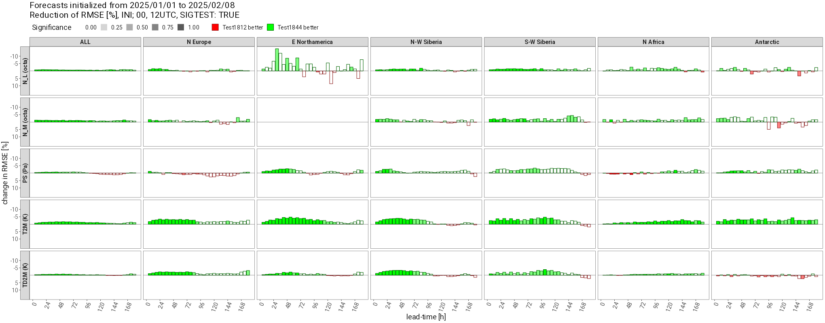
Consolidation of Surface-to-Atmosphere Transfer (ConSAT)
Impact of STIC-corrections to NWP:
  Quite large positive impact of “consideration of dissipative heating” in combination with “TKE-adaptation to LLDCs”
  (much more than expected)!
  Strong reduction of the long-standing cold-bias along the Antarctic cost during winter time
  Strong reduction of regional cold-bias during winter at the Northern Hemisphere
REF better
EXP better
Matthias Raschendorfer, Günther Zängl (DWD)
13
Matthias Raschendorfer
EWGLAM/SRNPW, Norrköping-Hybrid 2025

Slide 14
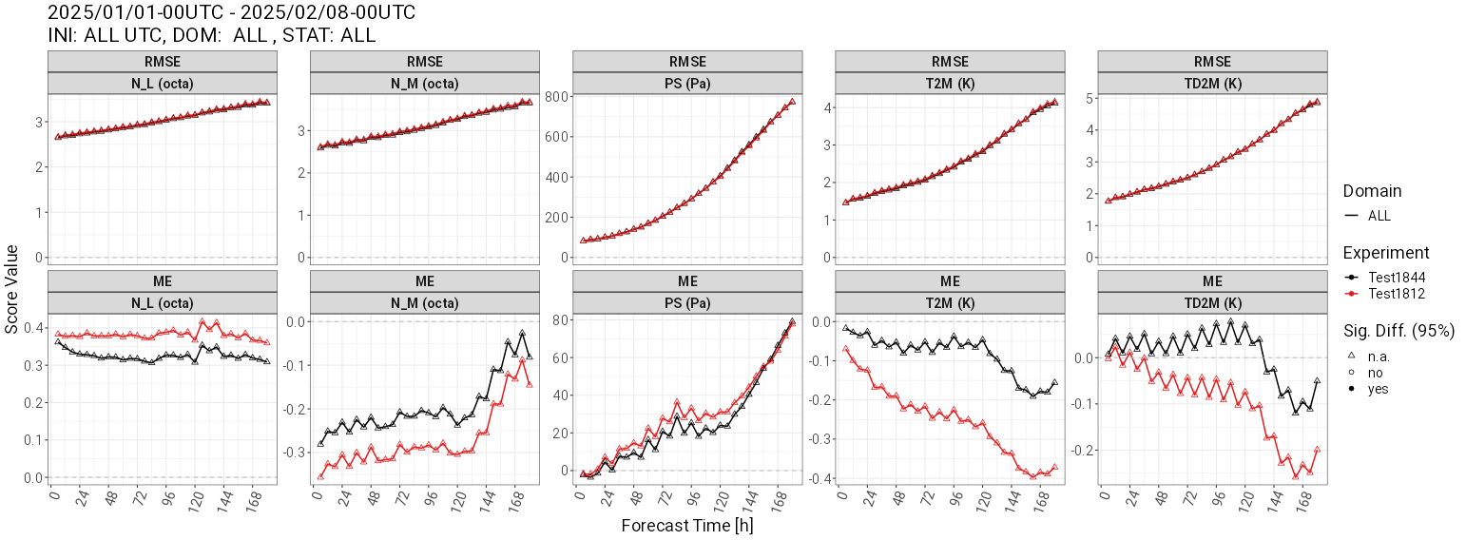
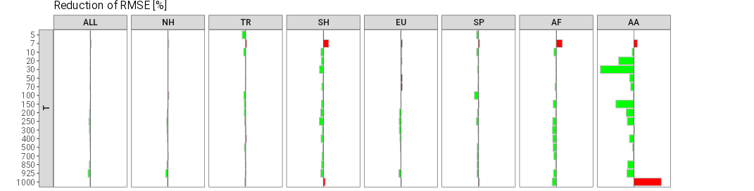
Consolidation of Surface-to-Atmosphere Transfer (ConSAT)
Impact of STIC-corrections to NWP:
EXP
REF
EXP. better
REF. better
Matthias Raschendorfer, Günther Zängl (DWD)
14
Matthias Raschendorfer
EWGLAM/SRNPW, Norrköping-Hybrid 2025

Slide 15
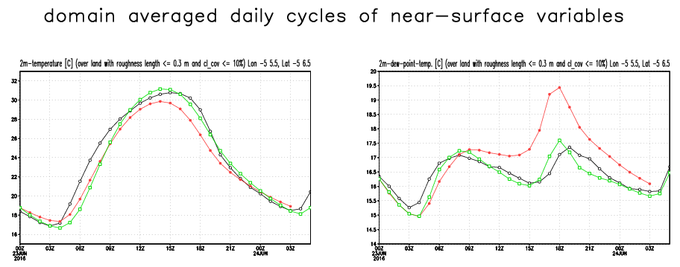
Consolidation of Surface-to-Atmosphere Transfer (ConSAT)
Treating the long-standing moist and cold near-surface bias at late afternoon
A prototypic canopy scheme in the COSMO-model has already proven to cure the problem
Has not yet been implemented into ICON due to strategic reasons
T_2m
TD_2m
amplitude slightly overestimated
removed cold bias in the afternoon!
almost perfect double wave!
Cover from roughness-elements
with its own heat-budget
SAI-dependent number of semi-transparent layers
Thermal layer-coupling by
SHF and LRF
SAT from cover-layers according to generalized BLA
still some problems
during heating of the cover (stable stratification within the roughness layer)
direct analysis of
near-surface variables
revised TURBDIFF
imported from ICON
revised TURBDIFF imported from ICON
+ new decoupled surface cover (canopy-scheme)
Matthias Raschendorfer (DWD)
15
Matthias Raschendorfer
EWGLAM/SRNPW, Norrköping-Hybrid 2025

Slide 16
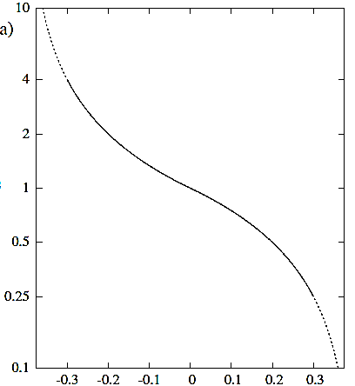
Consolidation of Surface-to-Atmosphere Transfer (ConSAT)
Approaching Hyper-Parameterization by Adaptive Parameter Tuning (APT):
  i = 1 2 3 4
  Time-filtered DA-increments of and at the lowermost model level
  Dominated by measurements of
  adapting to weather condition
  Proxies for local systematic error of (near-surface) and - amplitude
  Used as predictors for multiplicative empirical correction-factors for non-confident parameters:
  that appear to be dependent on the model state
  Land-use roughness and SSO blocking tendency
  Minimal evaporation resistances of bare soil and plant-stomata
  Heat-conductivity and -capacity
  Snow-albedo
  Minimal diffusion coefficient
  Hydraulic diffusivity of uppermost soil layer
  introduced last year
  Albedo of snow-free land-fraction
  Scaling factor in snow-fraction diagnostics
  function of model state: hyper-parameterization
  default value of (internal-global or external-local) parameter
https://rmets.onlinelibrary.wiley.com/doi/10.1002/qj.4535
according to Günther Zängl (DWD)
16
Matthias Raschendorfer
EWGLAM/SRNPW, Norrköping-Hybrid 2025

Slide 17
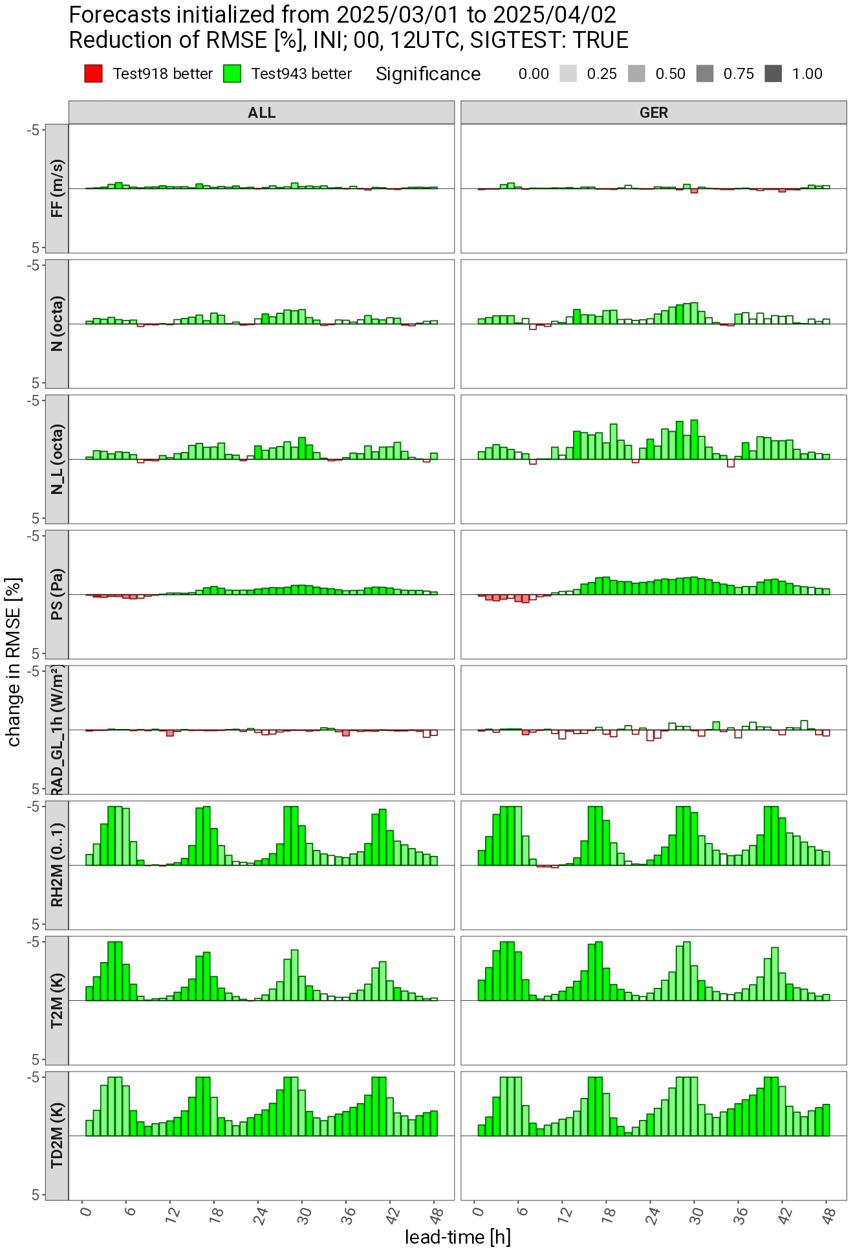
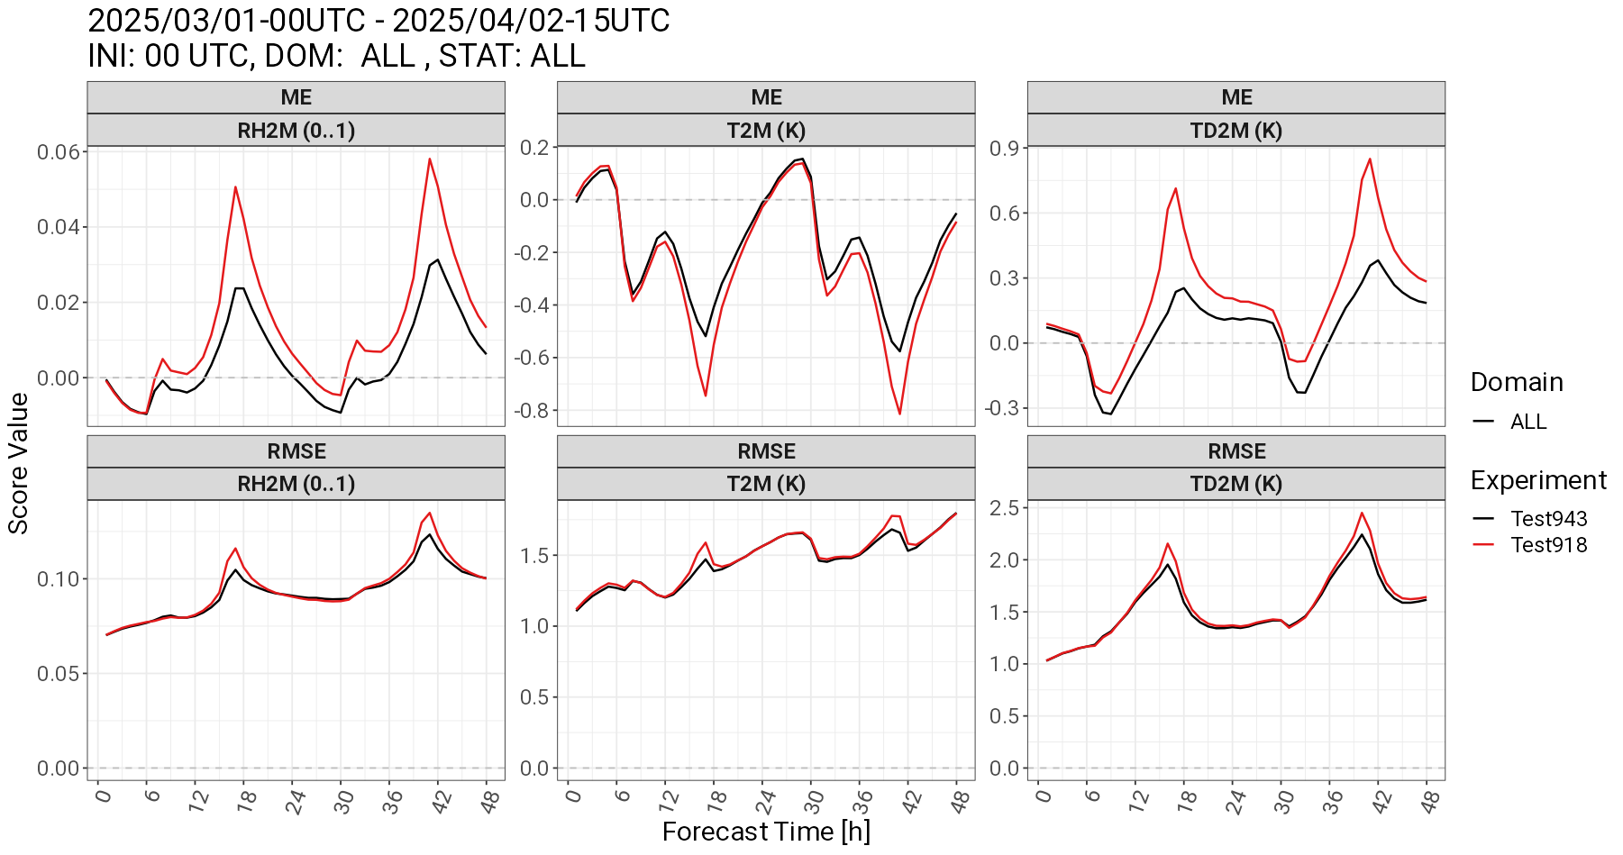
Consolidation of Surface-to-Atmosphere Transfer (ConSAT)
Reducing the moist and cold near-surface bias at late afternoon by conditional APT:
  by means of the predictor
(SHFL+LHFL) < 0 .AND. SHFL > 0 => increasing laminar resistance of scalar SAT
(SHFL+LHFL) < 0 .AND. LHFL_bare_soil < 0.25*SHFL => increasing pore resistance for bare-soil evap.
Reduced (upward) evaporation (LHFL < 0) at late afternoon
REF. better
EXP better
EXP
REF
Günther Zängl (DWD)
17
Matthias Raschendorfer
EWGLAM/SRNPW, Norrköping-Hybrid 2025

Slide 18
Some recent physics developments in COSMO for the ICON model
Conclusion (1):
COSMO-PP CAIIR
ART-component of ICON
Parameterization of micro-physical source terms (mainly at homogeneous conditions):
Updated droplet activation in connection with new aerosol input
More sophisticated activation according to Segal/Khain with CAMS aerosol-input: Significant impact on clouds and precipitation
ML-emulated parcel model ‘pyrcl’ is promising
Implementation of Spectral Bin Microphysics (SBM) as a reference
Mixed-phase SBM fully implemented: technically working with reasonable results
Actions around Aerosols and Reactive Trace gases (ART)
ICON-SmART: Preliminary results of seamless multi-year simulations of Aerosol and Reactive Tracer emissions with related chemistry and dynamics, aided by ML components
Empirical Hyper-Parameterization by Conditional Adaptive Parameter Tuning (APT)
Matthias Raschendorfer
EWGLAM/SRNPW, Norrköping-Hybrid 2025

Slide 19
Some recent physics developments in COSMO for the ICON model
Conclusion (2):
COSMO-action ConSAT
Particular DWD initiative
Parameterization of macroscopic sub-grid heterogeneity:
Consideration of dissipation heating
Dissipation heat-source due to conversions from MKE: Significant reduction of temperature-bias at winter time,
particularly along Antarctic coast
TKE-feedback on Lower Limits of Diffusion Coefficients (LLDC)
Missing link according to STIC-concept
Increases the positive impact from dissipation heating
Towards Empirical Hyper-Parameterization by Conditional Adaptive Parameter Tuning (APT)
“Verification-based” adaptations of parameters with DA-increments as predictors
Impact of a missing canopy scheme can partly be emulated:
Significant reduction of cold and moist near-surface bias at late afternoon
Should be extended by ML -> possible hybrid AI-WP approach
Empirical Hyper-Parameterization by Conditional Adaptive Parameter Tuning (APT)
Matthias Raschendorfer
EWGLAM/SRNPW, Norrköping-Hybrid 2025

