Slide 1

47th EWGLAM and 32nd SRNWP workshop
National and thematic posters

Slide 2
National posters

Slide 3

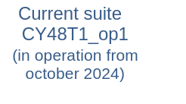
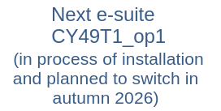
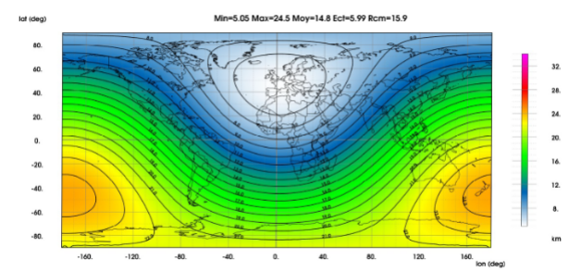
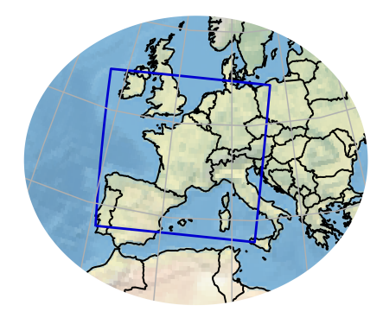
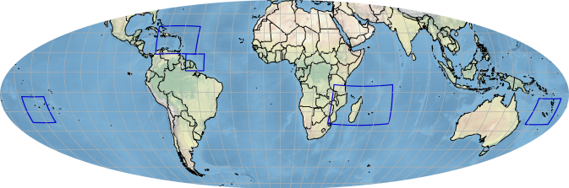

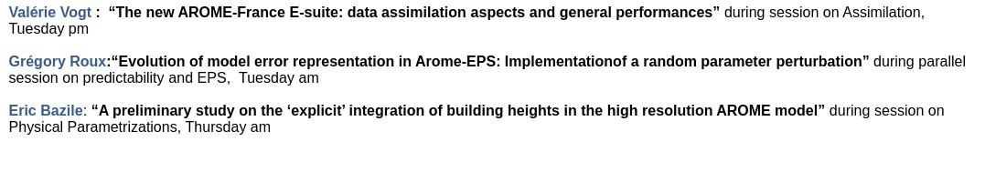
NWP systems @ Meteo-France : quick overview
Cécile LOO
Global system
LAM system
LAM overseas systems

Slide 4
Croatian Meteorological and Hydrological Service, Croatia, Endi Keresturi
All-sky assimilation of IASI data
• Conventional clear-sky data assimilation only considers data from regions without clouds. In preparation for the future hyperspectral infrared sounders, the assimilation of multilayer cloud-affected infrared radiances using the all-sky approach.
• Analyzing the cases, it was concluded that dynamical assignment of observation errors for all-sky channels performs as intended, and this setup can be used as the base for further development.
Visibility forecasting using neural networks
• Visibility forecasting using Long Short-Term Memory (LSTM) neural network is performed using ALADIN-HR40 NWP predictions and visibility observations at one airport location.
• LSTM generally outperforms ALADIN-HR40 during the first forecast day, while being comparable on the second and third forecast days in predicting low-visibility (below 2 km) occurrence in 12-hour windows.
Temperature post-processing using machine learning
• All tested ML models result in lower RMSE for all lead time hours compared to the raw ALADIN-HR40 and the currently operational analog-method-based post-processing.
• For the extremes, ML models still underperform compared to the NWP.
Verification of operational ALADIN-HR forecasts
• Two articles regarding the verification of operational ALADIN forecasts were submitted to the Croatian Meteorological Journal.
• Post-processed analog-based forecast ALADIN-HRAN shows superior results overall.

Slide 5
Summary of national poster ＠JMA, Japan, Masahiro Sawada
•The physical parameterizations of the Meso-Scale Model (MSM) with a horizontal grid spacing of 5-km has been improved in May. 2025.
•Horizontal grid spacing of the Local Forecast Model (LFM) is planned to be enhanced from 2-km to 1-km in Mar. 2026.
•LFM-based ensemble prediction system (LEPS) with 2-km horizontal grid spacing with 21-member is under experimental operation, and is planned to be operational in Mar. 2026.

Slide 6
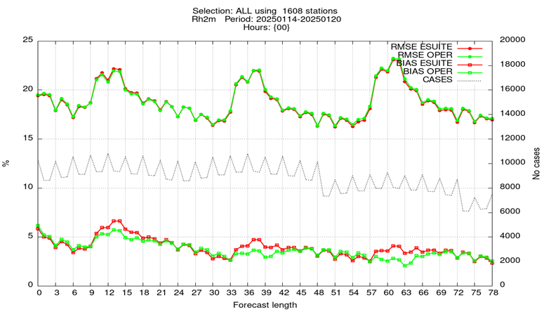
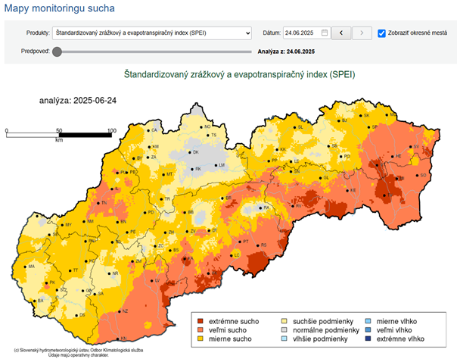
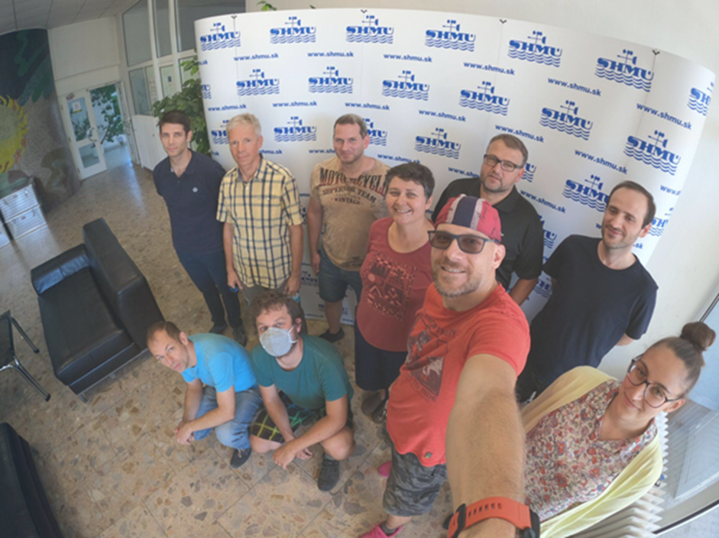
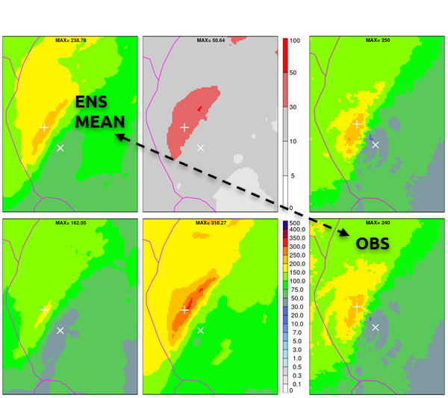
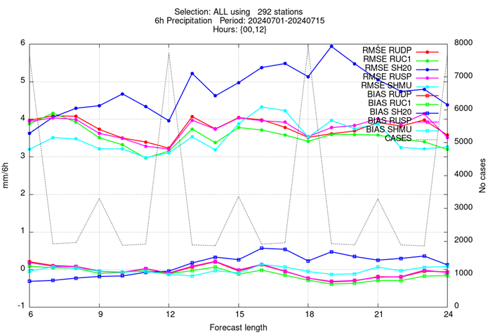
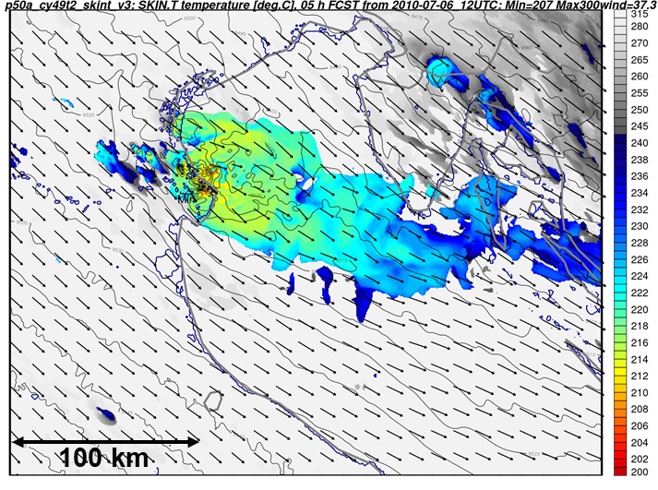
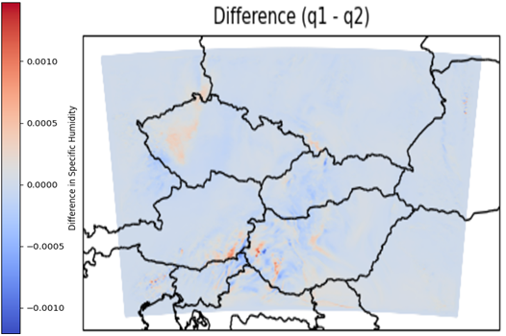
Slovak Hydrometeorological Institute, Slovakia
Presented by Oldřich Španiel
Massive exodus of NWP experts from SHMU
Upgrade of ALADIN/SHMU to 87 levels
Drought monitoring - SPEI index
6 colleagues out of 11 left SHMU, including our head, Mária Derková (Mariska)
prolonged integration (102h), new outputs, VARBC for ZTD, etc.
A-LAEF and ECMWF-EPS used in the forecast part of SPEI
ALA1: Radar assimilation
test suite
Single precision development
DE-330 project studies
6 hourly, +6h forecast, cases
Tested in 1 km resolution RUC
750m EPS, floods + severe convection

Slide 7

Summary of national poster of IMGW-PIB (Andrzej Mazur, Poland)
COSMO-CE PL - version 5.1 - is run in several spatial resolutions - 7km, 2.8km (deterministic), 2.8km (ensemble)
ICON-PL - version 2.6.2.2 - is run in equivalent space resolution of 2.5km.
COSMO-RUC, nowcasting forecast system is run in 2.8km/1hour (10 min.) spatio-temporal resolution, as the source of data for forecasts of precipitation field, hail detection or detection and nowcasting of precipitation type.
The results of the COSMO and ICON studies were compared to find the strengths and weaknesses of both models.
OBS: Transferring to a new computing server requires re-setting all runtime operational systems.
Several projects were carried out as part of R&D work (COSMO Priority Projects and/or Tasks) such as
Application of Personal Weather Station and Opportunistic Sensor Data CrowdSourcing (APOCS)
City Induced Temperature change Through Advanced modelling (CITTA)
Early warninG and AnaLysIs sysTEm for release and dispersion of contaminants (EGALITE)

Slide 8
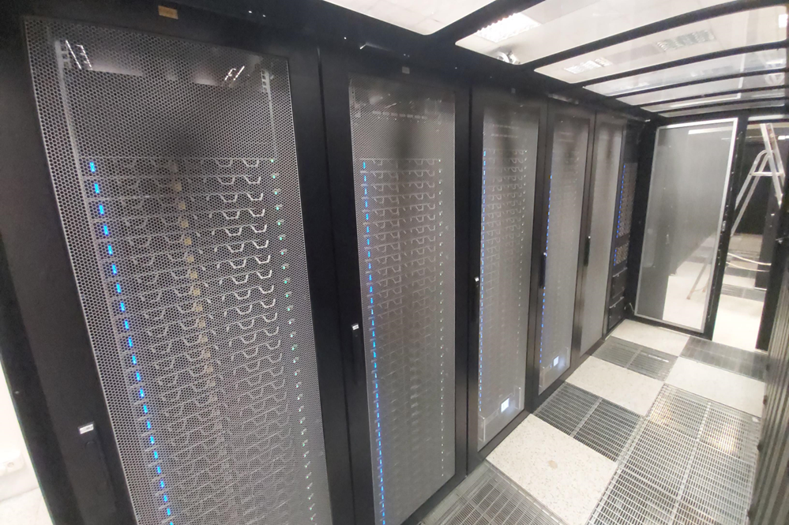
NWP in Poland
Marcin Kolonko, ACCORD team at IMGW-PIB Kraków
New operational computer clusters - SAWA and KRAK
ALARO CY46 verification tests with resolution 2.45 km,
70 vertical levels and 90 s timestep.
(for details refer to Piotr Sekuła, present in situ)
Examining timestep dependence of snowmelt in D95 in SURFEX for mountain station Hala Gąsienicowa (1523 m a.s.l.). Role of XTAU_SMELT. Work by Gabriel Stachura.
SAWA cluster
FourCastNet - AI-driven global model. Cascading Ensemble Method (CEM) compared to original ensemble forecasting method (ENS). Spread, BIAS, RMSE and CRPS scores of T2m (graphs in poster) and mslp. Work by Jadwiga Róg.
X-term treatment in vertical divergence variable, Calculation of X-term directly from model variables. ND4SYS=0 gives 7% CPU time saving and removal of spurious chimneys over orographic obstacles and removal of time oscillations of averaged spectral norms (graphs in poster). Work by Natalia Szopa.

Slide 9
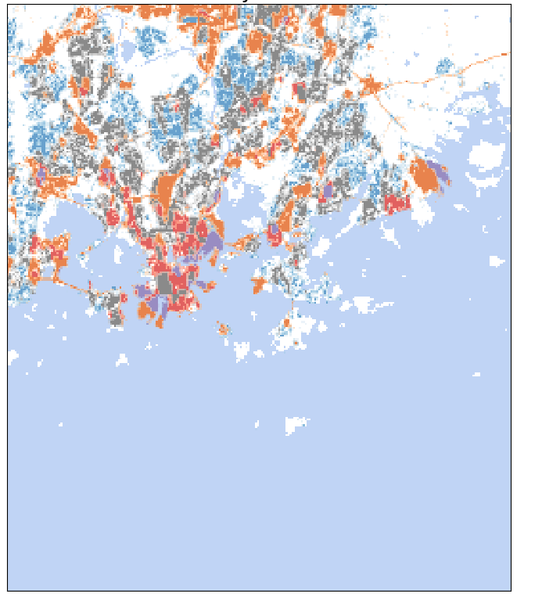
SRNWP activities at FMI in 2025
Presented by Reima Eresmaa
Extending geostationary satellite data coverage in the MetCoOp forecasting system
  Study demonstrates that valuable atmospheric information can be extracted from SEVIRI even at extreme viewing angles North of 60ºN latitude
Fine resolution ML-based physiography for NWP
  New, 60-m spatial resolution cover map ECO-SG-ML has been evaluated
  To enable the use of the cover map with SURFEX, LAI and albedo fields need to match the new cover map
Heat-related climate risk analysis for Helsinki
  A study utilizing the 60-m resolution cover map analysed the heat-related risks in current and future climates
  The study modelled surface conditions in Helsinki at 100 m resolution with SURFEX
Helsinki urban land use at 100 m resolution

Slide 10
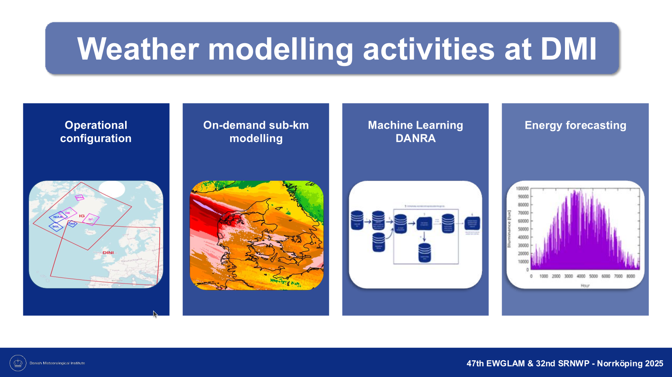

Slide 11
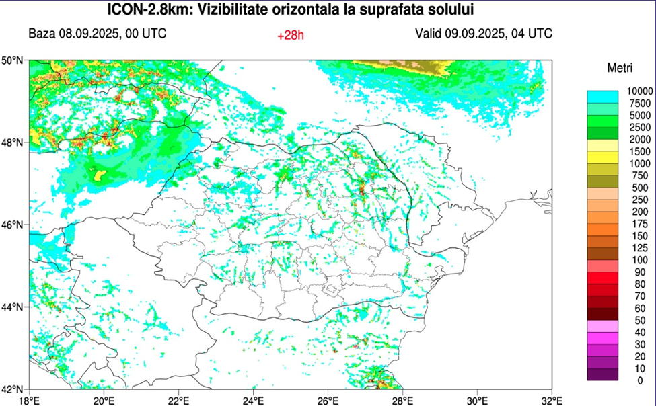
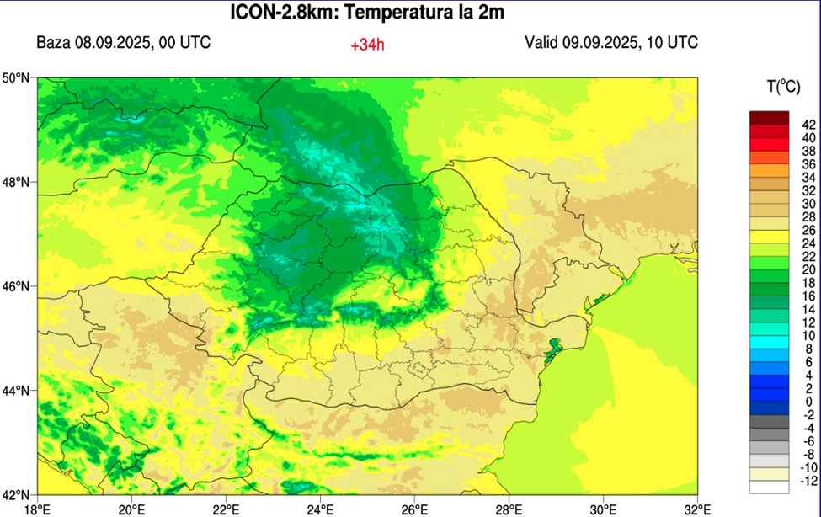
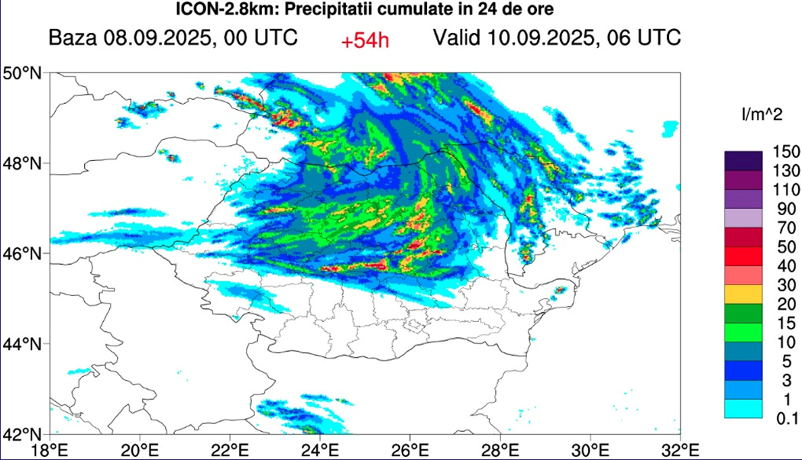
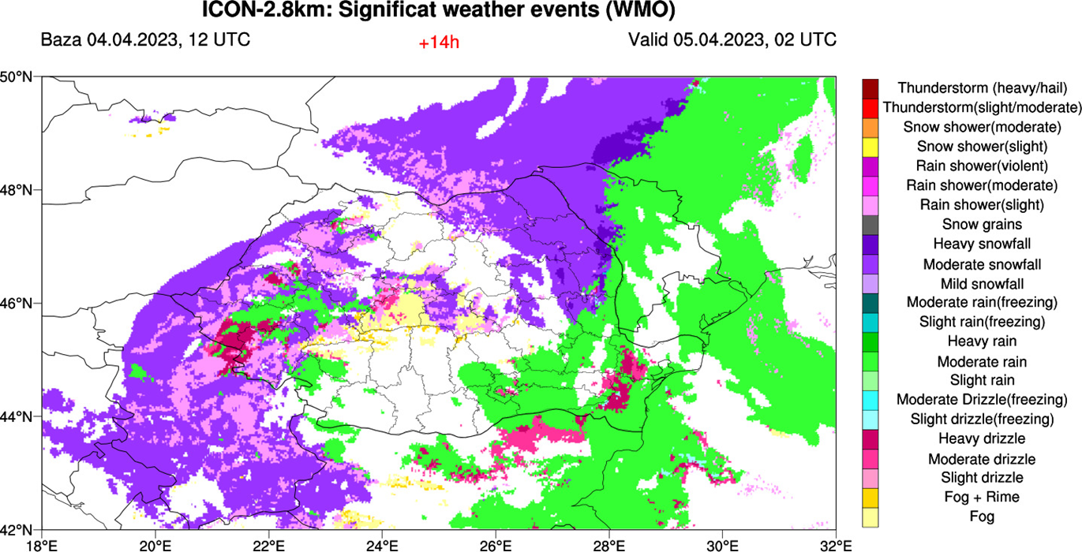
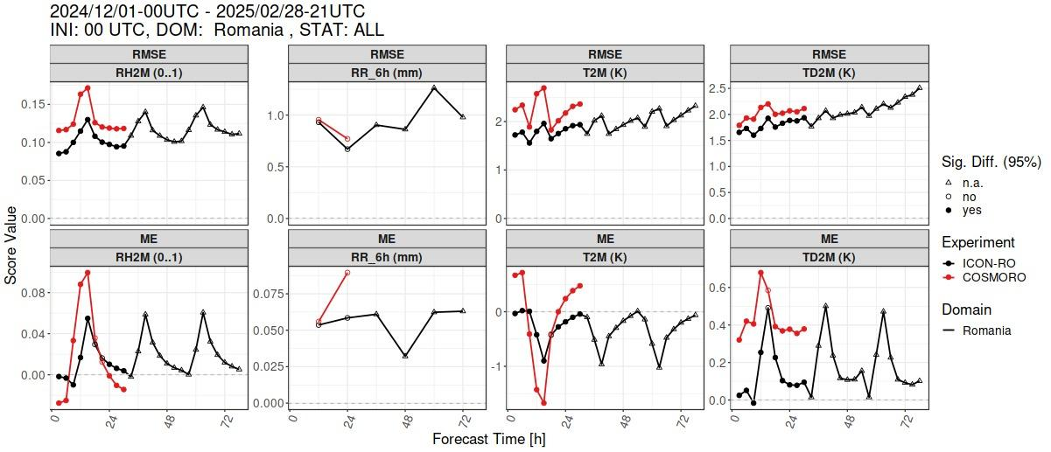
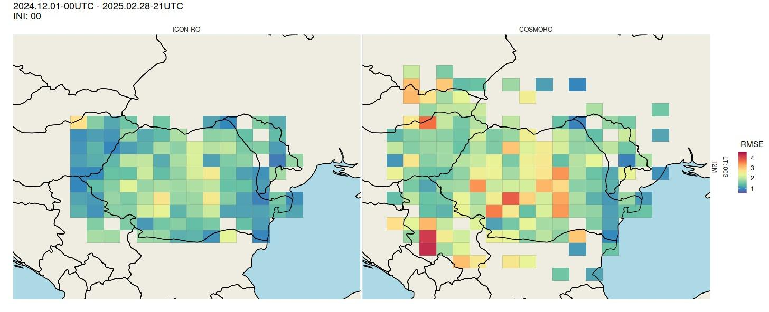
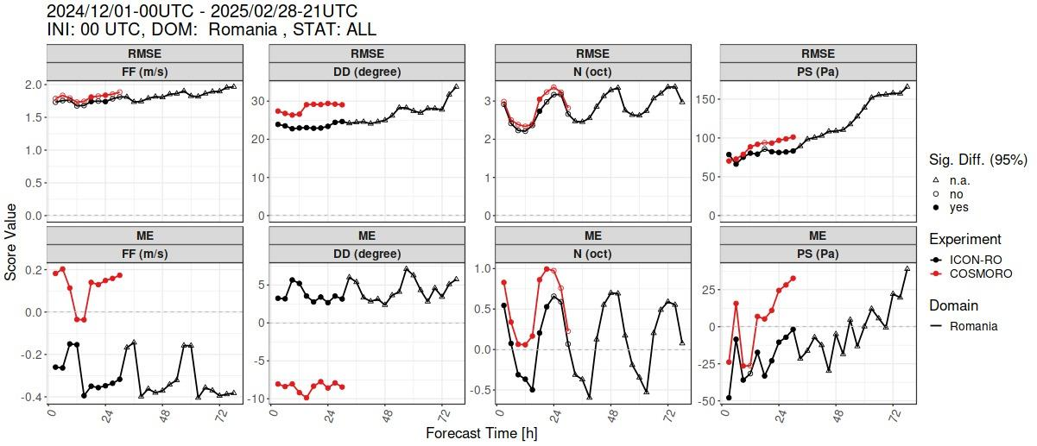
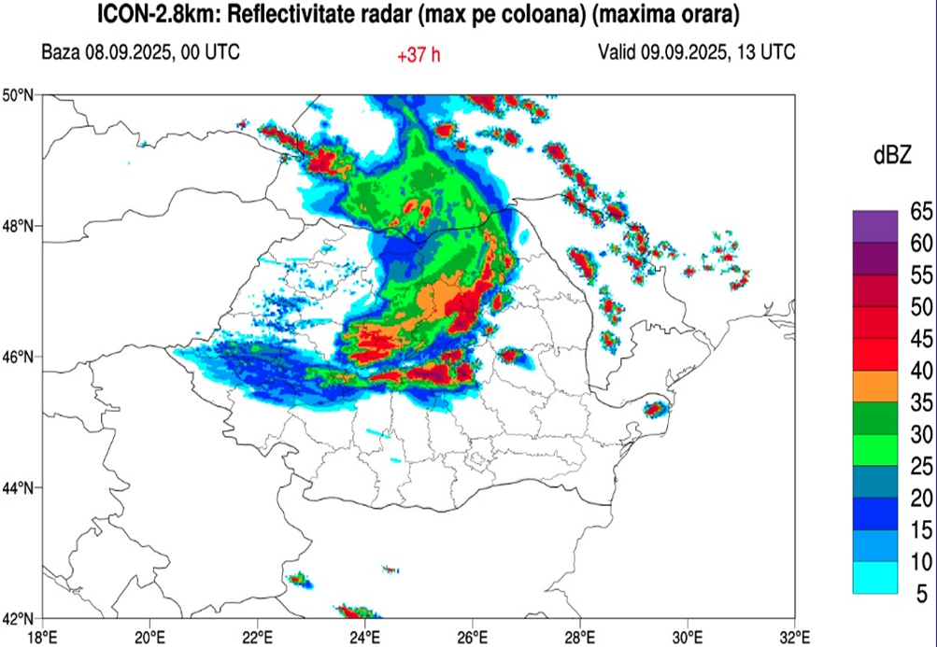
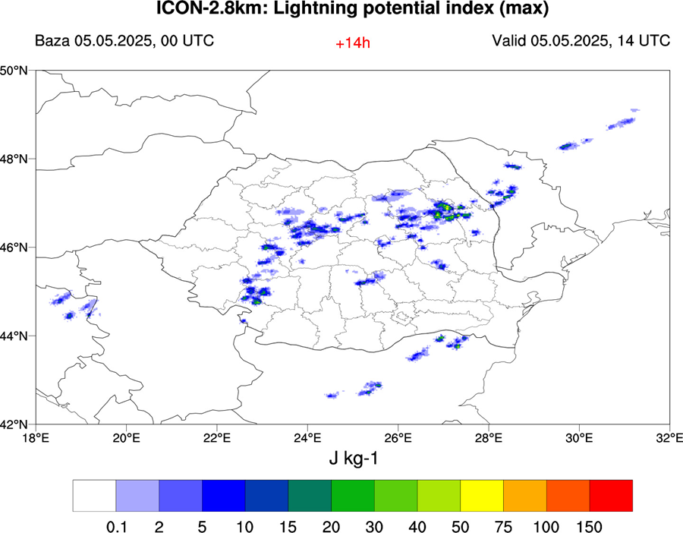
Numerical Weather Prediction using ICON-LAM-2.8km for Romanian territory,
Ștefan Dinicilă - National Meteorological Administration, Romania
• ICON RO -2.8km operational suite
• Verification results
• Testing dedicated products
for forecaster

Slide 12

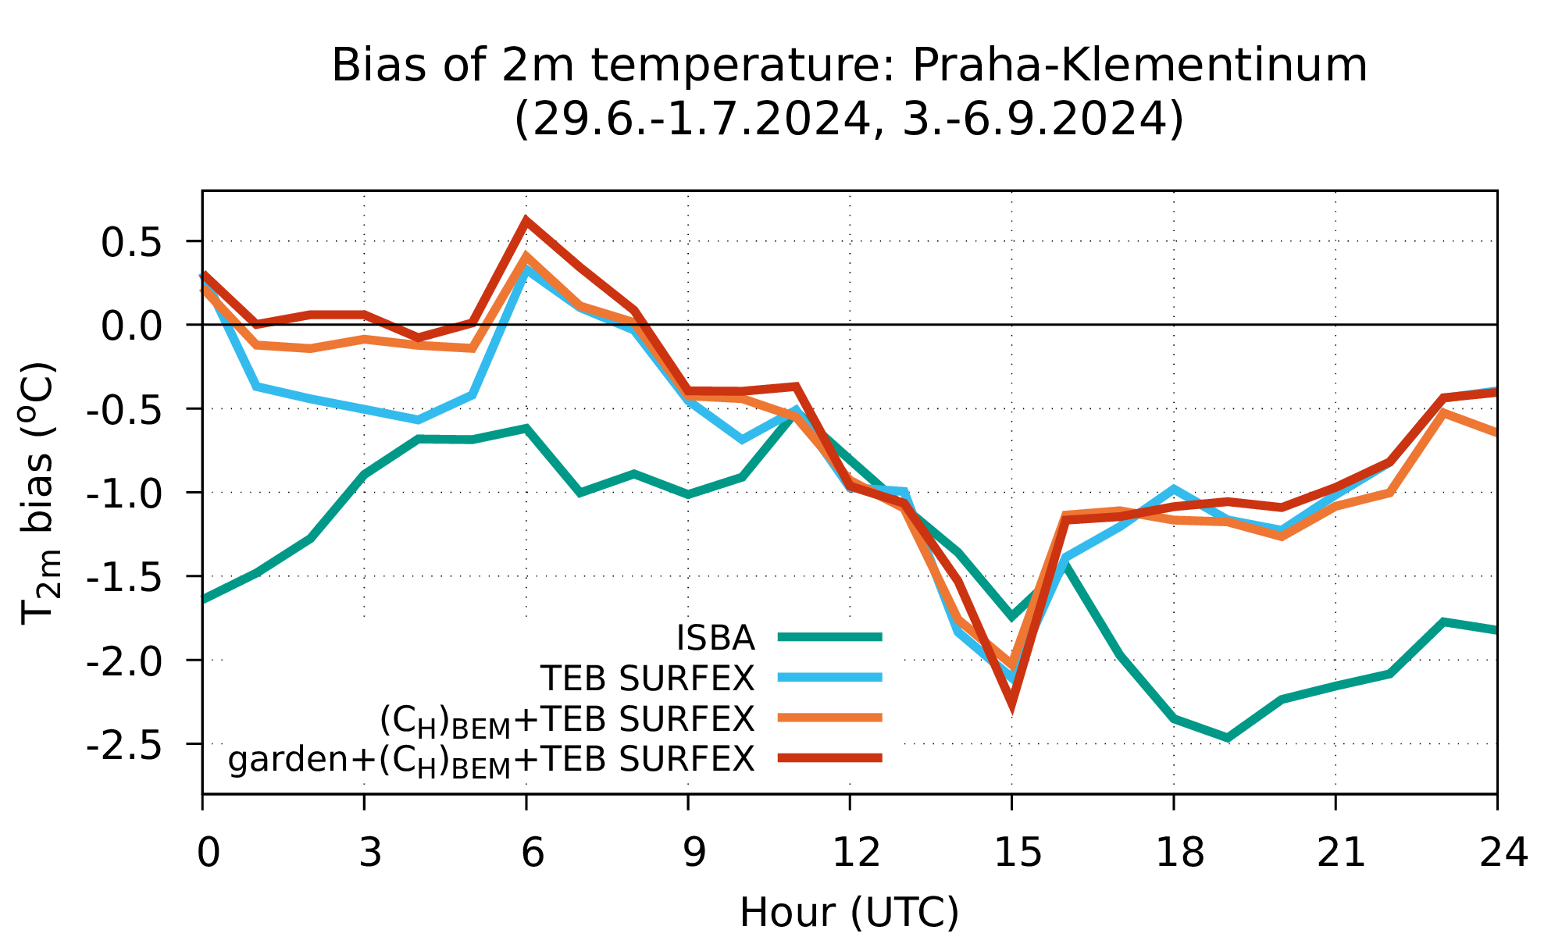
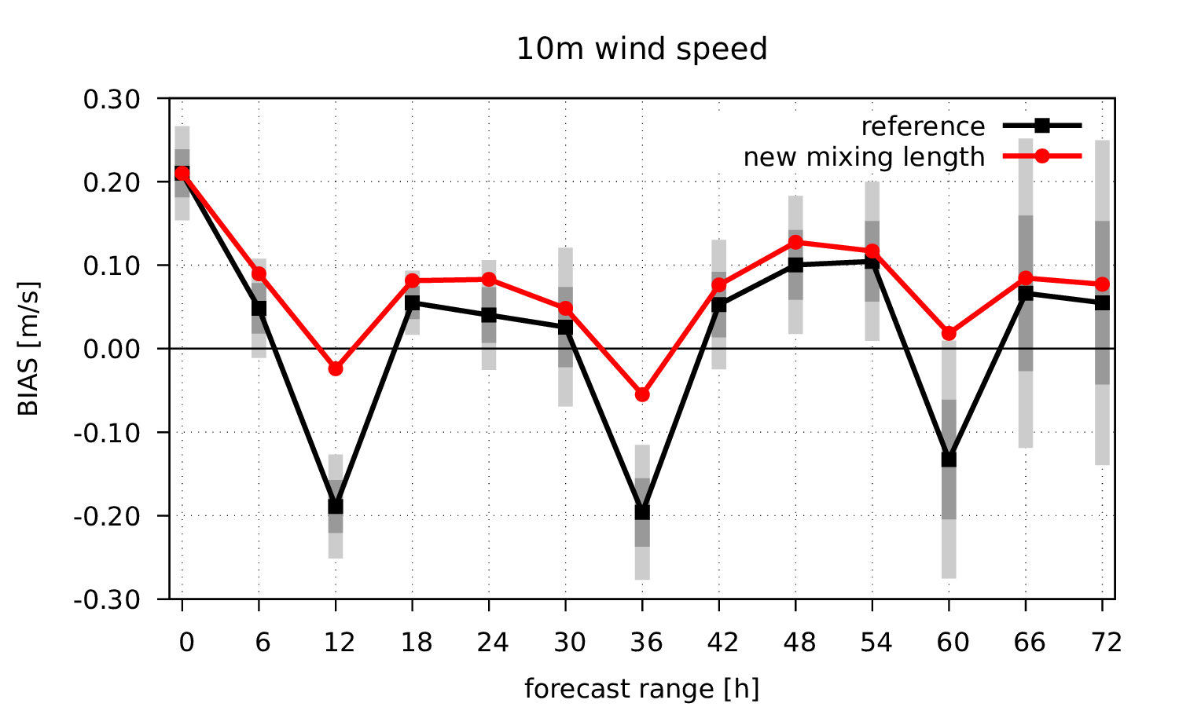
NWP activities at CHMI
Alena TROJAKOVA
Operational configuration and recent upgrades
  additional production at 03, 09, 15, 21 UTC
  data assimilation of OPERA radar reflectivity
  SEVIRI WV channels reintroduced with updated VARBC
Research highlights
Testing of turbulence mixing length
based on TKE in TOUCANS
Validation of TEB configuration

Slide 13
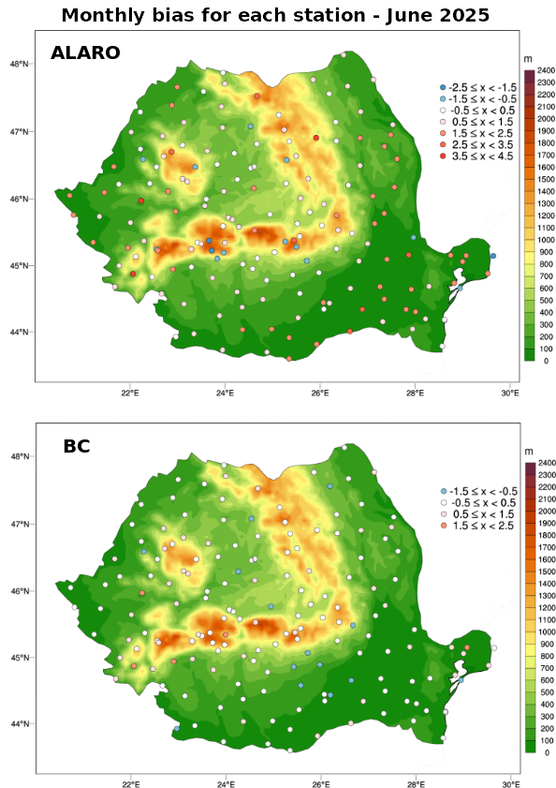
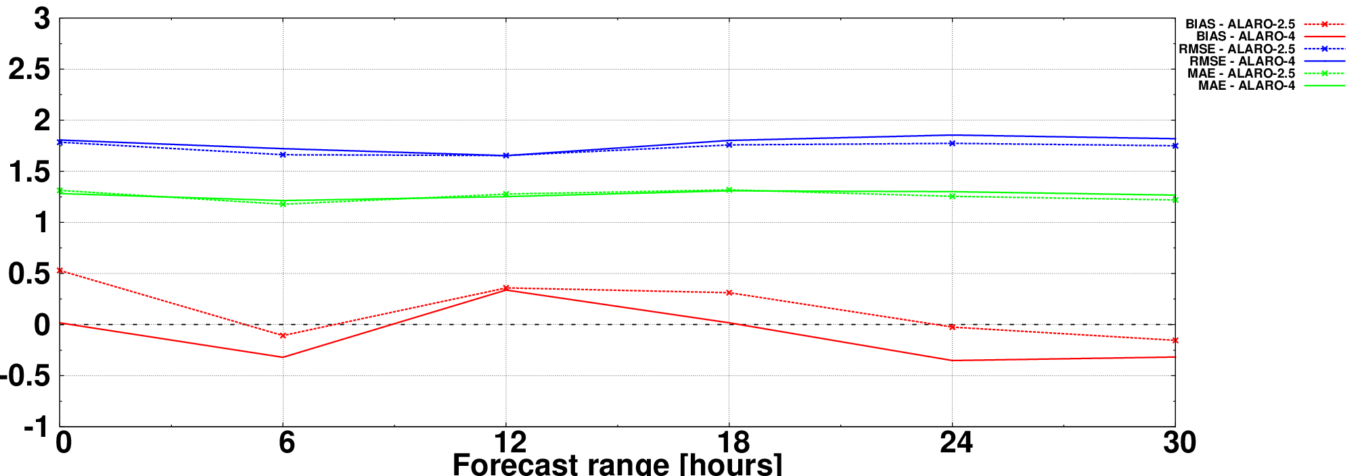

NWP activities in Romania - ACCORD
Mihail Oprea - National Meteorological Administration, Romania
Operational configurations
Migration on new computer nodes
Verification for preoperational 2.5 km ALARO
Bias-correction for temperature

Slide 14
NWP activities in AEMET (Spain)
Javier Calvo
E-suite based on Cy46h1 is running in real time with the aim to become operational in January 2026.
  Includes a large unified domain
  Several updates in clear sky satellite DA as SEVIRI over land, ATMS, NWHS2 and CrIS.
Offline Surfex Validation System (OSVAS). A set of tools have been developed to facilitate the validation of Surface processes using data from ICOS station network.
AI/ML forecasting first steps. Using Anemoi framework, a transfer learning technique and a stretched-grid. Good results compared to the deterministic NWP forecasts at 2.5 km

Slide 15
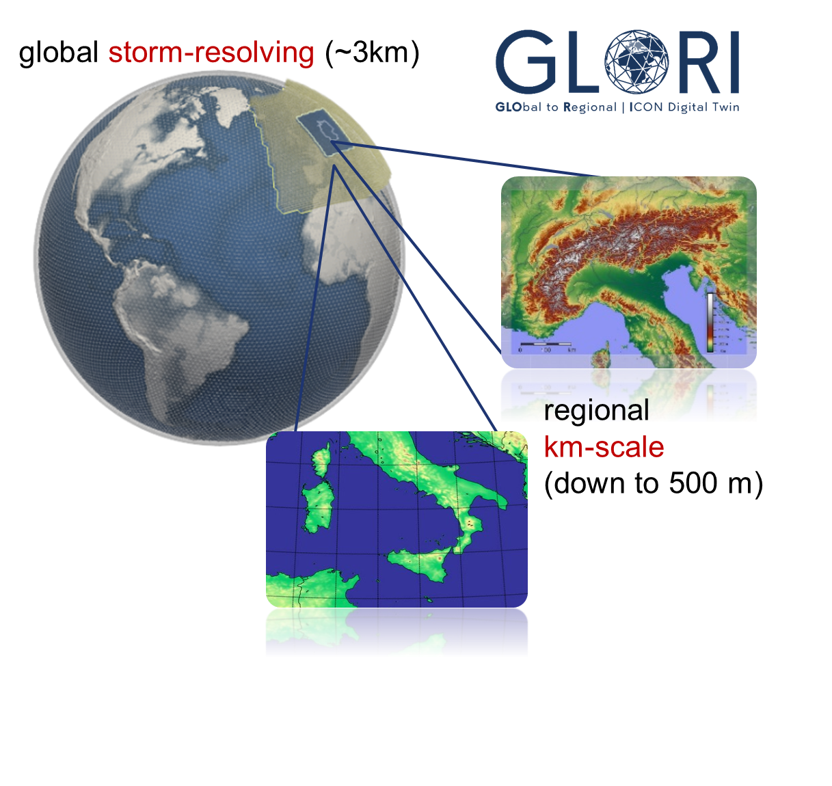
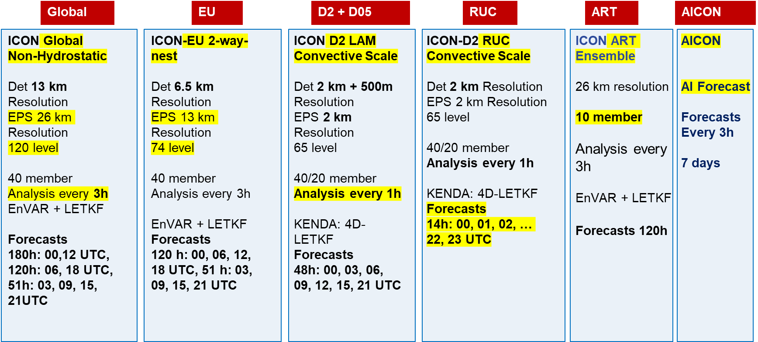
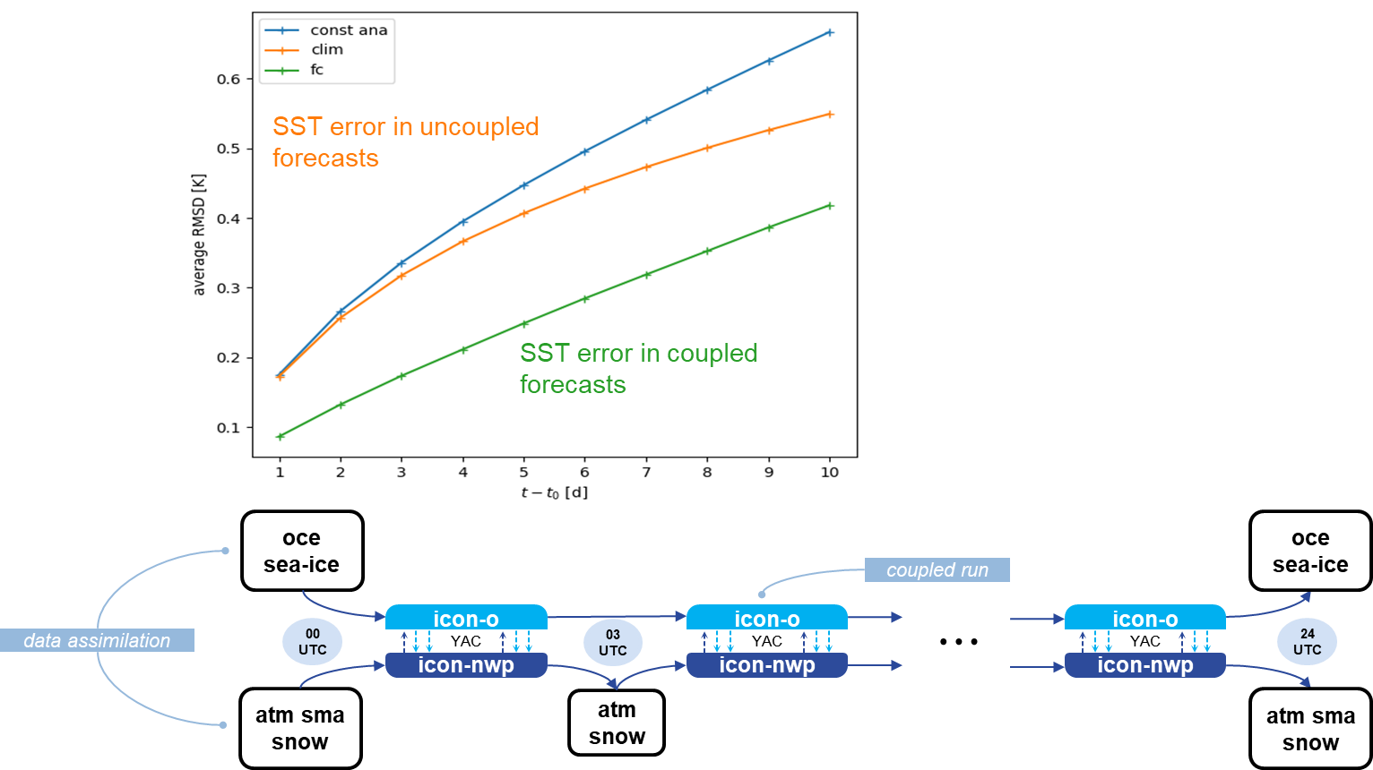
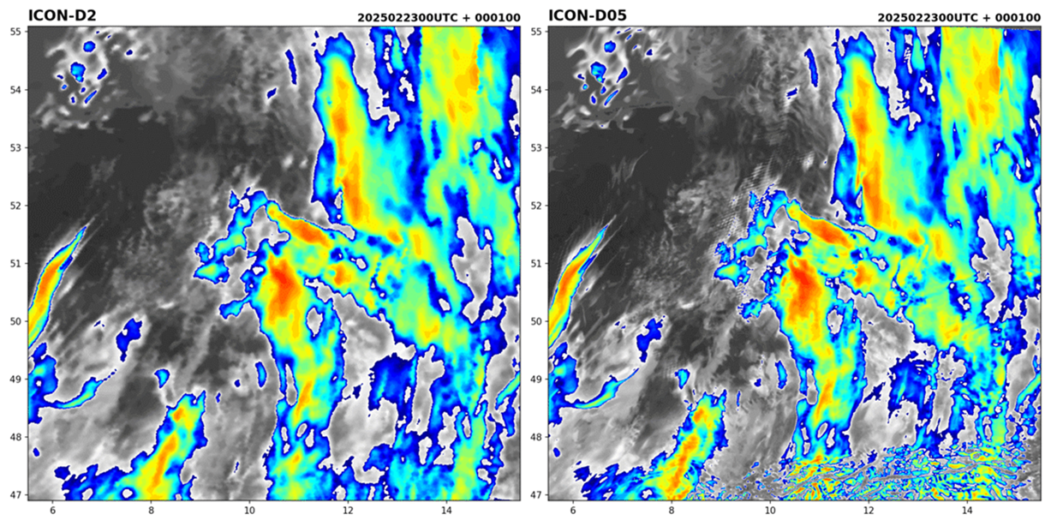
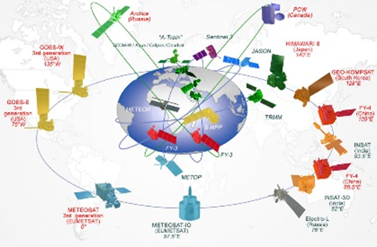
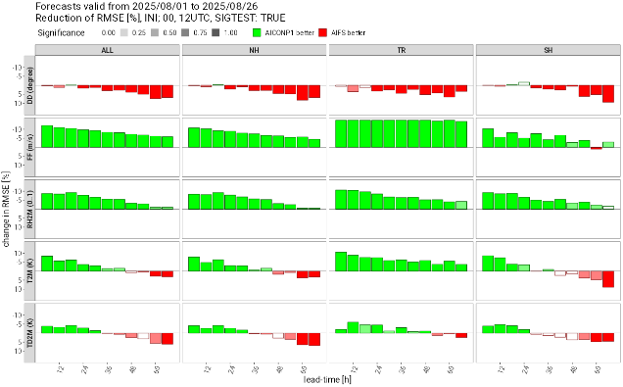
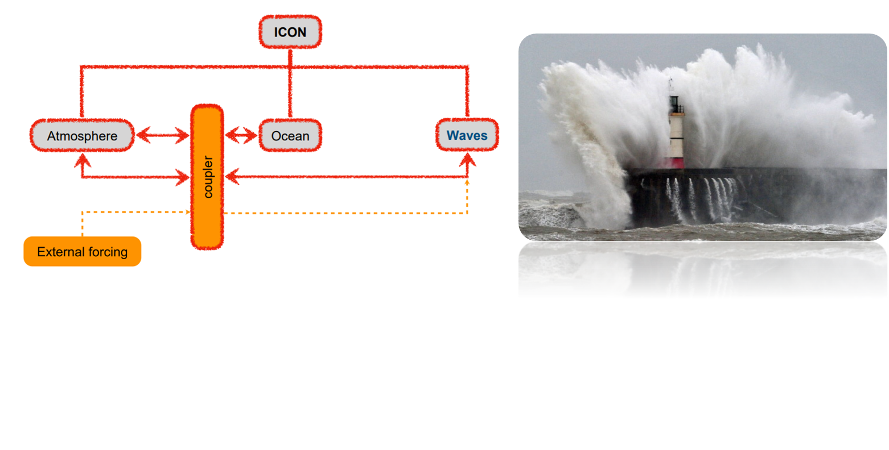
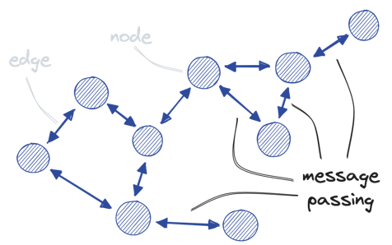
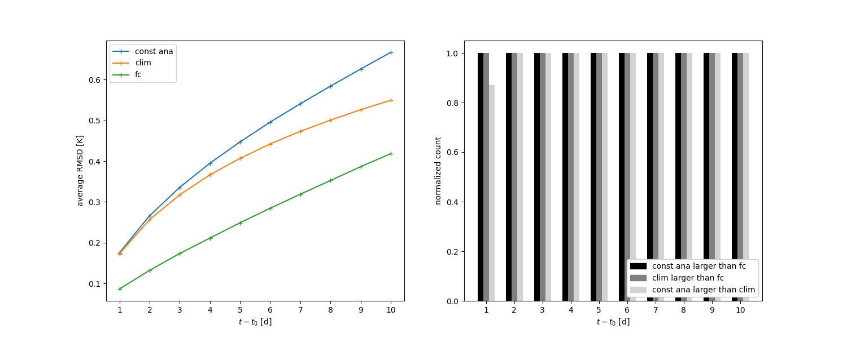

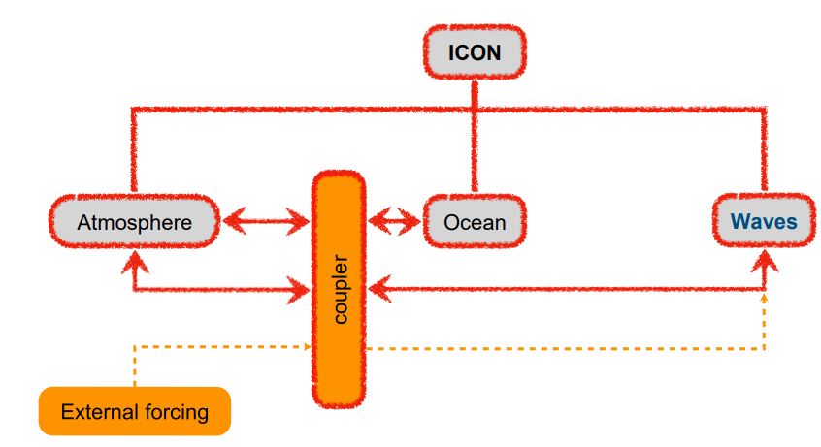
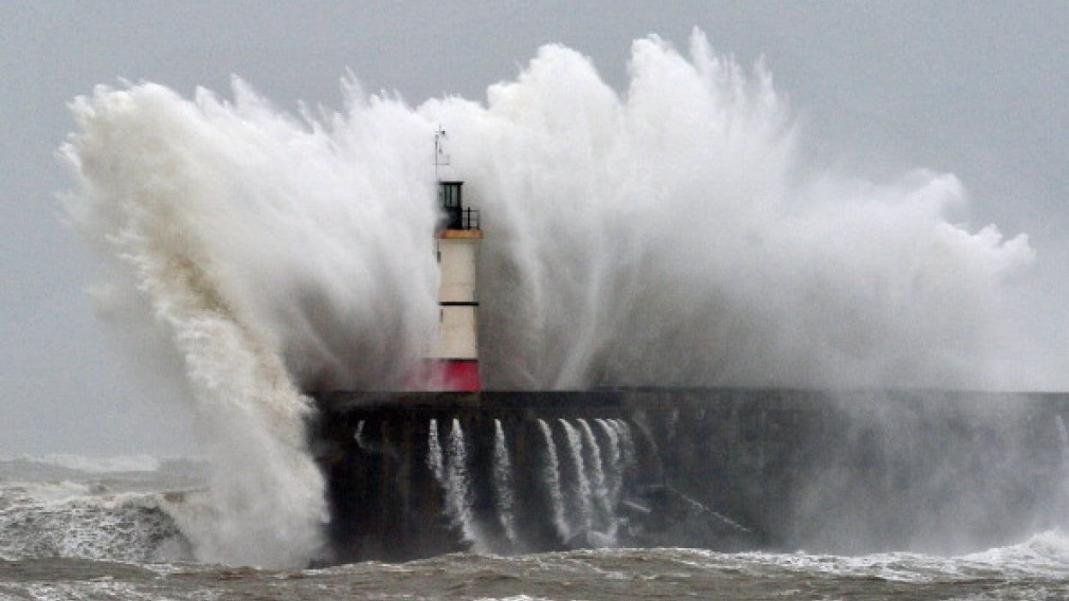

Numerical modelling at DWD:
Operational status and selected R&D activities
NWP model chain
coupled ocean-atmosphere
GLORI
digital twin
All-sky data assimilation
ICON@500m
AICON
ICON-WAVES
SST error in uncoupled forecasts
SST error in coupled forecasts
oce
sea-ice
oce
sea-ice
coupled run
00 UTC
icon-o
icon-o
icon-o
24 UTC
data assimilation
YAC
03 UTC
YAC
YAC
icon-nwp
icon-nwp
icon-nwp
atm sma
snow
atm
snow
atm sma
snow

Slide 16

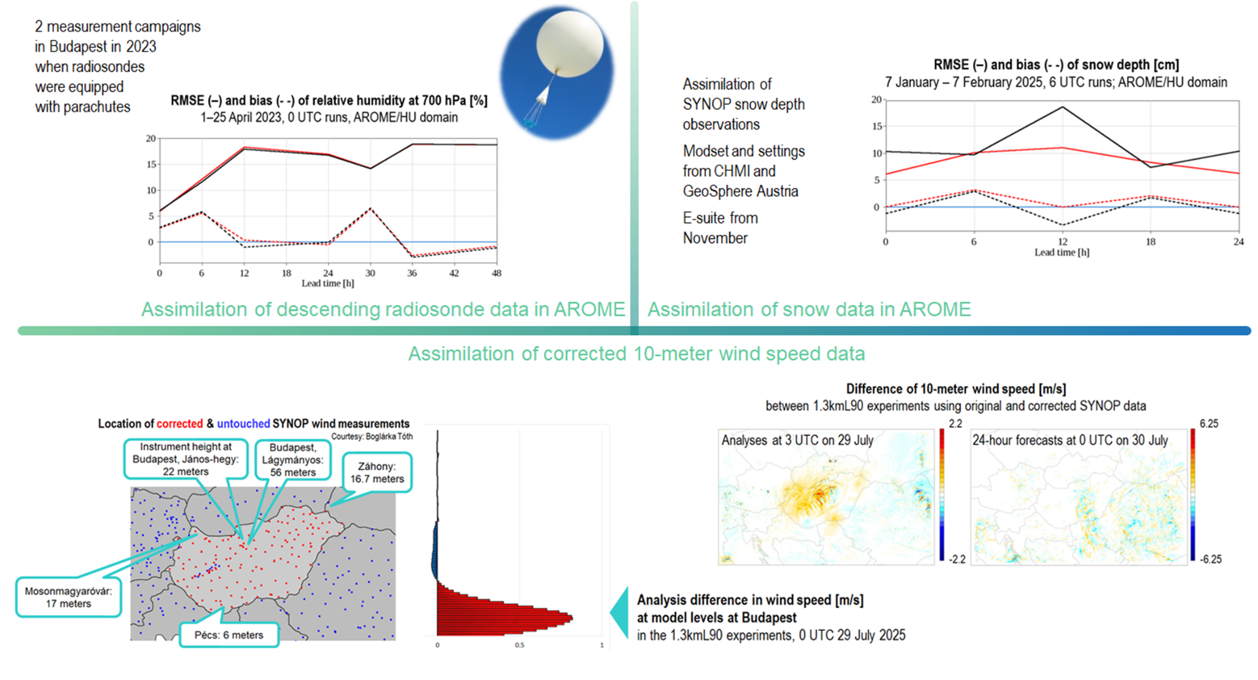
NWP activities at the Hungarian Meteorological Service
Gabriella Szépszó, Anikó Kardos-Várkonyi, Dávid Lancz, Helga Tóth

Slide 17
Thematic posters

Slide 18
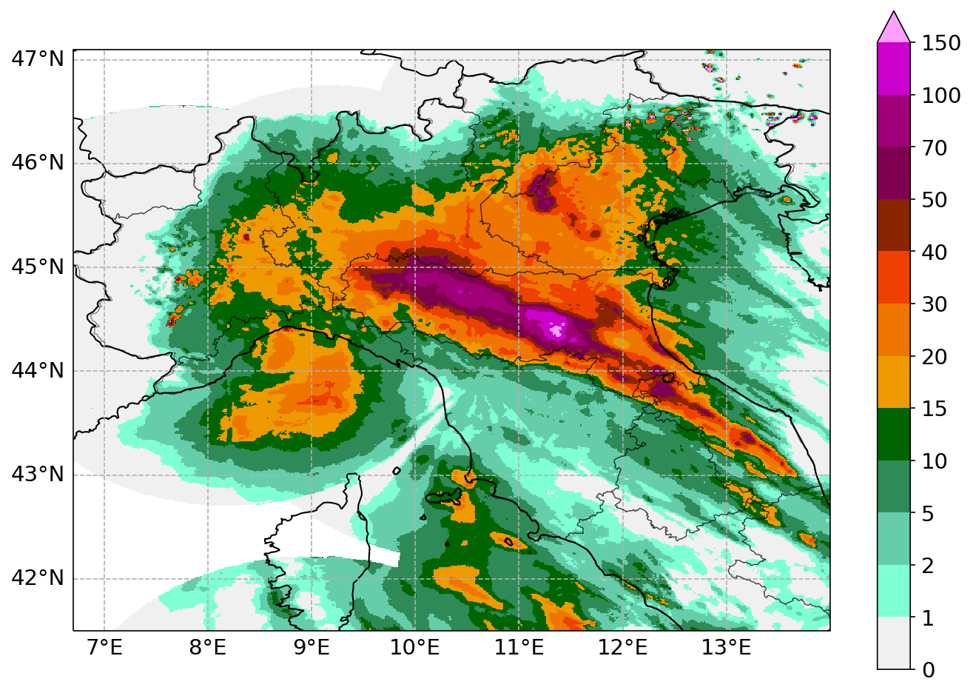
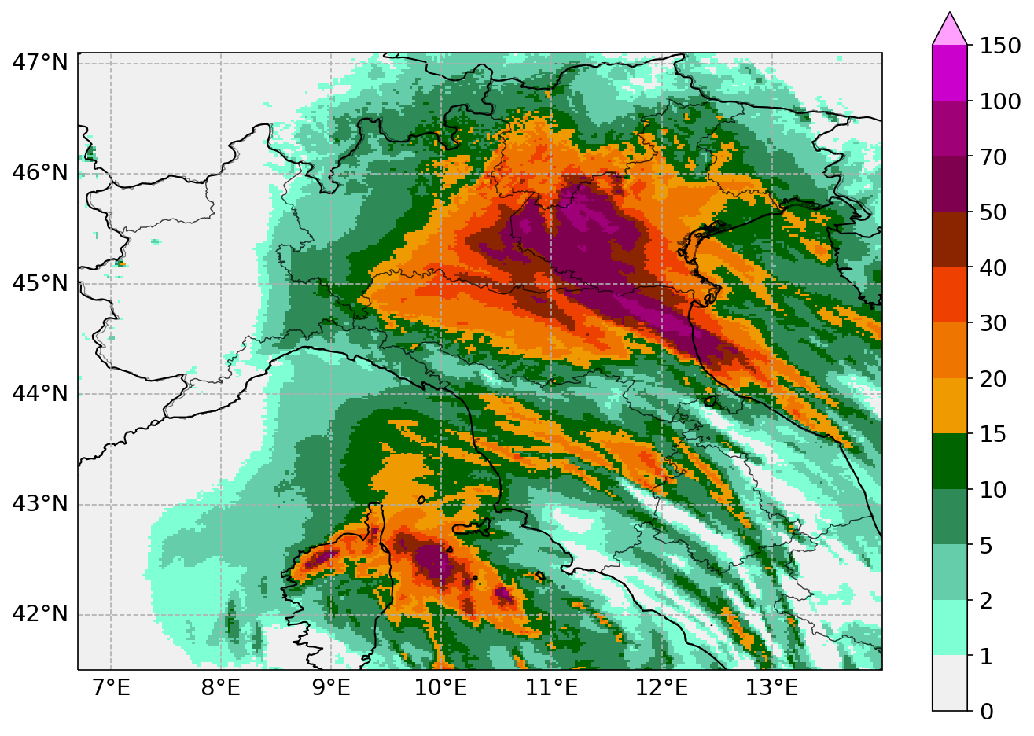


High-resolution data assimilation with ICON and KENDA at Agenzia ItaliaMeteo and Arpae
Gastaldo, Italy, Agenzia Italiameteo and Arpae
Using the Bologna flood of 19 October 2024 as a case study, we evaluate the impact of increasing model resolution in both forecasting and data assimilation within our national operational NWP system, based on ICON.
Operational ICON-2I
(2.2 km)
Experiment ICON-1I
(1.1 km)
Observations
(keep your expectations low)

Slide 19

Influence of perturbation of surface temperature on temperature inversion at selected SYNOP stations in Poland
T.Tabalchuk, A.Mazur, A.Wyszogrodzki, IMGW-PIB
We investigate how perturbations of surface level soil temperature affect the formation of nocturnal temperature inversions in Poland.
Approach
The COSMO-2k8 ensemble prediction system was applied. At the first stage, a 20-member ensemble was generated with perturbations to initial and boundary conditions. At the second stage, a new 40-member ensemble with four perturbation strategies was designed to improve the spread of near-surface temperature forecasts.
Key Findings
The initial experiments showed a rapid loss of spread among ensemble members, leading to poor representation of near-surface inversions. With the new perturbation scheme, the spread was maintained and propagated up to 900 hPa, improving the simulation of temperature profiles.

Slide 20
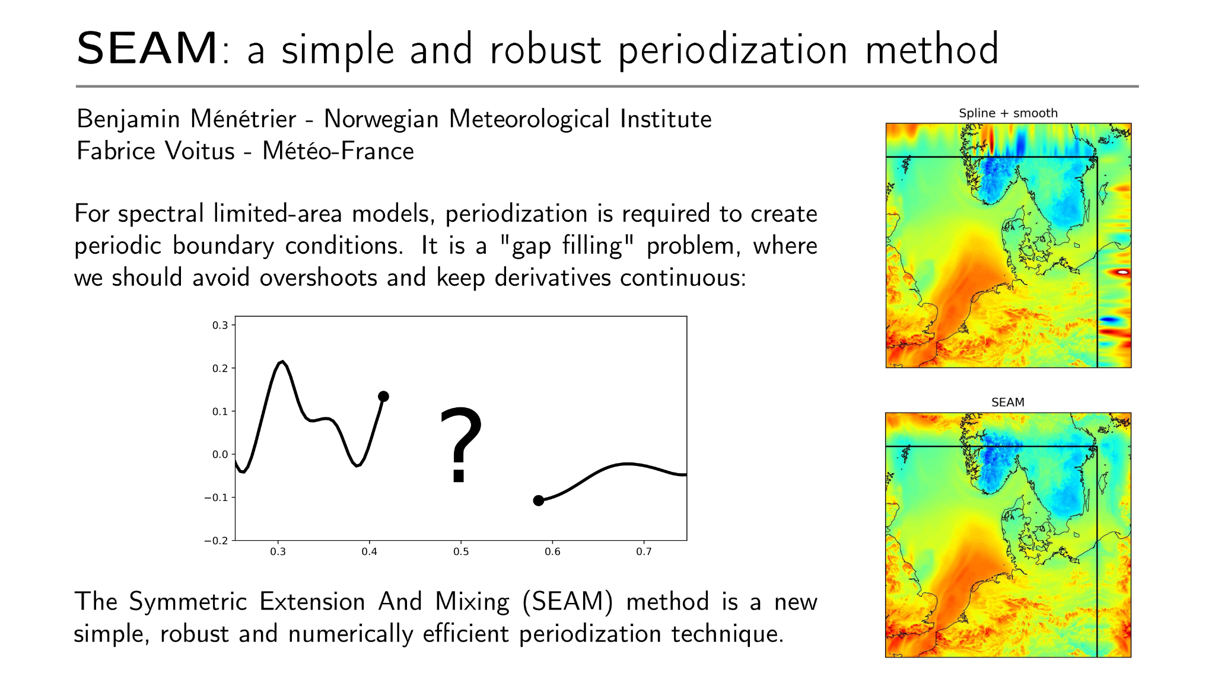

Slide 21
