Slide 1

High-resolution data assimilation in global and regional ICON for the GLORI Digital Twin
Xu Xu¹, Harald Anlauf¹, Klaus Stephan¹, Alberto de Lozar¹, Thorsten Steinert¹, Virginia Poli^{2,3}
¹ Deutscher Wetterdienst, Offenbach, Germany
² Agenzia Regionale per la Prevenzione, l’Ambiente, l’Energia dell’Emilia-Romagna (ARPAE), Bologna, Italy
³ Italia Meteo Agency, Bologna, Italy

Slide 2
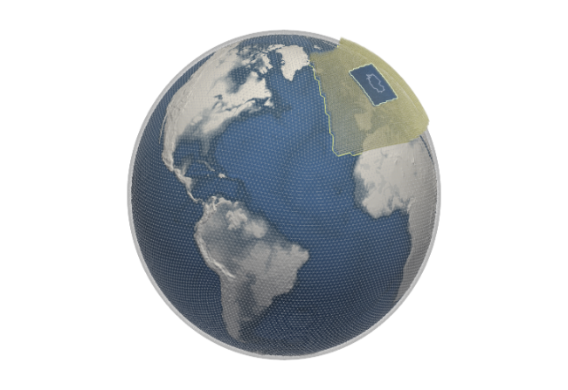
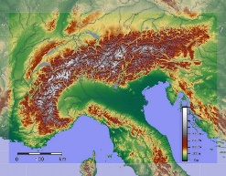
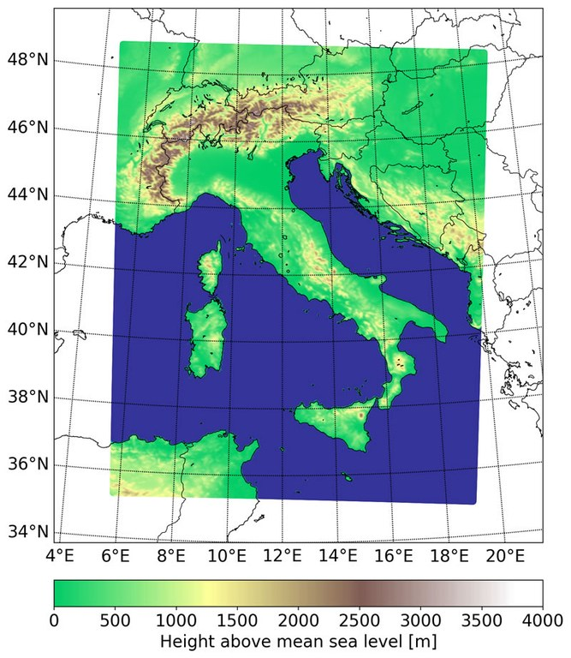
Global-to-Regional-ICON Digital Twin
EU storm-resolving (~3km)
Tri-lateral Cooperation
Germany, Italy, Switzerland
regional km-scale (down to 500 m)

Slide 3
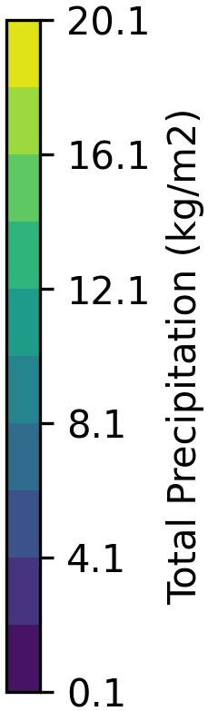
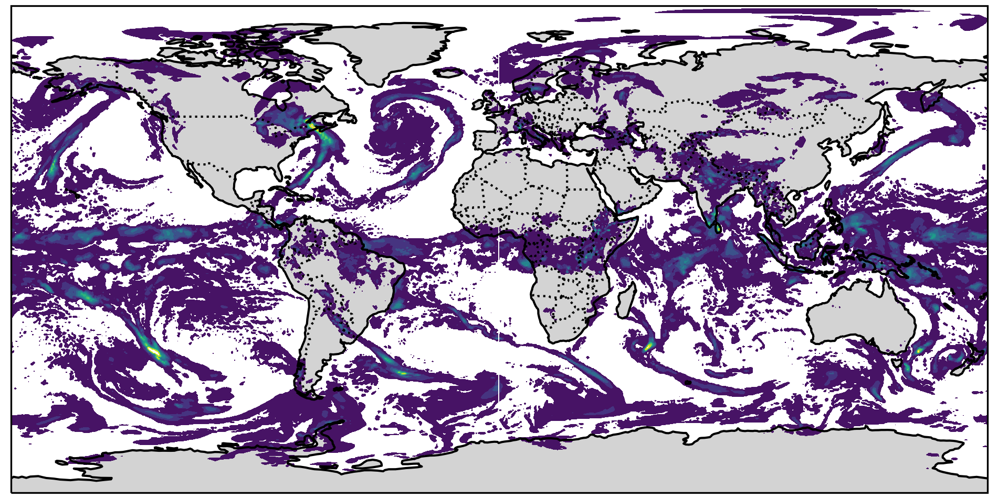
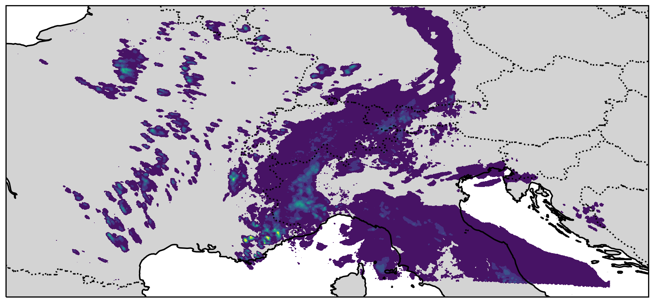
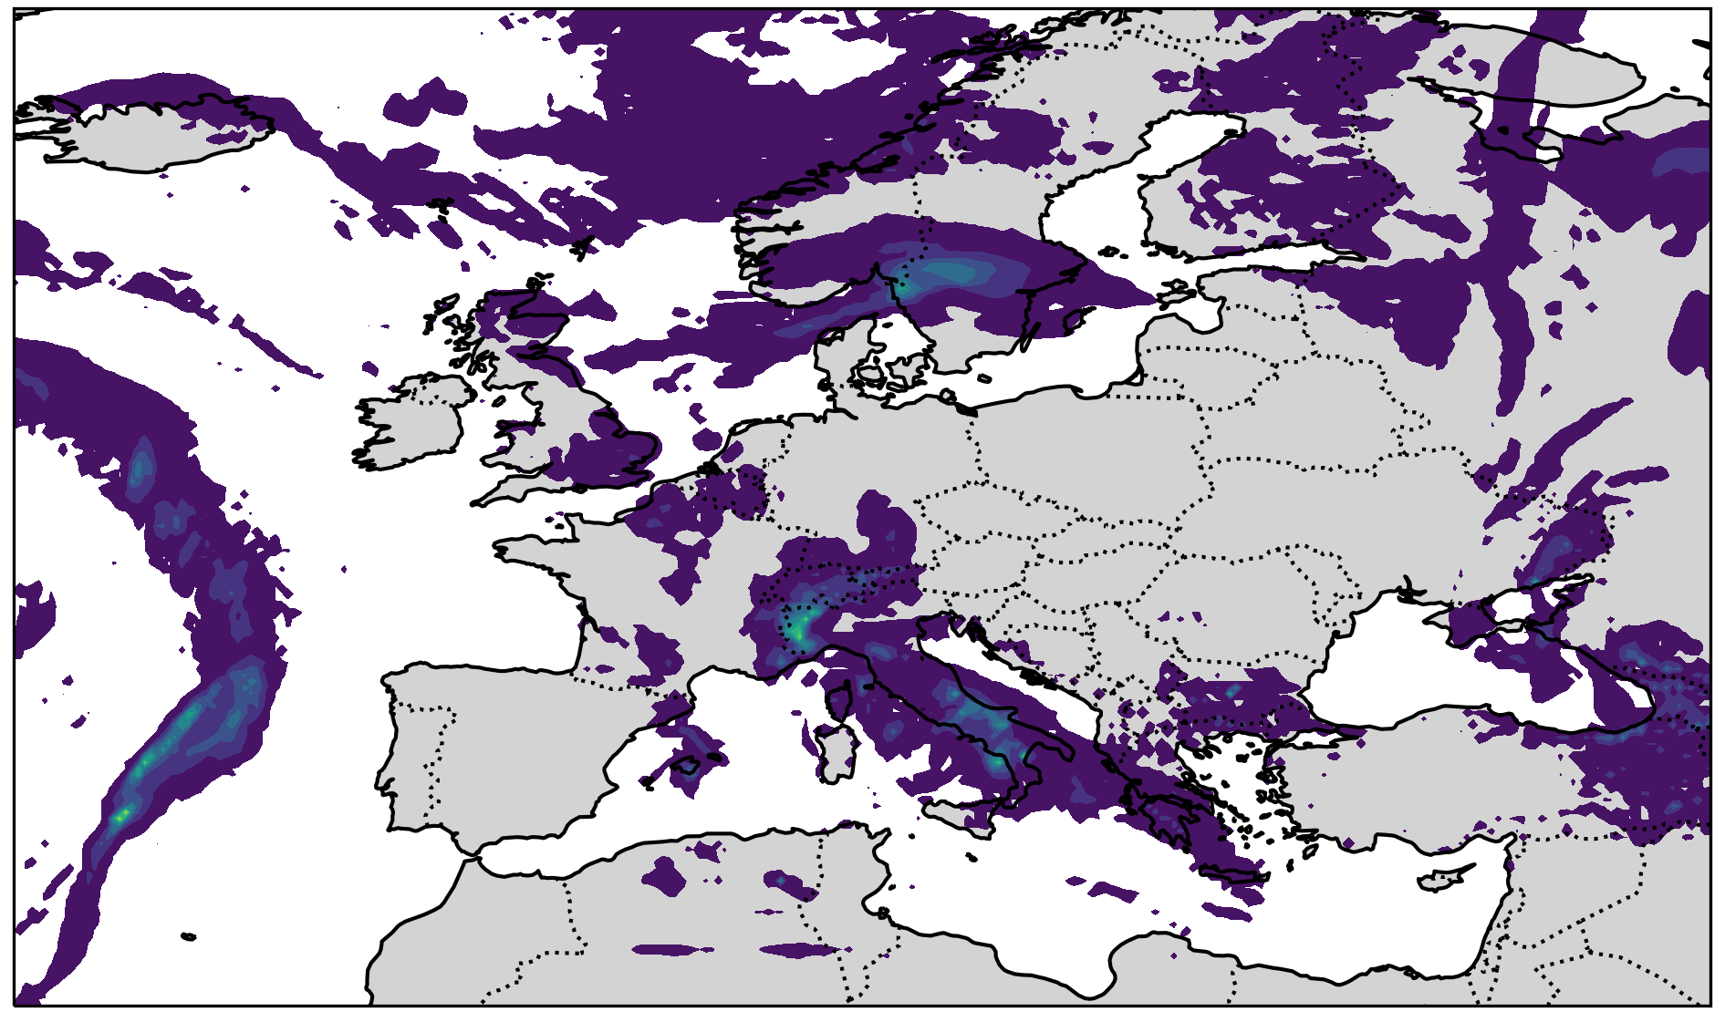
Implementation of GLORI DT
DWD GLORI Alpine Domain
Global
13 km
EU nest
2km
6.5km
Boundary
Global 6.5 km
EU-Nest 3.25 km
Alpine 1 km
We chose the period May 2023 to start our one month assimilation experiment. In this month, there are two floods in Italy at 02-03.05, and 16.05.

Slide 4
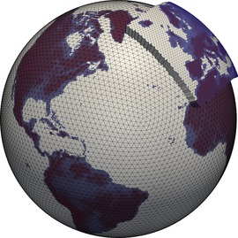

Global High Resolution Assimilation (ICON)
Global – EU nested
ICON
Deterministic Run:
3.25 km (one-way nested), L120
Assimilation: ENVAR
Ensembles:
13 km (two-way nested), L120
Ensemble members : 40
Deterministic Run: 13 km, L120
Ensemble: 26 km, L120
EU (two-way-nested)
Deterministic Run: 6.5 km, L74
Ensembles: 13 km, L74
Ensemble members: 40
Hybrid data assimilation: ENVAR + LETKF
Deterministic Run : 6.5 km, L120
Ensemble: 26 km, L120
Ensemblemitglied : 40
Assimilation: ENVAR + LETKF
Ongoing experiment: 2023050103 - 2023063100

Slide 5
Global High Resolution Assimilation (ICON)
ICON
Changes in parameterisation
(under testing)
dt_conv = 180.,120.
dt_sso = 360.,120.
dt_gwd = 360.,120.
tune_gkwake = 1.8, 0.25
tune_gfrcrit = 0.333, 0.333
tune_gkdrag = 0.22, 0.0
rayleigh_coeff = 1.0,5.0
Changes in set-up
int_g2n = 1
lvert_nest = false
num_lev = 120,120
lfeedback = false
support_baryctr_intp = false
inwp_gscp = 2
lgrayzone_deepconv = false, true

Slide 6
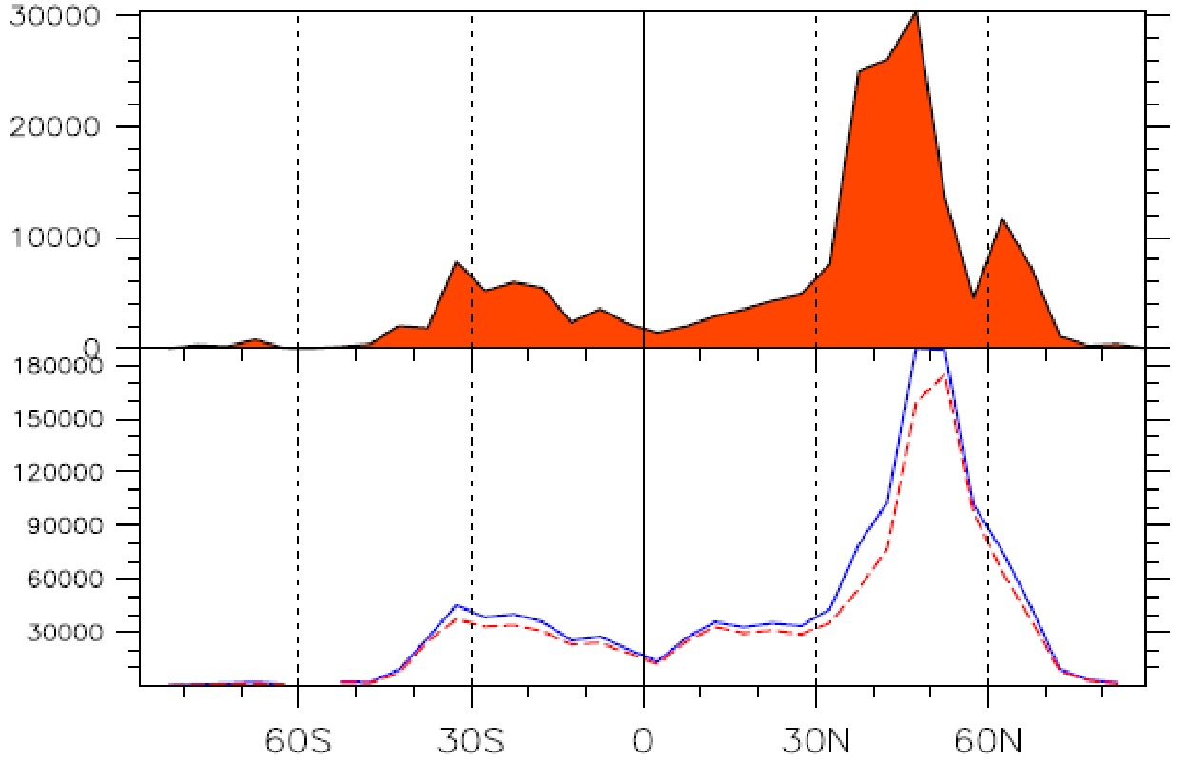
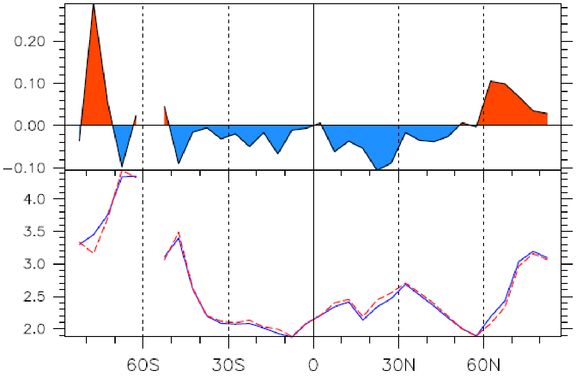
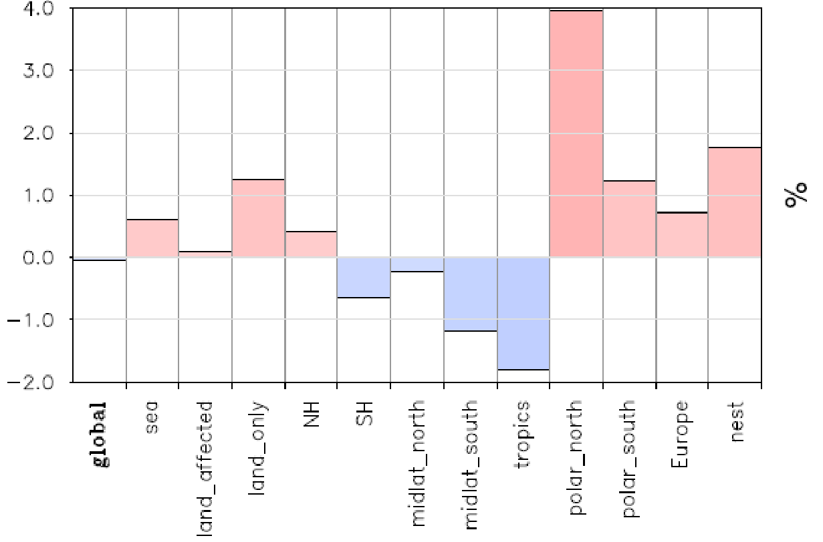
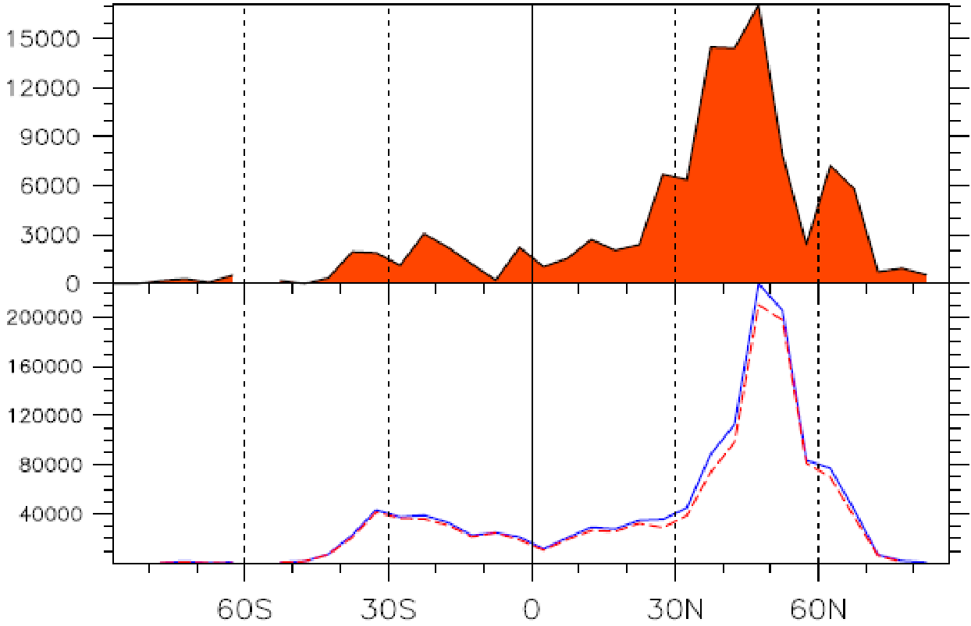
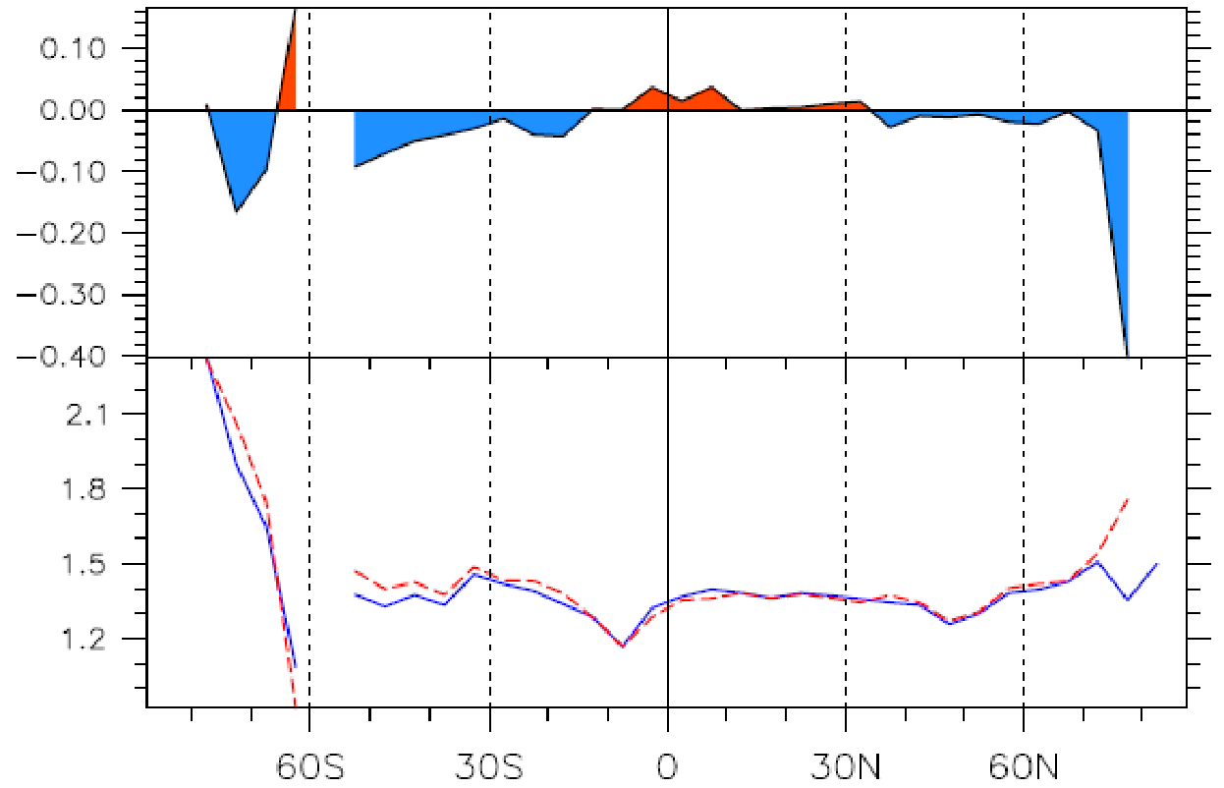
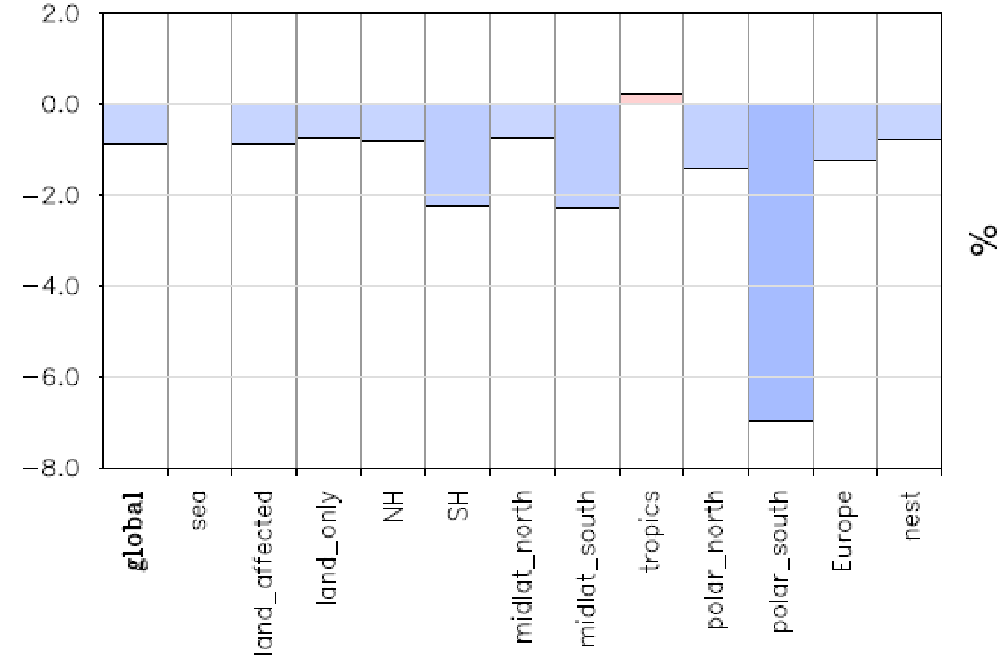
SYNOP Zonal Mean Statistics (2023050112 – 2023052412)
nobs
rms(o-f)
rms(o-f)
WIND
6.5 km
13 km
T2M

Slide 7
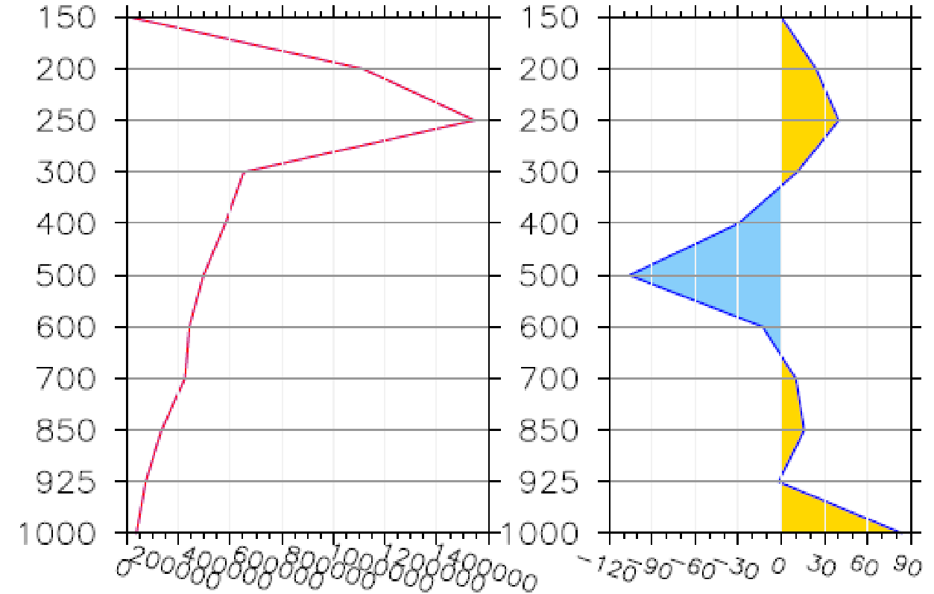
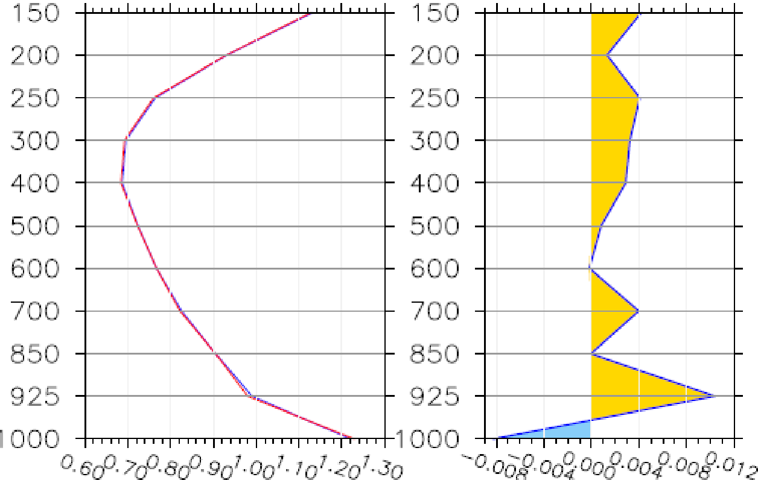
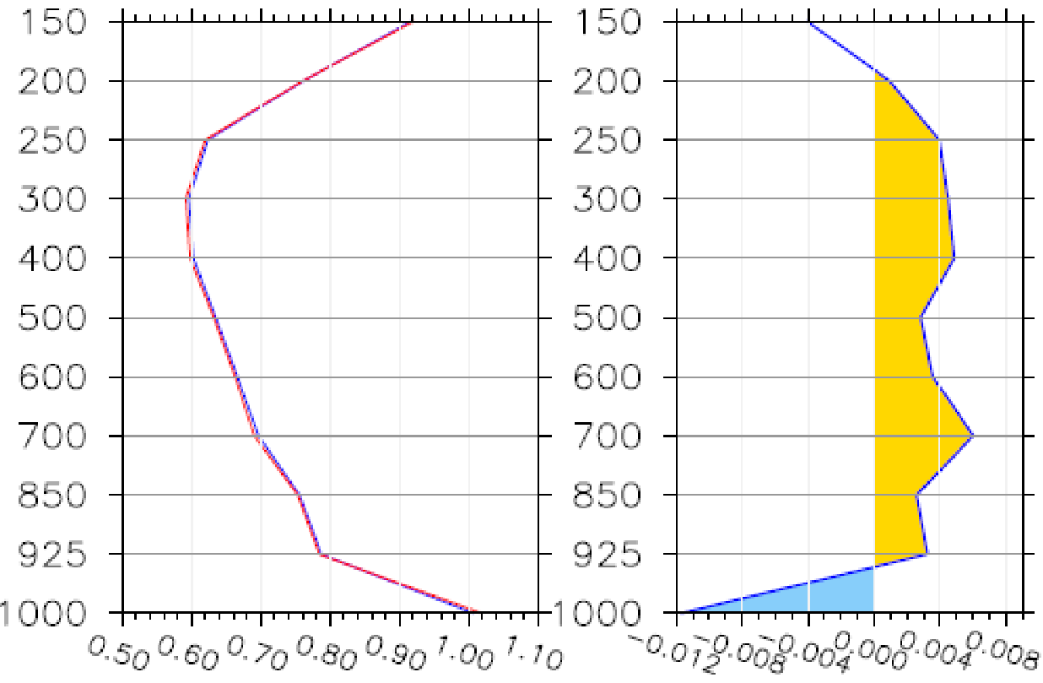
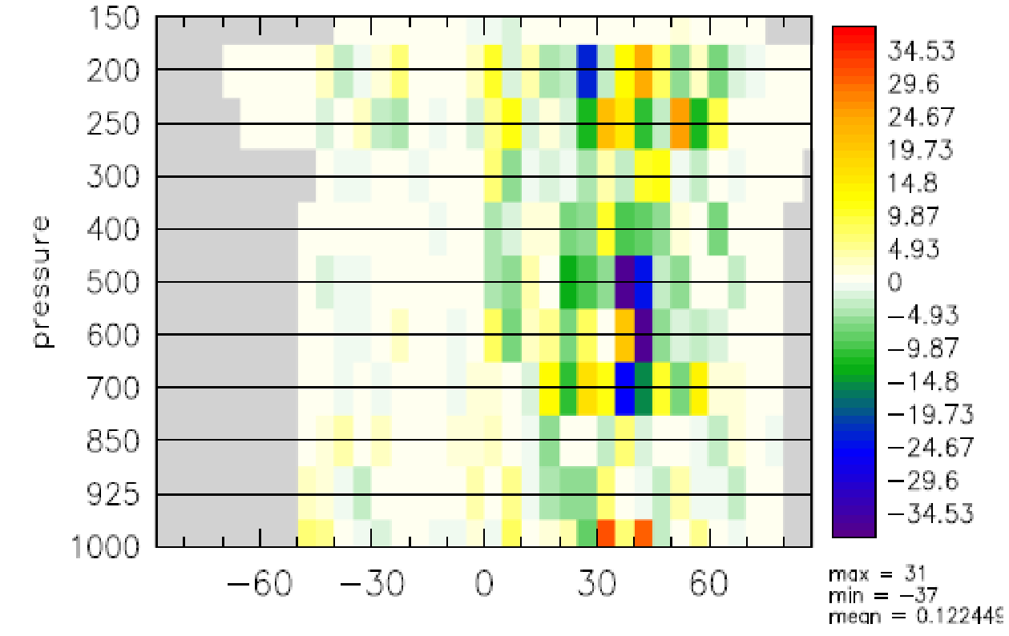
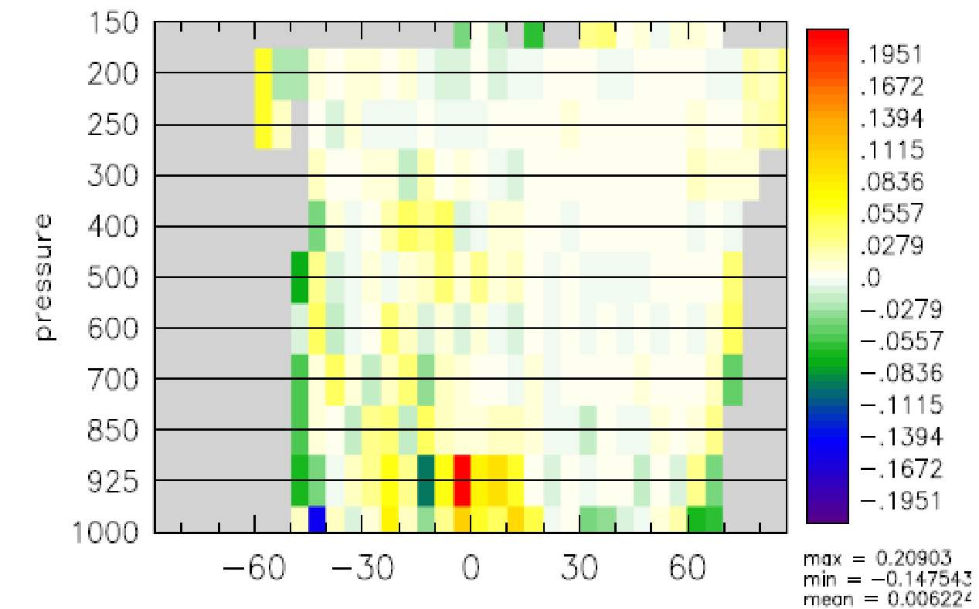
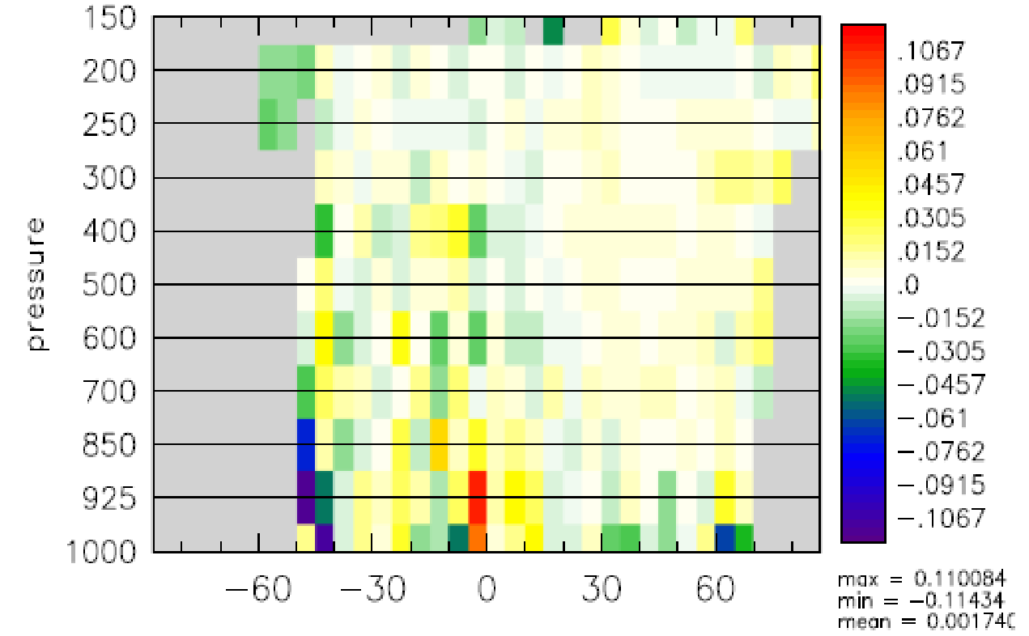
AIREP Temperature Statistics (2023050112 – 2023052412)
nobs
rms(o-f)
rms(o-a)
6.5 km
13 km

Slide 8
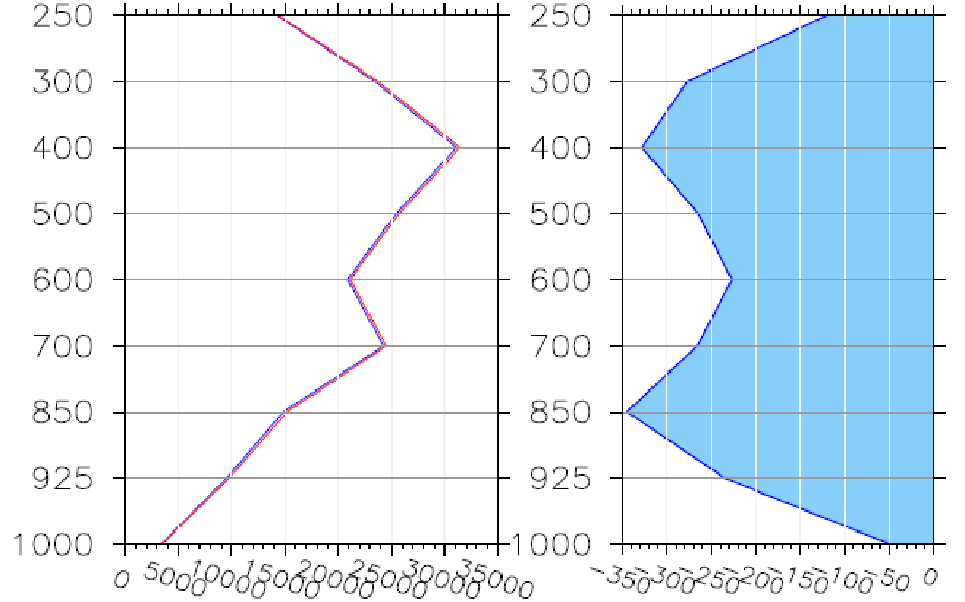
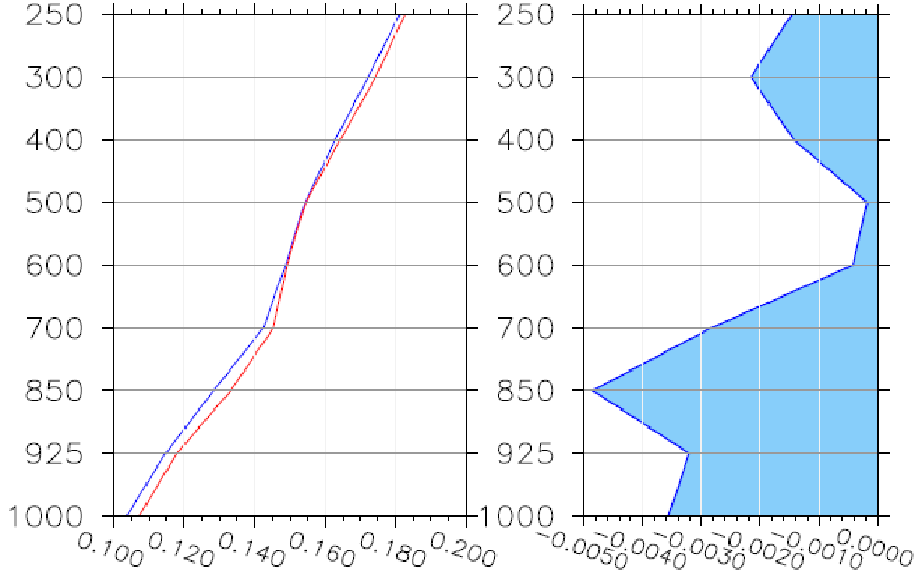
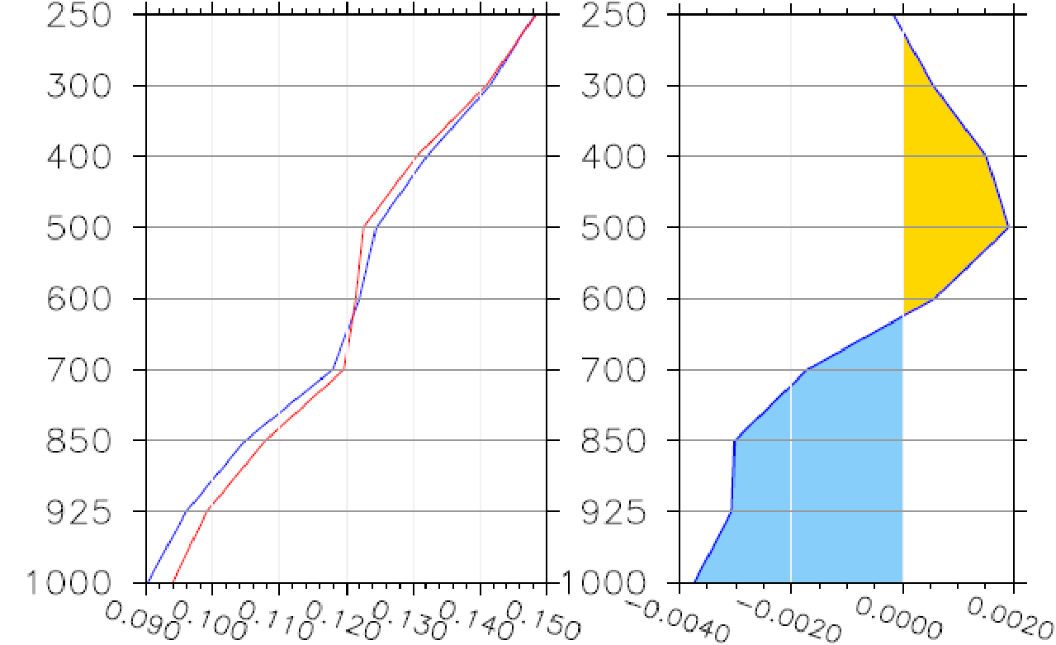
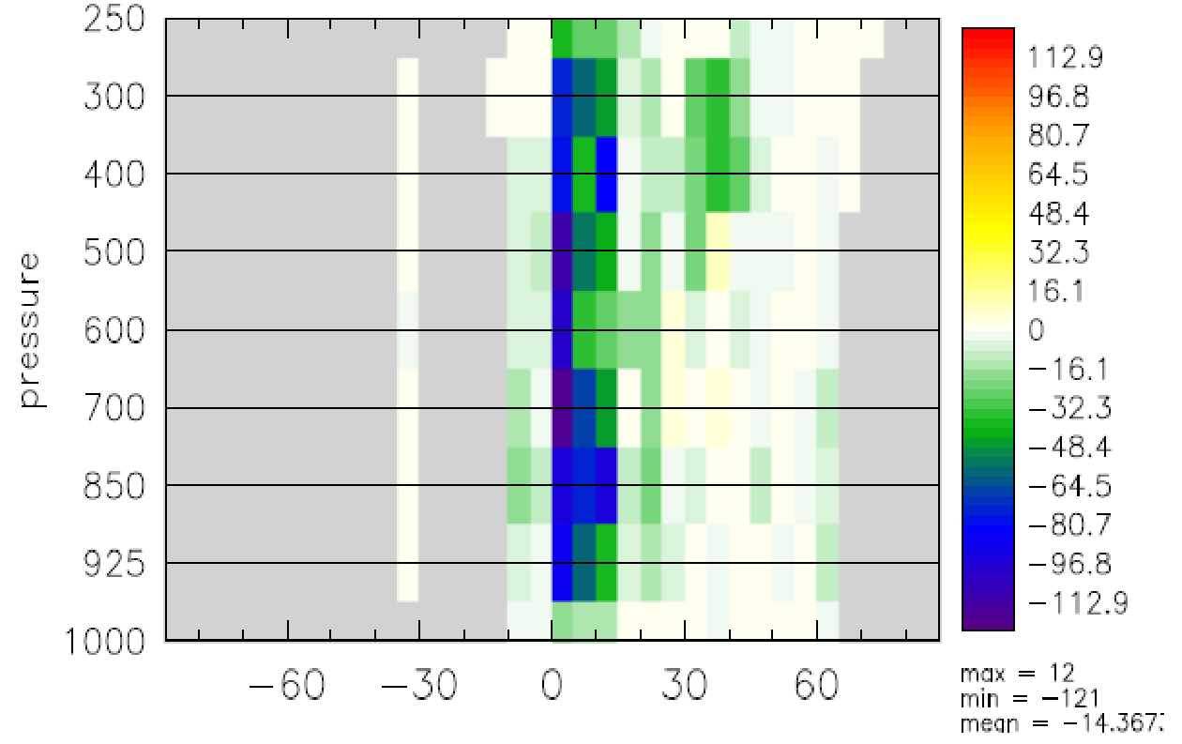
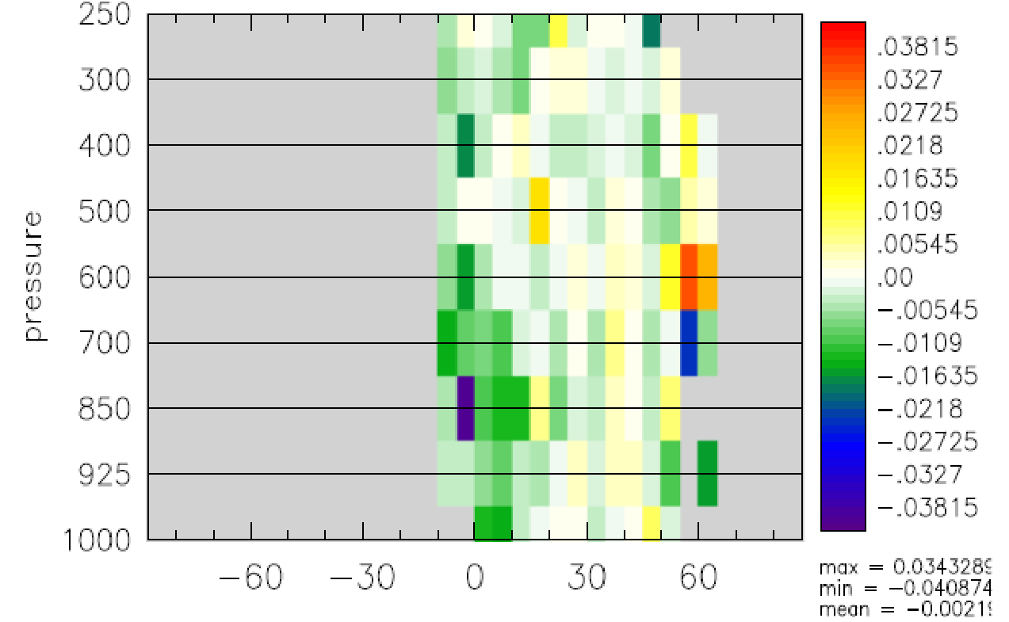
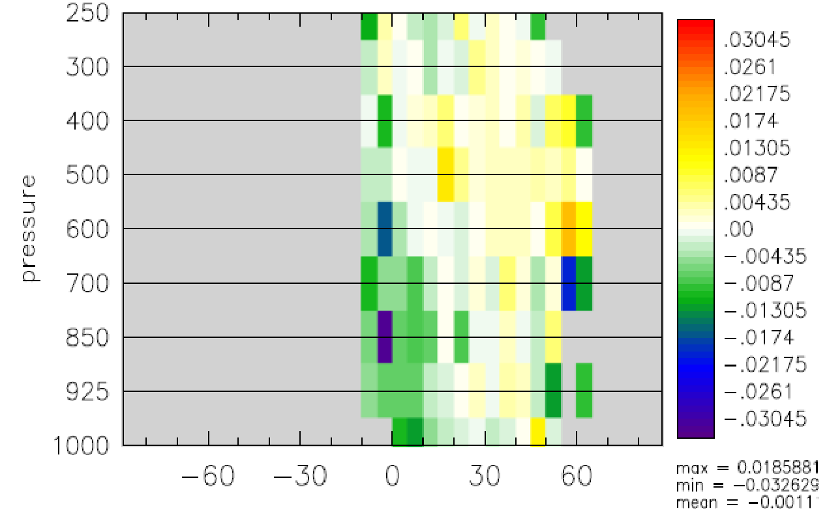
AIREP RH Statistics (2023050112 – 2023052412)
nobs
rms(o-f)
rms(o-a)
6.5 km
13 km

Slide 9
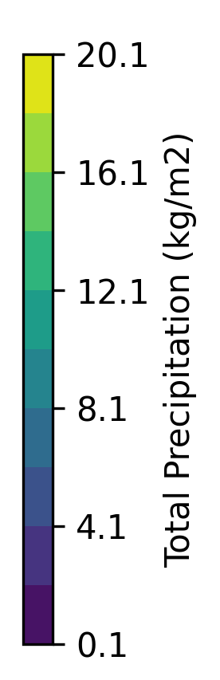
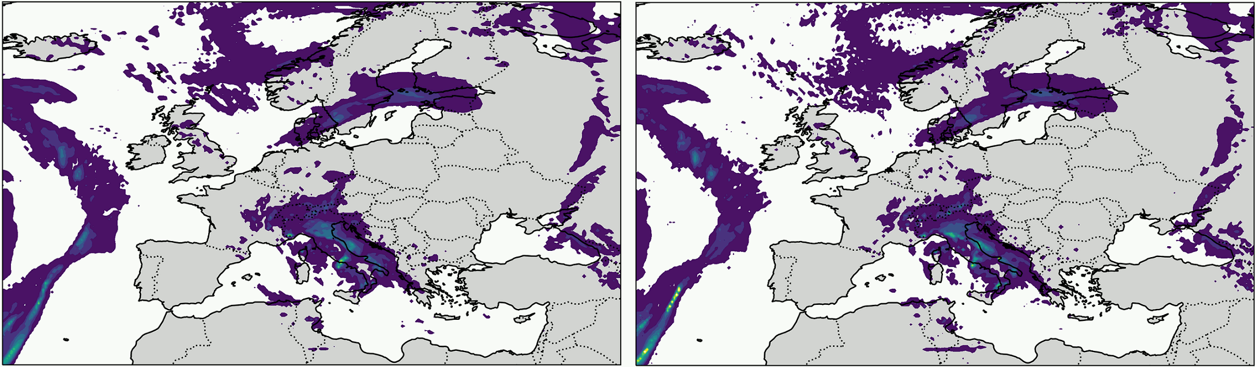
Global High Resolution Assimilation (ICON)
3 Hourly total precipitation 2023050121 – 2023050312 (lead hour = 3)
6.5 km EU nest
3.25 km EU nest

Slide 10
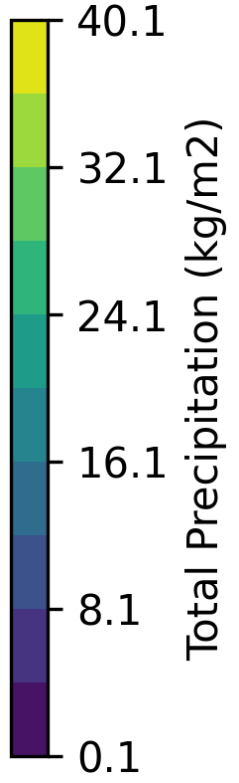
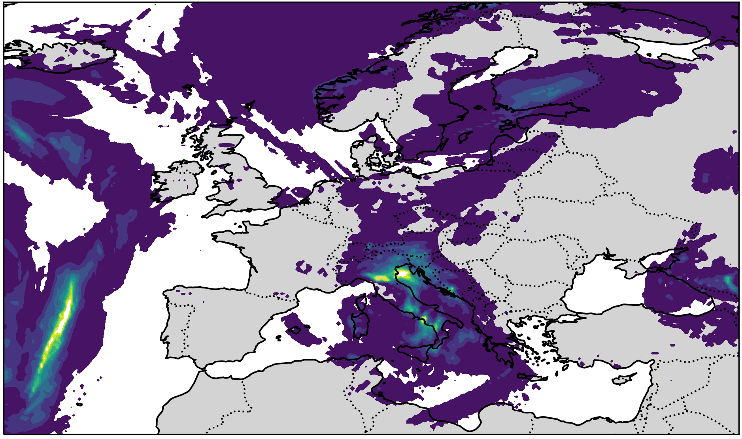
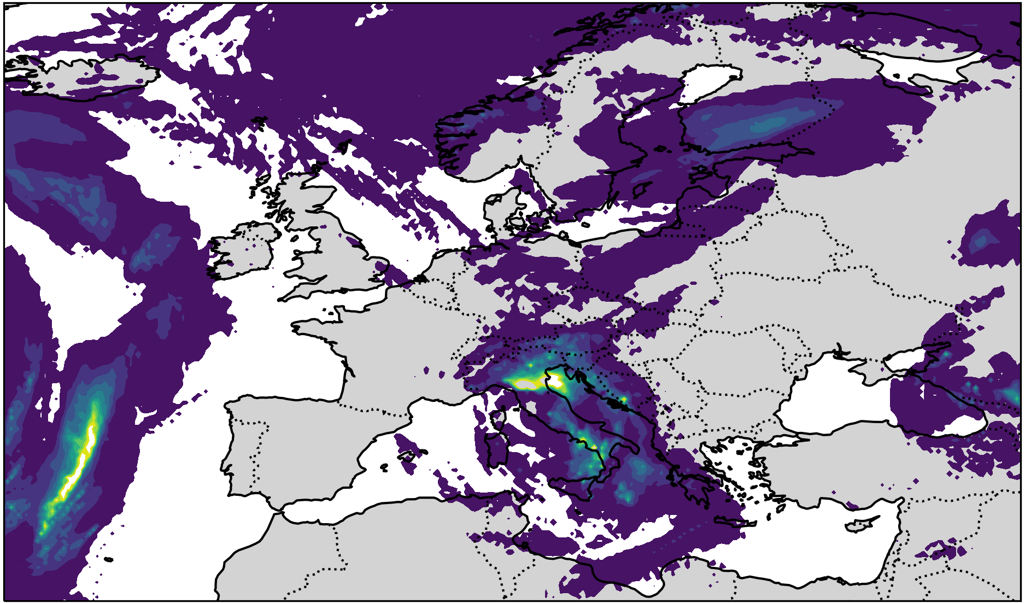
Global High Resolution Assimilation (ICON)
Total precipitation forcast at 2023050212 (lead hour 12)
6.5 km EU nest
3.25 km EU nest

Slide 11
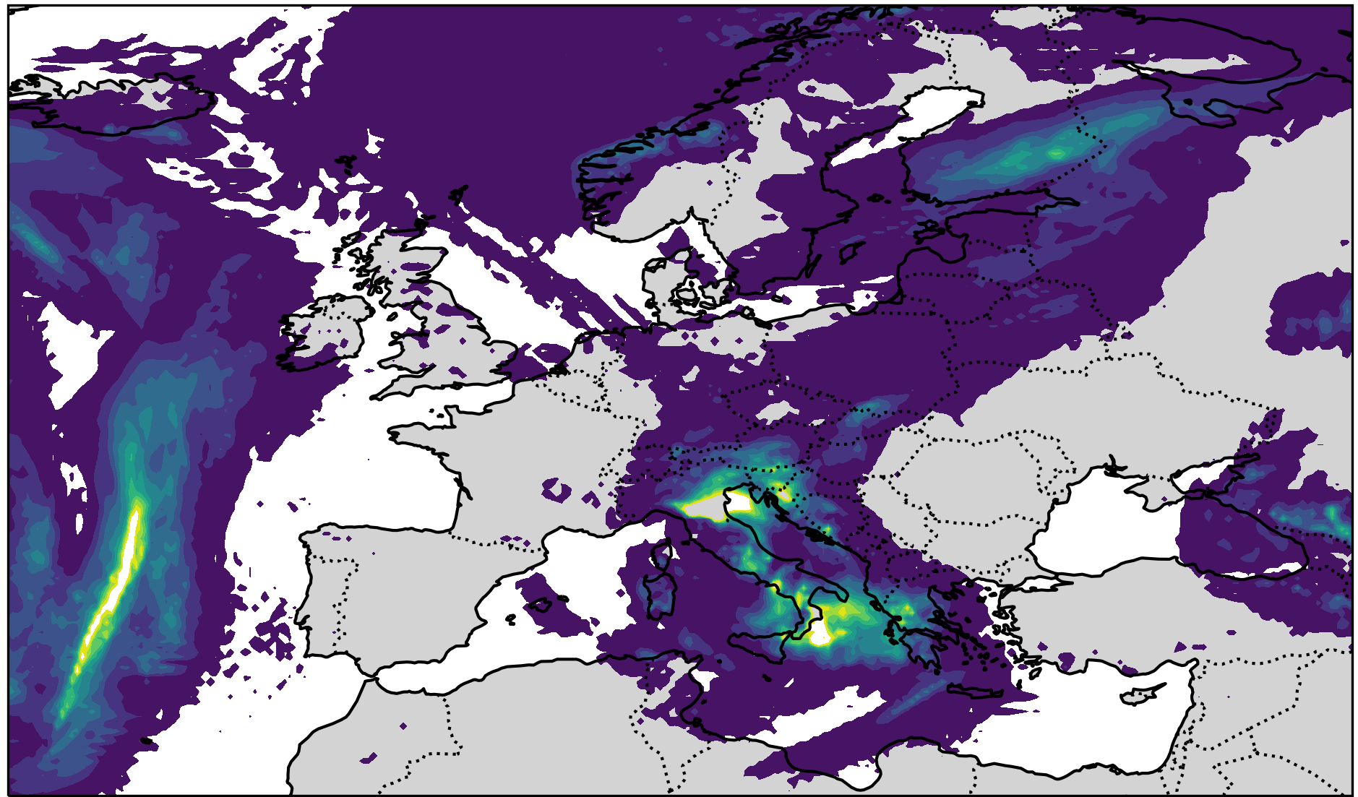
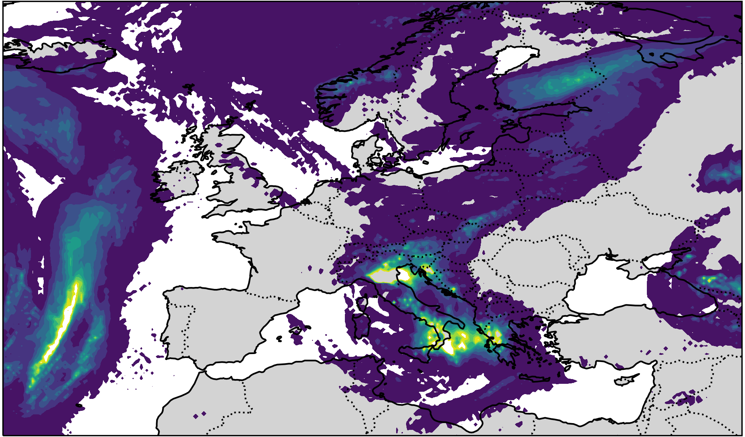
Global High Resolution Assimilation (ICON)
3 hourly total precipitation forcast at 2023050300 (lead hour 24)
6.5 km EU nest
3.25 km EU nest

Slide 12
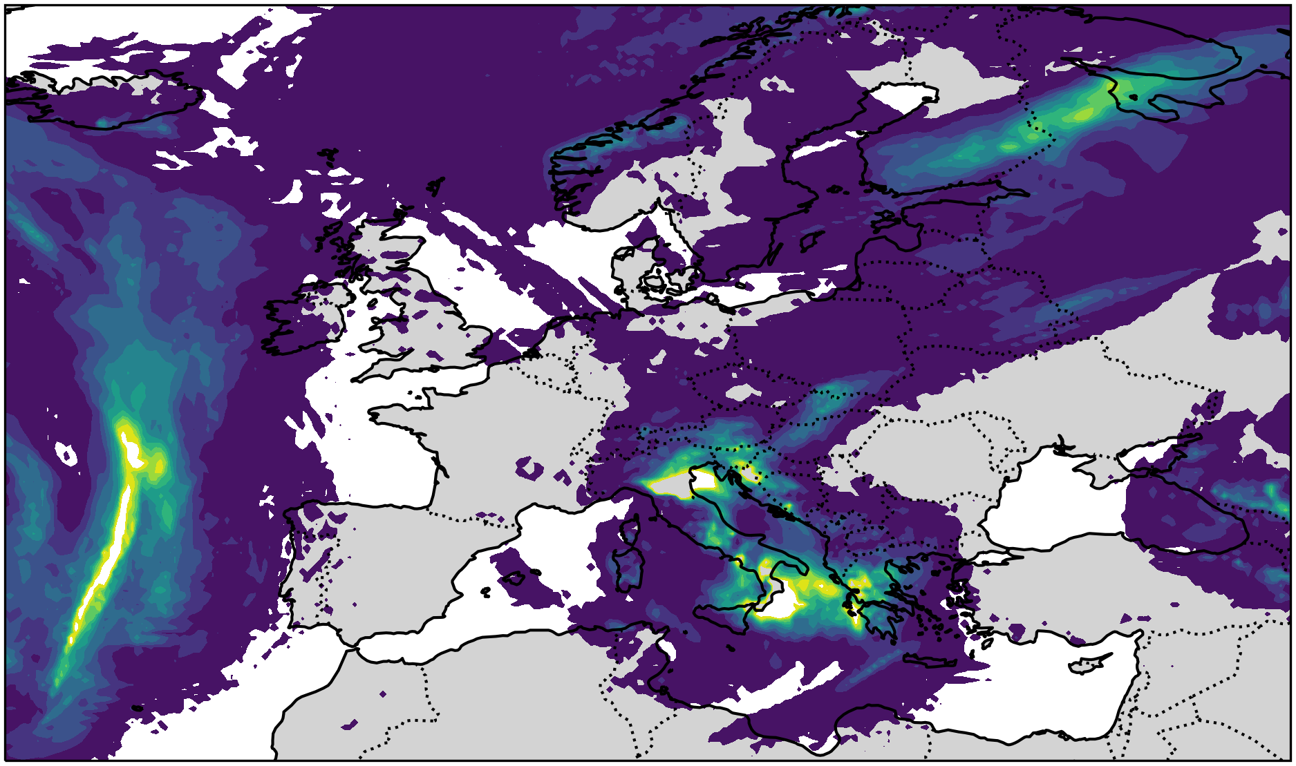
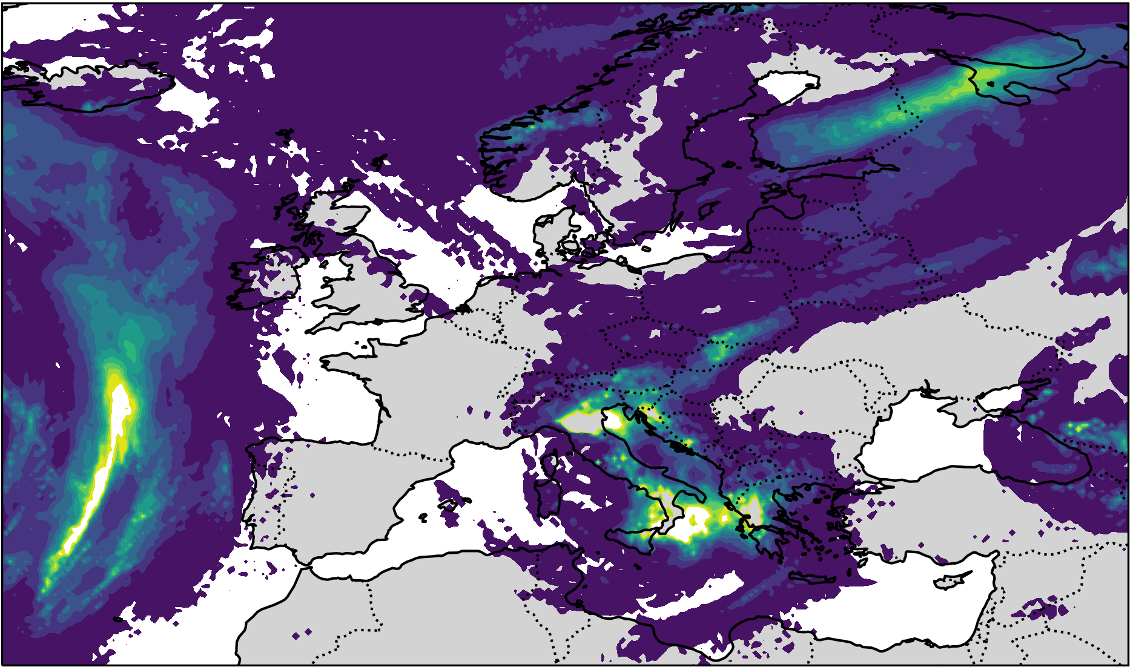
Global High Resolution Assimilation (ICON)
Total precipitation forcast at 2023050312 (lead hour 36)
6.5 km EU nest
3.25 km EU nest

Slide 13
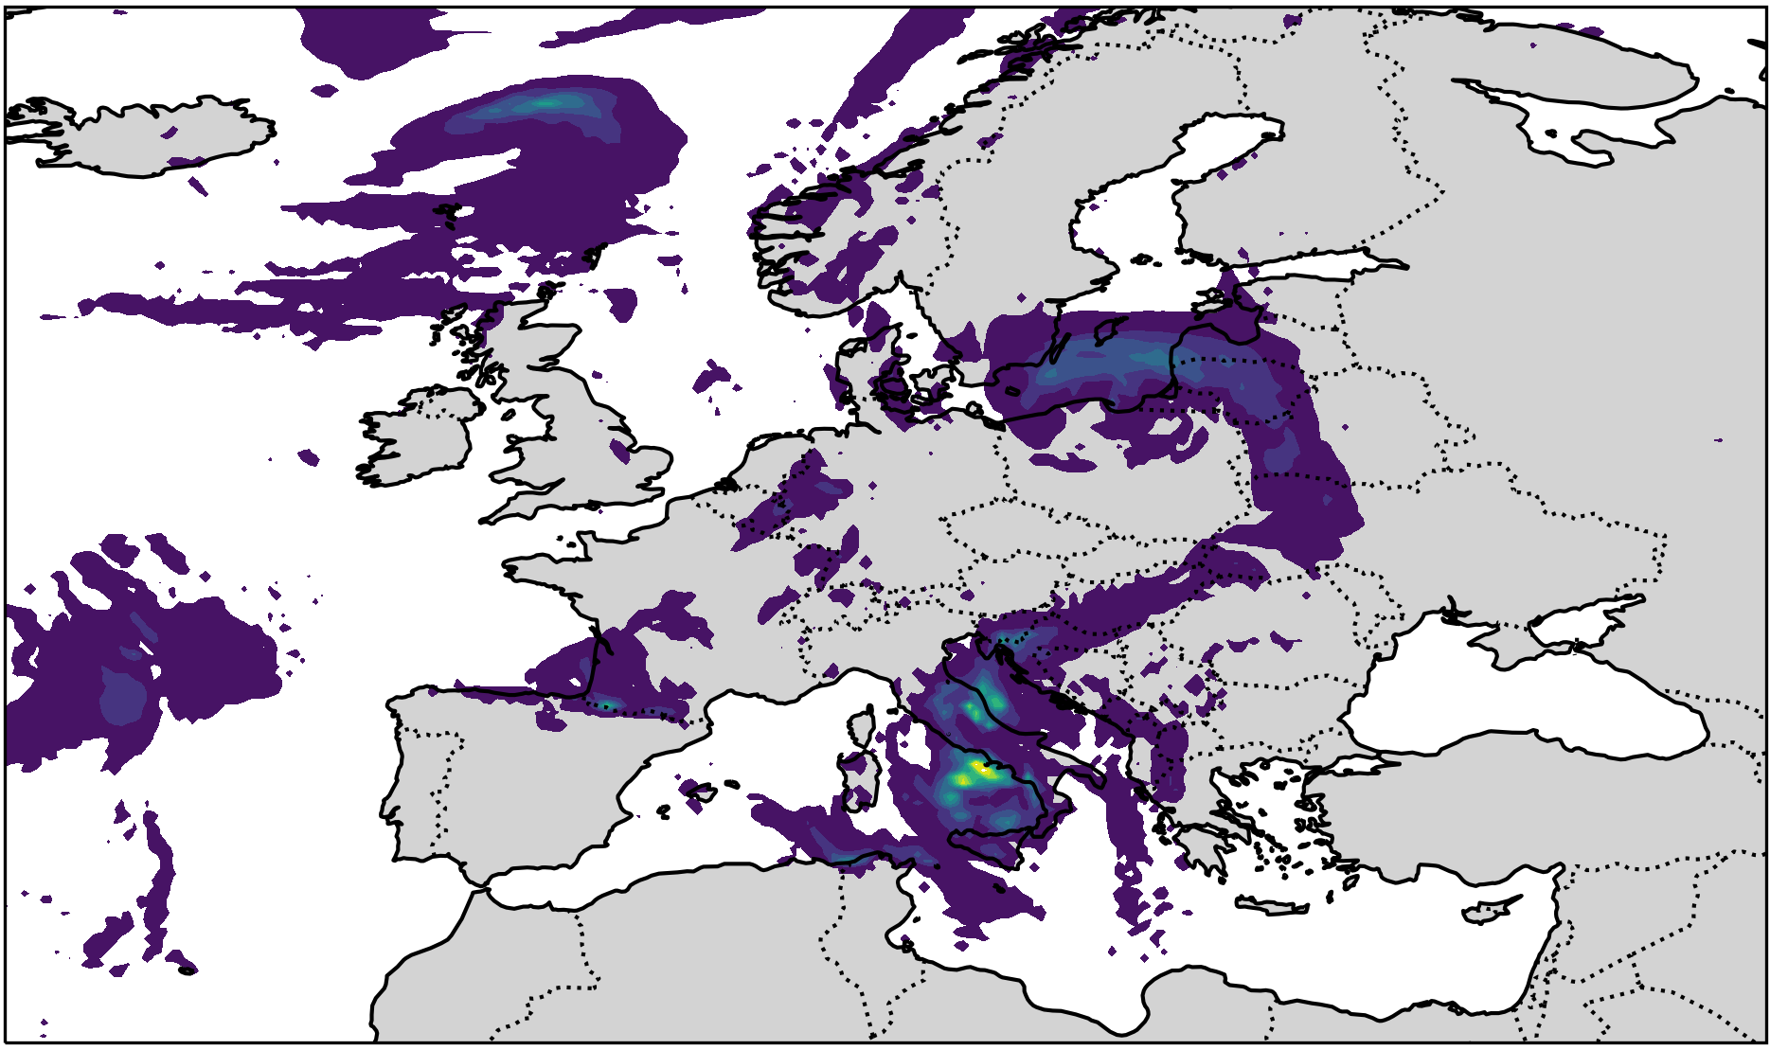
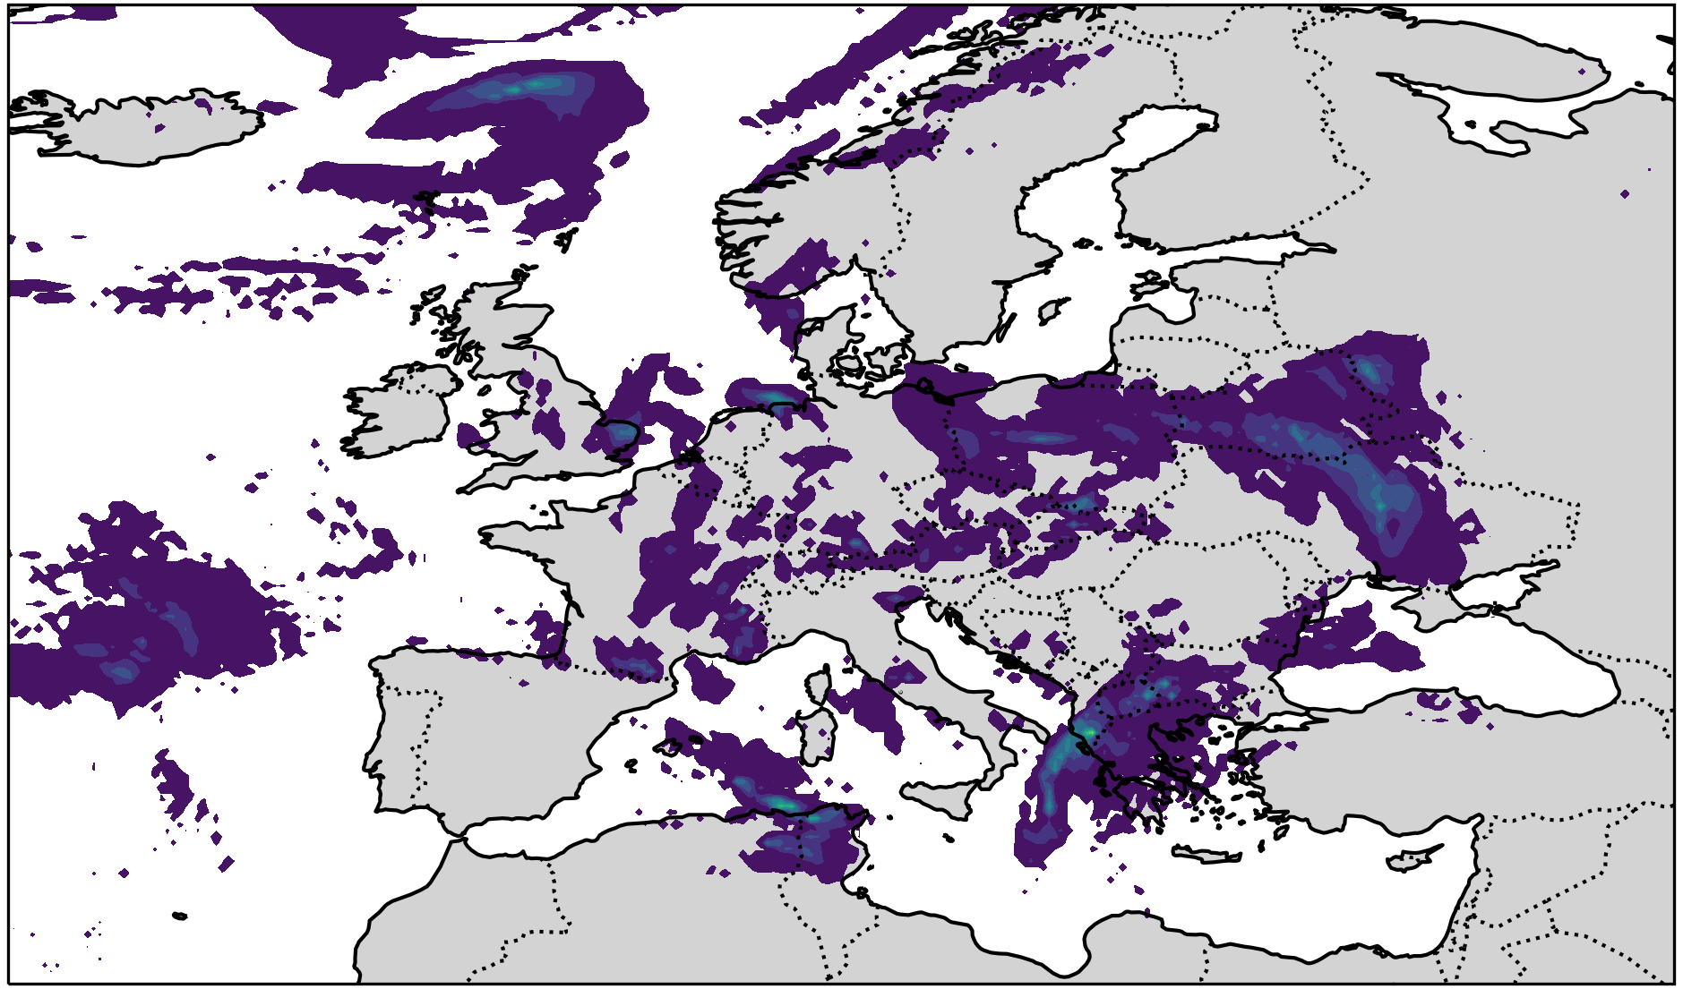
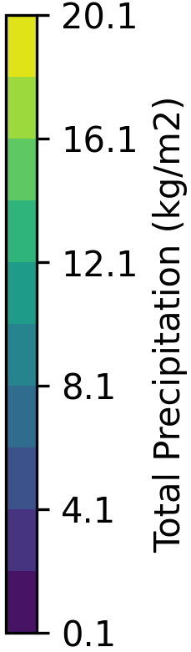
Global High Resolution Assimilation (ICON)
Total precipitation forcast at 2023051600 (lead hour 3)
6.5 km EU nest
3.25 km EU nest

Slide 14
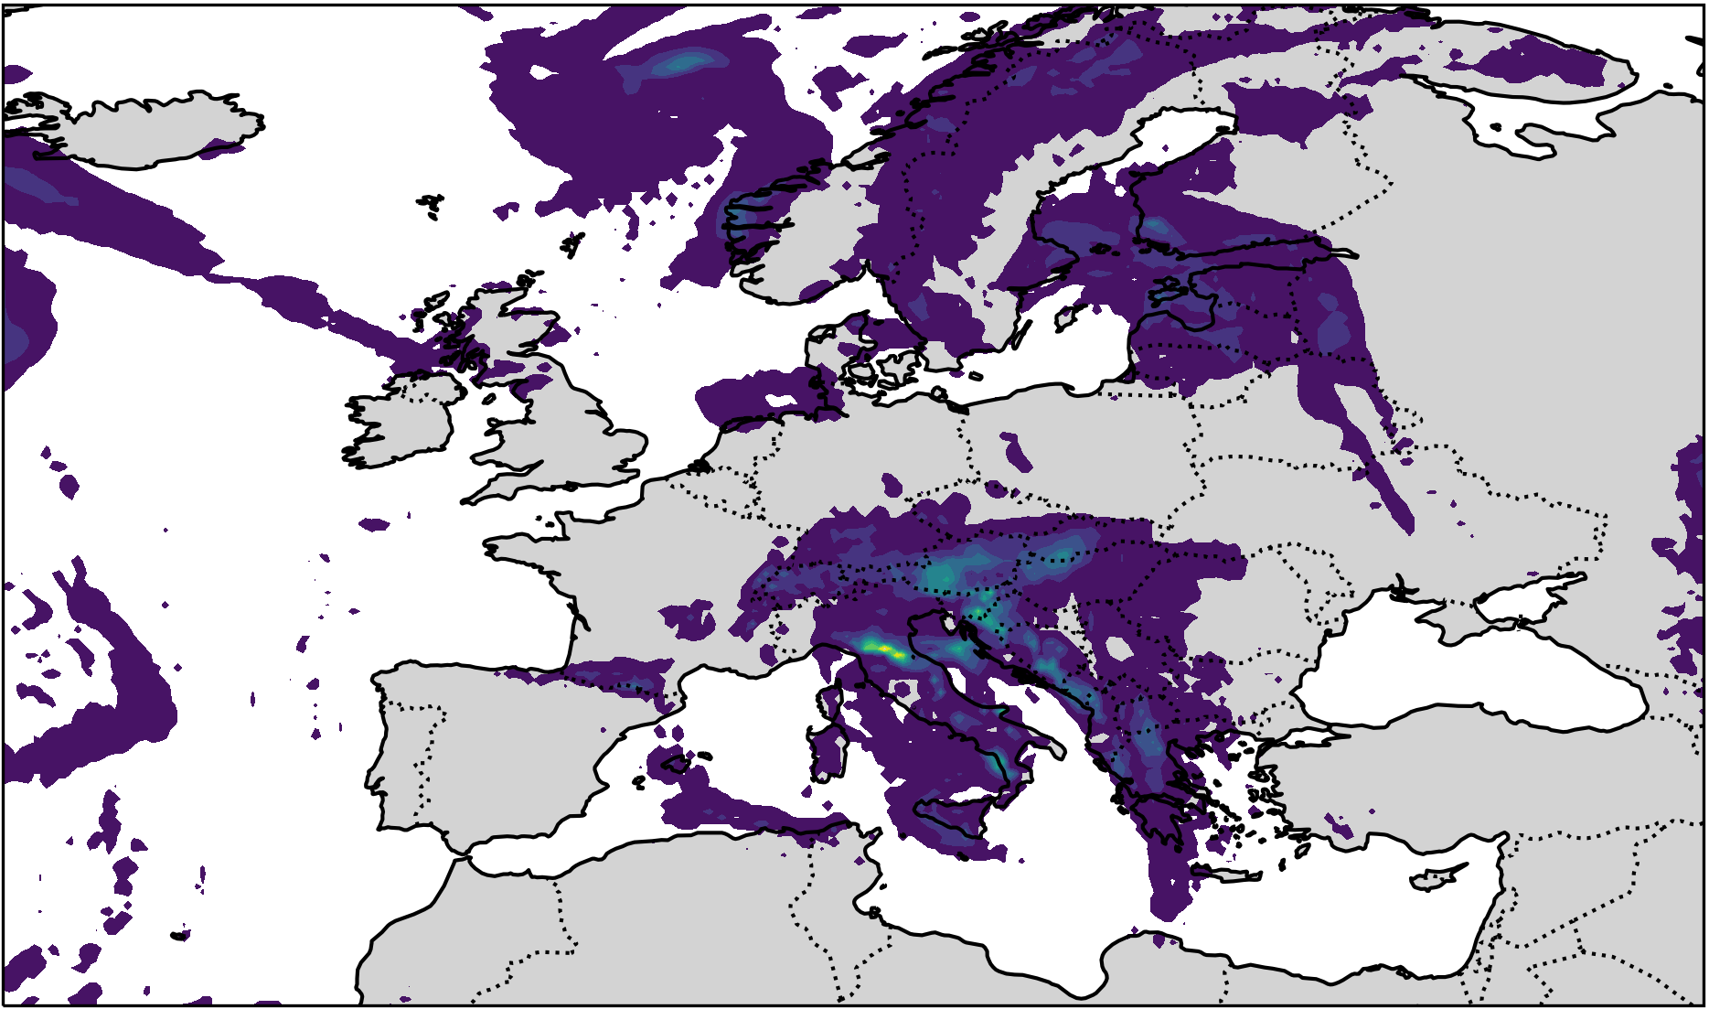
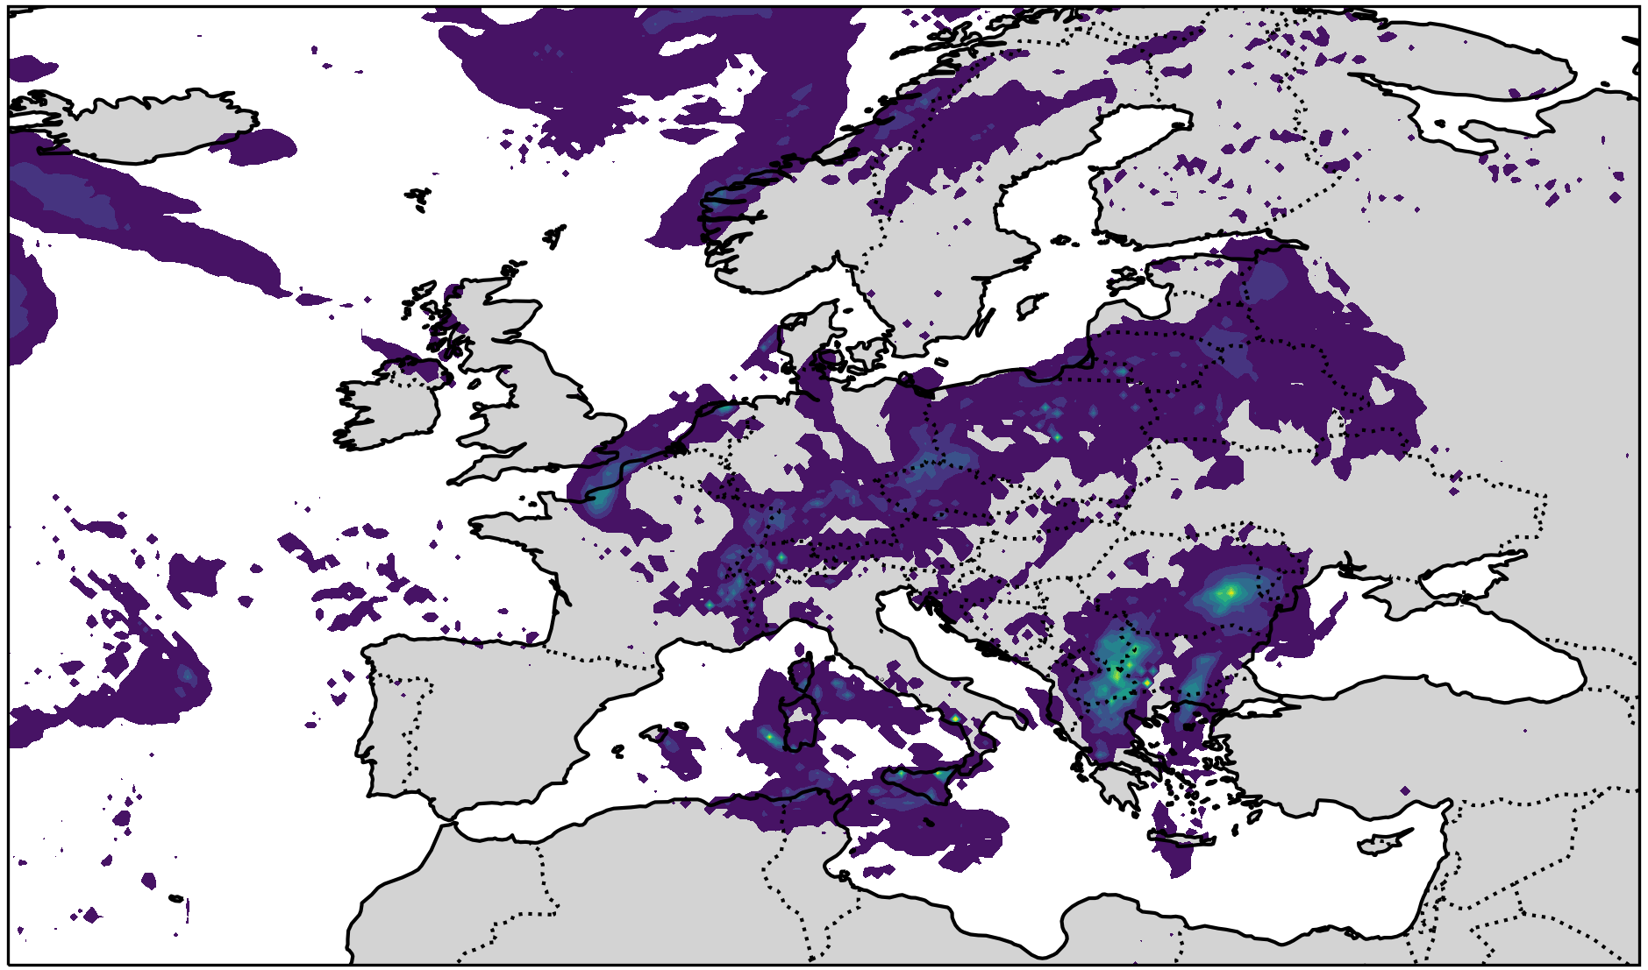
Global High Resolution Assimilation (ICON)
Total precipitation forcast at 2023051612 (lead hour 3)
6.5 km EU nest
3.25 km EU nest

Slide 15
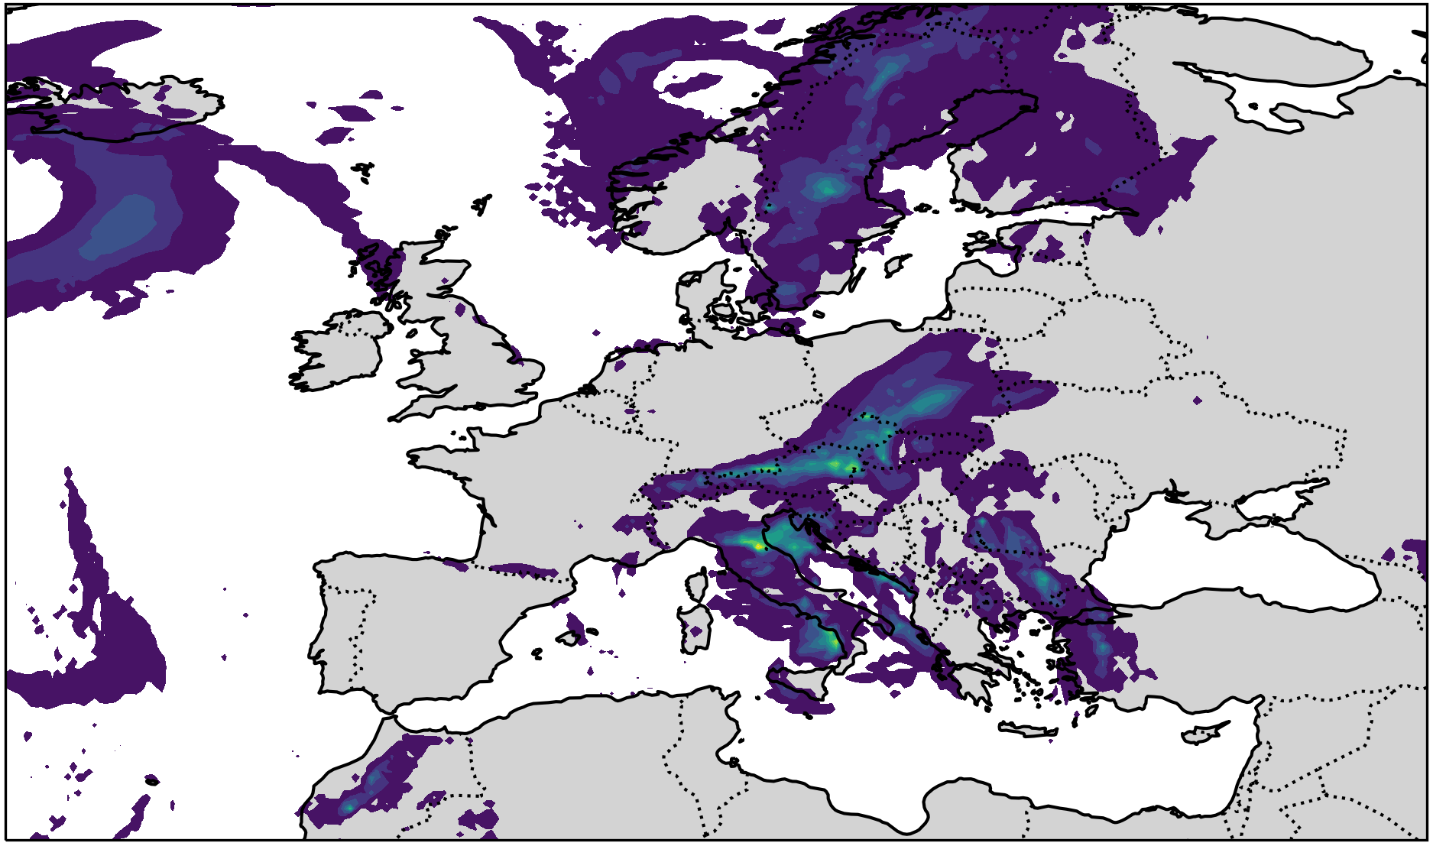
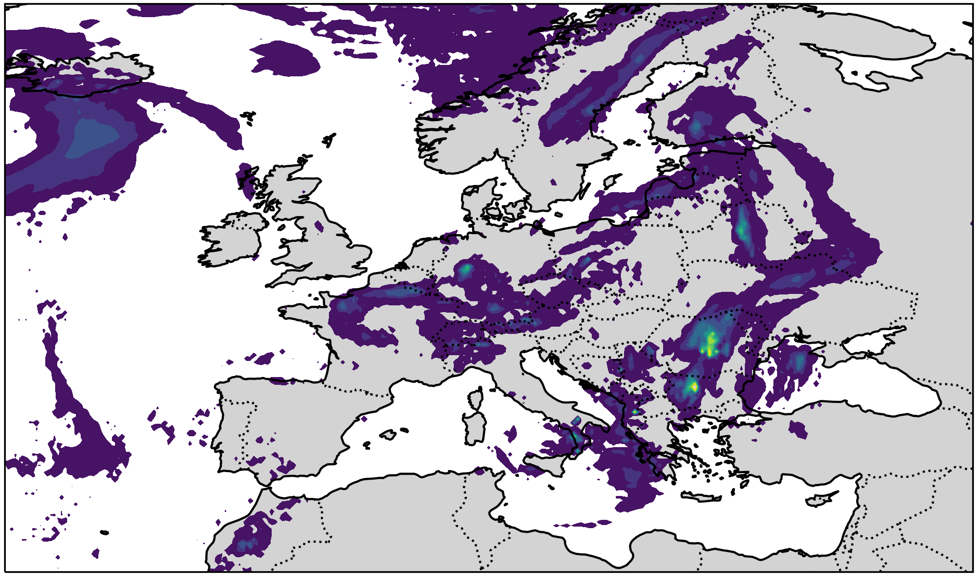
Global High Resolution Assimilation (ICON)
Total precipitation forcast at 2023051700 (lead hour 3)
6.5 km EU nest
3.25 km EU nest

Slide 16
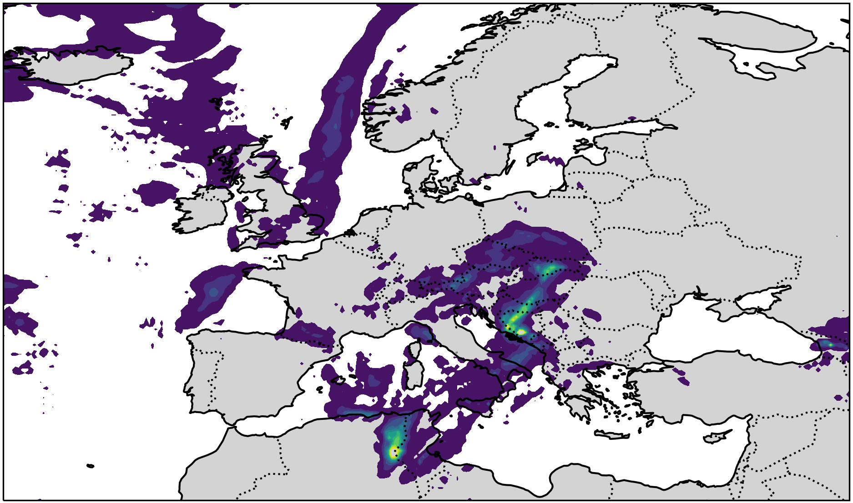
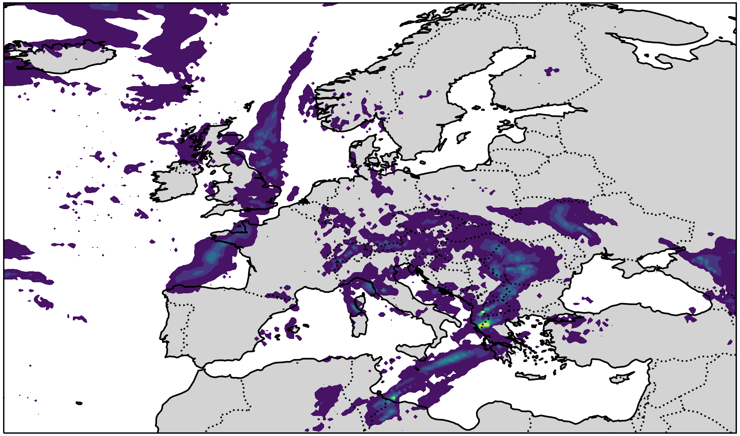
Global High Resolution Assimilation (ICON)
Total precipitation forcast at 2023051500 (lead hour 3)
6.5 km EU nest
3.25 km EU nest

Slide 17
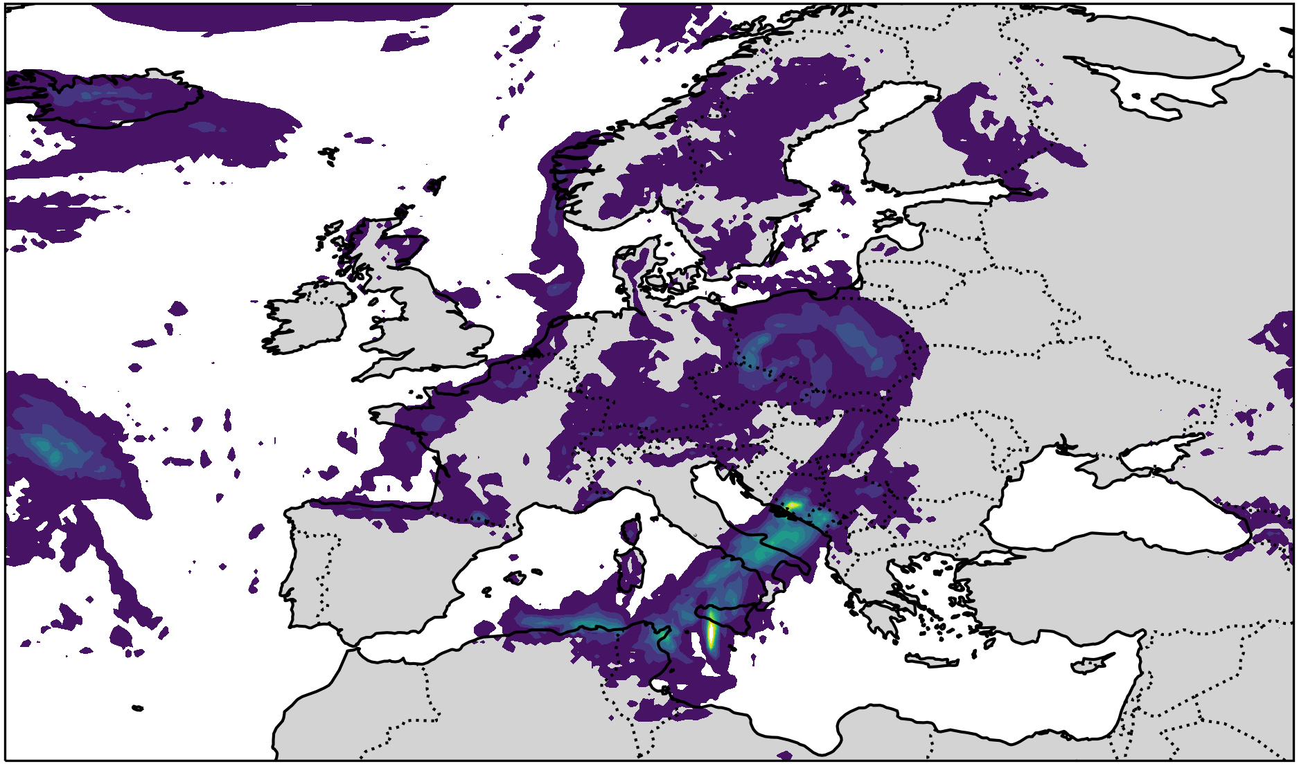
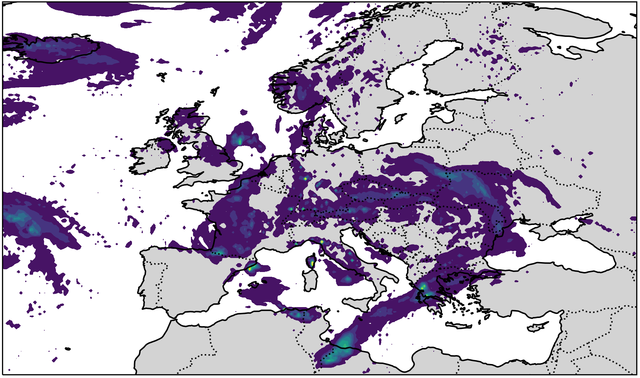
Global High Resolution Assimilation (ICON)
Total precipitation forcast at 2023051512 (lead hour 3)
6.5 km EU nest
3.25 km EU nest

Slide 18
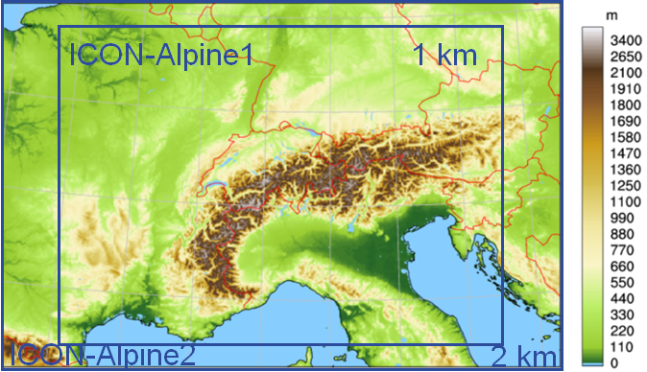
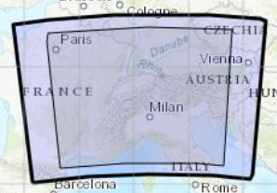
Regional High Resolution Assimilation (ICON-LAM)
GlORI-Alps
Basic Setup
High resolution assimilation (1 km)
1 km
500m
Deterministic Run: 2 km
Ensembles: 2 km
Assimilation: LETKF
Ensemble members: 40
Nest (two-way-nested)
Deterministic Run: 1 km
Ensembles: 1 km
Deterministic Run: 1 km
Ensembles: 1 km
Assimilation: LETKF
Ensemble members: 40
Nest (two-way-nested)
Deterministic Run: 500m
Ensembles: 500m
Boundary condition is interpolated from 6.5km EU nest

Slide 19
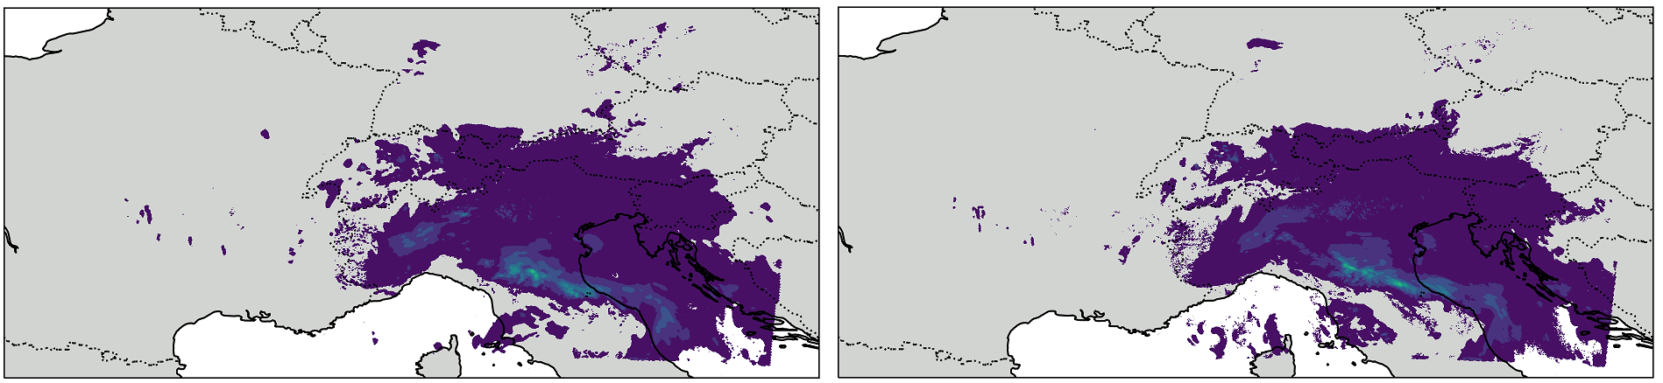
Regional High Resolution Assimilation (ICON-LAM)
Hourly total precipitation 2023050200 - 2023050212
2km Alps domain
1km Alps domain

Slide 20
Summary
In GLORI, we have implemented high-resolution data assimilation for the global model and kilometer-scale data assimilation for the regional model.
The ICON ASS setup currently includes two assimilation cycle :
The 6.5 km global run with ENVAR + LETKF
The 3.25 EU-nest run with ENVAR
The ICON-LAM assimilation cycle has been tested at 1km resolution
However, the performance of the high-resolution EU setup remains unstable, and the parameterization is still under review.

Slide 21
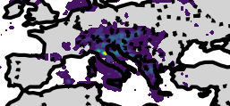

Total precipitation forcast at 2023051612 (lead hour 3, 6.5km)

Slide 22


Total precipitation forcast at 2023051612 (lead hour 3, 13km)

