Slide 1
Making use of data for physical land surface model developments at ECMWF
Christoph Rüdiger
ECWMF Land Modelling Team
Birgit Sützl, Francesca Covella, Gabriele Arduini, Gianpaolo Balsamo,
Jasper Denissen, Joe McNorton, Margarita Choulga, Nina Raoult, Souhail Boussetta, Xabier Pedruzo Bagazgoitia,
future hydrologist
as well as colleagues from ECMWF, in particular in the
Coupled Data Assimilation team
Hydrological Monitoring and Forecasting team
AIFS team
Notes:
What this presentation will contain – philosophical reflection, lesser so technical aspects
….. And a few intentional out of context quotes, because physical modelling and ML don’t get it quite right either

Slide 2
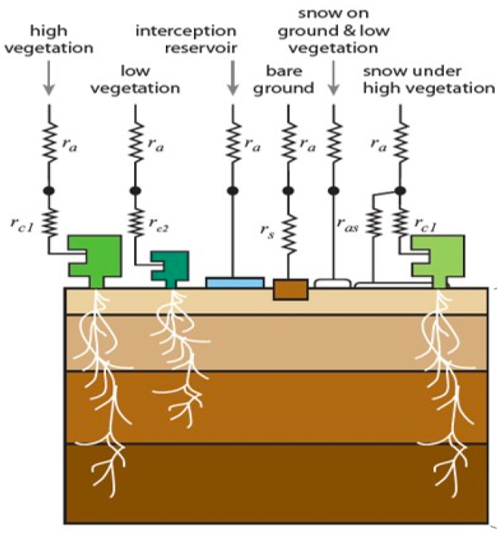
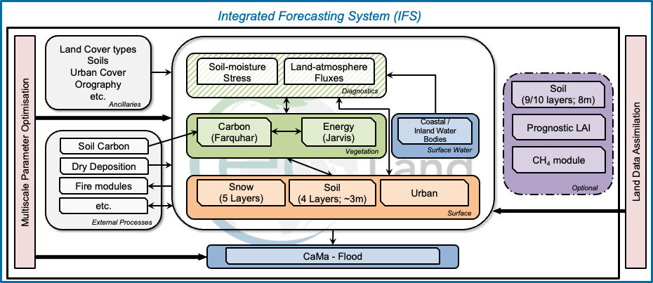
ecLand

Slide 3
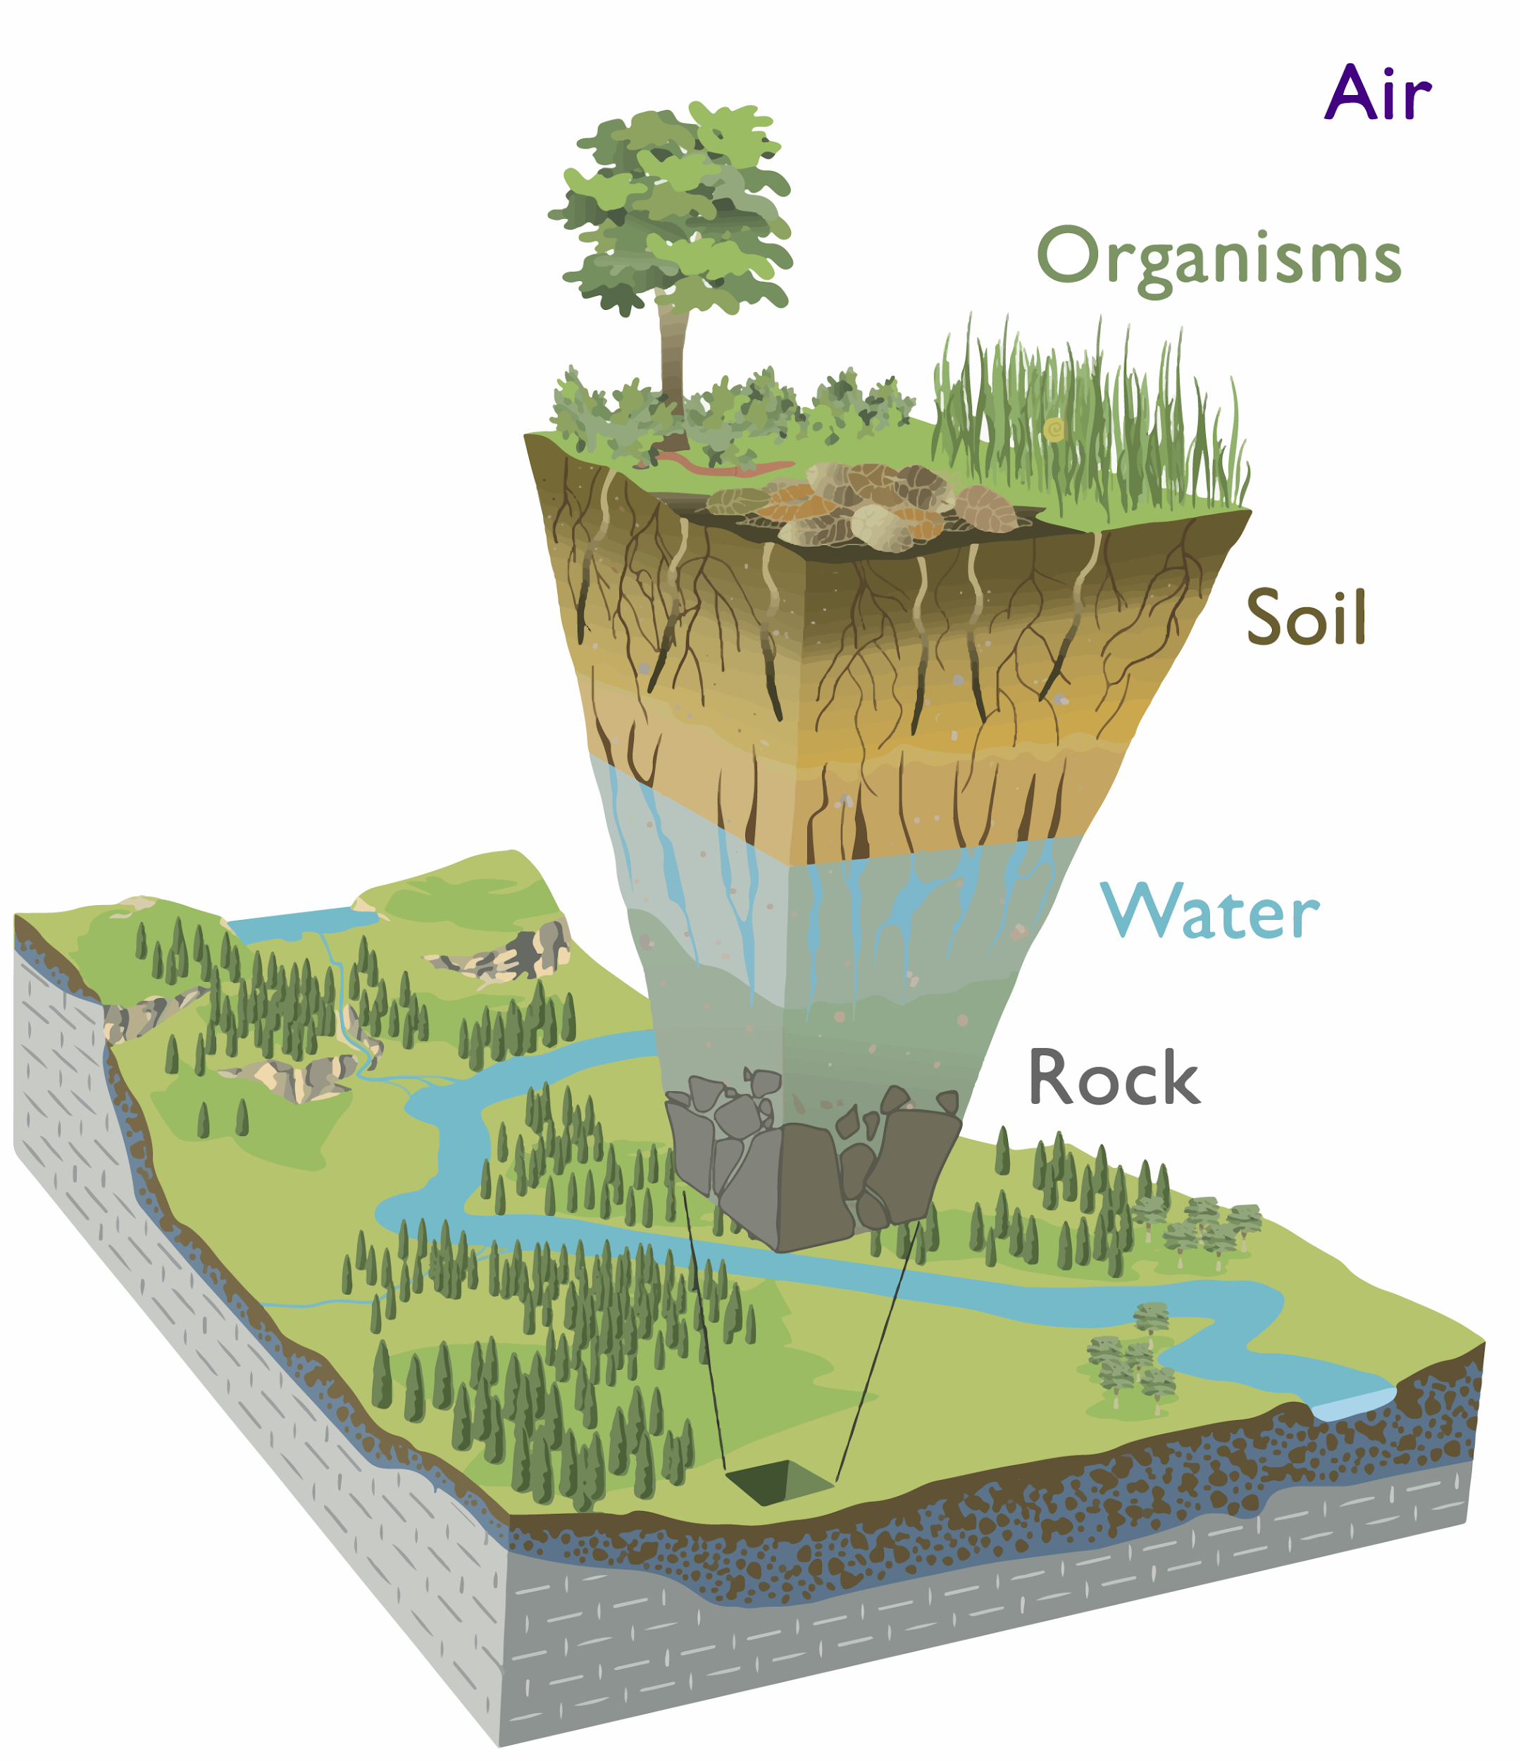

Processes Under Investigation
Orography
Coupling
Snow parameterisation/model
Glaciers and sea-ice
Sub-grid scale heterogeneity
Snow
Vegetation
Updated climatologies
Land cover and vegetation cover
Parameterisations and phenology
Urban processes (hydro, veg)
Land cover
Anthropogenic contributions
Urban
Additional soil layers
Soil maps and physics
Parameterisations
Runoff generation
CaMa-Flood
Irrigation/inundation
Plant-water availability (soil dynamic range)
Groundwater table representation
Dynamic water bodies
Coupling with ocean (2-ways)
Lakes
Image from Chorover et al., 2007

Slide 4
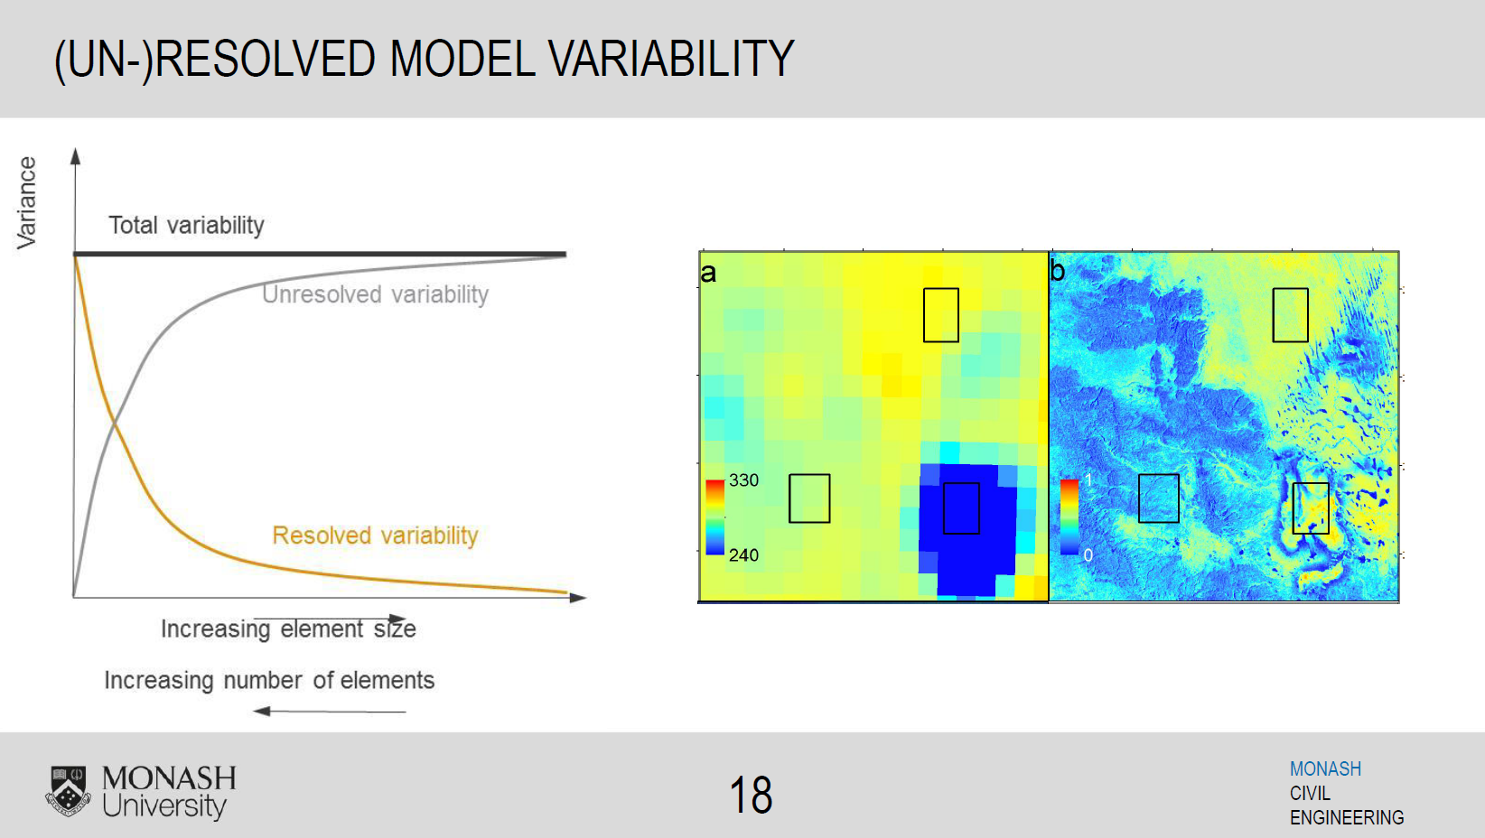
The Land Surface Model Paradigm
400 km
“Reality”
Resolved Complexity
Land Surface Models
400 km
Resolution⁻¹

Slide 5
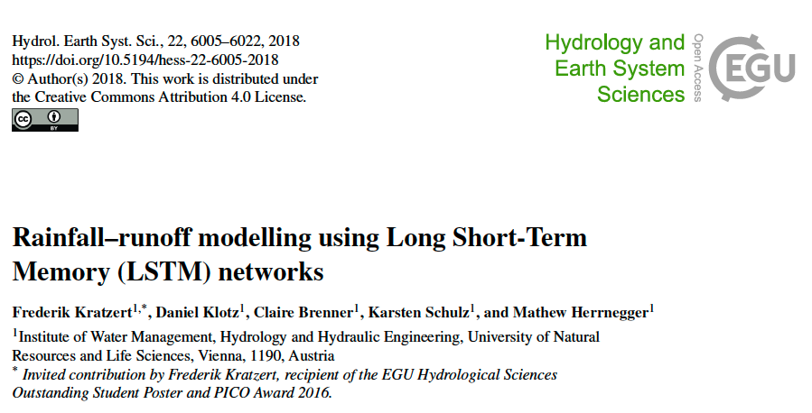
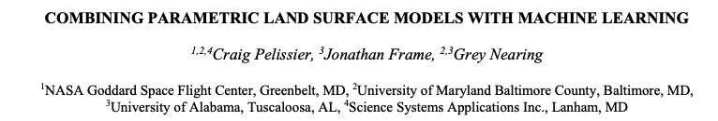
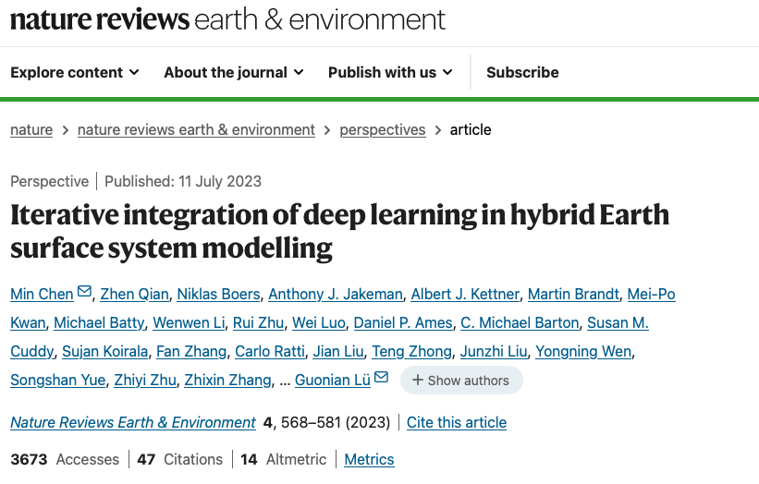
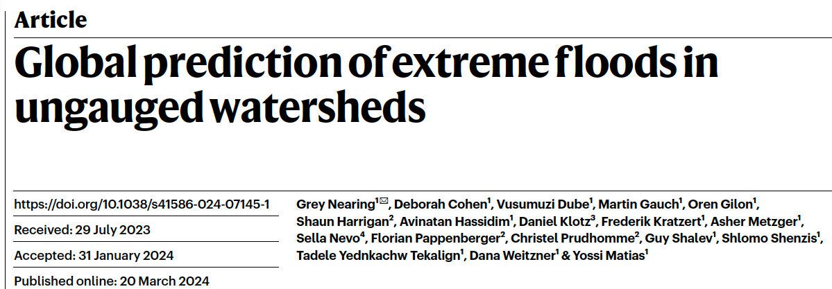
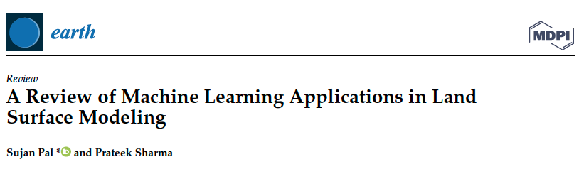
Machine Learning for and with Land Surface Models

Slide 6
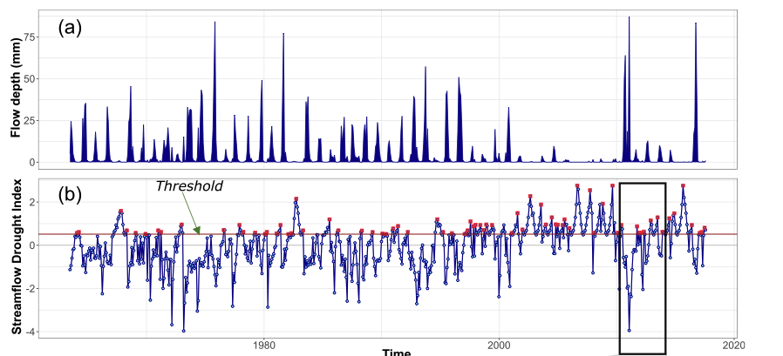
Stationarity Assumption
Misquoting Hegel : “History will teach us nothing…”
Goswami et al., 2022
Notes:
His quote was actually more geared towards "politicians and peoples" and that the here and now (and future) was more constraint by the conditions and situation at the time, rather than what happened in the past.
Essentially a lossy memory system.

Slide 7
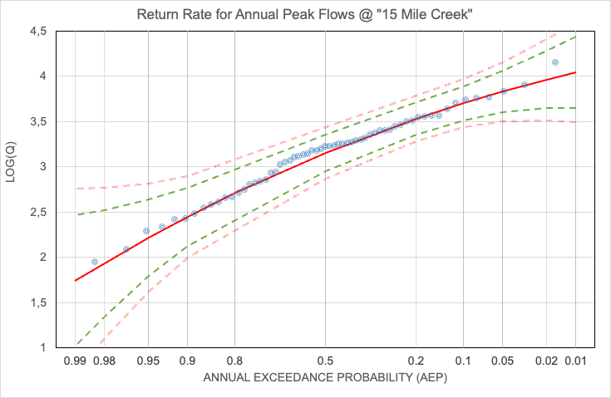
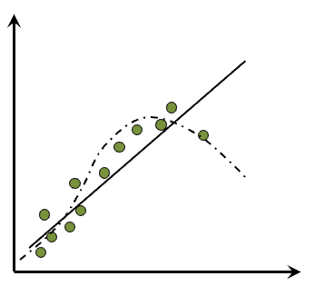
Predicting the Future From the Past

Slide 8
Bringing together physically- and data-driven parameters
Land surface observations
Phy.-based optimisation
𝒫_{p}
Physical model development
observations / physics
𝒫
ecLand, IFS
(observations)
ML / AI
𝒫_{ML}
Emulators / AIFS, coupling processes
model / observations
IFS, screen level var.
Ad-hoc tuning
𝒫_{opt}
Short-term forecasts
daily observations
Notes:
we need the physical model to create higher quality training data sets, but also to undertake long-term studies
this will improve the AIFS and its cousins, as well as the short-term forecast skills.
they all work together to make the models better - it is not logical to see them as separate entities

Slide 9

From the physical to the data-driven world (and back again)

Slide 10
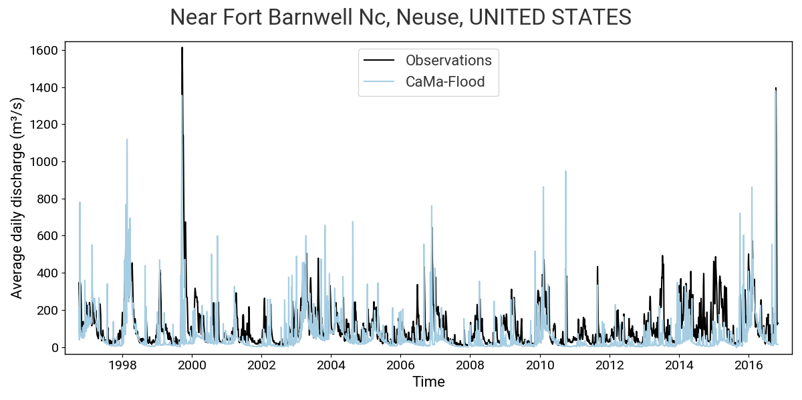
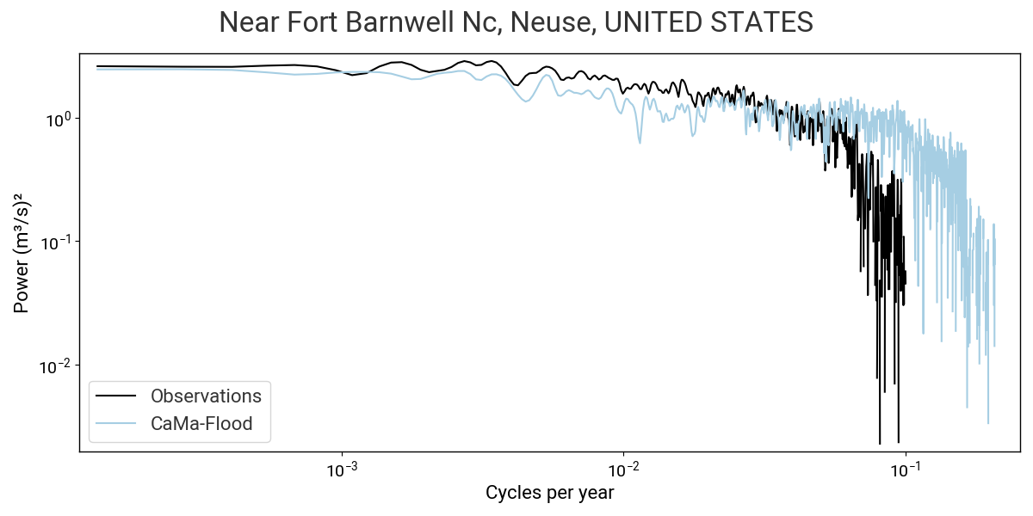
Runoff Generation
Spectral Properties of Runoff
Spectral decomposition
based on Weedon et al. (2015)

Slide 11
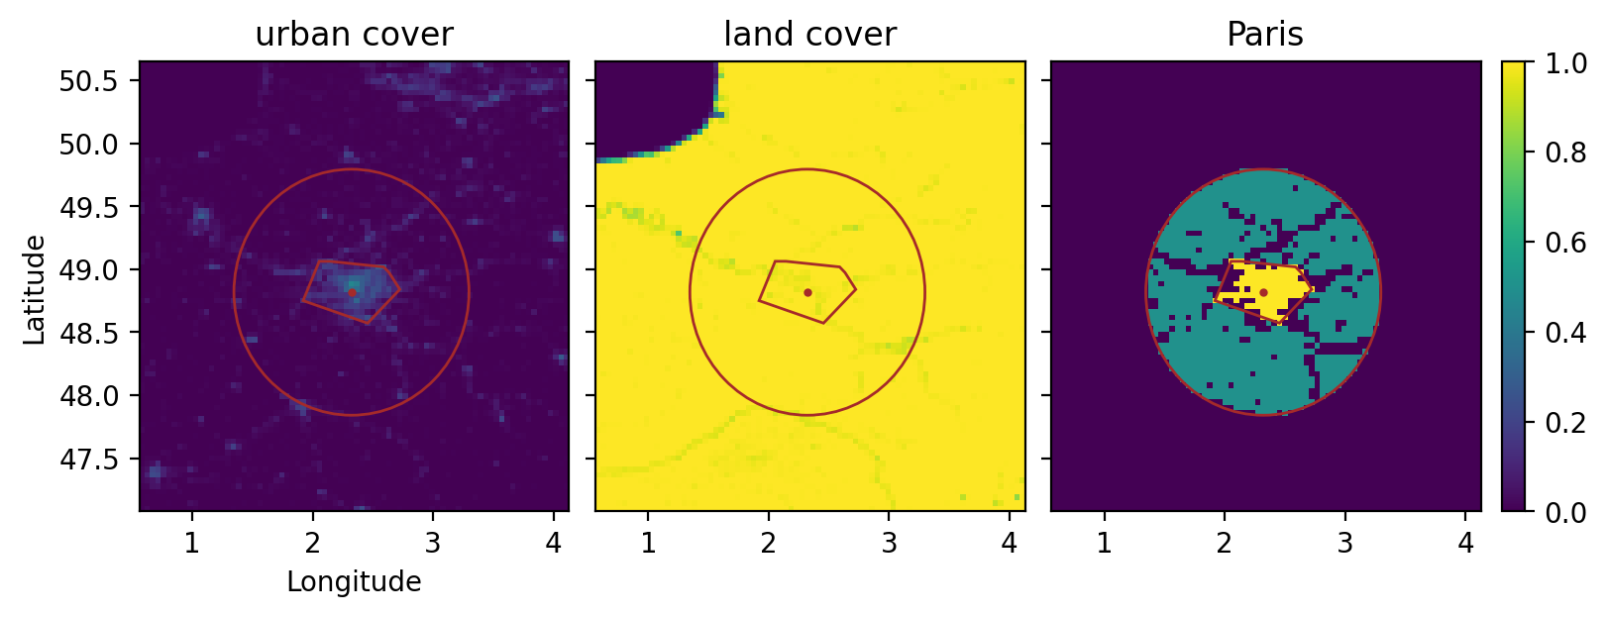
Urban Analytics
Global cities database: 10 largest cities per country with > 100 000 inhabitants
Methodology defines urban agglomerations and their rural surroundings:
  Urban agglomeration is defined as continuous cluster of grid points with an urban cover > 10% of grid-box area
  Rural land region within radius around the city, where:
    land cover > 99 % (exclude water)
    urban cover < 3 % (exclude sub-urban regions)
    grid-point not within the convex hull of city (excluding rural points that are surrounded/strongly influenced by urban points)
    radius scales by size of urban agglomeration
Around 200 cities worldwide at 9 km resolution that are sufficiently large for our data and this methodology
City centre
Urban agglomeration
Rural surrounding
Convex hull of city
Rural radius

Slide 12
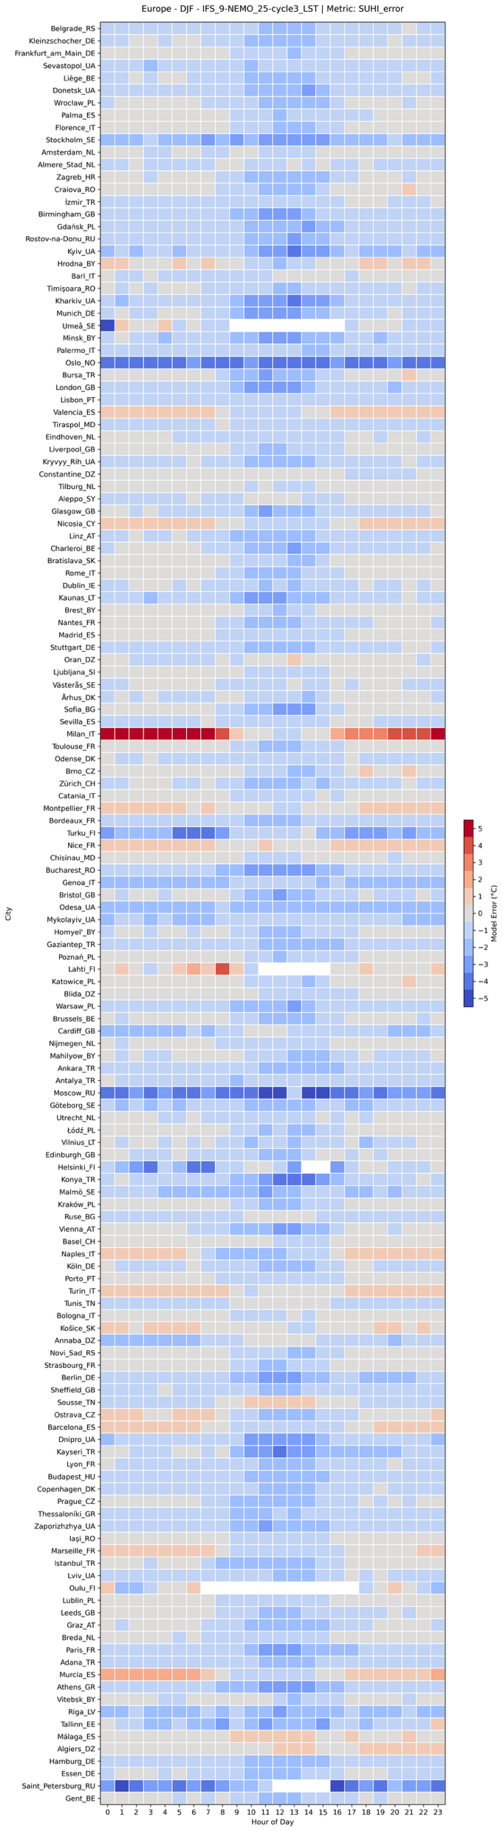
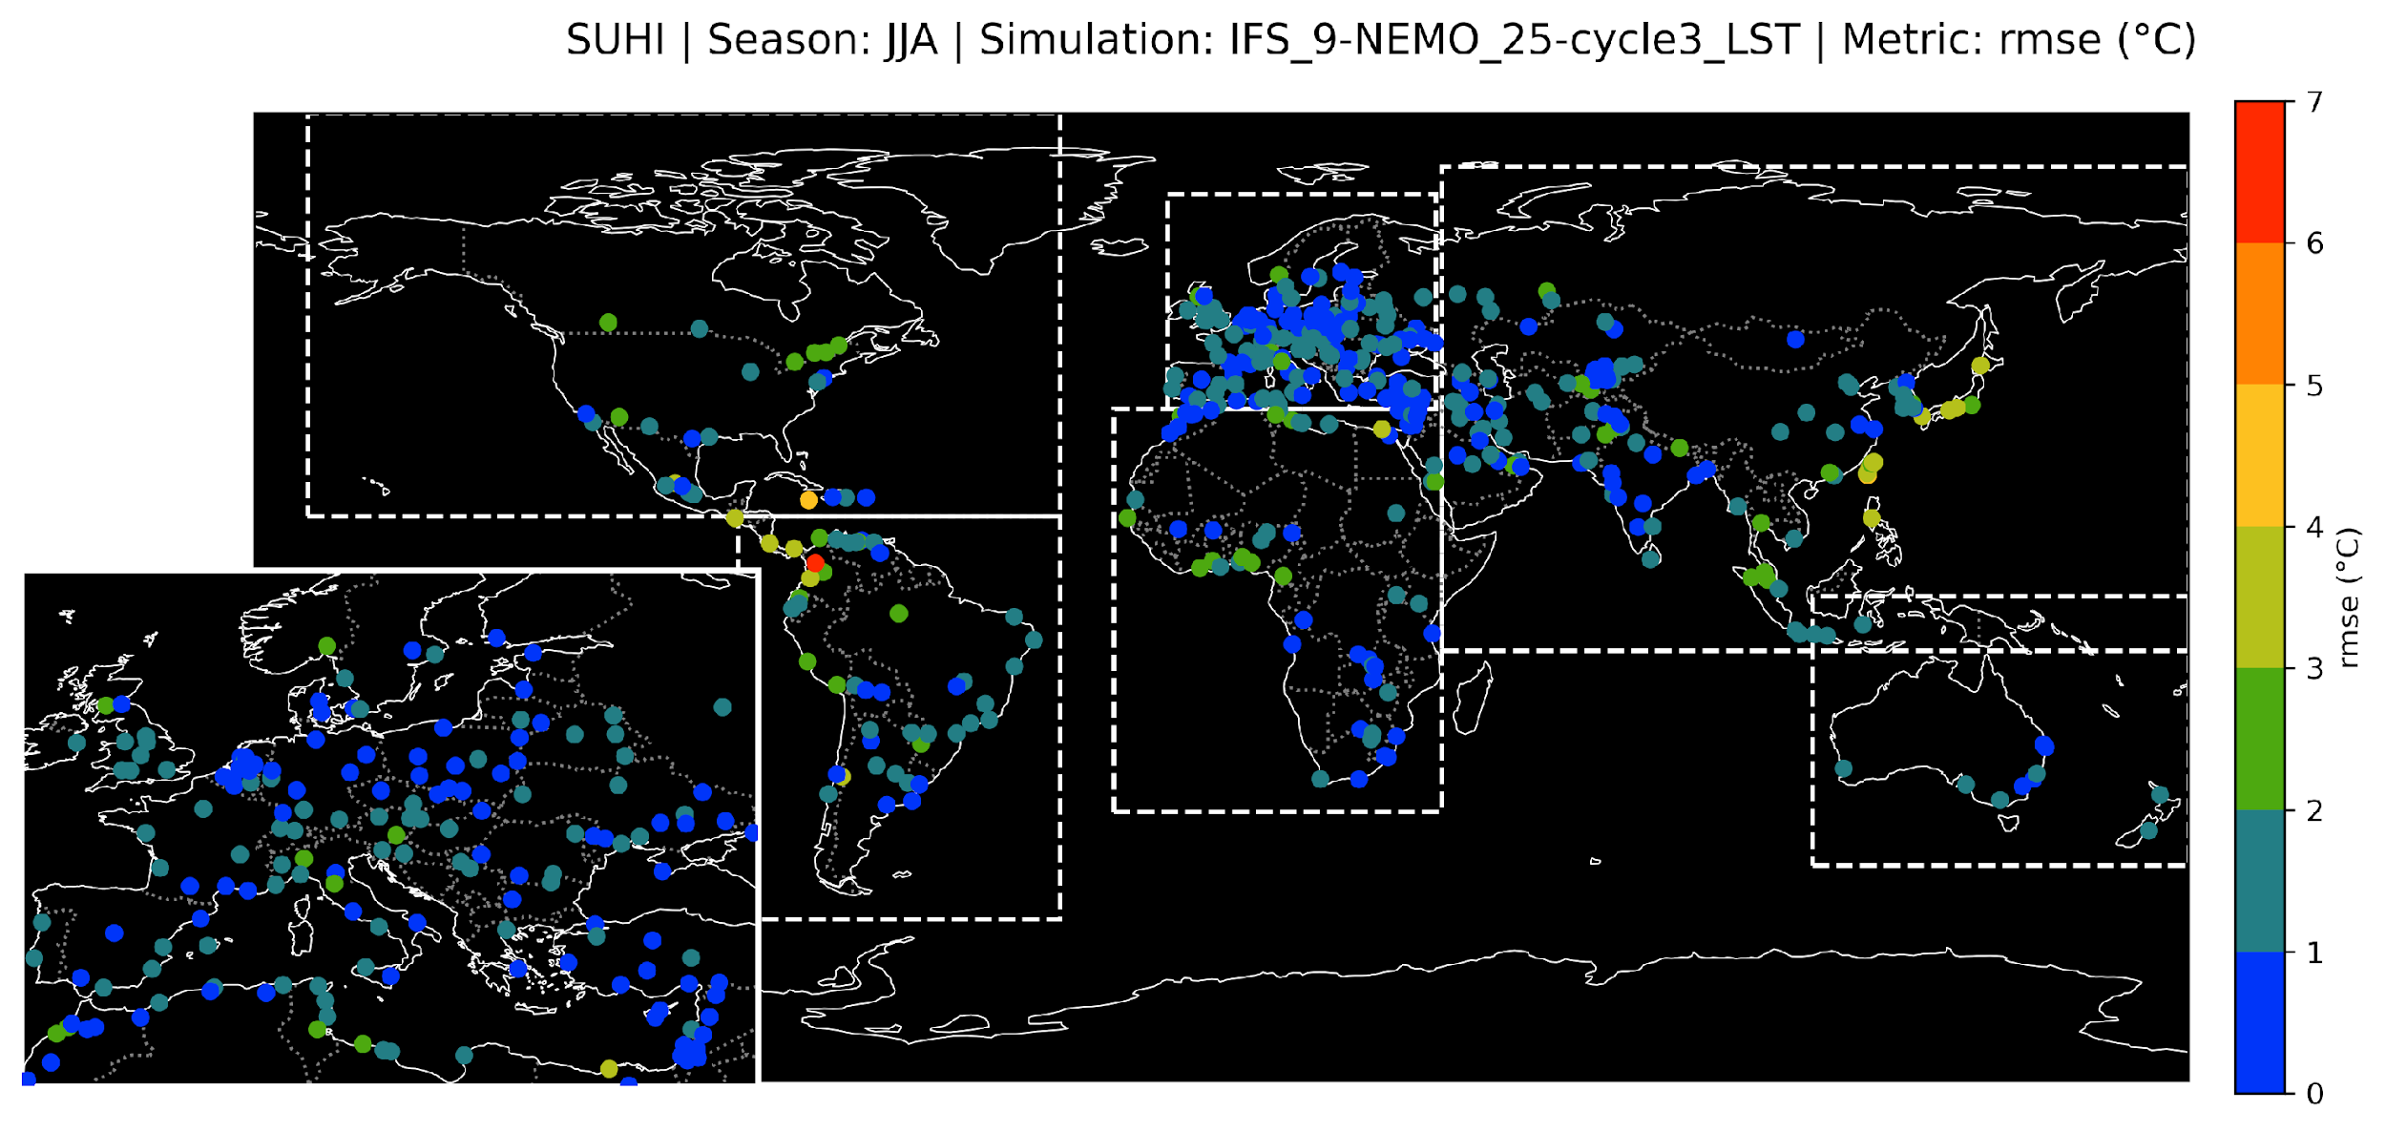
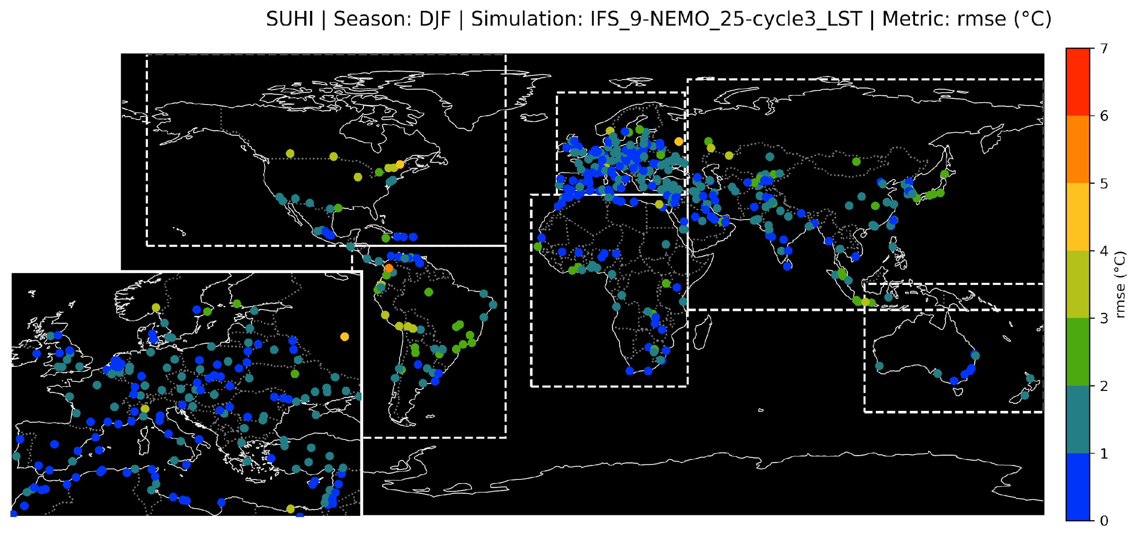
Urban Analytics
Diurnal cycles for European cities.
RMSE of mean diurnal cycle.
Generally good agreement between observations and simulations of SUHI.
RMSE of mean diurnal cycle of SUHI low at 9 km (mostly < 2 °C), largest in Tropics.

Slide 13
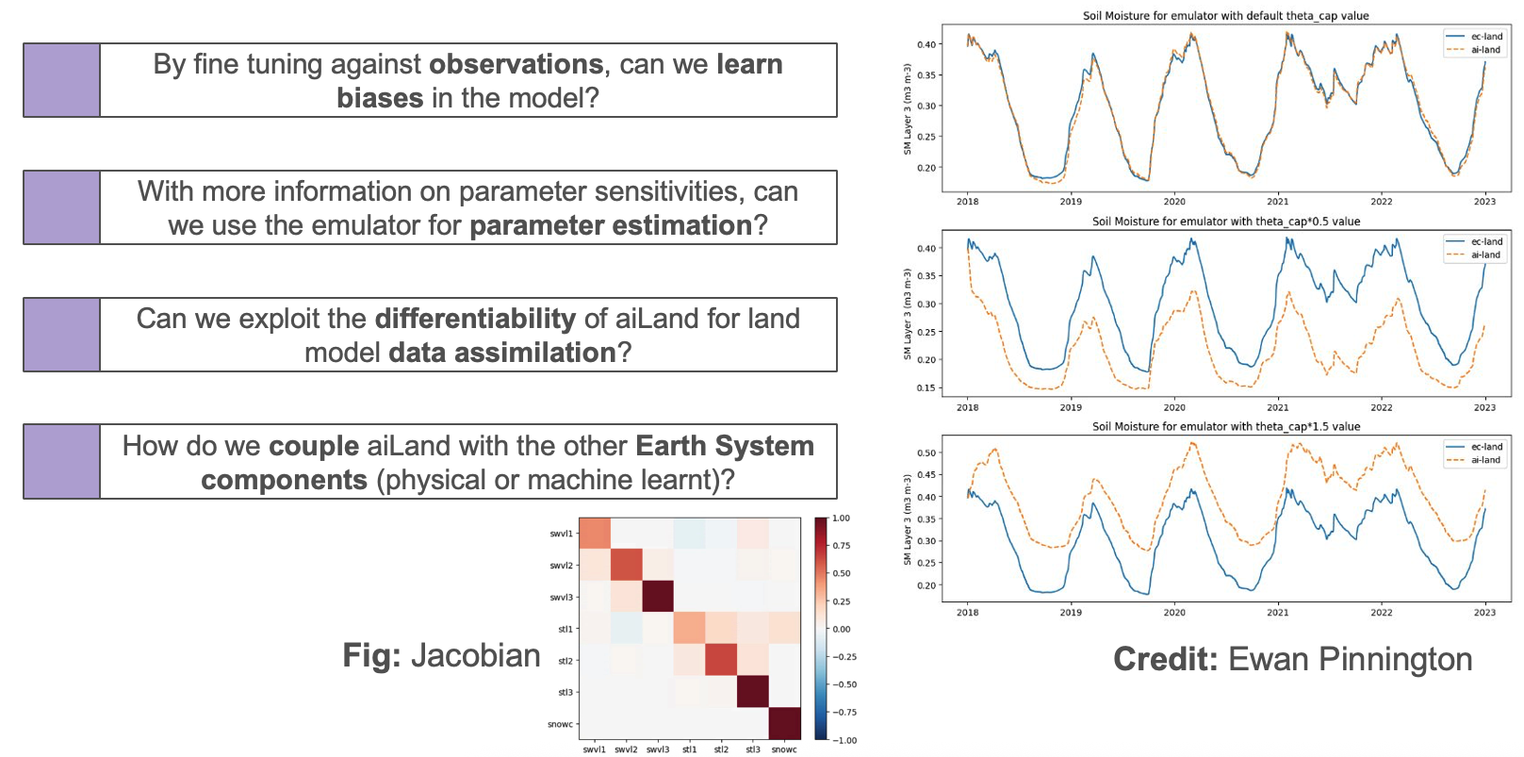
aiLand – Parameter Perturbations

Slide 14
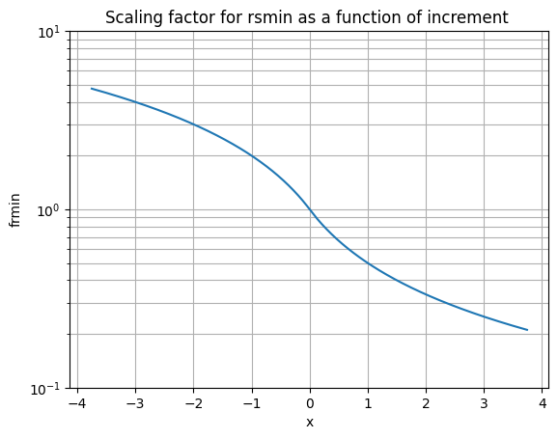
Adaptive Parameter Tuning (slides by Gabriele Arduini)
Optimisation of parameters using analysis increments and empirical functions.
First implemented for ICON NWP applications by Zängl et al. (2025)
For each forecast, parameters are adjusted based on a function of the analysis increments used to generate the initial conditions:
  2-metre temperature and humidity increments are used.
  The scaling function, f(incr), is chosen multiplicatively antisymmetric.
  It is used to scale a parameter p for the i-th forecast:
  In practice, parameters are updated every 12-hours windows
  of the 4D-Var
Pros
Simple: does not require complex algorithms
Fast: based on functional relationship, no iterations or inversions.
Flow-dependent: considers the error of the day
Cons
Simple: does not consider a cost function or Bayesian approach
Flow-dependent: ”model-of-the-day”
Scaling function
increments

Slide 15
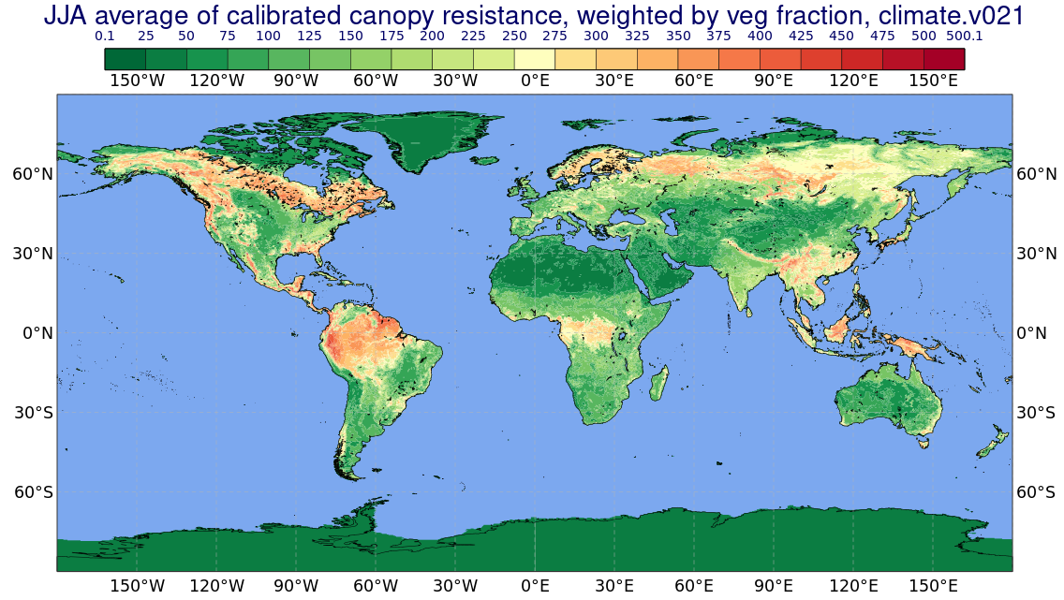
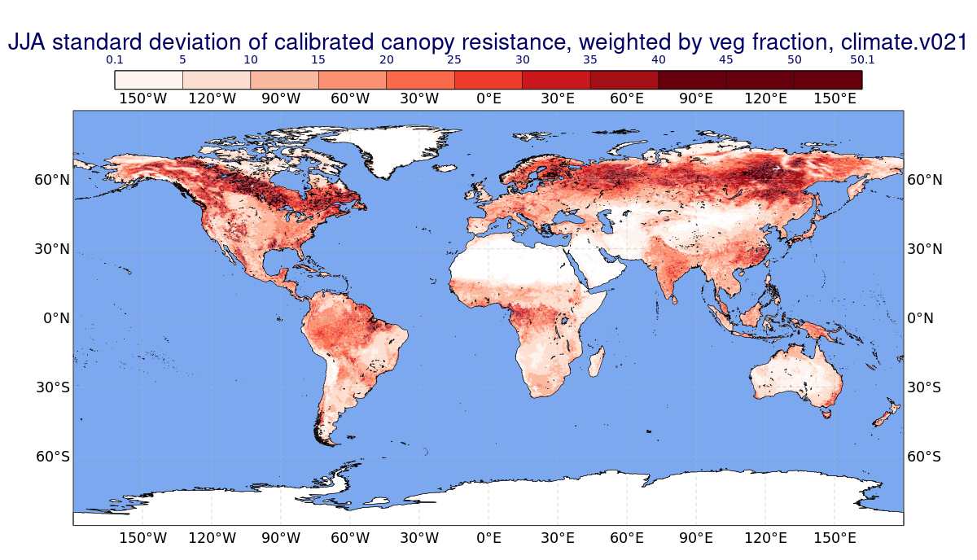
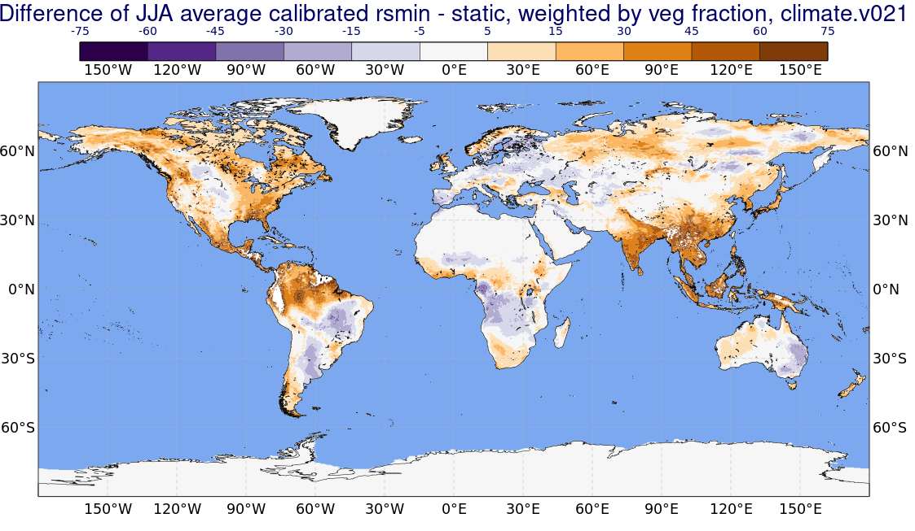
Adapted r_{s,min} – JJA 2023 statistics
JJA mean
JJA Standard Deviation
Consistent increase of r_{s,min} in ”hot-spot” area: Amazon forest, India and south-east Asia
Highest variability in the Forest regions in Eurasia and North America

Slide 16
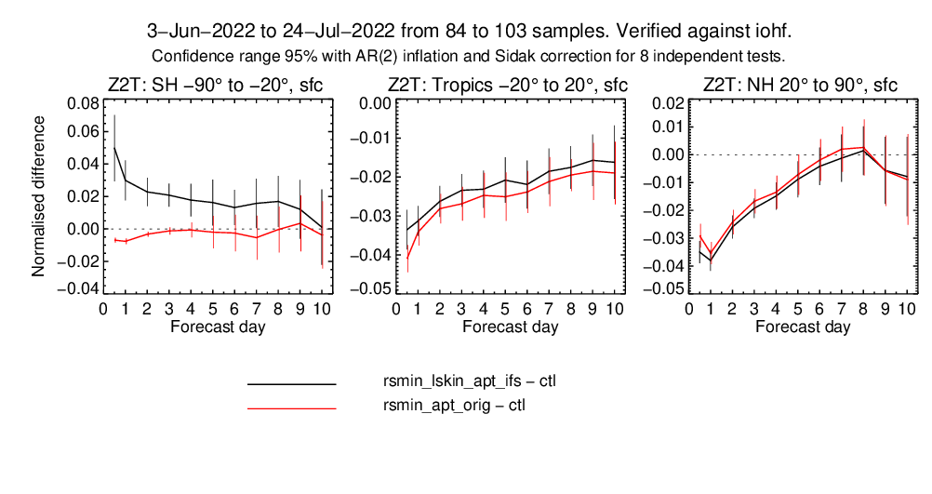
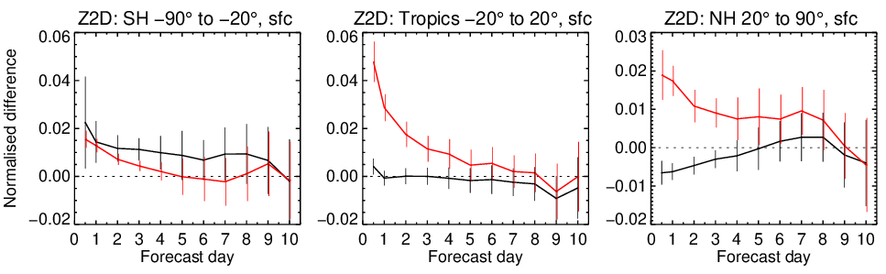
Impact on Forecasts
Normalised difference in RMSE between EXP and CTL, normalised by RMSE of CTL. Negative values indicate a RMSE reduction.
2-metre temperature
Generally positive impact on T2m in NH and Tropics (issue with winter in SH?).
Degradation in dew point with original method.
Further tuning on IFS characteristics required to have neutral/positive impact:
  Original method ”too aggressive” to correct T2m for IFS error characteristics
Impact in extra-tropics 🡪 0 in ~5 days.
Impact on tropics persists throughout the medium-ranges (known issues around tropical rainforests).
2-metre dew point temperature

Slide 17
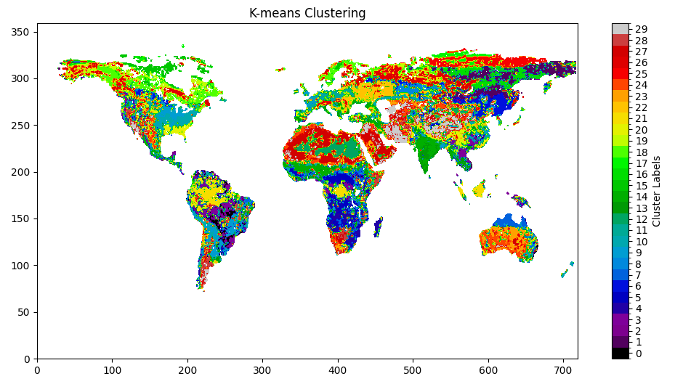
Spatialisation of Parameters

Slide 18
Conclusions
In the near future, there is space for both (especially now)
Significant improvements can still be gained from better physical process representations
Earth observation for the land surface is yet to be properly exploited (and I haven’t even touched on data assimilation)
In particular applications can be derived from ML/AI
ML/AI does not cover the entire spectrum of variables

Slide 19
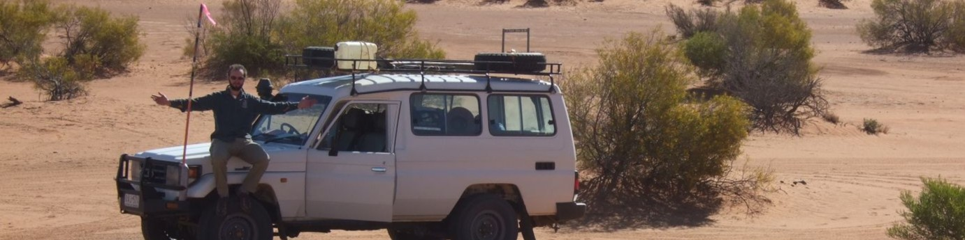
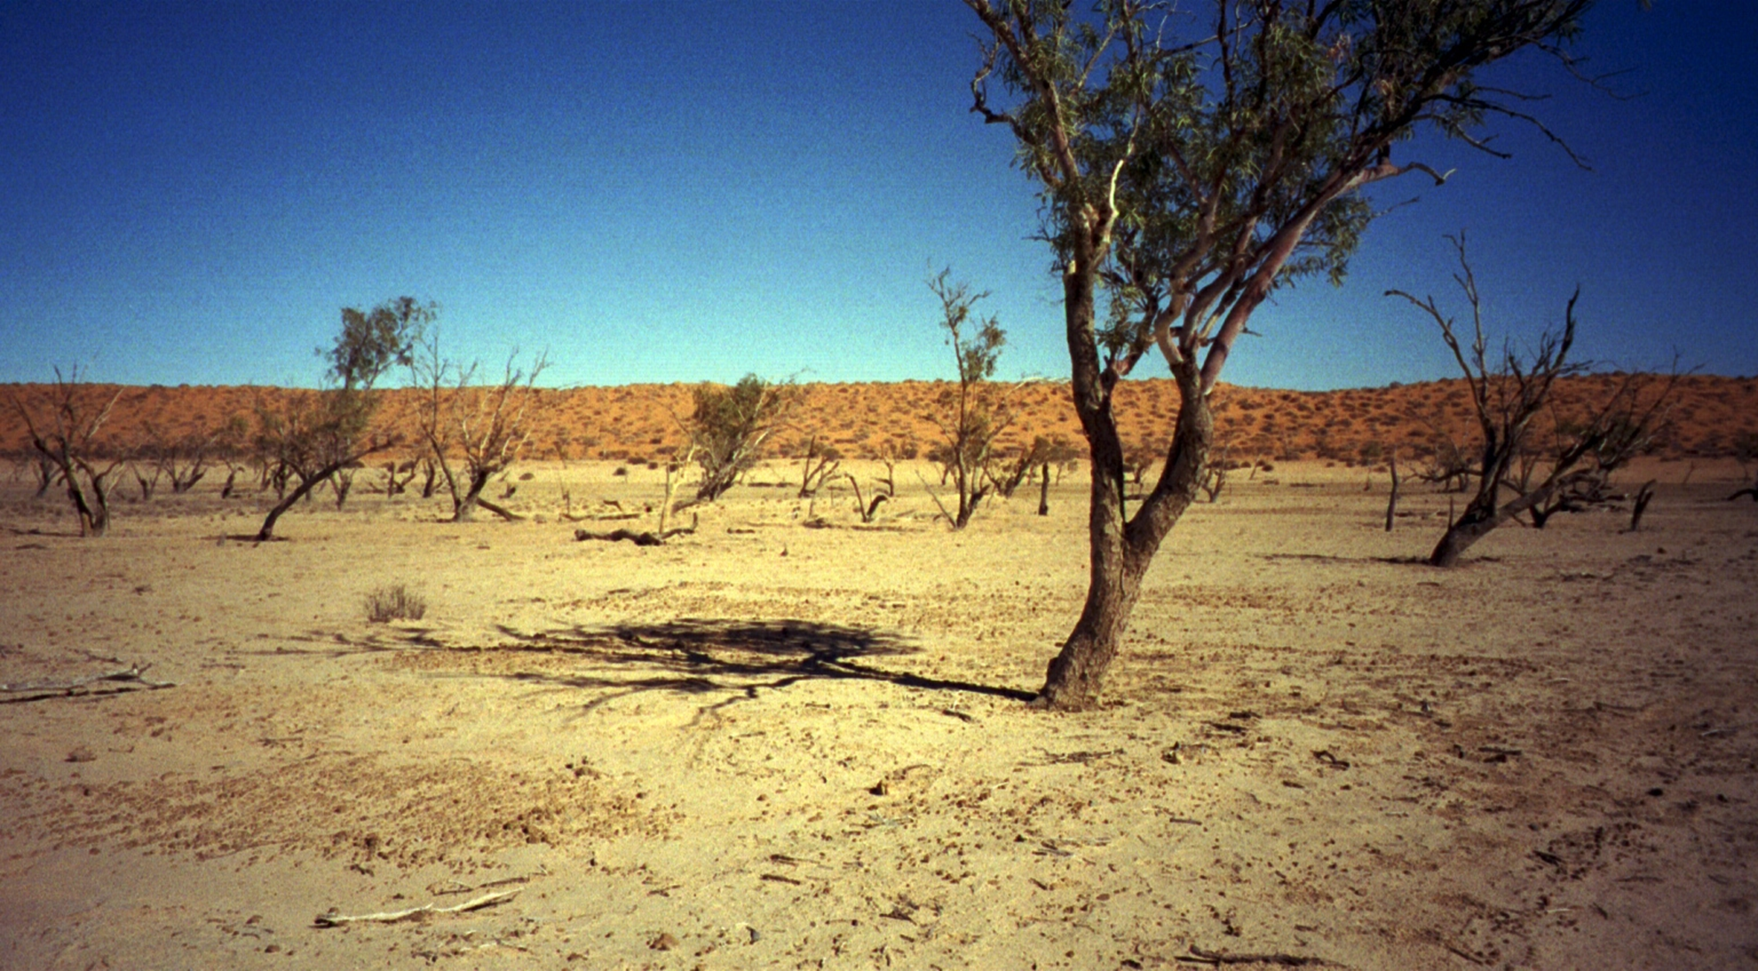
Thank you !
christoph.rudiger@ecmwf.int

Slide 20
Conclusions
What now ?
There may need to be a change to how we “do” land surface modelling
But how ?
We need to make more and better use of observations for land surface modelling
The value of ML4LM is not in the computational time, we need to exploit the added value there is in both providing complementary information
There is a need for physical modelling into the future (climate change, non-stationarity) to provide the background states, applications may be ML-driven
What is the risk ?
Thin line to walk between physically meaningful and “just” tuned parameters
A lack of spatial, observed data
Do we have to ?
Short answer – yes
Notes:
We have come a long way, don’t get me wrong! But we can do better, but for that, we need a different way of doing business. That doesn’t mean ML-only or physics-only, it means to be pragmatic and use one to make the other better.
We need to scale that wall to get to the next level -> may require a shift in how we operate and think about the land surface
Application specific land surface modelling -> need for seamlessness
We have a lot of data -> but it’s just models, not direct observations – we need to make more use of opportuinstic information (maybe serendipity)
LSMs are relatively cheap to run -> the value in ML is in the information, not the computational efficiency
Need to make use of joint learnings -> recognition that both have something to contribute
Physical modelling will be needed into the future -> ML isn’t great at extrapolating
Advantage of a joint approach -> seamless approach across times (make use of the ML information to improve the physics)
We have everything we need – LUMI, EuroHPC, ESA, EUMETSAT, many European partners ----- and universities

