Slide 1
Synthesizing systematic improvements during the model development cycle using data-driven methods
Marion Mittermaier

Slide 2
Overview
Why?
Multidimensional scaling
Dissimilarity metrics used for hypothesis testing
Results from the GC5-LFRic project
Conclusions

Slide 3
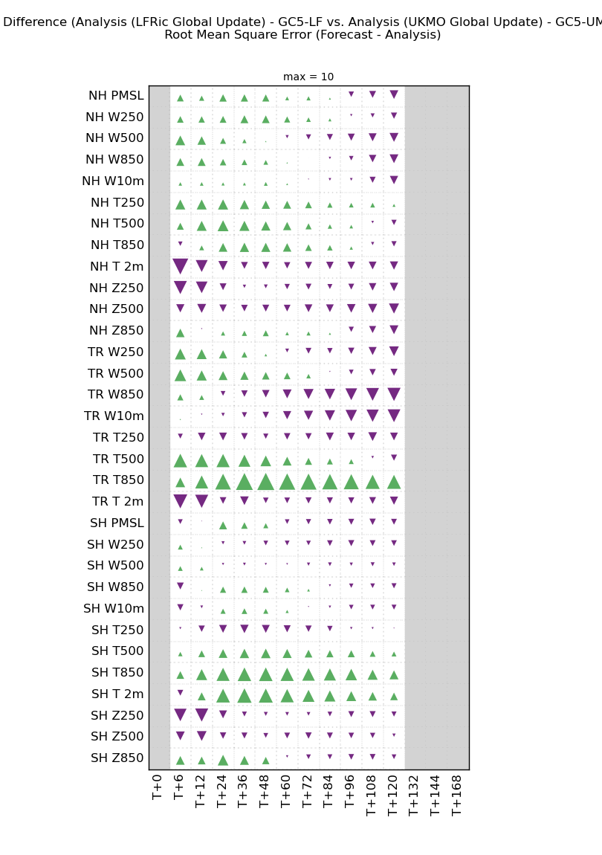
Why is such an approach desirable?
So many trials …. Data overload.
Each trial is assessed (and a scorecard produced) in isolation and joining the dots between the trials is done subjectively / ad hoc.
Multiple scorecards are produced making many two-way comparisons.
I’ve always thought it’s a “zoo” that I (at least) end up getting lost in!
Q: Can all these scores be brought together in a more systematic way?

Slide 4
The goal of the GC5-LFRic project was to show that LFRic is, at least to a good approximation, performing like the UM.
GC5- LFRic trials
Trial | Descriptor | Description
1 | Ctrl-ccs-w | Contiguous case studies, 3 months, atmosphere-only, winter
2 | Ctrl-ccs-s | Contiguous case studies, 3 months, atmosphere-only, summer
3 | Ctrl-atm-w | DA trial, 3 months, atmosphere-only, winter
4 | Ctrl-atm-s | DA trial, 3 months, atmosphere-only, summer
5 | Ctrl-cpl-w | DA trial, 3 months, coupled, winter
6 | Test-ccs-w-1 | Contiguous case studies, 3 months, atmosphere-only, winter, v3 test configuration
7 | Test-ccs-s-1 | Contiguous case studies, 3 months, atmosphere-only, summer, v3 test configuration
8 | Test-atm-w-1 | DA trial, 3 months, atmosphere-only, winter, v3 test configuration
9 | Test-atm-s-1 | DA trial, 3 months, atmosphere-only, summer, v3 test configuration
10 | Test-cpl-w-1 | DA trial, 3 months, coupled, winter, v3 test configuration
11 | Test-atm-w-2 | DA trial, 3 months, atmosphere-only, winter, v4 test configuration
12 | Test-atm-s-2 | DA trial, 3 months, atmosphere-only, summer, v4 test configuration
13 | Test-ccs-w-2 | Contiguous case studies, 3 months, atmosphere-only, winter, v4.1 test configuration
14 | Test-ccs-s-2 | Contiguous case studies, 3 months, atmosphere-only, summer, v4.1 test configuration
15 | Test-atm-w-3 | DA trial, 3 months, atmosphere-only, winter, v4.1 test configuration
16 | Test-atm-s-3 | DA trial, 3 months, atmosphere-only, summer, v4.1 test configuration
17 | Test-ccs-w-3 | Contiguous case studies, 3 months, atmosphere-only, winter, v4.2 test configuration
18 | Test-ccs-s-3 | Contiguous case studies, 3 months, atmosphere-only, summer, v4.2 test configuration
19 | Test-atm-w-4 | DA trial, 3 months, atmosphere-only, winter, v4.2 test configuration
20 | Test-atm-s-4 | DA trial, 3 months, atmosphere-only, summer, v4.2 test configuration
21 | Test-ccs-w-4 | Contiguous case studies, 3 months, atmosphere-only, winter, v4.3 test configuration
22 | Test-atm-w-5 | DA trial, 3 months, atmosphere-only, winter, v4.3 test configuration
23 | Test-atm-s-5 | DA trial, 3 months, atmosphere-only, summer, v4.3 test configuration
24 | Test-cpl-w-2 | DA trial, 3 months, coupled, winter, v4.3 test configuration
25 | Test-atm-w-6 | DA trial, 3 months, atmosphere-only, winter, v4.5 test configuration
26 | Test-atm-s-6 | DA trial, 3 months, atmosphere-only, summer, v4.5 test configuration
Many combinations!
Global ~ 40 km equivalent verified against analyses on the CBS 1.5º grid using RMSE
Typically, 3 months in length
Summer and winter
Contiguous case studies (so-called cold starts, no DA) and with DA
Atmosphere-only and coupled
Aside: Many more trials were run but much shorter. These were not included. This also only reflects the NWP part. The assessment of the climate runs is a wholly separate activity.

Slide 5
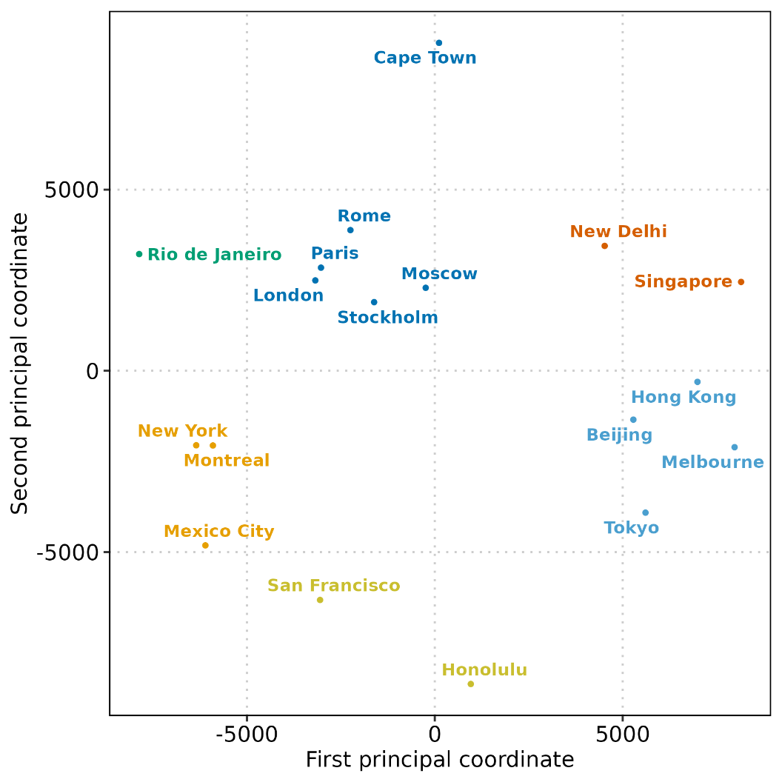
MDS: simple illustration
Also known as “principal coordinates analysis”, MDS is a multivariate data analysis approach which can be used to visualise the similarity or dissimilarity, which is directly related to the distance between two points in the phase space (typically 2-d for ease of interpretation).
Thus, a multi-dimensional problem is condensed/reduced to a 2-dimensional one.
Any quantity that can provide, in essence, a “distance” between two values can be used to form the basis, e.g. a score difference.
[Clustering can be applied as an additional visual aid but is not essential.]
Example: distances between major airports

Slide 6
Other dissimilarity metrics
ML has raised the profile of the Wasserstein distance (also known as the Kantorovich-Rubinstein metric).
Though not often explicitly mentioned, the basis of two-sample statistical tests is a distance-metric.
We often want to compare distributions of values to see how similar they are.
We’ve tested a range of metrics for the statistical power (likelihood that you will detect an effect when there is one). These are:
Kolmogorov-Smirnov
Kuiper
Cramer-Von-Mises
Anderson-Darling
Unweighted Wasserstein
Weighted Wasserstein (which combines the AD and WS tests)
For model development: the signals (differences) can often be small and noisy. Having statistical power to correctly discriminate the signal from the noise would seem to be important.
Increasing power
This approach is similar to the scorecard % change: pairwise comparison of all the scores combined 🡪 single number.

Slide 7
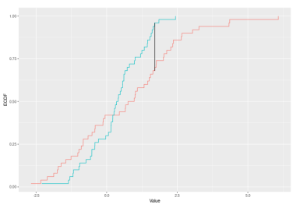
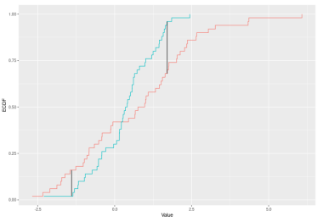
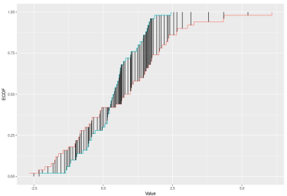
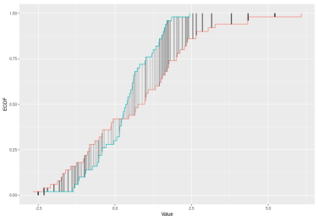
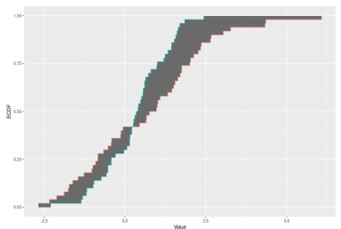
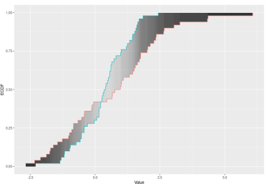
An illustration of the ECDF distance metrics
max
sum of max + min
sum of diffs
Kolmogorov-Smirnov
Kuiper
CvM
weighted sum of
diffs
integral of the diffs
weighted integral
of the diffs
Anderson-Darling
Wasserstein
DTS
From Dowd (2020)

Slide 8
The importance of normalisation
All data-driven approaches have this key requirement in one way or another.
RMSE is in the unit of the variable.
There are 32 metrics on our scorecard from (at least) 4 different variables 🡪 they are not directly comparable.
Two options are shown:
Z-scores normalised with respect to each variable across lead times
Correlation since 1-correlation is effectively a measure of dissimilarity.
For MDS, the lead times were kept separate, and the dimensionality was reduced from 32 to 2.
For the statistical tests the 32 x 11 scorecard is reduced to a single distance-based test statistic constructed from the z-score ECDF differences (a two-sample test)
So, why not use a skill score? It did not yield very satisfactory results…

Slide 9
Results
GC5-LFRic was a 2-year project to combine the GC5-UM science with the new Gung-Ho dynamical core and build the basis of our new global MOMENTUM model.
This model is driving future development of global NWP and climate applications (GC6).
The test dataset consists of the standard score card metrics calculated for the 21 long trials
(3 months) run during the project and 5 controls.
Unlike the usual model development cycle, we want to conclude that the GC5 science yields forecasts of comparable skill in the UM and LFRic. ( Aside: Test better than control would be nice but not the objective)

Slide 10
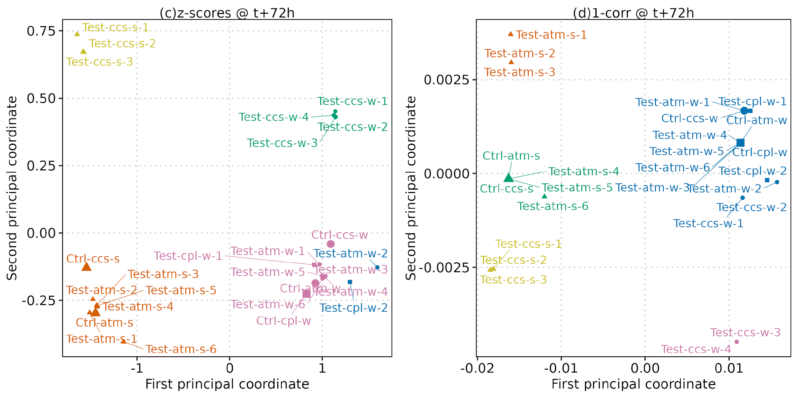
The principal coordinate diagram
26 trials summarised on one plot
Winter
Summer
(replace)
ccs- case studies; atm = DA atmosphere-only; cpl = DA coupled

Slide 11
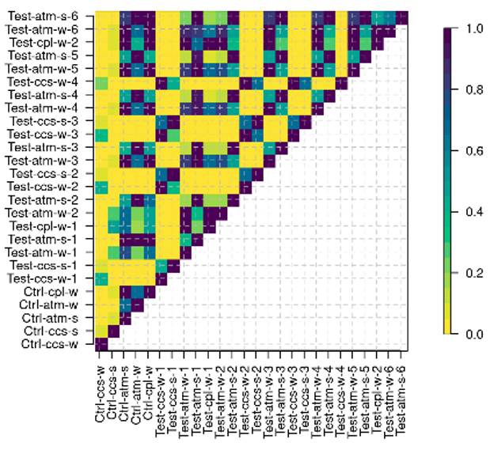
Plotting all the trials together using distance metric tests
Considering the squares in a row….
Each trial is compared with every other trial in a pair-wise fashion
Without a-priori information the tests pick out the similarities (and dissimilarities) between:
winter and summer,
DA and case-studies,
atmosphere-only and coupled.
These are KS results, which imply a great deal of statistical significance, even between the controls.
The diagram combines the journey of getting from “A to Z” in the model development cycle in one plot.
Increasing significance
p-value
This would suggest that LFRic is too different / dissimilar to the UM…. ? (not the outcome hoped for!)

Slide 12
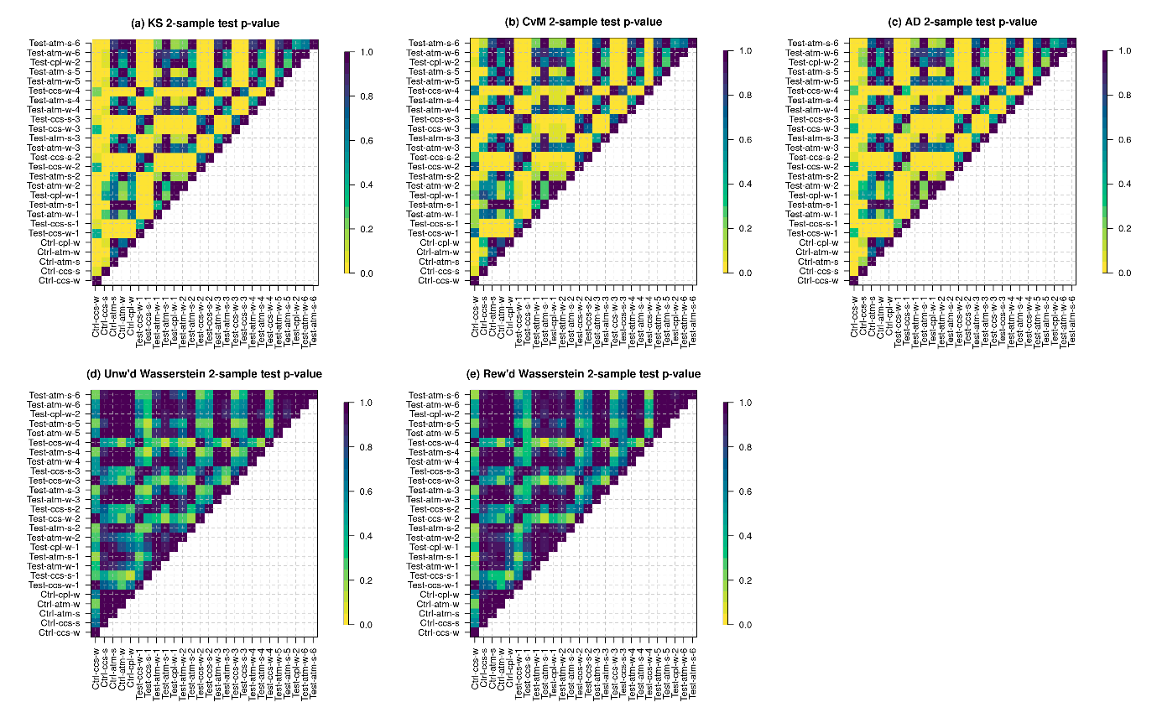
Comparing the power of different hypothesis tests
But, with increasing power, the level of statistically significant differences is steadily reduced such that with the final LFRic trials no statistically significant differences ~< 0.2 remain. RESULT!
The change in power comes with the use of the integrals.

Slide 13
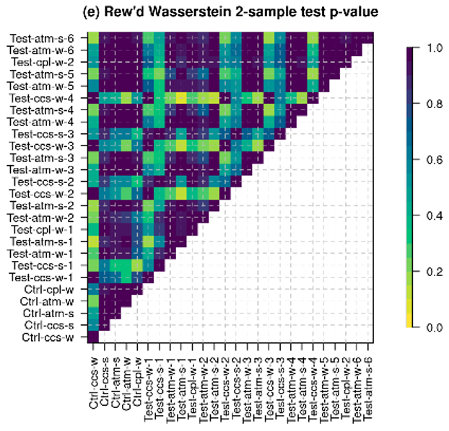
Comparing the power of different hypothesis tests
The statistical significance is removed from the final trials when using the integral-based tests.
Some p-values remain relatively low (~0.2) suggesting that the non-DA and DA results are still more different. The same holds for winter vs summer.

Slide 14
Conclusions
Results confirm/support the decisions made by more traditional or conventional methods.
Data-driven approaches with no a priori information correctly discriminate between summer and winter, DA and non-DA, atmosphere-only and coupled.
One curious result is the apparently large difference between winter and summer, which is (by far) bigger than any incremental change between model cycles.
Alternative ways in which we can visualise/summarise/map the journey of a model development cycle can provide a structured and objective way of synthesising lots of scores which we have historically looked at very simplistically (%change), and “across the process”, with considerable difficulty.

Slide 15
Why does this look familiar?
So, the ECDF metrics should have made you think of a score we commonly compute for ensembles….. The CRPS!
This is an interesting and intriguing connection of how we have been using distribution-based metrics in forecast verification… i.e. it’s not a new concept.
It does beg the question whether we can just compute the CRPS from the z-score distributions… watch this space?!
Aside: We need to look carefully at the dependence of the samples we compare. Most tests assume independence, noting that the CRPS compares dependent samples.

Slide 16
Thanks for listening!
Mittermaier, M.P., 2025: Using dissimilarity measures for summarising the improvement in performance throughout a model development cycle. Under revisions with Meteorological Applications.

