Slide 1





A New Toolbox for Spatial Forecast Verification
Examining Entropic Unbalanced Optimal Transport and Sinkhorn Divergences for Spatial Forecast Verification
Jacob J.M. Francis¹,
Colin J. Cotter²,
Marion P. Mittermaier³
¹SSCP DTP, Grantham Institute
²Department of Mathematics, ICL
³MET Office UK
Paper QR:
Notes:
We are going to look at optimal transport and its theory for use as a Spatial Forecast verification metric, but also how we can use its accompanying machinery and tools to form a sort of OT toolbox for verification .
Where we can use different parts from optimal transport for verification.
Note we’ll consider this verification in terms of verifying Precipitation fields.
Overview;
To start though I’ll try an give an intuition behind optimal transport, then explain some of the maths before going through some examples .

Slide 2

Problem
Verifying deterministic precipitation forecasts, whilst accounting for spatial patterns and structures, rather than focusing solely on point-wise hits or misses.
Developing a metric that is robust against the double penalty problem.
Creating a methodology that is valuable to both researchers and operational forecasters.
Methodology
Entropically Regularised Unbalanced Optimal transport, solved through Sinkhorn algorithm.
Unbalanced Sinkhorn Divergence.
Notes:
To over come this curse of dimensionality however, which is especially revelant if we wish to look at large forecasting models. We consider an entropically regularised version, where we add a KL term to our optimsation problem.
This gives us two benefits, One the convex nature of the KL term gives us uniqueness of solutions and two the dual version of the regularised problem offers a simple iterative update algorithm known as sinkhorns algorithm. However we won’t go in to that today.
Improtantly from this formulation we can still find an explicit plan, however of course there are some down sides which his we now have an extra parameter controlling the regularisation and the effect of the regularisation itself. This is known to blur plans. So that rather than being tight lines the plan like we saw before, we now blue the plan around the true line.
As an example, we can se ehere the example of changin the regularisation parameter with the coupling plan spearding out and as we reduce it the plan getting tighter to the unregularisated version. However the cost being the lower the parameter the higher the number of iterations to reach convergence. (or pseudo convergence). Here the input output is in the red and blue and the return plan is the 3D contour. Where we can see the clear blurring of the plan.
Again note so far we’ve been considering classical balanced OT where we demand mass conservation between the input outputs. However for precipitatino field we don’t know that this will always be the case . So instead we aim to relax this cinstraight. So instead these divergences= terms we can swap them out to create a the unbalanced counterpart.

Slide 3
Current OT applications within meteorology*
Data assimilation: Liu and Frank (2022); Bocquet et al. (2024); Feyeux et al. (2018)
Wind speed model aggregation: Papayiannis et al. (2018)
Hydrological misfit functions: Magyar and Sambridge (2023)
Pollutant metric: Farchi et al. (2016); Vanderbecken et al. (2023); Hyun et al. (2022)
Precipitation spatial metrics: Skok (2023); Skok and Lledó (2024)
Precipitation latent variable extraction: Nishizawa (2024)
* non-exhaustive

Slide 4
Optimal Transport Intuition
Notes:
Moving on from this 1D example we can consider a 2D version. Again we need to define and forecast and observation distribution in space.
Here the heart and doughnut. And we need to define a cost. Which maybe moving points on this grid and how many squares it needs to move.
Crucially these are required to have the same mass or same number of books
In classical OT we ensure mass conservation hence I’ve created these two plots with the same number of points, however we shall see that in the unblanaced setting we can drop this constraint.
In the lower plot we can take this to a more relatable case where we consider a blob of field in 2D and say an Euclidean L2 distance for our cost function. Our goal being to find the cheapest way again to morph one field into the other.
MASS = ACCUMULATAED Rain Volum?

Slide 5
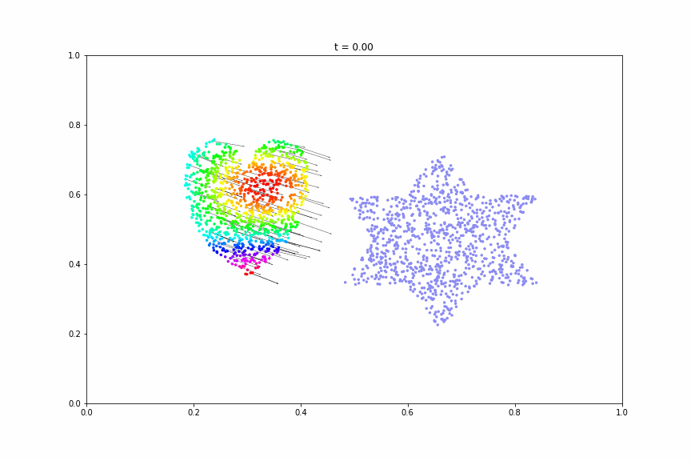
Optimal Transport Intuition
Notes:
Moving on from this 1D example we can consider a 2D version. Again we need to define and forecast and observation distribution in space.
Here the heart and doughnut. And we need to define a cost. Which maybe moving points on this grid and how many squares it needs to move.
Crucially these are required to have the same mass or same number of books
In classical OT we ensure mass conservation hence I’ve created these two plots with the same number of points, however we shall see that in the unblanaced setting we can drop this constraint.
In the lower plot we can take this to a more relatable case where we consider a blob of field in 2D and say an Euclidean L2 distance for our cost function. Our goal being to find the cheapest way again to morph one field into the other.
MASS = ACCUMULATAED Rain Volum?

Slide 6
Optimal Transport: Unbalanced
Destruction and Creation (L1)
vs
Transport
Notes:
These then are the version hat we can swap out o forma an unbalanced version where we can relax the mass constraint. This allows one for the framework to make sense in the precipitation case but also creates different behaviour. So tha instead of points having to move in the blaanced case, point can be destroyed and created.
Again this does add another parameter which can control the influence of these. Where by incraing the parameter we demand more mass constaint or decrease it and any plans allowed.
Another interpretation is that this parameter controls the ‘reach’ the field sees compared he other other fields.
Again by way of example we consider the Kullback Leiber divergence and total variawe the total variance nce case controls the imagine domain whilst the KL case doesn’t seem to have such an obvious case.
Since we’re looking at the unbalanced case the distributions don’t need to be filled and hence the plan that is outputted doesn’t necessarily have the same marginals as the input distributions.

Slide 7
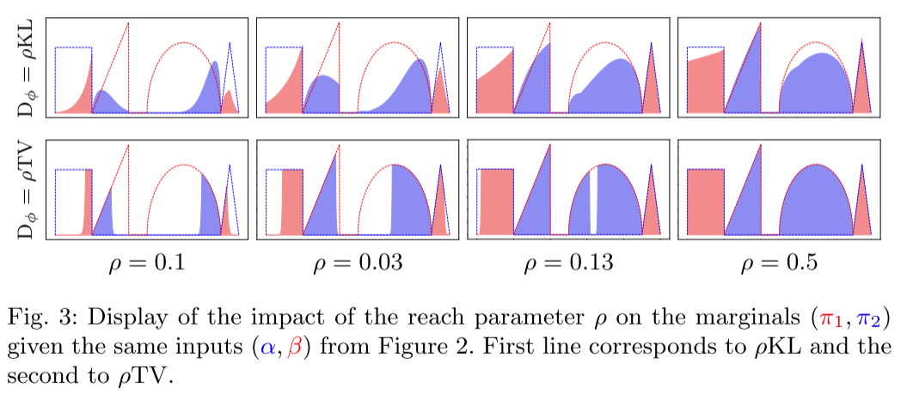

Optimal Transport: Unbalanced
[Séjourné et al, 2019]
Notes:
These then are the version hat we can swap out o forma an unbalanced version where we can relax the mass constraint. This allows one for the framework to make sense in the precipitation case but also creates different behaviour. So tha instead of points having to move in the blaanced case, point can be destroyed and created.
Again this does add another parameter which can control the influence of these. Where by incraing the parameter we demand more mass constaint or decrease it and any plans allowed.
Another interpretation is that this parameter controls the ‘reach’ the field sees compared he other other fields.
Again by way of example we consider the Kullback Leiber divergence and total variawe the total variance nce case controls the imagine domain whilst the KL case doesn’t seem to have such an obvious case.
Since we’re looking at the unbalanced case the distributions don’t need to be filled and hence the plan that is outputted doesn’t necessarily have the same marginals as the input distributions.

Slide 8
Sinkhorn Divergence
A numerical approximation, known as entropic regularisation, is used to solve the unbalanced optimal transport problem.
This approximation introduces some bias (or error) into the solution.
Sinkhorn Divergence corrects (debiases) this bias after solving the associated unbalanced optimal transport problem.
Notes:
These then are the version hat we can swap out o forma an unbalanced version where we can relax the mass constraint. This allows one for the framework to make sense in the precipitation case but also creates different behaviour. So tha instead of points having to move in the blaanced case, point can be destroyed and created.
Again this does add another parameter which can control the influence of these. Where by incraing the parameter we demand more mass constaint or decrease it and any plans allowed.
Another interpretation is that this parameter controls the ‘reach’ the field sees compared he other other fields.
Again by way of example we consider the Kullback Leiber divergence and total variawe the total variance nce case controls the imagine domain whilst the KL case doesn’t seem to have such an obvious case.
Since we’re looking at the unbalanced case the distributions don’t need to be filled and hence the plan that is outputted doesn’t necessarily have the same marginals as the input distributions.

Slide 9
Results
We are going to use the Unbalanced Sinkhorn Divergence, and Transport vectors as scores and tools to answer:
How does UOT behave in the context of the double penalty problem?
Given one tuneable parameter, how does changing it affect the methods behaviour?
Is there a diagnostic advantage in using the Sinkhorn divergence?
Given real intensity data, are any properties from the simplified setting retained or lost?
Data
From the Spatial Verification Intercomparison Project (ICP) and MesoVICT ICP
Gilleland et al. (2020), Ahijevych et al. (2009), Dorninger et al. (2013)
Notes:
These then are the version hat we can swap out o forma an unbalanced version where we can relax the mass constraint. This allows one for the framework to make sense in the precipitation case but also creates different behaviour. So tha instead of points having to move in the blaanced case, point can be destroyed and created.
Again this does add another parameter which can control the influence of these. Where by incraing the parameter we demand more mass constaint or decrease it and any plans allowed.
Another interpretation is that this parameter controls the ‘reach’ the field sees compared he other other fields.
Again by way of example we consider the Kullback Leiber divergence and total variawe the total variance nce case controls the imagine domain whilst the KL case doesn’t seem to have such an obvious case.
Since we’re looking at the unbalanced case the distributions don’t need to be filled and hence the plan that is outputted doesn’t necessarily have the same marginals as the input distributions.

Slide 10
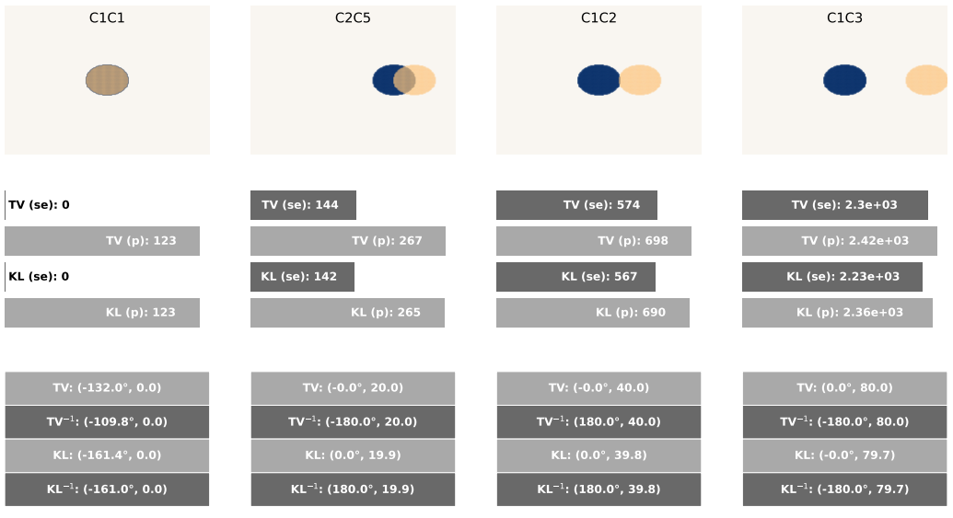
Translation
Key:
TV = total variation cost
KL = Kullback-Leiber cost
(se) = Sinkhorn Divergence cost
(p) = primal cost
-1 = inverse direction
( , ) = (Transport vector direction, Transport vector magnitude )
How does UOT behave in the context of the double penalty problem?
~ x4
Notes:
These then are the version hat we can swap out o forma an unbalanced version where we can relax the mass constraint. This allows one for the framework to make sense in the precipitation case but also creates different behaviour. So tha instead of points having to move in the blaanced case, point can be destroyed and created.
Again this does add another parameter which can control the influence of these. Where by incraing the parameter we demand more mass constaint or decrease it and any plans allowed.
Another interpretation is that this parameter controls the ‘reach’ the field sees compared he other other fields.
Again by way of example we consider the Kullback Leiber divergence and total variawe the total variance nce case controls the imagine domain whilst the KL case doesn’t seem to have such an obvious case.
Since we’re looking at the unbalanced case the distributions don’t need to be filled and hence the plan that is outputted doesn’t necessarily have the same marginals as the input distributions.

Slide 11
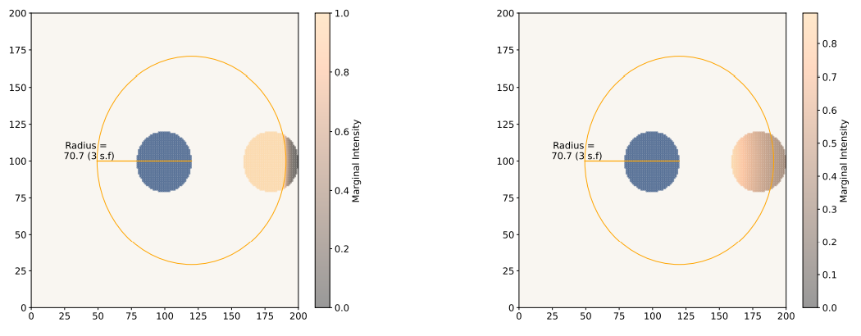
Reach Parameter
Given one tuneable parameter, how does changing it affect the methods behaviour?
TV
KL
Notes:
These then are the version hat we can swap out o forma an unbalanced version where we can relax the mass constraint. This allows one for the framework to make sense in the precipitation case but also creates different behaviour. So tha instead of points having to move in the blaanced case, point can be destroyed and created.
Again this does add another parameter which can control the influence of these. Where by incraing the parameter we demand more mass constaint or decrease it and any plans allowed.
Another interpretation is that this parameter controls the ‘reach’ the field sees compared he other other fields.
Again by way of example we consider the Kullback Leiber divergence and total variawe the total variance nce case controls the imagine domain whilst the KL case doesn’t seem to have such an obvious case.
Since we’re looking at the unbalanced case the distributions don’t need to be filled and hence the plan that is outputted doesn’t necessarily have the same marginals as the input distributions.

Slide 12
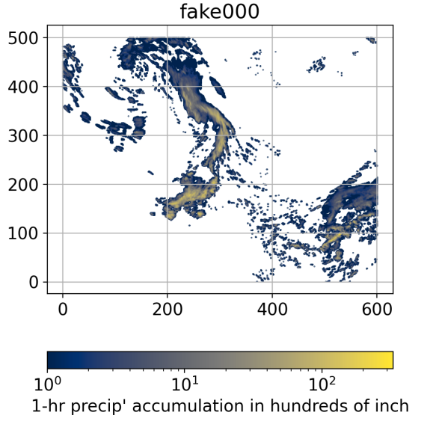
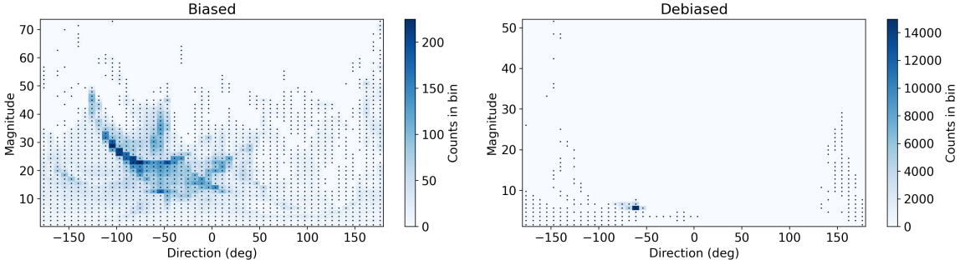
Translation (2D Histogram)
Is there a diagnostic advantage in using the Sinkhorn divergence?
Unbalanced Optimal Transport
Sinkhorn Divergence:

Slide 13
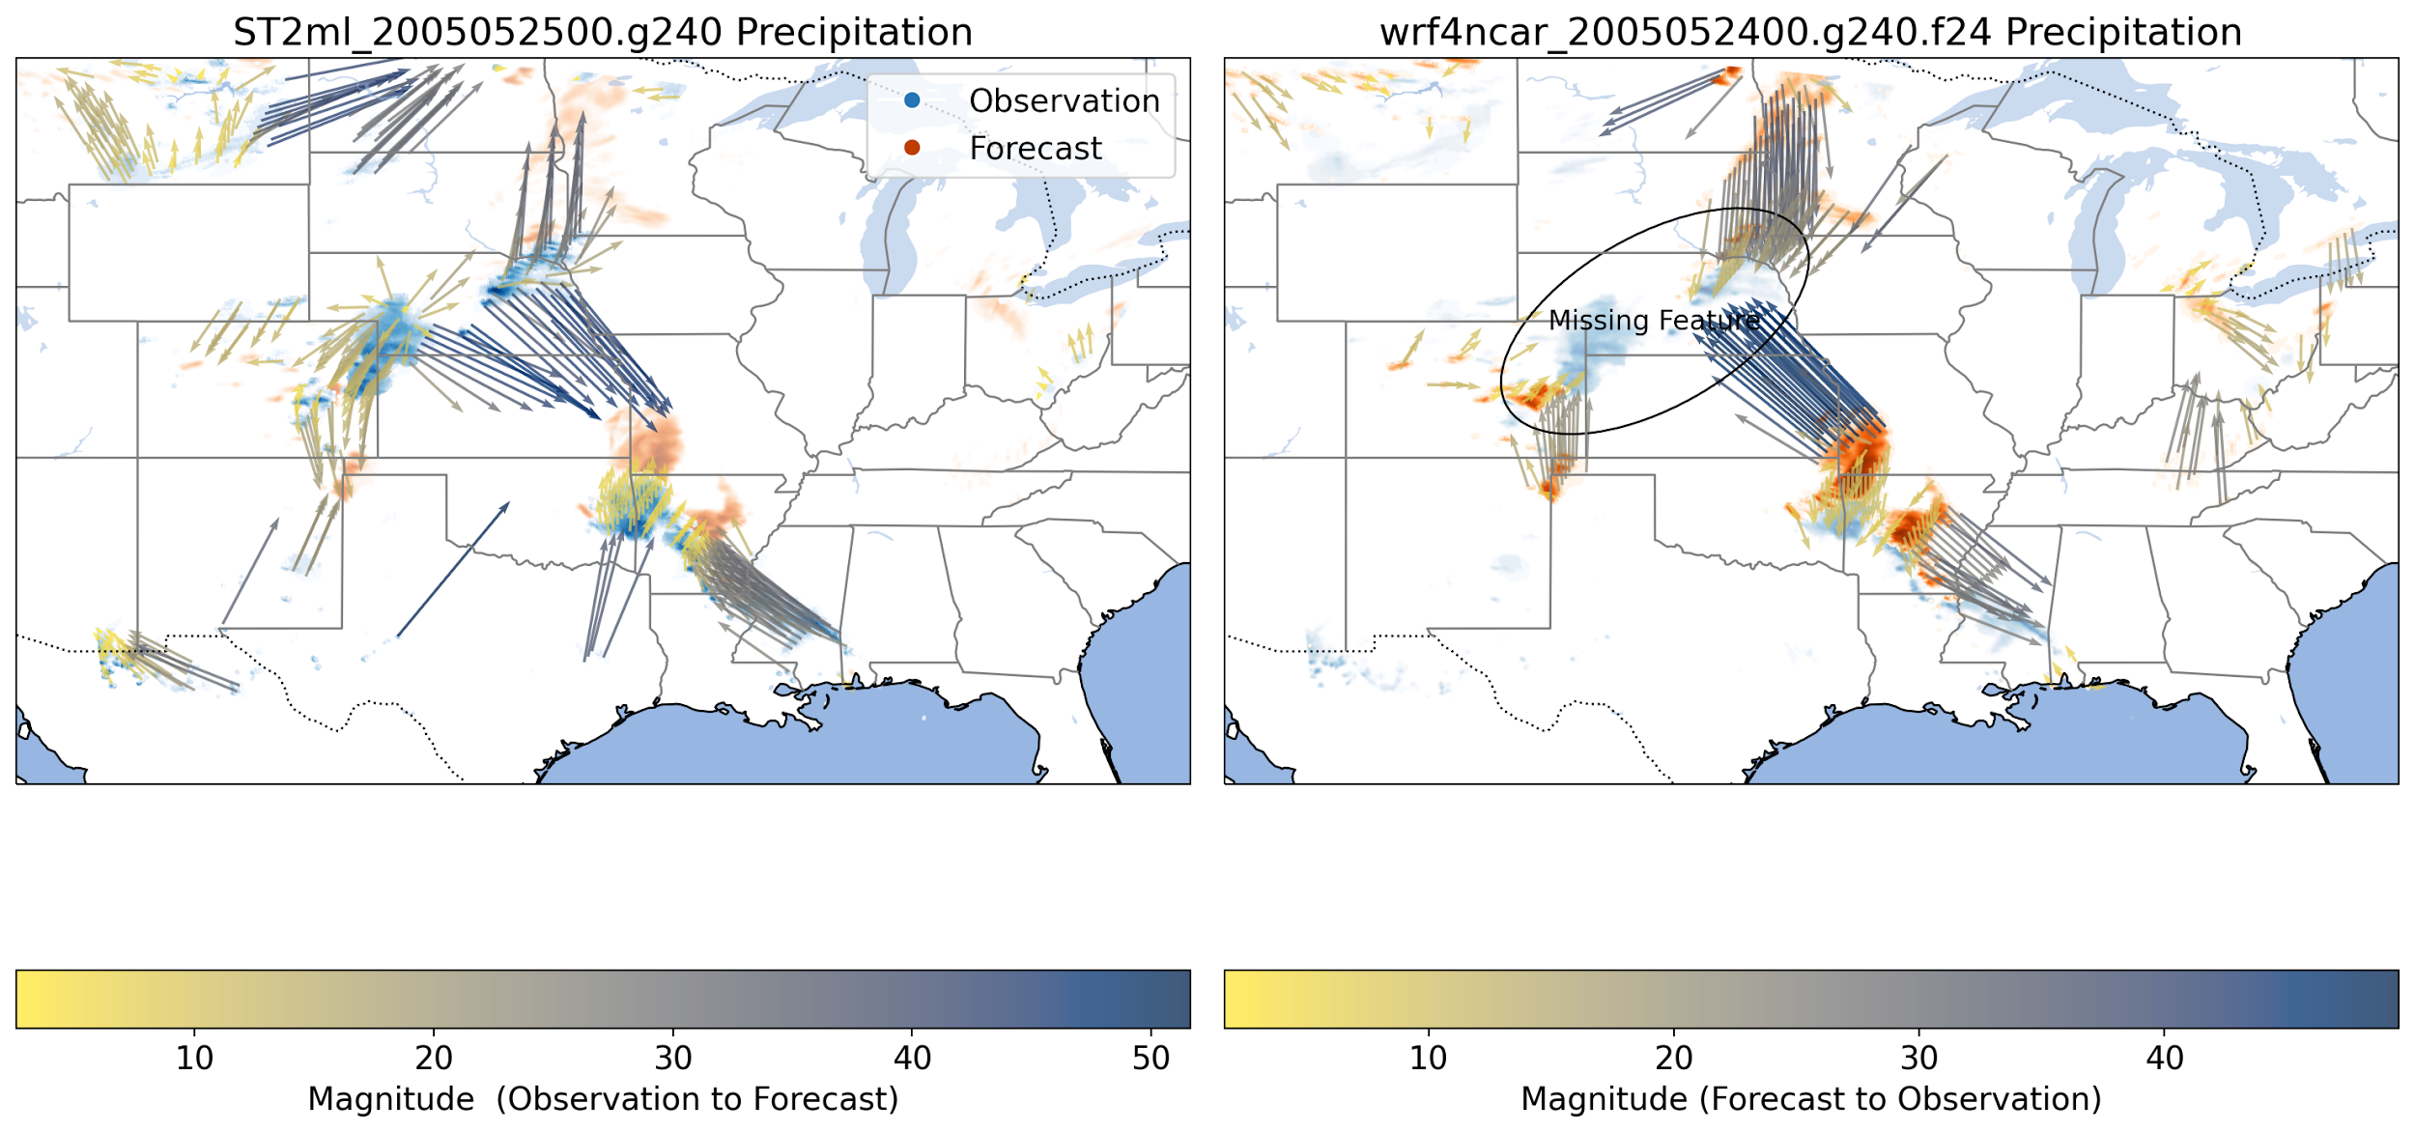
Spring 2005 ICP Case
Given real intensity data, are any properties from the simplified setting retained or lost?

Slide 14
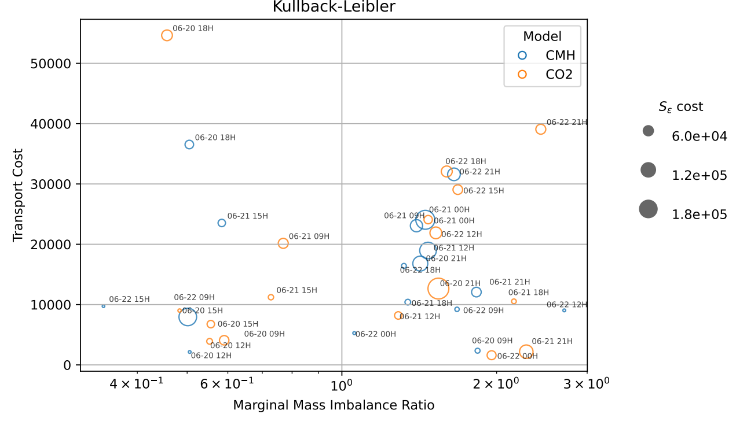
MesoVICT Core Case
Given real intensity data, are any properties from the simplified setting retained or lost?

Slide 15
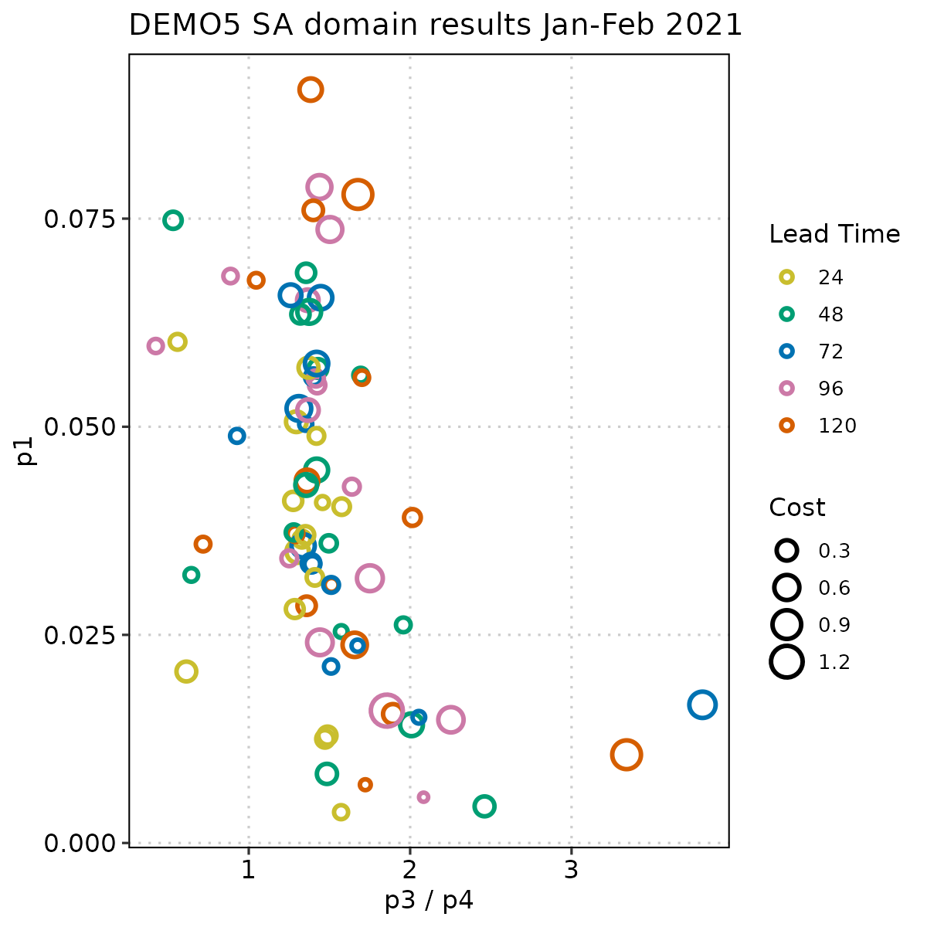
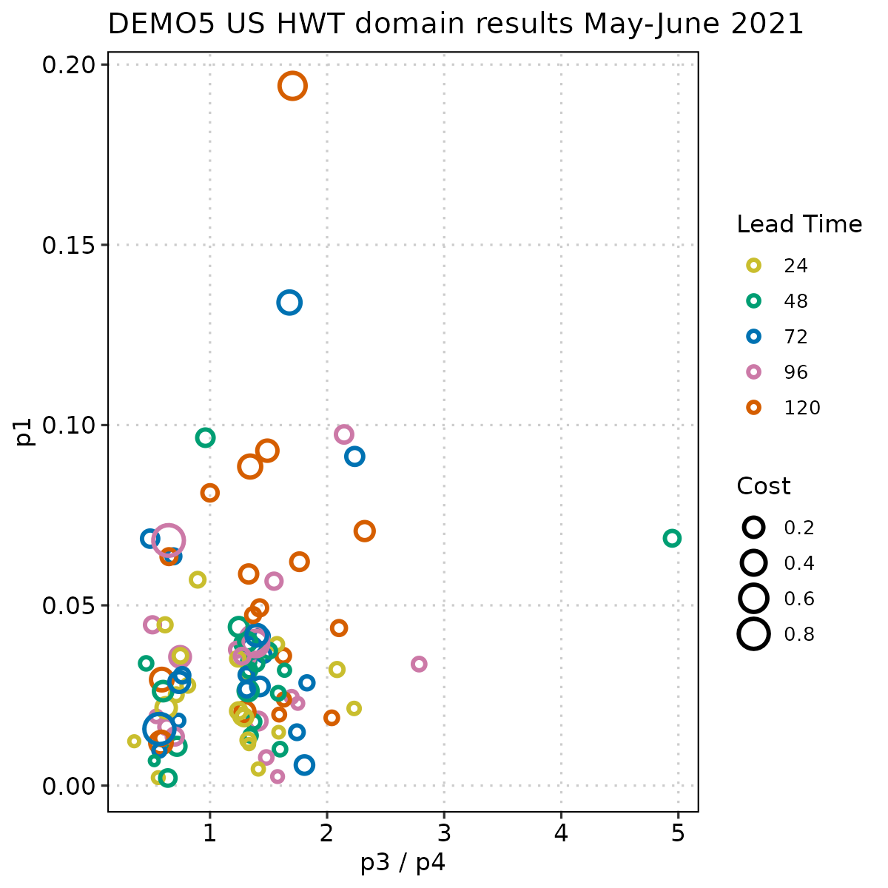
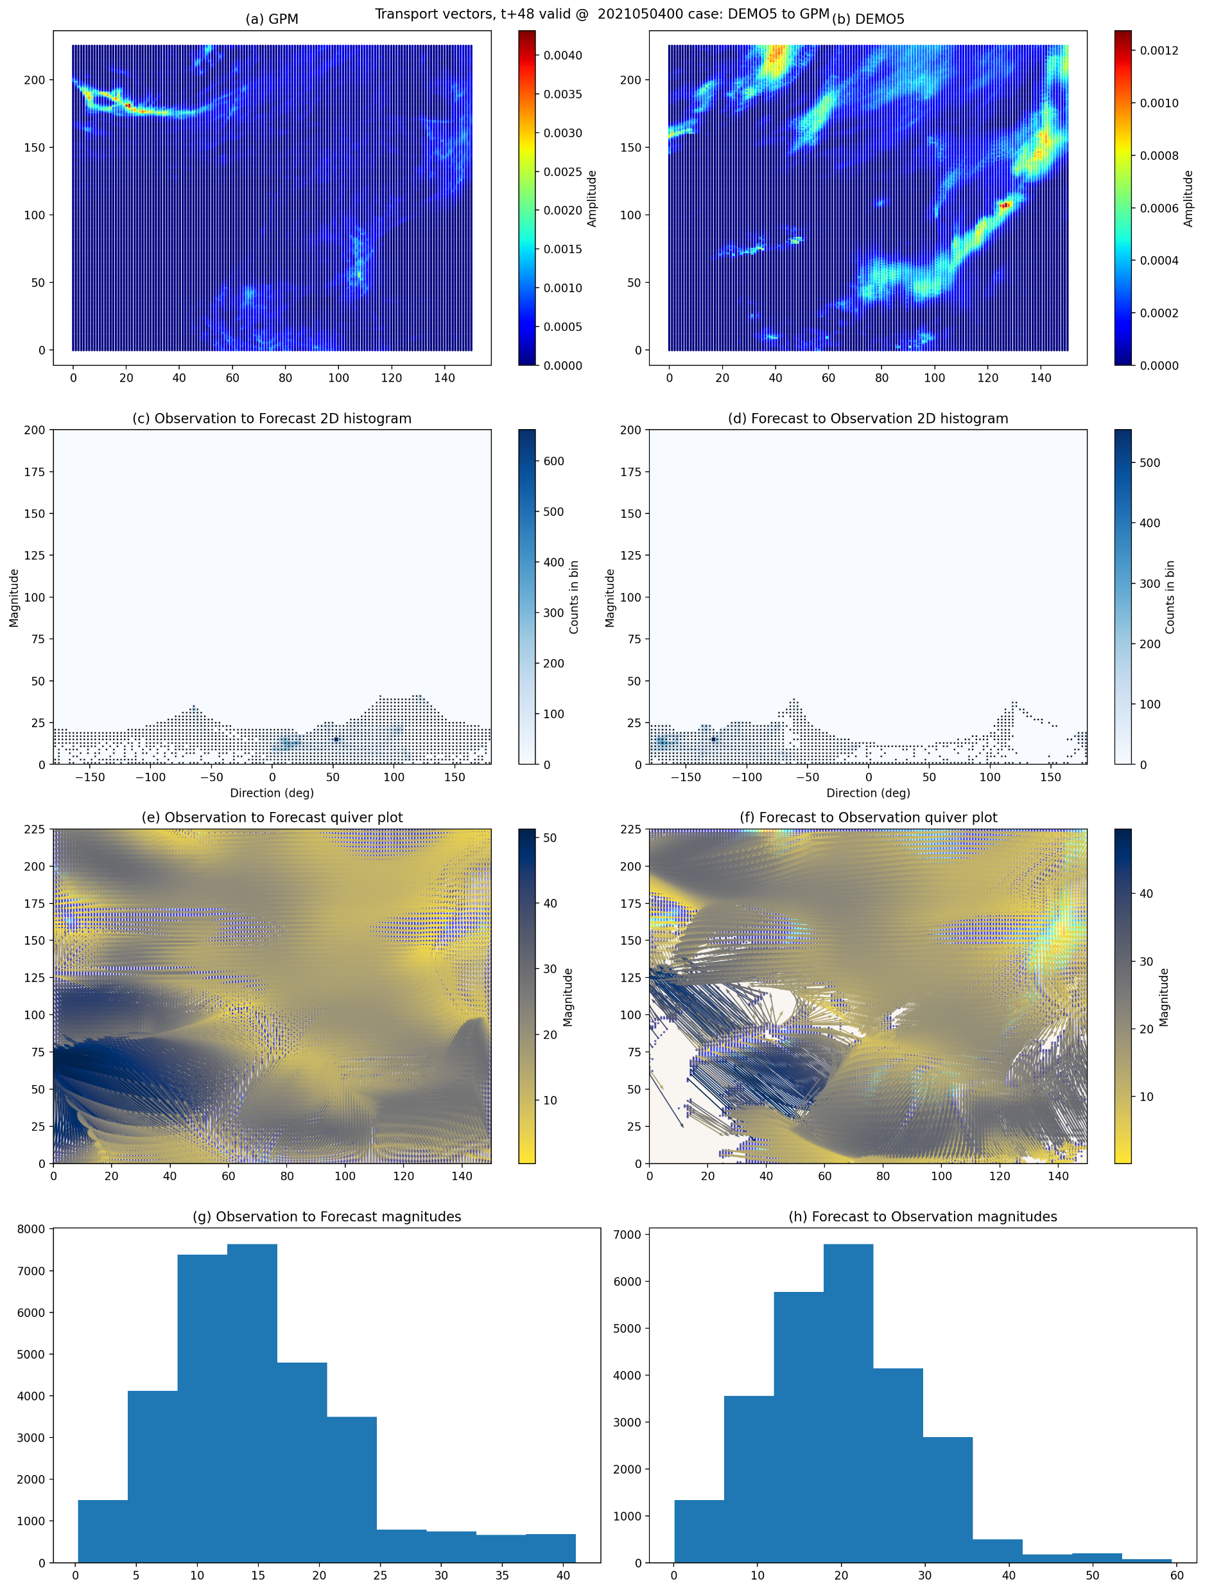
Work in Progress

Slide 16
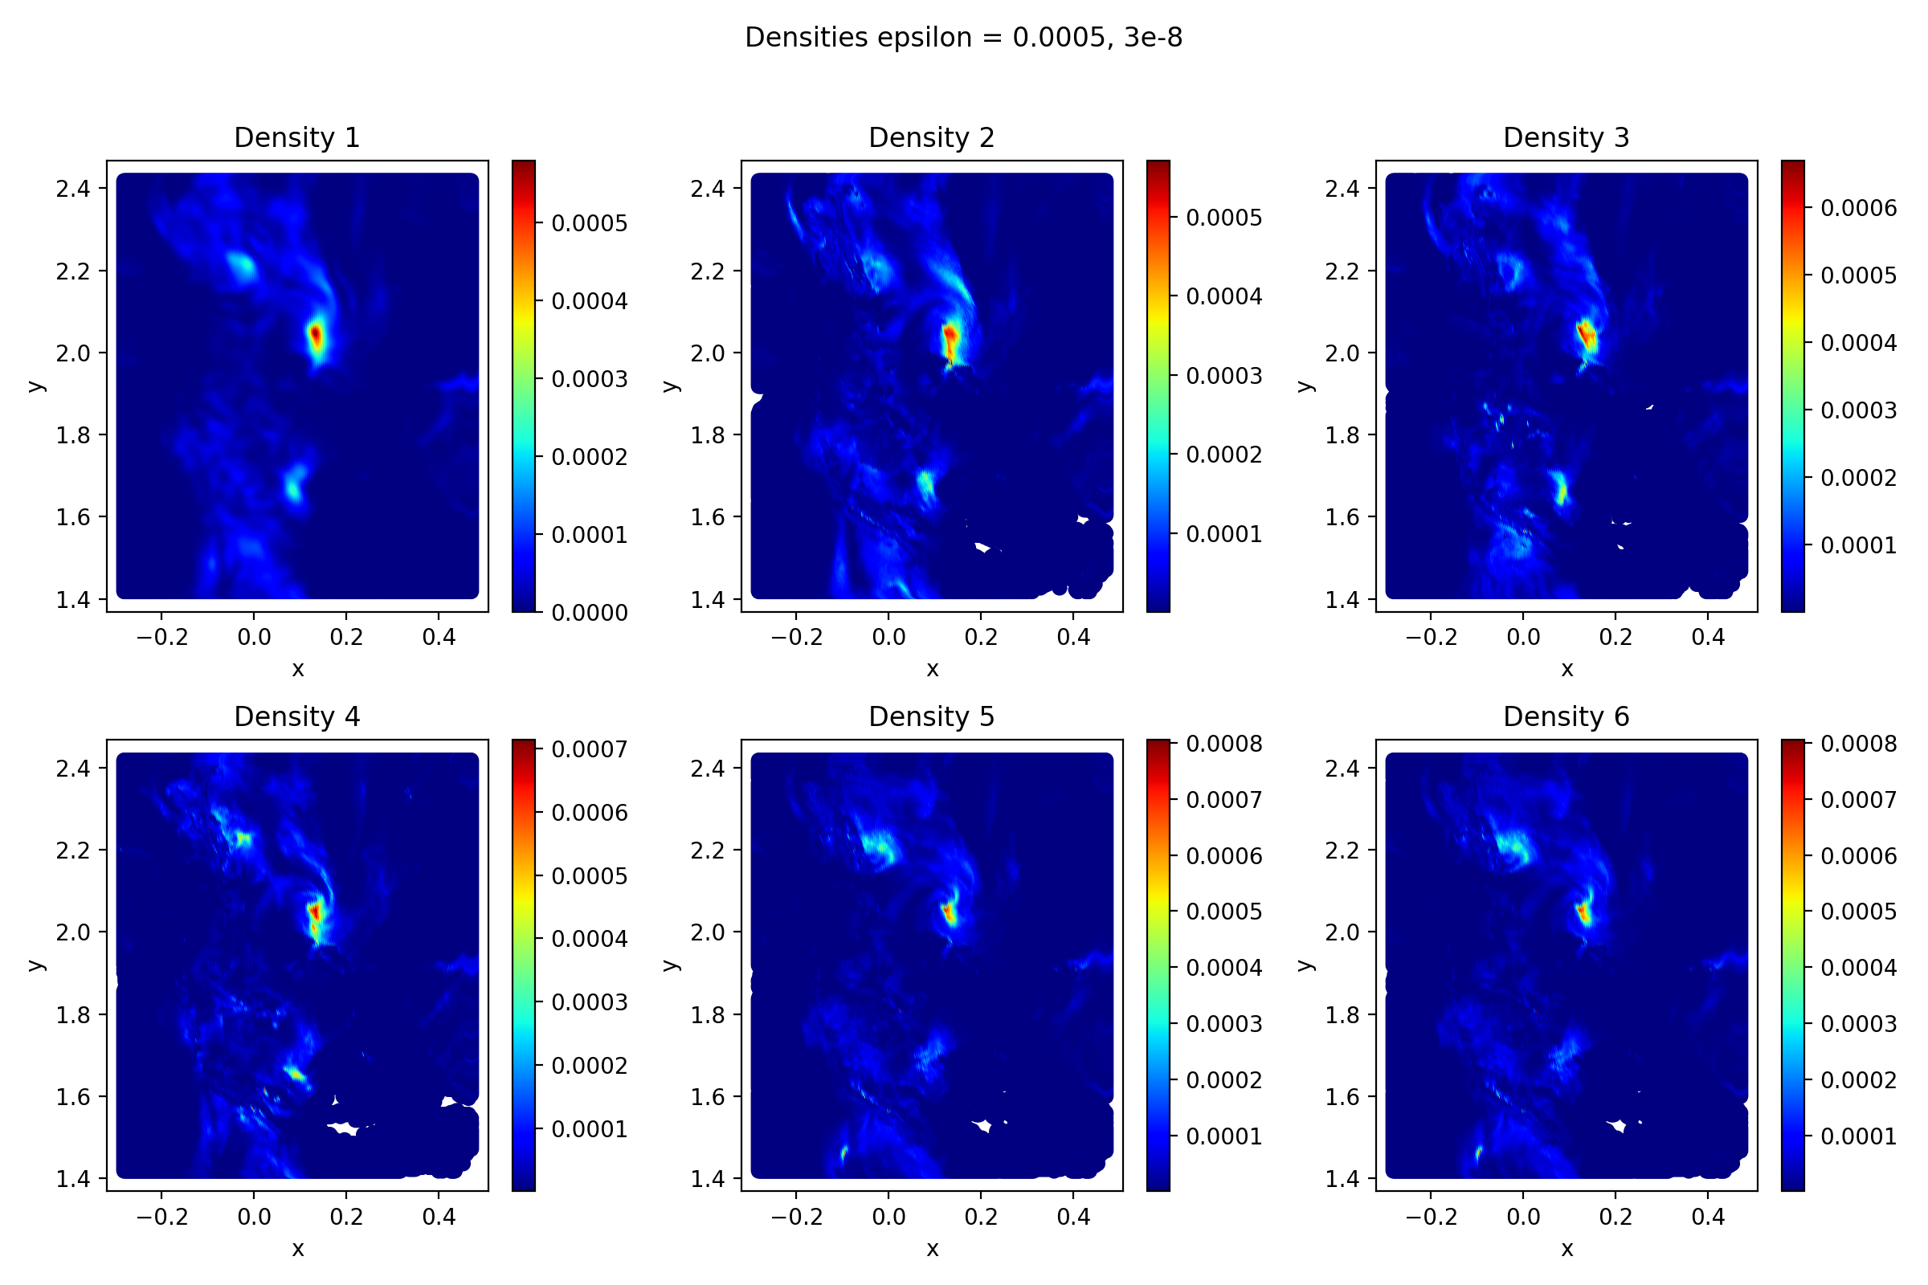
Work in Progress

Slide 17
Conclusion
It is clear then that UOT offers a comprehensive and integrated solution to spatial forecast verification, being multifaceted in its dealing with spatial and intensity error, computationally feasible and on a similar order to current methods, and parsimonious with some necessary choice.
Robust against double penalty.
Sinkhorn Divergence (debiasing) is essential for diagnosing transport error.
KL divergence is more robust to imbalances in rain mass, while in a truly balanced case, TV is better at diagnosing transport error.
Unbalanced Optimal Transport (UOT) focuses more on balancing mass than on overlaps.
Many visualizations are available to illustrate these concepts.
Notes:
Lastly then aside from the things I’ve just listed we’d like to explore more info-graphics and diagrams to show what is quite complicated information. On he right we’ve a potential plot, we were colour by the primal objective, and on the left right we have the dual two objective, ignoreing all regularisation contributions.
We plan to soon hav

Slide 18
Thank you
Feedback, thoughts and comments welcomed – jjf817@ic.ac.uk
References:
Peyré, G, and Cuturi, M. "Computational optimal transport: With applications to data science." Foundations and Trends in Machine Learning 11.5-6 (2019): 355-607.
Séjourné, T., Feydy, J., Vialard, F. X., Trouvé, A., & Peyré, G. "Sinkhorn divergences for unbalanced optimal transport." arXiv preprint arXiv:1910.12958 (2019).
Gilleland, E., Skok, G., Brown, B.G., Casati, B., Dorninger, M., Mittermaier, M.P., Roberts, N., Wilson, L.J., A “Novel Set of Geometric Verification Test Fields with Application to Distance Measures”. Monthly Weather Review 148, (2020) 1653–1673.
Ahijevych, D., Gilleland, E., Brown, B.G., Ebert, E.E., 2009. “Application of Spatial Verification Methods to Idealized and NWP Gridded Precipitation Forecasts”. Weather and Forecasting 24, 1485–1497
Dorninger, M., Mittermaier, M.P., Gilleland, E., Ebert, E.E., Brown, B.G., Wilson, L.J., 2013. “MesoVICT: Mesoscale Verification Inter-Comparison over Complex Terrain.” Technical Report NCAR/TN-505+STR. NCAR
J.J.M. Francis, C.J. Cotter, and M.P. Mittermaier (2025)

Slide 19
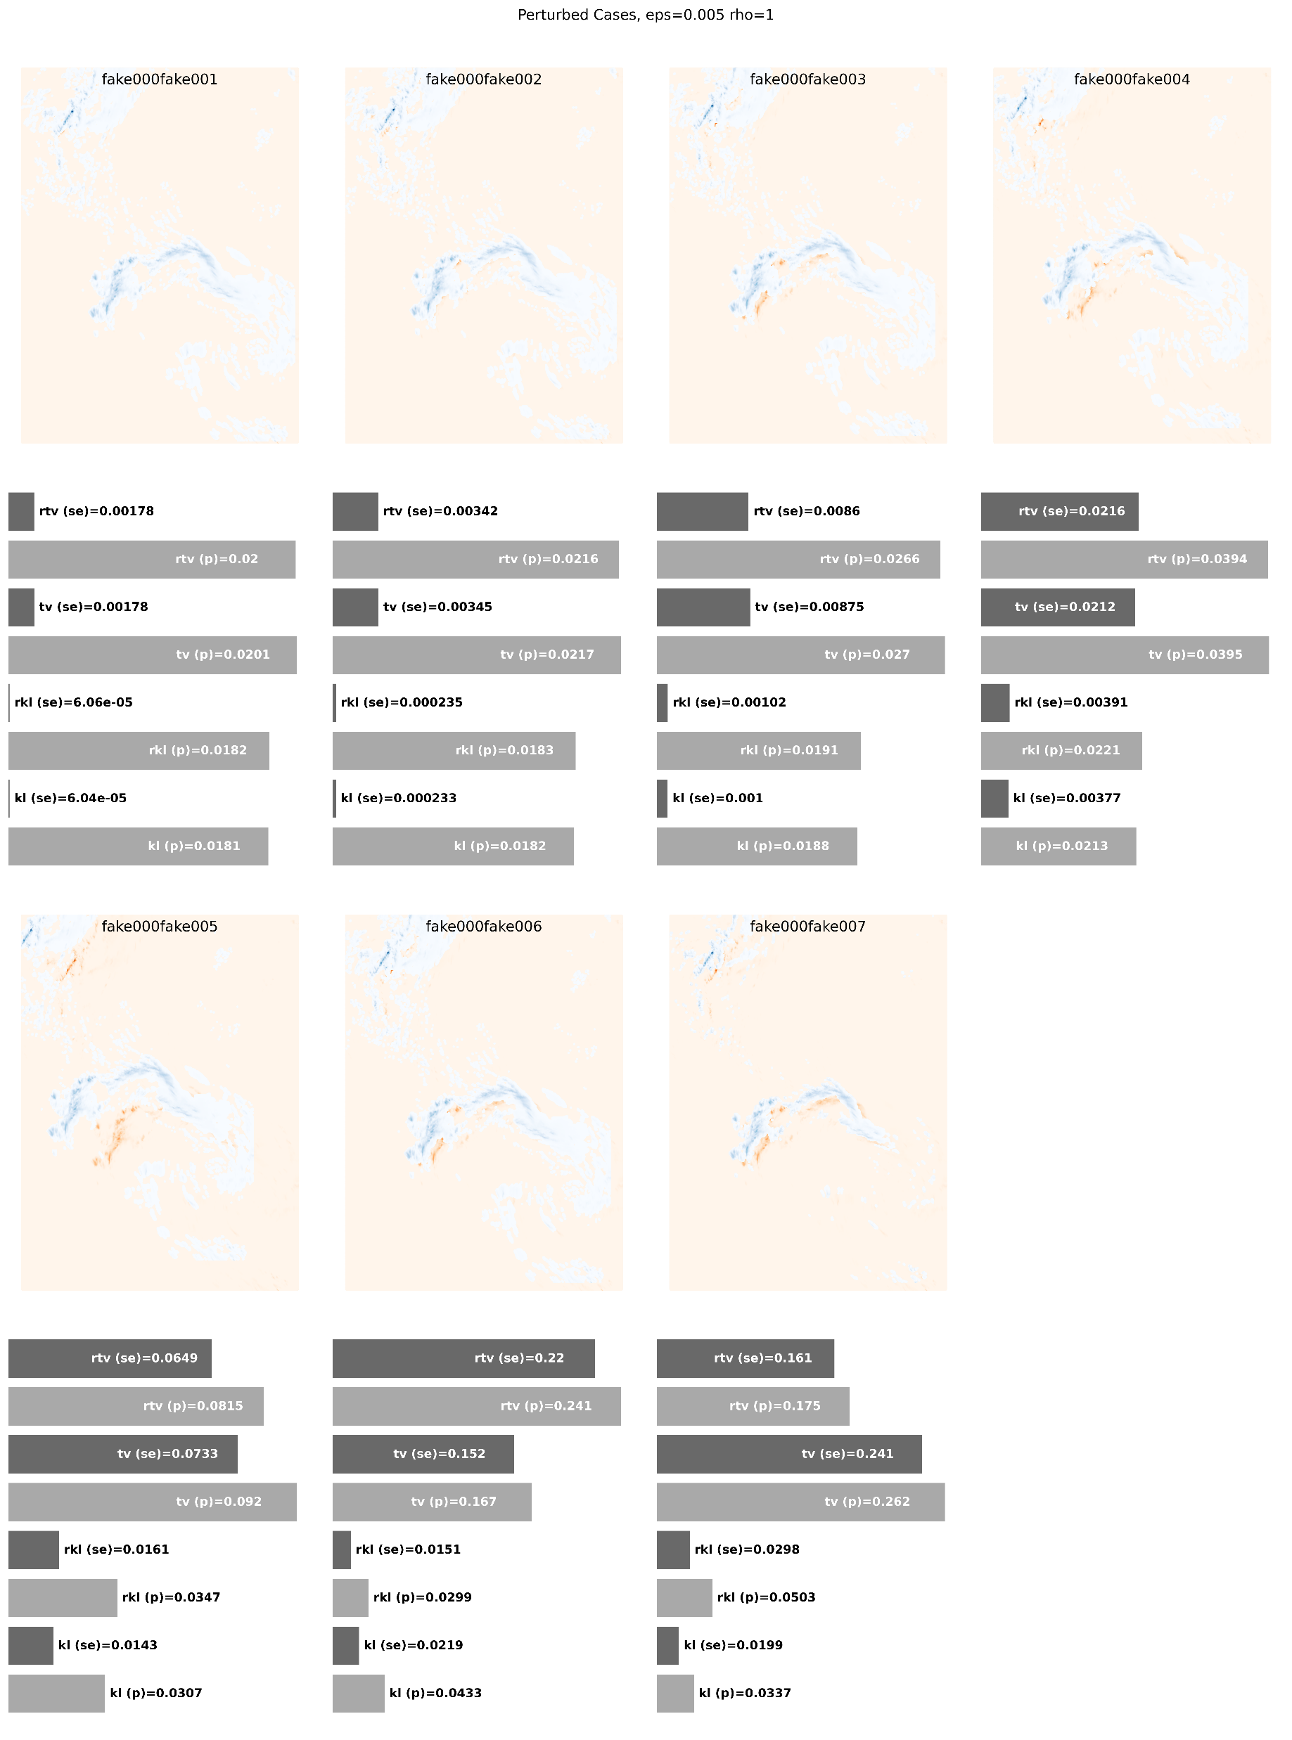
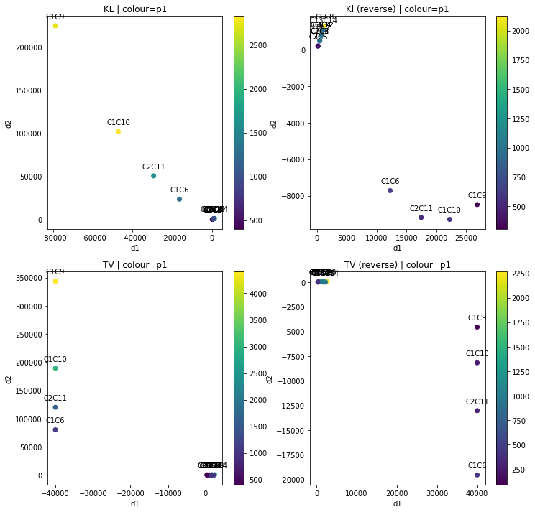
Future Work
Create informative diagrams/plots
Ensemble Application
Parameter optimisation in rho.
Optimise the algorithm for large data sets and ensemble models
Work with stakeholders for better understanding of use cases, and information they want.
Notes:
Lastly then aside from the things I’ve just listed we’d like to explore more info-graphics and diagrams to show what is quite complicated information. On he right we’ve a potential plot, we were colour by the primal objective, and on the left right we have the dual two objective, ignoreing all regularisation contributions.
We plan to soon hav

Slide 20
An OT Metric and Toolbox
Questions to ask of the metric:
Does the method inform performance at different scales?
Does the method provide information on location error?
Does the method provide information on intensity errors and distributions?
Does the method provide information on structural error?
Can the method give traditional information, hits, misses, false alarms etc. ?
OT offers many possibilities, including;
Geometric interpretation, with 7 potential terms to consider (3 dual, 4 primal)
Provides approximate transport plan, showing where most transport is required.
Parsimonious, only two parameters to tune. (Epsilon, Rho)
Can work on two different meshed data
Works on true intensity maps, rather than binary maps.
Notes:
So we’ve demonstrated some capacity behind OT as a metric and a tool for sptial verification. However in general where else can we expand.
Well here I’ve listed a few things we might want it to achieve and will be the focus of my research. So can scales be incorrorated, well of course we can just sample at different scales and compute all this distacnes, however we know there are efiicient algorithms which up scale to achieve convergence and offeres a clear route to exploring this.
There is obvious skill at location error as seen from the approximate maps.
Moreover there is also intensity and distribution information from taking the marginals of those returned. However, we didn’t explore this feature in these geometric cases which are all initialised with equal mass.
Again I think similar to location error the transport map may hint towards structure error though this may be from exploring more deeply the objevtive terms that go into the minimisation.

Slide 21
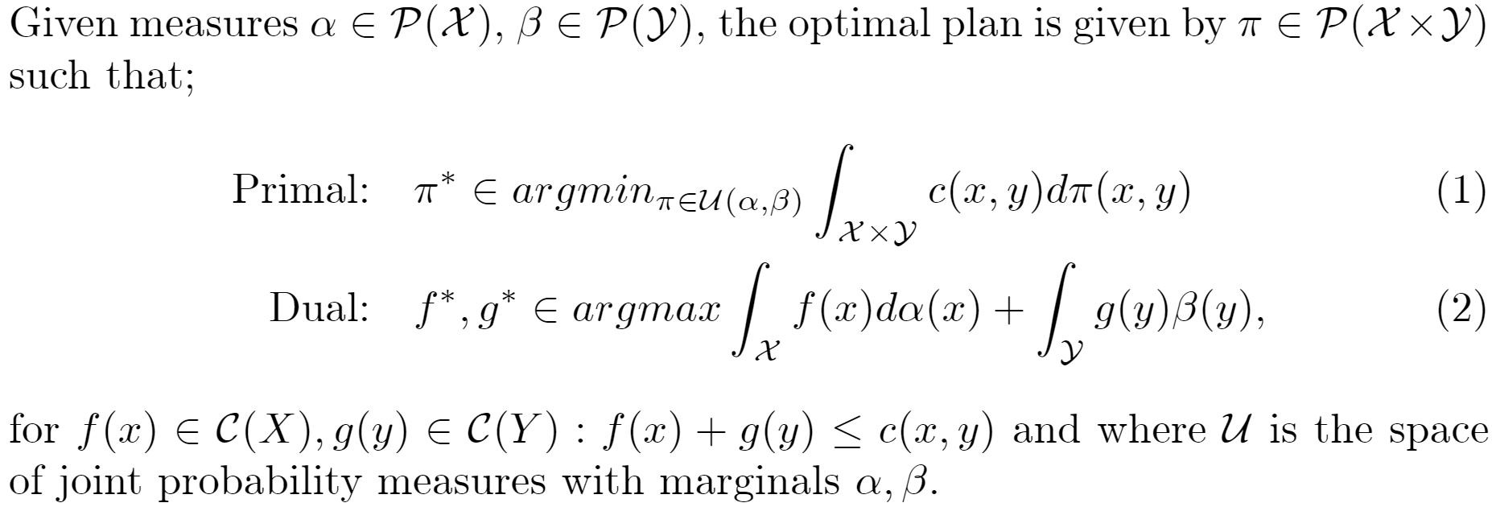

Optimal Transport (Wasserstein Distance)
Notes:
We now consider some of the underlying optimisation problems that are going on. Optimal transport was initially proposed in 1781 (I believe) by a French mathematician Gaspuage Monge. That is consider we have two distribution over some space (X,Y), we will consider these to be subsets of real 2D space and in general X==Y.
To overcome this we can relax this deterministic viewpoint to a probabilistic one, introduced by Kantorovich in the 1940s ( I believe).
No instead of searching for maps we looking for couplings which have marginals of the input output (or alpha beta). Moreover Kantorovich noted that this primal problem has an equivalent dual one.
Importantly this in now linear programming problem which can be easily implementation however does suffer from the curse of dimensionality.

Slide 22
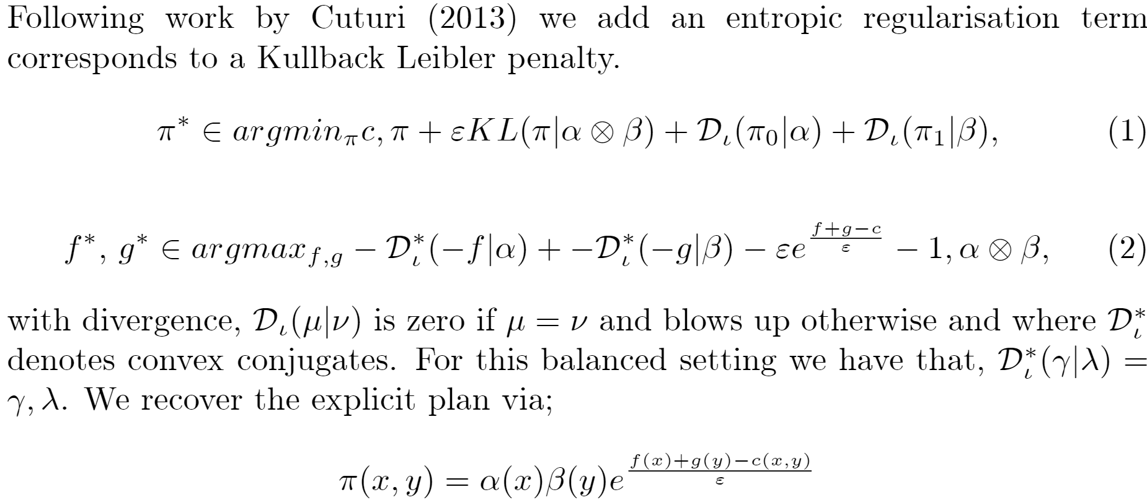
Entropic Regularisation
Notes:
To over come this curse of dimensionality however, which is espically reveleant if wee wish to look at large forecasting models. We consider an entropically regularied version, where we add a KL term to our optimsation probelme.
This gives us two benefits, One the convex nature of the KL term gives us unqiness of solutions and two the dual version of the regularsed problem offers a simple iterative update algorithm known as sinkhorns algorithm. However we won’t go in to that today.
Imprtantly from this formulation we can still find an explicit plan, however of course there are some down sides which his we now have an extra parameter controlling the regularisation and the effect of the regularisation itself. This is known to blur plans. So that rather than being tight lines the plan like we saw before, we now blue the plan around the true line.

Slide 23
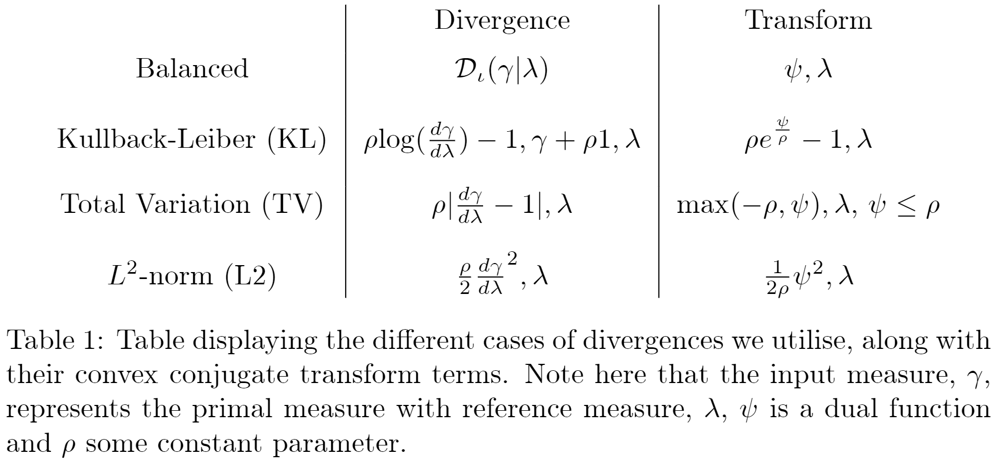
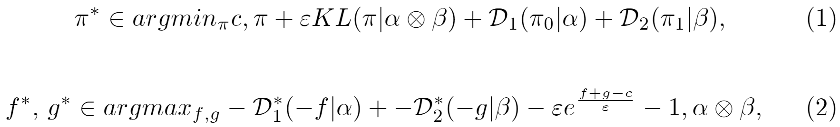
Optimal Transport: Unbalanced
Notes:
These then are the version hat we can swap out o forma an unbalanced version where we can relax the mass constraint. This allows one for the framework to make sense in the precipitation case but also creates different behaviour. So tha instead of points having to move in the blaanced case, point can be destroyed and created.
Again this does add another parameter which can control the influence of these. Where by incraing the parameter we demand more mass constaint or decrease it and any plans allowed.
Another interpretation is that this parameter controls the ‘reach’ the field sees compared he other other fields.

Slide 24
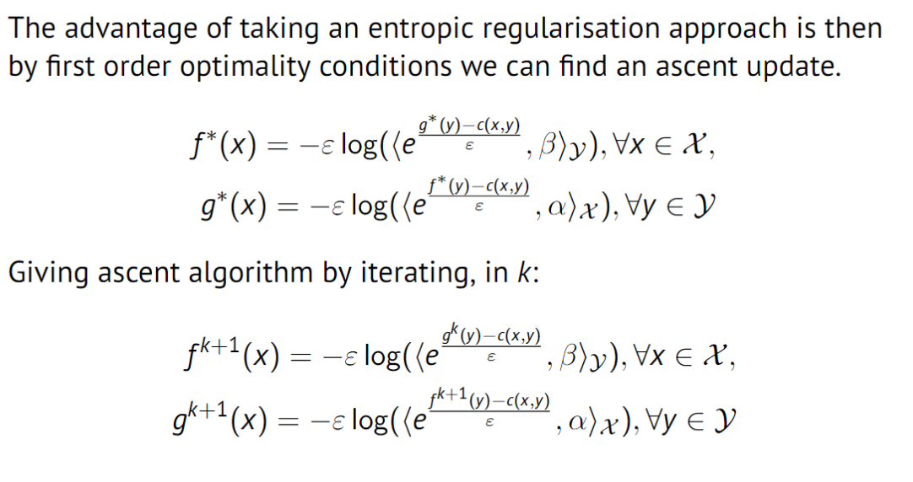
Sinkhorn’s Algorithm
Notes:
To over come this curse of dimensionality however, which is espically reveleant if wee wish to look at large forecasting models. We consider an entropically regularied version, where we add a KL term to our optimsation probelme.
This gives us two benefits, One the convex nature of the KL term gives us unqiness of solutions and two the dual version of the regularsed problem offers a simple iterative update algorithm known as sinkhorns algorithm. However we won’t go in to that today.
Imprtantly from this formulation we can still find an explicit plan, however of course there are some down sides which his we now have an extra parameter controlling the regularisation and the effect of the regularisation itself. This is known to blur plans. So that rather than being tight lines the plan like we saw before, we now blue the plan around the true line.

Slide 25
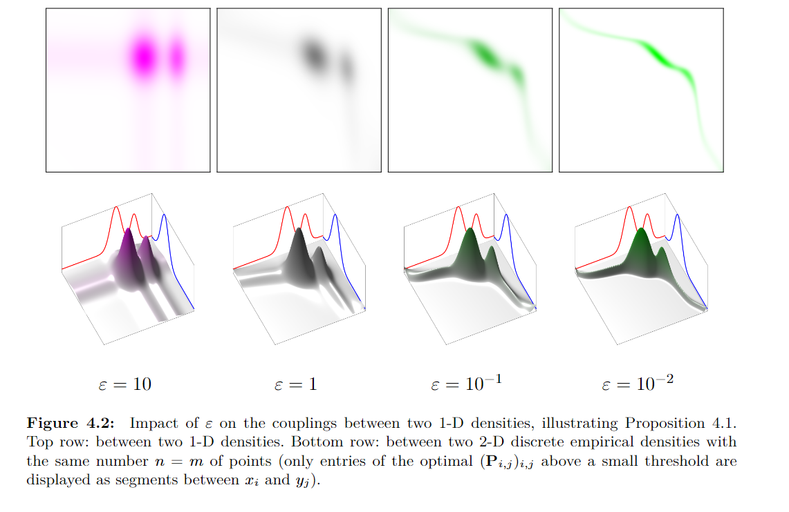
Sinkhorn Divergence: Plan
[Peyré and Cuturi, 2019]
Notes:
These then are the version hat we can swap out o forma an unbalanced version where we can relax the mass constraint. This allows one for the framework to make sense in the precipitation case but also creates different behaviour. So tha instead of points having to move in the blaanced case, point can be destroyed and created.
Again this does add another parameter which can control the influence of these. Where by incraing the parameter we demand more mass constaint or decrease it and any plans allowed.
Another interpretation is that this parameter controls the ‘reach’ the field sees compared he other other fields.
Again by way of example we consider the Kullback Leiber divergence and total variawe the total variance nce case controls the imagine domain whilst the KL case doesn’t seem to have such an obvious case.
Since we’re looking at the unbalanced case the distributions don’t need to be filled and hence the plan that is outputted doesn’t necessarily have the same marginals as the input distributions.

Slide 26
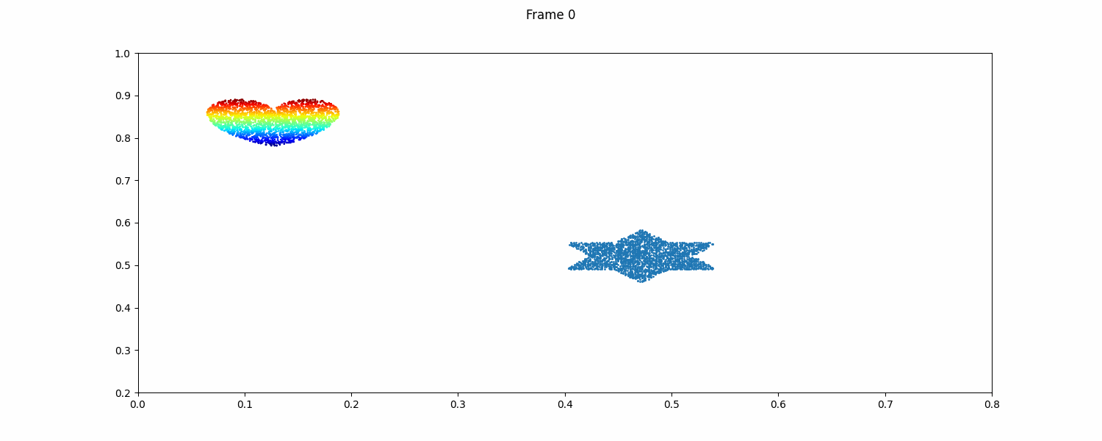
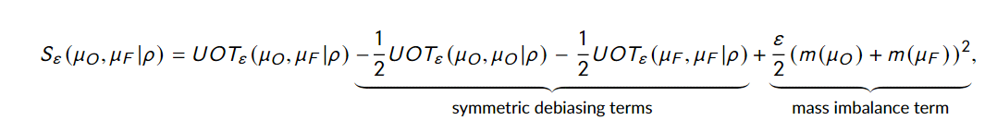
Sinkhorn Divergence
Primal or Biased UOT
Sinkhorn divergence, or debiased UOT
Notes:
These then are the version hat we can swap out o forma an unbalanced version where we can relax the mass constraint. This allows one for the framework to make sense in the precipitation case but also creates different behaviour. So tha instead of points having to move in the blaanced case, point can be destroyed and created.
Again this does add another parameter which can control the influence of these. Where by incraing the parameter we demand more mass constaint or decrease it and any plans allowed.
Another interpretation is that this parameter controls the ‘reach’ the field sees compared he other other fields.
Again by way of example we consider the Kullback Leiber divergence and total variawe the total variance nce case controls the imagine domain whilst the KL case doesn’t seem to have such an obvious case.
Since we’re looking at the unbalanced case the distributions don’t need to be filled and hence the plan that is outputted doesn’t necessarily have the same marginals as the input distributions.

Slide 27
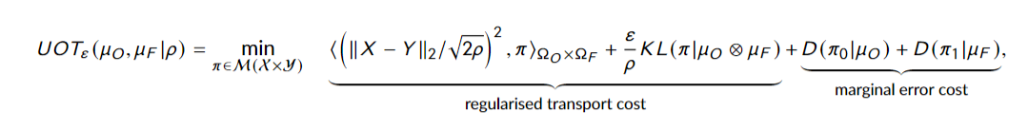
Metrics
Notes:
These then are the version hat we can swap out o forma an unbalanced version where we can relax the mass constraint. This allows one for the framework to make sense in the precipitation case but also creates different behaviour. So tha instead of points having to move in the blaanced case, point can be destroyed and created.
Again this does add another parameter which can control the influence of these. Where by incraing the parameter we demand more mass constaint or decrease it and any plans allowed.
Another interpretation is that this parameter controls the ‘reach’ the field sees compared he other other fields.
Again by way of example we consider the Kullback Leiber divergence and total variawe the total variance nce case controls the imagine domain whilst the KL case doesn’t seem to have such an obvious case.
Since we’re looking at the unbalanced case the distributions don’t need to be filled and hence the plan that is outputted doesn’t necessarily have the same marginals as the input distributions.

Slide 28
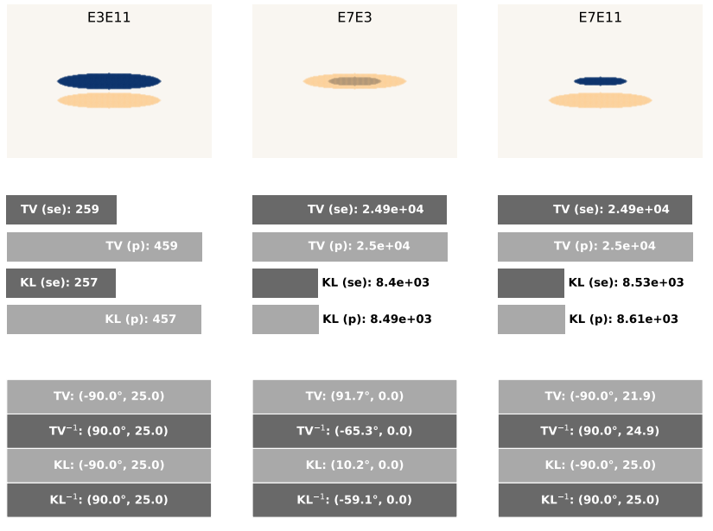
Over/Under Forecast
Key:
TV = total variation cost
KL = Kullback-Leiber cost
(se) = Sinkhorn Divergence cost
(p) = primal cost
-1 = inverse direction
( , ) = (Transport vector direction, Transport vector magnitude )
Is there a way to preferentially forecast to improve your UOT score?
Notes:
These then are the version hat we can swap out o forma an unbalanced version where we can relax the mass constraint. This allows one for the framework to make sense in the precipitation case but also creates different behaviour. So tha instead of points having to move in the blaanced case, point can be destroyed and created.
Again this does add another parameter which can control the influence of these. Where by incraing the parameter we demand more mass constaint or decrease it and any plans allowed.
Another interpretation is that this parameter controls the ‘reach’ the field sees compared he other other fields.
Again by way of example we consider the Kullback Leiber divergence and total variawe the total variance nce case controls the imagine domain whilst the KL case doesn’t seem to have such an obvious case.
Since we’re looking at the unbalanced case the distributions don’t need to be filled and hence the plan that is outputted doesn’t necessarily have the same marginals as the input distributions.

Slide 29
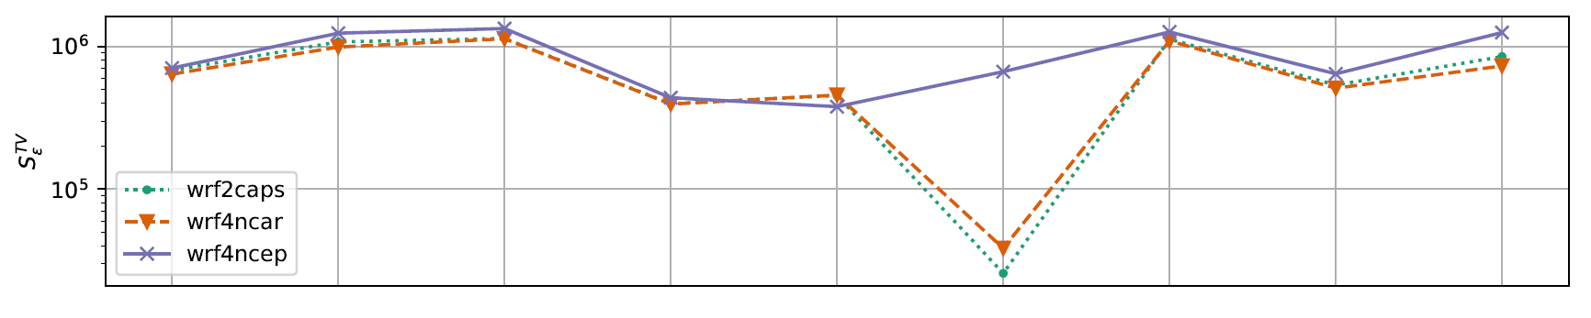
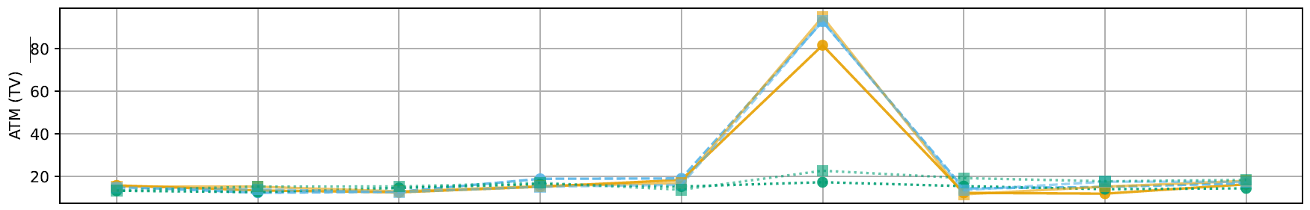

Spring 2005 ICP Case

Slide 30
