Slide 1

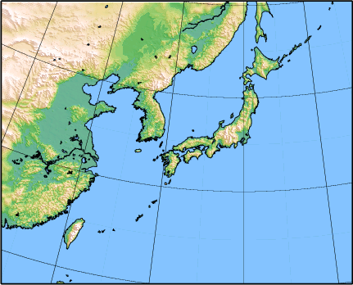
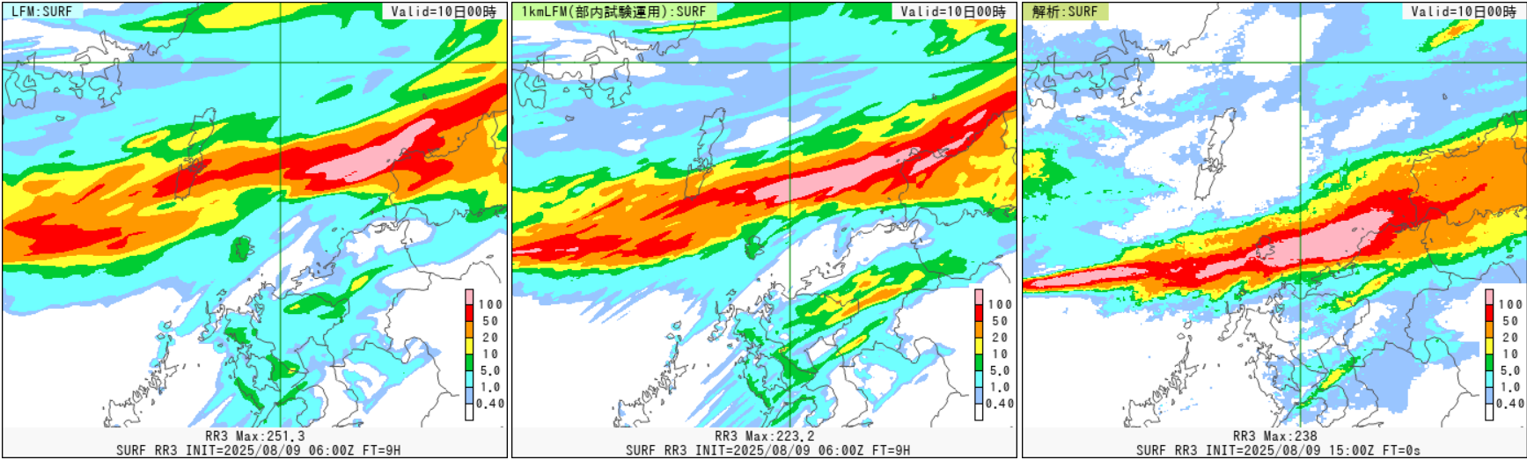
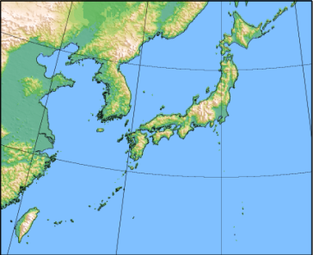
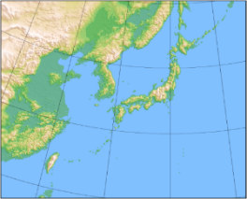
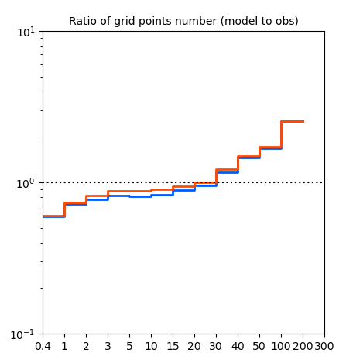
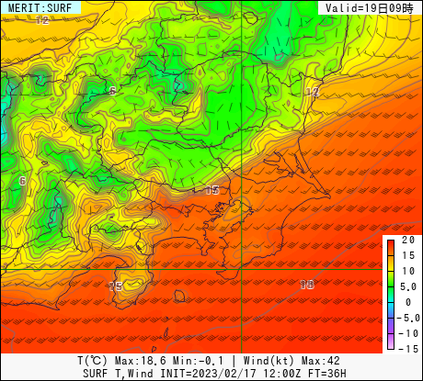
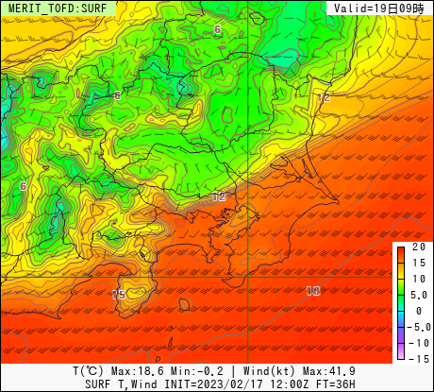
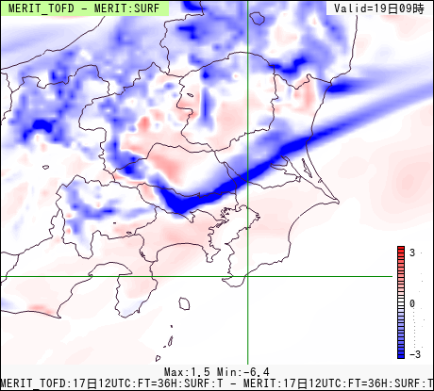
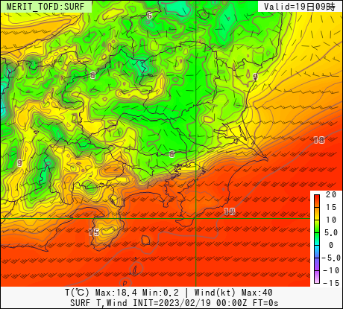
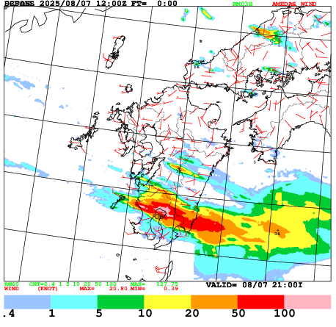
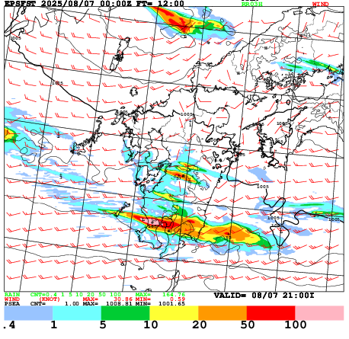
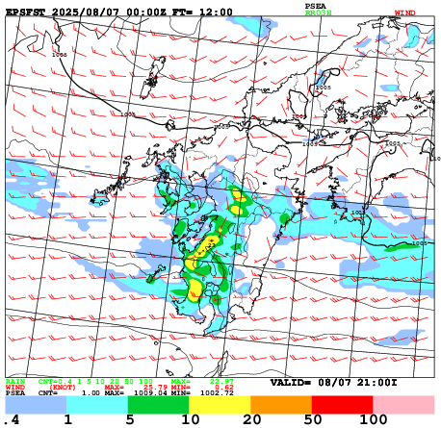
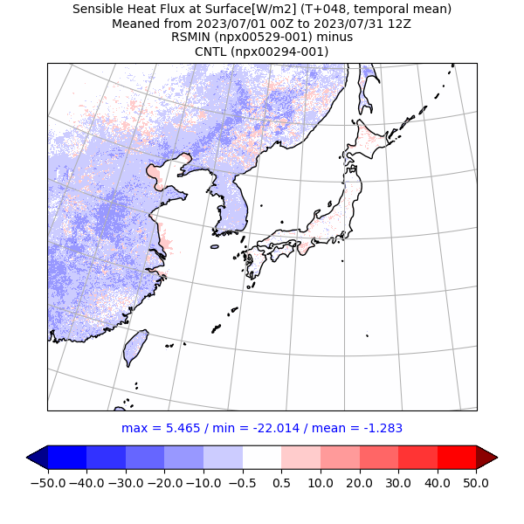
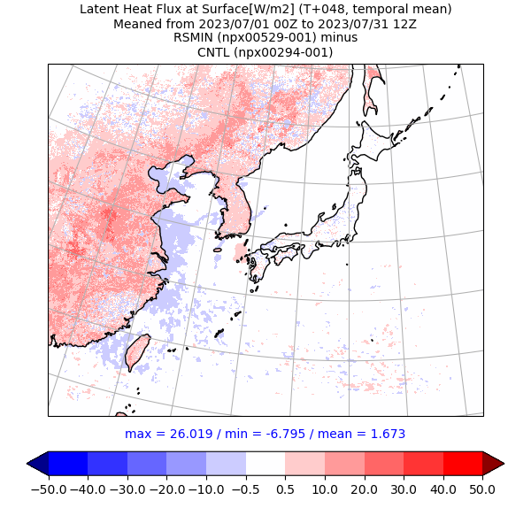
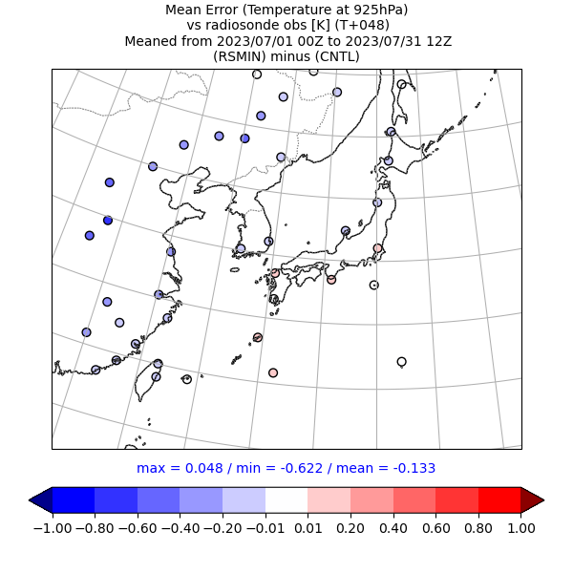

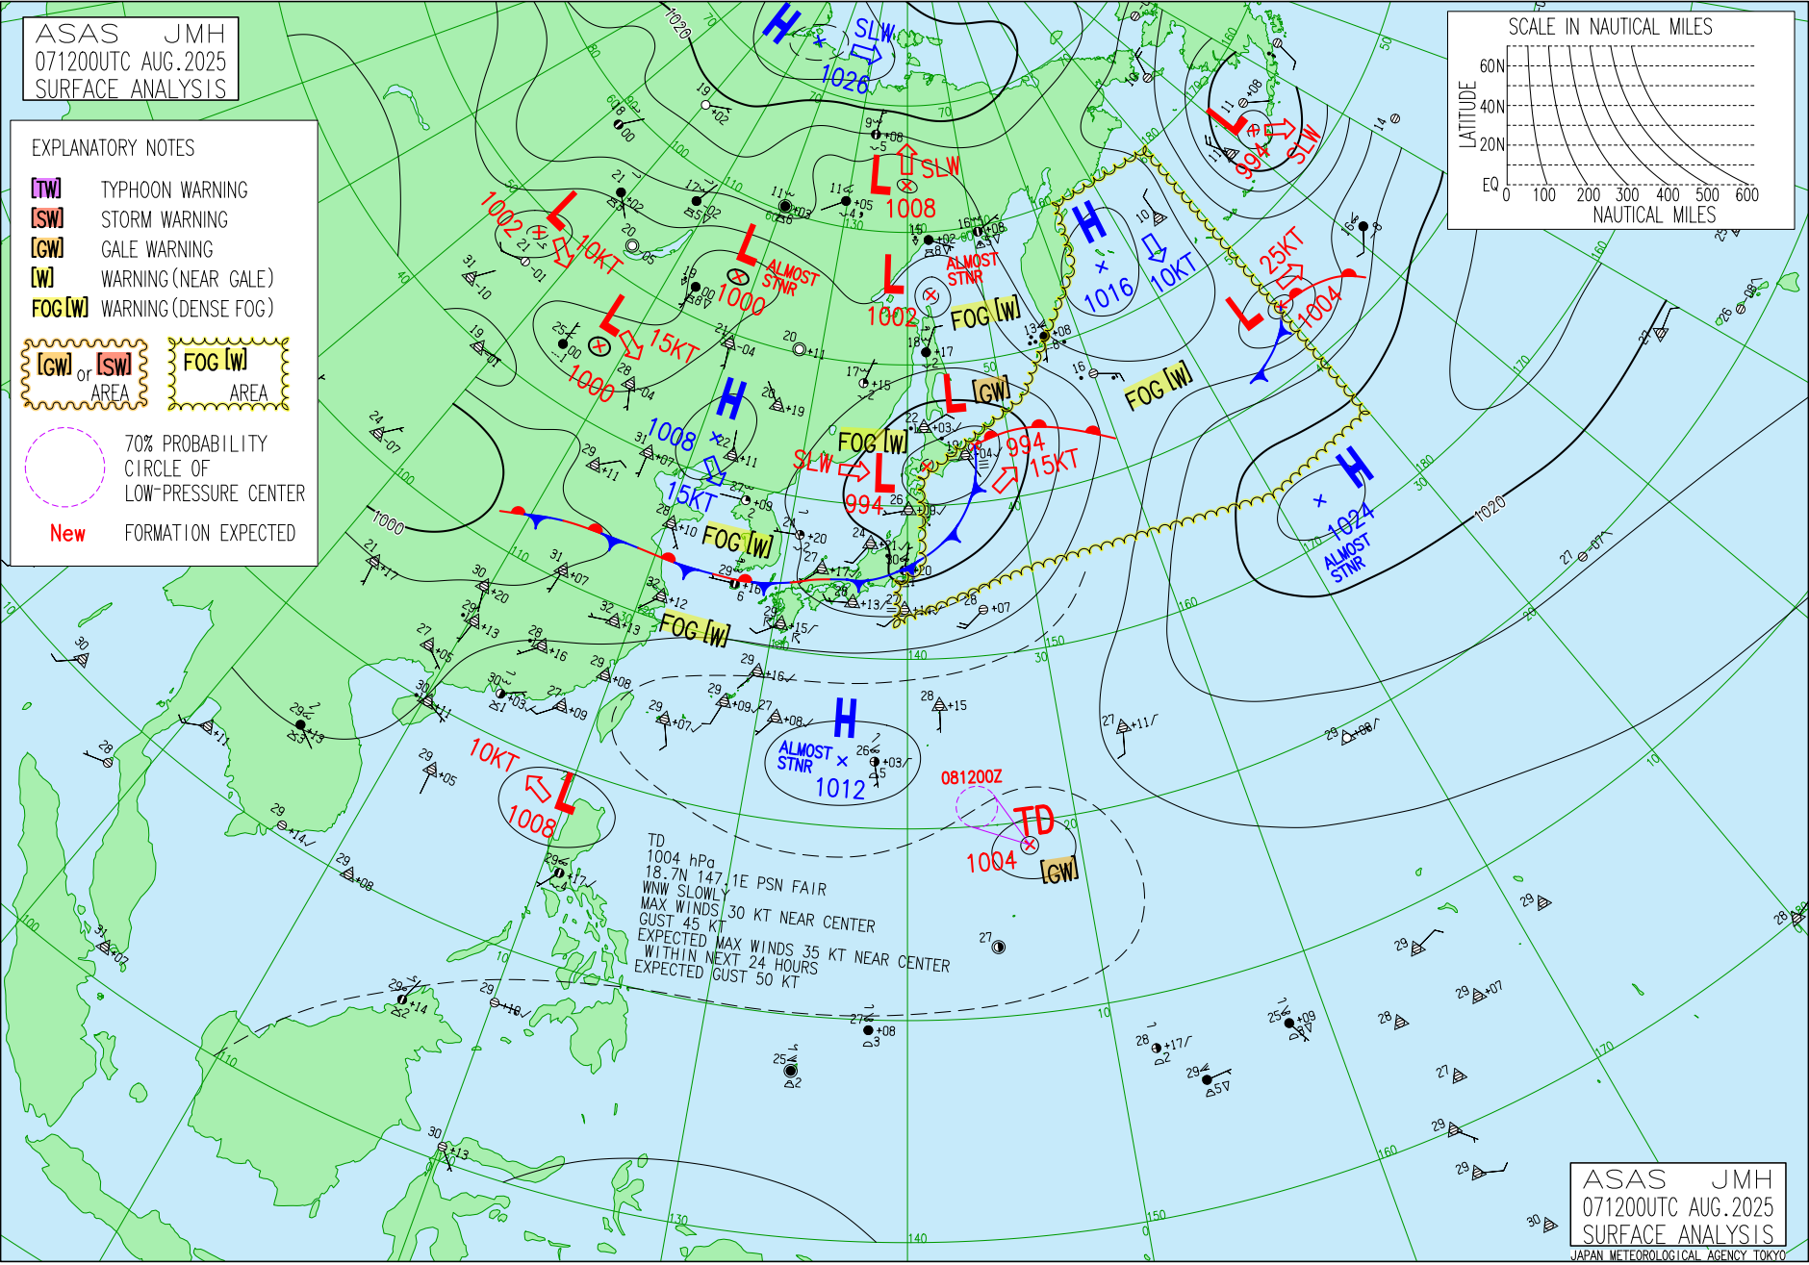
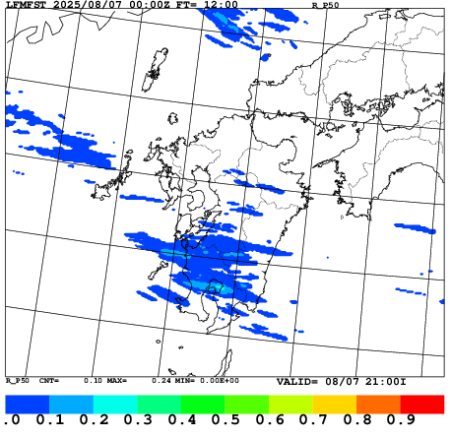
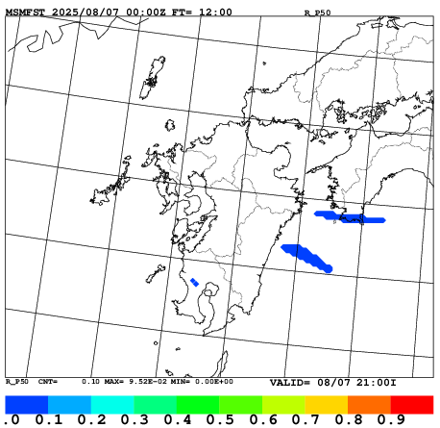
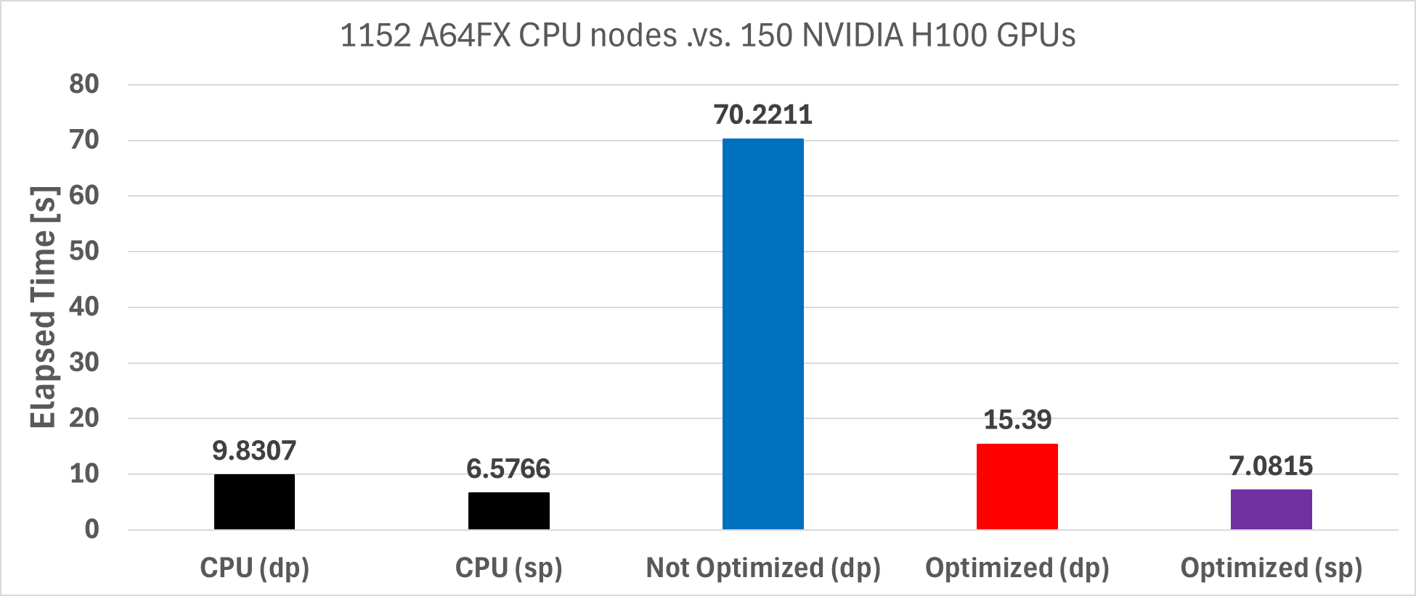
47th EWGLAM and 32th SRNWP meeting, 2025
Development of Limited-Area NWP Systems at JMA
Sawada Masahiro*, Matsubayashi Kengo, Kusabiraki Hiroshi, Ogihara Hirotaka, Aikawa Takuya, Tanoshita Junichi, Kubo Shinsuke, Fujiwara Tomoki, Okugawa Ryosuke, Ishida Ryoga, Kawano Kohei, Kawada Hideyuki, Hattori Hironori, Matsuba Fumitaka
Numerical Prediction Division, Japan Meteorological Agency, *msawada@met.kishou.go.jp
1. Regional operational NWP systems at JMA
4. Plan to enhance horizontal resolution of LFM from 2km to 1km
Meso-Scale Model (MSM):
Horizontal resolution: 5km
Vertical levels / top: 96 / 37.5km
Forecast hours (initial times): 78 hours (00, 12 UTC) 39 hours (03, 06, 09, 15, 18, 21 UTC)
Initial conditions: Meso-scale analysis (MA) (4D-Var)
Horizontal grid spacing of the LFM is planned to be improved from 2km to 1km in Mar. 2026. In addition, topography-related parameters were adjusted to match the 1km horizontal resolution.
With LFM-1km simulation, the timing of convective initiation becomes faster than LFM-2km, and excessive deep convection is mitigated.
(a) LFM-2km
Valid = 15UTC 9
(b) LFM-1km
Valid = 15UTC 9
(c) Obs
Valid = 15UTC 9
Local Forecast Model (LFM):
Horizontal resolution: 2km
Vertical levels / top: 76 / 21.8km
Forecast hours (initial times):
18 hours (00,03,06,09,12,15,18,21 UTC) 10 hours (hourly except for the above)
Initial conditions: Local analysis (LA) (hybrid 3D-Var)
Meso-Scale Ensemble Prediction System (MEPS):
Horizontal resolution: 5km
Vertical levels / top: 96 / 37.5km
Forecast hours (initial times): 39 hours (00, 06, 12, 18 UTC)
Initial conditions: Meso-scale analysis with ensemble perturbations (SV)
Ensemble members: 21 (Control = MSM)
Fig.4 Three-hour accumulated precipitation of forecast from (a) LFM, (b) LFM1km, and (c) observation (Obs.) for 1500UTC 9 August 2025. LFM and LFM1km are at T+9 initialized at 0600 UTC 9 August 2025.
Too much
The challenges are:
To further address the delay and displacement of convection
To represent the continuous generation and succession of convection
To mitigate the over-forecasting of heavy precipitation frequency
Further improvement of processes related to vertical transport associated with convection will be key issue
LFM
LFM1km
Ratio of grid point #
3-h precipitation
Too few
Regional operational NWP systems are using a non-hydrostatic model ASUCA (Ishida et al. 2022).
Fig.5 Histogram of three-hour accumulated precipitation of forecast experiments for 3-10 July 2023. Y-axis is model’s ratio of grid point number to observation.
2. Update of Meso-Scale Model (MSM2505)
May 2025
5. Development of LFM-based ensemble prediction system (LEPS)
Highlights:
Update of topographic dataset to MERIT DEM.
Introduction of a turbulent orographic form drag (TOFD). Standard deviations for topography were obtained from MERIT DEM.
Adjustment of minimum stomatal resistances in the vegetation.
A new LFM-based Ensemble Prediction System (LEPS) with a 2 km horizontal grid spacing and 21 members is under experimental operation, and is planned to be operational in Mar. 2026.
TBD
Local Ensemble Prediction System (LEPS):
Horizontal resolution: 2km
Vertical levels / top: 76 / 21.8km
Forecast hours (initial times): 21 hours (4 times/day)
Initial conditions: Local analysis with ensemble perturbations (derived from MEPS)
Ensemble members: 21 (Control = LFM-2km)
Update of topographic dataset from GTOPO30 to MERIT DEM (Yamazaki et al. 2017)
MERIT DEM: 3’’ resolution, GTOPO30: 30’’ resolution
Introduction of a turbulent orographic form drag (TOFD ; Beljaars et al 2004)
TOFD scheme integrates over the spectral orography to represent all the relevant scale.
coastal front in the experiment with TOFD was shifted to the south relative to the experiment without TOFD.
Topo. update
Topo. update+TOFD
DIFF
Analysis
Utilizing perturbations from MEPS forecasts for initial and lateral perturbations.
Due to the finer horizontal resolution of LFM to represent heavy rain than MSM, LEPS has a higher ability to capture the potential for heavy rain than MEPS, as expected.
Valid= 00UTC 19
Valid= 00UTC 19
Valid= 00UTC 19
Valid= 00UTC 19
(a)Obs.
(c)LEPS: CTLM(LFM-2km)
(e) MEPS: CTLM(MSM)
Fig. 1 Surface temperature forecasted for 0000 UTC 19 February 2023. MSM is at T+36 initialized at 1200 UTC 17 February 2023).
Adjustment of minimum stomatal resistances in the vegetation
Reduce the minimum stomatal resistances in low vegetation.
Revised model reduced the warm bias and the RMSE of temperature in the lower troposphere over the northeastern and central regions of China.
(b)Weather map
(d)LEPS: Prb.50mm/3h
(f)MEPS: Prb.50mm/3h
mm/3h
(a)SHF
(b)LHF
(c)BIAS
(d)RMSE
Fig.2 (a) sensible heat flux (SHF), (b) latent heat flux (LHF), (c) temperature bias, and (d) root mean square error (RMSE) differences (TEST – CNTL) for July 2023 (T+48). TEST is CNTL + adjustment of minimum stomatal resistances.
Fig.6 Three-hour accumulated precipitation of forecast from control run (CTLM), probabilistic forecast exceeding 50 mm/3h (Prb.50), and observation (Obs.) for 1200UTC 7 August 2025. (a)Obs., (b) Weather map, (c) LEPS: CTLM, (d) LEPS: Prb. 50mm/3h, (e) MEPS: CTLM, (f) MEPS: Prb.50mm/3h. LEPS and MEPS are at T+12 initialized at 0000 UTC 7 August 2025.
3. Development toward next-generation computing
The challenges are:
To further clarify the uncertainty in the forecast of mesoscale convective system.
To further investigate the perturbations on initial conditions, boundary conditions, and model parameters, which cause the uncertainty.
Ongoing development include:
Using single precision to reduce the physical memory and data size in IO.
Switch model precision by changing the Fortran KIND parameter.
GPU porting to adapt GPU-supercomputers, which have become mainstream in recent years.
Use of OpenACC directive
and code optimization.
References:
Ishida et al. (2022). ASUCA: the JMA operational non-hydrostatic model, J. Meteor. Soc. Japan, 100, doi:10.2151/jmsj.2022-043​
Beljaars, A. C. M., Brown, A. R., & Wood, N. (2004). A new parametrization of turbulent orographic form drag. Quart. J. Royal Meteor. Soc., 130(599), 1327–1.
Yamazaki, D., Ikeshima, D., Tawatari, R., Yamaguchi, T., O'Loughlin, F., Neal, J. C., Sampson, C. C., Kanae, S., & Bates, P. D. (2017). A high-accuracy map of global terrain elevations. Geophysical Research Letters, 44, 5844–5853.
Fig.3 Elapsed time for CPU double precision (dp), single precision (sp), GPU with original code (not optimized), GPU(dp) with optimized code, and GPU(sp) with optimized code.
Acknowledgement:
This work was supported by MEXT as “Government-Initiated Category of Supercomputer Fugaku” (hp250238) and used computational resources of supercomputer Fugaku provided by the RIKEN Center for Computational Science.

